Slide 1

Setup turtlebot dimensions
You will need:
A ruler with mm
A big piece of paper (A3 or bigger recommended)
Start

Slide 2
Setup turtlebot: Backlash
Press start to begin the turtlebot
Start

Slide 3
Setup turtlebot: Backlash
If the turtlebot moved forward, press Moved. Otherwise press No difference
Restart
10
No difference
Moved

Slide 4
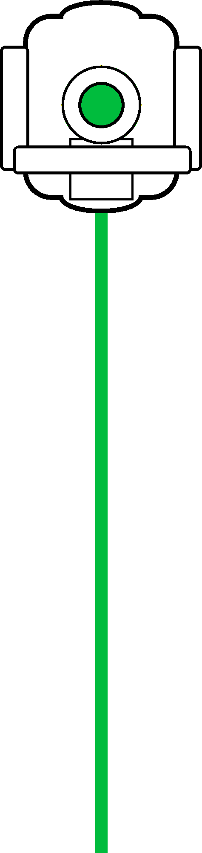
Setup turtlebot wheels
Press Draw to draw a line. Measure the length then input the value
Draw

Slide 5
Setup turtlebot wheels
Press Draw to draw a line. Measure the length then input the value
Length: mm
Next
Notes:
300 -> axle
Else back to draw page

Slide 6
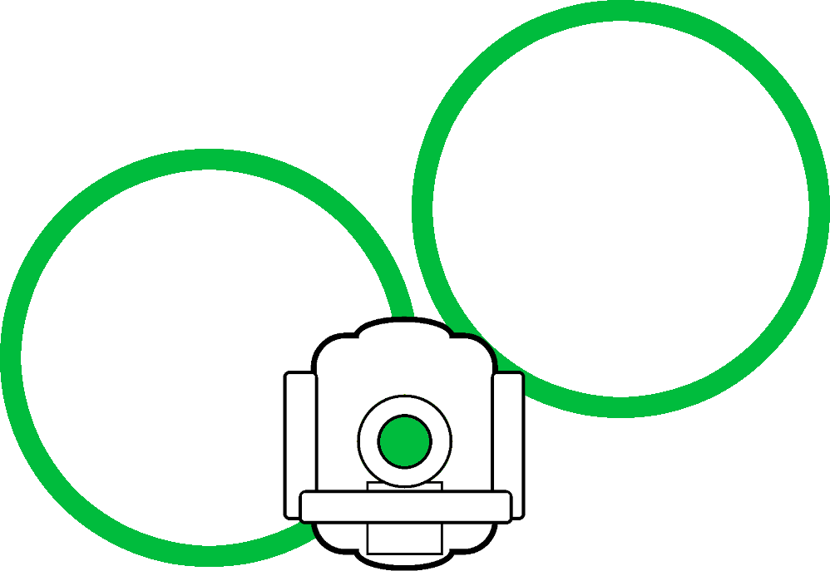
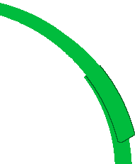

Setup turtlebot axle
Press Draw to draw two circles. Measure the distance of overlap/gap then input the values.
If a gap put "-" before the number
Draw

Slide 7
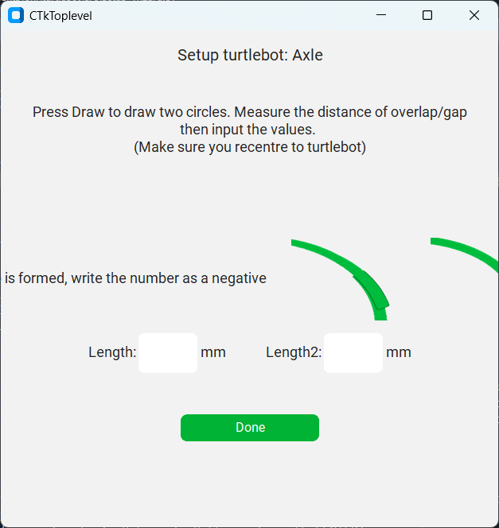
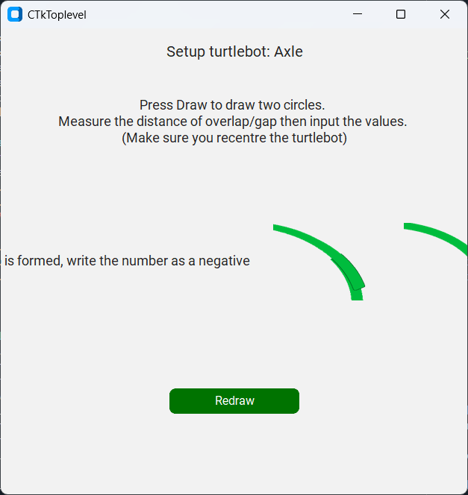
Setup turtlebot axle
Press Draw to draw two circles. Measure the distance of overlap/gap then input the values.
If a gap is formed, put "-" before the number
-
+
Length 1: mm
Length 2: mm
Done

