Slide 1
Program 2
More DEPTH

Slide 2
P2 Objectives
Compare two CPU scheduling algorithms:
Round-Robin scheduling (RR)
Multilevel Feedback-Queue Scheduling (MFQS)
Step-by-step procedure:
Observe the behavior of ThreadOS Scheduler that uses a Java-based round-robin scheduling algorithm and consider why Java thread priority is not working exactly as expected
Redesign ThreadOS Scheduler using Thread.suspend( ) and Thread.resume( ) so that it will rigidly work in a round-robin fashion
Revise your ThreadOS Scheduler as a multilevel feedback-queue scheduler (MFQS)
Compare these scheduling algorithms with test thread programs.

Slide 3
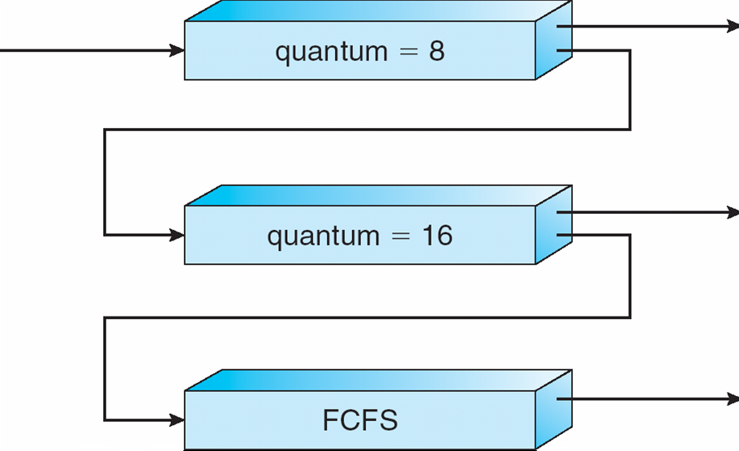
Multilevel Feedback-Queue Scheduling (MFQS) – Variable based on consumption
A new job enters queue Q₀ which is scheduled via FCFS. When it gains CPU, the current job receives 8 milliseconds. If it does not finish in 8 milliseconds, the job is moved to queue Q₁.
At Q₁ job is again scheduled via FCFS and receives 16 additional milliseconds.
If it still does not complete, it is preempted and moved to queue Q₂.

Slide 4
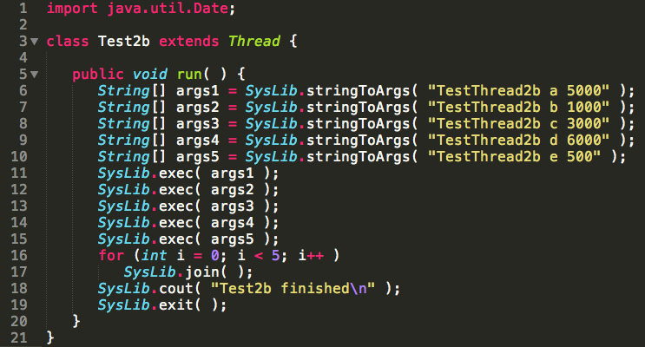
Test2b

Slide 5
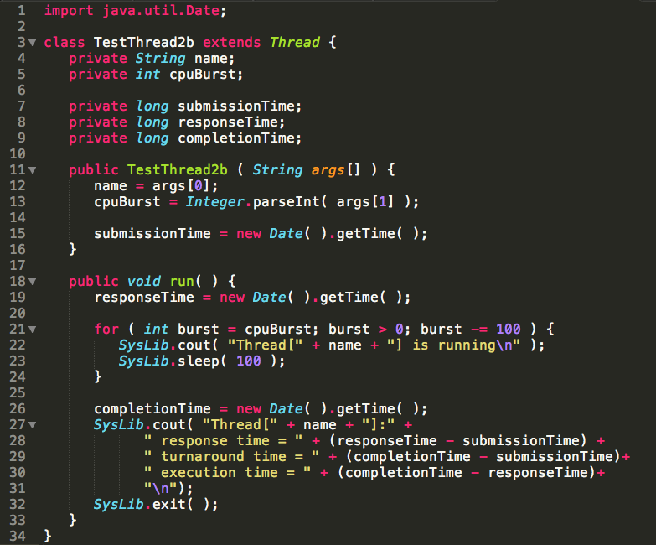
TestThread2b

Slide 6
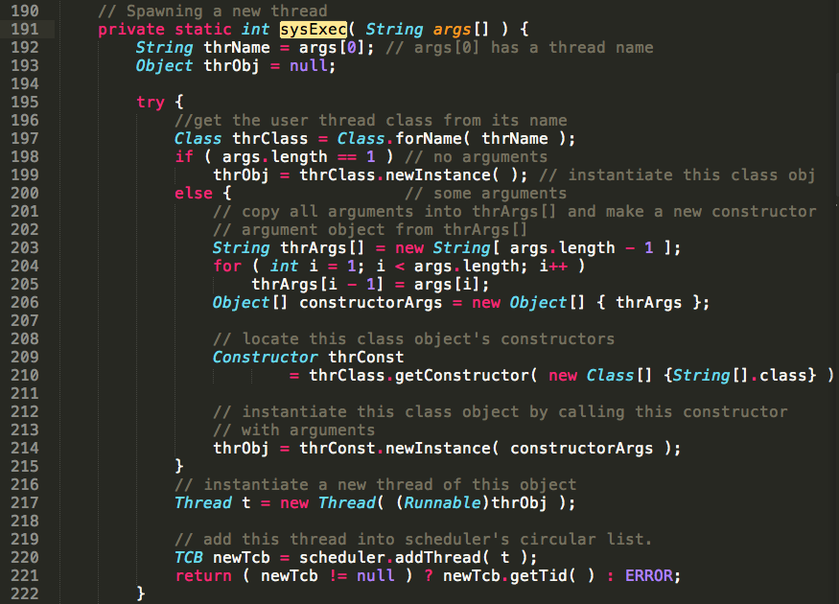
Starting ThreadOS App

Slide 7
Review Scheduler.Java
Review

Slide 8
1000ms
Loader
join()
1000ms
Test2b
join()
RR Scheduler
T_{A}
_{5000ms}
T_{B}
_{1000ms}
T_{C}
_{3000ms}
T_{D}
_{6000ms}
T_{E}
_{500ms}
Sleep(q)

Slide 9
RR + Suspend/Resume
SysLib.exec()
TCB
Suspended
Queue.add(TCB)
Queue
Sleep(q)
TCBs
t.Suspend()
Running
t.Resume()
getThread(TCB)

Slide 10
Gantt Model (RR No Changes)
0 ms
5s
7s
10,000ms
20,000ms
T_{a}
2000
5000
1000
3000
T_{b}
T_{c}
4000
3000
T_{d}
5000
6000
T_{e}
6000
500
Term | Equation
T_{wait} | = Time not executing
T_{turnaround} | = T_{completion -} T_{submission}
T_{execution} | = T_{completion -} T_{response}
TAT_{(Turn-around time)}
T_{response}
T_{execution}
T_{submission}

Slide 11
Gantt Model (RR Suspend/Resume)
0 ms
10,000ms
20,000ms
30,000ms
40,000ms
29s
T_{a}
2000
27000 (5000)
3000
T_{b}
7000 (1000)
10s
21s
4000
17000 (3000)
T_{c}
5000
28000 (6000)
33s
T_{d}
T_{e}
6000
500
7s
Term | Equation
T_{wait} | = Total time not executing
T_{turnaround} | = T_{completion -} T_{submission}
T_{execution} | = T_{completion -} T_{response}
TAT_{(Turn-around time)}
T_{response}
T_{execution}
T_{submission}

Slide 12
Evaluation
 | Naïve RR Scheduler
 | T-submission | T-response | TAT | T-execution
Ta | 0 | 1998 | 7003 | 5005
Tb | 0 | 2999 | 4000 | 1001
Tc | 0 | 3999 | 7001 | 3002
Td | 0 | 4999 | 11004 | 6005
Te | 0 | 5998 | 6498 | 500
 | Suspend/Resume RR Scheduler
 | T-submission | T-response | TAT | T-execution
Ta | 0 | 1999 | 29001 | 27002
Tb | 0 | 2999 | 10000 | 7001
Tc | 0 | 3999 | 21001 | 17002
Td | 0 | 4999 | 33001 | 28002
Te | 0 | 5999 | 6499 | 500

Slide 13
Java Synchronization (an aside, more later)
Every Object has a monitor and a monitor lock.
Synchronized statement ensures that all of the code in the block is locked and available to only one thread at a time.
Objects, methods and code blocks can all be locked atomically by use of the synchronized statement
Atomic hardware support used to implement.

