Slide 1
MONICA_software
- based on CoMPASS RAW data lists .root
- parent directory of DAQ/ CoMPASS project

Slide 2
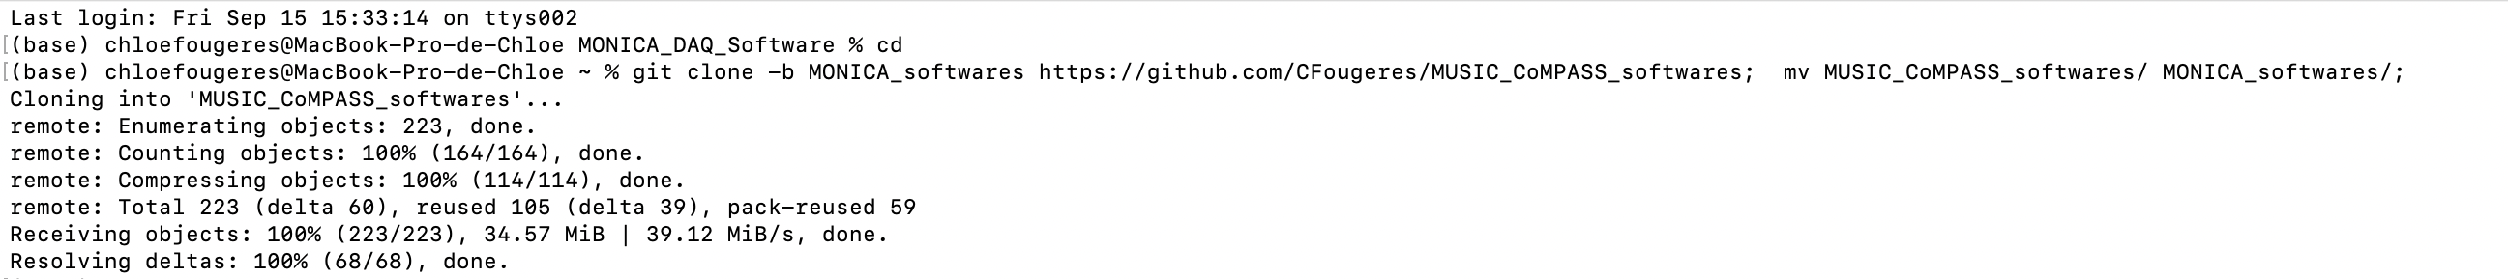
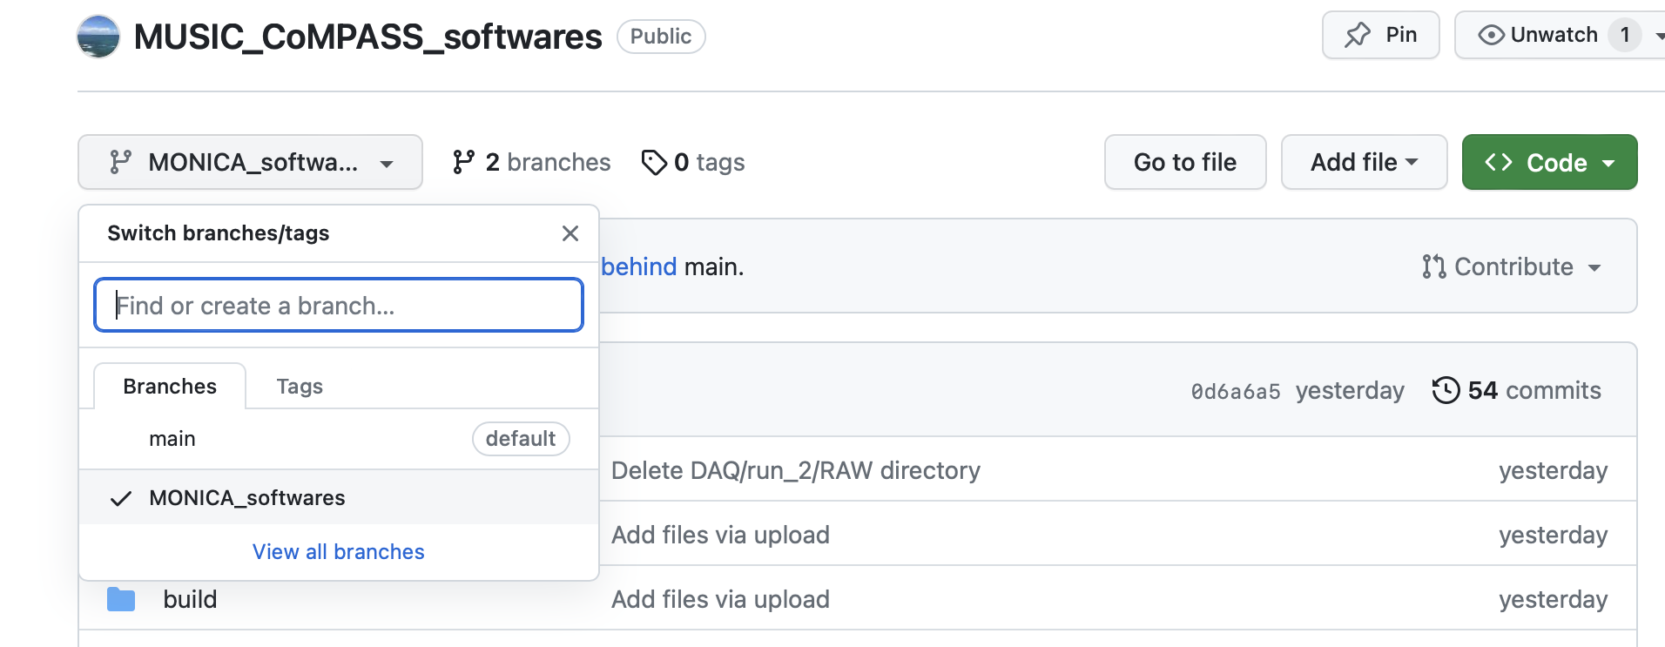
To get the softwares
In terminal (if git installed on the computer, as the case in bavarians one)
git clone -b MONICA_softwares https://github.com/CFougeres/MUSIC_CoMPASS_softwares; mv MUSIC_CoMPASS_softwares/ MONICA_softwares/;
From Github website https://github.com/CFougeres/MUSIC_CoMPASS_softwares
Select MONICA_softwares branch
by opening the branch tab

Slide 3
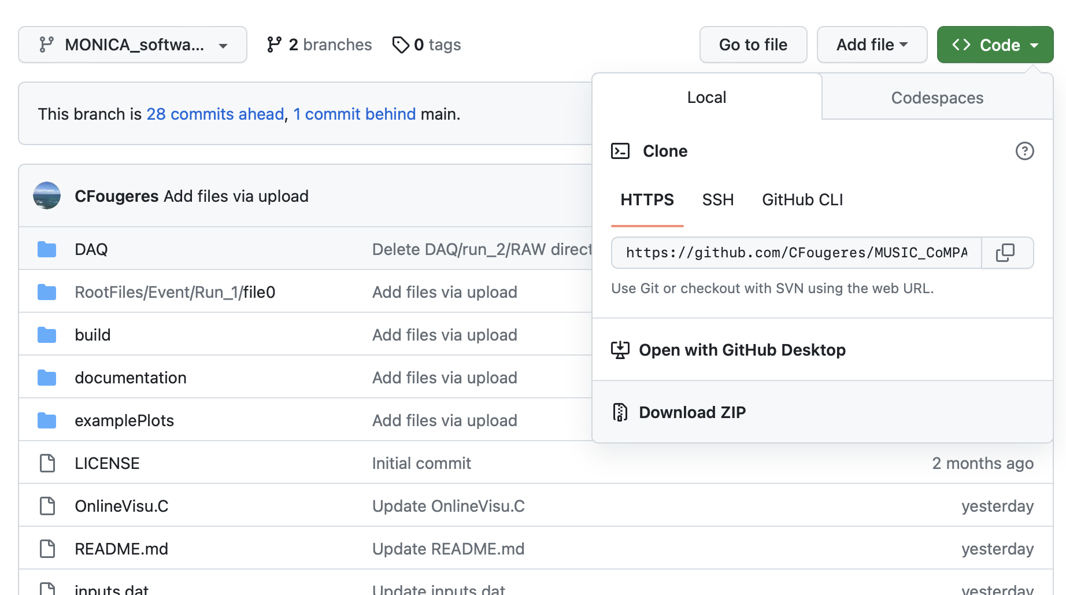
To get the softwares
From Github website https://github.com/CFougeres/MUSIC_CoMPASS_softwares
Select MONICA_software branch
Download the code .zip by opening the « code » green tab
Rename directory as MONICA_softwares

Slide 4
Directory structure
MONICA_DAQ_Software/
OnlineVisu.C → code for online visualization
inputs.dat → user inputs, self-explanatory (run data to see online, time window in μs..)
DAQ/ → for CoMPASS runs
RootFiles/
Event/
Run_#/ → for Run Event trees
build/
BuildingEvent.C →code for building Run Event trees from CoMPASS Raw Lists trees
DAQTopology.h → matrix to translate Digitizer Channels to Physical Signals
Builder.h
OnlineVisu.h
cpFile.sh mkRunDir.sh → bash script to create folders for storing Run Event trees
examplePlots/ documentation/
README.md LICENSE

Slide 5
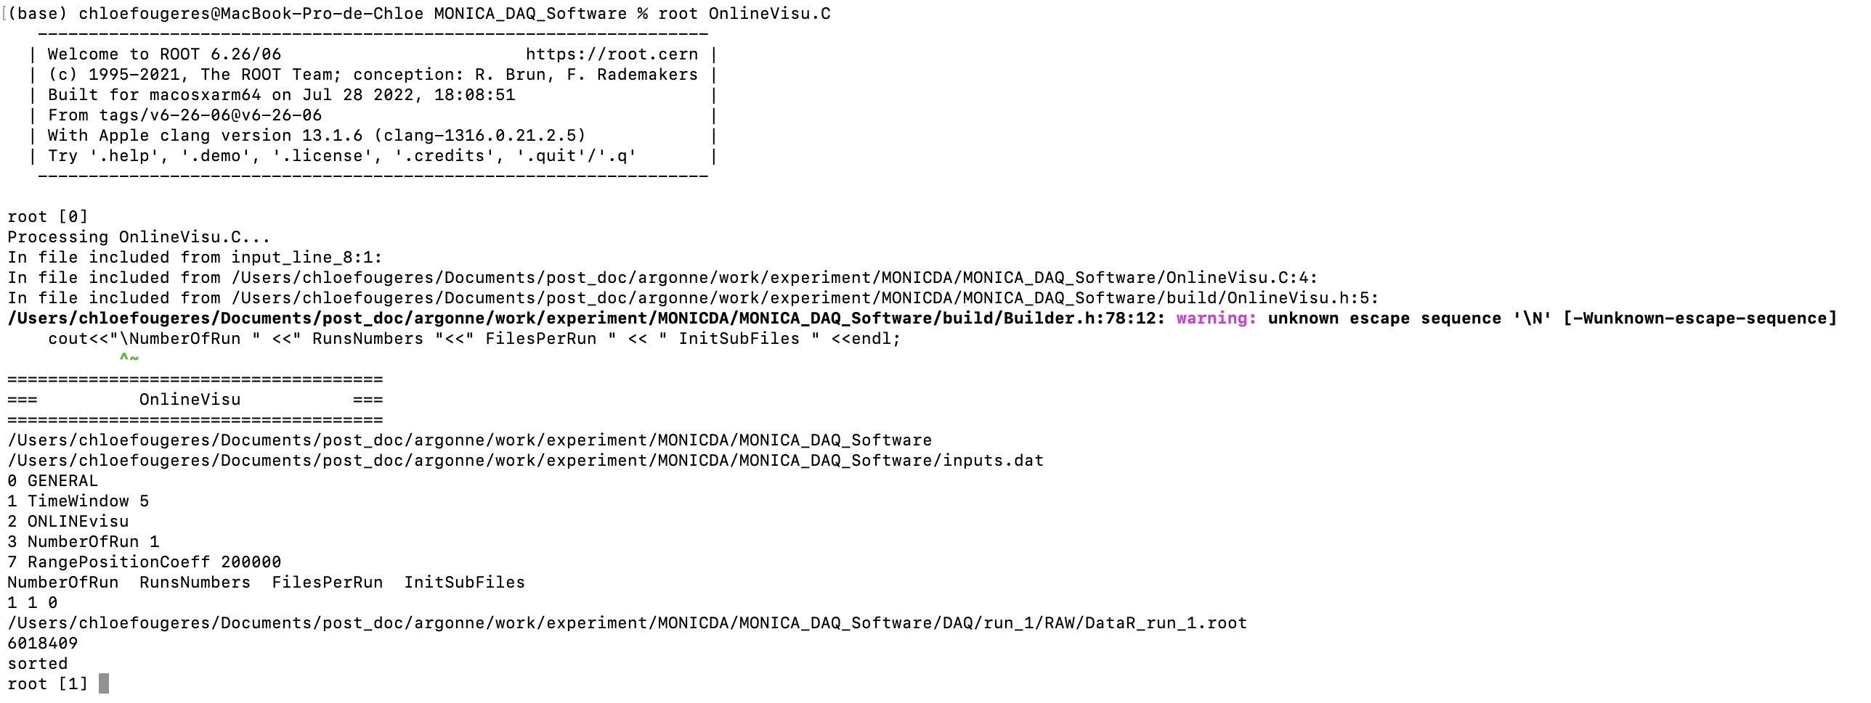
To run the code
In terminal
cd MONICA_DAQ_Software/
root OnlineVisu.C
user’ inputs, controlling inputs.dat file is properly read

Slide 6
Plots= MONICA

Slide 7
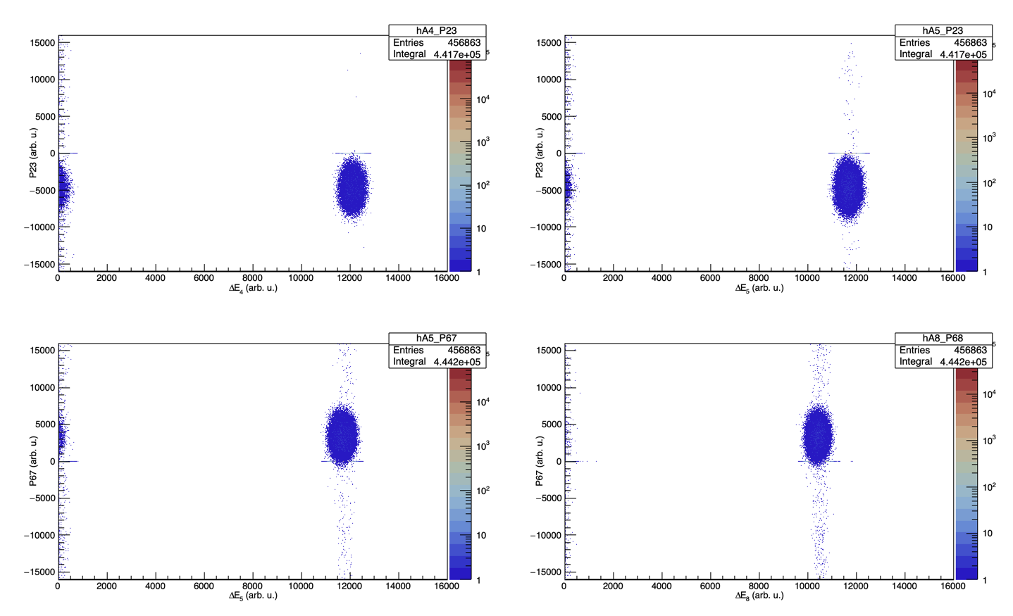
Plots= MONICA

Slide 8
Plots=Silicon

Slide 9
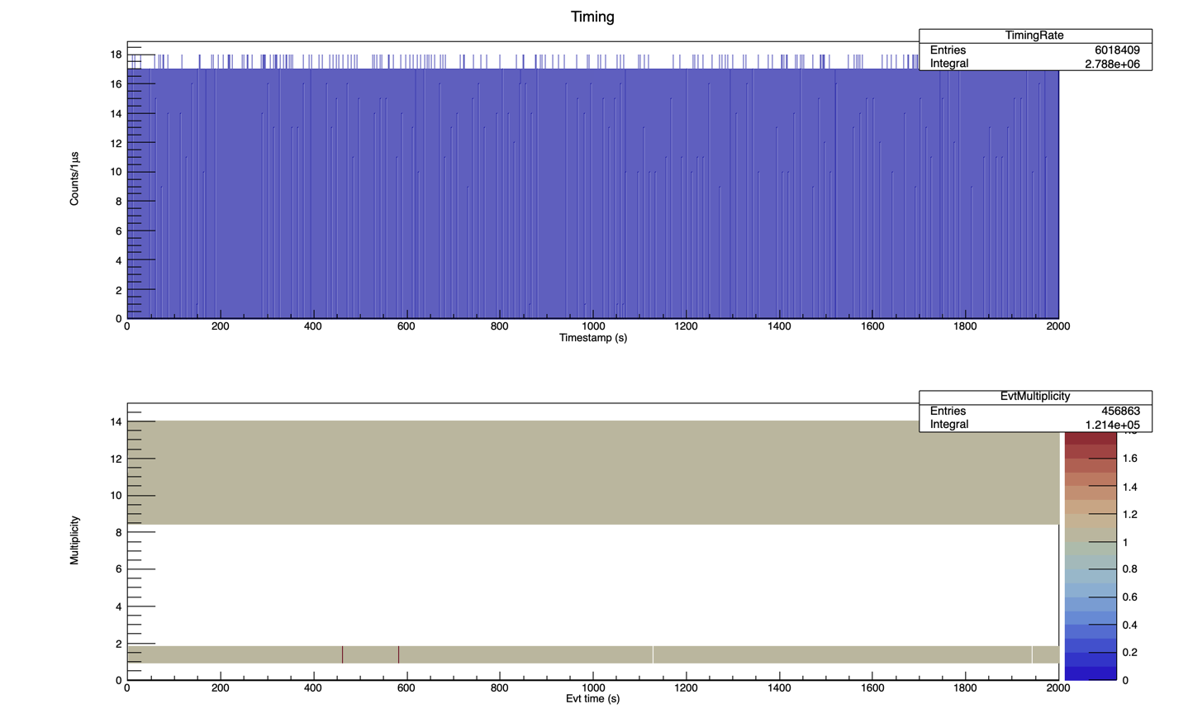
Plots=Rates

Slide 10
To run the code

Slide 11
