Slide 1
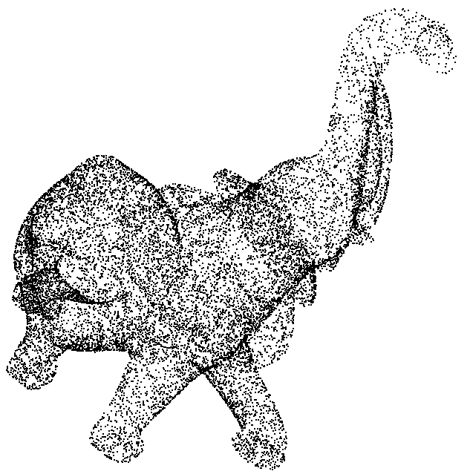
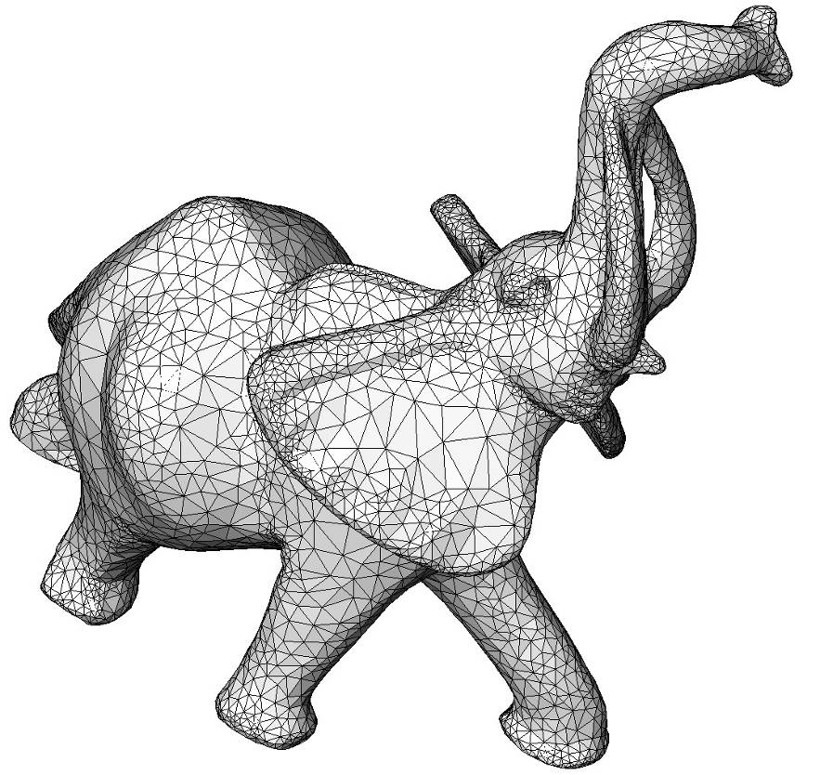
Poisson
Left: 17K points sampled on an elephant (Minolta laser scanner)
Right: reconstructed surface

Slide 2

APSS
Left: 17K points sampled on an elephant (Minolta laser scanner)
Right: reconstructed surface

Slide 3
Surface_reconstruction_points_ 3 Pipeline
Point set
Clean point set
Clean points with oriented normals
Analysis
Processing
Normals
Reconstruction
Contouring
Bounding box
Bounding sphere
Centroid
Average spacing
Simplification
Outlier removal
Smoothing
Estimation
Orientation
Poisson
Algebraic point set surfaces
Surface mesh generator
Points with unoriented normals
implicit
function
surface
triangle mesh
(grayed out = in other CGAL packages)
Notes:
We can enter the pipeline later if we have a clean point set, or points with oriented normals, or points with unoriented normals, etc.

Slide 4
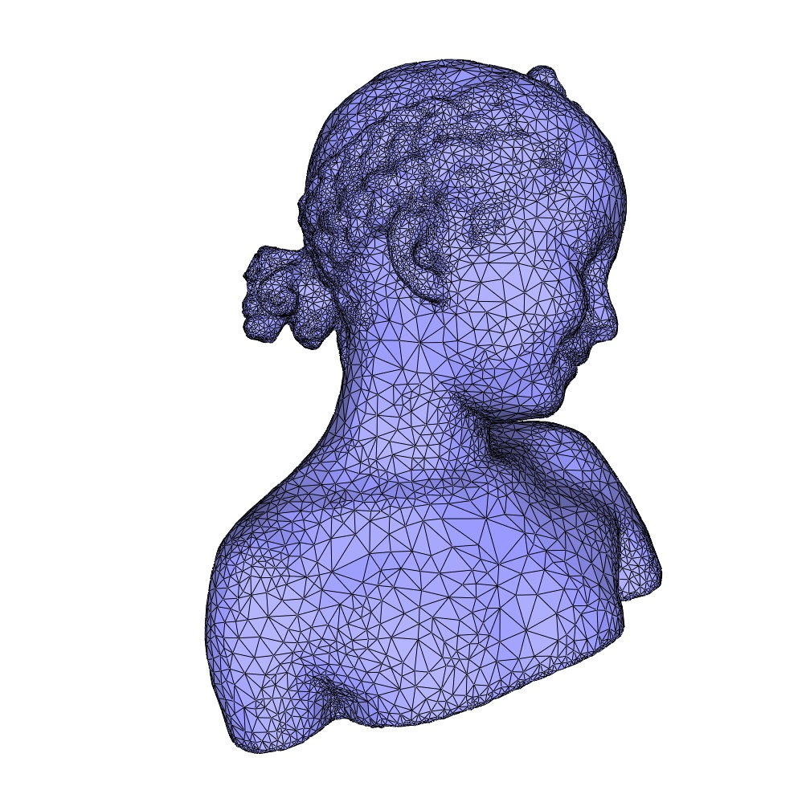
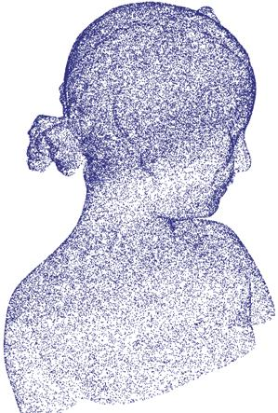
Poisson
Left: 120K points sampled on child statue (Minolta laser scanner)
Right: reconstructed surface

Slide 5
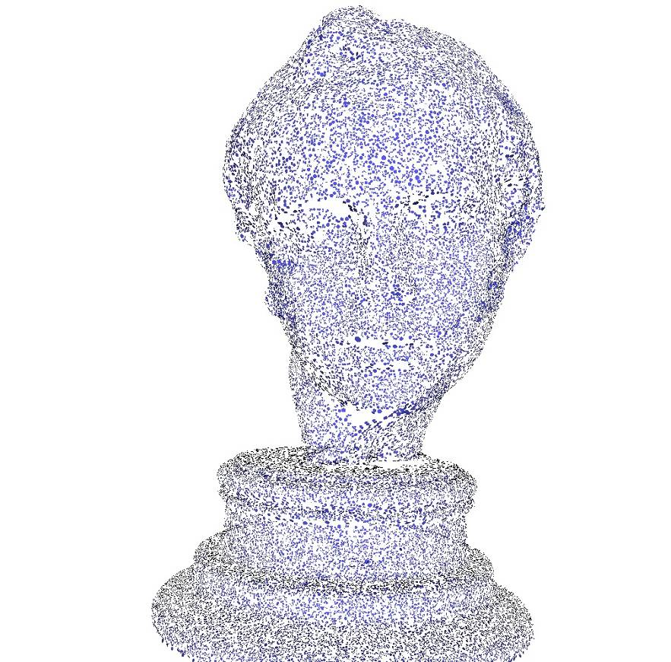
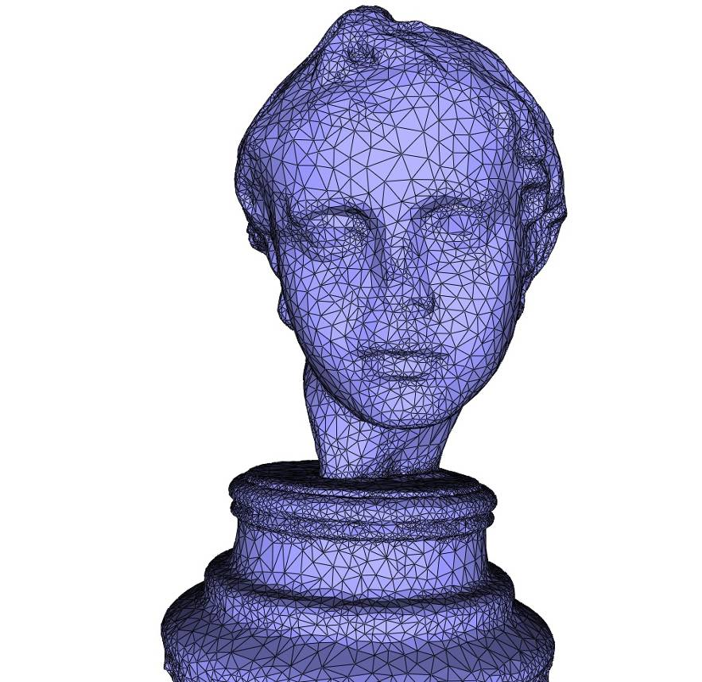
Poisson
Left: 120K points sampled on a statue (Minolta laser scanner)
Right: reconstructed surface

Slide 6
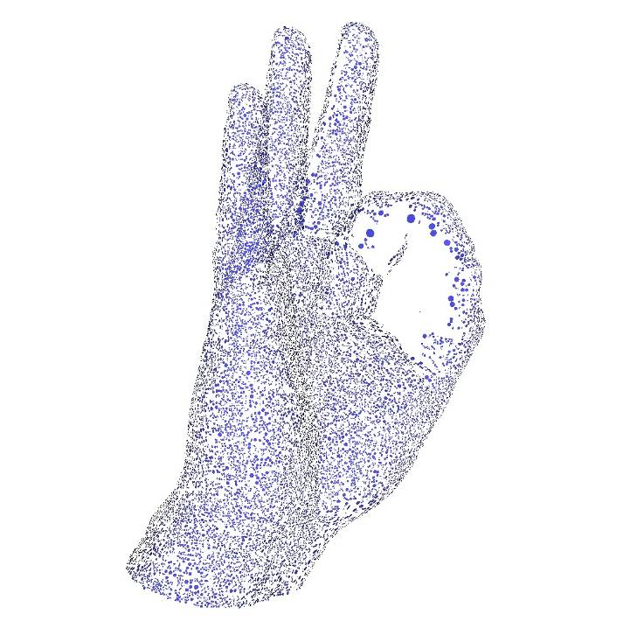
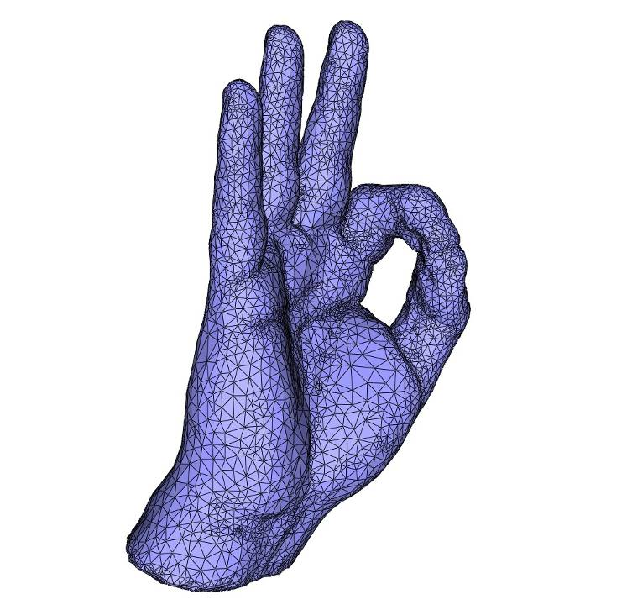
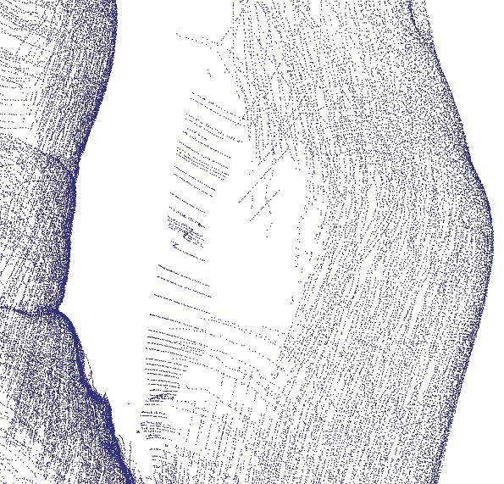
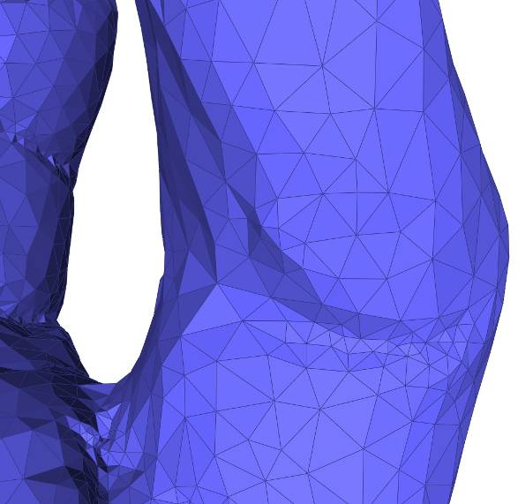
Poisson

Slide 7
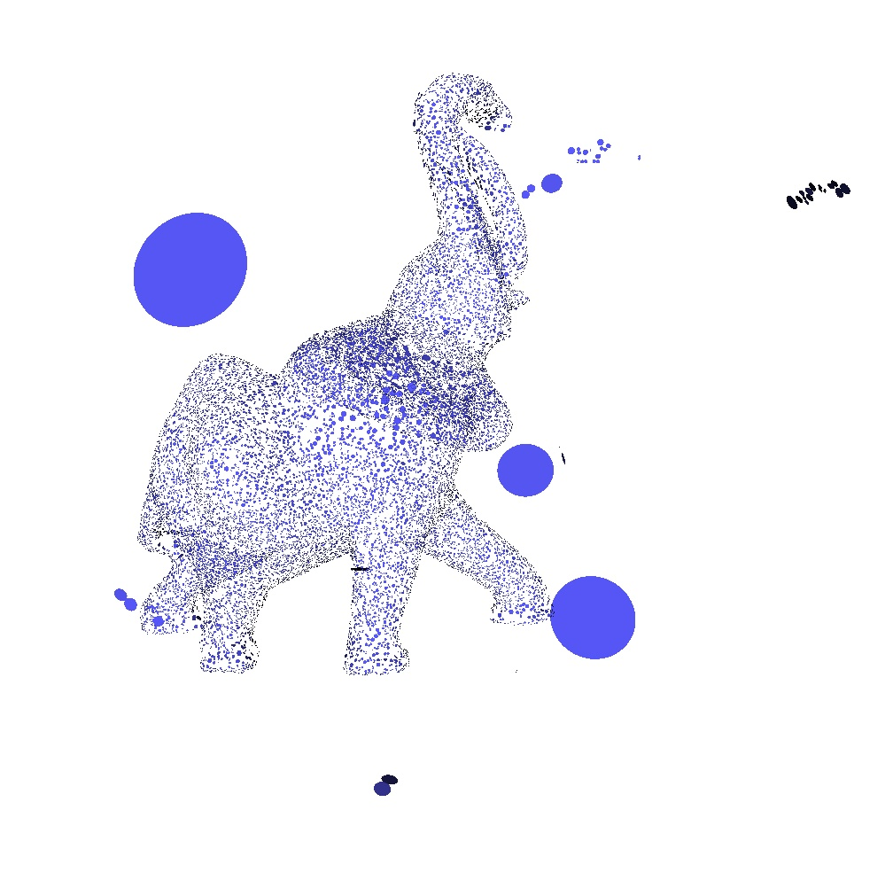
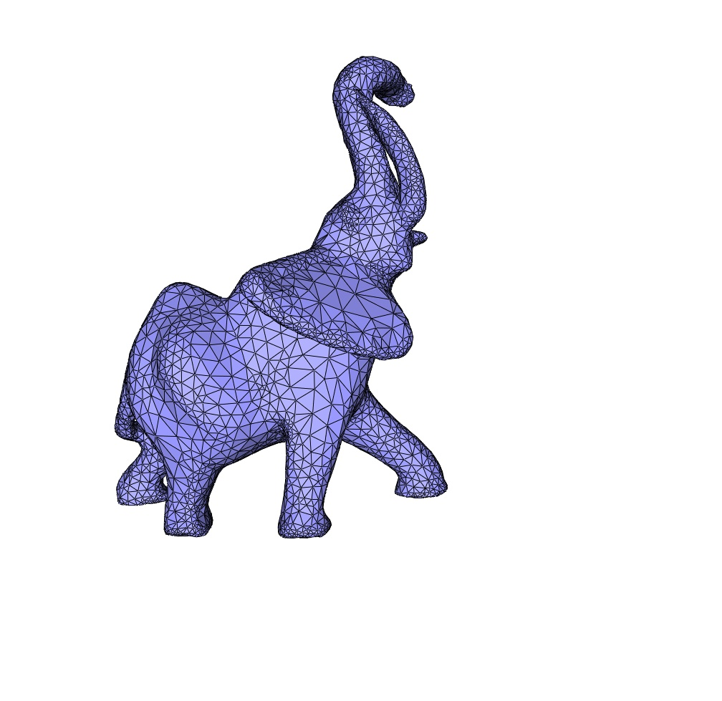
Poisson
Left: 70K points with (emphasized) outliers
Right: reconstructed surface

Slide 8
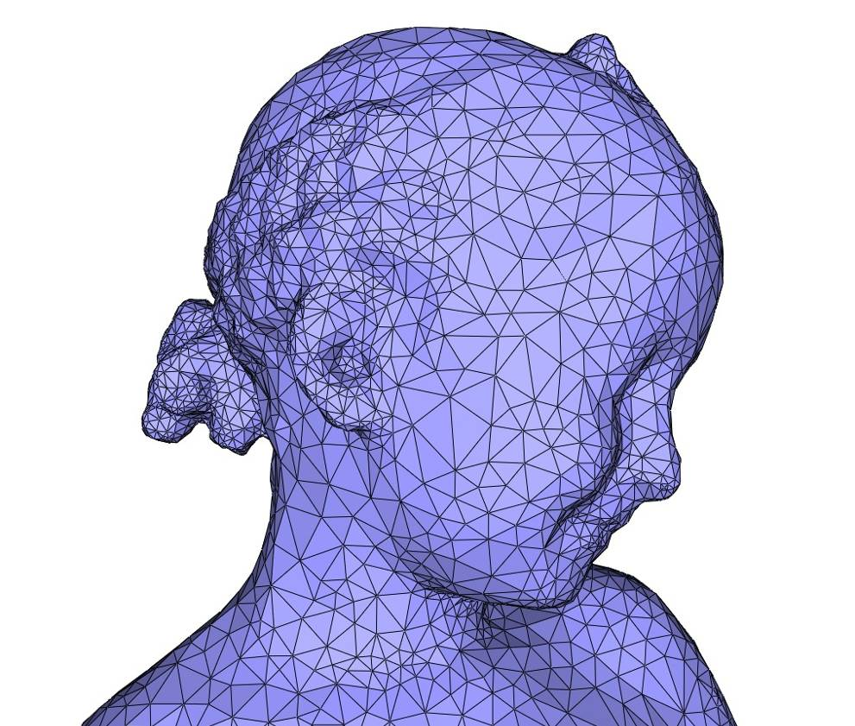
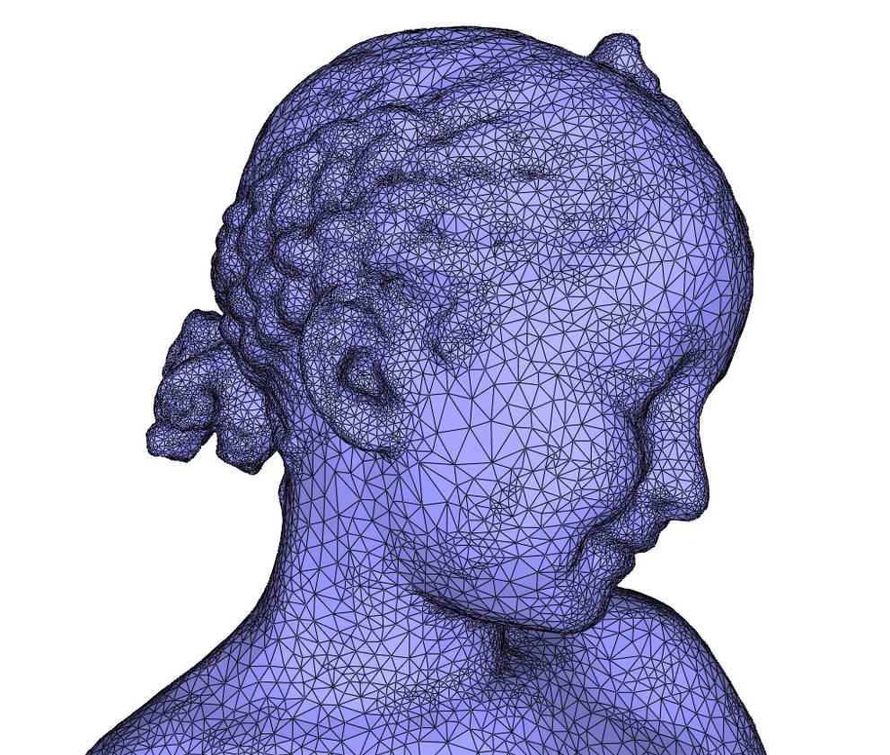
Poisson
Left: Bimba 120K reconstructed with distance = 0.25*average spacing
Right: Bimba 120K reconstructed with distance = 0.15*average spacing

Slide 9
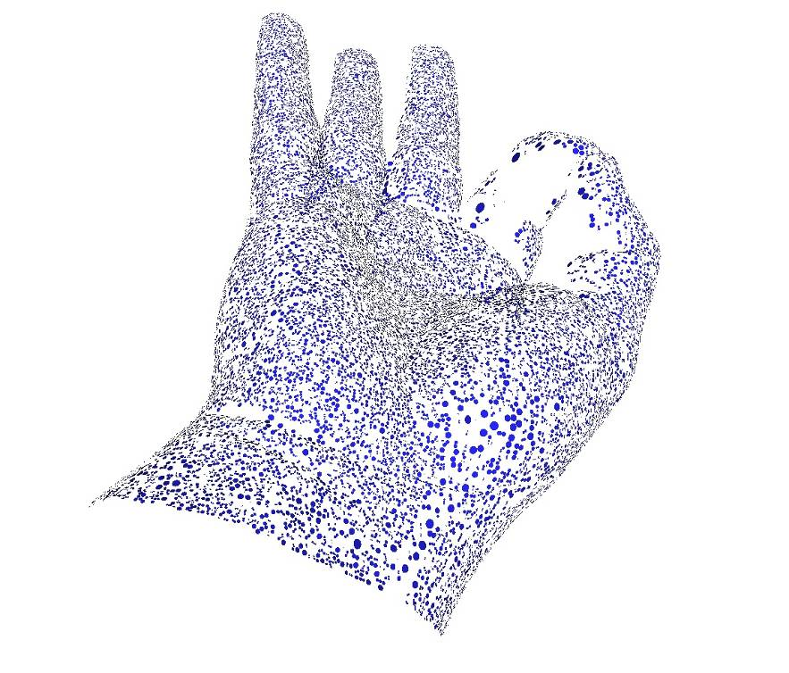
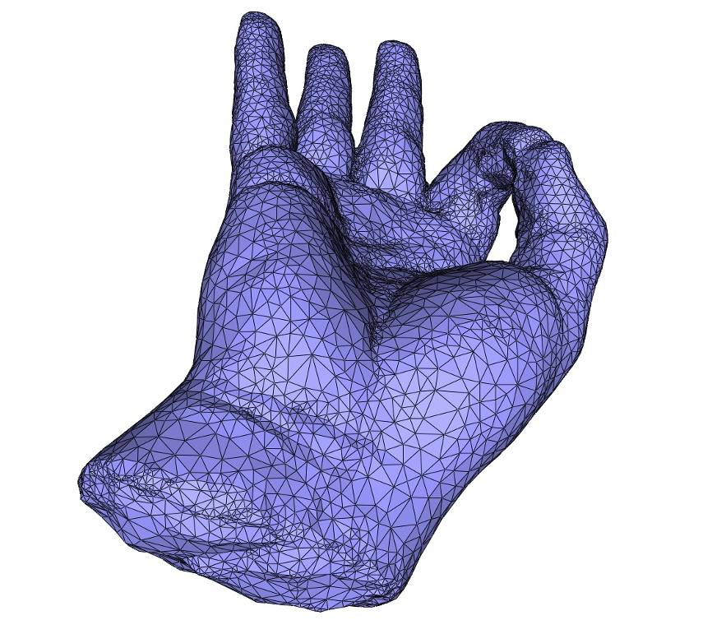
Poisson
Left: 65K points sampled on a hand with no data at the wrist base (Kreon laser scanner)
Right: reconstructed surface

Slide 10
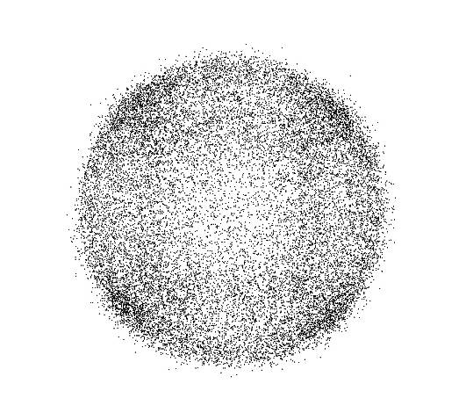
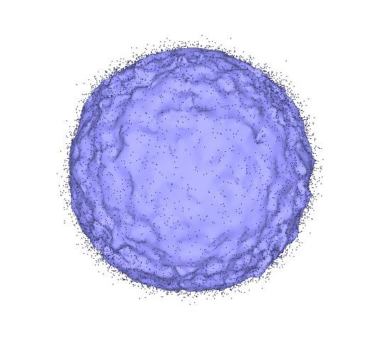
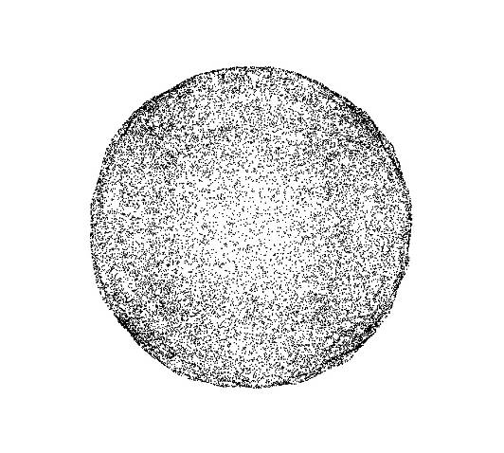
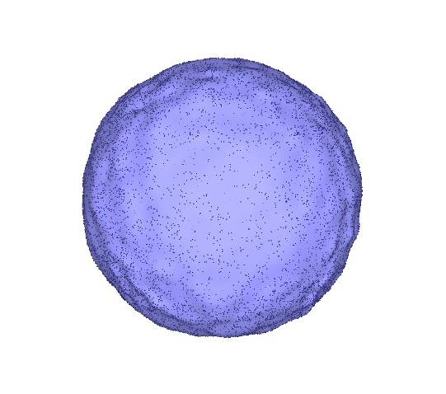
Poisson

Slide 11
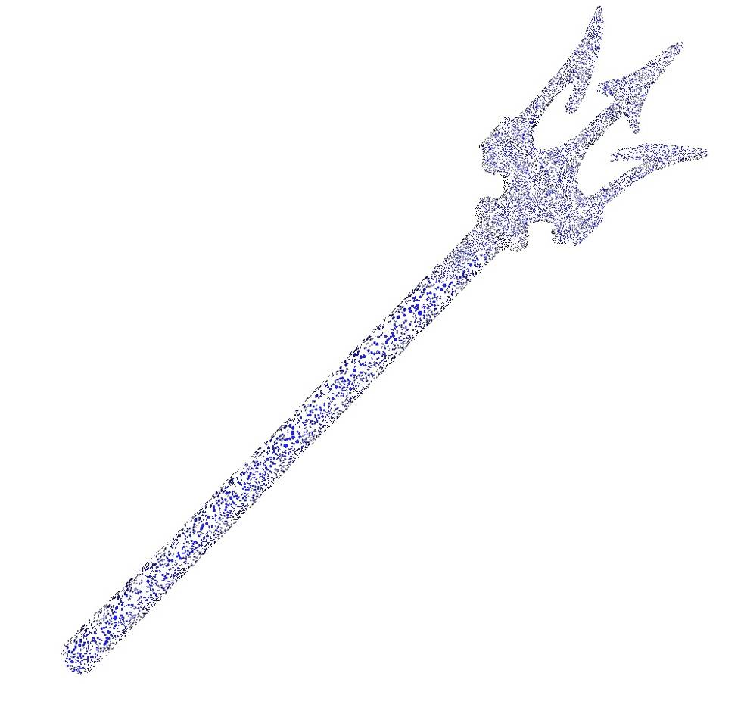
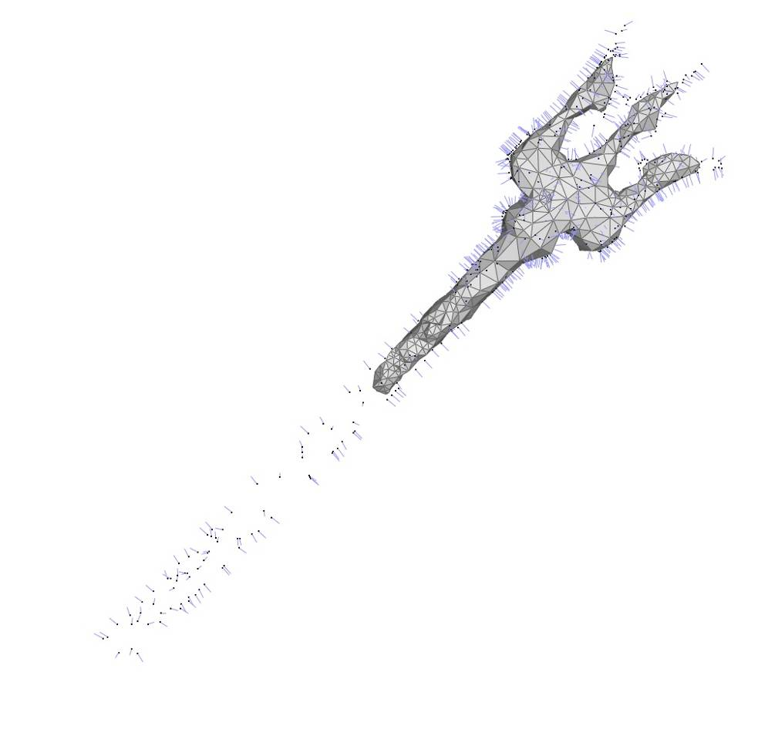
Poisson
Left: 50K points sampled on Neptune trident
Right: point set simplified to 1K then reconstructed

Slide 12
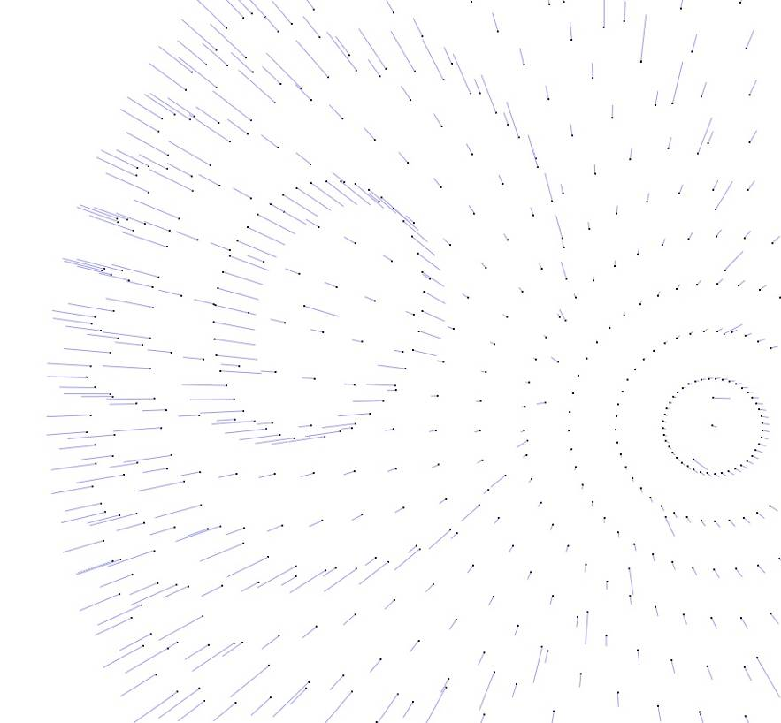
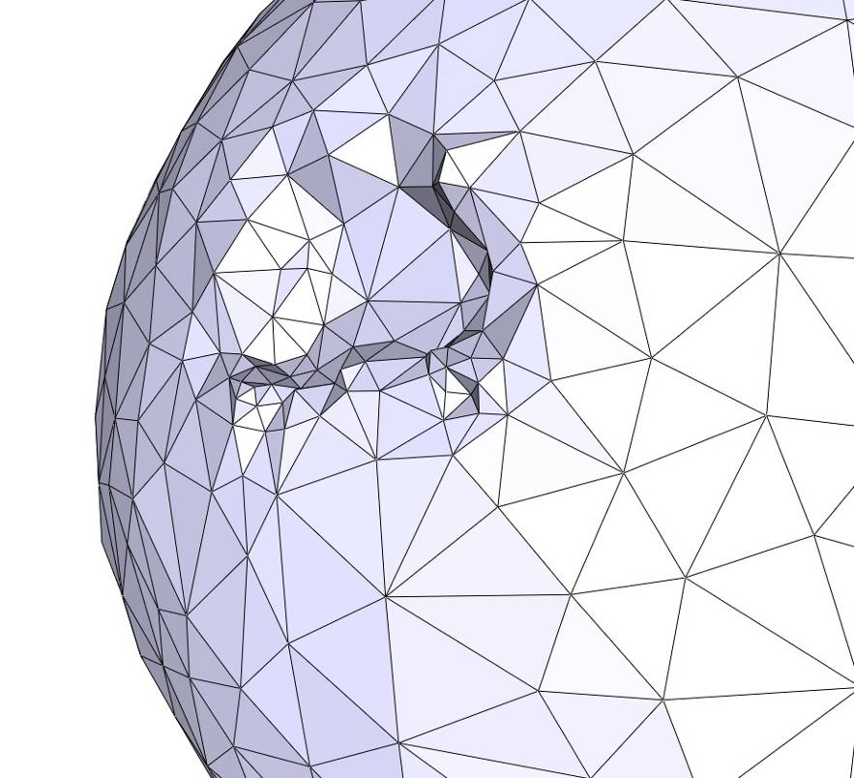
Poisson
Left: points sampled on a sphere with flipped normals
Right: reconstructed surface

Slide 13
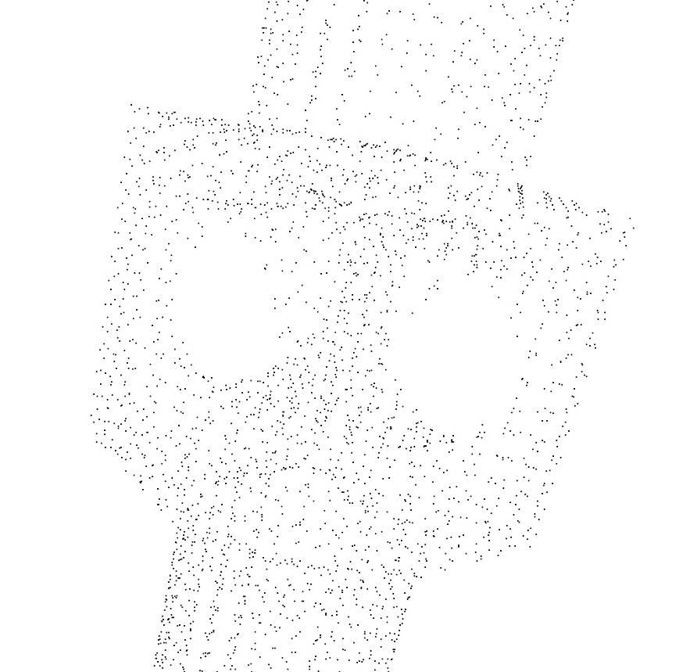
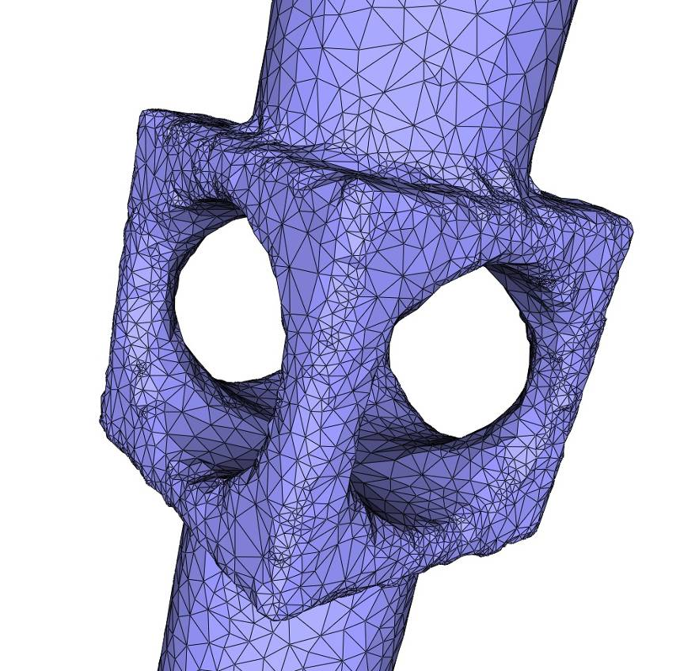
Poisson
Left: 4K points sampled on a mechanical piece with sharp edges
Right: reconstructed surface

Slide 14
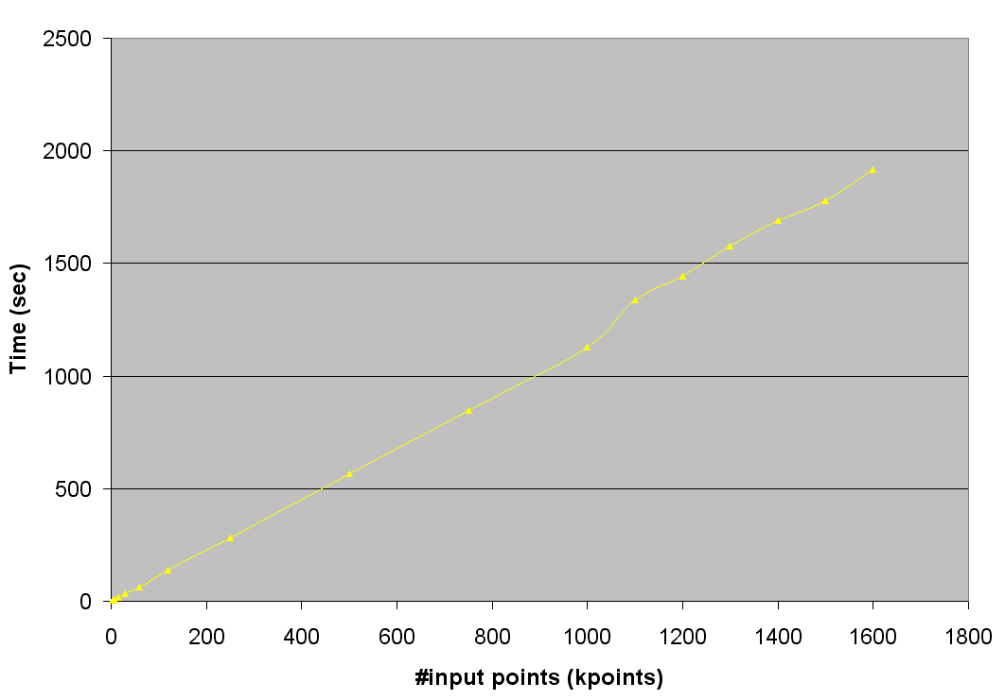
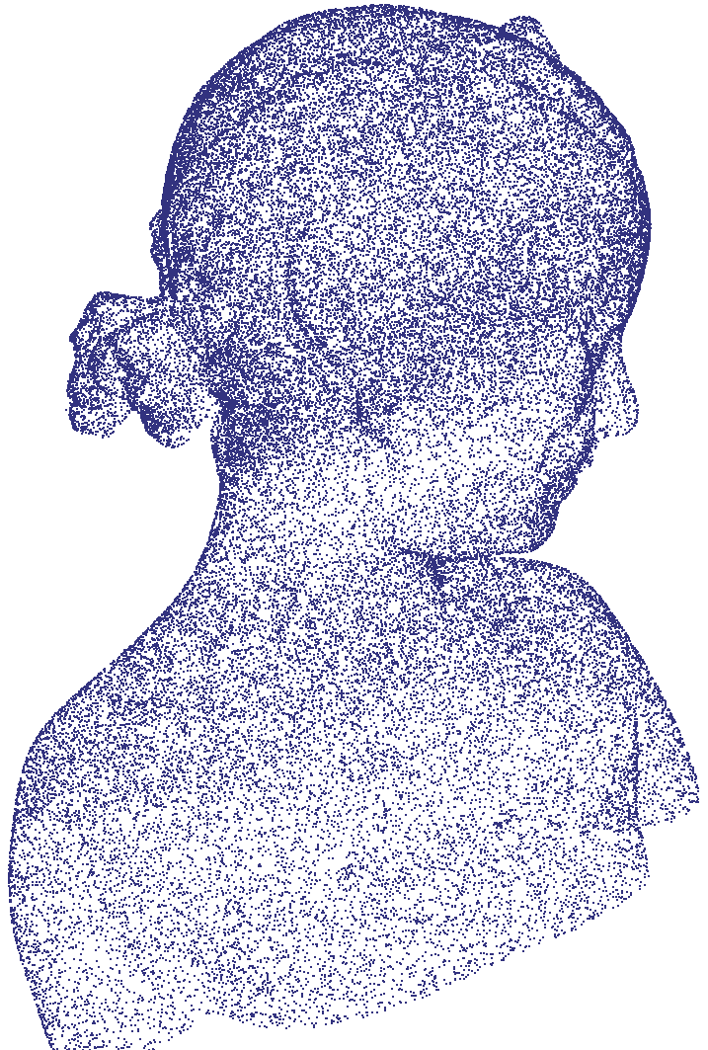
Poisson duration wrt #input points

Slide 15
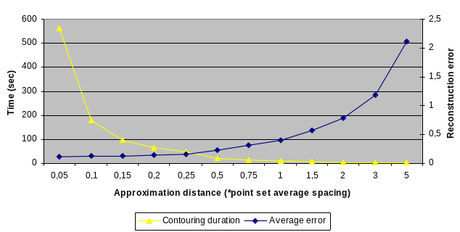
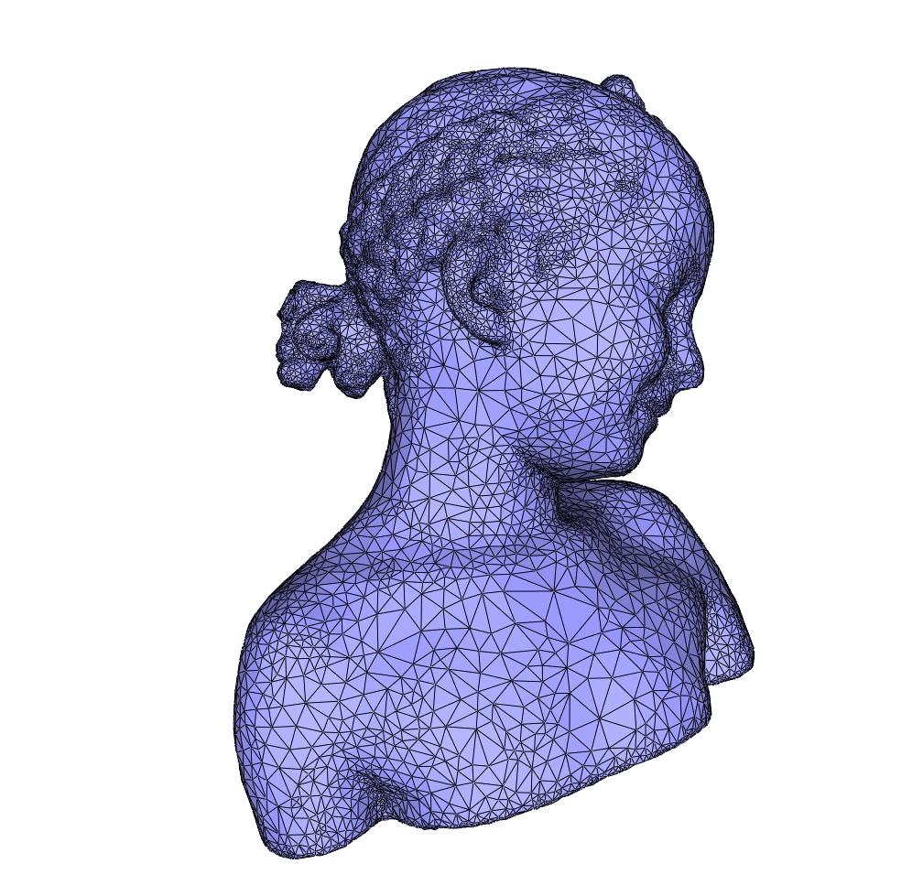
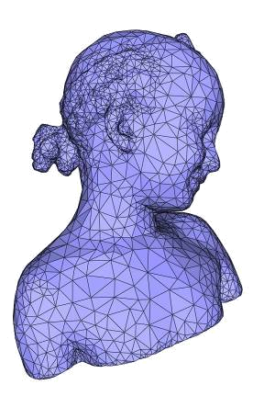
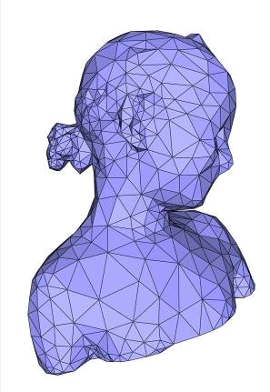
Surface meshing duration and error wrt approximation distance

Slide 16
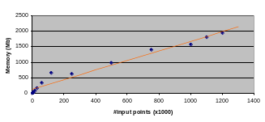
Memory wrt #input points

Slide 17
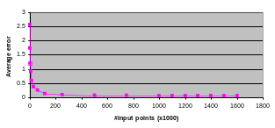
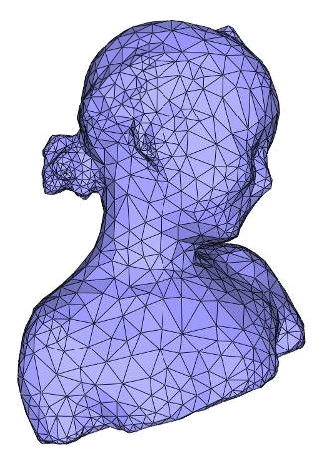
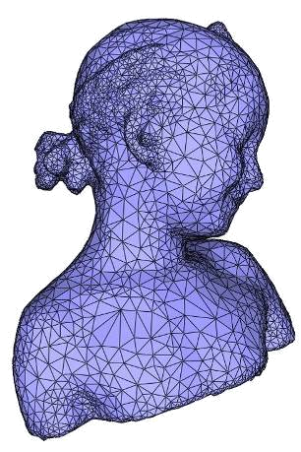
Reconstruction error wrt #input points

