Slide 1
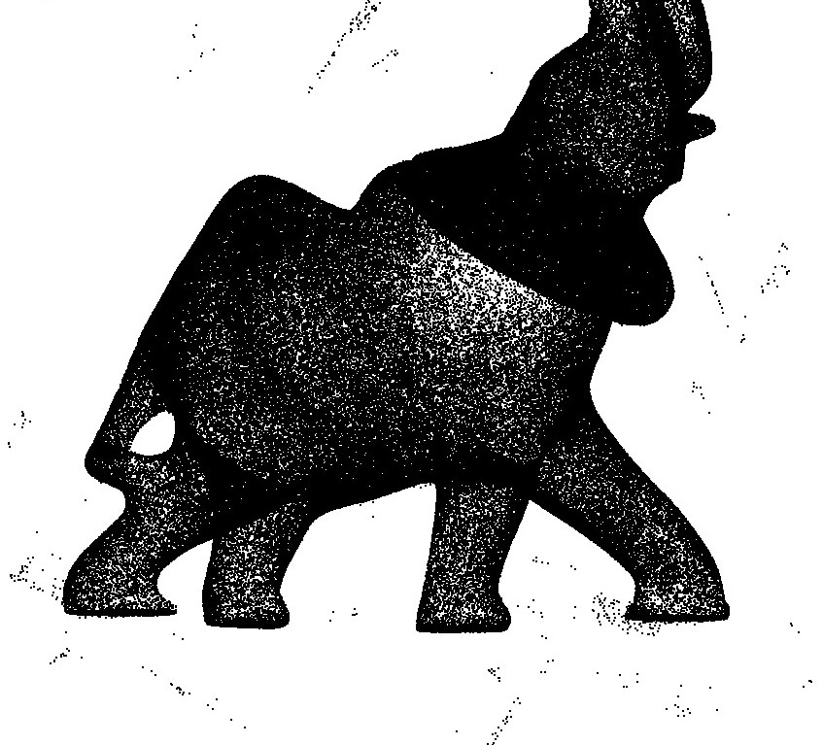
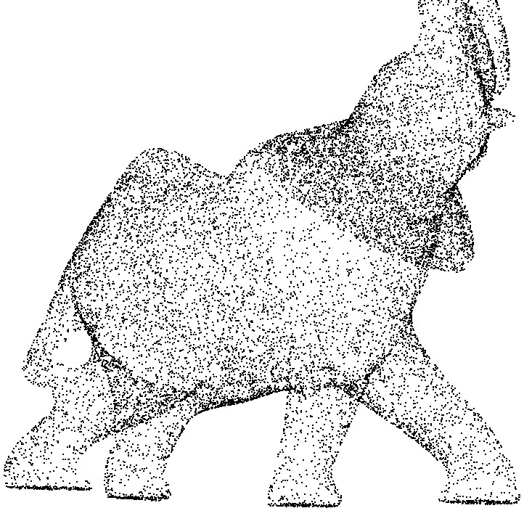
Point_set_processing_3 Introduction
Left: 275k points sampled on an elephant (Minolta laser scanner)
Right: point set cleaned and simplified to 17K points

Slide 2
Point_set_processing_3 Pipeline
Point set
Clean point set
Analysis
Processing
Normals
Bounding box
Bounding sphere
Centroid
Average spacing
Simplification
Outlier removal
Smoothing
Estimation
Orientation
Points with unoriented normals
Clean points with
oriented normals
(grayed out = in other CGAL packages)
Notes:
We can enter the pipeline later if we have a clean point set, or points with oriented normals, or points with unoriented normals, etc.

Slide 3
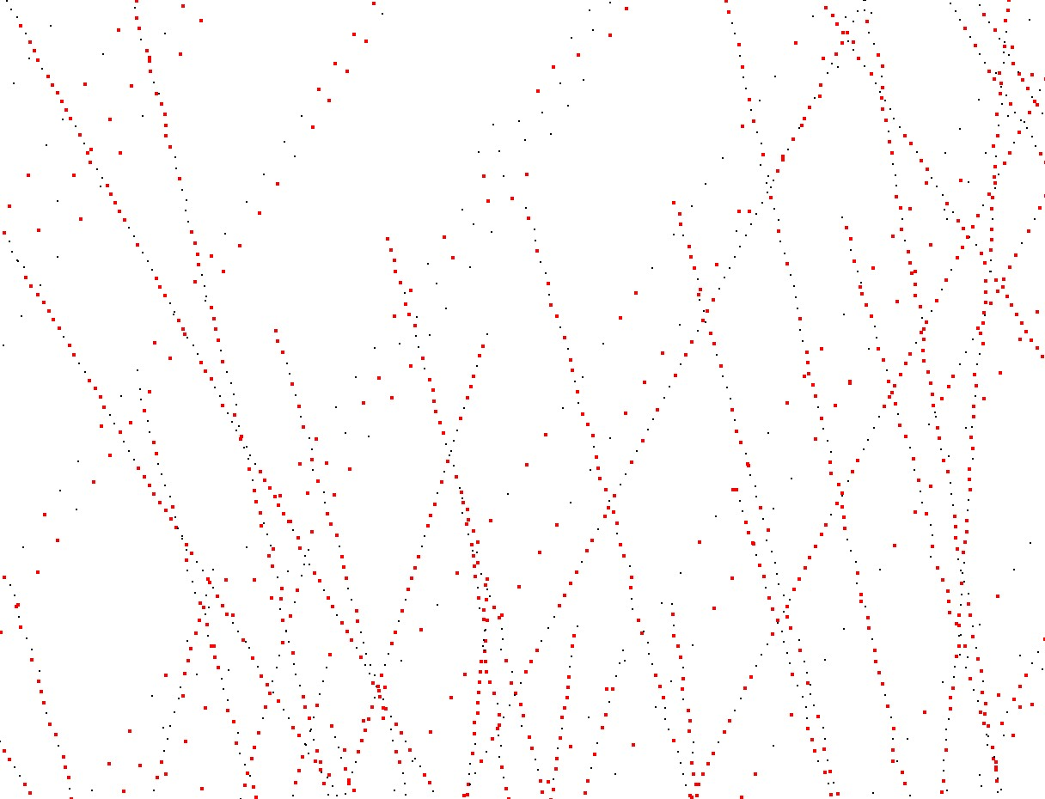
Simplification
from 100K to 50k points by random simplification

Slide 4
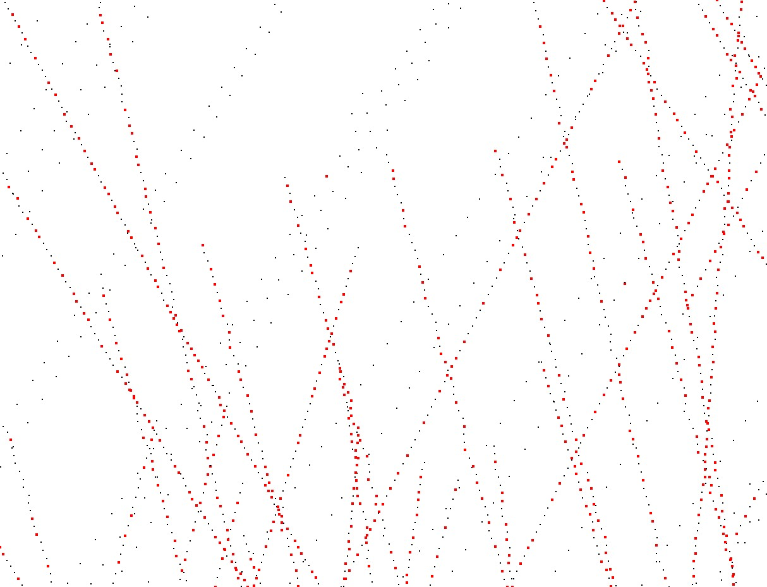
Simplification
from 100K to 50k points by clustering

Slide 5
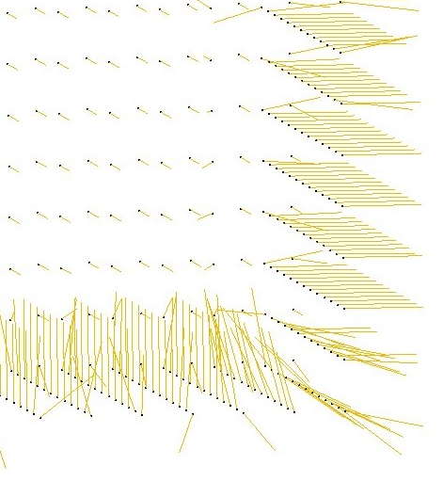
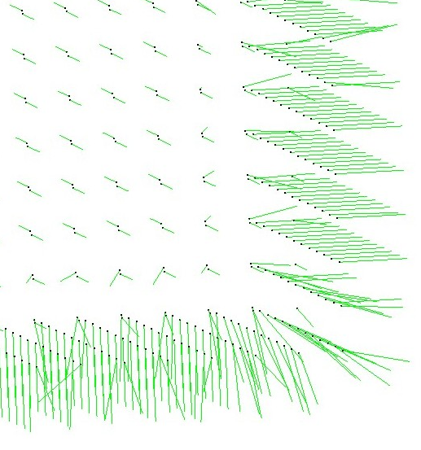
Example Normal Orientation
Normal Orientation through MST

