Slide 1
Testbed2 - Use Case 1
Scenario:
Show (query) geological units and fault and contacts (inc. age and lithology) and boreholes (collars) in data server local symbolisations), select and view contents (attributes)
- implementable as WMS. Exposes vocabulary issues.

Slide 2
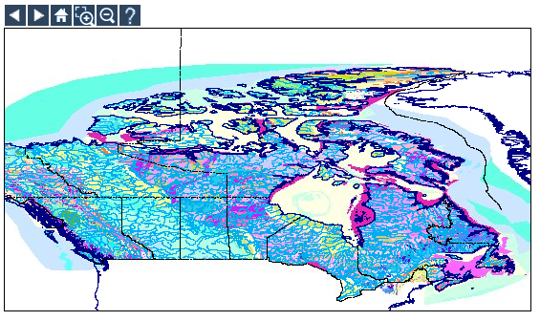
Testbed2 - Use Case 1
1. User selects service from Testbed participants
2. Service provides WMS showing GeologicUnit
3. User can zoom in and out and pan around map
Notes:
Show (query) geological units and fault and contacts (inc. age and lithology) and boreholes (collars) in data server local symbolisations), select and view contents (attributes) - implementable as WMS. Exposes vocabulary issues.
Comments:
Is this "GetFeatureInfo"?
We suggest using a WFS query on the GeologicFeature by ID because it will be re-used in Use-case 2
"implementable as WMS" - this specifies implementation where as a use-case should probably say "render an image". In which case we have two choices for implementation (or more):
implement server as WMS so an image is transmitted (This appears to be the suggested option for use-case 1 only)
implement server as WFS and the client renders the returned polygon (or whatever)
The use-case and design specification should really be separated but in this case we are taking shortcuts and being more implementation specific.
"local symbolisations" - the map will be inconsistent in symbology

Slide 3
Testbed2 - Use Case 1
4. User queries a geometry by selecting a single feature
5. Service provides GeoSciML of attributes of the selected MappedFeature and GeologicFeature
<?xml version="1.0" encoding="ISO-8859-1" ?>
- <wfs:FeatureCollection xmlns:wfs="http://www.opengis.net/wfs" xmlns:xlink="http://www.w3.org/1999/xlink" xmlns:gml=
"http://www.opengis.net/gml" xmlns:gsml="http://www.cgi-iugs.org/xml/GeoSciML/1">
- <gml:featureMember>
- <gsml:LithoStratographicUnit gml:id="ca.gc.nrcan.gdr.geologicUnit.3973">
<gml:name>Wsn</gml:name>
<gsml:purpose xlink:href="http://www.cgi-iugs.org/purpose#undefined" />
- <gsml:age>
- <gsml:GeologicAge>
- <gsml:value>
- <CGI_TermValue>
<gsml:value codeBase="http://www.cgi-iugs.org/period">Neoarchean</gsml:value>
</CGI_TermValue>
</gsml:value>
</gsml:GeologicAge>
</gsml:age>
<gsml:metadata xlink:href="http://www.cgi-iugs.org/metadata#undefined" />
- <gsml:occurence>
- <gsml:MappedFeature>
- <gsml:shape>
- <gml:Polygon>
- <gml:outerBoundaryIs>
- <gml:LinearRing>
<gml:coordinates>-88.4442,51.08018 -88.48241,51.07766 -88.50566,51.06435 -88.5054,51.0504 -88.48104,51.04148 -88.45225,51.03283 -88.43086,51.02025 -
...
Notes:
Show (query) geological units and fault and contacts (inc. age and lithology) and boreholes (collars) in data server local symbolisations), select and view contents (attributes) - implementable as WMS. Exposes vocabulary issues.
Comments:
Is this "GetFeatureInfo"?
We suggest using a WFS query on the GeologicFeature by ID because it will be re-used in Use-case 2
"implementable as WMS" - this specifies implementation where as a use-case should probably say "render an image". In which case we have two choices for implementation (or more):
implement server as WMS so an image is transmitted (This appears to be the suggested option for use-case 1 only)
implement server as WFS and the client renders the returned polygon (or whatever)
The use-case and design specification should really be separated but in this case we are taking shortcuts and being more implementation specific.
"local symbolisations" - the map will be inconsistent in symbology

Slide 4
Testbed2 - Use Case 1
1. Is this "GetFeatureInfo"?
  - GGIPAC suggested using a WFS query on the GeologicFeature by ID because it will be re-used in Use-case 2
2. "implementable as WMS" - this specifies implementation where as a use-case should probably say "render an image". In which case we have two choices for implementation (or more):
  - implement server as WMS so an image is transmitted (This appears to be the suggested option for use-case 1 only)
  - implement server as WFS and the client renders the returned polygon (or whatever)
3. "local symbolisations" - the map between Testbed participants will be inconsistent in symbology.
  - Are we symbolising on GeologicUnit “Name” and “Fault” and “Contact” and “Borehole”?
4. Do we return a separate xlinked XML document for the gsml:occurrence values?
5. Return the single feature as a collection for consistency with Use Case 2.
The use-case and design specification should really be separated but in this case we are taking shortcuts and being more implementation specific.

Slide 5
Testbed2 - Use Case 2
Scenario:
Select from the WMS (Use Case 1) by bounding box spatial selection (BBOX) for subset of features or boreholes.
Download the GML as WFS to a local file or download the GML for display (e.g. SVG) in the local client (e.g. borehole log).
Client has to handle WMS for the selection and WFS for the query filter requesting GML to be sent back.
Local servers may add thematic filter query [may be separate WFS for different 'views' of the data]

Slide 6
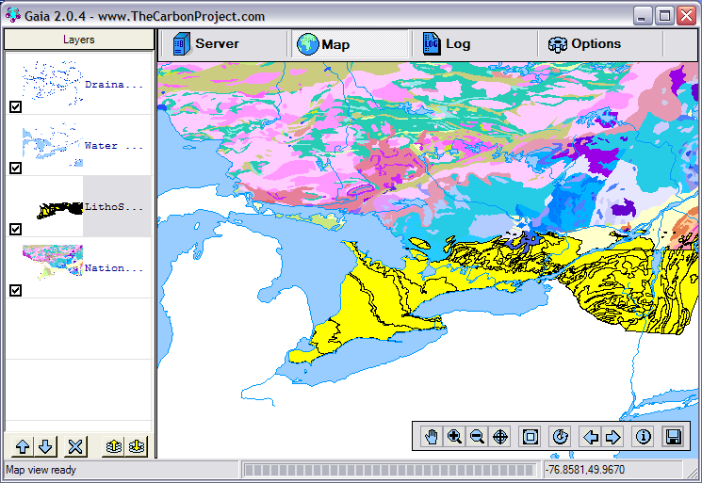
Testbed2 - Use Case 2
1. User selects query on Geological Unit, Geologic Structure, Borehole or All
2. User selects by drawing bounding box on map
3. Service highlights selected features
4. The service returns a document containing all the GSML for each of the collections of the selected FeatureTypes (3 documents)
(Do we have separate geometry documents --> 6 documents?)

Slide 7
Testbed2 - Use Case 2
Alternative Flow (Is this the first part of Use Case3?):
1. User selects query on GeologicUnit
2. User selects query by age or by composition (which composition?).
This query needs to be spelt out. What level do we allow?
3. Service returns a GML document with all the GeologicUnits and their properties that match that query.
4. The geometries that match the query are highlighted as selected on the map
5. The GML document is provided to the user as a formatted report (use of stylesheet)

