Slide 1
SeqDB: sequence database management system at the Swedish Museum of Natural History
Ingimar Erlingsson
Rodrigo Esparza-Salas
Notes:
SMNH = Swedish Museum of Natural History

Slide 2
SeqDB is a modern information system
Web accessible relational database
Robust data validation
Standardized and structured
Powerful searching and filtering
Bulk Editing (import / export of spreadsheets)
Export to external Systems (BOLD)
Record auditing
Automated backups
Notes:
Our defintion of a ‘modern information system’
Bulk editing:
Able to export after filtering data ….
Rodrigo:
“ We use SeqDB as a main information management system for NRMs DNA archive, as well as for the temporary DNA collections used in research projects and environmental monitoring activities”..
Thomas:
“traceability”
“transparency to external partners : we insert/import – available in the public interface “

Slide 3
What is a SeqDB ?
Provides standards compliant information management for
Collection Record to DNA Sequence Workflows
LIMS
Lab Work and Protocols
SeqDB
Physical Item Storage and Barcoding
Taxonomy
Sequence and genotype-data
DINA
Permanent Collections
+
Working Collections
Notes:
Web accessible application backed by a relation database
Provides standards compliant information management for Collection Record to DNA Sequence Workflows
Darwin Core Compliant ?
- var hittar jag det i Seqdb ? Fråga James …. vad betyder detta ?
Provides standards compliant information management for Collection Record ( länk till Permanent collection) to DNA Sequence Workflows
Compliant to both MixS, Genomic Standard Consortium, and DwcA. MixS – minimum information …..
‘beskriva sitt projekt …. ‘ - hur har man gjort …
Rodrigo : “ The alternatives to SeqDB would be:
a) To use a commercial Lab Information Management System (LIMS)
https://www.labsexplorer.com/c/2017-review-of-lab-information-management-systems-lims_23
Which might not have the same features for natural history collections as SeqDB
b) To develop a system in-house, which would probably take too long
c) To continue using excel sheets and/or Microsoft access or a similar database software which is not sustainable in the long term, and doesn’t have the advantages of keeping track of lab workflows.”

Slide 4

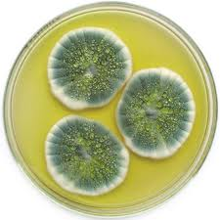
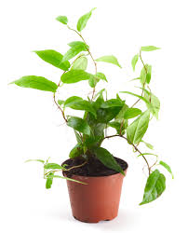
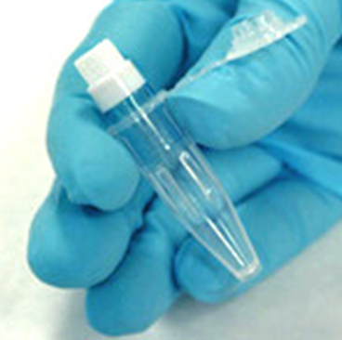
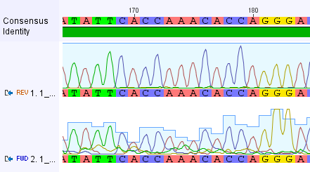
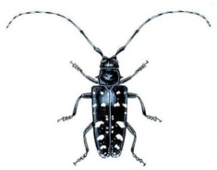
The SeqDB Sanger barcoding workflow
Specimen
(Example: Pure culture / Plant / Insect / Bacteria)
Sample
(DNA Extract)
Consensus Sequences (DNA Barcode)
Notes:
A simplified figure:
Rodrigo wrote
“SeqDB has features to account for extra steps of
the sanger sequencing workflow. If you want to highlight that the steps can include in order: Specimen, DNA extraction, PCR, Sequencing reaction, consensus DNA barcode. “

Slide 5
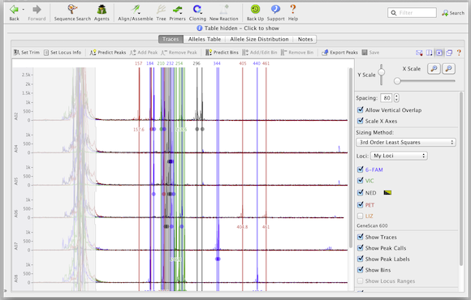
The SeqDB Genotyping workflow
Specimen
(Example: Pure culture / Plant / Insect / Bacteria)
Sample
(DNA Extract)
Genotyping Analysis
Notes:
A simplified figure:
Rodrigo wrote “Specimen, DNA extraction, PCR,
Genotyping analysis.”

Slide 6
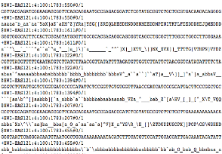
The SeqDB NGS workflow
Specimen
(Example: Pure culture / Plant / Insect / Bacteria)
Sample
(DNA Extract)
Sequencing Data
(FASTQ)
Notes:
A simplified figure:
Rodrigo wrote “ Specimen, DNA extraction, Library preparation, sequencing data. “

Slide 7
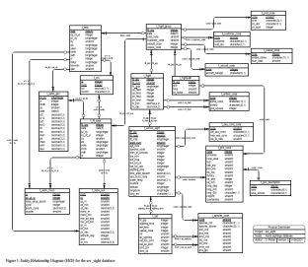
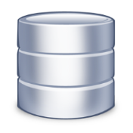
The SeqDB workflow
Data (Sequencing, genotyping)
Analysis Results & Reports
SeqDB
Analysis Tools and Pipelines

Slide 8
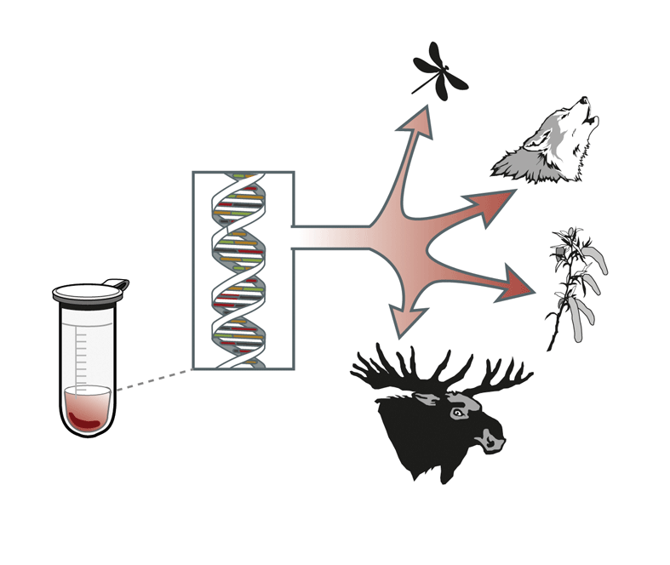
The SeqDB and The Swedish Natural History Museum
User CGI :
1 Use case : ‘the Bear-project’ - With individual genotype data (microsatellites)
No need to integrate with DINA

Slide 9
The SeqDB and The Swedish Natural History Museum
User : DNA lab
2 Use cases :
1. ‘Voucher specimens/DNA archive’
2. ‘Working DNA samples for temporary research projects’
Integration with DINA
No need to integrate with DINA
Notes:
BOLD exporter- I tested the BOLD exporter with some of the examples in the test version and it looks pretty straightforward. The samples are exported in FastA format in bulk, with attached information about the ID and taxonomy (genus,species) of each specimen. The format is ready to be imported into BOLD.
“ We use SeqDB as a main information management system for NRMs DNA archive, as well as for the temporary DNA collections used in research projects and environmental monitoring activities”.

Slide 10
Organisation
Groups
Collections
Projects
Account types
Administrators
Users
Guests
(public interface)

Slide 11
Organisation
Groups
NRM-DNA archive
Collections (e.g. Bryophytes, Mammals, Insects)
NRM-CGI
Collections (e.g. NV, County councils)
DNA Lab
Working collections (e.g. M. Irestedt, D. Marquina)
DINA

Slide 12
SeqDB
Issues to be decided
Organisational: Groups, collections, users, projects
Physical storage units
Account types and permissions
Integration with DINA
DINA = Master → SeqDB = Slave
“Minimally disruptive” Specimen information
ABS - questions
Notes:
BOLD exporter- I tested the BOLD exporter with some of the examples in the test version and it looks pretty straightforward. The samples are exported in FastA format in bulk, with attached information about the ID and taxonomy (genus,species) of each specimen. The format is ready to be imported into BOLD.
“ We use SeqDB as a main information management system for NRMs DNA archive, as well as for the temporary DNA collections used in research projects and environmental monitoring activities”.

Slide 13
Implementing SeqDB at the Museum
Gathering requirements from CGI and the DNA-Lab
Does SeqDB support our 3 use cases ?
Workshops with the ‘domain’-experts:
There is a need to customize the software
Driver: ‘the Bear-project’
Work : requirements, development, test, local deploy
Support of : import of Genotypes, to view Genotypes
Need for a public search-portal, for the Swedish EPA
Our Customization:
Integrated and developed support for a
Micronic scanner, Rack with 96 wells - preprinted viles
DevOps : We have packaged the SeqDB with Docker.
Driver : A harmonized production environment
Notes:
Running the service locally at our museum.
Access restricted, you have to sit within the museums network ….
The system is not open sourced yet; we get the binaries and db-changes when asked for

Slide 14
A physical archive and a digital archive
The Physical Archive
Short description
The Digital Archive
Short description

Slide 15
CGI – project : The Bear-project
Monitoring the scandinavian brown bear population
Citizen science
Genotype data
Provide basis for management decision
Metadata from other data base
Genotype data
SeqDB
Physical storage information (DNA)
Notes:
Citizen science = hunters
‘dna school ‘ on the nrm homepage -
A reoccurring project …

Slide 16
CGI – project : The Bear-project
Short description of the project
Monitoring and Managing the Swedish Brown Bear population
Will be a reoccurring project
Jägare som samlar avföringsprover …..
The Bear-Project
File 1: Rovbase.no→ metadata ( location, individual-id, …. )
File 2: Geniouse programvaran → genotype data
File 3: Micronic scanner → metadata ( position in the rack )
File = File1+File2+File 3 → import to SeqDB
Bild sidan 12 från erik, stryk export till bold
Förklaring.
Kort projekt, vad är syfte med projektet ?
Vilken metadatasparas tillsammans med provet
Använda en bild ?

Slide 17
Demo of the seqdb
Seqdb demo … 2:55
https://archive.org/details/simplescreenrecorder_seq-2018-09-07_17.30.29
https://archive.org/details/simplescreenrecorder_seq-2018-09-07_17.57.14

Slide 18
Demo of the public interface
https://archive.org/details/simplescreenrecorder-2018-09-06_20.31.16

Slide 19
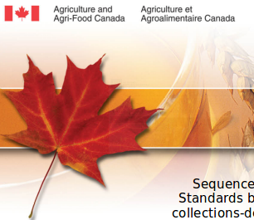
Credits to the AAFC
Credits to the Agriculture and Agri-Food Canada (AAFC) the creator of SeqDB
The AAFC are DINA-partners, part of the “DINA international Steering committee”
The SeqDB is in the process of being open sourced

Slide 20
Questions ?

Slide 21
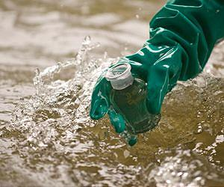
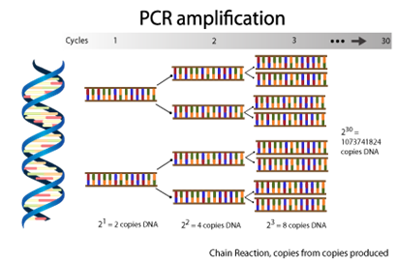

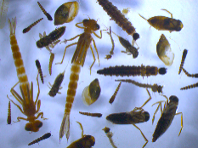
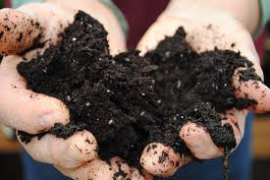
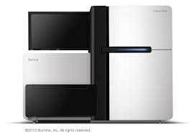
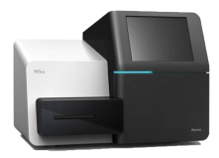
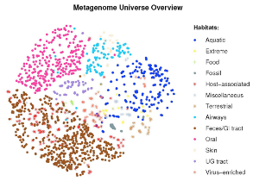
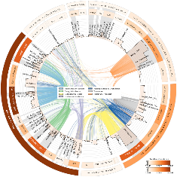
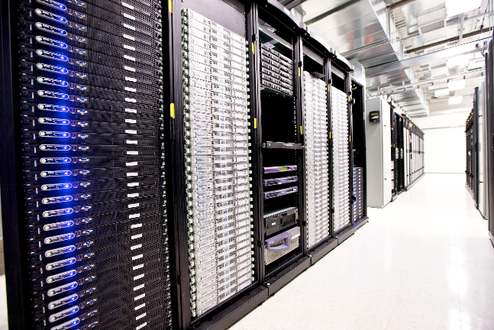
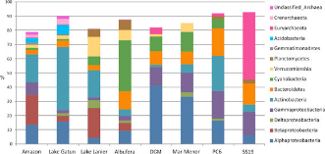
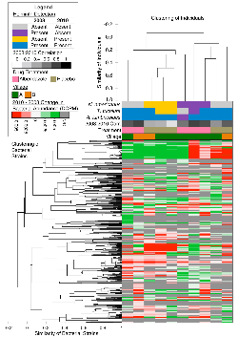
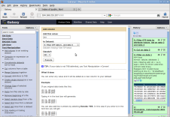
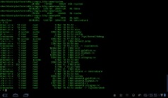
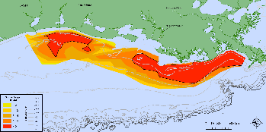
NGS Metagenomics Workflow
Environmental Sample Collection
DNA Extraction, PCR Amplification and Library Prep
Sequencing (NGS)
Analysis Results & Reports
SeqDB
Analysis Tools and Pipelines
Sequencing Data
(FASTQ)
Galaxy
Command
Line
10/26/2018
Notes:
The major shift with NGS projects is the scale difference between Sanger and NGS machines.
Due to the major amounts of Sequence Data, High Performance Computers are ideal for completing data analysis
21

