Slide 1


A Detailed GPU Cache Model Based on Reuse Distance Theory
Cedric Nugteren, Gert-Jan van den Braak, Henk Corporaal
Eindhoven University of Technology (Netherlands)
Henri Bal
Vrije Universiteit Amsterdam (Netherlands)

Slide 2
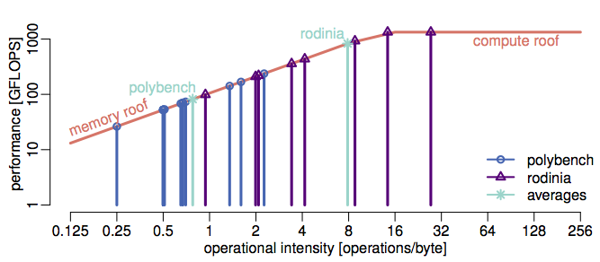
Why caches for GPUs?
Isn’t the GPU hiding memory latency through parallelism? Why bother with caches at all?
Lots of GPU programs are memory bandwidth bound (e.g. 18 out 31 for Parboil)
25% hits in the cache 25% ‘extra’ off-chip memory bandwidth up to 25% improved performance
This work focuses on the L1 data-caches only:
Finding the order of requests to the L1 is the main challenge
Existing multi-core CPU models can be re-used to get a L2 model
Modelling NVIDIA GPUs: L1 caches only reads
Notes:
Problem people might have: GPUs hide memory latencies through multi-threading, why bother with caches at all? Why should we investigate them? Well, a lot of GPU programs are in fact memory BW bound (show roofline quickly as illustration). Anything that we gain in the cache saves off-chip accesses, saving BW and thus giving (theoretically) equal performance improvements.
Small disclaimer: We focus on L1 only in this work. L1 is the main challenge, as finding the order of memory requests is the main challenge. Once this order is known and the L1 is modelled, all misses to the L1 are simply input to an L2 model. This L2 model can be based on existing reuse distance theory models, i.e. it is a similar problem as for existing multi-core CPU cache models.

Slide 3
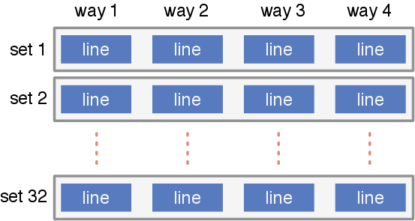
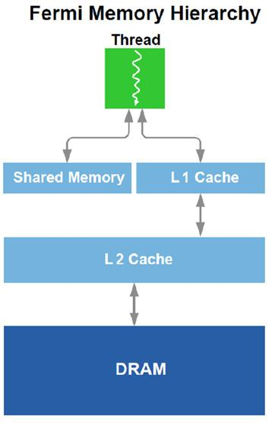
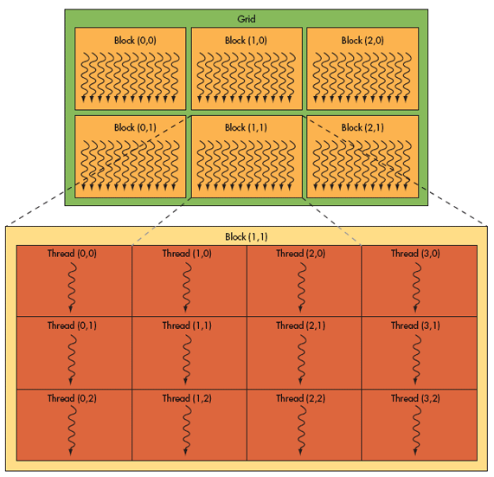
A cache model for GPUs
A (proper) GPU cache model does not exist yet. Why?
✓ Normal cache structure (lines, sets, ways)
✓ Typical hierarchy (per core L1, shared L2)
But how to find the order of requests?
X Hierarchy of threads, warps, threadblocks
X A single thread processes loads/stores in-order, but multiple threads can diverge w.r.t. each other
instr. 2
instr. 4
instr. 5
Notes:
GPU caches are normal CPU-like caches with ways, sets, cache-lines, replacement policies, L1/L2 hierarchy.
However, the challenge in making a GPU cache model lies in finding the order in which memory requests appear to the cache. Within a thread the order is fixed (instr 1, 2, 3, etc.), but it is not clear which threads execute when. Some run on different cores/SMs, some run sequential in time as threadblocks, some run in lock-step as warps, and some might diverge w.r.t. to each other based on conditionals or misses/hits.

Slide 4
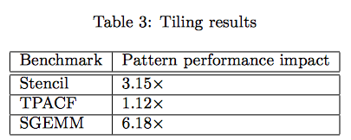
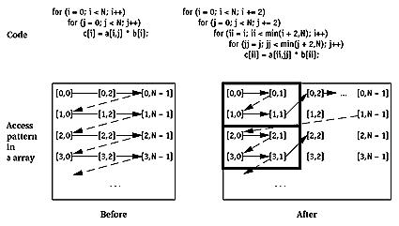
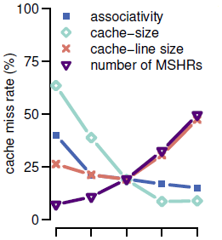
But what can it be used for?
A cache model can give:
A prediction of the amount of misses
Insight into the types of misses (e.g. compulsory, capacity, conflict)
Examples of using the cache model:
A GPU programmer can identify the amount and types of cache misses, guiding him through the optimisation space
An optimising compiler (e.g. PPCG) can apply loop-tiling based on a feedback-loop with a cache model
A processor architect can perform design space exploration based on the cache model’s parameters (e.g. associativity)
Notes:
The cache model can be used to get insight or a miss rate prediction.
3C model: compulsory, capacity, conflict misses, introduced by Mark Hill, the keynote speaker at HPCA
It can be used by GPU programmers, compilers, or processor designers. Some examples are mentioned.

Slide 5
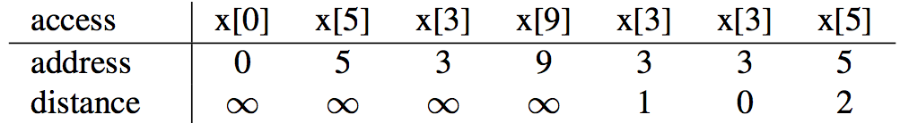
Background: reuse distance theory
Example of reuse distance theory:
For sequential processors
At address or at cache-line granularity
time
address ‘9’ in between
addresses ‘9’ and ‘3’ in between
Notes:
To estimate the amount of cache misses (based on the 3C model), a reuse distance profile can be constructed from a memory access trace.
OK, let’s get started with how cache models for CPUs work.
Explain reuse distance theory for an example at address granularity (step-by-step)

Slide 6
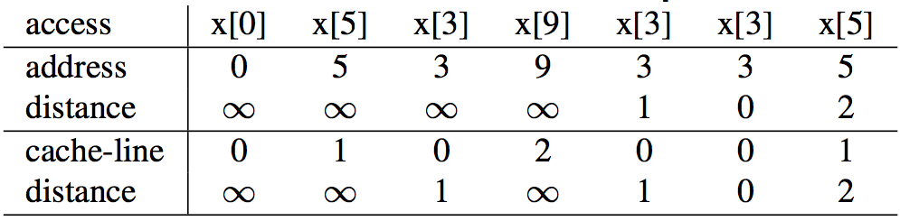
Background: reuse distance theory
Example of reuse distance theory:
For sequential processors
At address or at cache-line (e.g. 4 items) granularity
time
(integer divide by 4)
cache line ‘1’ in between
Notes:
Explain reuse distance theory for the same example at cache-line granularity (arrows only in animation)

Slide 7
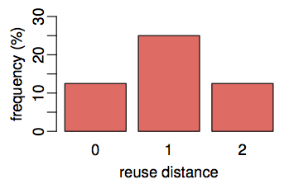

Background: reuse distance theory
Example of reuse distance theory:
For sequential processors
At address or at cache-line (e.g. 4 items) granularity
time
example cache
with 2 cache-lines
1 capacity
miss (14%)
(at cache-line granularity)
3 compulsory misses (42%)
Notes:
Explain how the reuse distance leads to a cache miss rate. On the left is an example table for the frequency (at cache-line granularity), on the right is the same but then visualised as a graph. Conclusion: 3 compulsory misses (42%) and 1 capacity miss (14%) for an example cache of 2 lines.

Slide 8
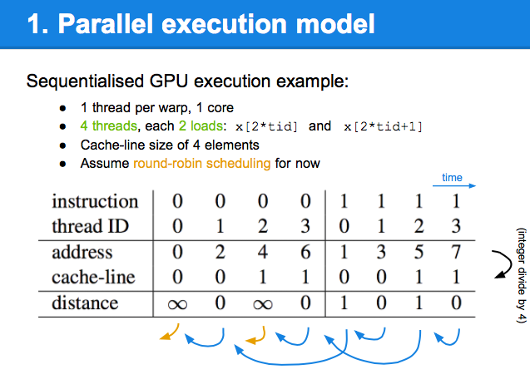
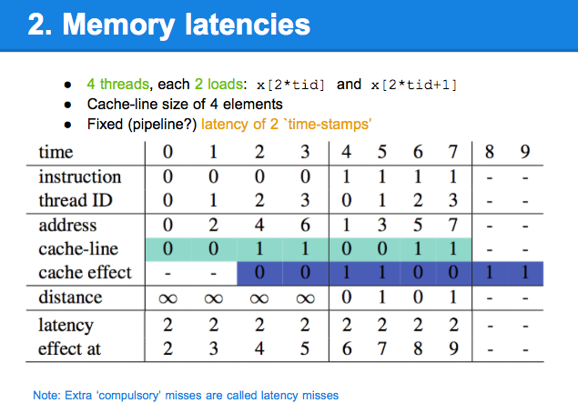
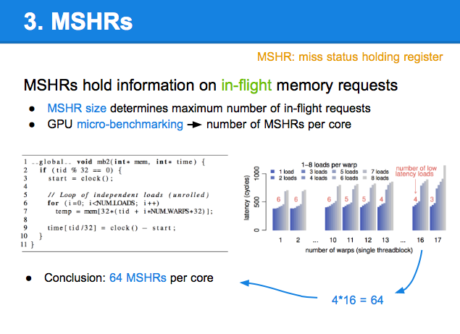
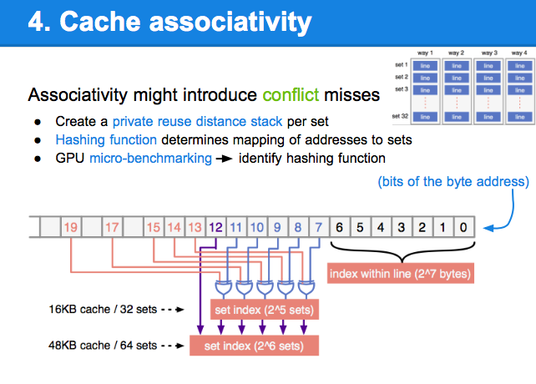
Extensions to reuse distance theory
Notes:
Overview slides. We’ll discuss 4 items (extensions to the existing theory) to fit GPUs (i.e. find the order in which accesses occur to the hardware):
- Execution model
- Memory latencies
- MSHRs
- Cache associativity (not really related to order)

Slide 9
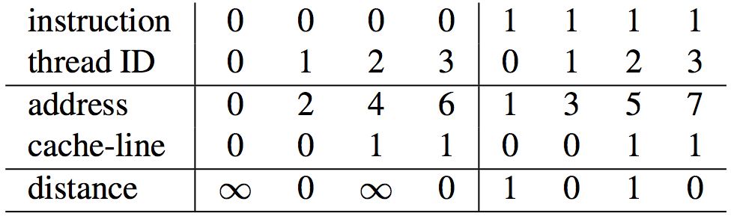
1. Parallel execution model
Sequentialised GPU execution example:
1 thread per warp, 1 core
4 threads, each 2 loads: x[2*tid] and x[2*tid+1]
Cache-line size of 4 elements
Assume round-robin scheduling for now
time
(integer divide by 4)
Notes:
Reuse distance theory works on a sequential trace of memory accesses. What if we just assume some kind of thread ordering on the GPU (round-robin for now): then we can apply the reuse distance theory as before. First instruction 0 for all threads, then instruction 1 for all threads. Calculate address, cache-line, and distance (cache-line granularity) as before. This gives us the cache miss rate in the end.
Note: tid is the thread ID

Slide 10
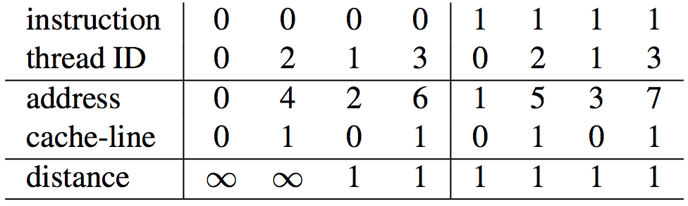
1. Parallel execution model
Sequentialised GPU execution example:
1 thread per warp, 1 core
4 threads, each 2 loads: x[2*tid] and x[2*tid+1]
Cache-line size of 4 elements
Assume round-robin scheduling for now
time
(integer divide by 4)
Notes:
Reuse distance theory works on a sequential trace of memory accesses. What if we just assume some kind of thread ordering on the GPU (round-robin for now): then we can apply the reuse distance theory as before. First instruction 0 for all threads, then instruction 1 for all threads. Calculate address, cache-line, and distance (cache-line granularity) as before. This gives us the cache miss rate in the end.
Note: tid is the thread ID

Slide 11
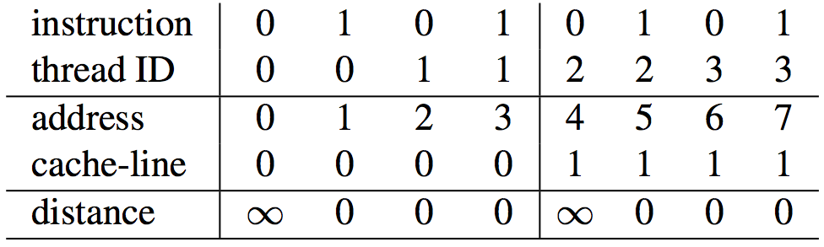
1. Parallel execution model
Sequentialised GPU execution example:
1 thread per warp, 1 core
4 threads, each 2 loads: x[2*tid] and x[2*tid+1]
Cache-line size of 4 elements
Assume round-robin scheduling for now
time
(integer divide by 4)
Notes:
Reuse distance theory works on a sequential trace of memory accesses. What if we just assume some kind of thread ordering on the GPU (round-robin for now): then we can apply the reuse distance theory as before. First instruction 0 for all threads, then instruction 1 for all threads. Calculate address, cache-line, and distance (cache-line granularity) as before. This gives us the cache miss rate in the end.
Note: tid is the thread ID

Slide 12
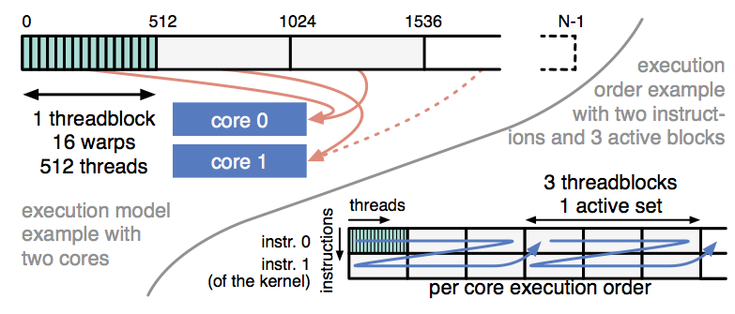
1. Parallel execution model
And how to handle warps, threadblocks, sets of active threads, multiple cores/SMs, etc?
Implemented in the model (see paper for details)
But is this the correct order?
2. What about memory latencies and thread divergence?
3. And isn’t there a maximum number of outstanding requests?
4. And did we handle cache associativity yet?
Notes:
However, what we did is not correct. The next 3 topics (2,3,4) will handle three main things we forgot about. What we don’t discuss further here is the thread hierarchy, see the paper for details. Picture is just for illustration, don’t explain it in detail.

Slide 13
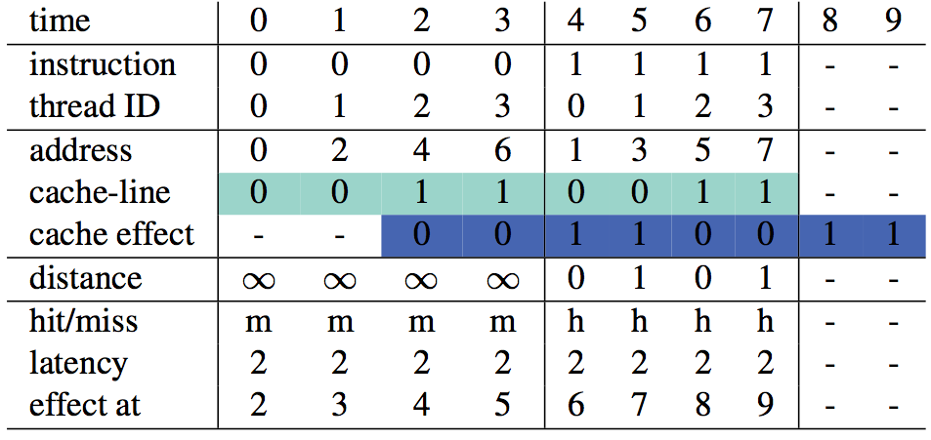
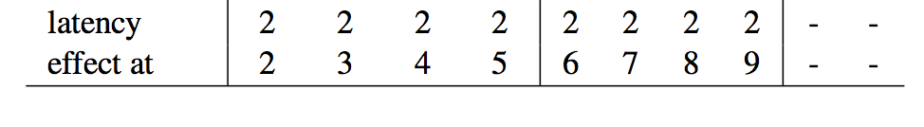
2. Memory latencies
4 threads, each 2 loads: x[2*tid] and x[2*tid+1]
Cache-line size of 4 elements
Fixed latency of 2 `time-stamps’
as before
Note: Extra ‘compulsory’ misses are called latency misses
Notes:
Note: time is not necessarily in seconds or in cycles, but rather in ‘units’.
- Instruction / thread ID as before
- Address / cache-line as before
- Now, every requests gets a fixed latency of 2 time units
- The ‘cache-effect’ row is the new ‘cache-line’ row on which to base the distance
Note that we have more compulsory misses than we had before. We call those extra misses latency misses

Slide 14
2. Memory latencies
Adding memory latencies changes reuse distances...
... and thus the cache miss rate
But are the latencies fixed?
And what values do they have?
Note: ‘time-stamps’ not real time
probability
half-normal
distribution
Use different values for hit / miss latencies
0
minimum
latency
latency
Most hit/miss behaviour (the ‘trend’) is already captured by:
Introducing miss latencies
Introducing a distribution
Notes:
Reuse distances are changed. But how to set the latencies?
Two things:
1) Use a separate hit and miss latency (see next slide)
2) Use some kind of distribution instead of a fixed latency
Still the same problem: what values? what distribution?
Luckily, most of the behaviour (hit/miss rates) is already captured by having some kind of: 1) latency, 2) distribution. Actual values (e.g. 10 vs 100) don’t have an impact as big as introducing latencies. Same holds for the distribution and its parameters (e.g. stddev).

Slide 15
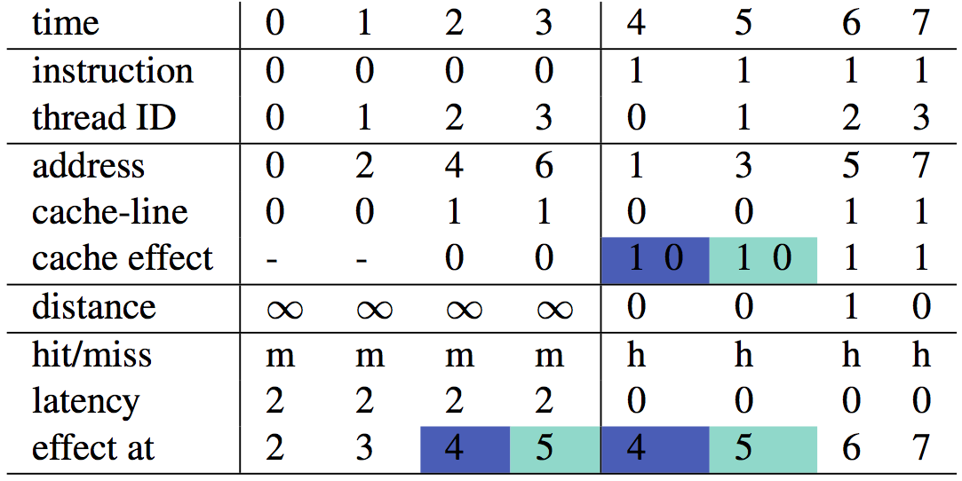
2. Memory latencies
4 threads, each 2 loads: x[2*tid] and x[2*tid+1]
Cache-line size of 4 elements
Variable latency of 2 (misses) and 0 (hits)
Notes:
Example as before, but now with a variable latency:
- 2 time-units for a miss
- 0 time-units for a hit
Note that at time 4 and 5 two ‘cache effects’ occur simultaneously (coloured in blue and green)
This slide is not too important. Bottomline is that the reuse distances change again and thus the cache hit/miss rates.

Slide 16
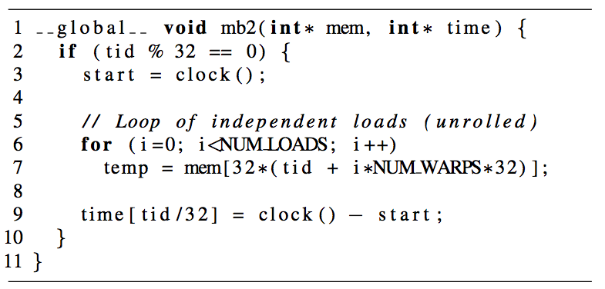
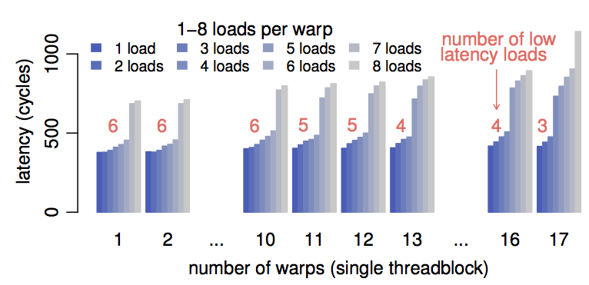
3. MSHRs
MSHR: miss status holding register
MSHRs hold information on in-flight memory requests
MSHR size determines maximum number of in-flight requests
GPU micro-benchmarking number of MSHRs per core
Conclusion: 64 MSHRs per core
4*16 = 64
Notes:
Explain what MSHRs are.
Next slide shows how this is incorporated in the model
Just mention here that we used micro-benchmarks (not how): the pictures are for fun

Slide 17
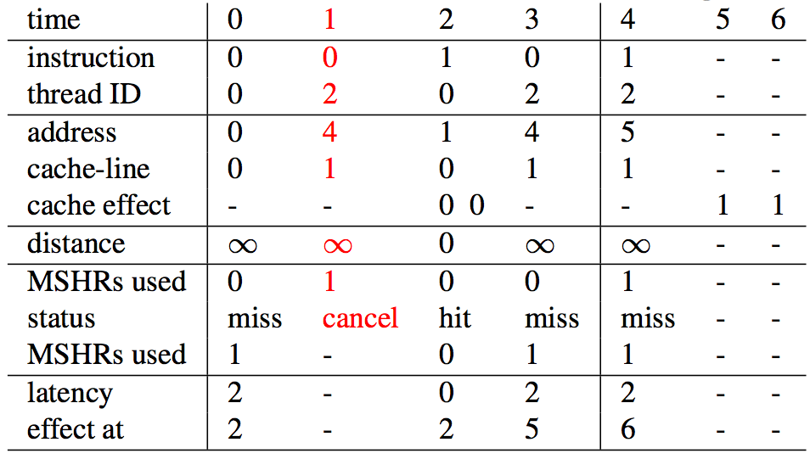
3. MSHRs
2 out of the 4 threads, each 2 loads: x[2*tid] and x[2*tid+1]
Cache-line size of 4 elements
Only 1 MSHR
postponed
Notes:
Same example as before, but:
- Only 2 out of the 4 threads (to keep it simple)
- Only 1 MSHR (not a lot - not realistic)
First instruction tid0: normal (but a miss: MSHR full)
First instruction tid1: miss and also MSHR full! Postponed/delayed
Second instruction tid0: normal (hit)
First instruction tid1: retry, now with MSHR available
Etc.

Slide 18
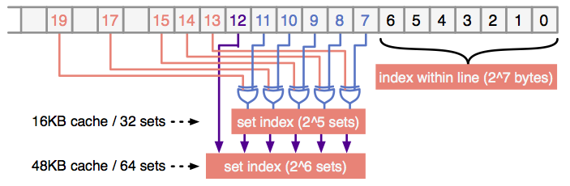
4. Cache associativity
Associativity might introduce conflict misses
Create a private reuse distance stack per set
Hashing function determines mapping of addresses to sets
GPU micro-benchmarking identify hashing function
(bits of the byte address)
Notes:
- Introduce cache associativity and sets
- Explain what a hashing function is: f(address) -> set ID
- Mention here that we used micro-benchmarks (not how)
- Shortly explain the results of the mapping: XOR operations using certain bits
Note: cache 16/48KB configuration was probably not mentioned before

Slide 19
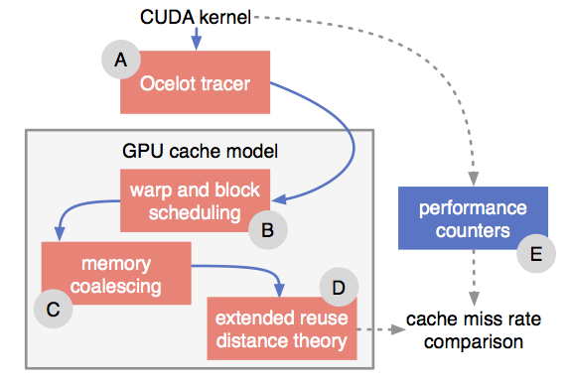
Implementation
Model (source-code) available at:
http://github.com/cnugteren/gpu-cache-model
profiler
Notes:
Quick slide:
- Mention that it is available on Github
- Mention that it uses Ocelot to generate unordered traces
- Mention that we can actually use hardware performance counters to compare and verify (next slide)

Slide 20
Experimental set-up
Two entire CUDA benchmark suites:
Parboil
PolyBench/GPU
NVIDIA GeForce GTX470 GPU with two configurations:
16KB L1 caches (results in presentation)
48KB L1 caches
Four types of misses identified:
Compulsory (cold misses)
Capacity (cache size not finite)
Associativity (set conflicts)
Latency (outstanding requests)
Compared against hardware counters using the profiler
Notes:
Quick slide:
- Two benchmark suites (almost) all kernels
- NVIDIA GPU with both cache configurations (16KB shown)
- 4 types of misses compared against the profiler (see next slide)

Slide 21
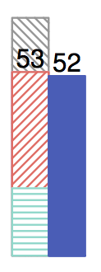
Verification results: example
Compared with hardware counters using the profiler (right)
Four types of misses modelled (left):
Compulsory (cold misses)
Capacity (cache size not finite)
Associativity (set conflicts)
Latency (outstanding requests)
none
for this kernel
Black number:
53% cache misses predicted
52% cache misses measured on hardware
(not including latency misses: not measured by the profiler)
example
kernel
Notes:
Example of a single result to get people familiar with the results:
- Explain left (model) versus right (hardware/real/profiler/measured)
- Explain different colours
- No associativity misses for this particular example
- Explain the black number (latency misses are not included in the number, as the profiler does not consider them misses: they don’t generate extra traffic to off-chip memory)

Slide 22
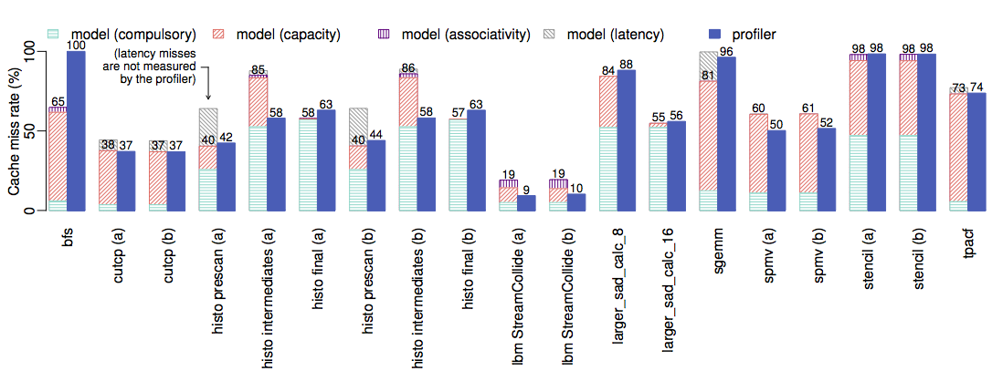
Verification results (1/3)
Note: matching numbers good accuracy of the cache model
Notes:
Parboil part 1/2
Mention a few examples (some that match nicely, some that don’t) and indicate them on the graphs.

Slide 23
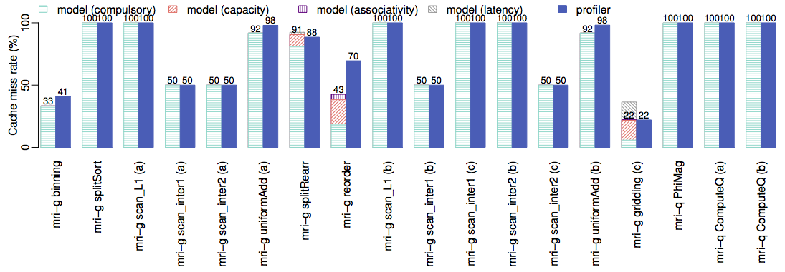
Verification results (2/3)
Note: matching numbers good accuracy of the cache model
Notes:
Parboil part 2/2
Mention a few examples (some that match nicely, some that don’t) and indicate them on the graphs.
Note: most have 100% misses, all compulsory. In other words, there is no data-reuse (or they use shared memory for that). The model captures this nicely.

Slide 24
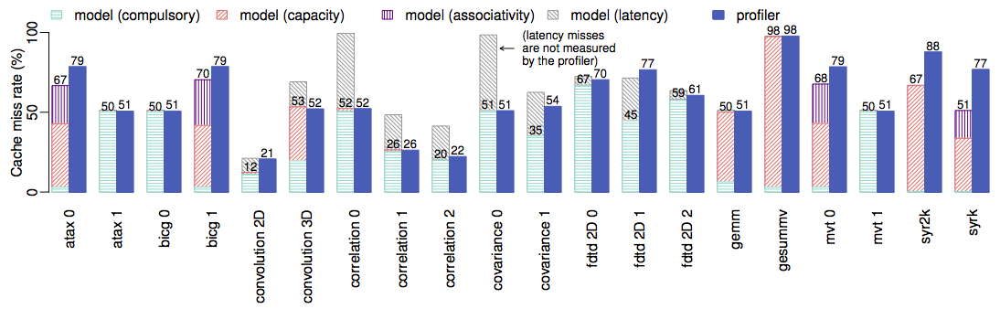
Verification results (3/3)
Note: matching numbers good accuracy of the cache model
Notes:
PolyBench
Mention a few examples (some that match nicely, some that don’t) and indicate them on the graphs.

Slide 25
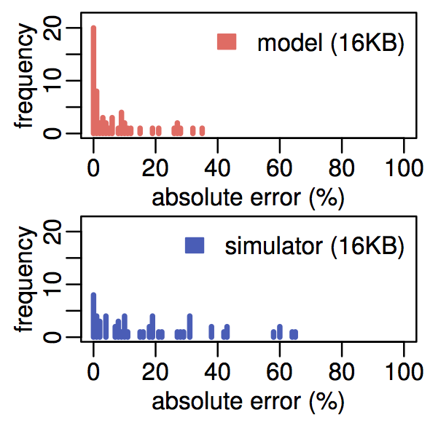
Are these results ‘good’?
Compared with the GPGPU-Sim simulator
Lower running time: from hours to minutes/seconds
Arithmetic mean absolute error: 6.4% (model) versus 18.1% (simulator)
Visualised as a histogram:
+1 @ 1%
|53% - 52%| = 1%
example
kernel
Notes:
We have seen the graphs, but is this good for a cache model? Let’s make a unusual comparison and compare it to a simulator.
Intuition: simulator is more accurate. Reality: model is more accurate (and faster of course). Reason: simulating/modelling the order in which threads execute and arrive at the cache is the real challenge here.
Example kernel explains how to read this graph: it is a histogram of absolute differences in cache miss rate

Slide 26
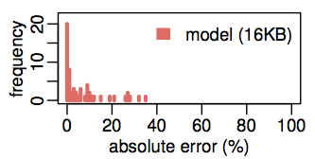
Did we really need so much detail?
arithmetic mean absolute error
Full model: 6.4% error
No associativity modelling: 9.6% error
No latency modelling: 12.1% error
No MSHR modelling: 7.1% error
Notes:
Yes, we do.
Error rates increase (higher is worse) as soon as we disable one of the modelling components. Can you imagine what happens if we disable all 3 of them? (maybe don’t ask - I don’t have the number, but make clear that these numbers here are disabling the individual parts of the model)
Picture is just the same as before, showing the 6.4% error on average.

Slide 27
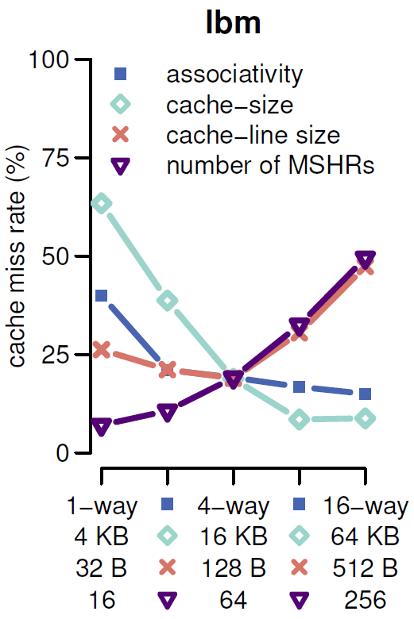
Design space exploration
Cache parameters:
Associativity
1-way → 16 way
Cache size
4KB → 64KB
Cache line size
32B → 512B
# MSHR
16 → 256
Notes:
Parboil LBM: Lattice-Boltzmann Method Fluid Dynamics
A fluid dynamics simulation of an enclosed, lid-driven cavity, using the Lattice-Boltzmann Method.

Slide 28
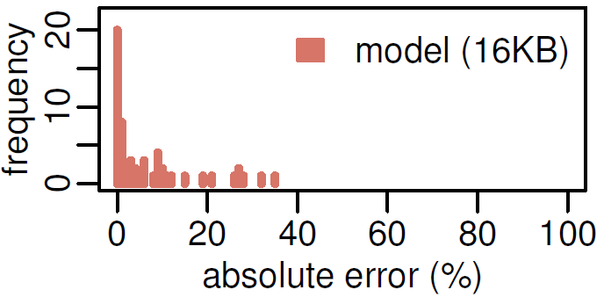
Summary
GPU cache model based on reuse distance theory
Parallel execution model
Memory latencies
probability
half-normal
distribution
Mean absolute error of 6.4%
0
minimum
latency
latency
MSHR
Cache associativity

Slide 29
Questions

