Slide 1


AI-assisted development
One workflow. Every project.
EUIPO
November 2026
ai-core — one AI workflow for every project and every developer
Notes:
WHAT TO SAY (1 min)
Good morning, and thank you for your time. I’m Carlos González, from Netcompany. Today I want to show you one simple idea: EUIPO runs six international cooperation programmes, and each of them has its own website. We propose to bring all six together into one platform, under one EUIPO brand, with one front door to the world. And what you are going to see is not a design concept. It is a working prototype that you can open and click through today.
FOCUS ON
• One platform for six programmes
• A working prototype, not a mock-up
— Notas (ES) —
Apertura (30 s).
- Presentarte y presentar Netcompany en una frase.
- La idea en una línea: los seis programmes de cooperación internacional de EUIPO, bajo una sola plataforma y una sola marca.
- Anticipa que lo que vas a enseñar es un prototipo navegable, no un concepto en papel.

Slide 2
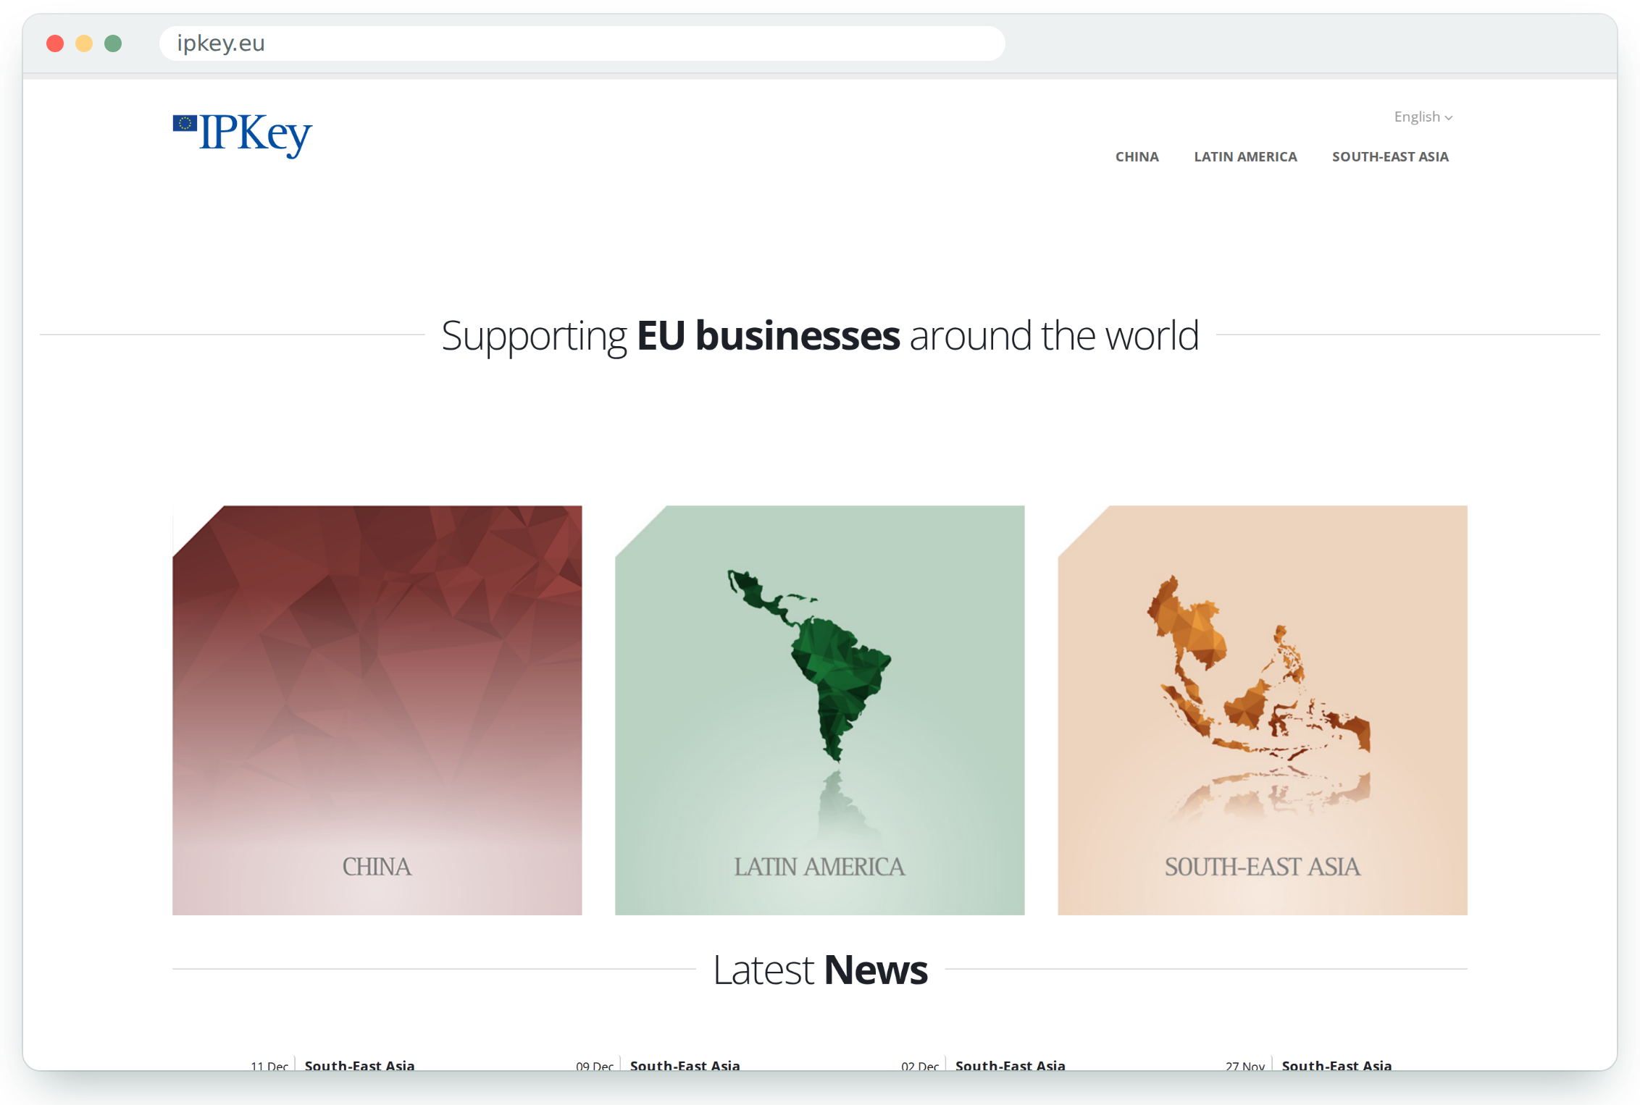
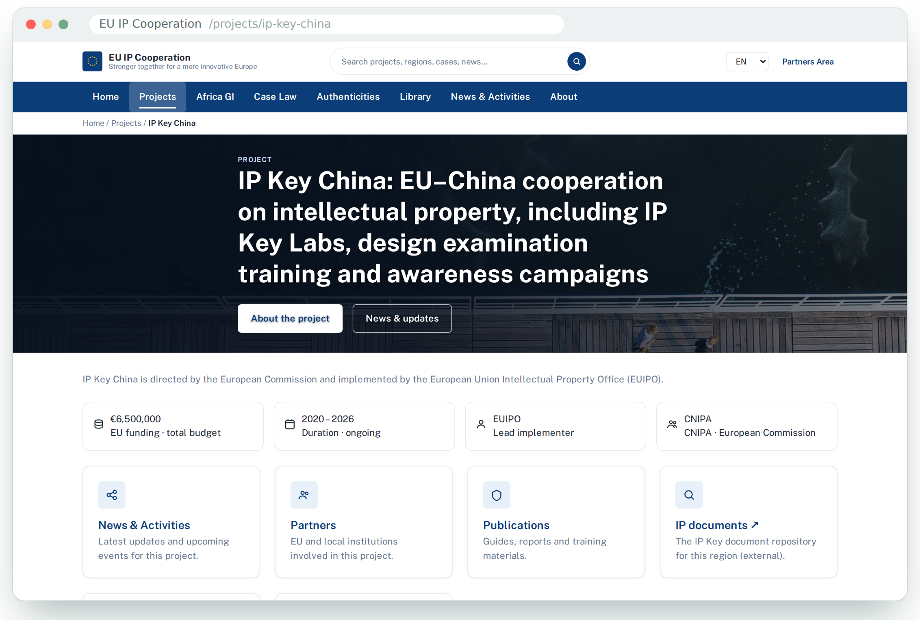
AI coding → ai-core
The same agent, now with a method, a memory and checks
WITHOUT A SHARED WORKFLOW
WITH AI-CORE
Every dev prompts in their own way
→
One fixed flow: ticket → plan → code → gate → impact → review → close
Rules the model may forget
→
Facts computed by scripts — the model reasons on them, it does not have to remember
“Where else is this used?” answered by grep
→
touchpoints and impact: every place a concept lives and the flows a change can break
Context lost between sessions
→
Ticket memory: state, decisions, open points — resumed with one command
Checks run by hand (or not)
→
gate: linters, types, tests and a smoke test in one run — only NEW errors fail
Endless review loops
→
Incremental review: findings kept, round 2 checks only what changed, max 2
The same bug solved twice
→
known issues: confirmed bugs and their pattern to watch, checked on every change
A setup copied once, then drifting
→
One source for every project: upgrade in one command, local edits kept
Notes:
WHAT TO SAY (45 s)
IP Key today is three regional websites in one: China, Latin America and South-East Asia. In the new platform they become three project pages, each with the same sections they have today: news and activities, work plan, partners, publications and about. Their document repository stays exactly as it is, and appears in the search as ‘External resources’, clearly labelled. And the four languages — English, Spanish, Portuguese and Chinese — are kept.
FOCUS ON
• Three regions = three project pages
• Document repository = External resources
— Notas (ES) —
IP Key: tres webs regionales dentro de una. En la nueva plataforma son tres proyectos (IP Key China, Latin America y South-East Asia), cada uno con su página y los mismos bloques que hoy: noticias y actividades, plan de trabajo, socios, publicaciones y 'about'.
- Su repositorio de documentos (las páginas 'IP information', con el buscador de Algolia) no se mueve: sigue gestionándose como hoy y aparece en el buscador de la plataforma como 'External resources', claramente separado y enlazando a los ficheros originales de ipkey.eu.
- Se mantienen los cuatro idiomas (EN, ES, PT, 中文).

Slide 3



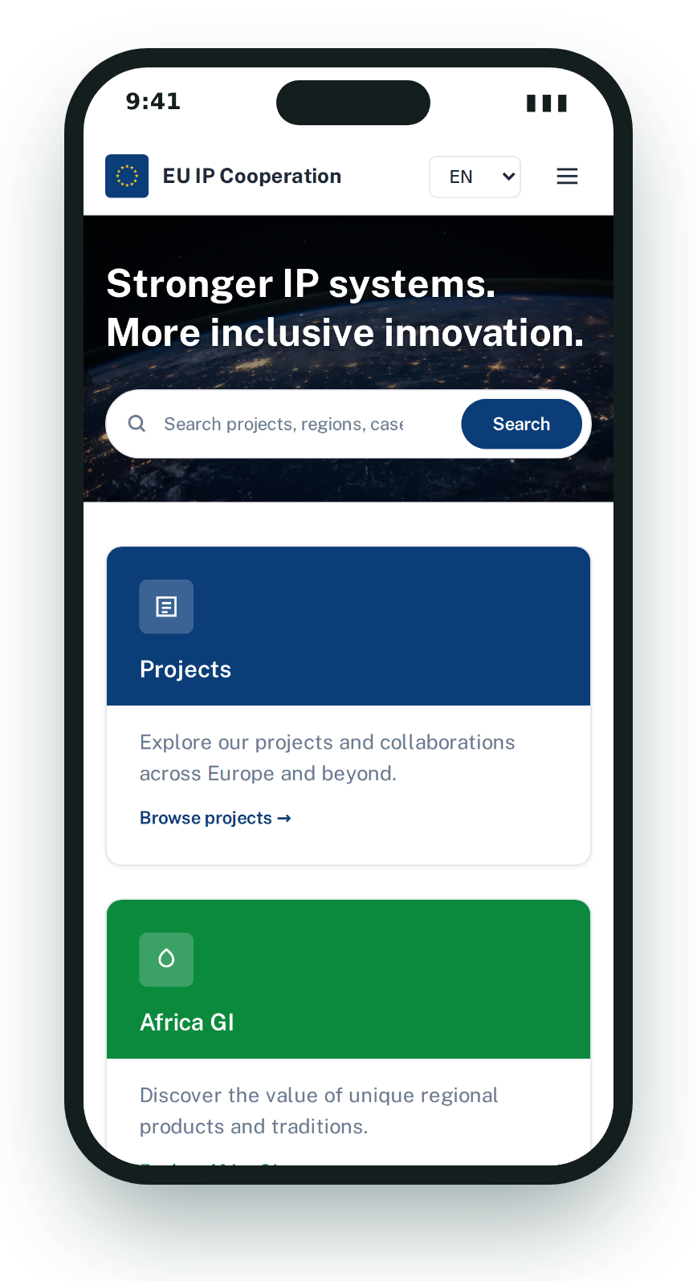
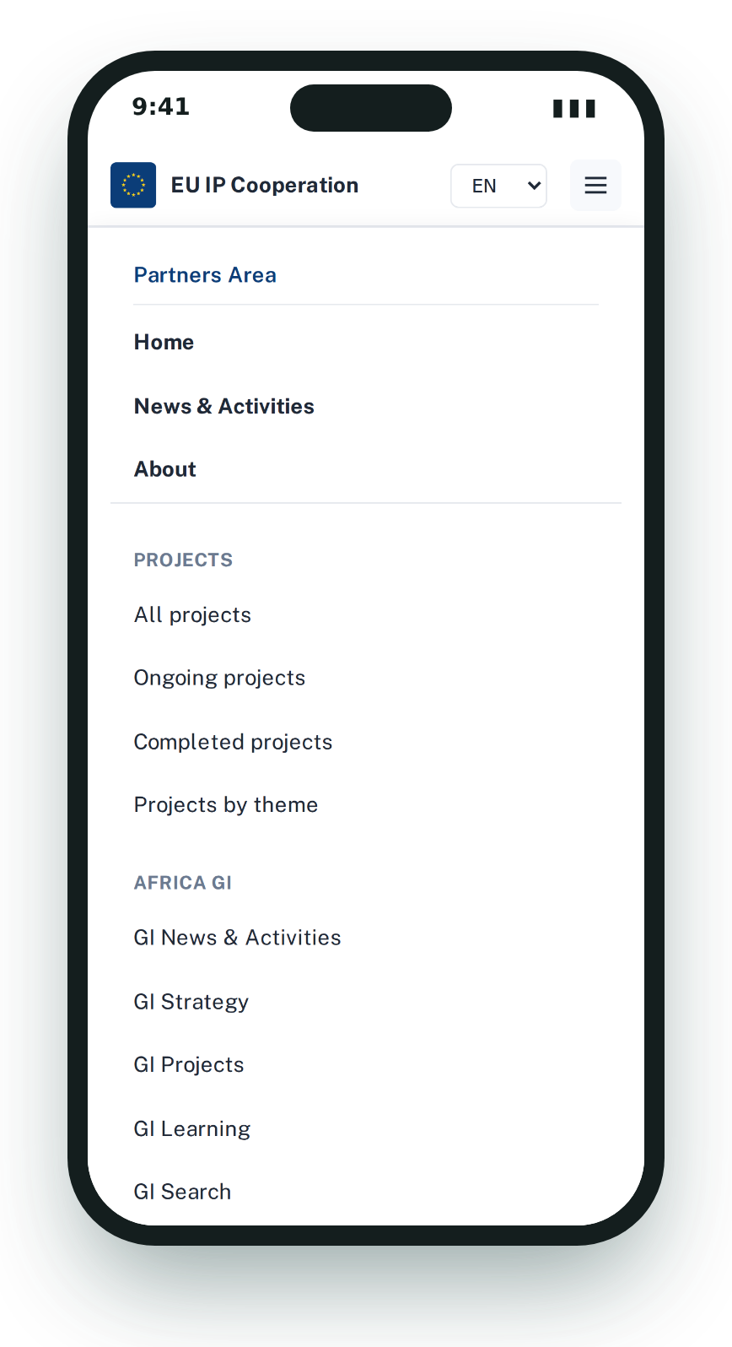
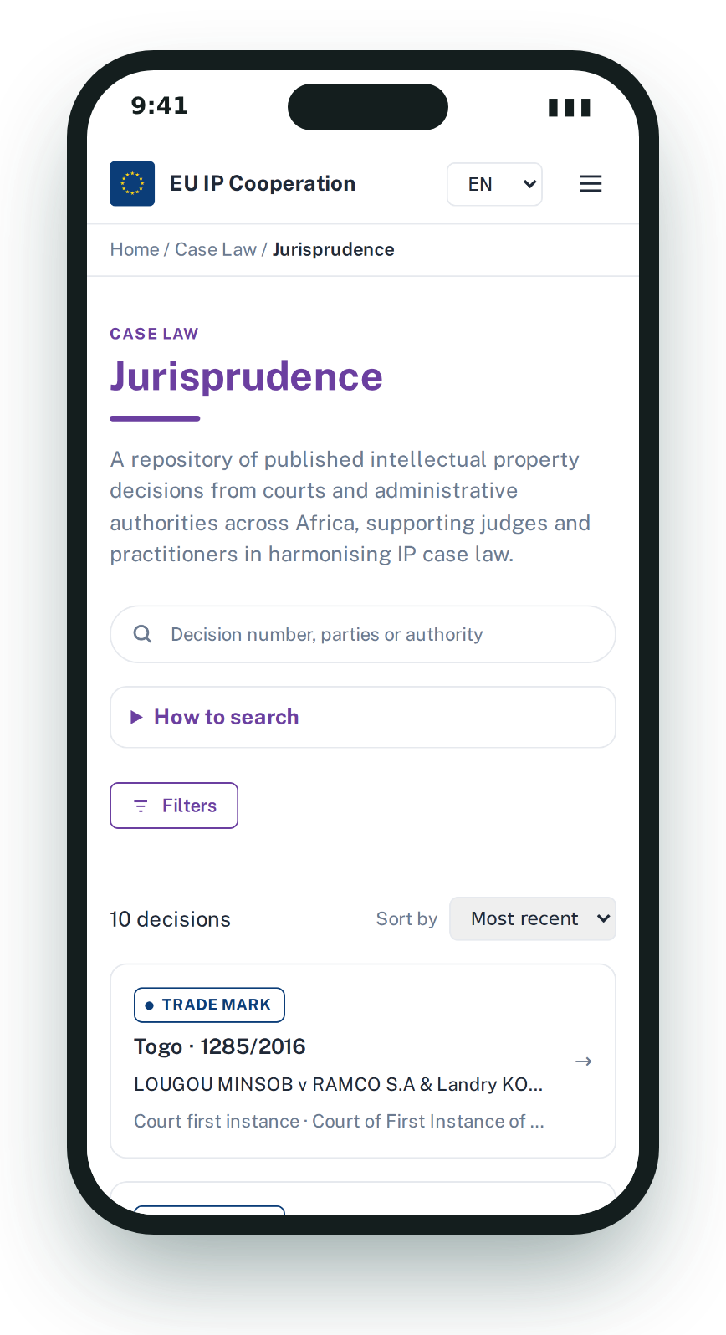
Built around three ideas
Deterministic first
Scripts compute the facts; the model reasons on them.
Memory in the repo
Tickets, skills and known issues travel with the team.
The human decides
The agent proposes the next command; it never commits.
Notes:
WHAT TO SAY (1 min)
Many of the people these programmes serve — partners in Africa, Asia and Latin America — use their phone. The platform is designed mobile-first: the menu folds, the text adapts and nothing is cut off. It speaks the languages the websites use today — English, French, Spanish, Portuguese and Chinese — from one selector. And accessibility is a requirement from the start, not an add-on.
FOCUS ON
• Mobile-first
• The languages used today
— Notas (ES) —
Gran parte del público (socios en África, Asia, Latinoamérica) accede desde el móvil.
- El prototipo está pensado primero para móvil: menú desplegable, textos que se adaptan, nada se corta.
- Los cinco idiomas que ya usan hoy las webs (inglés, francés, español, portugués y chino), en un solo selector.
- Accesibilidad como requisito, no como extra.

Slide 4
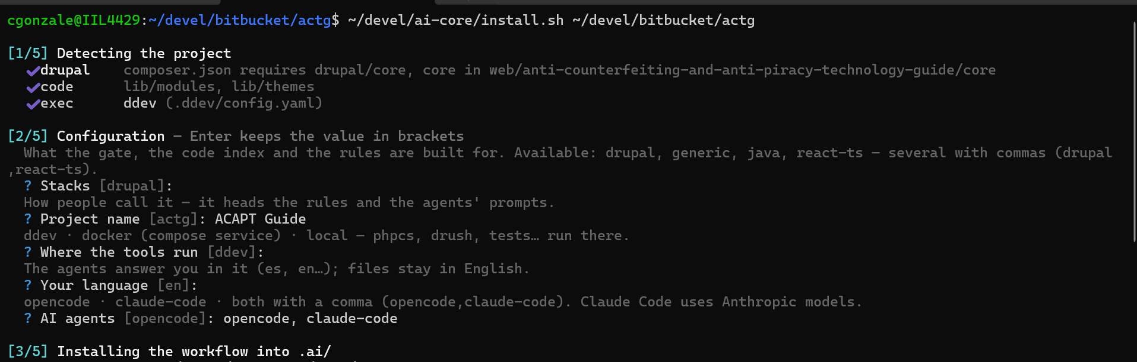
Installed in one command
Detects and prepares
Stack, code paths and ddev — then the tools this machine needs, offered to install.
Installs and wires it
Rules, agents, indexes and git hooks; opencode and Claude Code ready in minutes.
Checks itself
Every prompt tested against the model gateway, then /doctor: one fix per line.

Slide 5







A ticket, step by step
The same path for every change. The agent proposes each step with one ▶ Next line; the developer runs it.
1
›
2
›
3
›
4
Open the ticket
Plan and build
Gate and review
Test and close
/ticket finds similar past bugs and tickets, every place the concept lives (touchpoints) and the flows at risk (impact).
/plan proposes options and blocks; every edit is recorded in the ticket and checked at once against the installed hook signatures.
/gate runs the stack's linters, types, tests and a smoke test; /review and /security review independently — round 2 only what changed.
/tests writes the manual checklist; the developer tests; /close records the known issue and proposes the two commits.
RESULT
RESULT
RESULT
RESULT
Scope and risks on one page, before any code.
Code that follows the plan, block by block.
Only NEW errors block; evidence lines go to the ticket.
Knowledge kept for the next developer.
During the whole
ticket
The agent never commits
— the developer does.
Several devs, one ticket
each one writes only their own diary.
/doctor checks the setup
and says how to fix it.
Notes:
WHAT TO SAY (2 min)
How do we get there without risk? In four steps. One: take stock — we list everything on the six websites and decide with each programme what moves, what merges and what is retired. Two: build the platform — one design, one structure, the four sections and the shared services. Three: move the content — imported automatically, with documents, images and translations, and every old address linked to its new page. Four: switch over site by site, starting with a pilot. And during the whole migration: no website goes offline before its replacement is live, old links keep working, and each programme approves its content.
FOCUS ON
• Four steps
• Nothing goes offline early
• Old links keep working
— Notas (ES) —
Esta diapositiva explica CÓMO se pasa de las seis webs actuales a la plataforma nueva: el proceso de migración, en cuatro pasos y sin tecnicismos.
1. Inventario: se revisa todo lo que hay en las seis webs (páginas, documentos, noticias, usuarios) y, con cada programa, se decide qué se traslada, qué se fusiona (por ejemplo, noticias duplicadas) y qué se retira (páginas sin uso o restos, como las páginas copiadas de IP Key que quedan en Africa GI). El resultado es el mapa que ya habéis visto en las diapositivas web por web.
2. Construir la plataforma: un diseño, una estructura, las cuatro secciones y los servicios compartidos.
3. Trasladar el contenido: se importa de forma automática desde las seis webs, con documentos, imágenes y traducciones, y cada dirección antigua se enlaza con su página nueva. Cada equipo revisa su contenido.
4. Cambio web a web: ninguna web se apaga hasta que su sección está en marcha. Se empieza por un piloto (por ejemplo, las webs de proyectos, que comparten estructura: International IP Cooperation, IP Key y AfrIPI) y después el resto.
- Franja inferior: las tres garantías que reducen el riesgo. Nada se apaga antes de tiempo, los enlaces antiguos siguen funcionando y cada programa da el visto bueno a su contenido.
- No des fechas: el calendario se define tras el inventario.

Slide 6






What each tool saves you
touchpoints
No forgotten place: config, permissions, form alters, templates, translations.
impact
The flows a change can break, and the past bugs on the same code.
gate
phpcs, phpstan and a smoke test in one run; only new errors fail.
API signatures
Hooks checked against the installed Drupal: no invented signatures.
Incremental review
Findings kept in the ticket; at most two rounds.
integrations
REST, OpenID, mail and cron mapped, with drift warnings.
Notes:
WHAT TO SAY (1.5 min)
So what does EUIPO gain? For visitors: one search and clear journeys, without jumping between six websites. For EUIPO: a stronger brand, one platform to host, secure and update instead of six, and a shared audience with better visibility in search engines. And for the future: a new programme joins as a new section, not as a new website. [Pick the two or three benefits that matter most to the people in the room.]
FOCUS ON
• Visitors: one search, clear journeys
• EUIPO: stronger brand, lower running costs
• Ready to grow
— Notas (ES) —
Los beneficios, en el lenguaje de quien decide.
- Para los visitantes: un buscador, recorridos claros.
- Para EUIPO: una marca más fuerte, menos coste de mantenimiento (un sistema en lugar de seis), más alcance.
- Para el futuro: un nuevo programa se incorpora como una sección nueva, sin montar otra web.
- Elige los dos o tres que más resuenen con la audiencia concreta y desarrolla solo esos.

Slide 7
What the team gains
Faster onboarding
A new developer clones two repositories and runs one command.
Fewer regressions
Side effects and known bugs checked on every change.
Shared memory
What one developer learns, the next one finds.
One method
The same flow for Drupal, React, Java or any stack.
Updates, not copies
upgrade.sh shows what changes; hand edits are kept, improvements promoted.
Works with your models
Qwen on-premise or any provider; prompts pre-checked against the gateway.

Slide 8
Built to be trusted
Tested on every stack
31 automated tests and 17 golden snapshots taken from a real project.
Team-safe by design
One diary per developer and owned plan blocks: no merge conflicts.
Diagnoses itself
/doctor checks hooks, plugins, indexes, tools and prompts — one fix each.
Runs where you work
Linux, macOS, Windows and WSL: commands run where the tools live.
Fewer tokens
Indexed code: where and callers return line ranges, not whole files.
The human decides
It never commits or pushes; a claim without evidence is marked ASSUMED.

Slide 9

One workflow
for every project
and every developer.
Let’s build with it.
Notes:
WHAT TO SAY (1 min)
To close: six programmes with one mission deserve one home — one home for every story of EU IP cooperation. The prototype exists, and you can explore it today. Our proposal for the next step is either a working session with the programme teams, or a pilot with one or two programmes. Which would you prefer to start with?
FOCUS ON
• One home for six programmes
• Ask for the next step
— Notas (ES) —
Cierre emocional.
- Recupera la idea del inicio: seis programas con una misma misión merecen una sola casa.
- Recuerda que el prototipo ya funciona y se puede navegar hoy.
- Pide un siguiente paso concreto: sesión de trabajo con los responsables de cada programa, o un piloto con uno o dos programas.

Slide 10
Carlos González Mujica
Carlos.GONZALEZMUJICA@netcompany.com
Notes:
WHAT TO SAY (Q&A)
Thank you very much. I’m happy to answer your questions. [If someone asks about a specific website, go back to its slide, 5 to 10. If a question is very technical, answer in one sentence and offer a separate technical session.]
FOCUS ON
• Leave this slide on screen
• Go back to slides 5–10 for site questions
— Notas (ES) —
Gracias y turno de preguntas. Completa aquí tu cargo y teléfono si quieres añadirlos.

