Slide 1
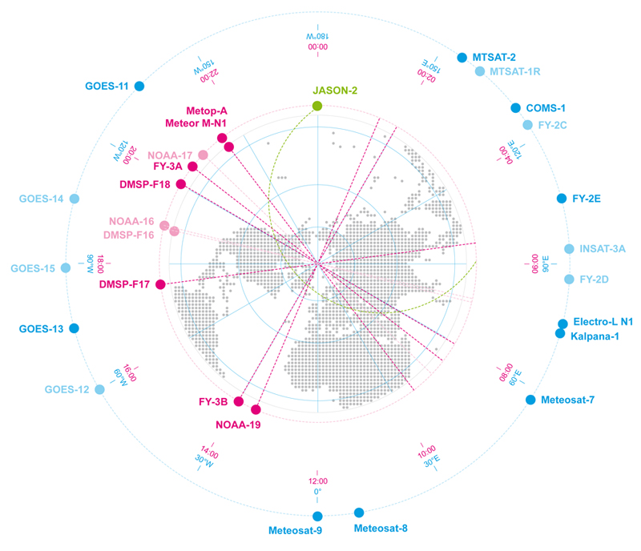
CGMS WMO Task Force on Metadata Implementation Progress
Presented to CGMS-42 Working Group IV, agenda item WGIV/9.1

Slide 2
Background
CGMS 40: Decision to create a Task Force on metadata implementation to increase the involvement of Satellite Data Providers in the WIS and improve the WIS search experience regarding Satellite data products in WMO WIS catalogues
CGMS 40.42: The CGMS Secretariat to draft, in consultation with the WMO secretariat and the Co-Chair of the IPET-MDRD, the ToR for the CGMS-WMO Task Force on metadata implementation
CGMS 41: ToR prepared as EUM-WP-03, and agreed by WG-IV in CGMS-41 and Task Force members to be nominated

Slide 3
Overview
WIS Refresher
WIS from the User Point of view
Satellite Products visibility in the WIS
Task Force Goals
Task Force Status

Slide 4
What is the WIS?
WMO response to the challenges implied by the increase of data diversity and volume that need to be exchanged to provide high quality weather related services:
Increase of high resolution satellite products since 2000
WIS is the system of systems allowing to move from:
a paradigm of managing message exchanges (GTS)
to a paradigm of managing data and information

Slide 5
Focus on some WIS Goals
To open access to meteorological products to a much larger community:
Unlike GTS, no need to be part of the WIS to get the data
Will favour the creation of cross-domain synergies
To increase the volume of data exchanged within WMO framework:
Going away from GTS practices (bulletin, routing) will allow to control larger data exchanges
While maintaining the interfaces and services of the GTS
WIS Benefits for Satellite data:
Provide a better access for all users to satellite products
Allow to cope with the increase of satellite product volumes in the next decade

Slide 6
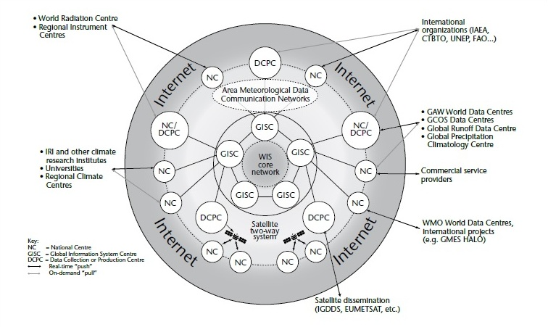
WIS Organisation
Notes:
Global Information System Centre (GISC)
Discovery services based on synchronized product catalogues
Provision of data intended for global exchange
Provide access to DCPC products via the DCPC
Data Collection and Production Centres
Satellite Data Providers are typically DCPCs
Produce and Collect products in its area of responsibility
Describe their products according to WMO standards and provide that description to the GISC
National Centre
Collect Observational data within their country
Collect, generate and disseminate products for national use
Describe their products according to WMO standards and provide that description to the GISC

Slide 7
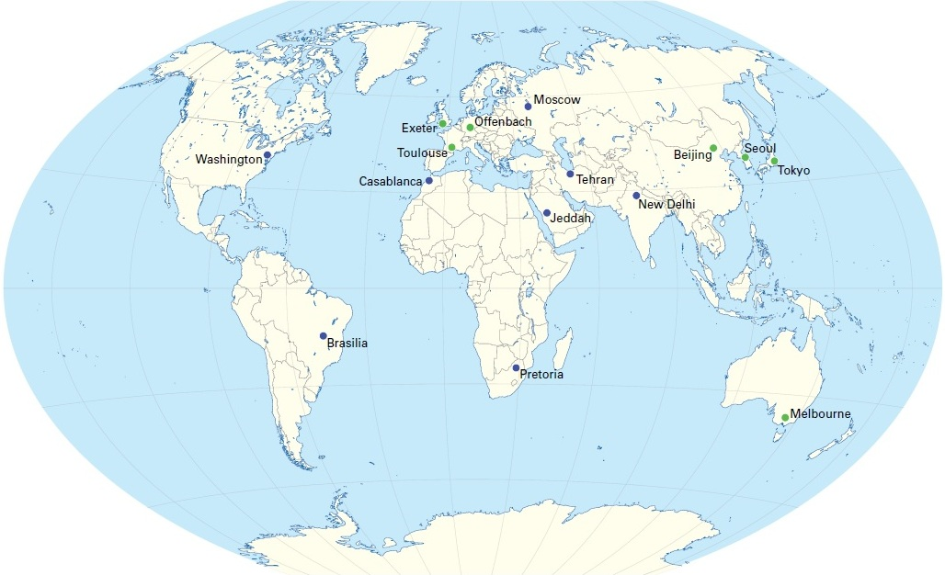
WIS Implementation Status
Operational since 10 Feb 2012:
15 operational GISCs
54 operational DCPCs
223 operational NCs
Operational exchange of data intended for global exchange
Operational exchange of metadata records based on a profile of ISO metadata (WMO Core Profile 1.3) to build the catalogue of products amongst GISCs
Users can discover and retrieve products

Slide 8
WIS from the user point of view
It is not easy to consistently find products amongst the different WIS Discovery Services implementations
There is a large potential to improve the WIS Discovery services when compared to industry search engines:
The WIS should mimic the existing search engine interfaces to provide the best possible search experience
No generalised use of a standardised product categorisation allowing new users to understand what is in the catalogue
Metadata Product description is often incomplete
On-going development to enhance the usability of discovery services:
Provide guidance on how to search products
Metadata structure (XML) is often visible in the results and prevents users from focusing on the product description itself

Slide 9
Satellite Products in the WIS
There is currently a limited number of Satellite products outside the ones intended for global exchange:
CMA, NOAA, EUMETSAT
Description could be improved to provide more info on actual data content:
In particular due to the automatic generation of metadata records covering GTS bulletins

Slide 10
Improving usability of WIS for Sat Data
WIS is very attractive and Satellite Operators can benefit from the WIS objectives
Work still needs to be done to make full use of the WIS by Satellite Operators:
To make Satellite Data available via the WIS
To allow users to discover more Sat products via the WIS
The CGMS Task Force on Metadata Implementation (CGMS TF-MI) has been created to help CGMS members to get benefits from WIS

Slide 11
CGMS TF-MI Goals (1)
Increase the participation of satellite data providers in the WIS:
Contribute to WIS and build an attractive one-stop-shop to discover and access Satellite products
Use the TF-MI as a forum for discussing matters concerning the WIS from a user’s perspective:
Promote the usage of WIS for Satellite data providers and facilitate their contribution
Relay consistent and consolidated views from the Satellite Providers to the WMO WIS implementation groups:
Provide inputs regarding metadata matters to IPET-MDRD
Provide inputs regarding the WIS implementation to ET-WISC

Slide 12
CGMS TF-MI Goals (2)
To get more benefits from the WIS Discovery Services for Sat Operators:
Improve Sat product description and consolidate it amongst the providers to make it more coherent for the users
Insure that the WMO metadata Core profile is compliant with other Satellite Providers interoperability efforts to minimise cost and increase cross-domain fertilization:
ESA Heterogeneous Missions Accessibility (HMA)
CEOS WGISS Integrated Catalogue (CWIC)

Slide 13
CGMS TF-MI Tasks
Facilitate satellite products metadata management
Gap analysis between WMO Core Profile 1.3 and other ISO profiles used by the satellite data provider
Deliver road-map to unify profiles when possible
Improve user search experience for satellite products
Define set of mandatory attribute to be present per satellite products to provide a meaningful discovery experience to users
Define guidance documentation and template examples
Report resulting outcomes to IPET-MDRD
Defined in TF-MI ToR (CGMS-41-WP-03) including recommended update

Slide 14
CGMS TF-MI Creation Status
Current list of Task Force members is:
CMA: Dongfeng Luo
EUM: Michael Schick, Guillaume Aubert
JMA: Dr Hiroshi Kunimatsu
KMA: Byung- Il Lee
NOAA: Anna Milan, John Kocrmor
Roshydromet: Dr Zoya Andreeva
WMO: Nils Hettich
What is needed for finalising the TF creation:
Confirmation of membership
Election of a Chair
Nomination from other Data Providers

Slide 15
Initial Work Plan
Improve User accessibility of Satellite Data for global exchange via WIS:
Assessment of related Metadata content in GISC catalogue
Renew Metadata content if necessary:
Based on defined guidance
Verification of user accessibility of Sat Data for global exchange from GISCs in different WMO regions
Develop guidance and examples for the main TBD satellite data products
Provision of:
Working paper report to the next CGMS
Executive summary of the working paper forwarded to ET-WISC

Slide 16
Thank you Questions?

