Slide 1
What’s out there?
WMO online resources on satellite systems, datasets, and products
Stephan Bojinski, Jérôme Lafeuille, Nils Hettich
WMO Space Programme
World Meteorological Organization (WMO)
EUMETSAT Meteorological Satellite Conference, Geneva
26 September 2014
WMO; Observation and Information System Department (OBS)

Slide 2
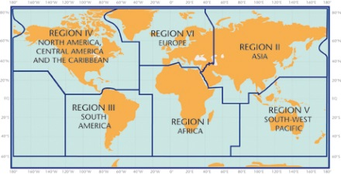
WMO Online resources
Product Access Guide (PAG)
  “easier access to quality-controlled satellite datasets and products”
Observing System Capability Analysis and Review tool (OSCAR/Space)
“all about current and planned satellites, instruments and their capabilities”
…for the benefit of 191 WMO Member states
Notes:
WMO Space Programme mandate:
Key objective of WMO is to:
Raise awareness of satellites and their capability
Promote availability and utilization of satellite data and products for weather, climate, water applications

Slide 3
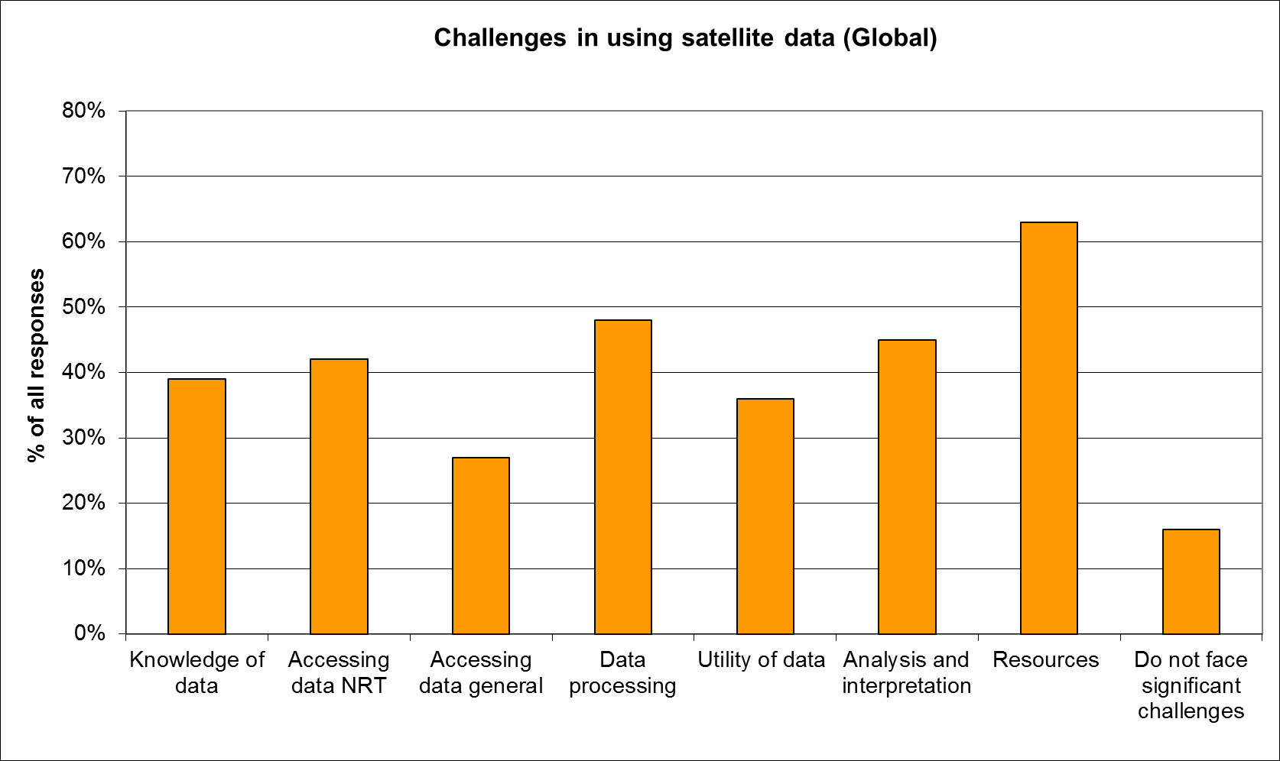
(1) Product Access Guide (PAG)
WMO 2012 Survey: 227 responses from 96 countries

Slide 4
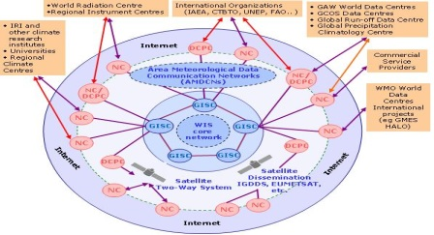
(1) Product Access Guide (PAG)
Motivation
  Web-based WMO resource to
    Facilitate online search for well-documented satellite-based products and related information (expert groups, training material)
    Enhance visibility of satellite datasets and products
    To address insufficient user awareness
  Complementing the WIS:
    Data Access and Retrieval catalogue:
      No controlled vocabulary, requires advance knowledge of datasets, incomplete range of products, no links to related expert groups, training material
  More targeted search experience than using…
    Google: Try out “+satellite +wind +noaa/eumetsat/cma”
    GEO Portal: “precipitation” yields 8700 hits
Notes:
Use the words from the poster
Not necessarily links to expert groups, training material

Slide 5



(1) Product Access Guide (PAG) - Implementation
  Points to stable URLs
  Requires minimum product metadata, to help users:
WMO Space Programme website wmo.int/sat
Product Access Guide
Product Collections
Point of contact | Applicability domain
Product identifier | Geographical region
Providing organization | Resolution
Data source | Update frequency
Access information | Quality indication / documentation
Training Material
Expert Groups
Maintained by Providers
  Providers of satellite data retain
  full ownership and responsibility
  for their products
Notes:
Providers can be satellite operators, SAFs, NMSs, resa

Slide 6
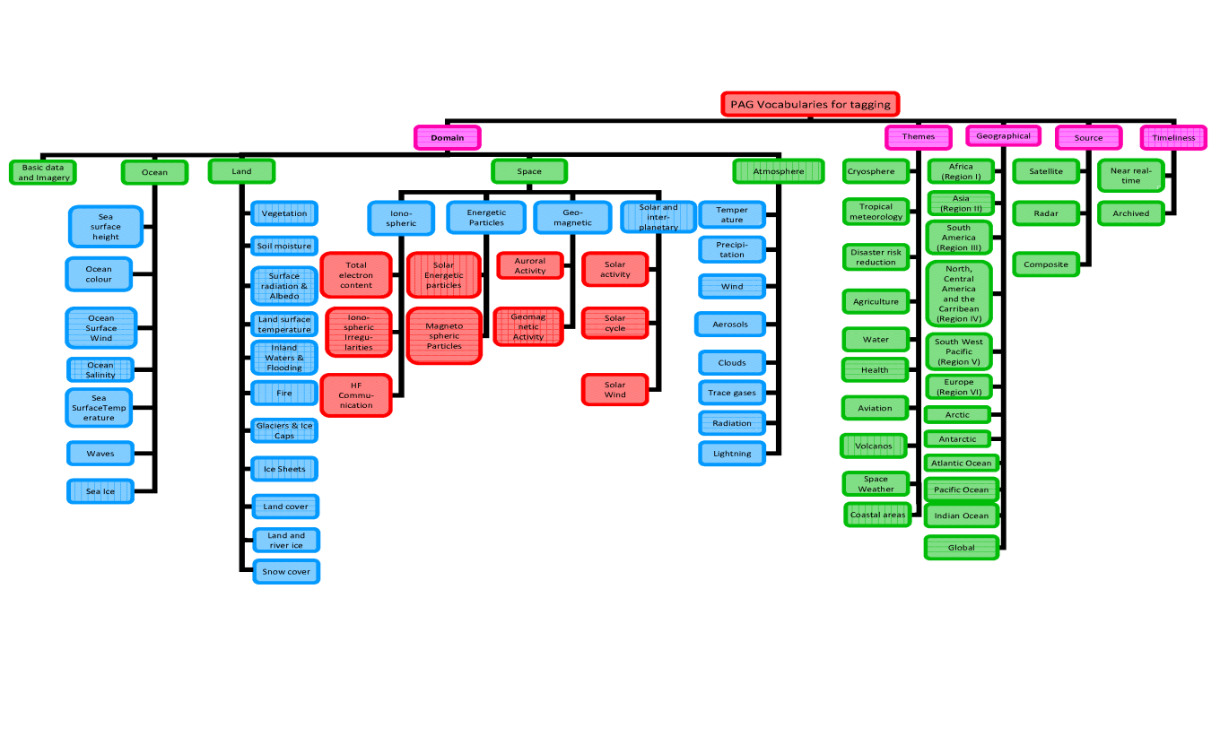
(1) Product Access Guide (PAG) – Data model
Links to product collections are “tagged”
By geophysical variable, geographical region, theme, …
Terminology consistent with METEOTERM, Int’l Met Vocabulary
Reflects 13 WMO application areas, Space Weather,
GFCS themes

Slide 7
(1) Product Access Guide (PAG) – Data model

Slide 8
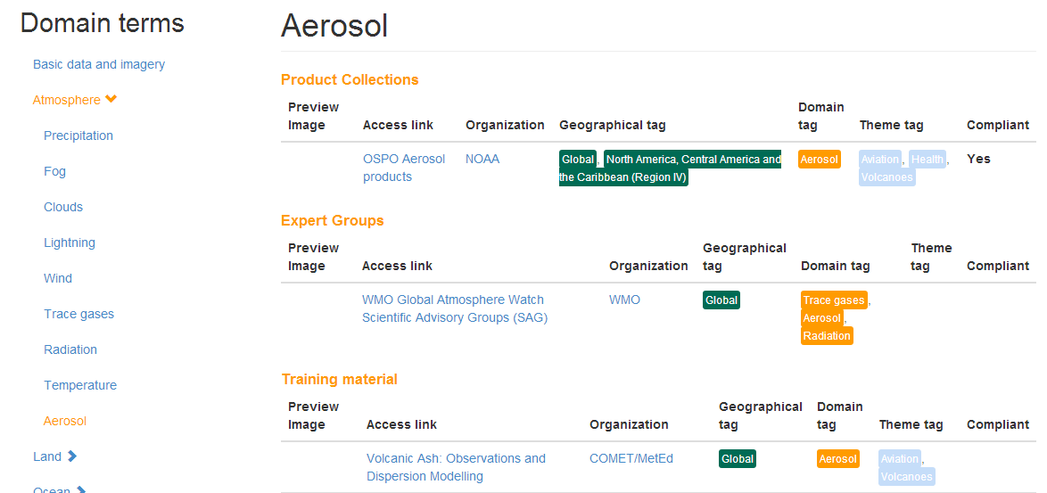
(1) Product Access Guide (PAG) - Example
PAG Link: https://www.wmo-sat.info/product-access-guide/
Hierarchical/Simple Search: select by clicking on the domain
Advanced Search: based on combination of tags:Domain, theme, geographic regional, organization providing and type of content.
Highlighted themes: based on themes such as Tropical meteorology, water, health, disaster
Notes:
Example of LST inAfrica

Slide 9
(1) Product Access Guide (PAG) – Current status
  Links to 81 product collections in domains Imagery, Atmosphere, Ocean, Land, Space Weather
  From providers:
  BoM Australia, CSWFC, DLR, EUMETSAT, FMI, INPE,
  IAG Russia, JMA, NASA, NICT, NOAA, ROB
23 links to sets of corresponding online training materials
(some require registration)
14 links to international expert groups
(e.g., on precipitation, winds)
Work in progress
Quality, not quantity

Slide 10
(2) Observing System Capability Analysis and Review tool (OSCAR)
On-line resource describing observing capabilities
  For reference purpose for users
  To support global planning and optimization
Building block of WIGOS (WMO Integrated Global Observing System)
  Contains 3 modules: requirements, space, surface
  Cornerstone of Rolling Review of Requirements
  Part of the WIGOS Information Resource (WIR)

Slide 11
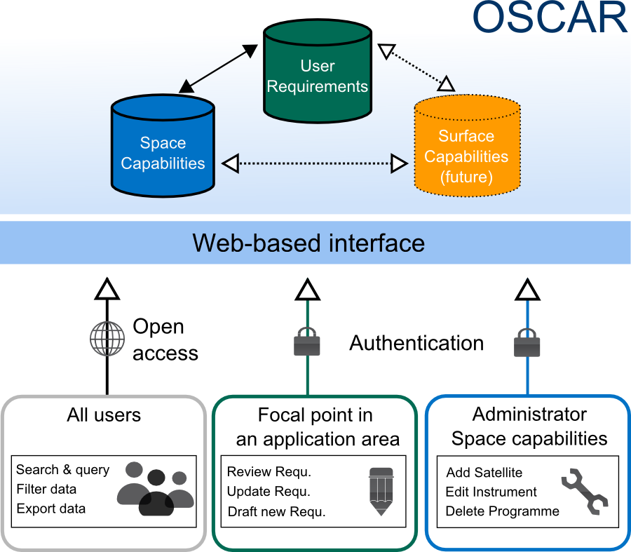
(2) OSCAR | Concept
Notes:
Illustration of OSCAR and how the the 3 parts store different kinds of data, they are linked together,
Because of the important interlinks between the individual parts, the database application is build on a concept of central hosting at WMO, with distributed responsibilities”
This allows to have one coherent unified web-based interface for the end user,
but also allows us to have multiple contributors with different, very specific editing rights on each of the components,
A few examples are visualized here,
Normal users can access and query all data
Focal Points can additionally maintain
And a satellite editor, or Administrator for the Space part has rights to update satellite launchdates or add new instruments etc
As it is web-based, it can be accessed from anyhwere

Slide 12
(2) OSCAR/Space
OSCAR/
Space
Inventory of factual information
  > 600 Earth observation satellites
  > 800 instruments with detailed characteristics
  Space agencies and programmes
  Regularly updated with input from agencies
Expert assessments of space-based capabilities
  Comparison with WMO Vision and plans
  Assessment of the relevance and limitations of typical instruments for measuring particular variables
Notes:
Inventory of factual information of what was formerly in the DOSSIER
The responsibilty for Maintenance of this part is with the WMO Space Programme

Slide 13
(2) OSCAR/Space
Factual information
Knowing all about satellite and instrument characteristics…

Slide 14
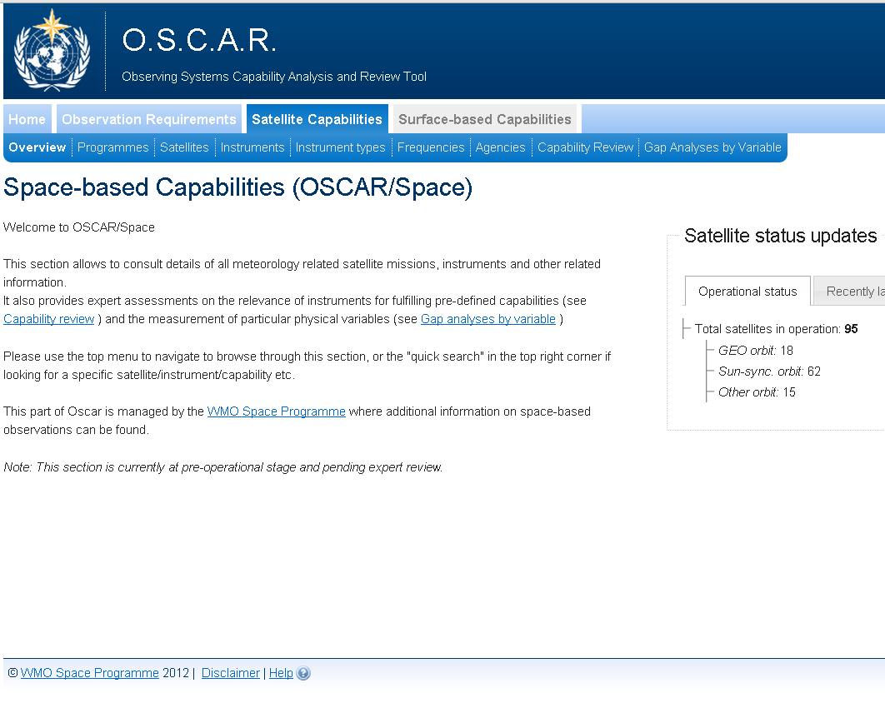
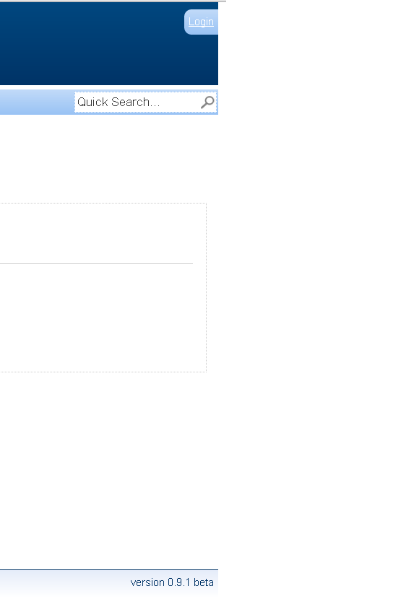
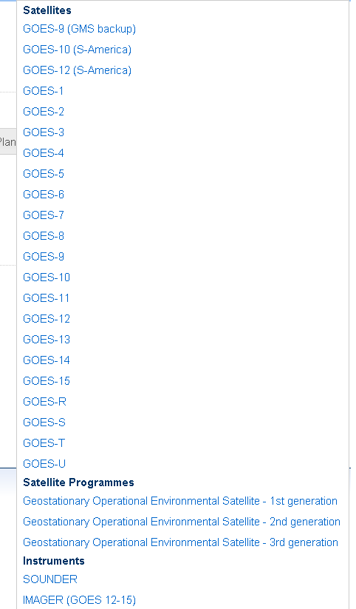
(www.wmo.int/oscar)
Quicksearch box
www.wmo.int/oscar
GOE…
9th Annual Symposium on Future Operational Environmental Satellite Systems, Austin, 10/01/2013

Slide 15
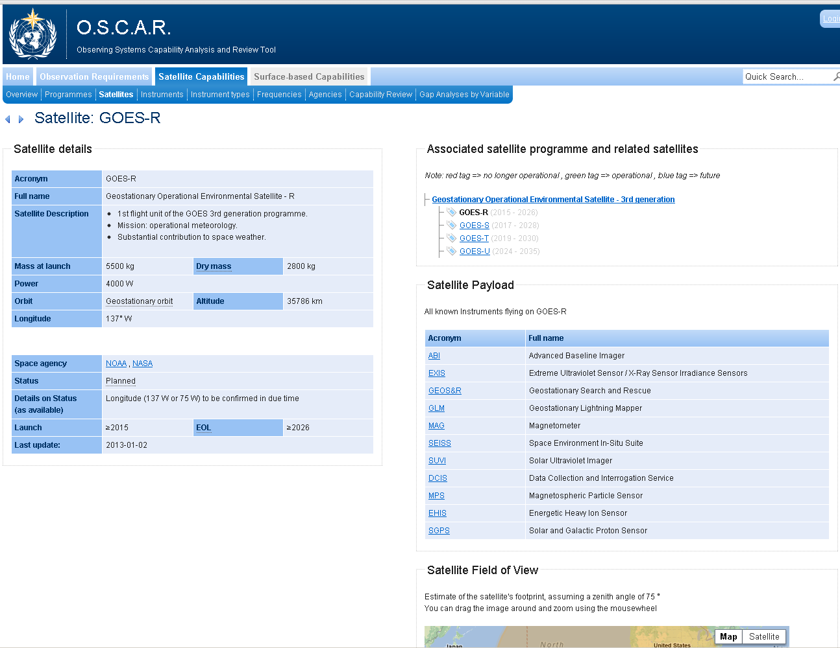
Satellite view
Satellite view (e.g. GOES-R)
9th Annual Symposium on Future Operational Environmental Satellite Systems, Austin, 10/01/2013

Slide 16
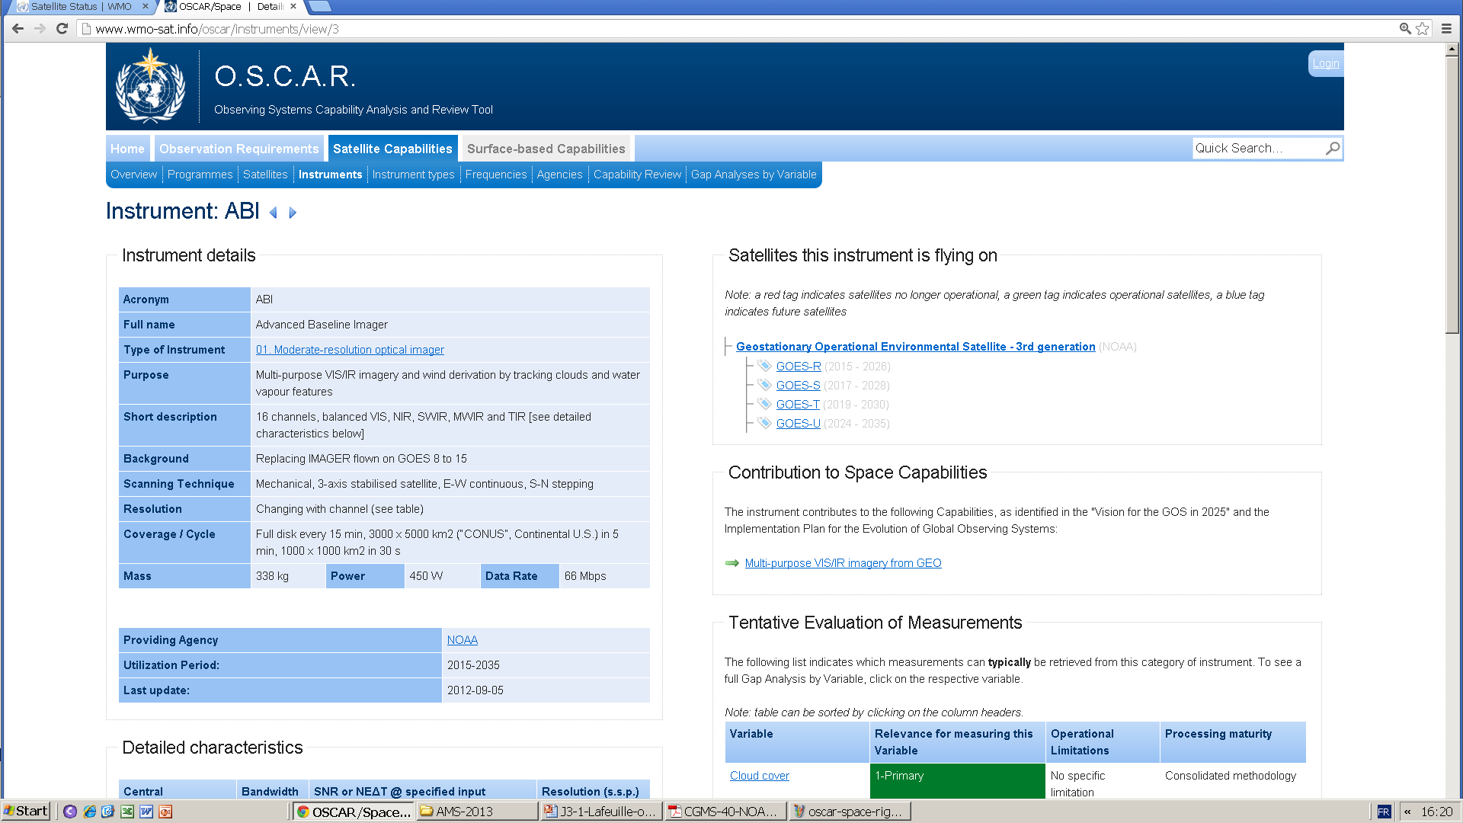
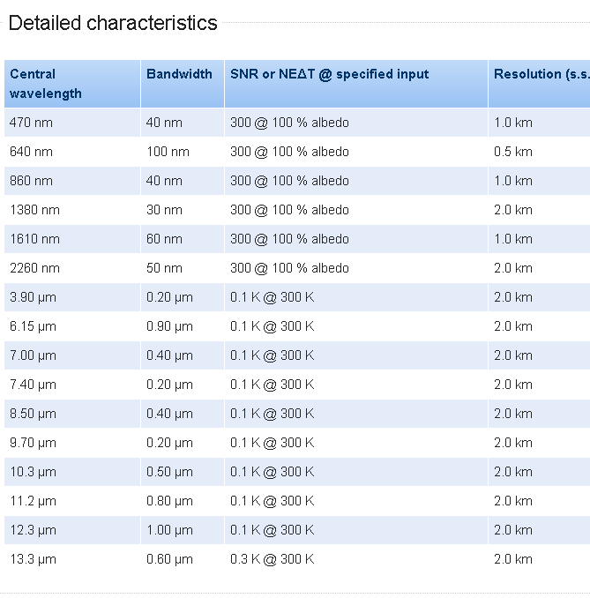
Instrument view (1)

Slide 17
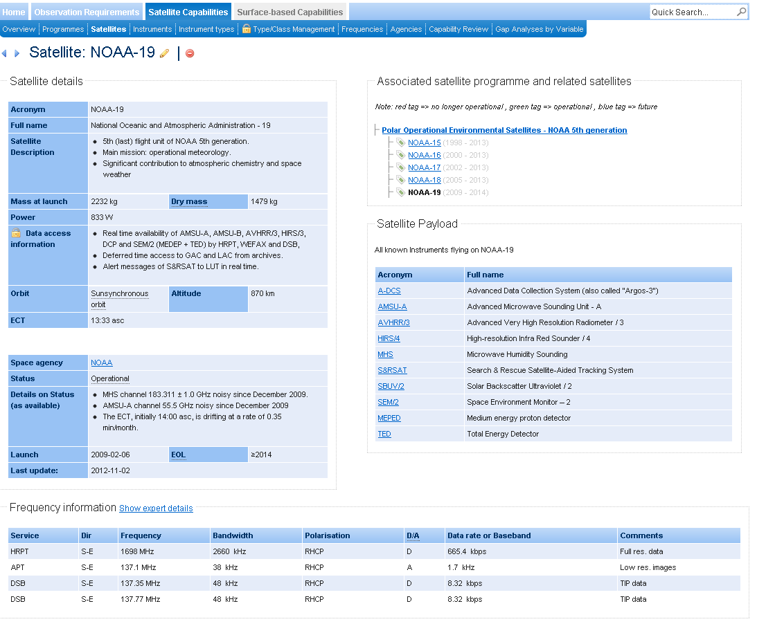
Satellite frequency information
(Example: NOAA-19)

Slide 18
(2) OSCAR/Space
From instruments to variables
Given a category of instrument : which variables can typically be retrieved?
Given a variable: which categories of instruments are typically relevant to measure it ?
OSCAR provides first-level, expert-reviewed assessments based on instrument design features

Slide 19
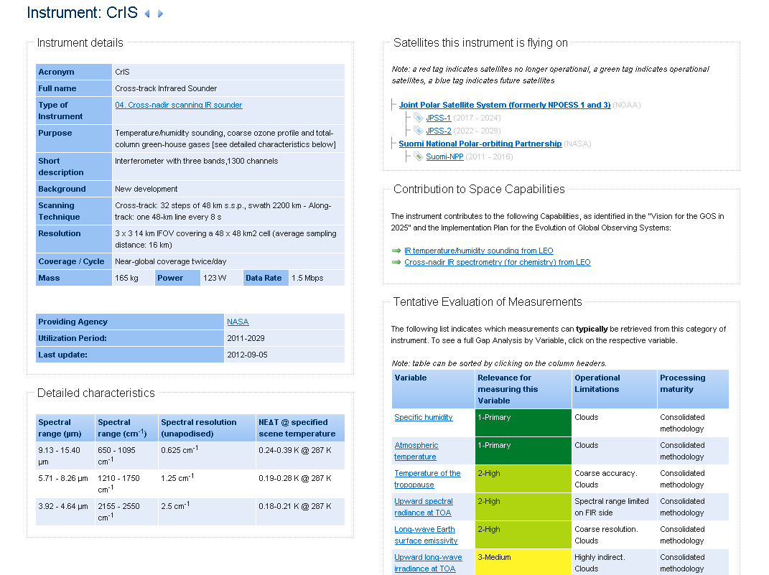
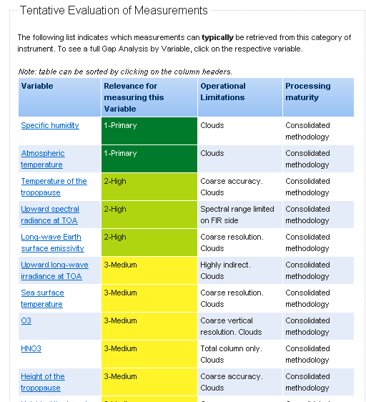
Instrument view (2)
9th Annual Symposium on Future Operational Environmental Satellite Systems, Austin, 10/01/2013

Slide 20
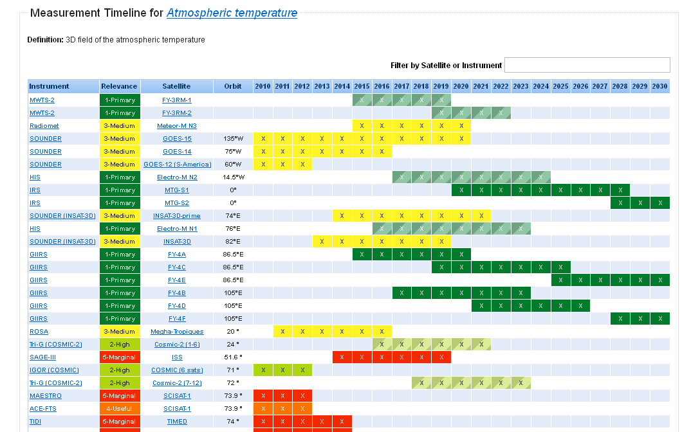
Variable view
9th Annual Symposium on Future Operational Environmental Satellite Systems, Austin, 10/01/2013

Slide 21
(2) OSCAR/Space
Comparing global plans with user expectations
(e.g., the WMO Vision for the GOS in 2025)

Slide 22
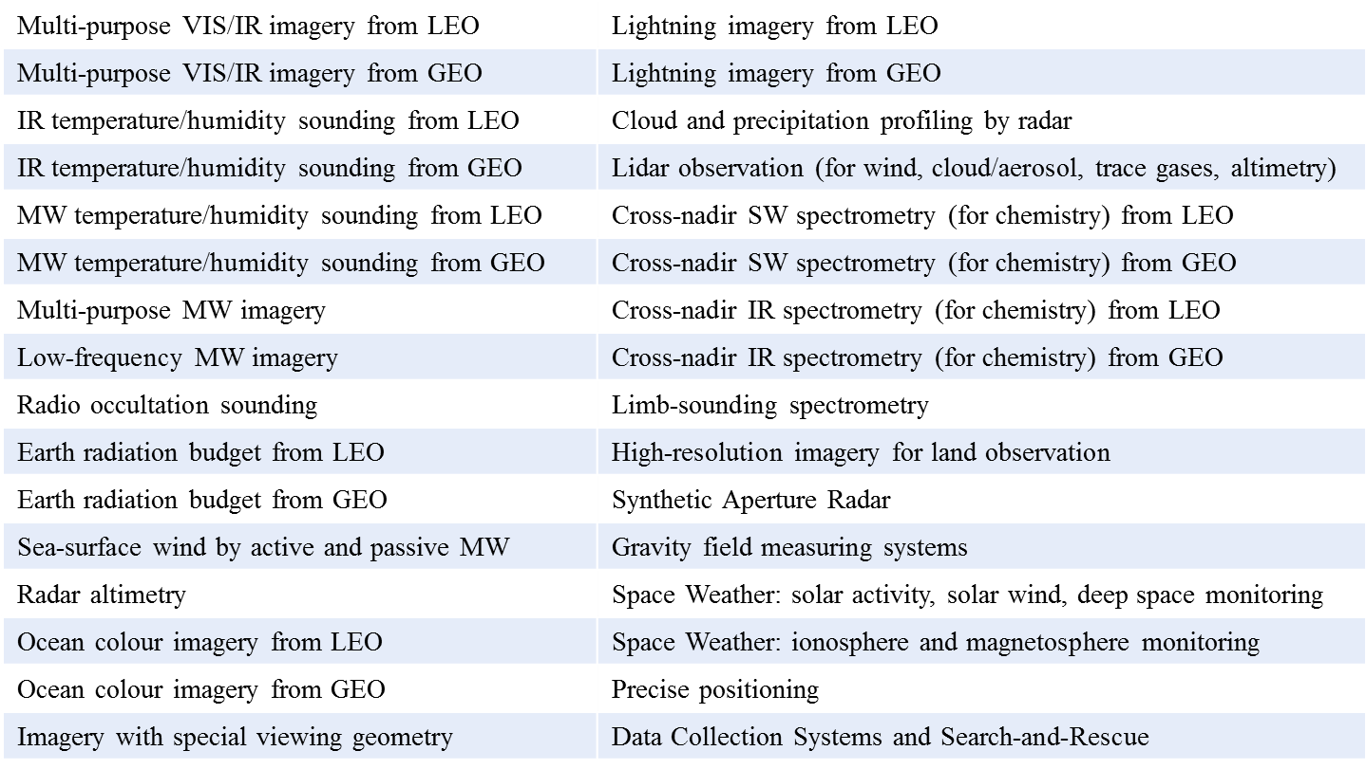
List of target « capabilities » in OSCAR
as required to implement the Vision

Slide 23
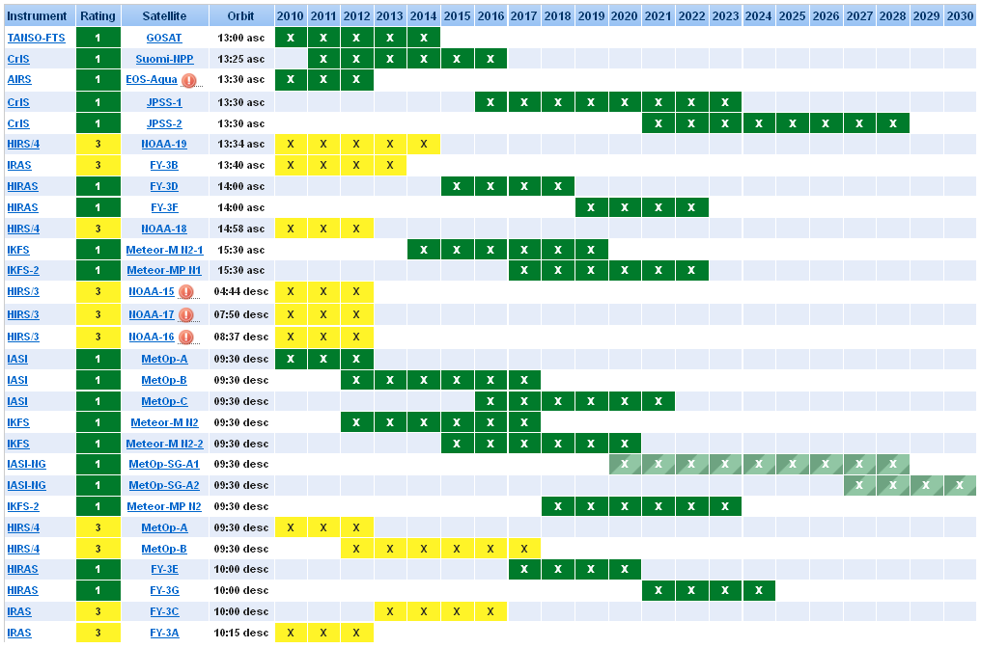
IR SOUNDING from LEO
PM
Gap in early morning
AM
9th Annual Symposium on Future Operational Environmental Satellite Systems, Austin, 10/01/2013

Slide 24
(2) OSCAR/Space
Benefits and limitations
Convenient resource for reports, applications, training
Support to high-level global coordination of satellite plans within CGMS and WMO
  Contingency planning, frequency spectrum management
  Architecture for climate monitoring from space
«Gap analysis» only provided for quick reference
  Based on sensor classes, not individual sensors
  Currently based on sensor design, not actual status or data availability
  Single sensors, regardless of possible combinations
  Cannot replace detailed gap analysis but convenient starting point for such analysis

Slide 25
Product Access Guide:
https://www.wmo-sat.info/product-access-guide/
OSCAR/Space:
http://www.wmo-sat.info/oscar/spacecapabilities

Slide 26
Thank you for your attention
Stephan Bojinski
sbojinski@wmo.int

