Slide 1
Mapping CGMS Satellite Extension Metadata to ISO19115/WMOCore
Telco
17.12.2015
Dr. Uwe Voges (con terra GmbH)

Slide 2
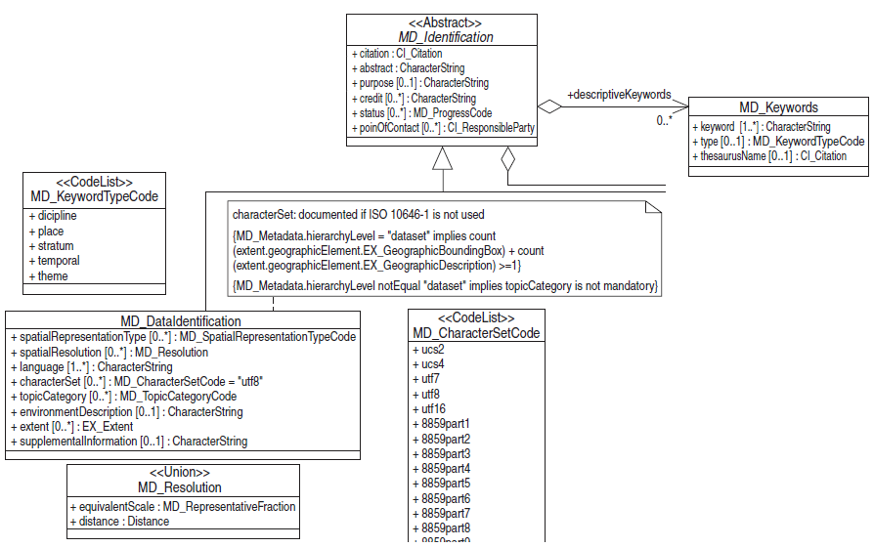
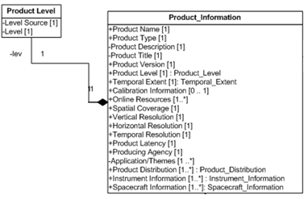
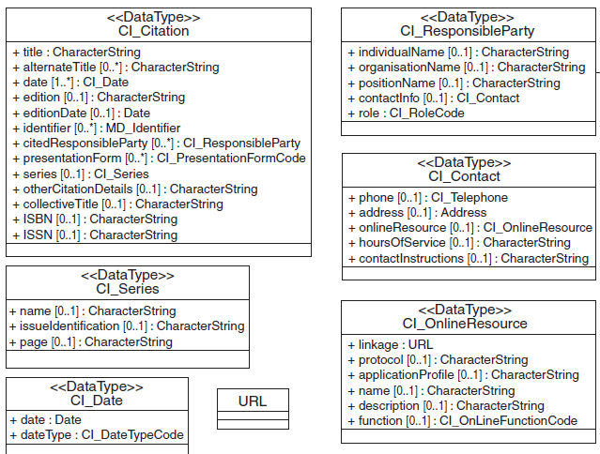
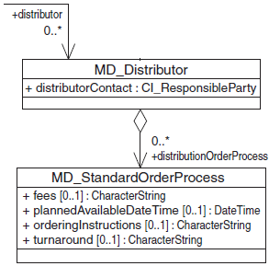
Mapping CGMS Productinformation to ISO19115
See next slide

Slide 3
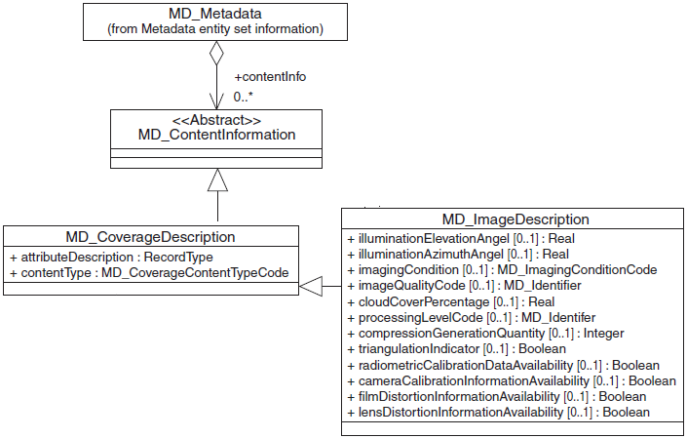

Mapping CGMS ProductLevel to ISO19115

Slide 4
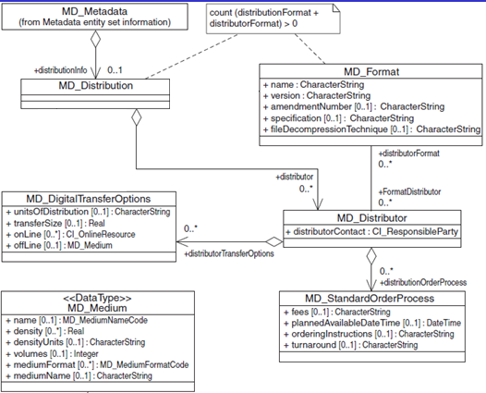
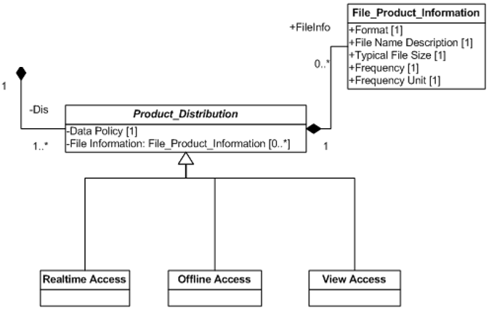
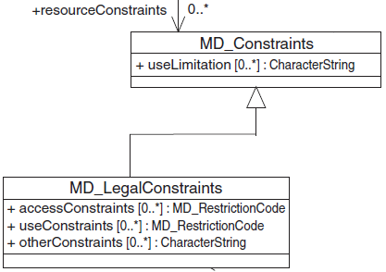
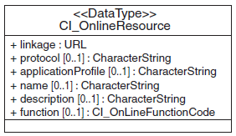
Mapping CGMS ProductDistribution to ISO19115
A convention is needed, like: for every combination format/ distribution-Channel one instance of gmd:distributor with a cohesive pair of MD_Format and MD_DigitalTransferOptions must be provided:
/gmd:MD_Metadata/gmd:distributionInfo/gmd:MD_Distribution/gmd:distributor/gmd:MD_Distributor/gmd:distributorFormat
plus one instance of /gmd:MD_Metadata/gmd:distributionInfo/gmd:MD_Distribution/gmd:distributor/gmd:MD_Distributor/gmd:distributorTransferOptions

Slide 5
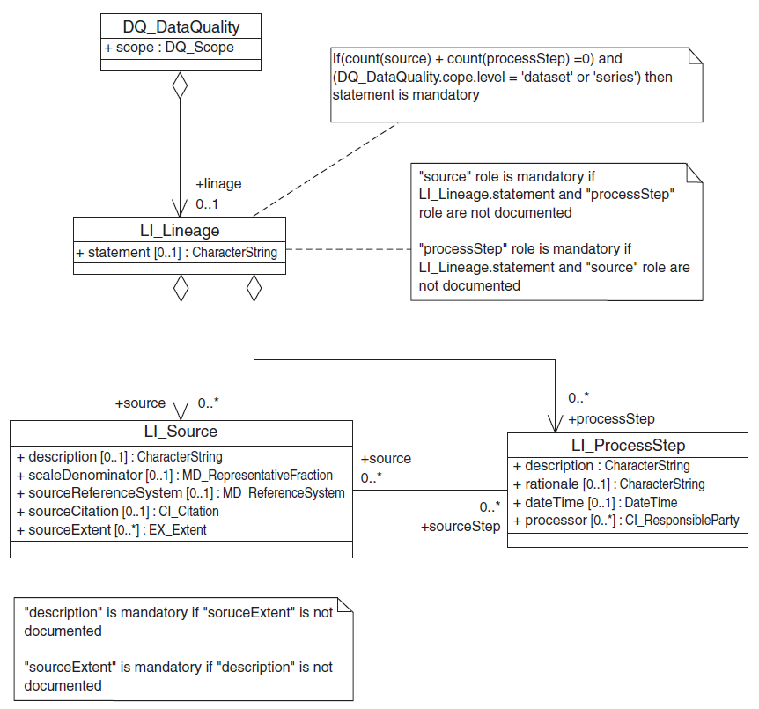
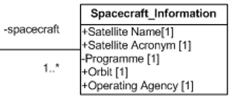
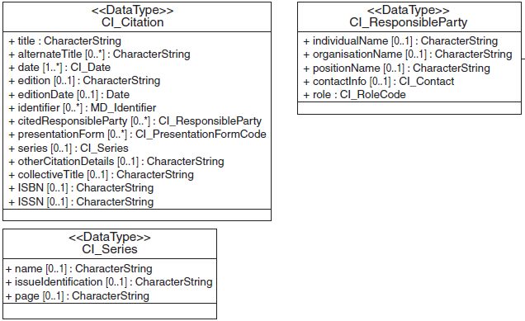
Mapping CGMS Spacecraft_Information to ISO19115
statement = “cgms:acquisition”
description = “cgms:platform”

Slide 6
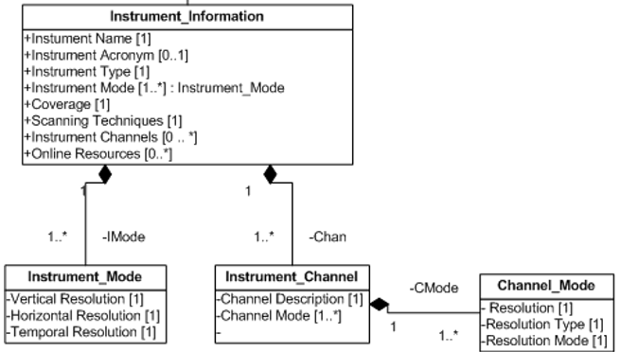
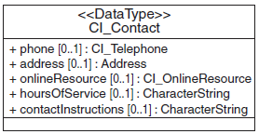
Mapping CGMS Instrument_Information to ISO19115 (I)
statement = “cgms:acquisition”
description = “cgms:instrument”
description = “cgms:mode”
roleCode=“cgms:modeVerticalResolution”
roleCode=“cgms:modeHorizontalResolution”
roleCode=“cgms:modeTemporalResolution”

Slide 7
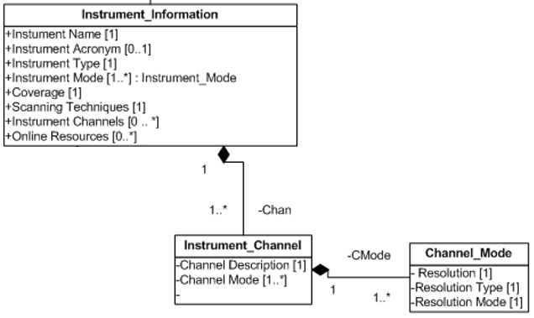
Mapping CGMS Instrument_Information to ISO19115 (II)
description = “cgms:channel“
description = “cgms:channelMode“
description =“cgms:channelModeName”
description =“cgms:channelModeResolutionType”
description =“cgms:channelMResolutionInformation”

Slide 8
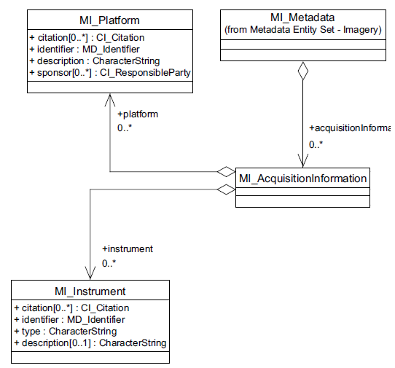
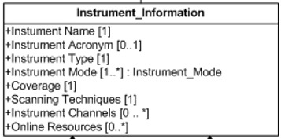
Mapping CGMS Spacecraft/Instrument _Infor-mation to ISO19115 + ISO19115-2 (for comparison)
statement = “cgms:acquisition”
description = “cgms:platform”
description = “cgms:instrument”
ISO19115-2
ISO19115

