Slide 1

Week 2 Escaping Flatland
Linear models and their limitations

Slide 2
Models
Descriptive
Predictive
Inferential
Causal
Outcome
Predictor

Slide 3
Models
Descriptive
Predictive
Inferential
Causal
Social trust
Inequality
The aim of modelling is to explain
Are we assuming a “linear” relationship?
Are we assuming that no other factors affect trust?
Are we assuming that the relationship between “inequality” and trust is not affected by other factors? (hidden “third” variables?)

Slide 4
Inference
From “data” to “population”
From “association” to “causality”
Statistical inference can be formulated as a set of operations on data that yield estimates and uncertainty statements about predictions and parameters of some underlying process or population (Gelman, Hill, and Vehtari 2020)
From a mathematical standpoint, these probabilistic uncertainty statements are derived based on some assumed probability model for observed data.
The normal (Gaussian) distribution — linear regression
The binomial distribution — logistic regression
So far we have focused on the “point” estimates from regression models

Slide 5
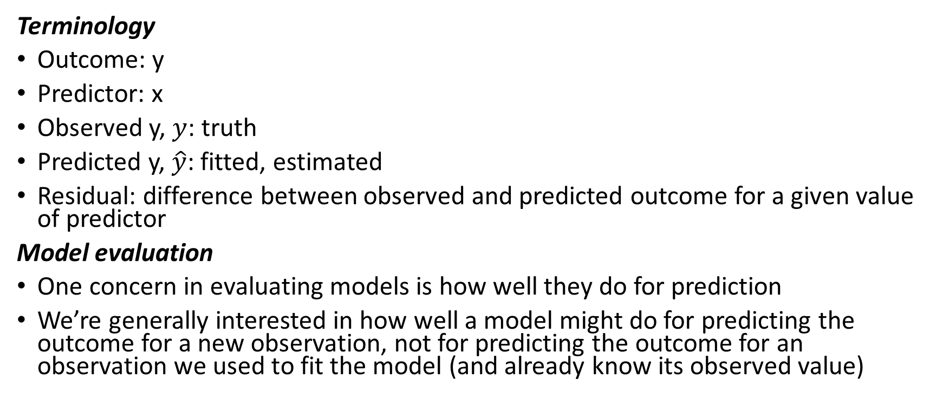
Estimation
Terminology
Outcome: y
Predictor: x
Observed y, $y$: truth
Predicted y, $\hat{y}$: fitted, estimated
Residual: difference between observed and predicted outcome for a given value of predictor
Model evaluation
One concern in evaluating models is how well they do for prediction
We’re generally interested in how well a model might do for predicting the outcome for a new observation, not for predicting the outcome for an observation we used to fit the model (and already know its observed value)

Slide 6

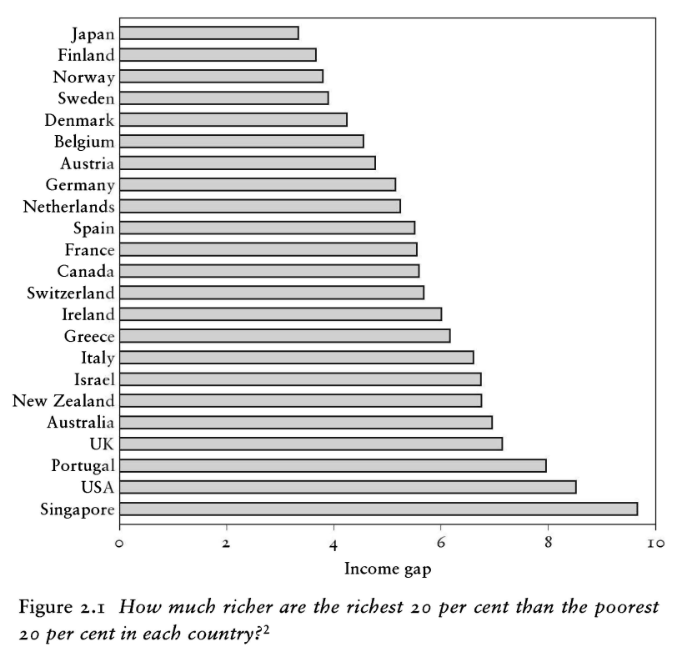
“The spirit level” (2010)

Slide 7
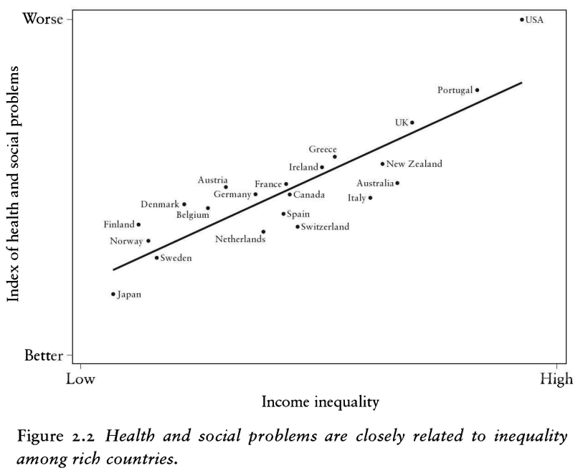
“The spirit level” (2010)

Slide 8
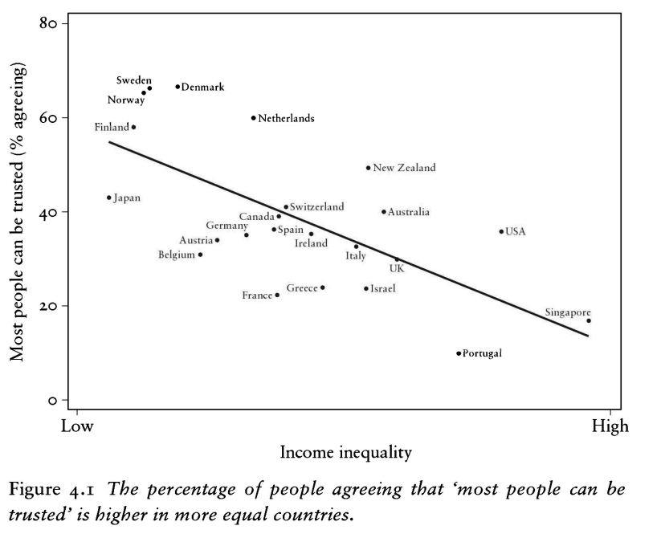
“The spirit level” (2010)

Slide 9
describe_distribution(inequality)
Variable | Mean | SD | IQR | Range | Skewness | Kurtosis | n | n_Missing ------------------------------------------------------------------------------------------------------------ trust_pct | 25.73 | 18.41 | 21.14 | [2.14, 77.42] | 1.13 | 0.62 | 89 | 0 GDPpercap2 | 27447.01 | 21342.56 | 28284.55 | [1987.97, 1.23e+05] | 1.62 | 4.20 | 86 | 3 pop | 5.78e+07 | 1.58e+08 | 4.68e+07 | [73837.00, 1.40e+09] | 7.32 | 61.13 | 87 | 2 urban_pop_pct | 67.92 | 18.93 | 25.93 | [20.31, 100.00] | -0.49 | -0.38 | 87 | 2 inc_top20 | 42.69 | 5.09 | 6.80 | [34.56, 57.35] | 0.86 | 0.42 | 79 | 10 inc_bottom20 | 7.15 | 1.62 | 2.32 | [3.45, 10.08] | -0.19 | -0.69 | 79 | 10 s80s20 | 6.50 | 2.60 | 2.79 | [3.52, 16.64] | 1.67 | 3.50 | 79 | 10

Slide 10
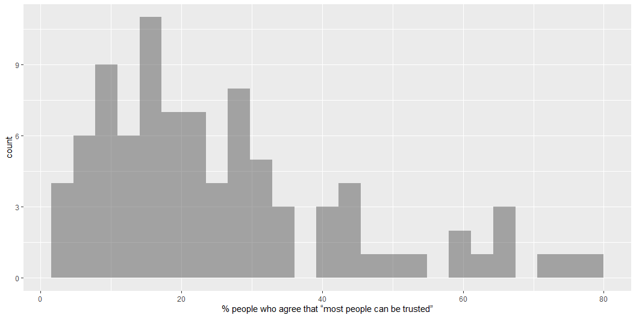
gf_histogram( ~ trust_pct, data = inequality)

Slide 11
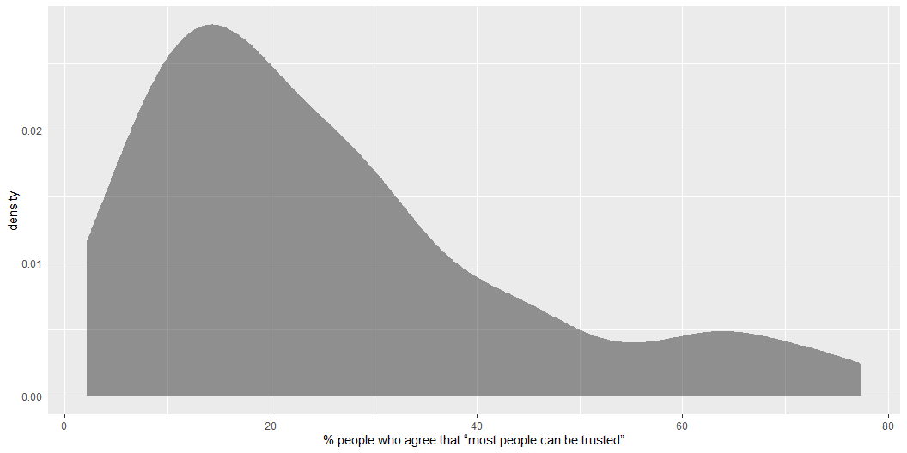
gf_density( ~ trust_pct, data = inequality)

Slide 12
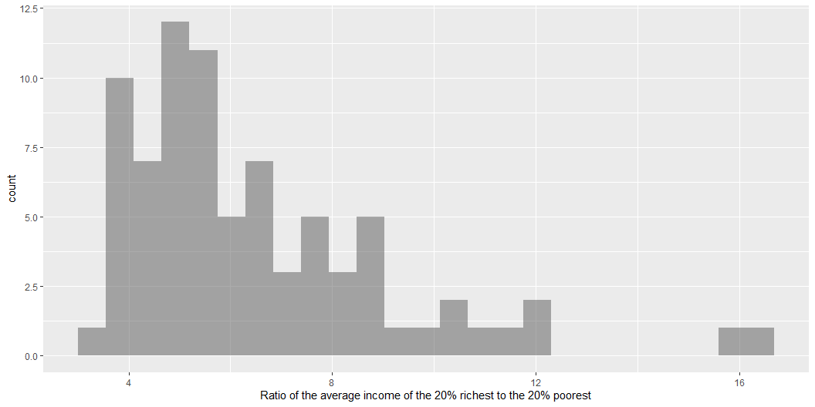
gf_histogram( ~ s80s20, data = inequality)

Slide 13
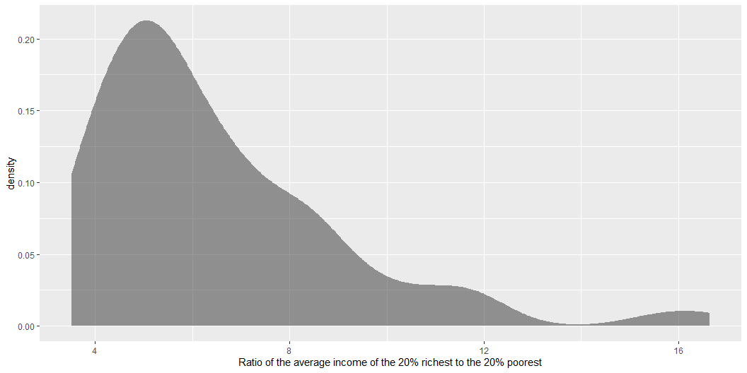
gf_density( ~ s80s20, data = inequality)

Slide 14
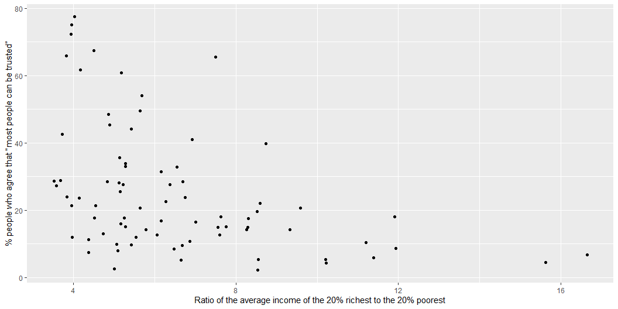

Slide 15
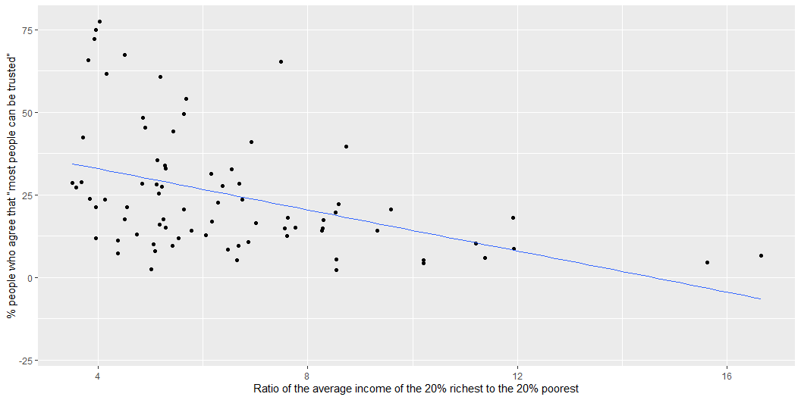

Slide 16
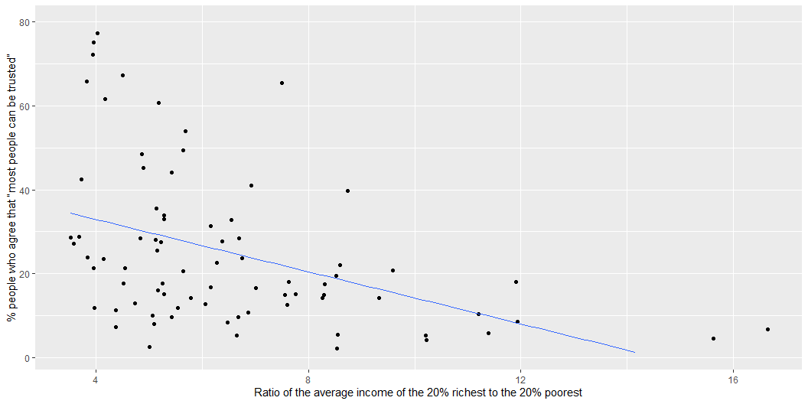

Slide 17
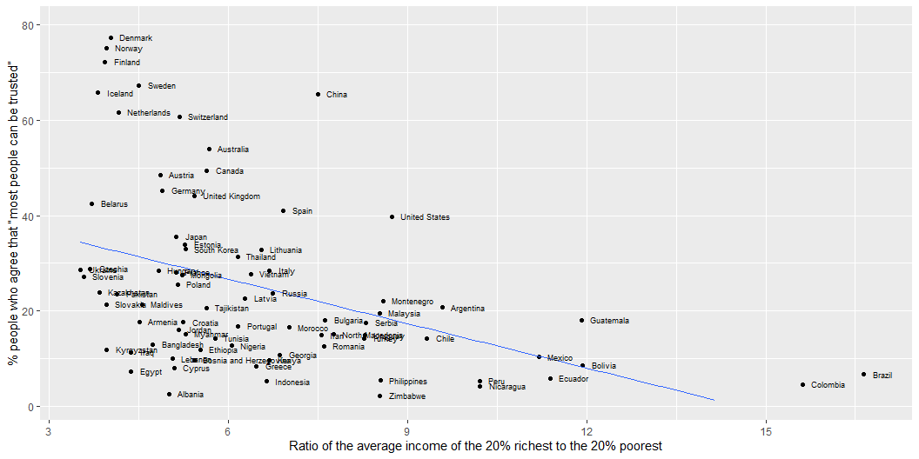

Slide 18
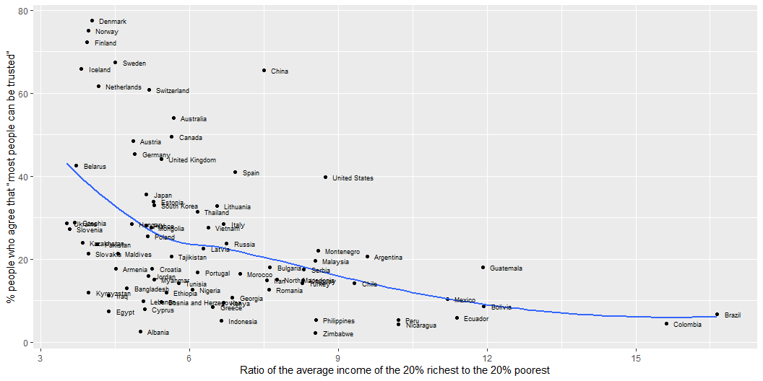

Slide 19
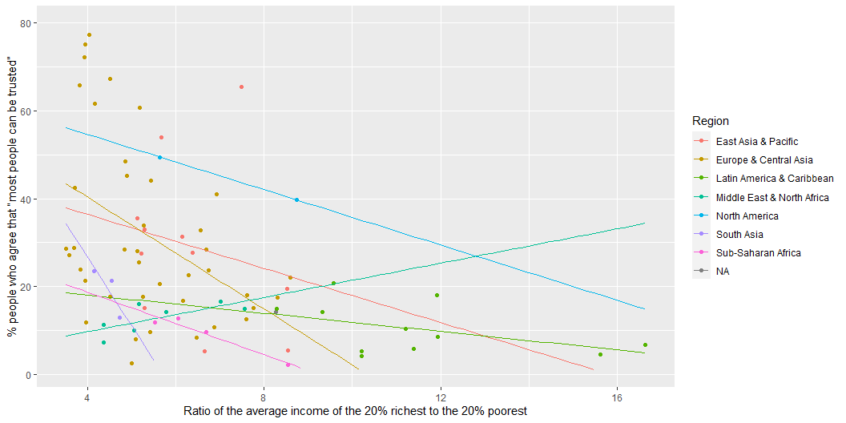

Slide 20
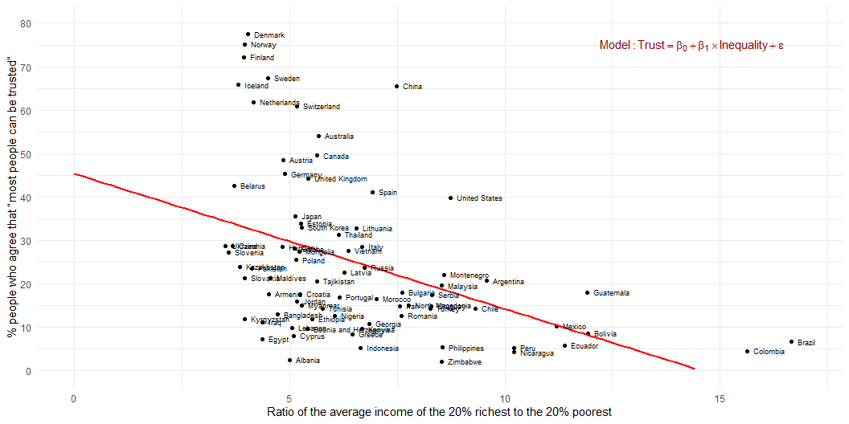
Estimation
Association between inequality and social trust at cross-national comparative level (W3Ex1) (Wilkinson and Pickett 2010)

Slide 21
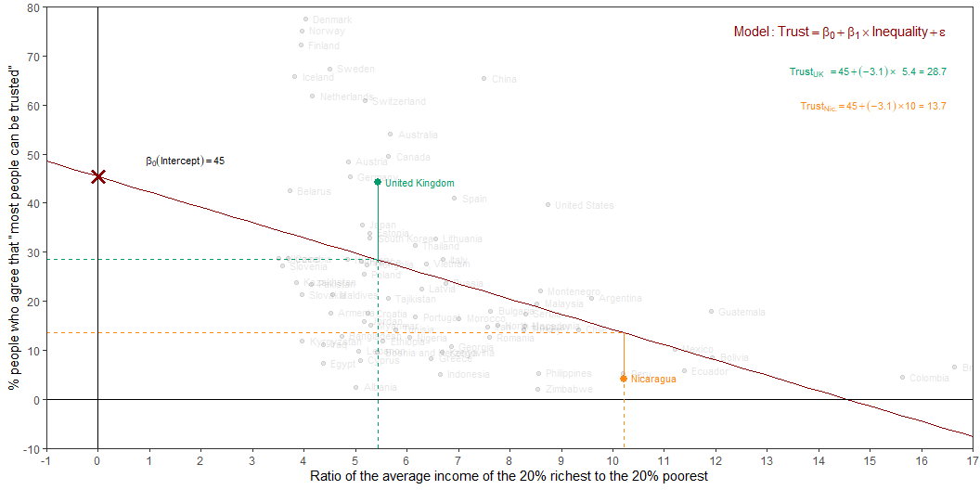
Estimation
Intercept: Social trust in countries with 0 inequality is expected to be 45.4 on average.
Slope: For each additional point increase in Inequality, the model predicts the level of social trust to be lower, on average, by 3.1 points.

Slide 22
From (sample) estimation to (population) inference
For each additional point increase in Inequality, the model predicts the level of social trust to be lower, on average, by 3.1 points
This estimate is valid for the single sample of the countries in the model
But what if we’re not interested in quantifying the relationship between Inequality and Trust in only this sample?
What if we want to say something about the relationship between these variables for all the countries in the world?

Slide 23
Statistical inference
Statistical inference allows provide methods and tools for us to use the single sample we have observed to make valid statements (inferences) about the population it comes from
For our inferences to be valid, the sample should be random and representative of the population we’re interested in

Slide 24

Inference for simple linear regression
Calculate a confidence interval for the slope, $β_{1}$
Conduct a hypothesis test for the interval, $β_{1}$

Slide 25
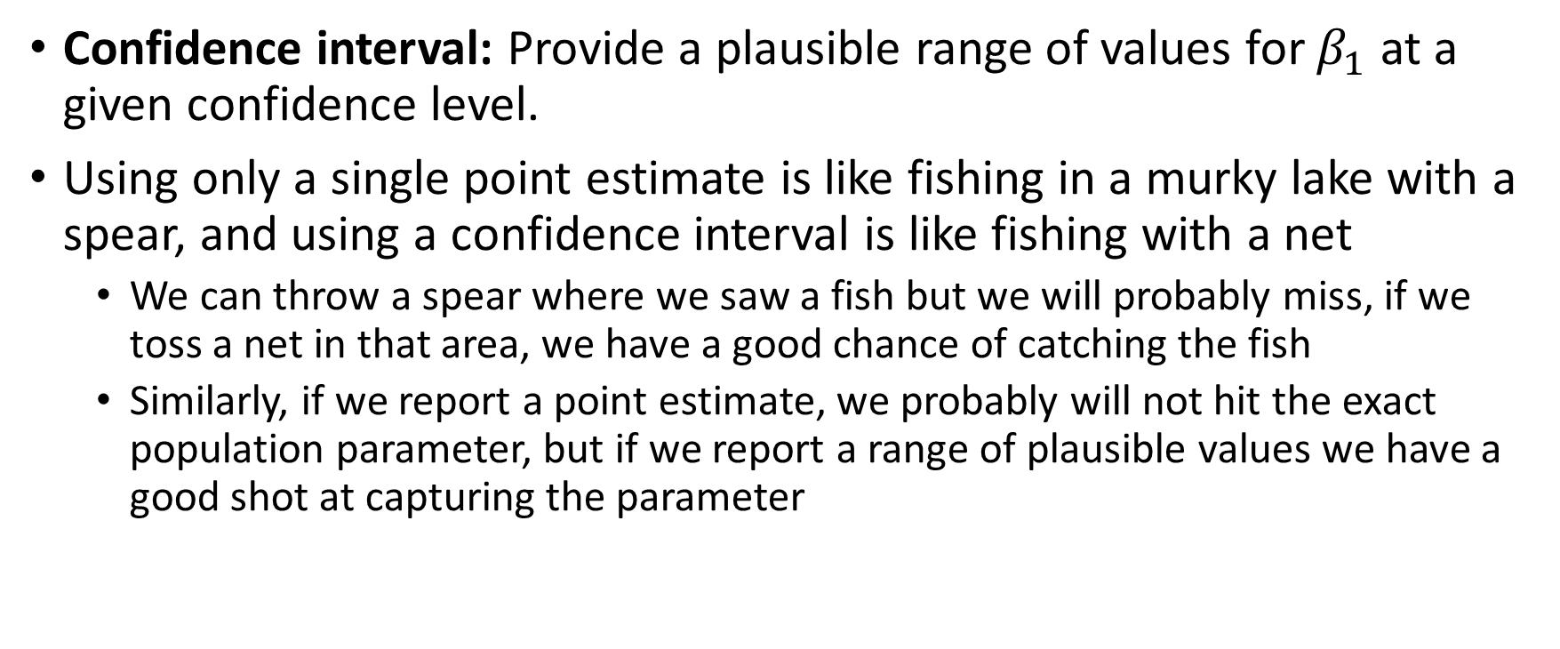
Confidence interval for the slope
Confidence interval: Provide a plausible range of values for $β_{1}$ at a given confidence level.
Using only a single point estimate is like fishing in a murky lake with a spear, and using a confidence interval is like fishing with a net
We can throw a spear where we saw a fish but we will probably miss, if we toss a net in that area, we have a good chance of catching the fish
Similarly, if we report a point estimate, we probably will not hit the exact population parameter, but if we report a range of plausible values we have a good shot at capturing the parameter

Slide 26
Quantify the variability of the slope
Two approaches:
Via simulation
Via mathematical models
Bootstrapping to quantify the variability of the slope for the purpose of estimation:
Bootstrap new samples from the original sample
Fit models to each of the samples and estimate the slope
Use features of the distribution of the bootstrapped slopes to construct a confidence interval

Slide 27
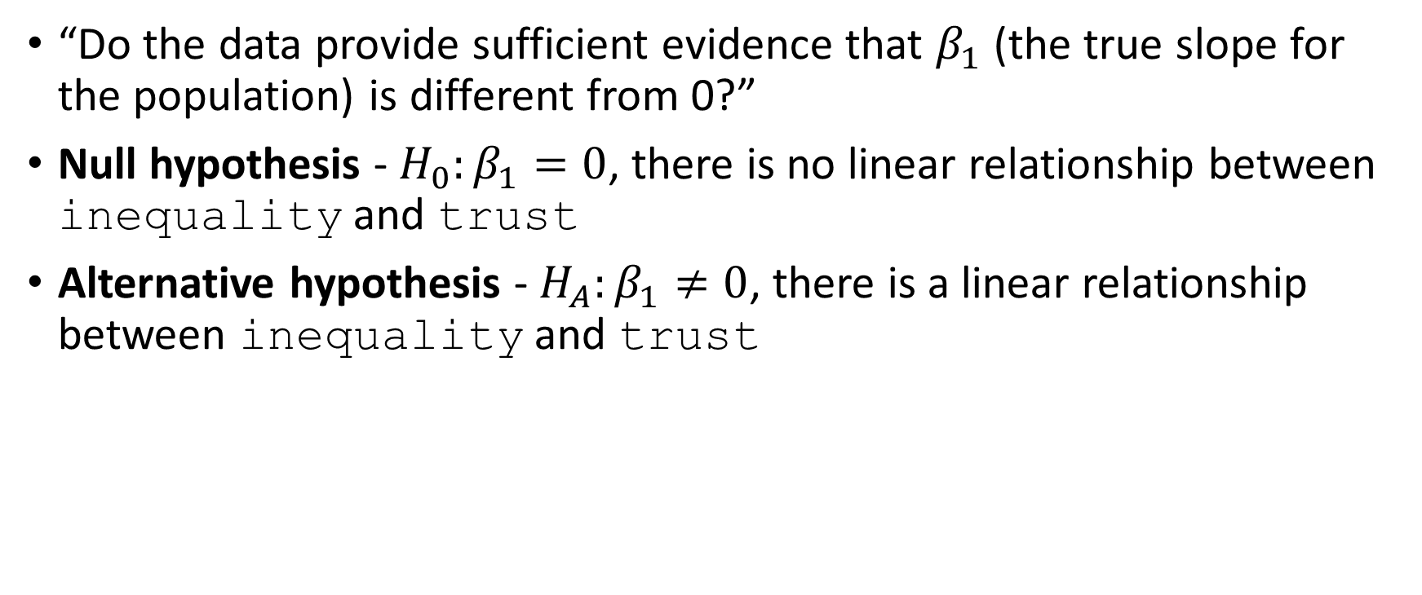
Hypothesis test for the slope
“Do the data provide sufficient evidence that $β_{1}$ (the true slope for the population) is different from 0?”
Null hypothesis - $H_{0}:β_{1}=0$, there is no linear relationship between inequality and trust
Alternative hypothesis - $H_{A}:β_{1}≠0$, there is a linear relationship between inequality and trust

Slide 28
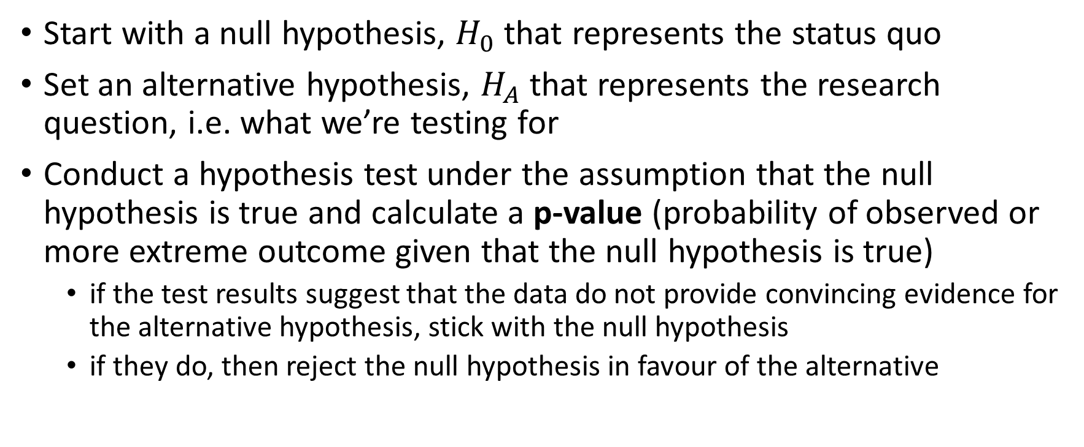
Hypothesis testing framework
Start with a null hypothesis, $H_{0}$ that represents the status quo
Set an alternative hypothesis, $H_{A}$ that represents the research question, i.e. what we’re testing for
Conduct a hypothesis test under the assumption that the null hypothesis is true and calculate a p-value (probability of observed or more extreme outcome given that the null hypothesis is true)
if the test results suggest that the data do not provide convincing evidence for the alternative hypothesis, stick with the null hypothesis
if they do, then reject the null hypothesis in favour of the alternative

Slide 29
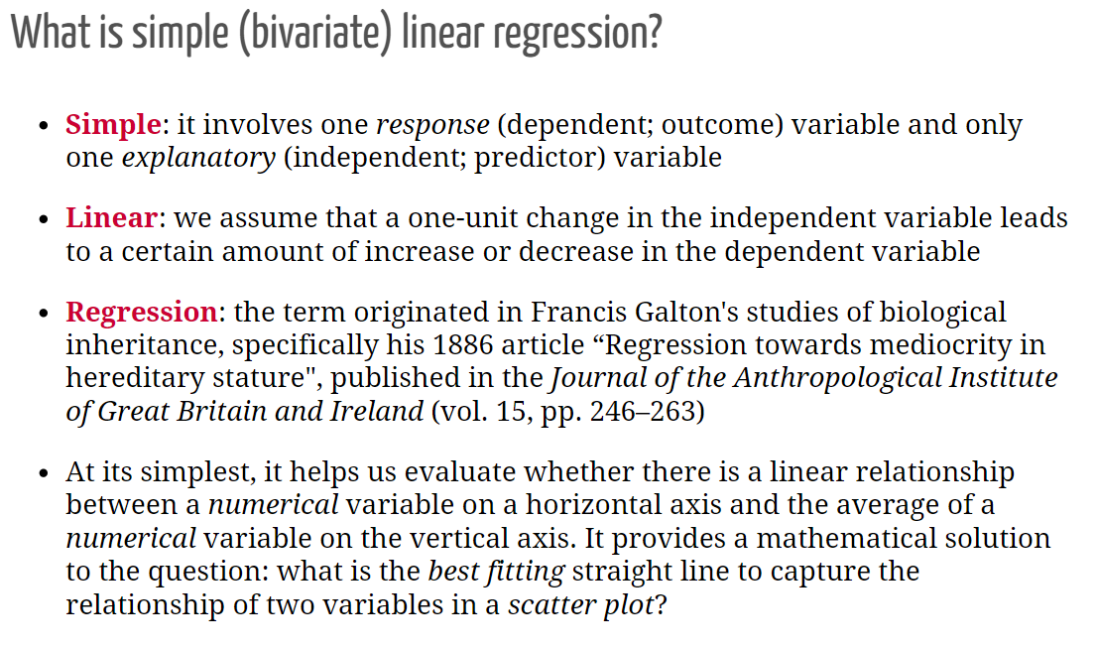

Slide 30
What is a ‘best’ line?
The same regression line could represent very different relationships
Source: F. J. Anscombe (1973). Graphs in Statistical Analysis. The American Statistician, 27(1):17-21. If you have access to JSTOR you can get the article at the following link: http://www.jstor.org/stable/2682899

Slide 31
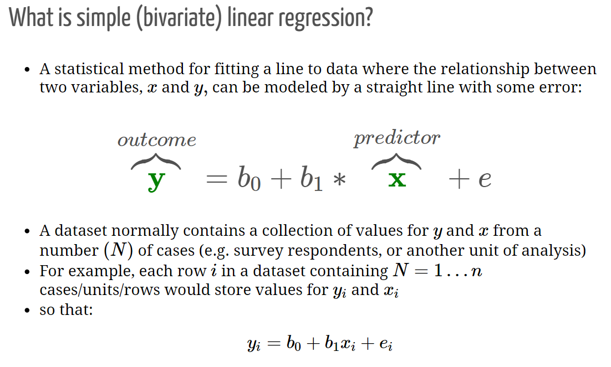

Slide 32
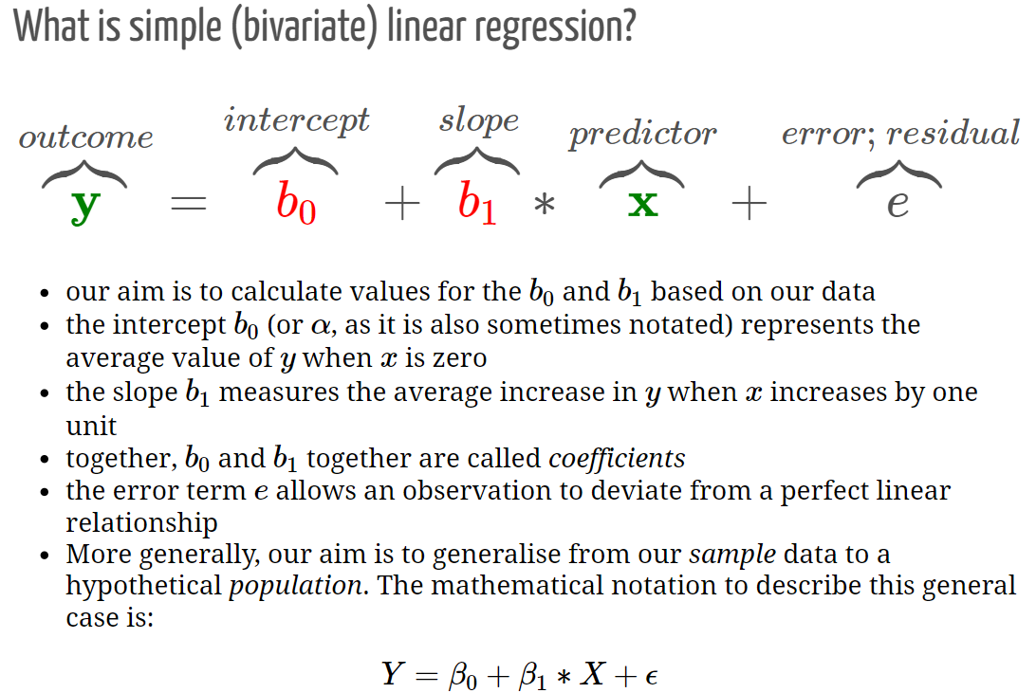

Slide 33
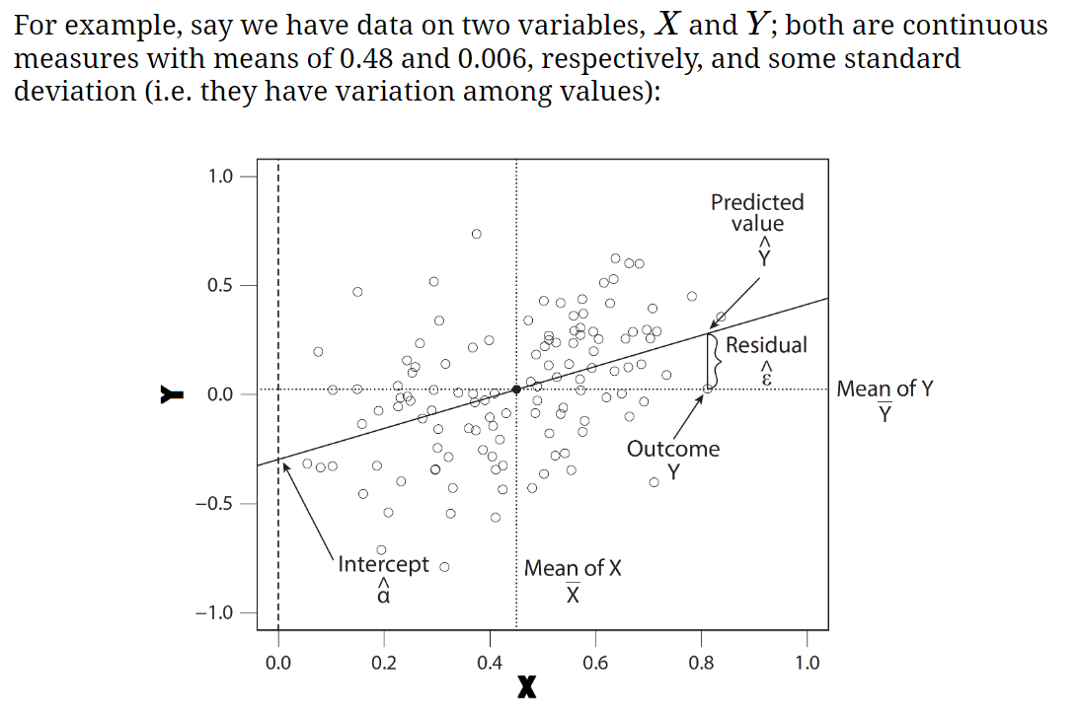

Slide 34
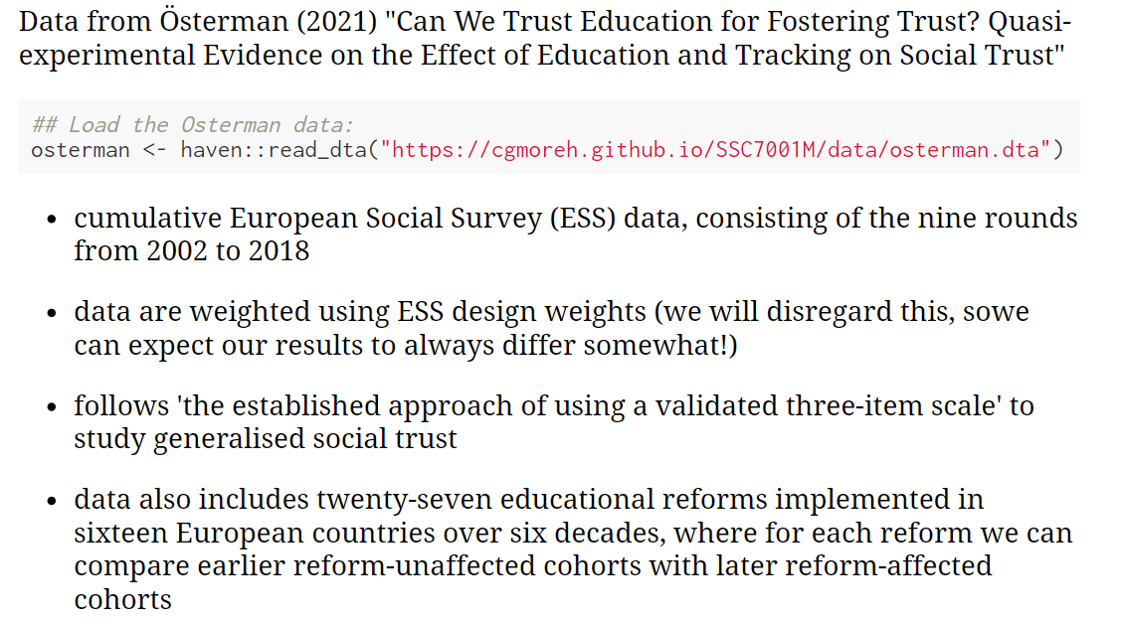

Slide 35
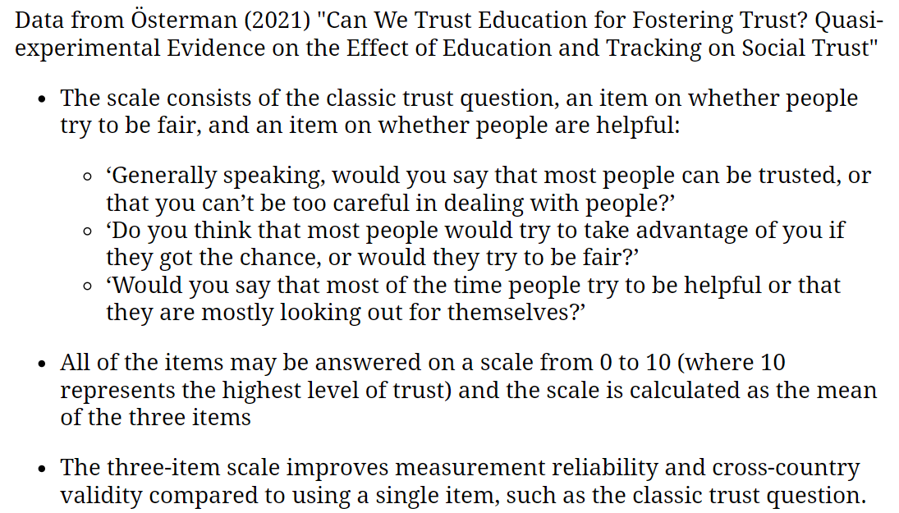

Slide 36
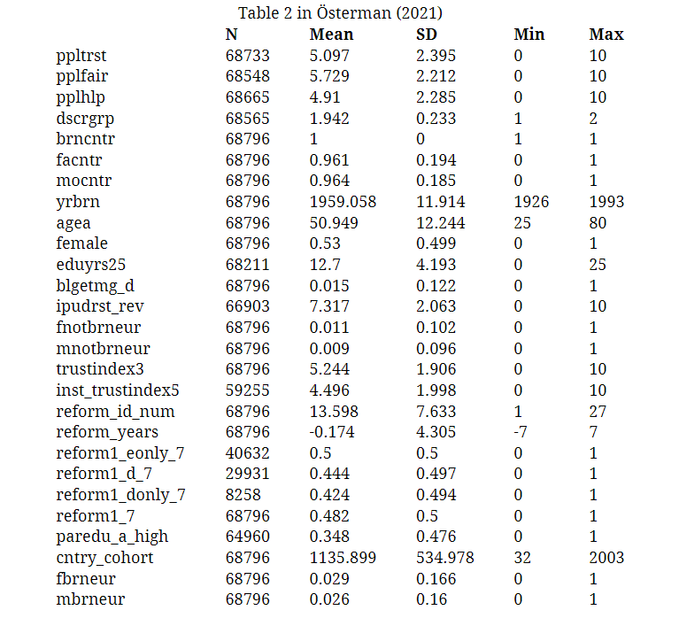

Slide 37
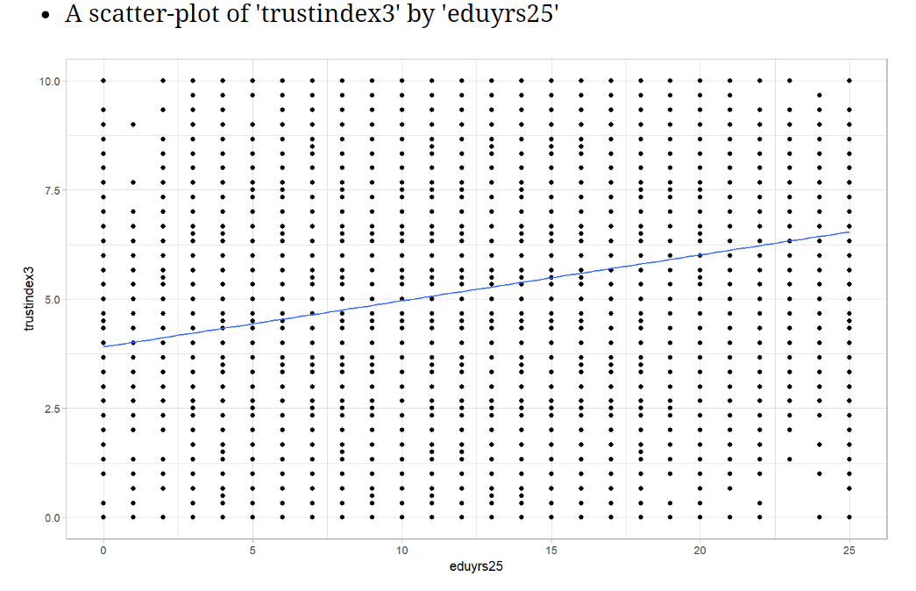

Slide 38
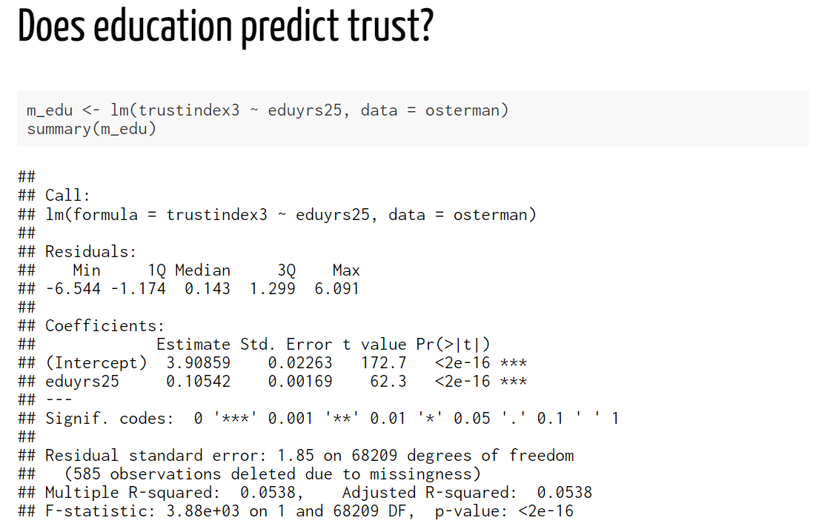
The “slope” coefficient; rather weak, but more years of education completed is associated with higher levels of social trust
p-value; very small; smaller than 0.001, and definitely smaller than 0.05 (for what it’s worth)
Conclusion:
One’s education appears to have an impact on their level of social trust. Each additional year of completed formal education is associated with a 0.105-point increase on the measured “social trust” scale. Based on the p-value (<0.001), we reject the null-hypothesis that this relationship would appear in our data by chance only, and provisionally accept that education affects social trust in the wider EU population.

Slide 39
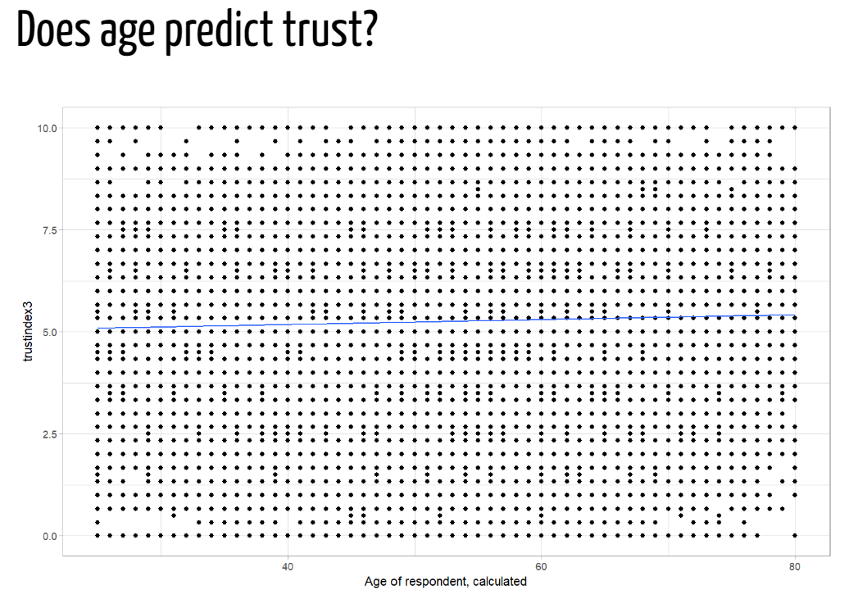

Slide 40
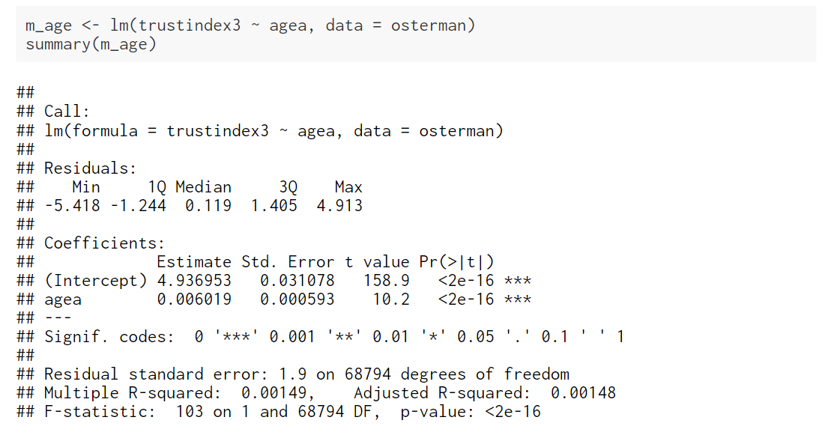
The “slope” coefficient; rather weak, but being older is associated with higher levels of social trust
p-value; very small; smaller than 0.001, and definitely smaller than 0.05 (for what it’s worth)
Conclusion:
One’s age appears to have an impact on their level of social trust. This association is weak in substantive terms. Each additional year of age is associated with a 0.006-point increase on the measured “social trust” scale. Based on the p-value (<0.001), we reject the null-hypothesis that this relationship would appear in our data by chance only, and provisionally accept that age affects social trust in the wider EU population.

Slide 41
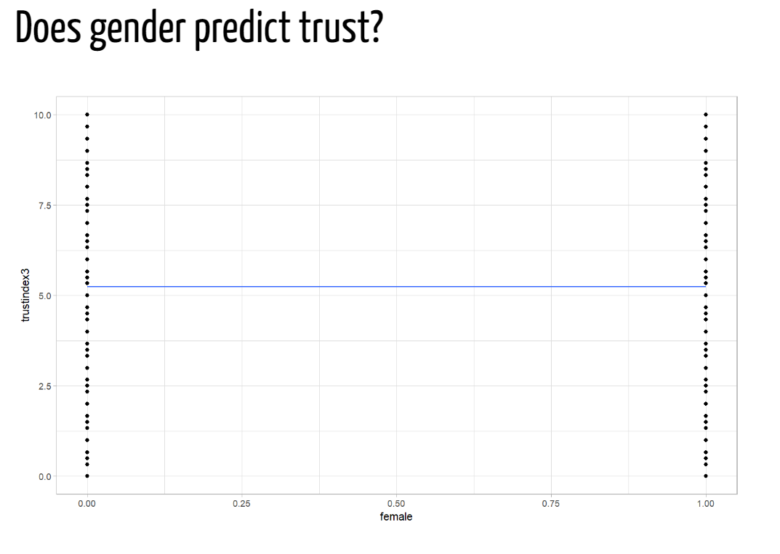

Slide 42
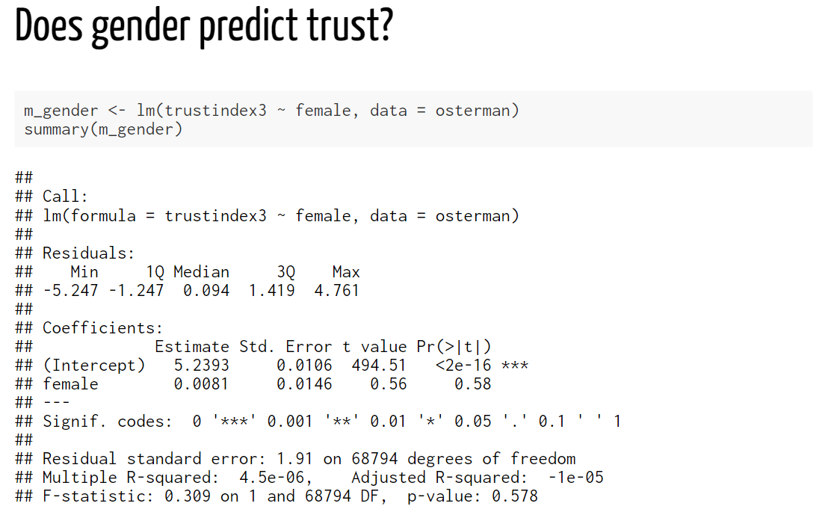
The “slope” coefficient; very weak, but being a woman is associated with higher levels of social trust compared to being a man
p-value; it runs on a 0-1 scale, so 0.58 (i.e. 58%) is very high, and much much higher than 0.05 (for what it’s worth)
Conclusion:
One’s sex doesn’t appear to have an impact on their level of social trust. The average score of women on the social trust scale is merely 0.008 points higher than that of men. Based on the p-value (0.58), we cannot reject the null-hypothesis that the difference between men and women in the wider EU population is in fact equal to 0 (as opposed to 0.008). There is in fact a probability of 0.58 (or 58%) that we would be wrong in rejecting the null-hypothesis. In conclusion, we don’t have evidence to suggest that sex is associated with differences in levels of social trust.

Slide 43
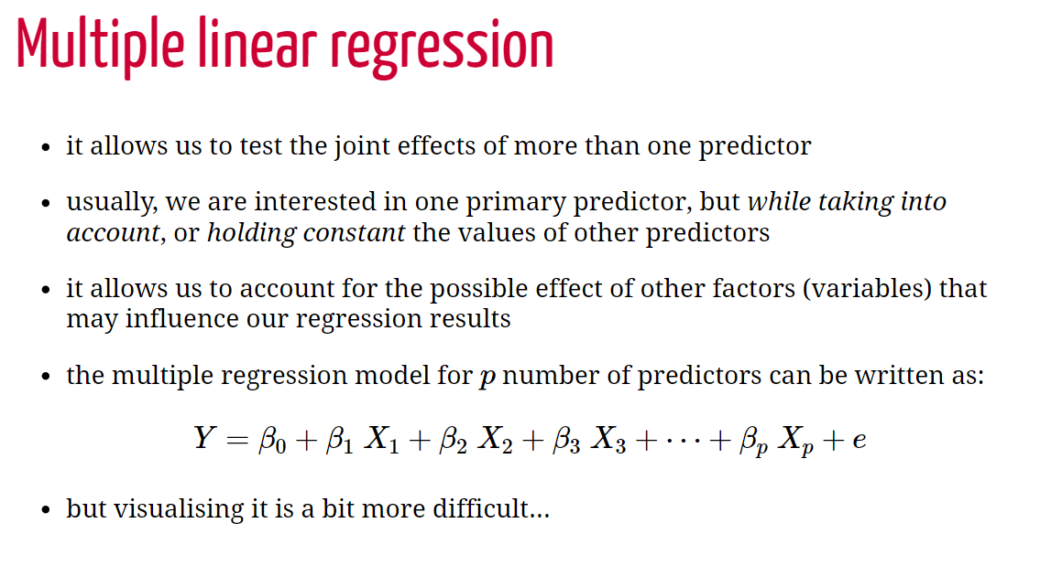

Slide 44
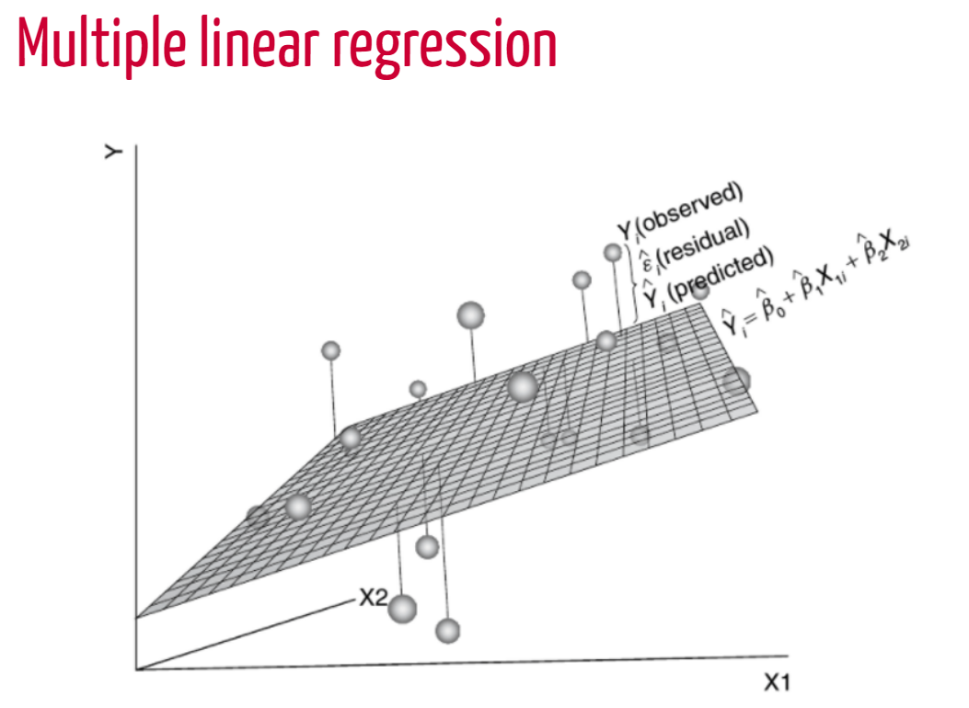
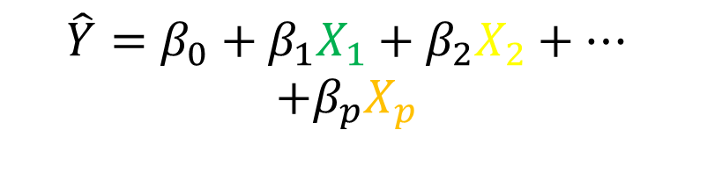
$$\hat{Y}=β_{0}+β_{1}X_{1}+β_{2}X_{2}+…$$
$$+β_{p}X_{p}$$
X1
X2
X3
60%
unexplained

Slide 45
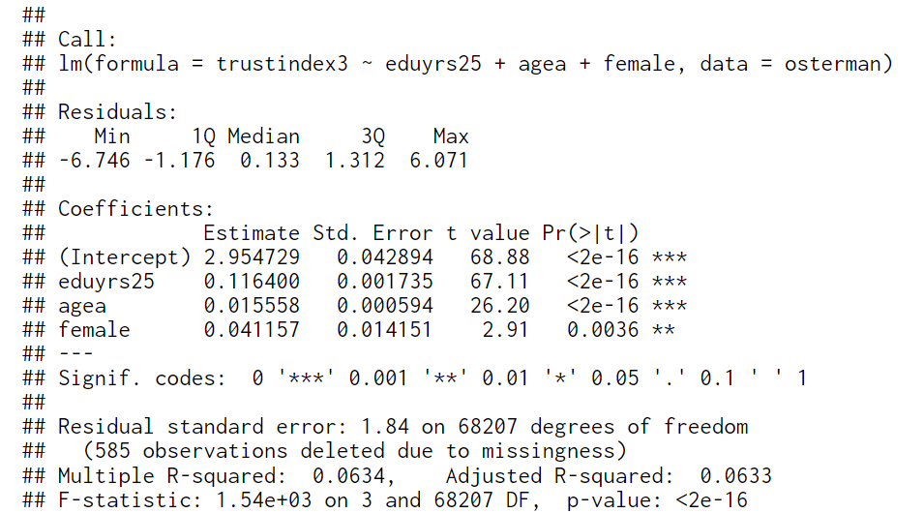
We are now interpreting each “slope” coefficient, keeping in mind that they represent the effect of that variable while keeping constant (eliminating) the effect of the other variables in the model
p-value; small!; smaller than 0.01; note that this has changed compared to the previous model; now, once we also account for education and age (i.e. keeping the effect of those variables constant, one’s sex seems to have an impact on their level of social trust
Conclusion:
In a statistical model that predicts levels of social trust from education, age and gender, we find that all three predictors are associated with social trust. Having more education, being older and being a woman is associated with higher levels of social trust.
This is now the p-value for the entire model

