Slide 2
Linear models
Generalised linear models
Interaction models
Multilevel models
Causal models
Longitudinal models
Week 2
Lines
Linear models and their limitations

Slide 3
Modelling
Computation
Reproducibility
Application

Slide 4

Modelling
Computation
Reproducibility
Application
Linear models
Coefficients
Error / Noise
Intercept
Slope
$$y_{n}=β_{0}1+β_{1}x_{n}+ε_{n},$$
where $ε_{n}\sim 𝒩(μ=0, σ)$
Normal / Gaussian
distribution
Mean
Standard Deviation
Notes:
Let’s see what that actually means.
Take the simplest linear regression model, with a single predictor and a slope and intercept coefficient, and normally distributed noise. This model can be written using standard regression notation as (1). This is equivalent to the sampling involving the residual shown in (2); and can be reduced still further to (3). In R the lm() function implements linear regression using least squares estimation and its formula looks like (4). The glm() function can estimate generalised linear models, but is equivalent to lm() with the default setting that specifies the Gaussian/Normal as the statistical distribution family assumed by the model.

Slide 5
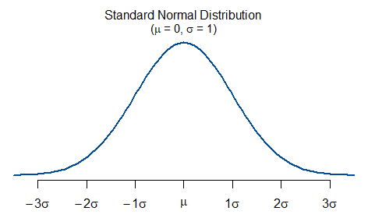

Modelling
Computation
Reproducibility
Application
Linear models
Coefficients
Error / Noise
Intercept
Slope
$$y_{n}=β_{0}1+β_{1}x_{n}+ε_{n},$$
where $ε_{n}\sim 𝒩(μ=0, σ)$
Normal / Gaussian
distribution
Mean
Standard Deviation
Notes:
Let’s see what that actually means.
Take the simplest linear regression model, with a single predictor and a slope and intercept coefficient, and normally distributed noise. This model can be written using standard regression notation as (1). This is equivalent to the sampling involving the residual shown in (2); and can be reduced still further to (3). In R the lm() function implements linear regression using least squares estimation and its formula looks like (4). The glm() function can estimate generalised linear models, but is equivalent to lm() with the default setting that specifies the Gaussian/Normal as the statistical distribution family assumed by the model.

Slide 6
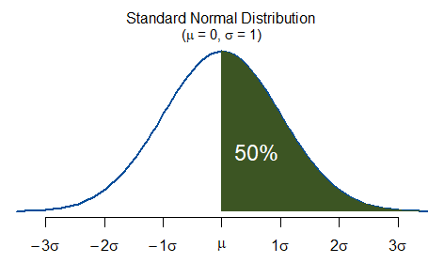

Modelling
Computation
Reproducibility
Application
Linear models
Coefficients
Error / Noise
Intercept
Slope
$$y_{n}=β_{0}1+β_{1}x_{n}+ε_{n},$$
where $ε_{n}\sim 𝒩(μ=0, σ)$
Normal / Gaussian
distribution
Mean
Standard Deviation
Notes:
Let’s see what that actually means.
Take the simplest linear regression model, with a single predictor and a slope and intercept coefficient, and normally distributed noise. This model can be written using standard regression notation as (1). This is equivalent to the sampling involving the residual shown in (2); and can be reduced still further to (3). In R the lm() function implements linear regression using least squares estimation and its formula looks like (4). The glm() function can estimate generalised linear models, but is equivalent to lm() with the default setting that specifies the Gaussian/Normal as the statistical distribution family assumed by the model.

Slide 7
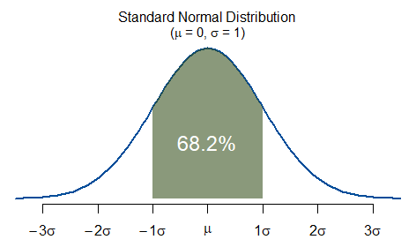
Modelling
Computation
Reproducibility
Application
Linear models
Coefficients
Error / Noise
Intercept
Slope
$$y_{n}=β_{0}1+β_{1}x_{n}+ε_{n},$$
where $ε_{n}\sim 𝒩(μ=0, σ)$
Normal / Gaussian
distribution
Mean
Standard Deviation
Notes:
Let’s see what that actually means.
Take the simplest linear regression model, with a single predictor and a slope and intercept coefficient, and normally distributed noise. This model can be written using standard regression notation as (1). This is equivalent to the sampling involving the residual shown in (2); and can be reduced still further to (3). In R the lm() function implements linear regression using least squares estimation and its formula looks like (4). The glm() function can estimate generalised linear models, but is equivalent to lm() with the default setting that specifies the Gaussian/Normal as the statistical distribution family assumed by the model.

Slide 8
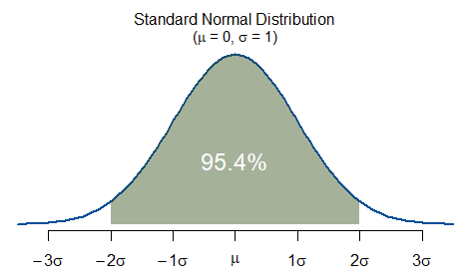
Modelling
Computation
Reproducibility
Application
Linear models
Coefficients
Error / Noise
Intercept
Slope
$$y_{n}=β_{0}1+β_{1}x_{n}+ε_{n},$$
where $ε_{n}\sim 𝒩(μ=0, σ)$
Normal / Gaussian
distribution
Mean
Standard Deviation
Notes:
Let’s see what that actually means.
Take the simplest linear regression model, with a single predictor and a slope and intercept coefficient, and normally distributed noise. This model can be written using standard regression notation as (1). This is equivalent to the sampling involving the residual shown in (2); and can be reduced still further to (3). In R the lm() function implements linear regression using least squares estimation and its formula looks like (4). The glm() function can estimate generalised linear models, but is equivalent to lm() with the default setting that specifies the Gaussian/Normal as the statistical distribution family assumed by the model.

Slide 9
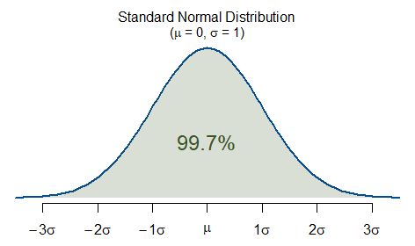
Modelling
Computation
Reproducibility
Application
Linear models
Coefficients
Error / Noise
Intercept
Slope
$$y_{n}=β_{0}1+β_{1}x_{n}+ε_{n},$$
where $ε_{n}\sim 𝒩(μ=0, σ)$
Normal / Gaussian
distribution
Mean
Standard Deviation
Notes:
Let’s see what that actually means.
Take the simplest linear regression model, with a single predictor and a slope and intercept coefficient, and normally distributed noise. This model can be written using standard regression notation as (1). This is equivalent to the sampling involving the residual shown in (2); and can be reduced still further to (3). In R the lm() function implements linear regression using least squares estimation and its formula looks like (4). The glm() function can estimate generalised linear models, but is equivalent to lm() with the default setting that specifies the Gaussian/Normal as the statistical distribution family assumed by the model.

Slide 10
Modelling
Computation
Reproducibility
Application
Linear models
Coefficients
Error / Noise
Intercept
Slope
$$y_{n}=β_{0}1+β_{1}x_{n}+ε_{n},$$
where $ε_{n}\sim 𝒩(μ=0, σ)$
Normal / Gaussian
distribution
Mean
Standard Deviation
Notes:
The simplest linear regression model is the following, with a single predictor and a slope and intercept coefficient, and normally distributed noise. This model can be written using standard regression notation as (1). This is equivalent to the sampling involving the residual shown in (2); and can be reduced still further to (3). In R the lm() function implements linear regression using least squares estimation and its formula looks like (4).

Slide 11
Modelling
Computation
Reproducibility
Application
Linear models
Coefficients
Error / Noise
Intercept
Slope
$$y_{n}=β_{0}1+β_{1}x_{n}+ε_{n},$$
where $ε_{n}\sim 𝒩(μ=0, σ)$
Normal / Gaussian
distribution
Mean
Standard Deviation
$$y_{n}−\left(β_{0}1+β_{1}X_{n}\right) \sim 𝒩(μ=0,σ)$$
Notes:
The simplest linear regression model is the following, with a single predictor and a slope and intercept coefficient, and normally distributed noise. This model can be written using standard regression notation as (1). This is equivalent to the sampling involving the residual shown in (2); and can be reduced still further to (3). In R the lm() function implements linear regression using least squares estimation and its formula looks like (4).

Slide 12

Modelling
Computation
Reproducibility
Application
Linear models
Coefficients
Error / Noise
Intercept
Slope
$$y_{n}=β_{0}1+β_{1}x_{n}+ε_{n},$$
where $ε_{n}\sim 𝒩(μ=0, σ)$
Normal / Gaussian
distribution
Mean
Standard Deviation
$$y_{n}−\left(β_{0}1+β_{1}X_{n}\right) \sim 𝒩(μ=0,σ)$$
$$y_{n} \sim 𝒩\left({μ=β}_{0}1+β_{1}X_{n}, σ\right)$$
Notes:
The simplest linear regression model is the following, with a single predictor and a slope and intercept coefficient, and normally distributed noise. This model can be written using standard regression notation as (1). This is equivalent to the sampling involving the residual shown in (2); and can be reduced still further to (3). In R the lm() function implements linear regression using least squares estimation and its formula looks like (4).

Slide 13

Modelling
Computation
Reproducibility
Application
Linear models
$$y_{n} \sim 𝒩\left({μ=β}_{0}1+β_{1}X_{n}, σ\right)$$
Notes:
Let’s see what that actually means.
Take the simplest linear regression model, with a single predictor and a slope and intercept coefficient, and normally distributed noise. This model can be written using standard regression notation as (1). This is equivalent to the sampling involving the residual shown in (2); and can be reduced still further to (3). In R the lm() function implements linear regression using least squares estimation and its formula looks like (4). The glm() function can estimate generalised linear models, but is equivalent to lm() with the default setting that specifies the Gaussian/Normal as the statistical distribution family assumed by the model.

Slide 14
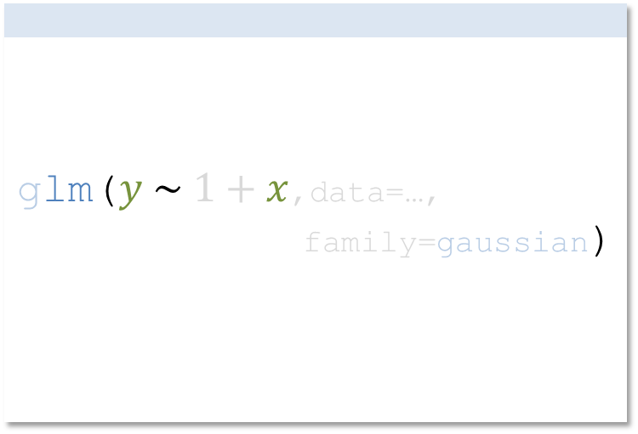
Modelling
Computation
Reproducibility
Application
Linear models
glm($y \sim 1+x$,data=…, family=gaussian)
$$y_{n} \sim 𝒩\left({μ=β}_{0}1+β_{1}X_{n}, σ\right)$$
Notes:
Let’s see what that actually means.
Take the simplest linear regression model, with a single predictor and a slope and intercept coefficient, and normally distributed noise. This model can be written using standard regression notation as (1). This is equivalent to the sampling involving the residual shown in (2); and can be reduced still further to (3). In R the lm() function implements linear regression using least squares estimation and its formula looks like (4). The glm() function can estimate generalised linear models, but is equivalent to lm() with the default setting that specifies the Gaussian/Normal as the statistical distribution family assumed by the model.

Slide 15

Modelling
Computation
Reproducibility
Application
Linear models
glm($y \sim 1+x$,data=…, family=gaussian)
Example
Children’s body weight ($y$) (in kg.) as a function of age ($x$) (in months)
Data = 100 (n) male children aged 0-36 months
$$y_{n} \sim 𝒩\left({μ=β}_{0}1+β_{1}X_{n}, σ\right)$$
Notes:
Let’s see what that actually means.
Take the simplest linear regression model, with a single predictor and a slope and intercept coefficient, and normally distributed noise. This model can be written using standard regression notation as (1). This is equivalent to the sampling involving the residual shown in (2); and can be reduced still further to (3). In R the lm() function implements linear regression using least squares estimation and its formula looks like (4). The glm() function can estimate generalised linear models, but is equivalent to lm() with the default setting that specifies the Gaussian/Normal as the statistical distribution family assumed by the model.

Slide 16
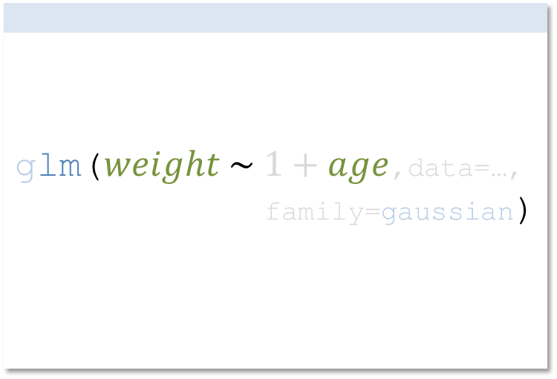

Modelling
Computation
Reproducibility
Application
Linear models
glm($weight \sim 1+age$,data=…, family=gaussian)
Example
Children’s body weight ($y$) (in kg.) as a function of age ($x$) (in months)
Data = 100 (n) male children aged 0-36 months
$${weight}_{n} \sim 𝒩\left({μ=β}_{0}1+β_{1}{age}_{n}, σ\right)$$
Notes:
Let’s see what that actually means.
Take the simplest linear regression model, with a single predictor and a slope and intercept coefficient, and normally distributed noise. This model can be written using standard regression notation as (1). This is equivalent to the sampling involving the residual shown in (2); and can be reduced still further to (3). In R the lm() function implements linear regression using least squares estimation and its formula looks like (4). The glm() function can estimate generalised linear models, but is equivalent to lm() with the default setting that specifies the Gaussian/Normal as the statistical distribution family assumed by the model.

Slide 17

Modelling
Computation
Reproducibility
Application
Linear models
>
Example
Children’s body weight ($y$) (in kg.) as a function of age ($x$) (in months)
Data = 100 (n) male children aged 0-36 months
$${weight}_{n} \sim 𝒩\left({μ=β}_{0}1+β_{1}{age}_{n}, σ\right)$$
Notes:
Let’s see what that actually means.
Take the simplest linear regression model, with a single predictor and a slope and intercept coefficient, and normally distributed noise. This model can be written using standard regression notation as (1). This is equivalent to the sampling involving the residual shown in (2); and can be reduced still further to (3). In R the lm() function implements linear regression using least squares estimation and its formula looks like (4). The glm() function can estimate generalised linear models, but is equivalent to lm() with the default setting that specifies the Gaussian/Normal as the statistical distribution family assumed by the model.

Slide 18

Modelling
Computation
Reproducibility
Application
Linear models
> n = 100 >
Example
Children’s body weight ($y$) (in kg.) as a function of age ($x$) (in months)
Data = 100 (n) male children aged 0-36 months
$${weight}_{n} \sim 𝒩\left({μ=β}_{0}1+β_{1}{age}_{n}, σ\right)$$
Notes:
Let’s see what that actually means.
Take the simplest linear regression model, with a single predictor and a slope and intercept coefficient, and normally distributed noise. This model can be written using standard regression notation as (1). This is equivalent to the sampling involving the residual shown in (2); and can be reduced still further to (3). In R the lm() function implements linear regression using least squares estimation and its formula looks like (4). The glm() function can estimate generalised linear models, but is equivalent to lm() with the default setting that specifies the Gaussian/Normal as the statistical distribution family assumed by the model.

Slide 19

Modelling
Computation
Reproducibility
Application
Linear models
> n = 100 > age = sample(0:36, n, replace = TRUE) >
Example
Children’s body weight ($y$) (in kg.) as a function of age ($x$) (in months)
Data = 100 (n) male children aged 0-36 months
$${weight}_{n} \sim 𝒩\left({μ=β}_{0}1+β_{1}{age}_{n}, σ\right)$$
Notes:
Let’s see what that actually means.
Take the simplest linear regression model, with a single predictor and a slope and intercept coefficient, and normally distributed noise. This model can be written using standard regression notation as (1). This is equivalent to the sampling involving the residual shown in (2); and can be reduced still further to (3). In R the lm() function implements linear regression using least squares estimation and its formula looks like (4). The glm() function can estimate generalised linear models, but is equivalent to lm() with the default setting that specifies the Gaussian/Normal as the statistical distribution family assumed by the model.

Slide 20
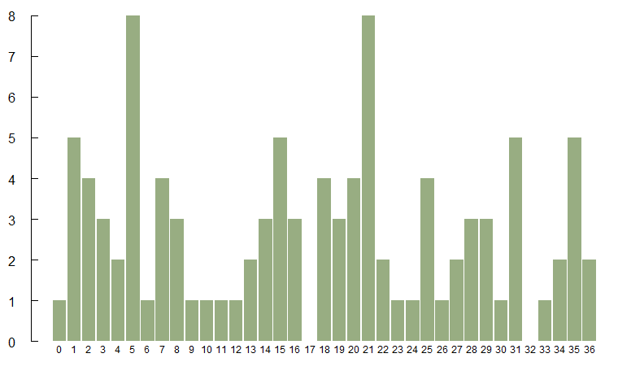

Modelling
Computation
Reproducibility
Application
Linear models
> n = 100 > age = sample(0:36, n, replace = TRUE) Number of distinct values: 35 Values: [1] 27 15 21 36 8 4 15 3 33 21 25 [12] 5 14 13 13 3 3 20 19 2 35 30 [23] 28 4 1 19 2 22 35 7 31 1 14 [34] 5 28 31 7 25 16 7 31 21 34 15 [45] 2 21 9 21 24 2 18 25 22 5 19 [56] 6 31 5 36 26 11 7 0 35 27 18 [67] 8 29 16 21 5 20 20 31 12 16 1 [78] 5 1 15 10 35 34 25 35 20 5 8 [89] 18 21 28 15 1 23 29 5 29 18 14 [100] 21
$${weight}_{n} \sim 𝒩\left({μ=β}_{0}1+β_{1}{age}_{n}, σ\right)$$
Notes:
Let’s see what that actually means.
Take the simplest linear regression model, with a single predictor and a slope and intercept coefficient, and normally distributed noise. This model can be written using standard regression notation as (1). This is equivalent to the sampling involving the residual shown in (2); and can be reduced still further to (3). In R the lm() function implements linear regression using least squares estimation and its formula looks like (4). The glm() function can estimate generalised linear models, but is equivalent to lm() with the default setting that specifies the Gaussian/Normal as the statistical distribution family assumed by the model.

Slide 21

Modelling
Computation
Reproducibility
Application
Linear models
> n = 100 > age = sample(0:36, n, replace = TRUE) > b_0 = ...? > b_1 = ...? >
Example
Children’s body weight ($y$) (in kg.) as a function of age ($x$) (in months)
Data = 100 (n) male children aged 0-36 months
$${weight}_{n} \sim 𝒩\left({μ=β}_{0}1+β_{1}{age}_{n}, σ\right)$$
Notes:
Let’s see what that actually means.
Take the simplest linear regression model, with a single predictor and a slope and intercept coefficient, and normally distributed noise. This model can be written using standard regression notation as (1). This is equivalent to the sampling involving the residual shown in (2); and can be reduced still further to (3). In R the lm() function implements linear regression using least squares estimation and its formula looks like (4). The glm() function can estimate generalised linear models, but is equivalent to lm() with the default setting that specifies the Gaussian/Normal as the statistical distribution family assumed by the model.

Slide 22
Modelling
Computation
Reproducibility
Application
Linear models
> n = 100 > age = sample(0:36, n, replace = TRUE) > b_0 = 3.4 > b_1 = 0.3 >
Example
Children’s body weight ($y$) (in kg.) as a function of age ($x$) (in months)
Data = 100 (n) male children aged 0-36 months
$${weight}_{n} \sim 𝒩\left({μ=β}_{0}1+β_{1}{age}_{n}, σ\right)$$
Notes:
Let’s see what that actually means.
Take the simplest linear regression model, with a single predictor and a slope and intercept coefficient, and normally distributed noise. This model can be written using standard regression notation as (1). This is equivalent to the sampling involving the residual shown in (2); and can be reduced still further to (3). In R the lm() function implements linear regression using least squares estimation and its formula looks like (4). The glm() function can estimate generalised linear models, but is equivalent to lm() with the default setting that specifies the Gaussian/Normal as the statistical distribution family assumed by the model.

Slide 23

Modelling
Computation
Reproducibility
Application
Linear models
> n = 100 > age = sample(0:36, n, replace = TRUE) > b_0 = 3.4 > b_1 = 0.3 > mu_weight = b_0*1 + b_1*age >
Example
Children’s body weight ($y$) (in kg.) as a function of age ($x$) (in months)
Data = 100 (n) male children aged 0-36 months
$${weight}_{n} \sim 𝒩\left({μ=β}_{0}1+β_{1}{age}_{n}, σ\right)$$
Notes:
Let’s see what that actually means.
Take the simplest linear regression model, with a single predictor and a slope and intercept coefficient, and normally distributed noise. This model can be written using standard regression notation as (1). This is equivalent to the sampling involving the residual shown in (2); and can be reduced still further to (3). In R the lm() function implements linear regression using least squares estimation and its formula looks like (4). The glm() function can estimate generalised linear models, but is equivalent to lm() with the default setting that specifies the Gaussian/Normal as the statistical distribution family assumed by the model.

Slide 24
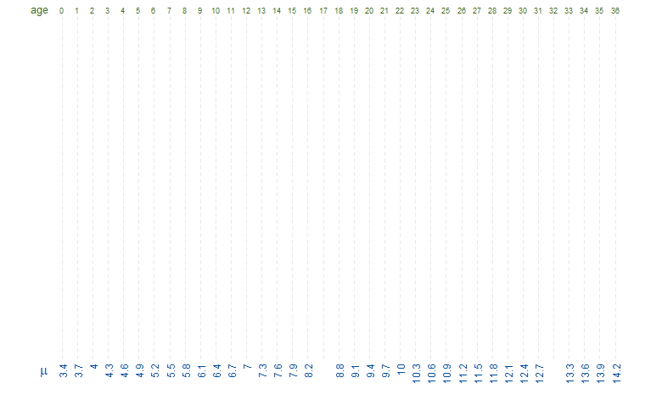
Modelling
Computation
Reproducibility
Application
Linear models
> n = 100 > age = sample(0:36, n, replace = TRUE) > b_0 = 3.4 > b_1 = 0.3 > mu_weight = b_0*1 + b_1*age Number of distinct values: 35 Summary: Min. 1st Qu. Median Mean 3rd Qu. Max. 3.4 5.5 8.8 8.539 10.975 14.2
$${weight}_{n} \sim 𝒩\left({μ=β}_{0}1+β_{1}{age}_{n}, σ\right)$$
Notes:
Let’s see what that actually means.
Take the simplest linear regression model, with a single predictor and a slope and intercept coefficient, and normally distributed noise. This model can be written using standard regression notation as (1). This is equivalent to the sampling involving the residual shown in (2); and can be reduced still further to (3). In R the lm() function implements linear regression using least squares estimation and its formula looks like (4). The glm() function can estimate generalised linear models, but is equivalent to lm() with the default setting that specifies the Gaussian/Normal as the statistical distribution family assumed by the model.

Slide 25
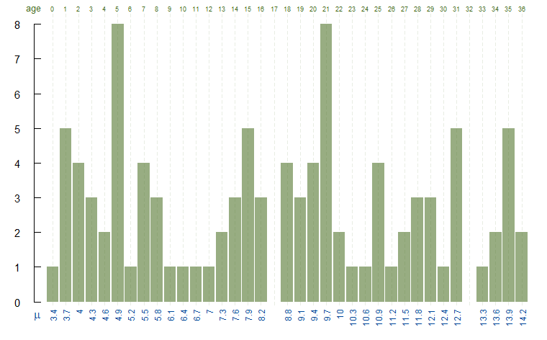
Modelling
Computation
Reproducibility
Application
Linear models
> n = 100 > age = sample(0:36, n, replace = TRUE) > b_0 = 3.4 > b_1 = 0.3 > mu_weight = b_0*1 + b_1*age Number of distinct values: 35 Summary: Min. 1st Qu. Median Mean 3rd Qu. Max. 3.4 5.5 8.8 8.539 10.975 14.2
$${weight}_{n} \sim 𝒩\left({μ=β}_{0}1+β_{1}{age}_{n}, σ\right)$$
Notes:
Let’s see what that actually means.
Take the simplest linear regression model, with a single predictor and a slope and intercept coefficient, and normally distributed noise. This model can be written using standard regression notation as (1). This is equivalent to the sampling involving the residual shown in (2); and can be reduced still further to (3). In R the lm() function implements linear regression using least squares estimation and its formula looks like (4). The glm() function can estimate generalised linear models, but is equivalent to lm() with the default setting that specifies the Gaussian/Normal as the statistical distribution family assumed by the model.

Slide 26
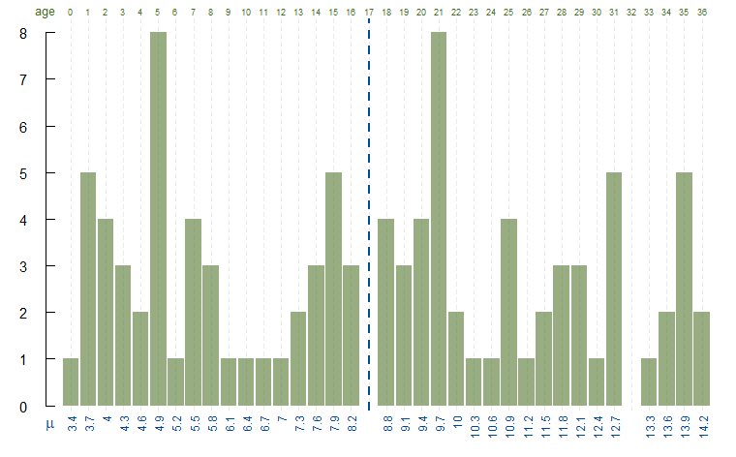
Modelling
Computation
Reproducibility
Application
Linear models
> n = 100 > age = sample(0:36, n, replace = TRUE) > b_0 = 3.4 > b_1 = 0.3 > mu_weight = b_0*1 + b_1*age Number of distinct values: 35 Summary: Min. 1st Qu. Median Mean 3rd Qu. Max. 3.4 5.5 8.8 8.539 10.975 14.2
$${weight}_{n} \sim 𝒩\left({μ=β}_{0}1+β_{1}{age}_{n}, σ\right)$$
Notes:
Let’s see what that actually means.
Take the simplest linear regression model, with a single predictor and a slope and intercept coefficient, and normally distributed noise. This model can be written using standard regression notation as (1). This is equivalent to the sampling involving the residual shown in (2); and can be reduced still further to (3). In R the lm() function implements linear regression using least squares estimation and its formula looks like (4). The glm() function can estimate generalised linear models, but is equivalent to lm() with the default setting that specifies the Gaussian/Normal as the statistical distribution family assumed by the model.

Slide 27
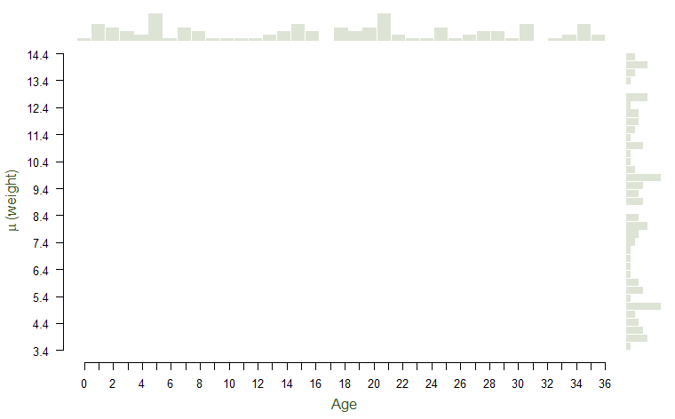
Modelling
Computation
Reproducibility
Application
Linear models
> n = 100 > age = sample(0:36, n, replace = TRUE) > b_0 = 3.4 > b_1 = 0.3 > mu_weight = b_0*1 + b_1*age
$${weight}_{n} \sim 𝒩\left({μ=β}_{0}1+β_{1}{age}_{n}, σ\right)$$
Notes:
Let’s see what that actually means.
Take the simplest linear regression model, with a single predictor and a slope and intercept coefficient, and normally distributed noise. This model can be written using standard regression notation as (1). This is equivalent to the sampling involving the residual shown in (2); and can be reduced still further to (3). In R the lm() function implements linear regression using least squares estimation and its formula looks like (4). The glm() function can estimate generalised linear models, but is equivalent to lm() with the default setting that specifies the Gaussian/Normal as the statistical distribution family assumed by the model.

Slide 28
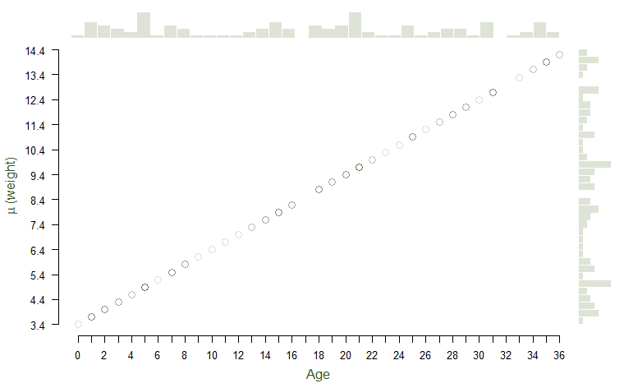
Modelling
Computation
Reproducibility
Application
Linear models
> n = 100 > age = sample(0:36, n, replace = TRUE) > b_0 = 3.4 > b_1 = 0.3 > mu_weight = b_0*1 + b_1*age
$${weight}_{n} \sim 𝒩\left({μ=β}_{0}1+β_{1}{age}_{n}, σ\right)$$
Notes:
Let’s see what that actually means.
Take the simplest linear regression model, with a single predictor and a slope and intercept coefficient, and normally distributed noise. This model can be written using standard regression notation as (1). This is equivalent to the sampling involving the residual shown in (2); and can be reduced still further to (3). In R the lm() function implements linear regression using least squares estimation and its formula looks like (4). The glm() function can estimate generalised linear models, but is equivalent to lm() with the default setting that specifies the Gaussian/Normal as the statistical distribution family assumed by the model.

Slide 29

Modelling
Computation
Reproducibility
Application
Linear models
> n = 100 > age = sample(0:36, n, replace = TRUE) > b_0 = 3.4 > b_1 = 0.3 > mu_weight = b_0*1 + b_1*age > sigma_weight = ...? >
Example
Children’s body weight ($y$) (in kg.) as a function of age ($x$) (in months)
Data = 100 (n) male children aged 0-36 months
$${weight}_{n} \sim 𝒩\left({μ=β}_{0}1+β_{1}{age}_{n}, σ\right)$$
Notes:
Let’s see what that actually means.
Take the simplest linear regression model, with a single predictor and a slope and intercept coefficient, and normally distributed noise. This model can be written using standard regression notation as (1). This is equivalent to the sampling involving the residual shown in (2); and can be reduced still further to (3). In R the lm() function implements linear regression using least squares estimation and its formula looks like (4). The glm() function can estimate generalised linear models, but is equivalent to lm() with the default setting that specifies the Gaussian/Normal as the statistical distribution family assumed by the model.

Slide 30
Modelling
Computation
Reproducibility
Application
Linear models
> n = 100 > age = sample(0:36, n, replace = TRUE) > b_0 = 3.4 > b_1 = 0.3 > mu_weight = b_0*1 + b_1*age > sigma_weight = 0.5 >
Example
Children’s body weight ($y$) (in kg.) as a function of age ($x$) (in months)
Data = 100 (n) male children aged 0-36 months
$${weight}_{n} \sim 𝒩\left({μ=β}_{0}1+β_{1}{age}_{n}, σ\right)$$
Notes:
Let’s see what that actually means.
Take the simplest linear regression model, with a single predictor and a slope and intercept coefficient, and normally distributed noise. This model can be written using standard regression notation as (1). This is equivalent to the sampling involving the residual shown in (2); and can be reduced still further to (3). In R the lm() function implements linear regression using least squares estimation and its formula looks like (4). The glm() function can estimate generalised linear models, but is equivalent to lm() with the default setting that specifies the Gaussian/Normal as the statistical distribution family assumed by the model.

Slide 31
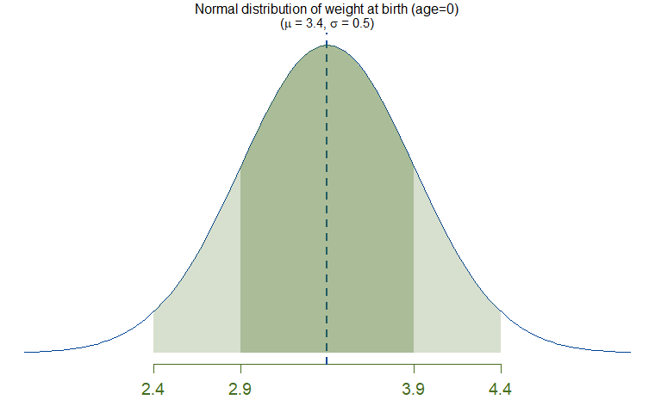

Modelling
Computation
Reproducibility
Application
Linear models
> n = 100 > age = sample(0:36, n, replace = TRUE) > b_0 = 3.4 > b_1 = 0.3 > mu_weight = b_0*1 + b_1*age > sigma_weight = 0.5 >
$${weight}_{n} \sim 𝒩\left({μ=β}_{0}1+β_{1}{age}_{n}, σ\right)$$
Notes:
Let’s see what that actually means.
Take the simplest linear regression model, with a single predictor and a slope and intercept coefficient, and normally distributed noise. This model can be written using standard regression notation as (1). This is equivalent to the sampling involving the residual shown in (2); and can be reduced still further to (3). In R the lm() function implements linear regression using least squares estimation and its formula looks like (4). The glm() function can estimate generalised linear models, but is equivalent to lm() with the default setting that specifies the Gaussian/Normal as the statistical distribution family assumed by the model.

Slide 32
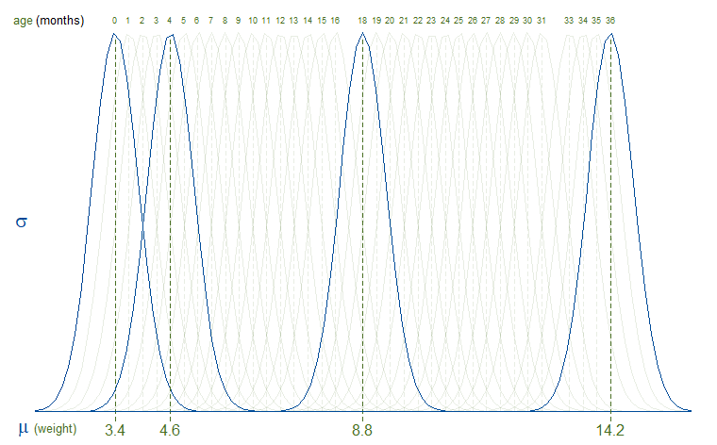

Modelling
Computation
Reproducibility
Application
Linear models
> n = 100 > age = sample(0:36, n, replace = TRUE) > b_0 = 3.4 > b_1 = 0.3 > mu_weight = b_0*1 + b_1*age > sigma_weight = 0.5 >
$${weight}_{n} \sim 𝒩\left({μ=β}_{0}1+β_{1}{age}_{n},σ\right)$$
Notes:
Let’s see what that actually means.
Take the simplest linear regression model, with a single predictor and a slope and intercept coefficient, and normally distributed noise. This model can be written using standard regression notation as (1). This is equivalent to the sampling involving the residual shown in (2); and can be reduced still further to (3). In R the lm() function implements linear regression using least squares estimation and its formula looks like (4). The glm() function can estimate generalised linear models, but is equivalent to lm() with the default setting that specifies the Gaussian/Normal as the statistical distribution family assumed by the model.

Slide 33

Modelling
Computation
Reproducibility
Application
Linear models
> n = 100 > age = sample(0:36, n, replace = TRUE) > b_0 = 3.4 > b_1 = 0.3 > mu_weight = b_0*1 + b_1*age > sigma_weight = 0.5 > weight = rnorm(n, mu_weight, sigma_weight) >
$${weight}_{n} \sim 𝒩\left({μ=β}_{0}1+β_{1}{age}_{n}, σ\right)$$
Notes:
Let’s see what that actually means.
Take the simplest linear regression model, with a single predictor and a slope and intercept coefficient, and normally distributed noise. This model can be written using standard regression notation as (1). This is equivalent to the sampling involving the residual shown in (2); and can be reduced still further to (3). In R the lm() function implements linear regression using least squares estimation and its formula looks like (4). The glm() function can estimate generalised linear models, but is equivalent to lm() with the default setting that specifies the Gaussian/Normal as the statistical distribution family assumed by the model.

Slide 34
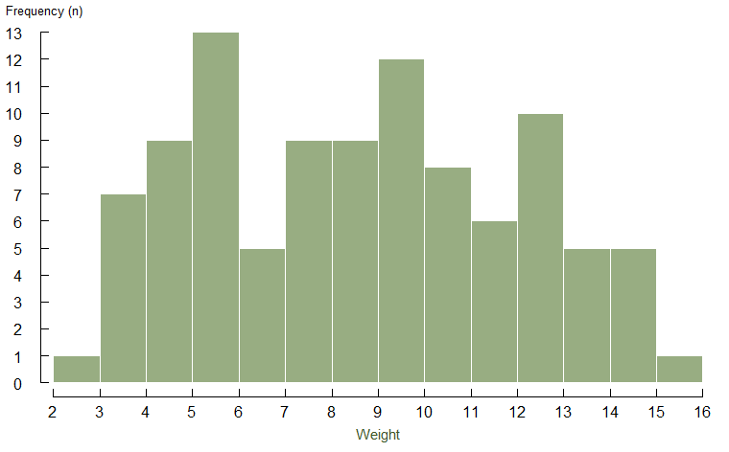

Modelling
Computation
Reproducibility
Application
Linear models
> n = 100 > age = sample(0:36, n, replace = TRUE) > b_0 = 3.4 > b_1 = 0.3 > mu_weight = b_0*1 + b_1*age > sigma_weight = 0.5 > weight = rnorm(n, mu_weight, sigma_weight) Number of distinct values: 100 Summary: Min. 1st Qu. Median Mean 3rd Qu. Max. 2.334 5.594 8.426 8.595 11.350 15.031
$${weight}_{n} \sim 𝒩\left({μ=β}_{0}1+β_{1}{age}_{n}, σ\right)$$
Notes:
Let’s see what that actually means.
Take the simplest linear regression model, with a single predictor and a slope and intercept coefficient, and normally distributed noise. This model can be written using standard regression notation as (1). This is equivalent to the sampling involving the residual shown in (2); and can be reduced still further to (3). In R the lm() function implements linear regression using least squares estimation and its formula looks like (4). The glm() function can estimate generalised linear models, but is equivalent to lm() with the default setting that specifies the Gaussian/Normal as the statistical distribution family assumed by the model.

Slide 35
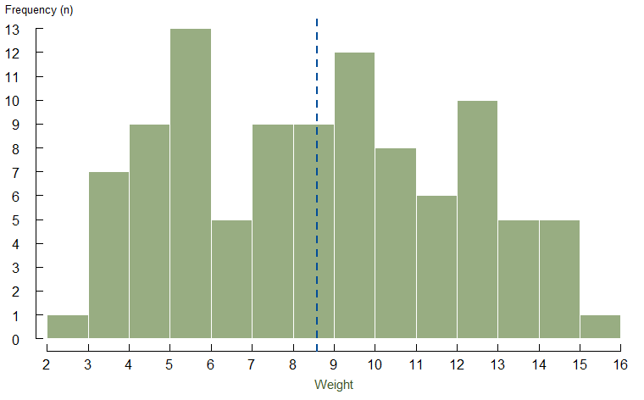
Modelling
Computation
Reproducibility
Application
Linear models
> n = 100 > age = sample(0:36, n, replace = TRUE) > b_0 = 3.4 > b_1 = 0.3 > mu_weight = b_0*1 + b_1*age > sigma_weight = 0.5 > weight = rnorm(n, mu_weight, sigma_weight) Number of distinct values: 100 Summary: Min. 1st Qu. Median Mean 3rd Qu. Max. 2.334 5.594 8.426 8.595 11.350 15.031
$${weight}_{n} \sim 𝒩\left({μ=β}_{0}1+β_{1}{age}_{n}, σ\right)$$
Notes:
Let’s see what that actually means.
Take the simplest linear regression model, with a single predictor and a slope and intercept coefficient, and normally distributed noise. This model can be written using standard regression notation as (1). This is equivalent to the sampling involving the residual shown in (2); and can be reduced still further to (3). In R the lm() function implements linear regression using least squares estimation and its formula looks like (4). The glm() function can estimate generalised linear models, but is equivalent to lm() with the default setting that specifies the Gaussian/Normal as the statistical distribution family assumed by the model.

Slide 36
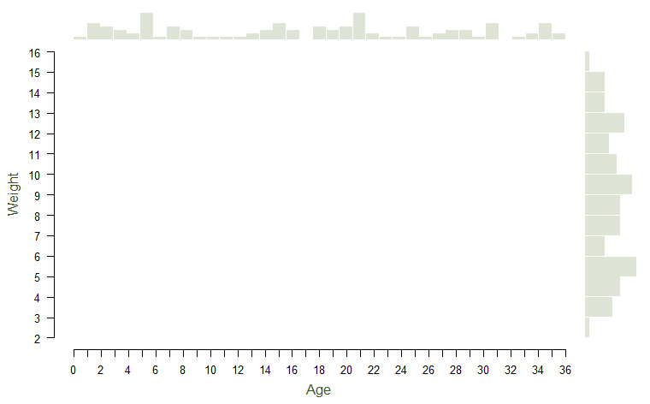

Modelling
Computation
Reproducibility
Application
Linear models
> n = 100 > age = sample(0:36, n, replace = TRUE) > b_0 = 3.4 > b_1 = 0.3 > mu_weight = b_0*1 + b_1*age > sigma_weight = 0.5 > weight = rnorm(n, mu_weight, sigma_weight) >
$${weight}_{n} \sim 𝒩\left({μ=β}_{0}1+β_{1}{age}_{n}, σ\right)$$
Notes:
Let’s see what that actually means.
Take the simplest linear regression model, with a single predictor and a slope and intercept coefficient, and normally distributed noise. This model can be written using standard regression notation as (1). This is equivalent to the sampling involving the residual shown in (2); and can be reduced still further to (3). In R the lm() function implements linear regression using least squares estimation and its formula looks like (4). The glm() function can estimate generalised linear models, but is equivalent to lm() with the default setting that specifies the Gaussian/Normal as the statistical distribution family assumed by the model.

Slide 37
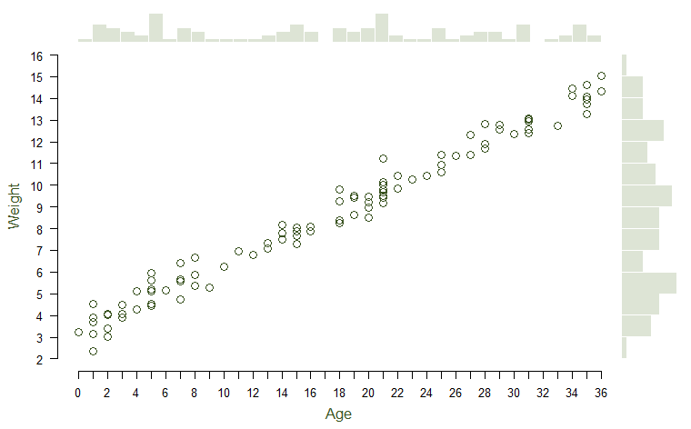
Modelling
Computation
Reproducibility
Application
Linear models
> n = 100 > age = sample(0:36, n, replace = TRUE) > b_0 = 3.4 > b_1 = 0.3 > mu_weight = b_0*1 + b_1*age > sigma_weight = 0.5 > weight = rnorm(n, mu_weight, sigma_weight) >
$${weight}_{n} \sim 𝒩\left({μ=β}_{0}1+β_{1}{age}_{n}, σ\right)$$
Notes:
Let’s see what that actually means.
Take the simplest linear regression model, with a single predictor and a slope and intercept coefficient, and normally distributed noise. This model can be written using standard regression notation as (1). This is equivalent to the sampling involving the residual shown in (2); and can be reduced still further to (3). In R the lm() function implements linear regression using least squares estimation and its formula looks like (4). The glm() function can estimate generalised linear models, but is equivalent to lm() with the default setting that specifies the Gaussian/Normal as the statistical distribution family assumed by the model.

Slide 38
Modelling
Computation
Reproducibility
Application
Linear models
> n = 100 > age = sample(0:36, n, replace = TRUE) > b_0 = 3.4 > b_1 = 0.3 > mu_weight = b_0*1 + b_1*age > sigma_weight = 0.5 > weight = rnorm(n, mu_weight, sigma_weight) > lm(weight ~ 1 + age)
$${weight}_{n} \sim 𝒩\left({μ=β}_{0}1+β_{1}{age}_{n}, σ\right)$$
Notes:
Let’s see what that actually means.
Take the simplest linear regression model, with a single predictor and a slope and intercept coefficient, and normally distributed noise. This model can be written using standard regression notation as (1). This is equivalent to the sampling involving the residual shown in (2); and can be reduced still further to (3). In R the lm() function implements linear regression using least squares estimation and its formula looks like (4). The glm() function can estimate generalised linear models, but is equivalent to lm() with the default setting that specifies the Gaussian/Normal as the statistical distribution family assumed by the model.

Slide 39
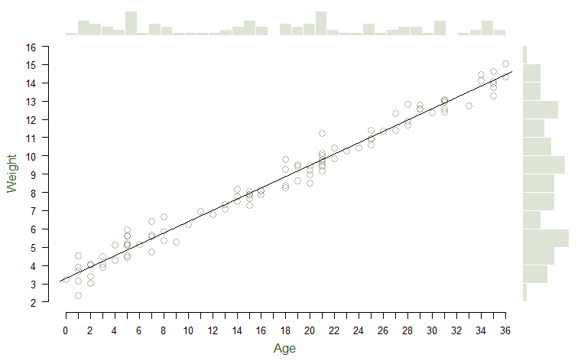
Modelling
Computation
Reproducibility
Application
Linear models
> n = 100 > age = sample(0:36, n, replace = TRUE) > b_0 = 3.4 > b_1 = 0.3 > mu_weight = b_0*1 + b_1*age > sigma_weight = 0.5 > weight = rnorm(n, mu_weight, sigma_weight) > lm(weight ~ 1 + age) |> coefficients() (Intercept) age 3.305786 0.308748
$${weight}_{n} \sim 𝒩\left({μ=β}_{0}1+β_{1}{age}_{n}, σ\right)$$
Notes:
Let’s see what that actually means.
Take the simplest linear regression model, with a single predictor and a slope and intercept coefficient, and normally distributed noise. This model can be written using standard regression notation as (1). This is equivalent to the sampling involving the residual shown in (2); and can be reduced still further to (3). In R the lm() function implements linear regression using least squares estimation and its formula looks like (4). The glm() function can estimate generalised linear models, but is equivalent to lm() with the default setting that specifies the Gaussian/Normal as the statistical distribution family assumed by the model.

Slide 40
Modelling
Computation
Reproducibility
Application
Linear models
> n = 100 > age = sample(0:36, n, replace = TRUE) > b_0 = 3.4 > b_1 = 0.3 > mu_weight = b_0*1 + b_1*age > sigma_weight = 0.5 > weight = rnorm(n, mu_weight, sigma_weight) > glm(weight ~ 1 + age, family = gaussian) |> coefficients() (Intercept) age 3.305786 0.308748
$${weight}_{n} \sim 𝒩\left({μ=β}_{0}1+β_{1}{age}_{n}, σ\right)$$
Notes:
Let’s see what that actually means.
Take the simplest linear regression model, with a single predictor and a slope and intercept coefficient, and normally distributed noise. This model can be written using standard regression notation as (1). This is equivalent to the sampling involving the residual shown in (2); and can be reduced still further to (3). In R the lm() function implements linear regression using least squares estimation and its formula looks like (4). The glm() function can estimate generalised linear models, but is equivalent to lm() with the default setting that specifies the Gaussian/Normal as the statistical distribution family assumed by the model.

Slide 41
Modelling
Computation
Reproducibility
Application
Linear models
> n = 100 > age = sample(0:36, n, replace = TRUE) > b_0 = 3.4 > b_1 = 0.3 > mu_weight = b_0*1 + b_1*age > sigma_weight = 0.5 > weight = rnorm(n, mu_weight, sigma_weight) > glm(weight ~ 1 + age, family = gaussian) |> coefficients() (Intercept) age 3.305786 0.308748
$${weight}_{n} \sim 𝒩\left({μ=β}_{0}1+β_{1}{age}_{n}, σ\right)$$
Notes:
Let’s see what that actually means.
Take the simplest linear regression model, with a single predictor and a slope and intercept coefficient, and normally distributed noise. This model can be written using standard regression notation as (1). This is equivalent to the sampling involving the residual shown in (2); and can be reduced still further to (3). In R the lm() function implements linear regression using least squares estimation and its formula looks like (4). The glm() function can estimate generalised linear models, but is equivalent to lm() with the default setting that specifies the Gaussian/Normal as the statistical distribution family assumed by the model.

Slide 42
Modelling
Computation
Reproducibility
Application
Akaeda (2023) “Trust and the Educational Gap in the Demand for Redistribution: Evidence from the World Values Survey and the European Value Study”. International Sociology 38(3): 290–310
Dawson (2019) “How Persistent Is Generalised Trust?” Sociology 53(3): 590–99
Dingemans and Van Ingen (2015) “Does Religion Breed Trust? A Cross-National Study of the Effects of Religious Involvement, Religious Faith, and Religious Context on Social Trust”. Journal for the Scientific Study of Religion 54(4):739–55
Kumove (2024) “Take Five? Testing the Cultural and Experiential Theories of Generalised Trust Against Five Criteria”. Political Studies
Mitchell (2021) “Social Trust and Anti-immigrant Attitudes in Europe: A Longitudinal Multi-Level Analysis”. Frontiers in Sociology 6: 604884
Österman (2021) ”Can We Trust Education for Fostering Trust? Quasi-Experimental Evidence on the Effect of Education and Tracking on Social Trust”. Social Indicators Research 154(1):211–33
Wilkinson and Pickett (2010) “Income Inequality and Trust”, in Chapter 4 of The Spirit Level: Why Greater Equality Makes Societies Stronger. New York: Bloomsbury Press
Wu (2021) “Education and Social Trust in Global Perspective”. Sociological Perspectives 64(6):1166–86

Slide 43
Linear models
Generalised linear models
Interaction models
Causal models
Multilevel models
Longitudinal models
Akaeda (2023) “Trust and the Educational Gap in the Demand for Redistribution: Evidence from the World Values Survey and the European Value Study”. International Sociology 38(3): 290–310
Dawson (2019) “How Persistent Is Generalised Trust?” Sociology 53(3): 590–99
Dingemans and Van Ingen (2015) “Does Religion Breed Trust? A Cross-National Study of the Effects of Religious Involvement, Religious Faith, and Religious Context on Social Trust”. Journal for the Scientific Study of Religion 54(4):739–55
Kumove (2024) “Take Five? Testing the Cultural and Experiential Theories of Generalised Trust Against Five Criteria”. Political Studies
Mitchell (2021) “Social Trust and Anti-immigrant Attitudes in Europe: A Longitudinal Multi-Level Analysis”. Frontiers in Sociology 6: 604884
Österman (2021) ”Can We Trust Education for Fostering Trust? Quasi-Experimental Evidence on the Effect of Education and Tracking on Social Trust”. Social Indicators Research 154(1):211–33
Wilkinson and Pickett (2010) “Income Inequality and Trust”, in Chapter 4 of The Spirit Level: Why Greater Equality Makes Societies Stronger. New York: Bloomsbury Press
Wu (2021) “Education and Social Trust in Global Perspective”. Sociological Perspectives 64(6):1166–86

Slide 44
Linear models
Generalised linear models
Interaction models
Causal models
Multilevel models
Longitudinal models
Akaeda (2023) “Trust and the Educational Gap in the Demand for Redistribution: Evidence from the World Values Survey and the European Value Study”. International Sociology 38(3): 290–310
Dawson (2019) “How Persistent Is Generalised Trust?” Sociology 53(3): 590–99
Dingemans and Van Ingen (2015) “Does Religion Breed Trust? A Cross-National Study of the Effects of Religious Involvement, Religious Faith, and Religious Context on Social Trust”. Journal for the Scientific Study of Religion 54(4):739–55
Kumove (2024) “Take Five? Testing the Cultural and Experiential Theories of Generalised Trust Against Five Criteria”. Political Studies
Mitchell (2021) “Social Trust and Anti-immigrant Attitudes in Europe: A Longitudinal Multi-Level Analysis”. Frontiers in Sociology 6: 604884
Österman (2021) ”Can We Trust Education for Fostering Trust? Quasi-Experimental Evidence on the Effect of Education and Tracking on Social Trust”. Social Indicators Research 154(1):211–33
Wilkinson and Pickett (2010) “Income Inequality and Trust”, in Chapter 4 of The Spirit Level: Why Greater Equality Makes Societies Stronger. New York: Bloomsbury Press
Wu (2021) “Education and Social Trust in Global Perspective”. Sociological Perspectives 64(6):1166–86

Slide 45
Linear models
Generalised linear models
Interaction models
Causal models
Multilevel models
Longitudinal models
Akaeda (2023) “Trust and the Educational Gap in the Demand for Redistribution: Evidence from the World Values Survey and the European Value Study”. International Sociology 38(3): 290–310
Dawson (2019) “How Persistent Is Generalised Trust?” Sociology 53(3): 590–99
Dingemans and Van Ingen (2015) “Does Religion Breed Trust? A Cross-National Study of the Effects of Religious Involvement, Religious Faith, and Religious Context on Social Trust”. Journal for the Scientific Study of Religion 54(4):739–55
Kumove (2024) “Take Five? Testing the Cultural and Experiential Theories of Generalised Trust Against Five Criteria”. Political Studies
Mitchell (2021) “Social Trust and Anti-immigrant Attitudes in Europe: A Longitudinal Multi-Level Analysis”. Frontiers in Sociology 6: 604884
Österman (2021) ”Can We Trust Education for Fostering Trust? Quasi-Experimental Evidence on the Effect of Education and Tracking on Social Trust”. Social Indicators Research 154(1):211–33
Wilkinson and Pickett (2010) “Income Inequality and Trust”, in Chapter 4 of The Spirit Level: Why Greater Equality Makes Societies Stronger. New York: Bloomsbury Press
Wu (2021) “Education and Social Trust in Global Perspective”. Sociological Perspectives 64(6):1166–86

Slide 46

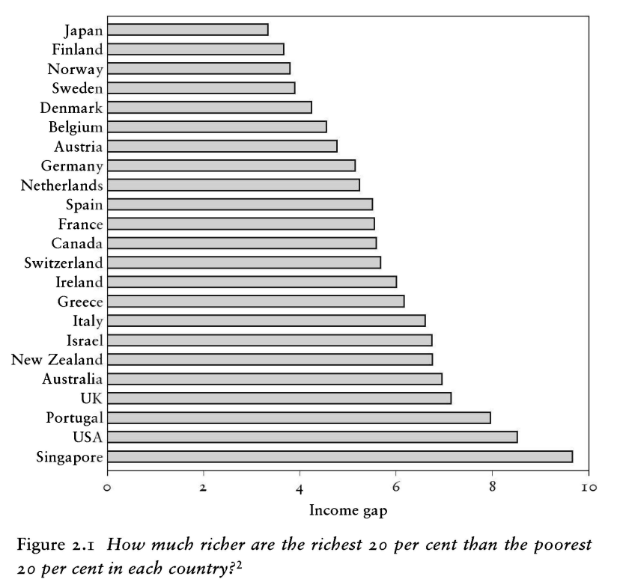
“The spirit level” (2010)

Slide 47
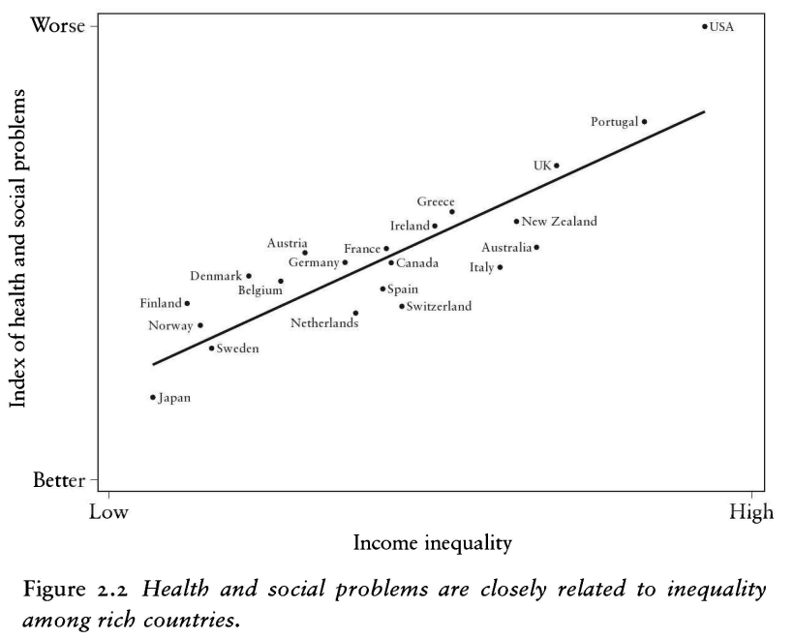
“The spirit level” (2010)

Slide 48
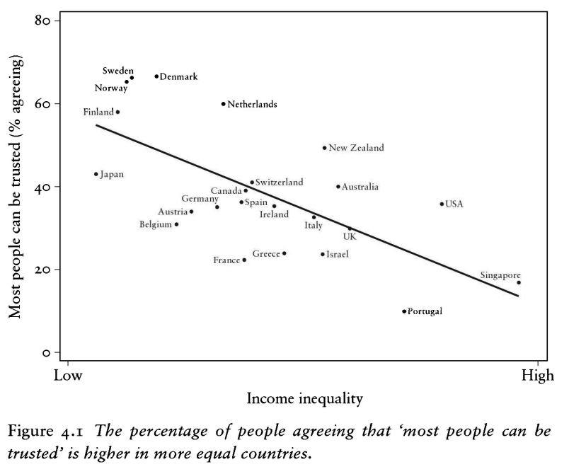
“The spirit level” (2010)

Slide 49

“The spirit level” (2010)

Slide 50
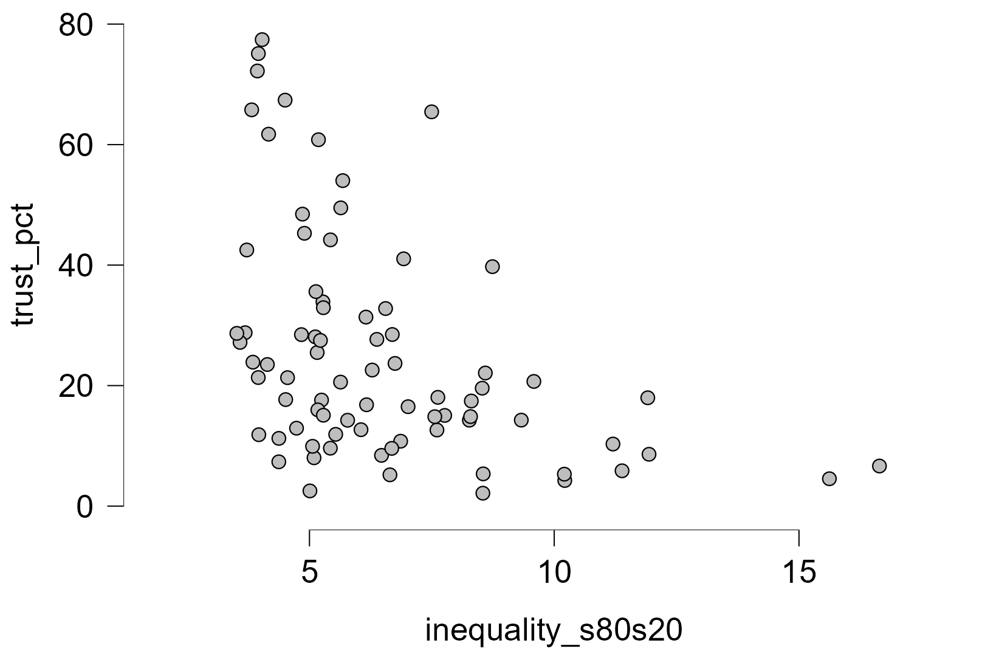
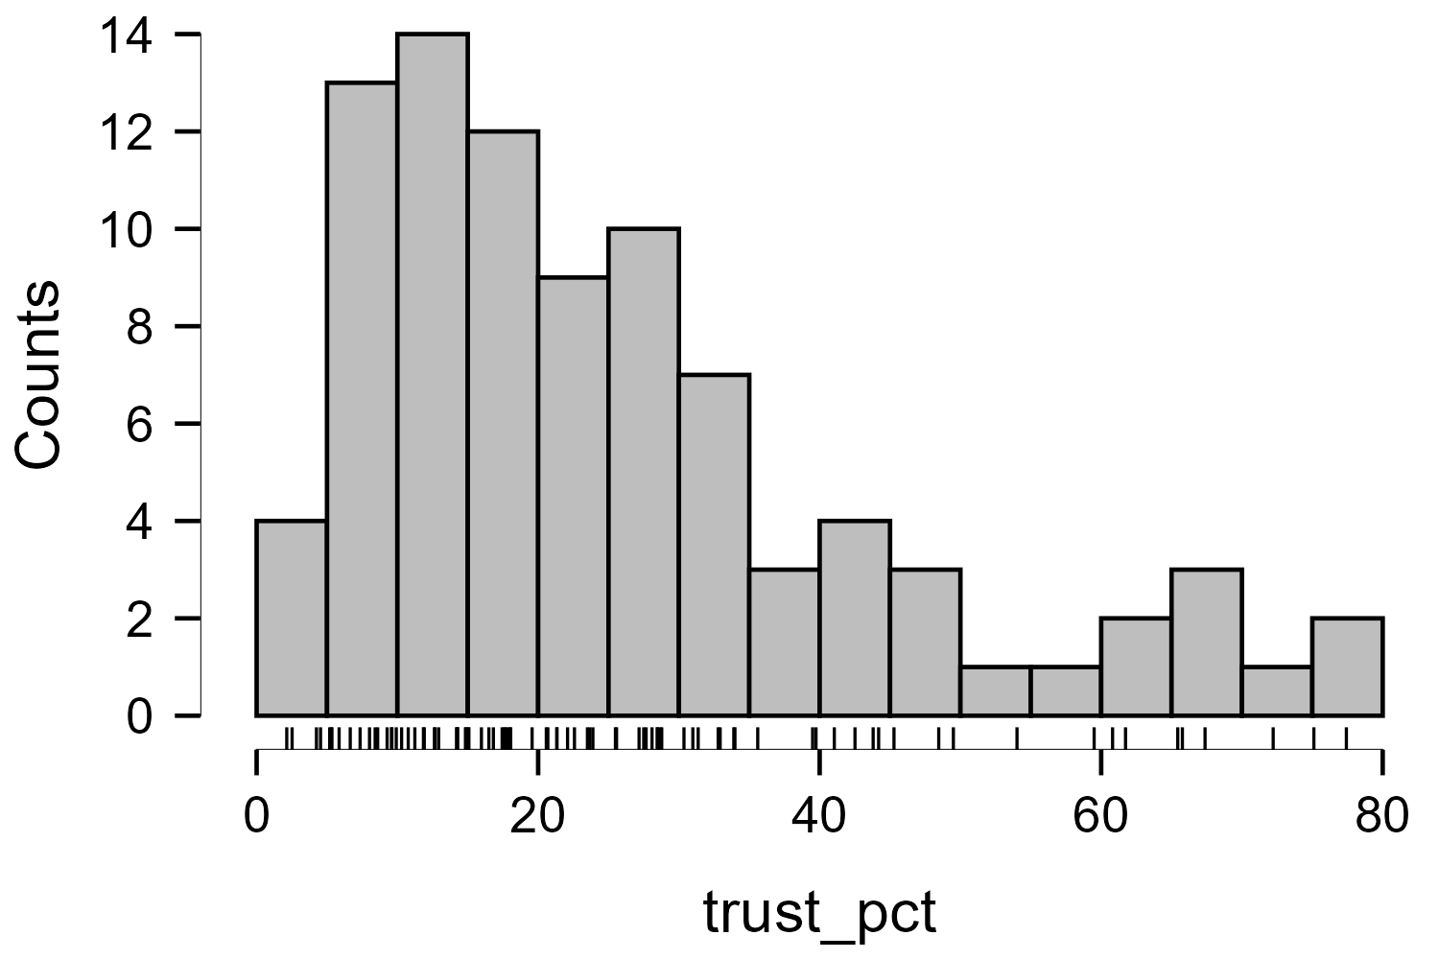
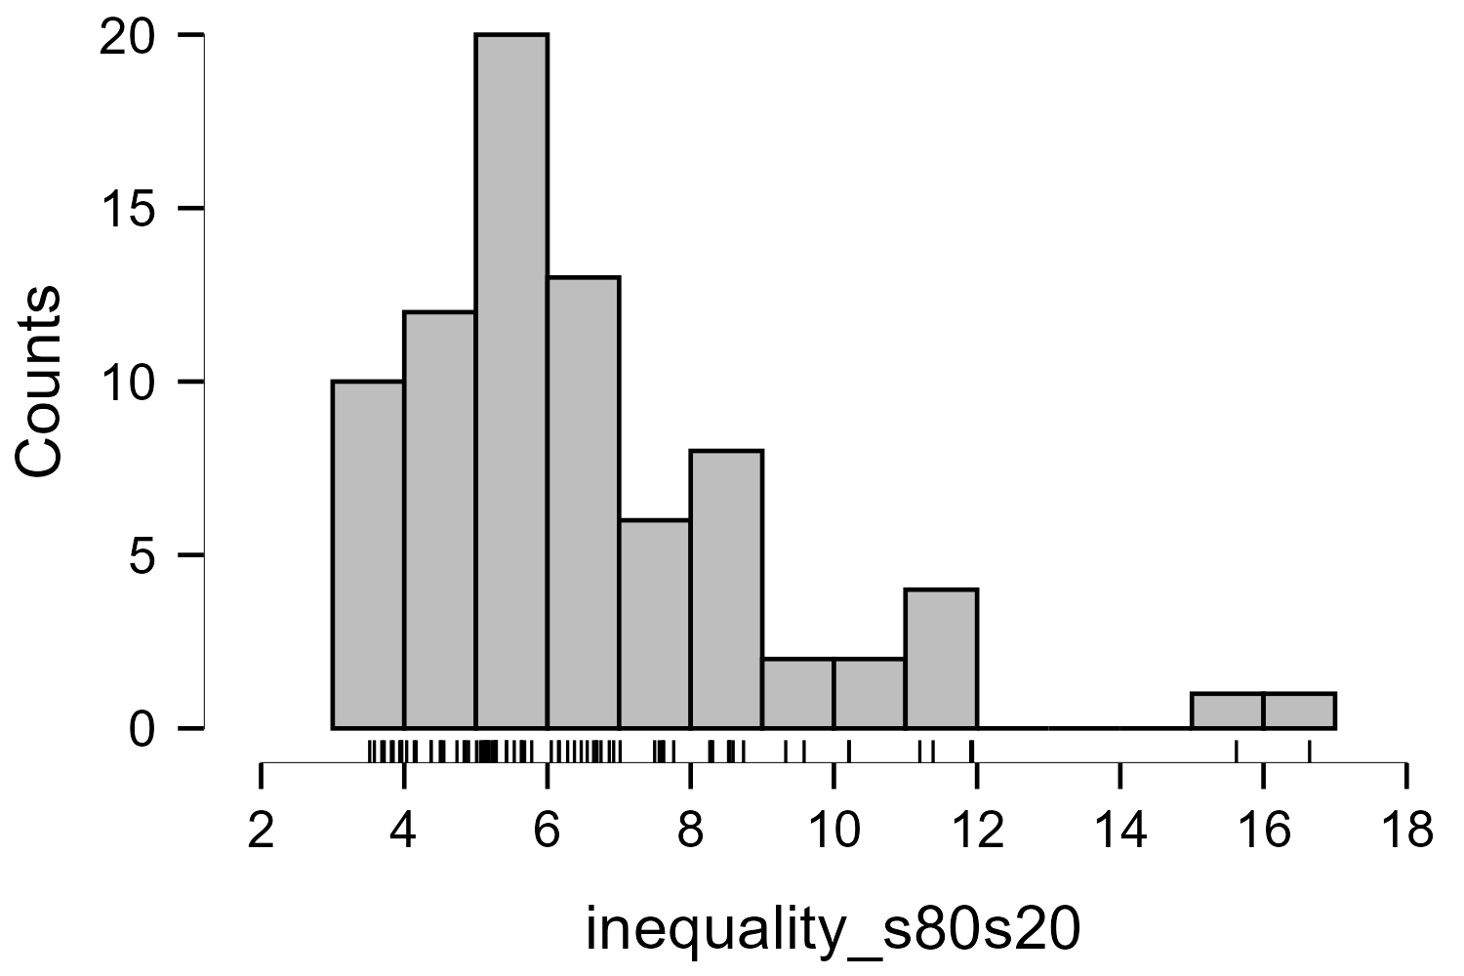
Inequality ←→ Social trust
Descriptive Statistics
 | trust_pct | inequality_s80s20
Valid | 89 | 79
Missing | 0 | 10
Mean | 25.731 | 6.504
Std. Deviation | 18.406 | 2.597
Minimum | 2.140 | 3.517
Maximum | 77.420 | 16.644

Slide 51
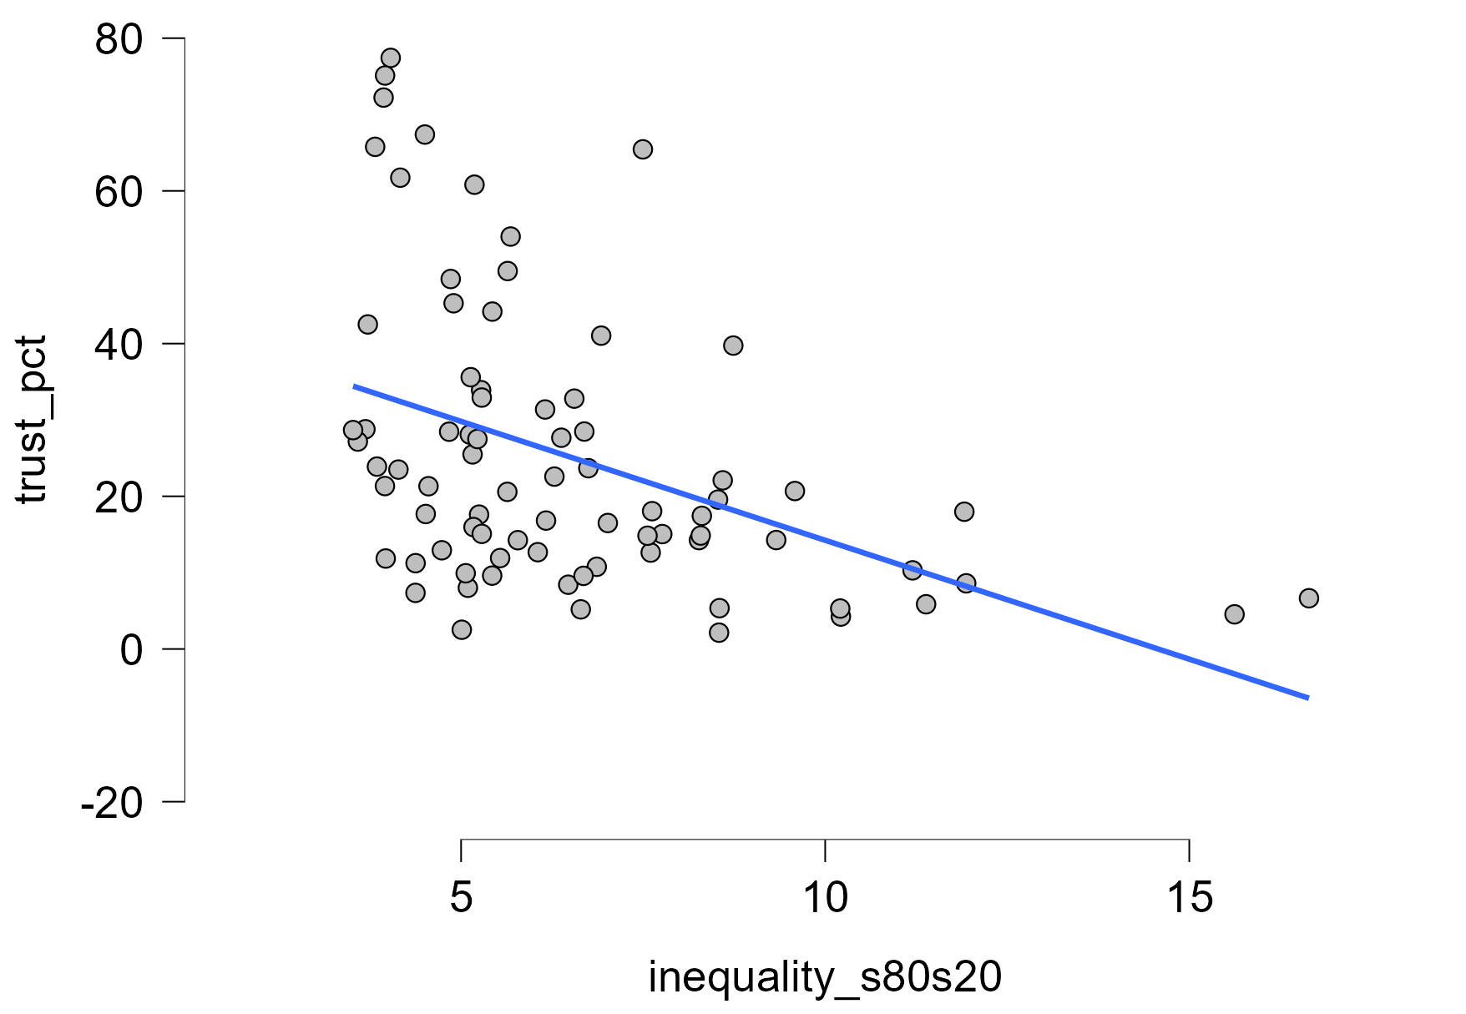
Inequality → Social trust
Descriptive Statistics
 | trust_pct | inequality_s80s20
Valid | 89 | 79
Missing | 0 | 10
Mean | 25.731 | 6.504
Std. Deviation | 18.406 | 2.597
Minimum | 2.140 | 3.517
Maximum | 77.420 | 16.644

Slide 52
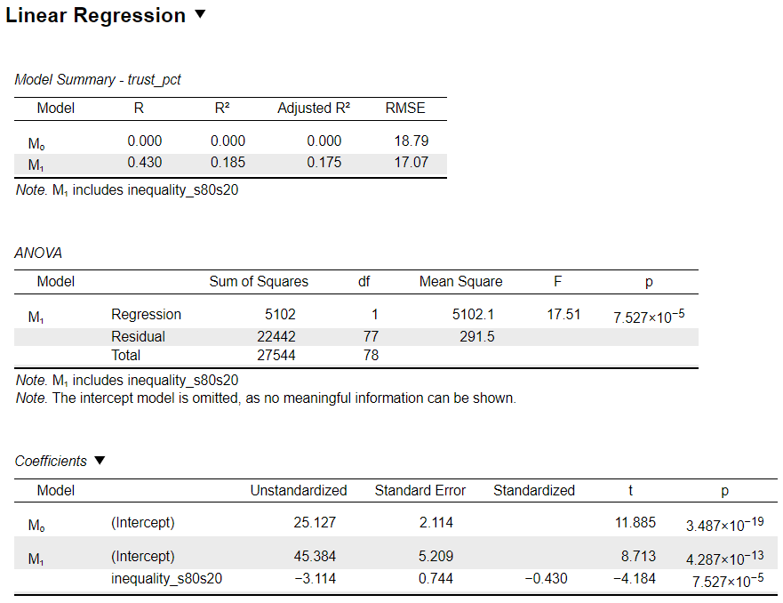
Inequality → Social trust

Slide 53
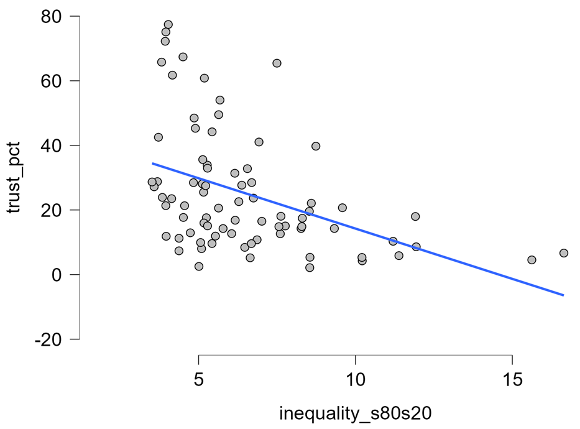
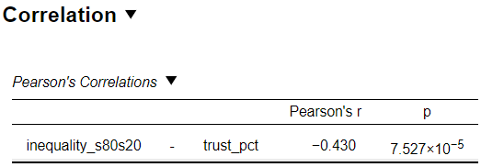
Inequality ←→ Social trust

Slide 54
Inequality → Social trust

Slide 55
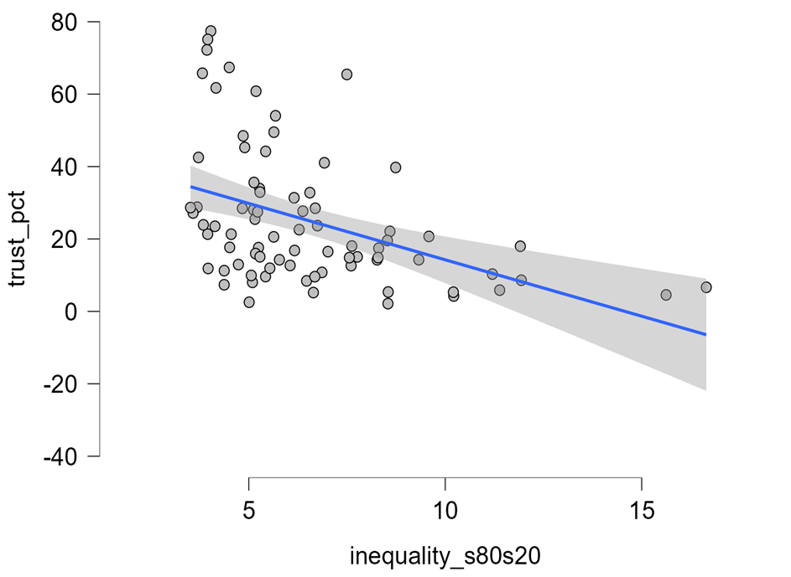
Inequality → Social trust

Slide 56
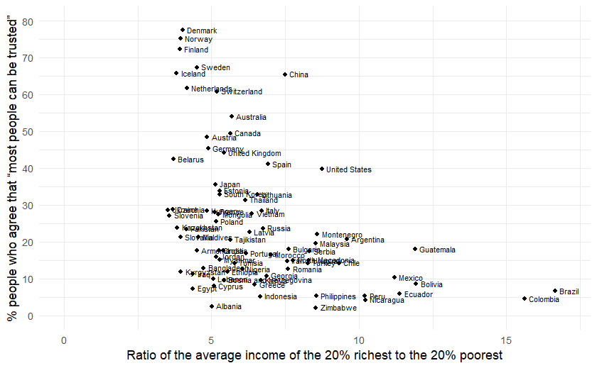
“The spirit level” (2010)

Slide 57
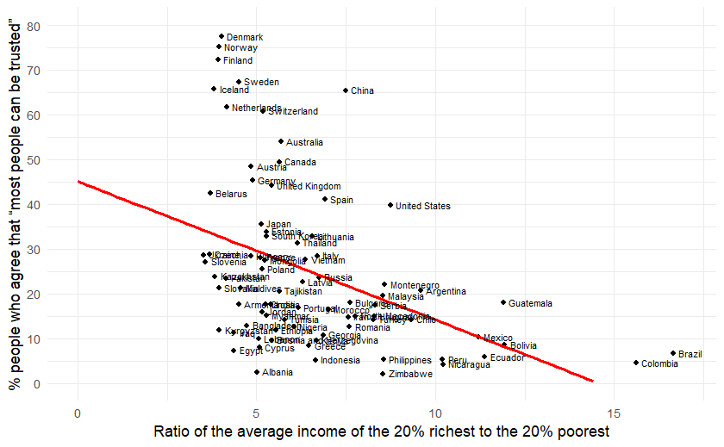
“The spirit level” (2010)

Slide 58
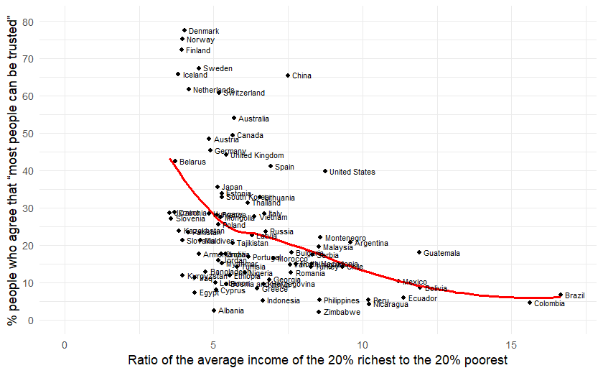
“The spirit level” (2010)

Slide 59
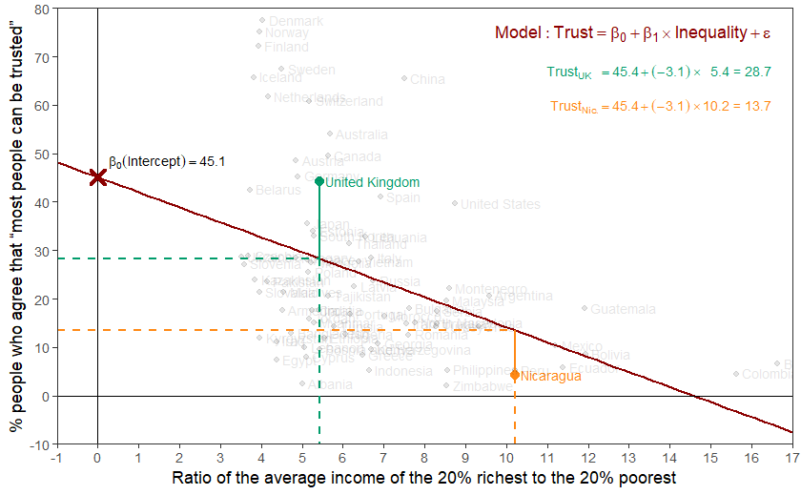
“The spirit level” (2010)

Slide 60
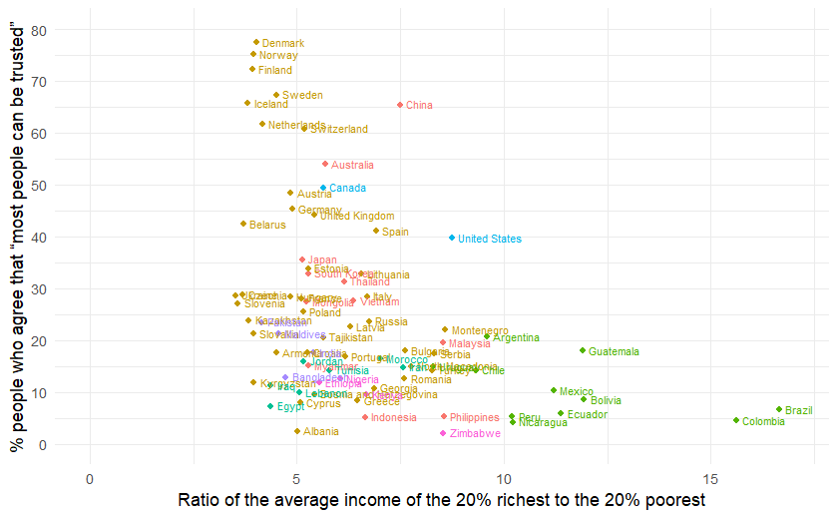
“The spirit level” (2010)

Slide 61
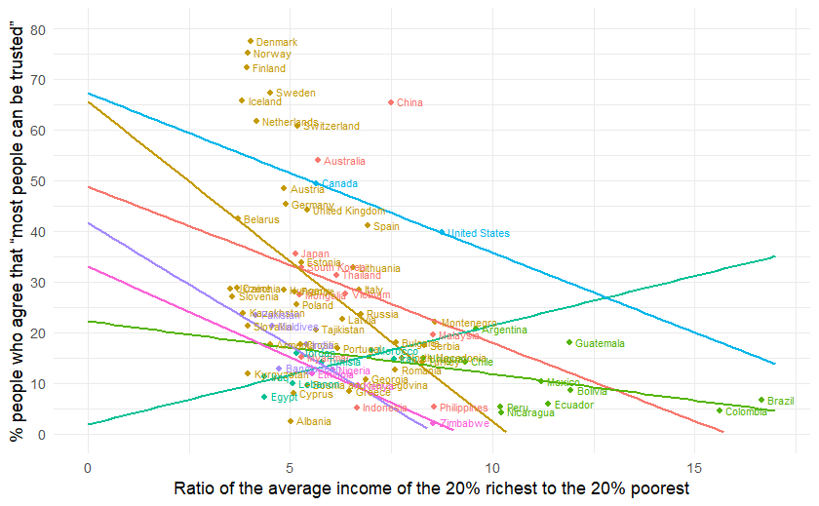
“The spirit level” (2010)

Slide 62
describe_distribution(inequality)
Variable | Mean | SD | IQR | Range | Skewness | Kurtosis | n | n_Missing ------------------------------------------------------------------------------------------------------------ trust_pct | 25.73 | 18.41 | 21.14 | [2.14, 77.42] | 1.13 | 0.62 | 89 | 0 GDPpercap2 | 27447.01 | 21342.56 | 28284.55 | [1987.97, 1.23e+05] | 1.62 | 4.20 | 86 | 3 pop | 5.78e+07 | 1.58e+08 | 4.68e+07 | [73837.00, 1.40e+09] | 7.32 | 61.13 | 87 | 2 urban_pop_pct | 67.92 | 18.93 | 25.93 | [20.31, 100.00] | -0.49 | -0.38 | 87 | 2 inc_top20 | 42.69 | 5.09 | 6.80 | [34.56, 57.35] | 0.86 | 0.42 | 79 | 10 inc_bottom20 | 7.15 | 1.62 | 2.32 | [3.45, 10.08] | -0.19 | -0.69 | 79 | 10 s80s20 | 6.50 | 2.60 | 2.79 | [3.52, 16.64] | 1.67 | 3.50 | 79 | 10

Slide 63
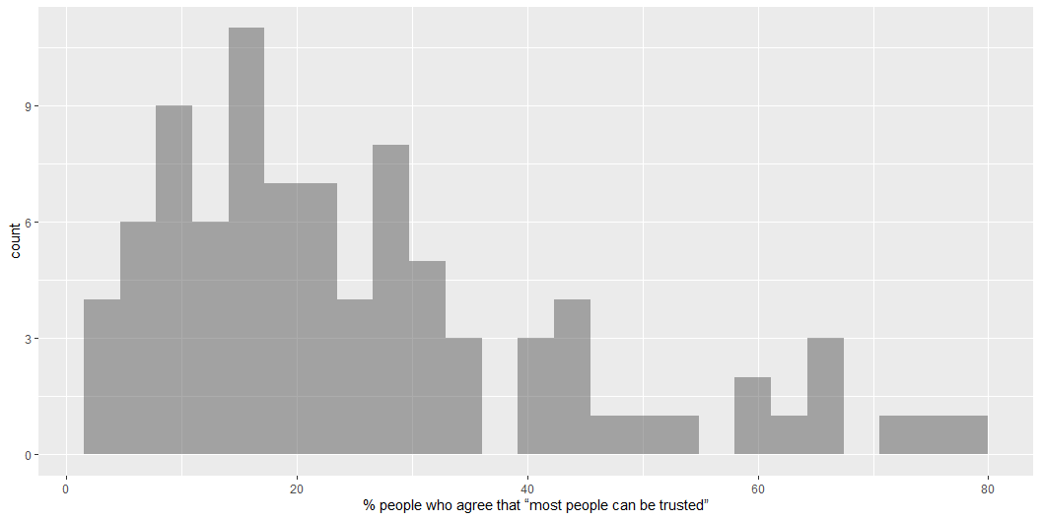
gf_histogram( ~ trust_pct, data = inequality)

Slide 64
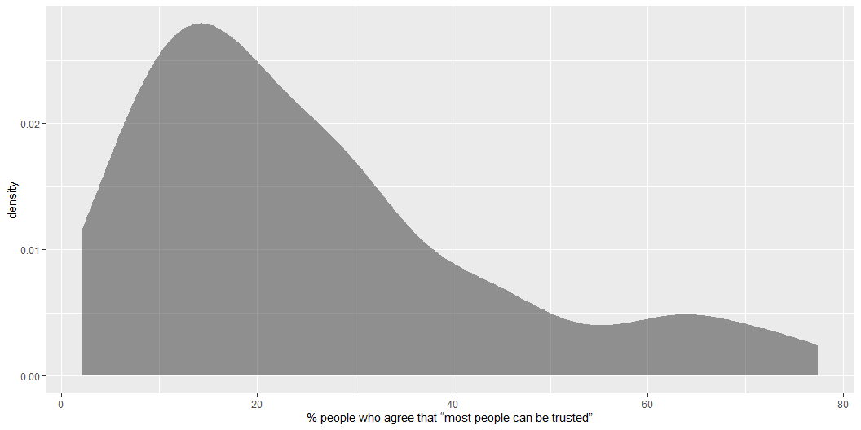
gf_density( ~ trust_pct, data = inequality)

Slide 65
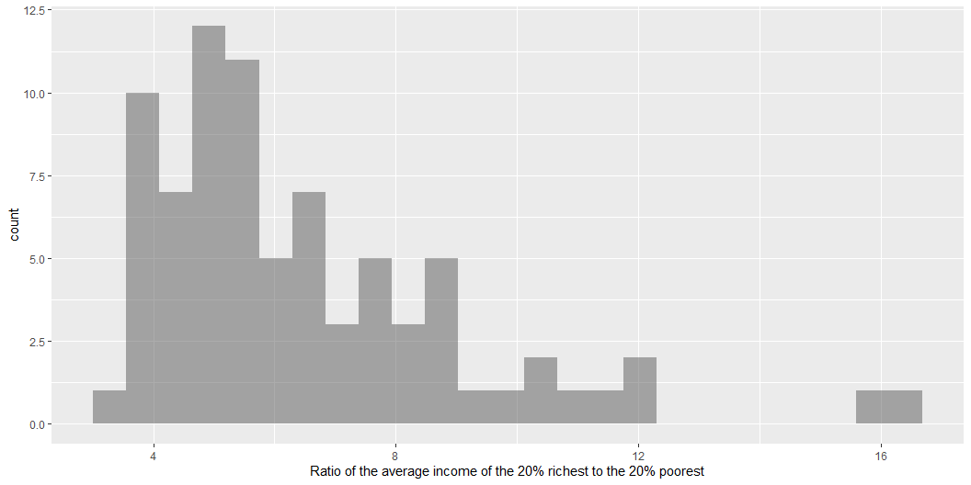
gf_histogram( ~ s80s20, data = inequality)

Slide 66
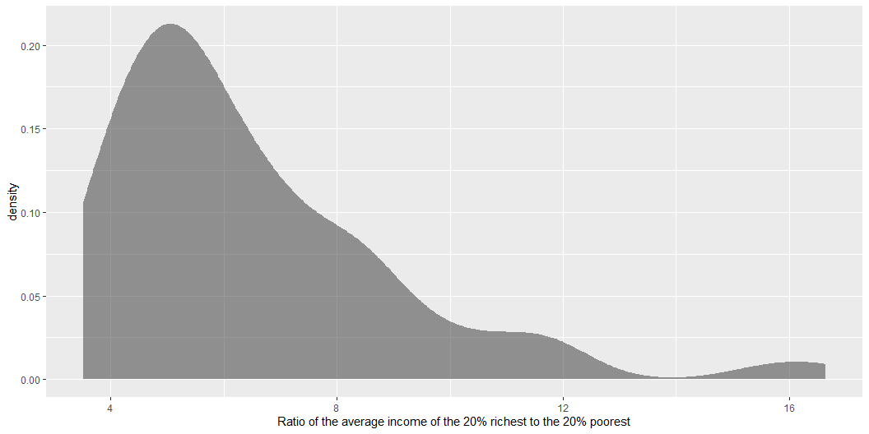
gf_density( ~ s80s20, data = inequality)

Slide 67
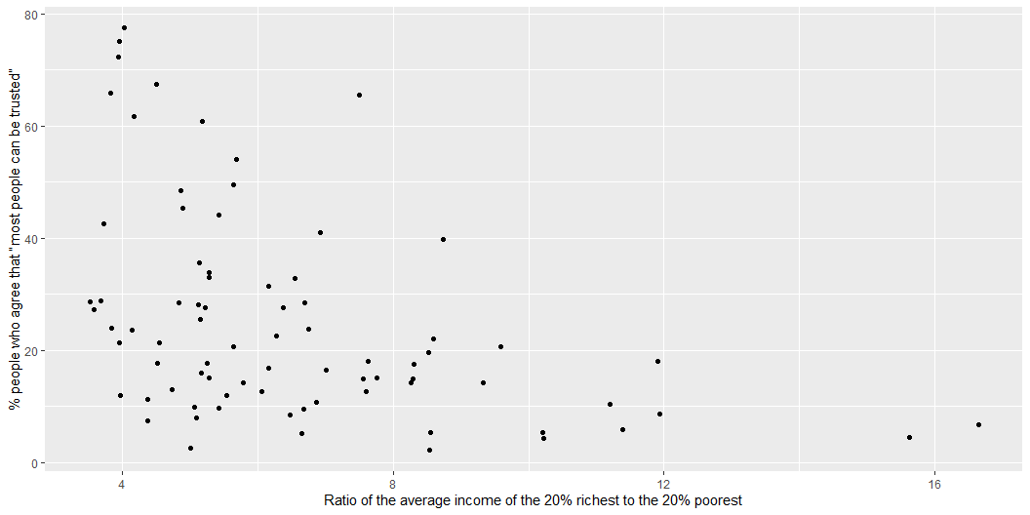

Slide 68
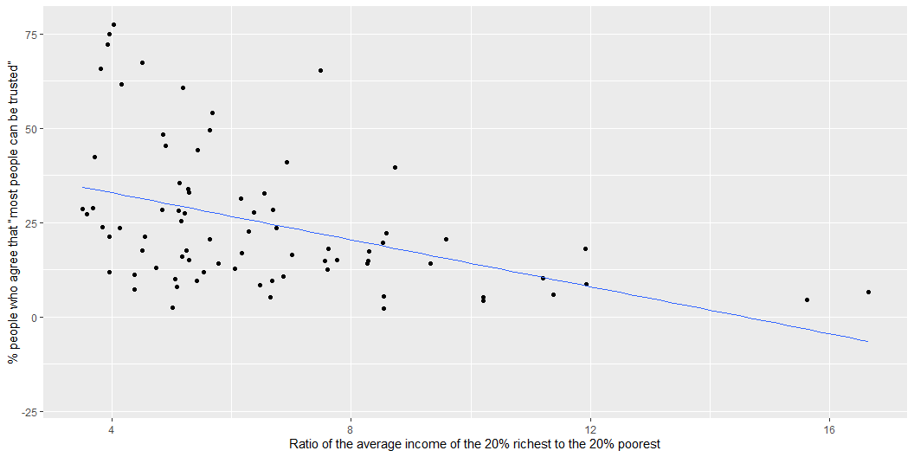

Slide 69
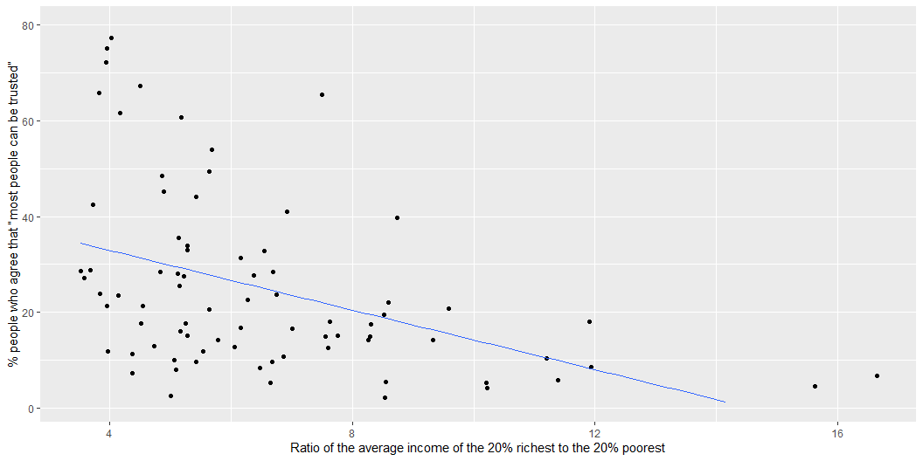

Slide 70
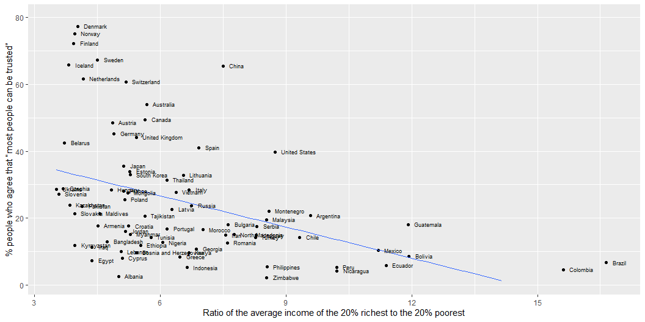

Slide 71
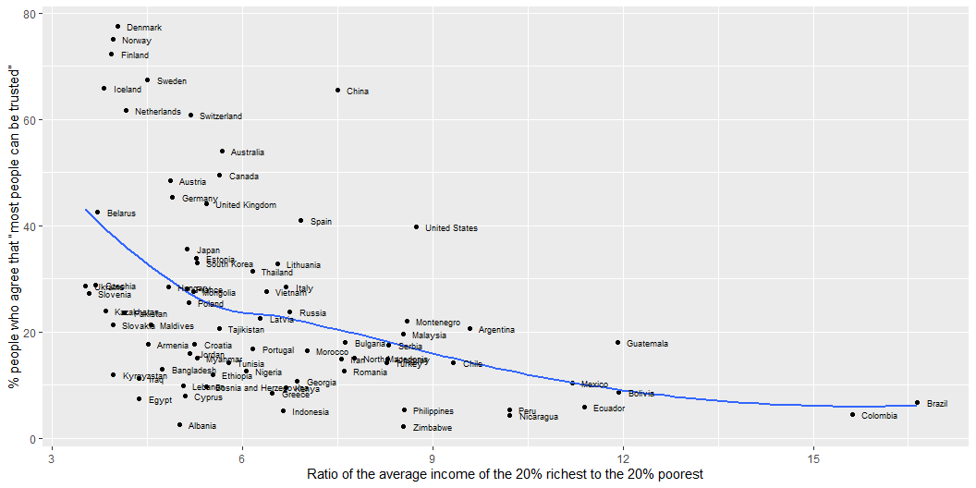

Slide 72
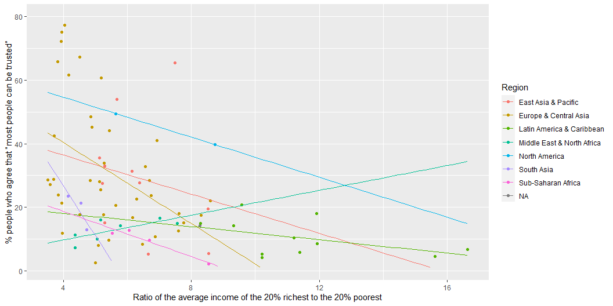

Slide 73
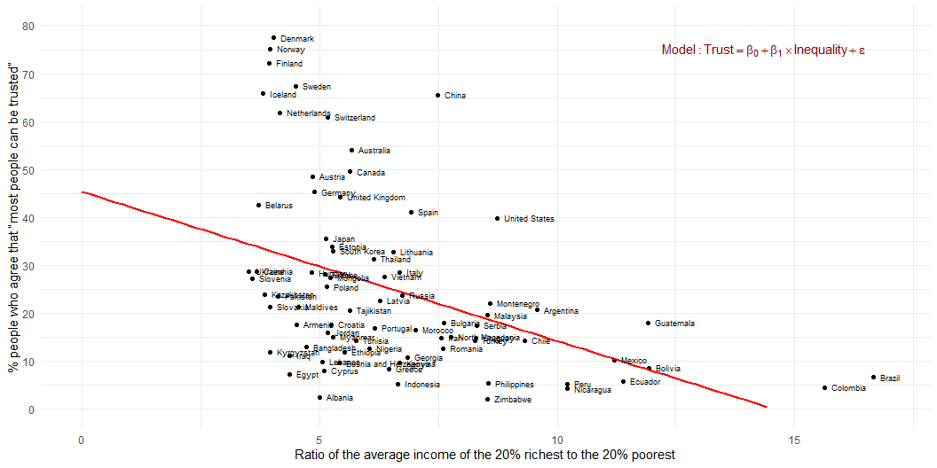
Estimation
Association between inequality and social trust at cross-national comparative level (W3Ex1) (Wilkinson and Pickett 2010)

Slide 74
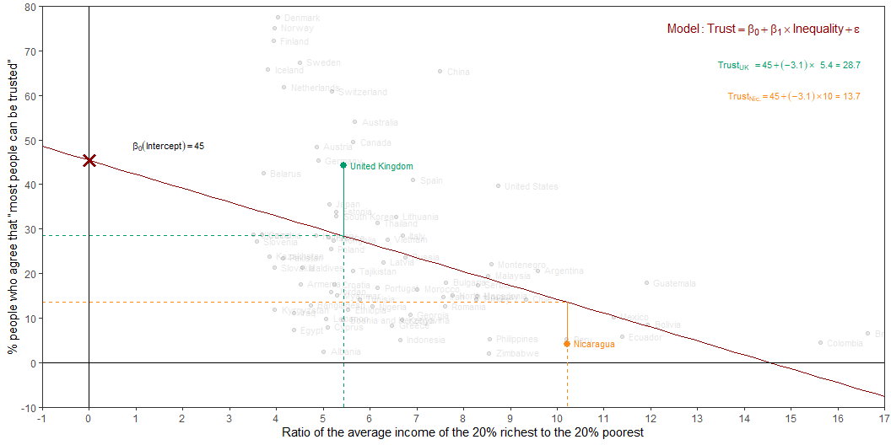
Estimation
Intercept: Social trust in countries with 0 inequality is expected to be 45.4 on average.
Slope: For each additional point increase in Inequality, the model predicts the level of social trust to be lower, on average, by 3.1 points.

Slide 75
From (sample) estimation to (population) inference
For each additional point increase in Inequality, the model predicts the level of social trust to be lower, on average, by 3.1 points
This estimate is valid for the single sample of the countries in the model
But what if we’re not interested in quantifying the relationship between Inequality and Trust in only this sample?
What if we want to say something about the relationship between these variables for all the countries in the world?

Slide 76
Statistical inference
Statistical inference allows provide methods and tools for us to use the single sample we have observed to make valid statements (inferences) about the population it comes from
For our inferences to be valid, the sample should be random and representative of the population we’re interested in

Slide 77

Inference for simple linear regression
Calculate a confidence interval for the slope, $β_{1}$
Conduct a hypothesis test for the interval, $β_{1}$

Slide 78

Confidence interval for the slope
Confidence interval: Provide a plausible range of values for $β_{1}$ at a given confidence level.
Using only a single point estimate is like fishing in a murky lake with a spear, and using a confidence interval is like fishing with a net
We can throw a spear where we saw a fish but we will probably miss, if we toss a net in that area, we have a good chance of catching the fish
Similarly, if we report a point estimate, we probably will not hit the exact population parameter, but if we report a range of plausible values we have a good shot at capturing the parameter

Slide 79
Quantify the variability of the slope
Two approaches:
Via simulation
Via mathematical models
Bootstrapping to quantify the variability of the slope for the purpose of estimation:
Bootstrap new samples from the original sample
Fit models to each of the samples and estimate the slope
Use features of the distribution of the bootstrapped slopes to construct a confidence interval

Slide 80

Hypothesis test for the slope
“Do the data provide sufficient evidence that $β_{1}$ (the true slope for the population) is different from 0?”
Null hypothesis - $H_{0}:β_{1}=0$, there is no linear relationship between inequality and trust
Alternative hypothesis - $H_{A}:β_{1}≠0$, there is a linear relationship between inequality and trust

Slide 81

Hypothesis testing framework
Start with a null hypothesis, $H_{0}$ that represents the status quo
Set an alternative hypothesis, $H_{A}$ that represents the research question, i.e. what we’re testing for
Conduct a hypothesis test under the assumption that the null hypothesis is true and calculate a p-value (probability of observed or more extreme outcome given that the null hypothesis is true)
if the test results suggest that the data do not provide convincing evidence for the alternative hypothesis, stick with the null hypothesis
if they do, then reject the null hypothesis in favour of the alternative

Slide 82


Slide 83
What is a ‘best’ line?
The same regression line could represent very different relationships
Source: F. J. Anscombe (1973). Graphs in Statistical Analysis. The American Statistician, 27(1):17-21. If you have access to JSTOR you can get the article at the following link: http://www.jstor.org/stable/2682899

Slide 84


Slide 85


Slide 86


Slide 87


Slide 88


Slide 89


Slide 90


Slide 91

The “slope” coefficient; rather weak, but more years of education completed is associated with higher levels of social trust
p-value; very small; smaller than 0.001, and definitely smaller than 0.05 (for what it’s worth)
Conclusion:
One’s education appears to have an impact on their level of social trust. Each additional year of completed formal education is associated with a 0.105-point increase on the measured “social trust” scale. Based on the p-value (<0.001), we reject the null-hypothesis that this relationship would appear in our data by chance only, and provisionally accept that education affects social trust in the wider EU population.

Slide 92


Slide 93

The “slope” coefficient; rather weak, but being older is associated with higher levels of social trust
p-value; very small; smaller than 0.001, and definitely smaller than 0.05 (for what it’s worth)
Conclusion:
One’s age appears to have an impact on their level of social trust. This association is weak in substantive terms. Each additional year of age is associated with a 0.006-point increase on the measured “social trust” scale. Based on the p-value (<0.001), we reject the null-hypothesis that this relationship would appear in our data by chance only, and provisionally accept that age affects social trust in the wider EU population.

Slide 94


Slide 95

The “slope” coefficient; very weak, but being a woman is associated with higher levels of social trust compared to being a man
p-value; it runs on a 0-1 scale, so 0.58 (i.e. 58%) is very high, and much much higher than 0.05 (for what it’s worth)
Conclusion:
One’s sex doesn’t appear to have an impact on their level of social trust. The average score of women on the social trust scale is merely 0.008 points higher than that of men. Based on the p-value (0.58), we cannot reject the null-hypothesis that the difference between men and women in the wider EU population is in fact equal to 0 (as opposed to 0.008). There is in fact a probability of 0.58 (or 58%) that we would be wrong in rejecting the null-hypothesis. In conclusion, we don’t have evidence to suggest that sex is associated with differences in levels of social trust.

Slide 96


Slide 97


$$\hat{Y}=β_{0}+β_{1}X_{1}+β_{2}X_{2}+…$$
$$+β_{p}X_{p}$$
X1
X2
X3
60%
unexplained

Slide 98

We are now interpreting each “slope” coefficient, keeping in mind that they represent the effect of that variable while keeping constant (eliminating) the effect of the other variables in the model
p-value; small!; smaller than 0.01; note that this has changed compared to the previous model; now, once we also account for education and age (i.e. keeping the effect of those variables constant, one’s sex seems to have an impact on their level of social trust
Conclusion:
In a statistical model that predicts levels of social trust from education, age and gender, we find that all three predictors are associated with social trust. Having more education, being older and being a woman is associated with higher levels of social trust.
This is now the p-value for the entire model

