Slide 2
Linear models
Generalised linear models
Interaction models
Multilevel models
Causal models
Longitudinal models
Week 3
Curves
Generalised linear models

Slide 3
Review of multiple linear regression

Slide 4
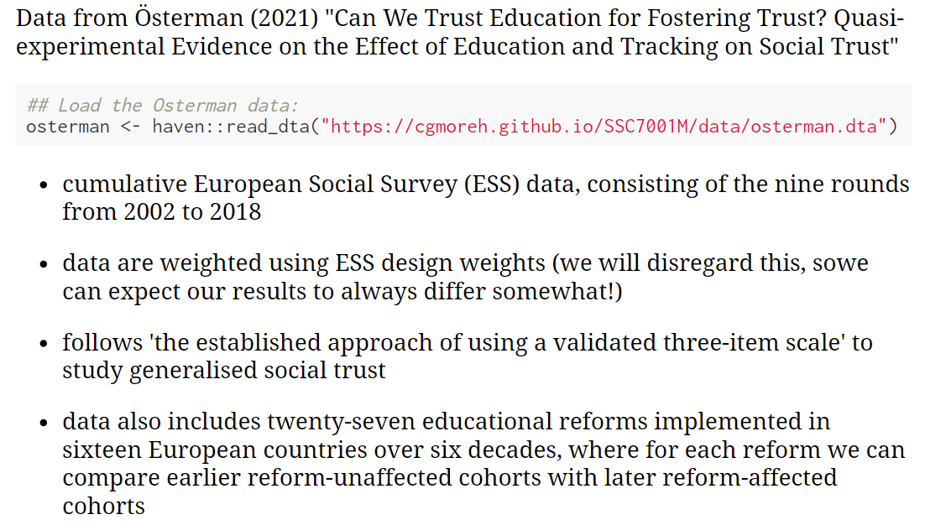

Slide 5
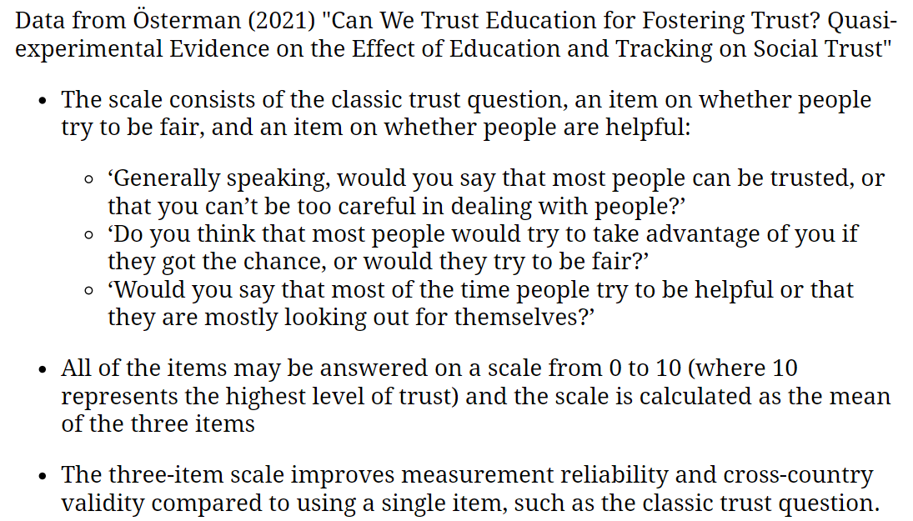

Slide 6
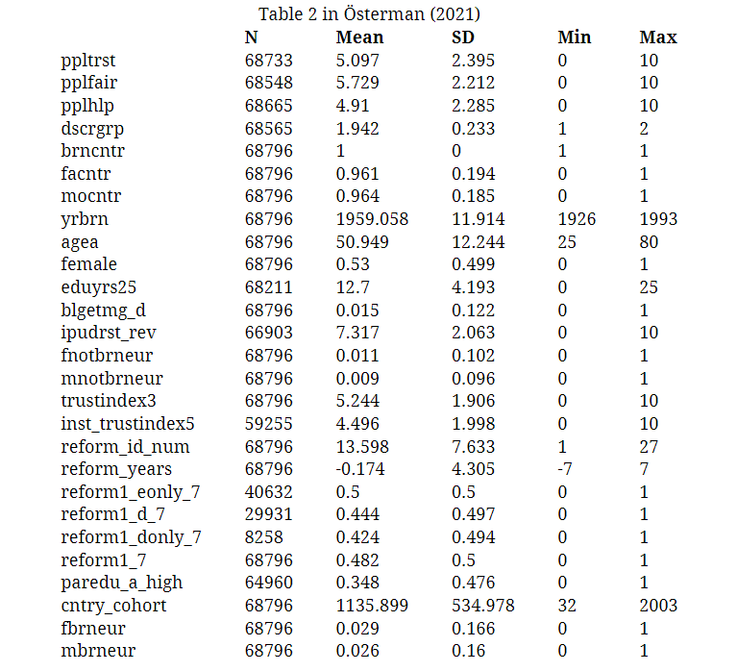

Slide 7
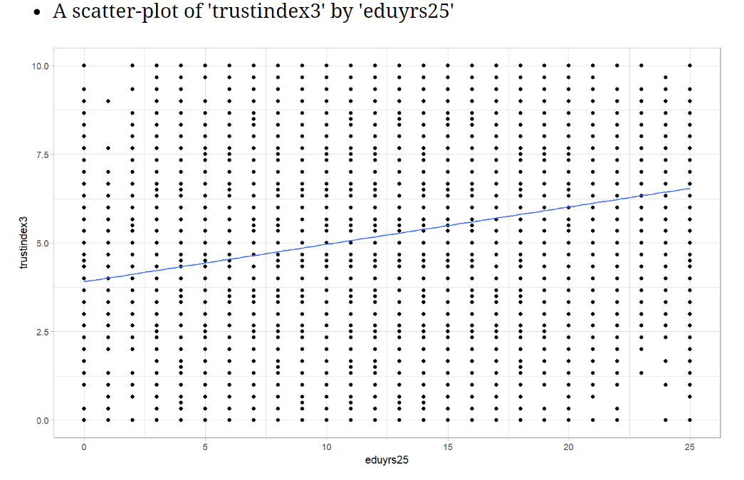

Slide 8
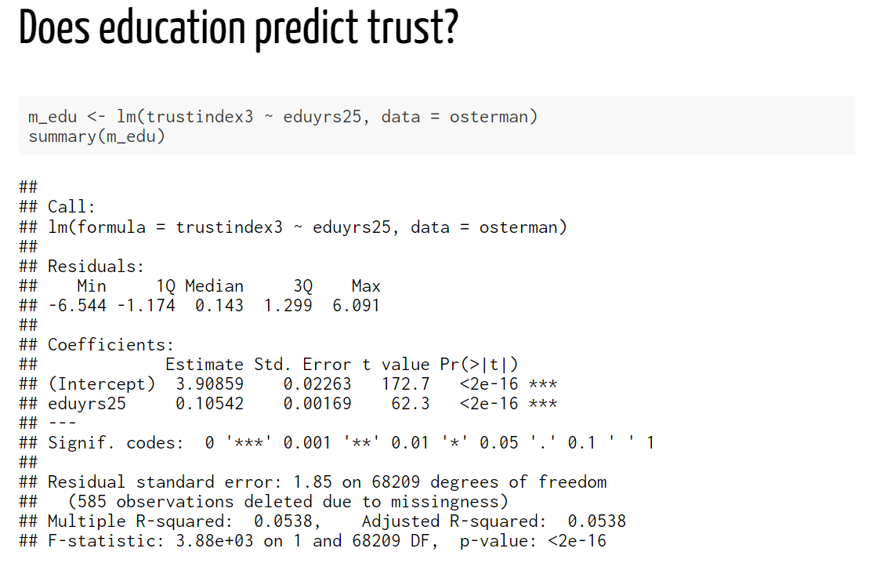
The “slope” coefficient; rather weak, but more years of education completed is associated with higher levels of social trust
p-value; very small; smaller than 0.001, and definitely smaller than 0.05 (for what it’s worth)
Conclusion:
One’s education appears to have an impact on their level of social trust. Each additional year of completed formal education is associated with a 0.105-point increase on the measured “social trust” scale. Based on the p-value (<0.001), we reject the null-hypothesis that this relationship would appear in our data by chance only, and provisionally accept that education affects social trust in the wider EU population.

Slide 9
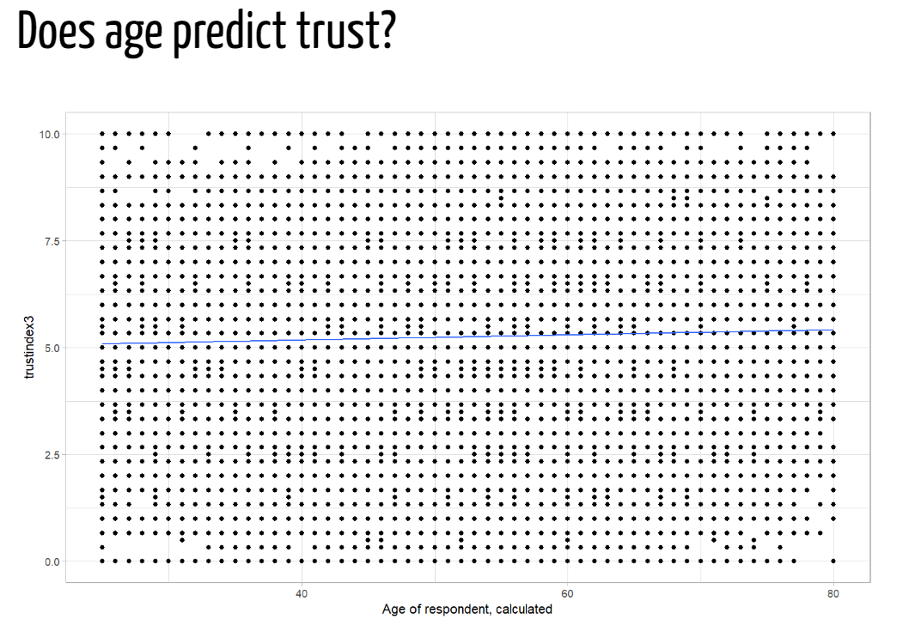

Slide 10
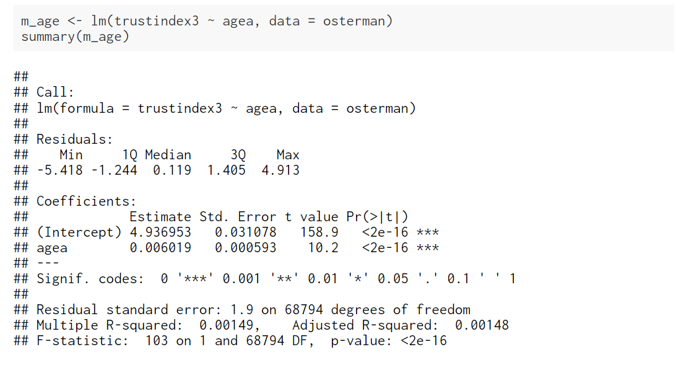
The “slope” coefficient; rather weak, but being older is associated with higher levels of social trust
p-value; very small; smaller than 0.001, and definitely smaller than 0.05 (for what it’s worth)
Conclusion:
One’s age appears to have an impact on their level of social trust. This association is weak in substantive terms. Each additional year of age is associated with a 0.006-point increase on the measured “social trust” scale. Based on the p-value (<0.001), we reject the null-hypothesis that this relationship would appear in our data by chance only, and provisionally accept that age affects social trust in the wider EU population.

Slide 11
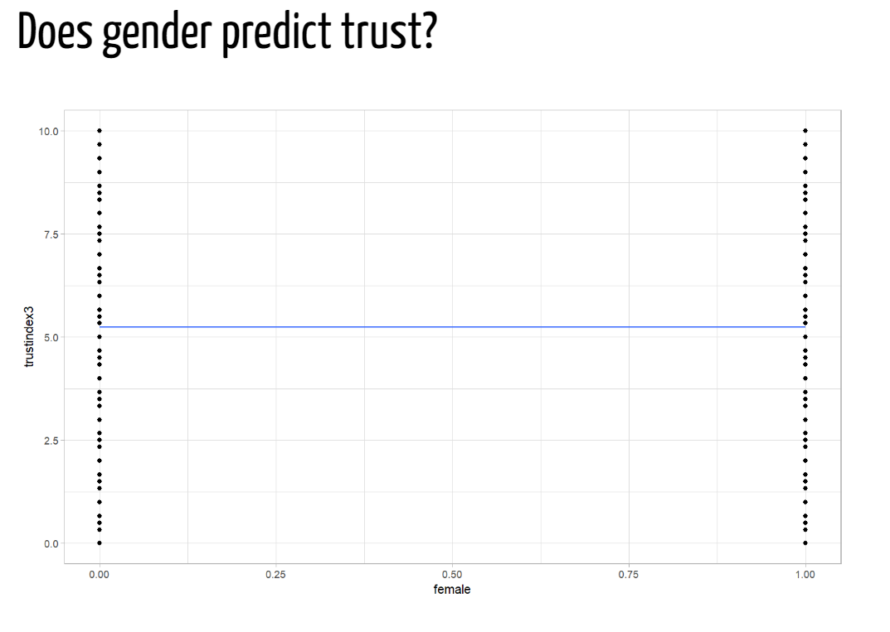

Slide 12
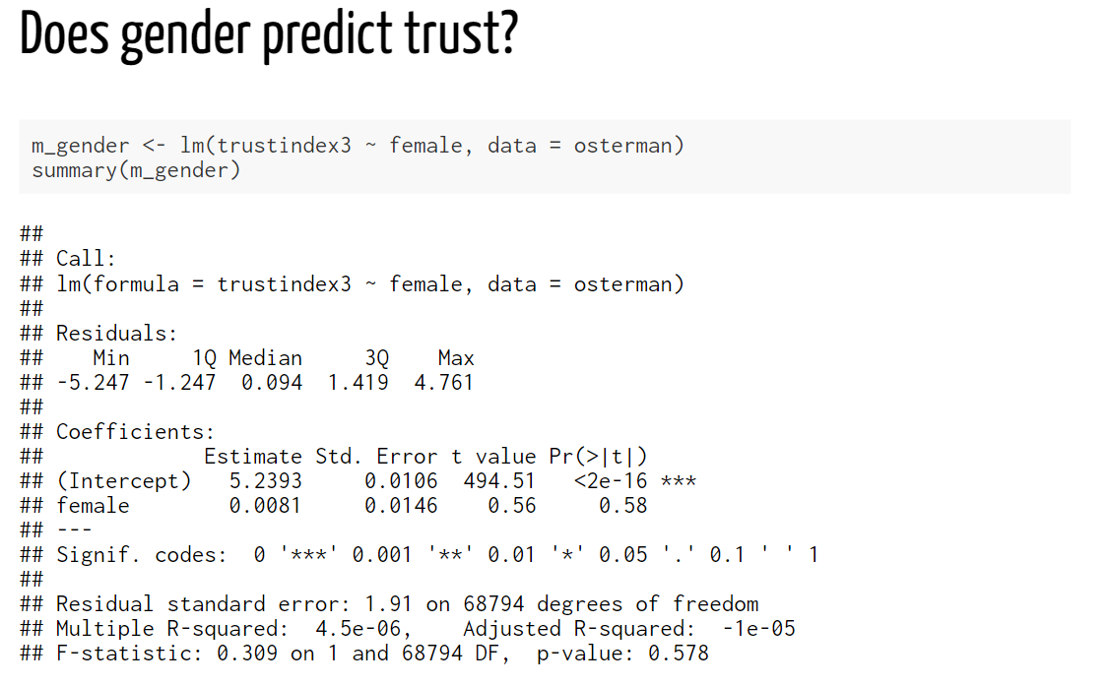
The “slope” coefficient; very weak, but being a woman is associated with higher levels of social trust compared to being a man
p-value; it runs on a 0-1 scale, so 0.58 (i.e. 58%) is very high, and much much higher than 0.05 (for what it’s worth)
Conclusion:
One’s sex doesn’t appear to have an impact on their level of social trust. The average score of women on the social trust scale is merely 0.008 points higher than that of men. Based on the p-value (0.58), we cannot reject the null-hypothesis that the difference between men and women in the wider EU population is in fact equal to 0 (as opposed to 0.008). There is in fact a probability of 0.58 (or 58%) that we would be wrong in rejecting the null-hypothesis. In conclusion, we don’t have evidence to suggest that sex is associated with differences in levels of social trust.

Slide 13
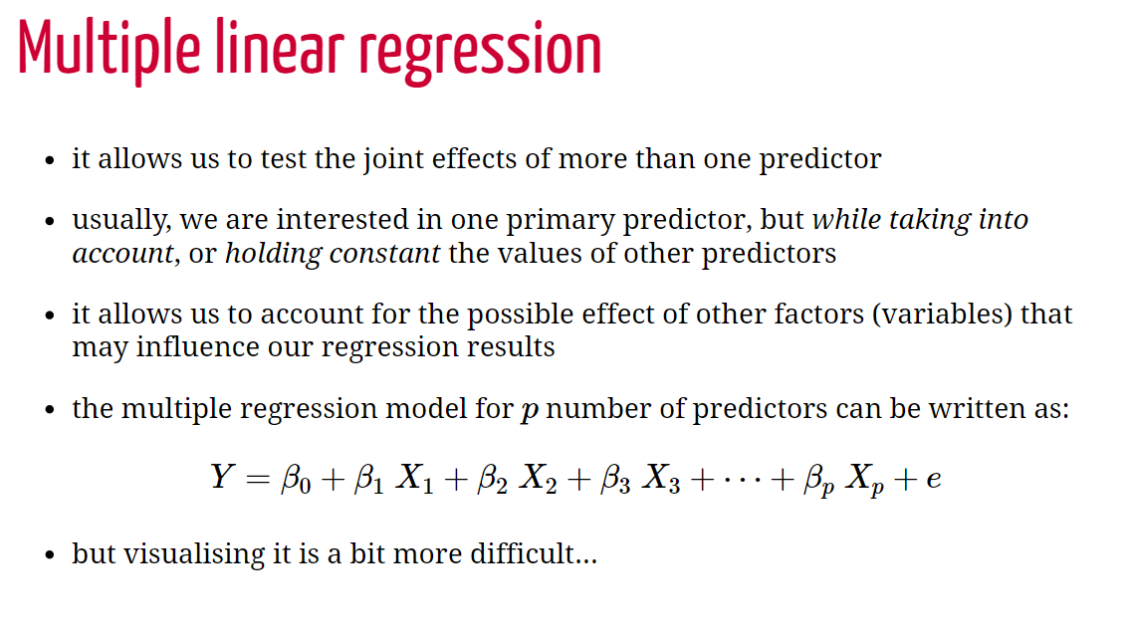

Slide 14
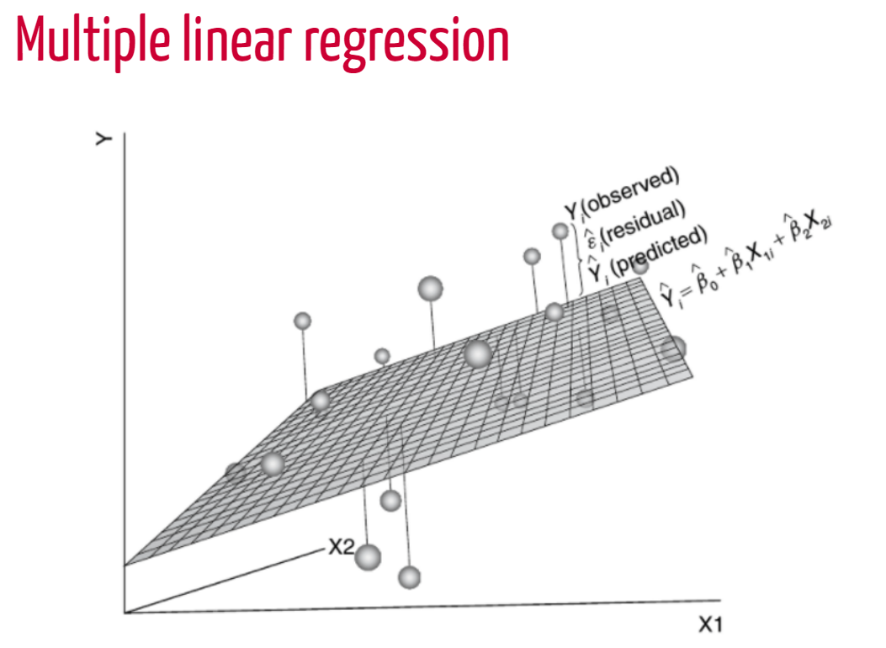
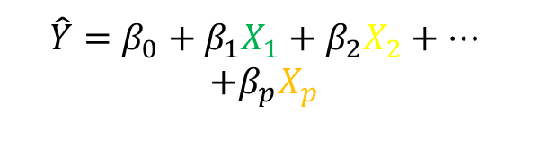
$$\hat{Y}=β_{0}+β_{1}X_{1}+β_{2}X_{2}+…$$
$$+β_{p}X_{p}$$
X1
X2
X3
60%
unexplained

Slide 15
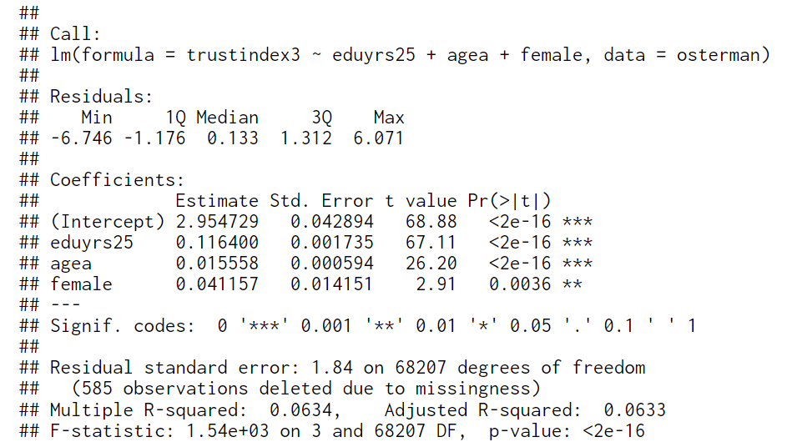
We are now interpreting each “slope” coefficient, keeping in mind that they represent the effect of that variable while keeping constant (eliminating) the effect of the other variables in the model
p-value; small!; smaller than 0.01; note that this has changed compared to the previous model; now, once we also account for education and age (i.e. keeping the effect of those variables constant, one’s sex seems to have an impact on their level of social trust
Conclusion:
In a statistical model that predicts levels of social trust from education, age and gender, we find that all three predictors are associated with social trust. Having more education, being older and being a woman is associated with higher levels of social trust.
This is now the p-value for the entire model

Slide 16
Logistic regression

Slide 17

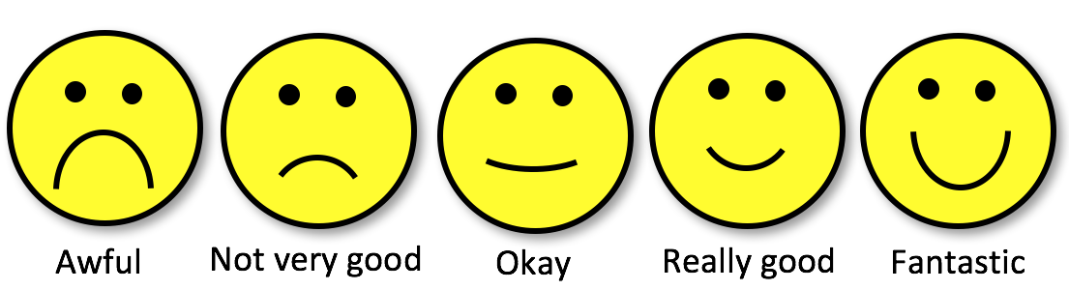
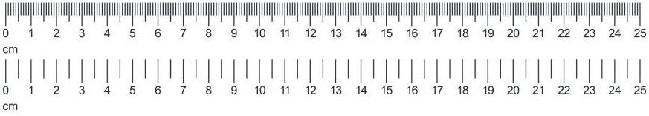
Dichotomous outcomes?
Categorical:
Nominal
Variable
types
/
Measurement
levels
Categorical:
Ordinal
Scale/Numeric:
Discrete,
Ratio,
Interval

Slide 18
Dichotomous outcomes?
Categorical:
Nominal
Variable
types
/
Measurement
levels
Categorical:
Ordinal
Scale/Numeric:
Discrete,
Ratio,
Interval

Slide 19
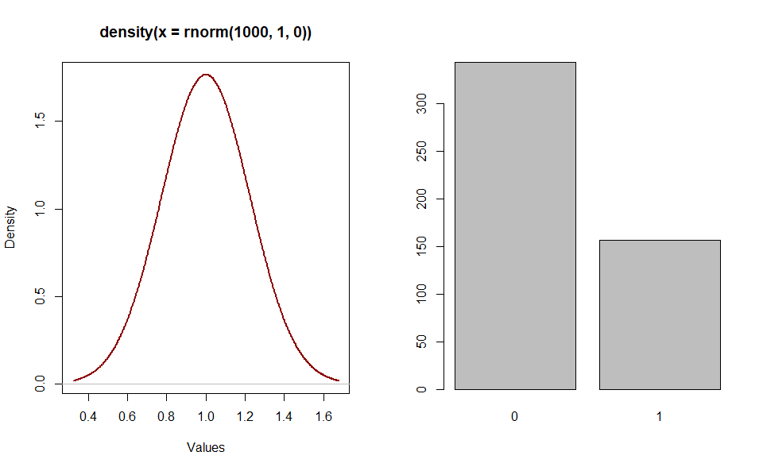
Dichotomous outcomes?

Slide 20
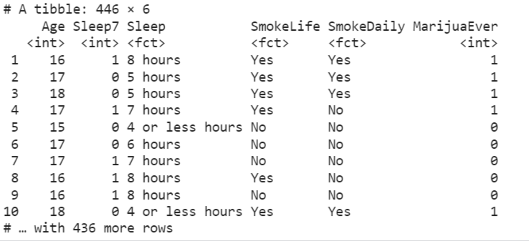
Example
Question: “Do teenagers get 7+ hours of sleep?”
Students in grades 9 - 12 surveyed about health risk behaviours including whether they usually get 7 or more hours of sleep
Sleep:
1 = “Yes”
0 = “No”

Slide 21
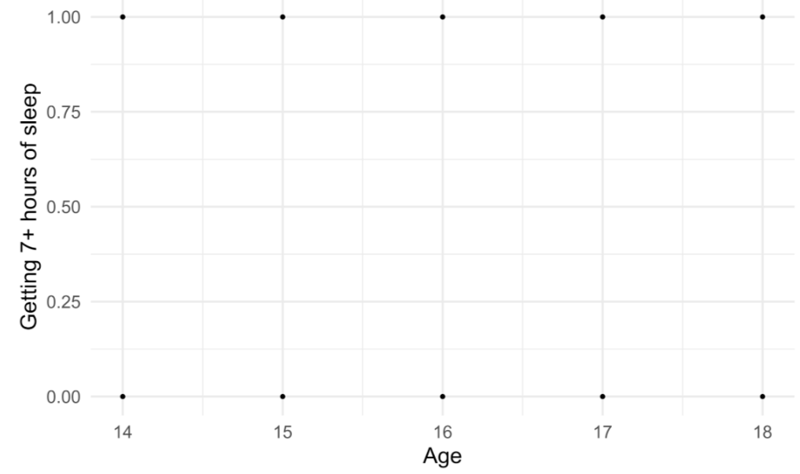
Example

Slide 22
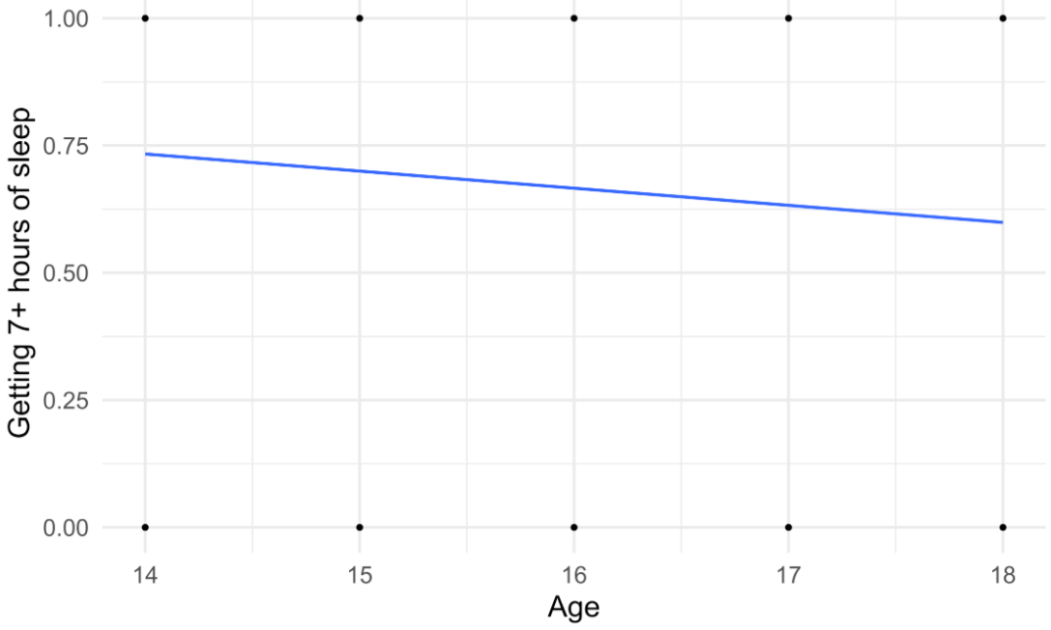
Example
Outcome: 1 = yes, 0 = no

Slide 23
Example
Outcome: Probability of getting 7+ hours of sleep

Slide 24
Example
Outcome: Probability of getting 7+ hours of sleep (Linear model)

Slide 25
Example
Outcome: Probability of getting 7+ hours of sleep (Logistic model)

Slide 26
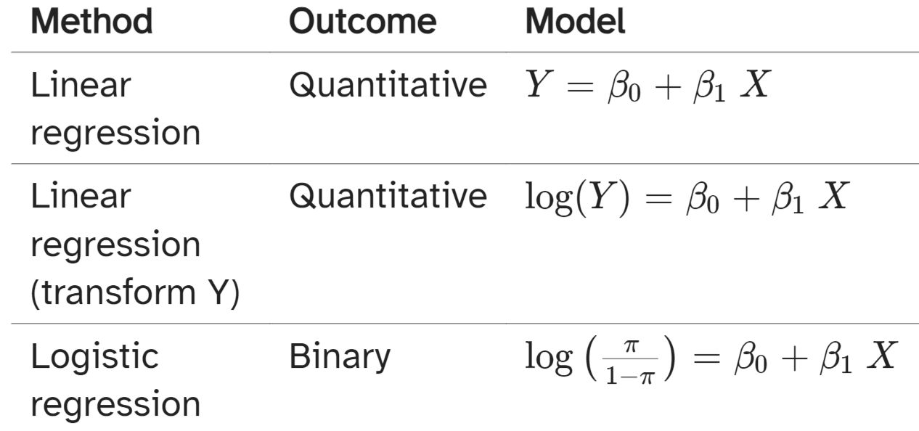
Different types of models

Slide 27
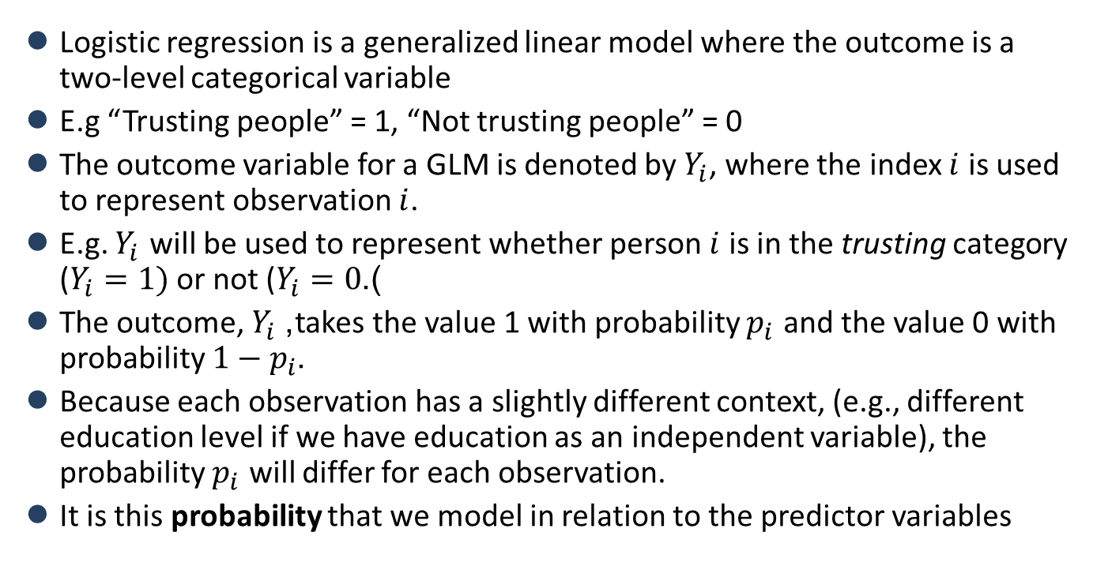
What is logistic regression?
Logistic regression is a generalized linear model where the outcome is a two-level categorical variable
E.g “Trusting people” = 1, “Not trusting people” = 0
The outcome variable for a GLM is denoted by $Y_{i}$, where the index $i$ is used to represent observation $i$.
E.g. $Y_{i}$ will be used to represent whether person $i$ is in the trusting category ($Y_{i}=1)$or not ($Y_{i}=0$).
The outcome, $Y_{i}$, takes the value 1 with probability $p_{i}$ and the value 0 with probability $1−p_{i}$.
Because each observation has a slightly different context, (e.g., different education level if we have education as an independent variable), the probability $p_{i}$ will differ for each observation.
It is this probability that we model in relation to the predictor variables

Slide 28
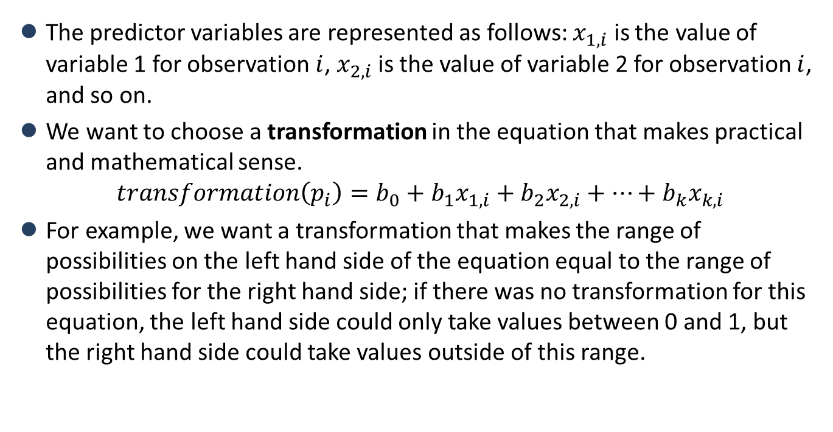
The logit transformation
The predictor variables are represented as follows: $x_{1,i}$ is the value of variable 1 for observation $i$, $x_{2,i}$ is the value of variable 2 for observation $i$, and so on.
We want to choose a transformation in the equation that makes practical and mathematical sense.
$$transformation\left(p_{i}\right)=b_{0}+b_{1}x_{1,i}+b_{2}x_{2,i}+⋯+b_{k}x_{k,i}$$
For example, we want a transformation that makes the range of possibilities on the left hand side of the equation equal to the range of possibilities for the right hand side; if there was no transformation for this equation, the left hand side could only take values between 0 and 1, but the right hand side could take values outside of this range.

Slide 29
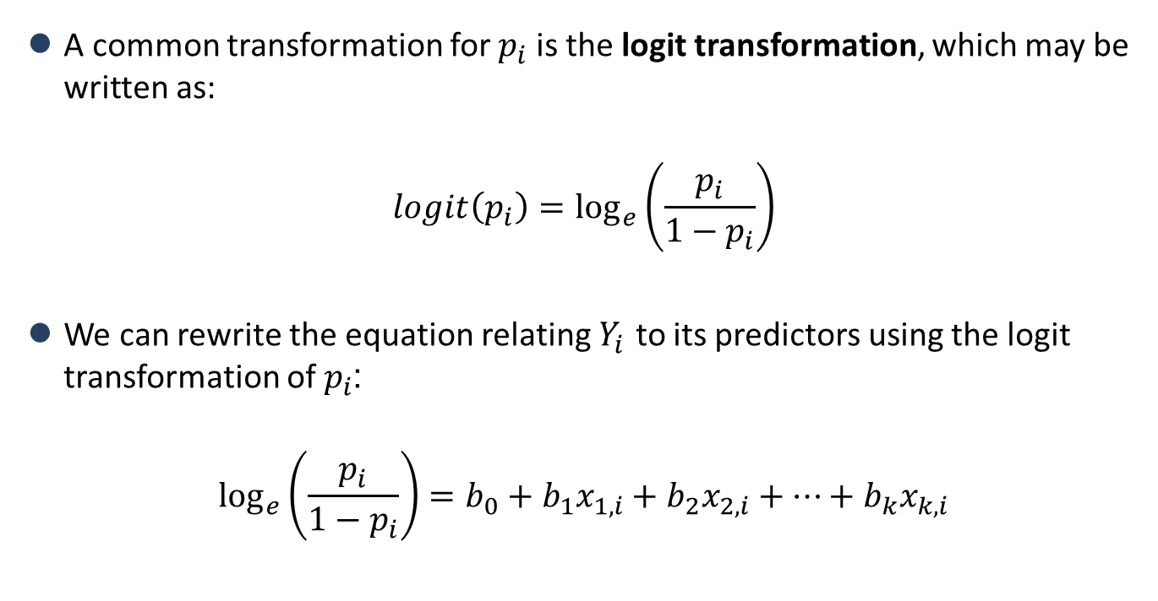
The logit transformation
A common transformation for $p_{i}$ is the logit transformation, which may be written as:
$$logit\left(p_{i}\right)=\log_{e}\left(\frac{p_{i}}{1−p_{i}}\right)$$
We can rewrite the equation relating $Y_{i}$ to its predictors using the logit transformation of $p_{i}$:
$$\log_{e}\left(\frac{p_{i}}{1−p_{i}}\right)=b_{0}+b_{1}x_{1,i}+b_{2}x_{2,i}+⋯+b_{k}x_{k,i}$$

Slide 30
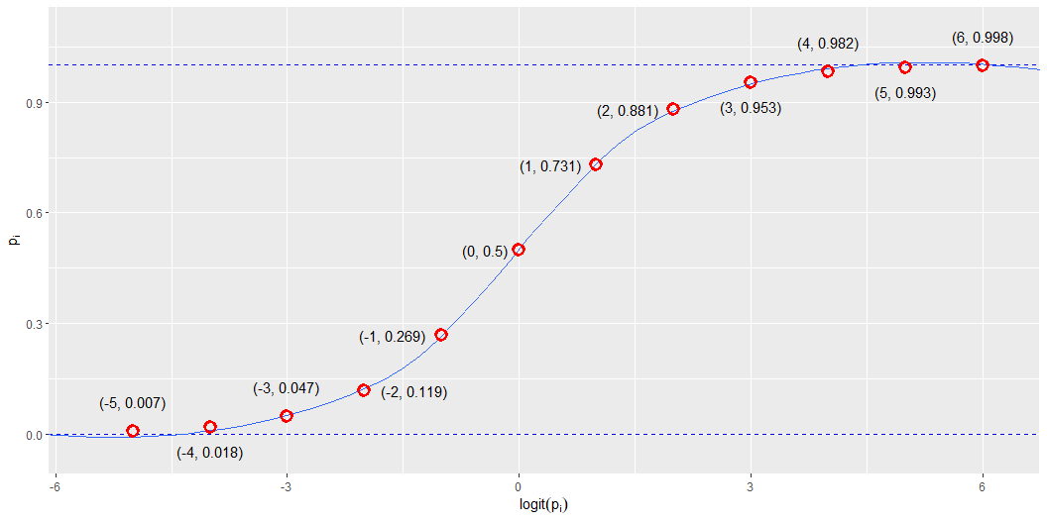
The logit transformation

Slide 31
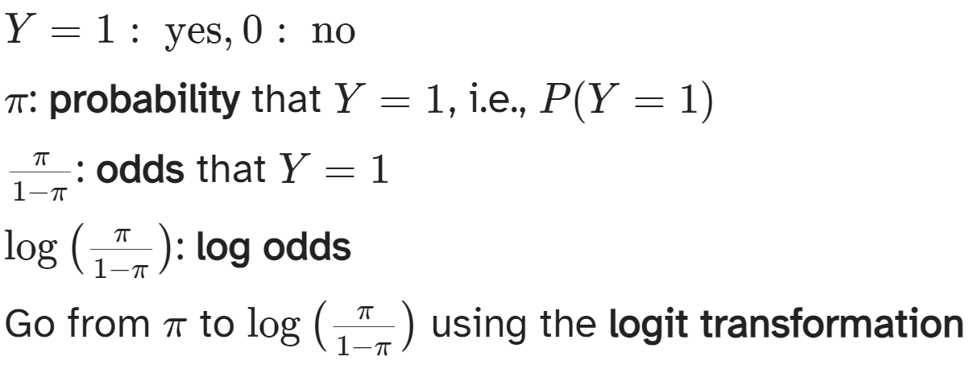
Odds and probabilities

Slide 32
Odds and probabilities
probs | odds | log_odds
0.01 | 0.01 | -4.60
0.05 | 0.05 | -2.94
0.10 | 0.11 | -2.20
0.20 | 0.25 | -1.39
0.33 | 0.50 | -0.69
0.40 | 0.67 | -0.41
0.50 | 1.00 | 0.00
0.60 | 1.50 | 0.41
0.67 | 2.00 | 0.69
0.80 | 4.00 | 1.39
0.90 | 9.00 | 2.20
0.95 | 19.00 | 2.94
0.99 | 99.00 | 4.60

Slide 33
Odds
Suppose there is a 70% chance it will rain tomorrow
Probability it will rain is p = 0.7
Probability it won’t rain is 1 − p = 0.3
Odds it will rain are 7 to 3, 7:3, 0.7/0.3 ≈ 2.33

Slide 34
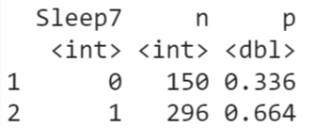
Are teenagers getting enough sleep?
P(7+ hours of sleep) = P(Y=1) = p = 0.664
P(< 7 hours of sleep)=P(Y=0) = 1−p = 0.336
P(odds of 7+ hours of sleep) = 0.664/0.336 = 1.976

Slide 35
Logistic regression: application

Slide 36
How does education relate to social trust?
Application reading:
Wu, Cary. 2021. “Education and Social Trust in Global Perspective.” Sociological Perspectives 64 (6): 1166–86. https://doi.org/10.1177/0731121421990045.
“there is a strong and positive relation between education level and trust”.
However, “several studies have shown that education might yield differential impacts on trust in different societies. In Sweden, Sven Oskarsson et al. (2017) show that education has little impact on trust. In China, Cary Wu and Zhilei Shi (2020) suggest that education has a negative impact on people’s trust. Several cross-national studies have also shown that the education and trust association can vary from positive to negative depending on the specific institutional contexts …”

Slide 37
How does education relate to social trust?
Methods:
“For the WVS, I use the standard survey item asking, “Generally speaking, would you say that most people can be trusted or that you can’t be too careful in dealing with people?” (Rosenberg 1956). The variable is coded on a 0 to 1 scale, with 1 corresponding to high levels of trust.” (p. 1170)
“For the WVS, I measure educational attainment using respondents’ highest education level attained with eight categories, namely, 1 = no formal education or inadequately completed elementary education, 2 = completed (compulsory) elementary education, 3 = incomplete secondary school: technical/vocational, 4 = complete secondary school: technical/vocational, 5 = incomplete secondary: university, 6 = complete secondary: university, 7 = some university without degree, and 8 = university with degree/higher education. In some analyses, I treat education as a categorical variable. To reduce the number of categories, I recode respondents’ education into Primary, Secondary, Post-secondary, and Tertiary. This is also consistent with the most recent wave of the WVS coding” (p. 1171)
“I also control for relevant demographic covariates such as gender, age, income, marital status, and occupational status at the individual level” (p. 1172)

Slide 38
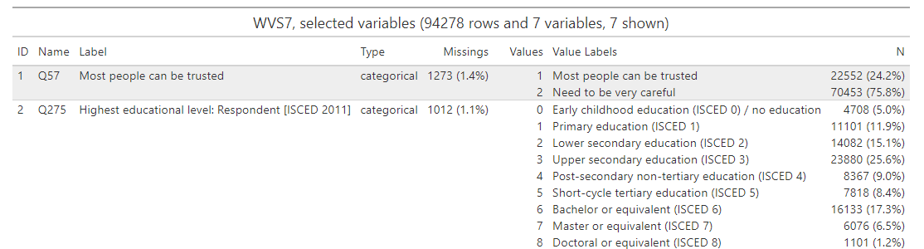
How does education relate to social trust?

Slide 39
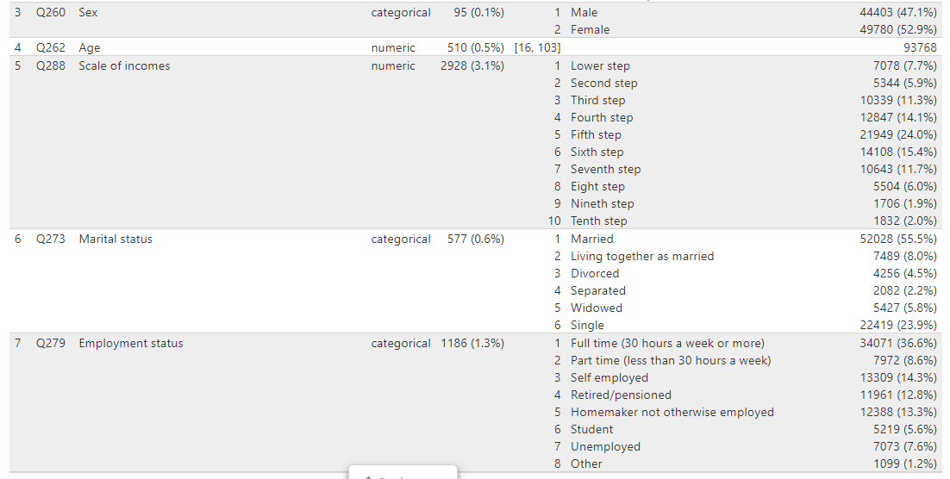
How does education relate to social trust?

Slide 40
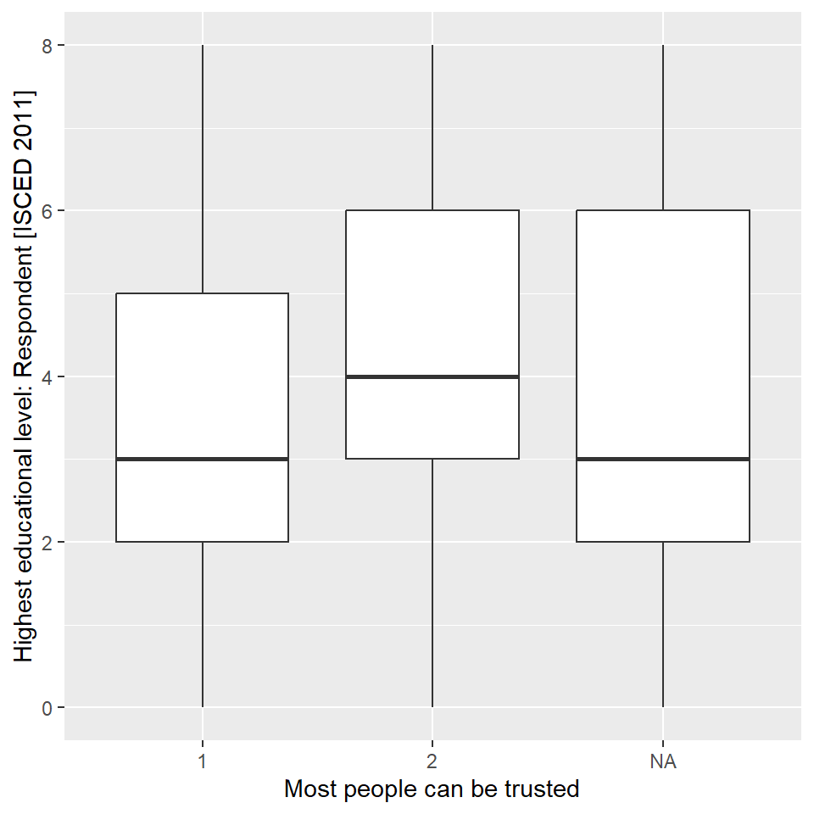
How does education relate to social trust?

Slide 41
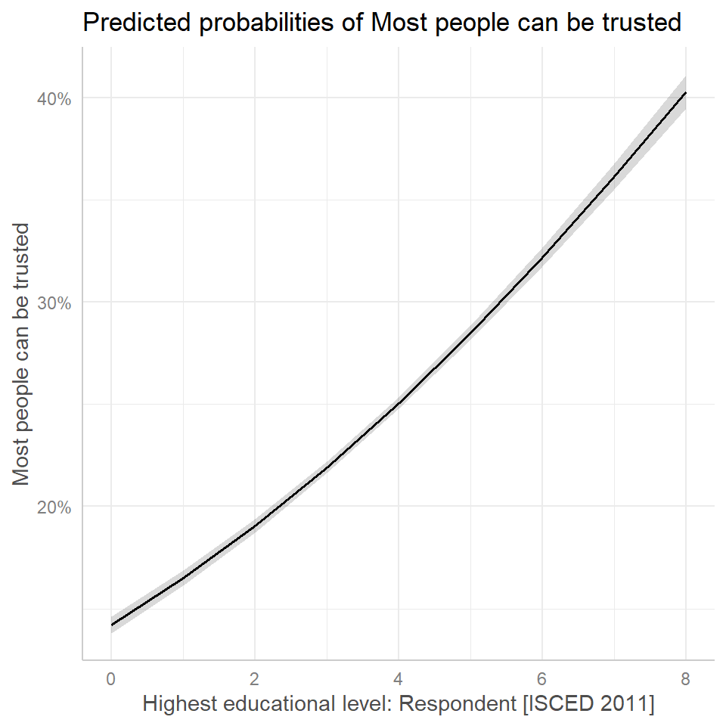
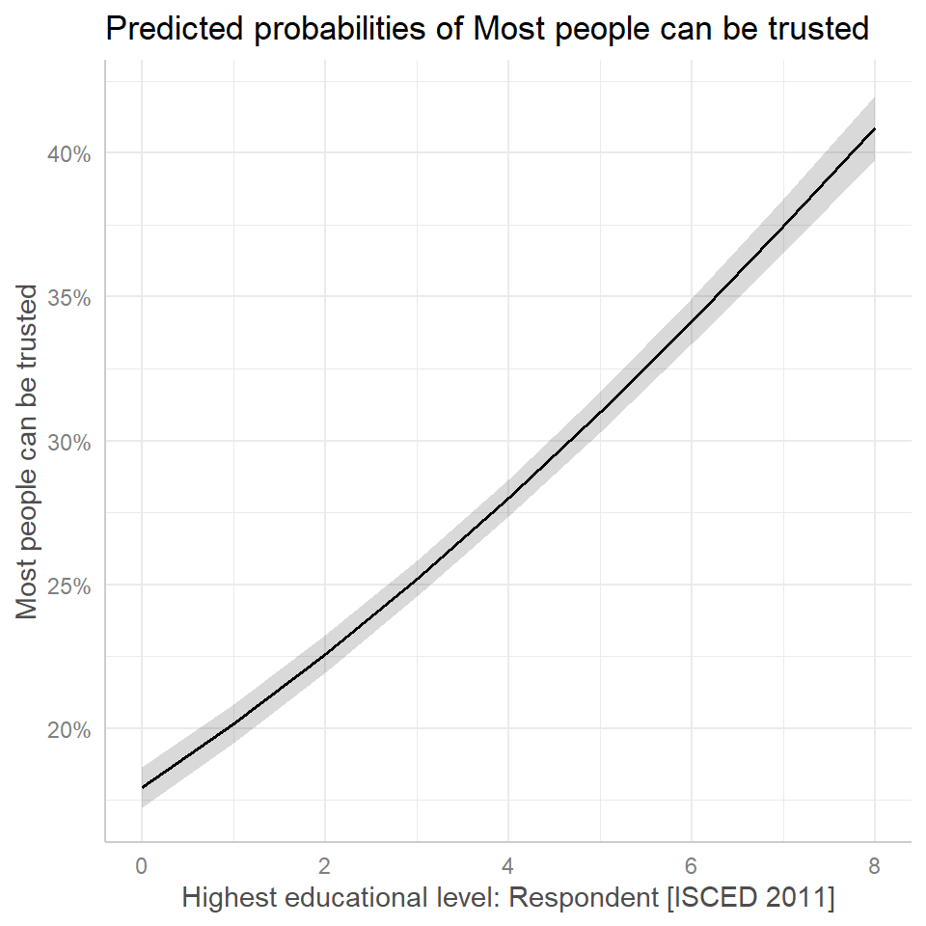
How does education relate to social trust?

Slide 42
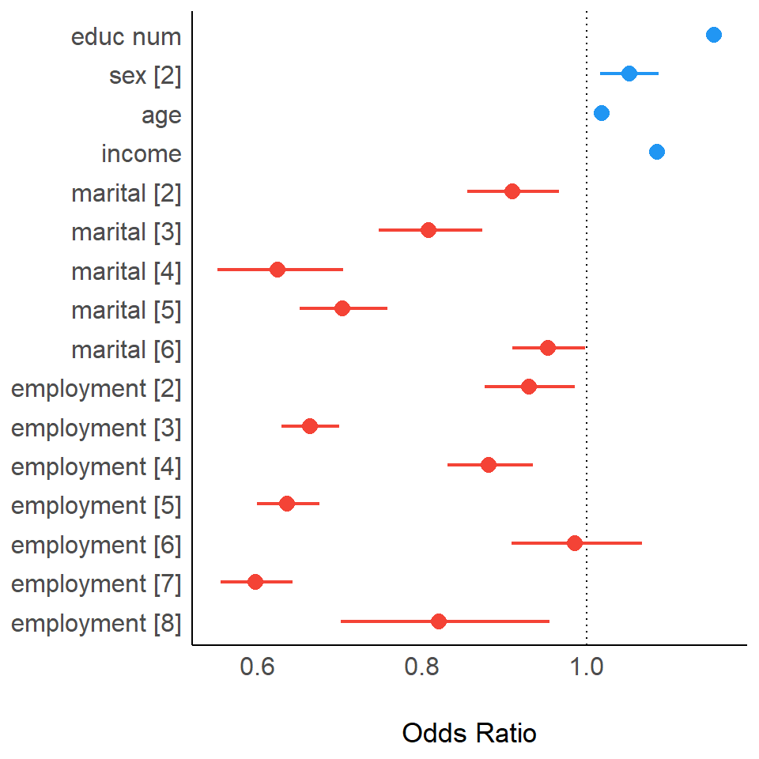
How does education relate to social trust?

