Slide 2
Linear models
Generalised linear models
Causal models
Interaction models
Multilevel models
Longitudinal models
Week 4
Interactions
Estimating, plotting and interpreting interaction effects

Slide 3
Some review

Slide 4
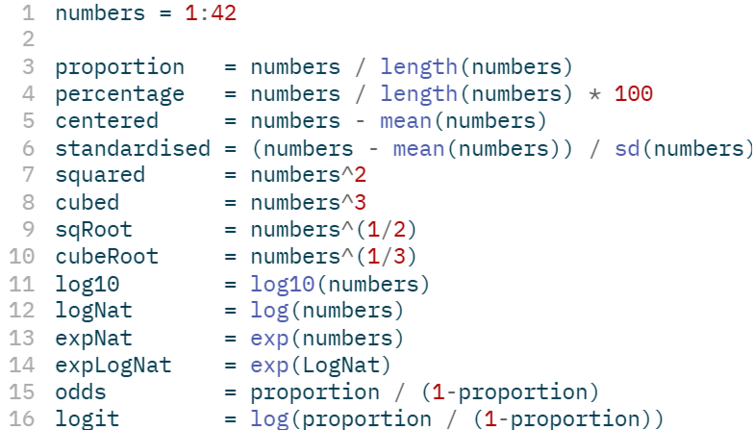
Transformations

Slide 5
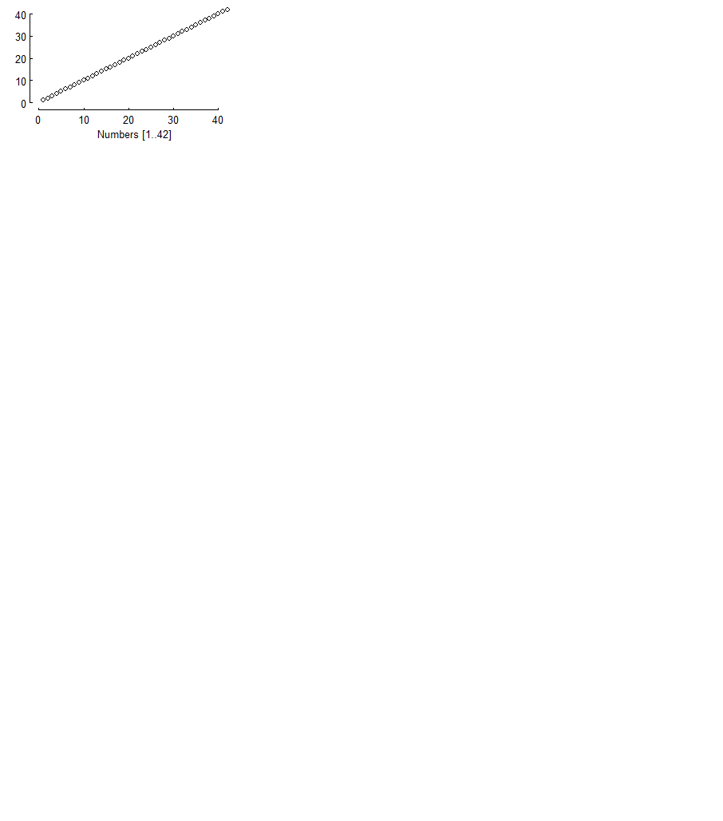

Transformations

Slide 6
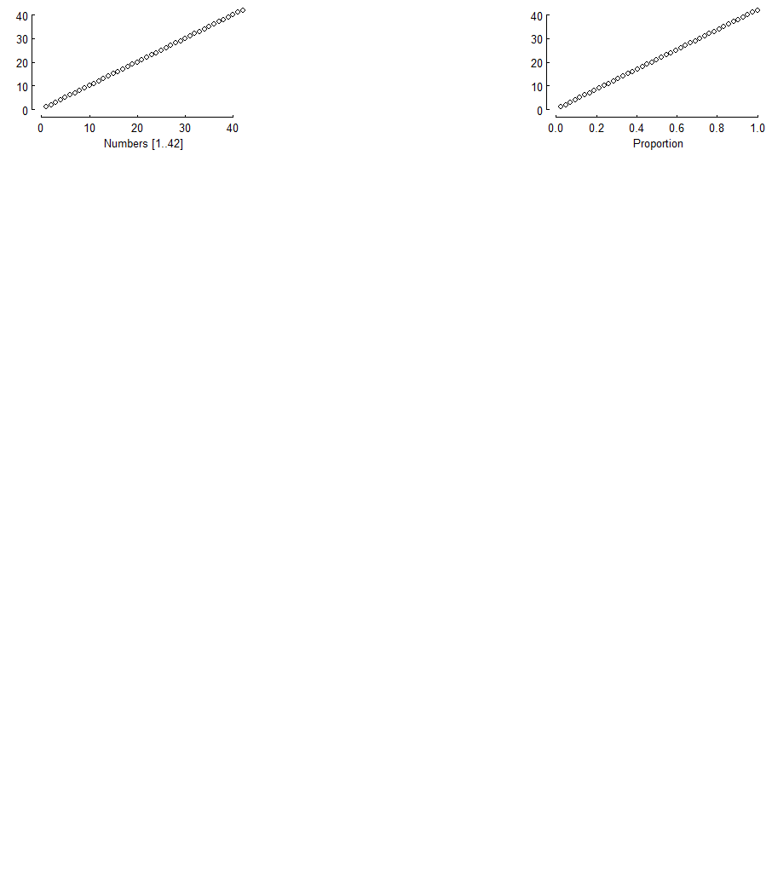
Transformations

Slide 7
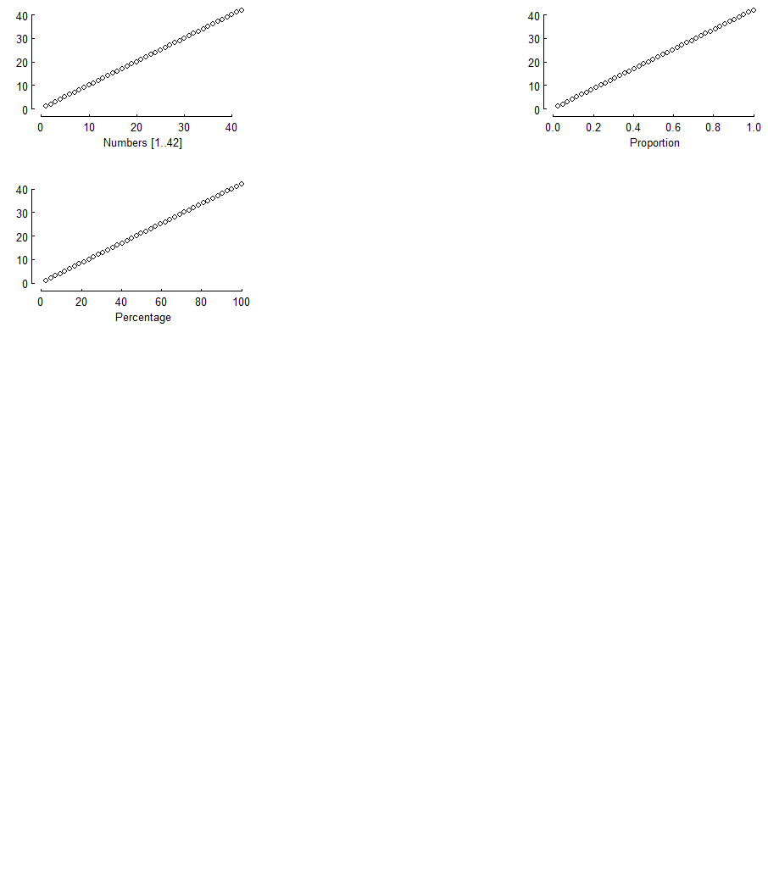
Transformations

Slide 8
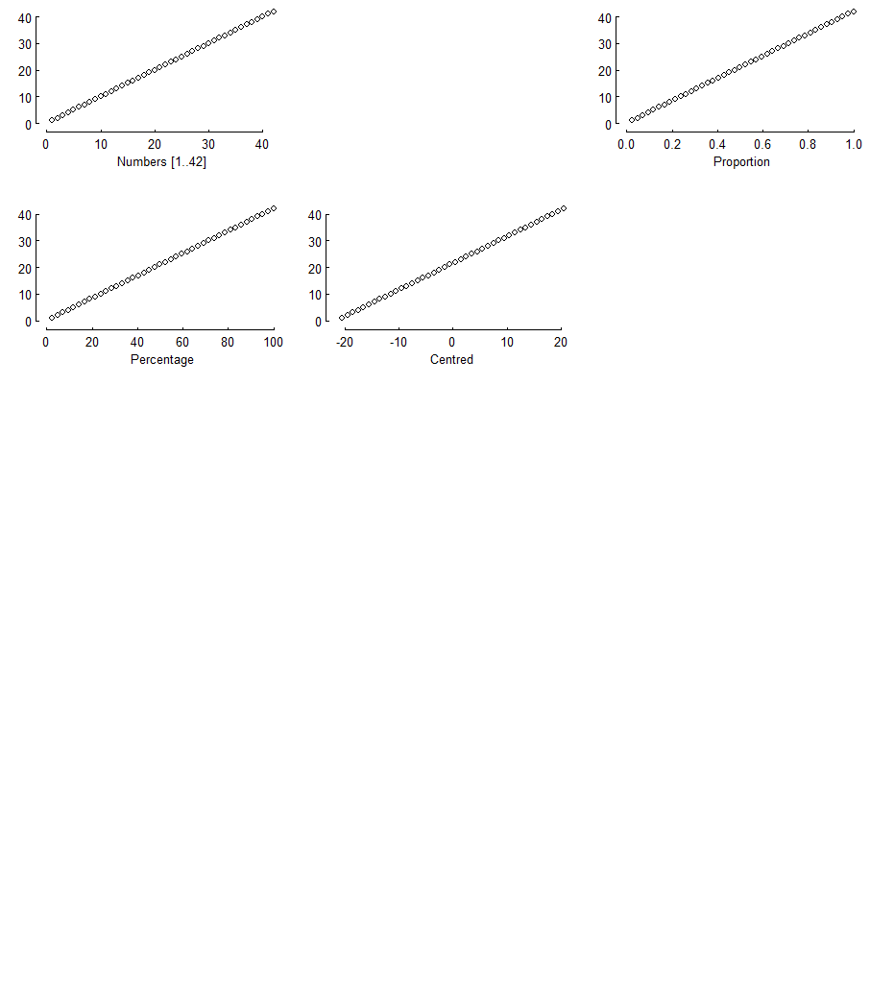
Transformations

Slide 9
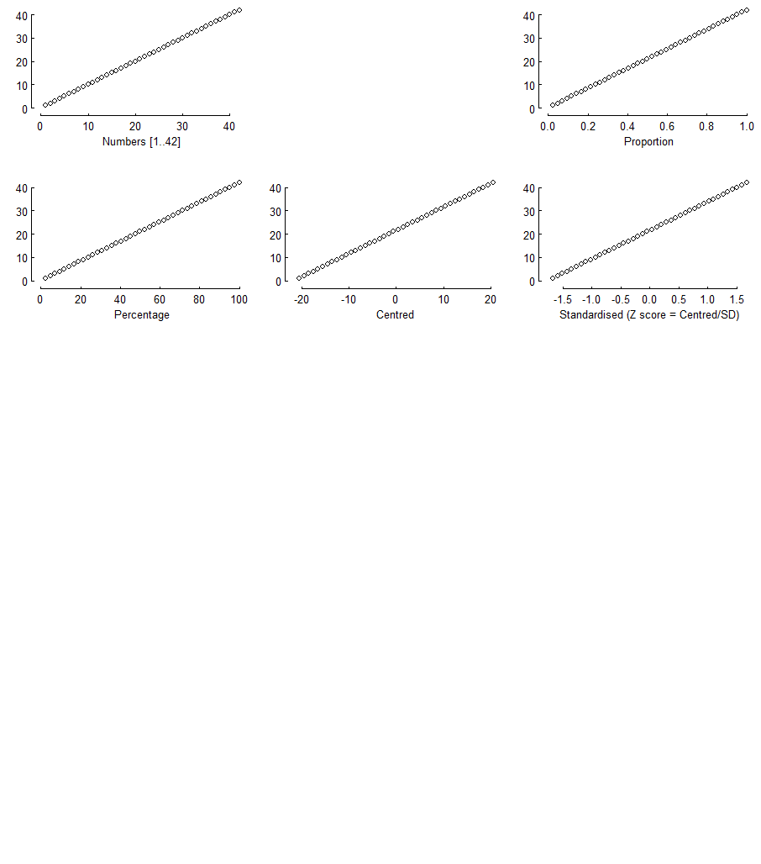
Transformations

Slide 10
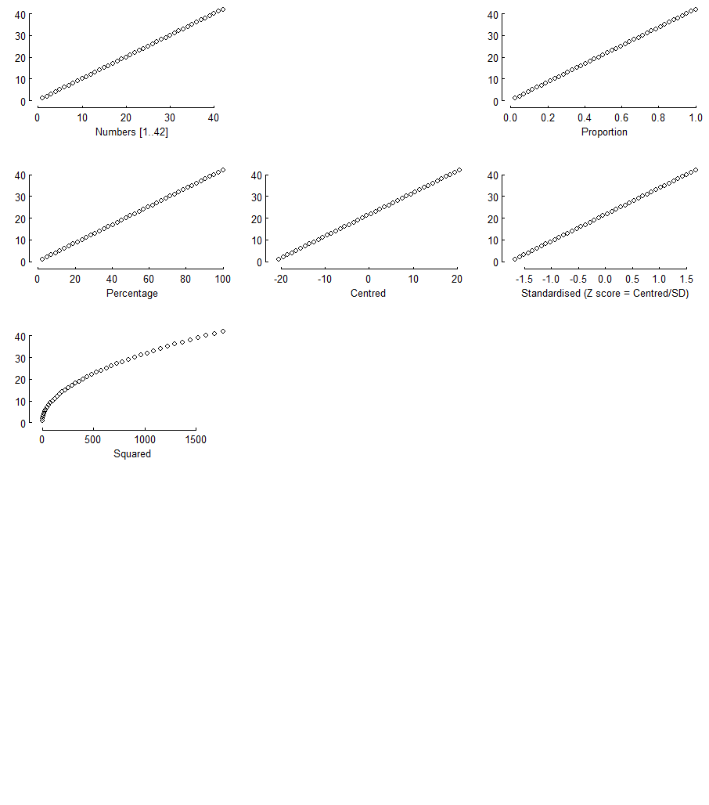
Transformations

Slide 11
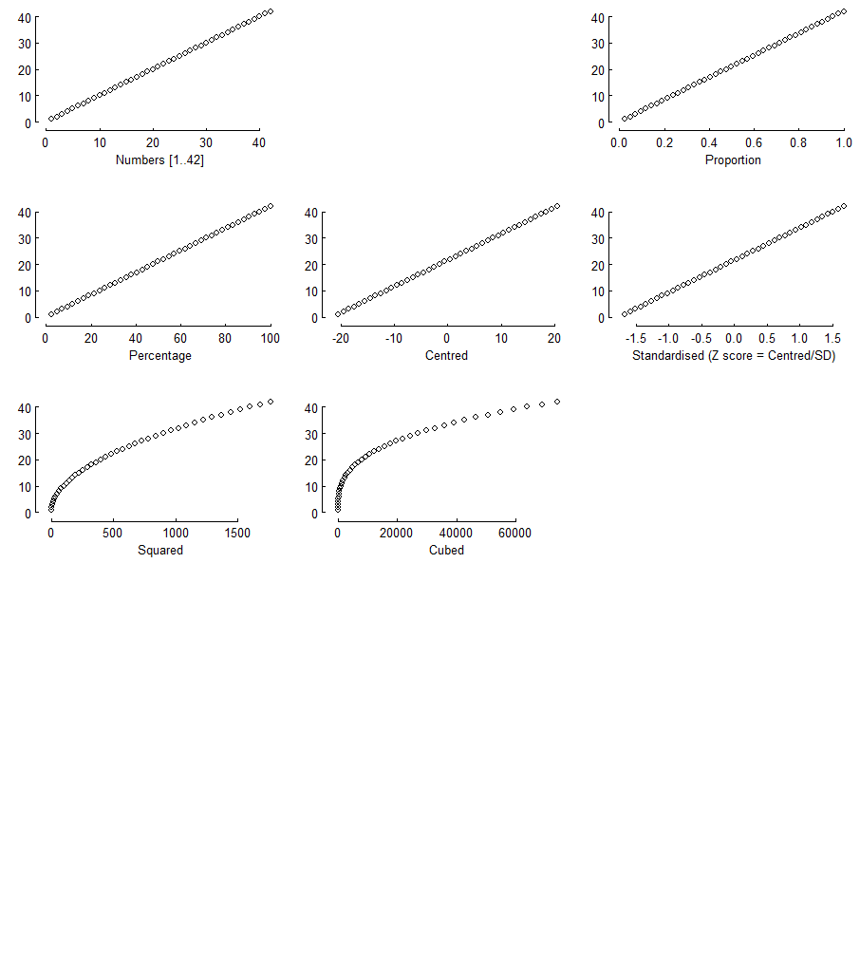
Transformations

Slide 12
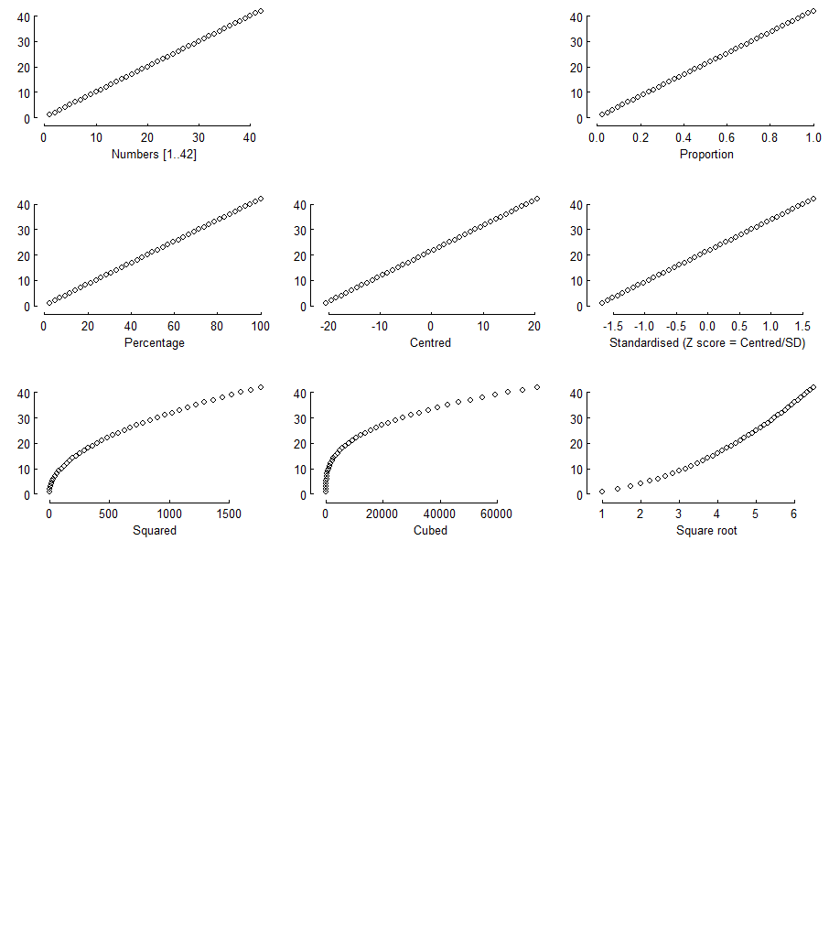
Transformations

Slide 13
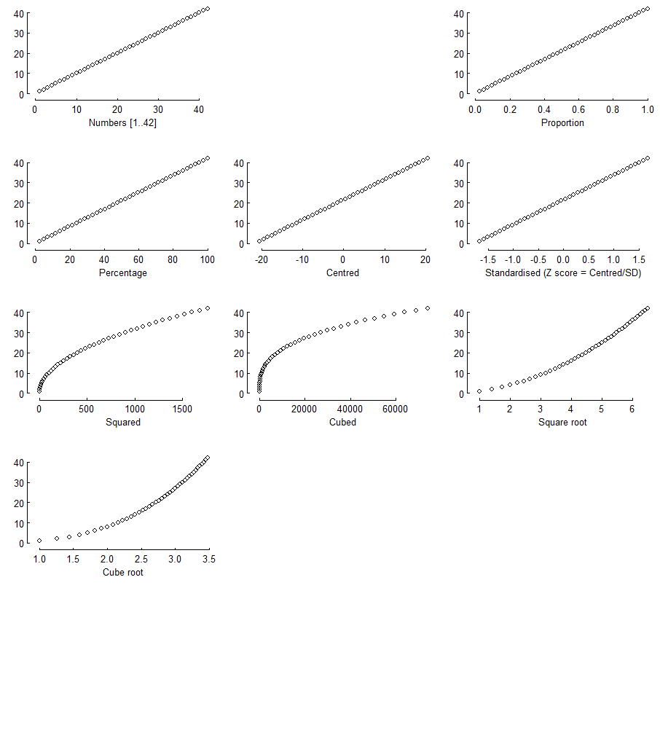
Transformations

Slide 14
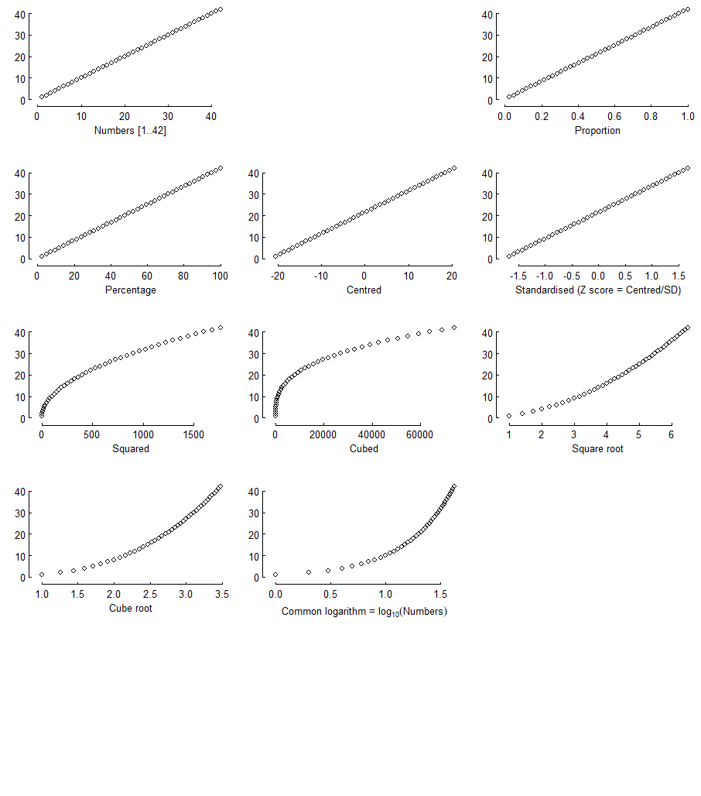
Transformations

Slide 15
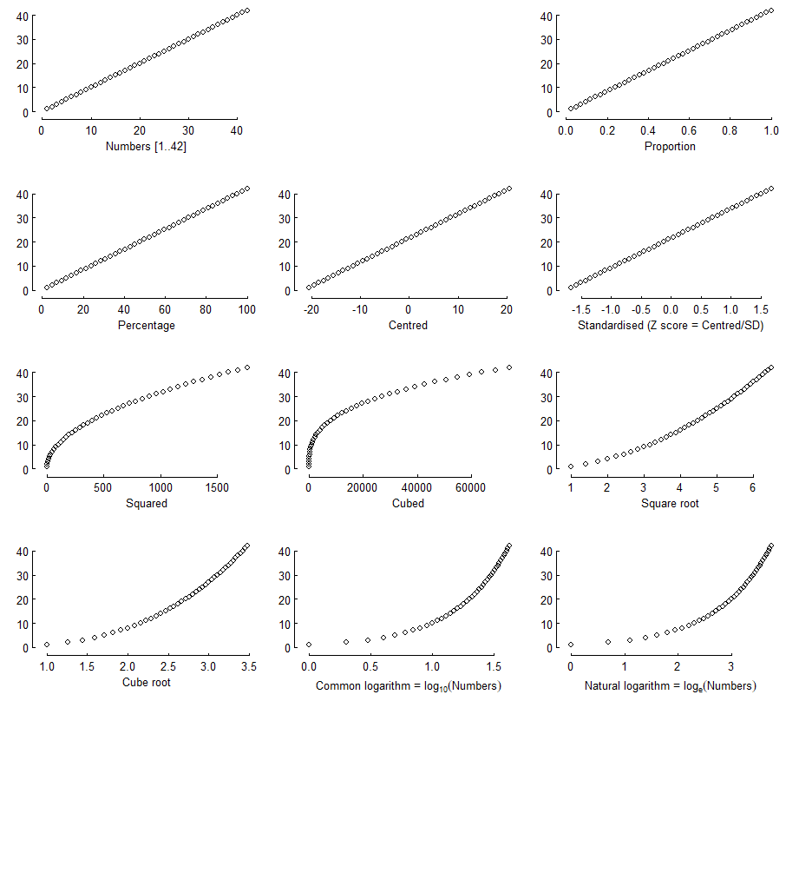
Transformations

Slide 16
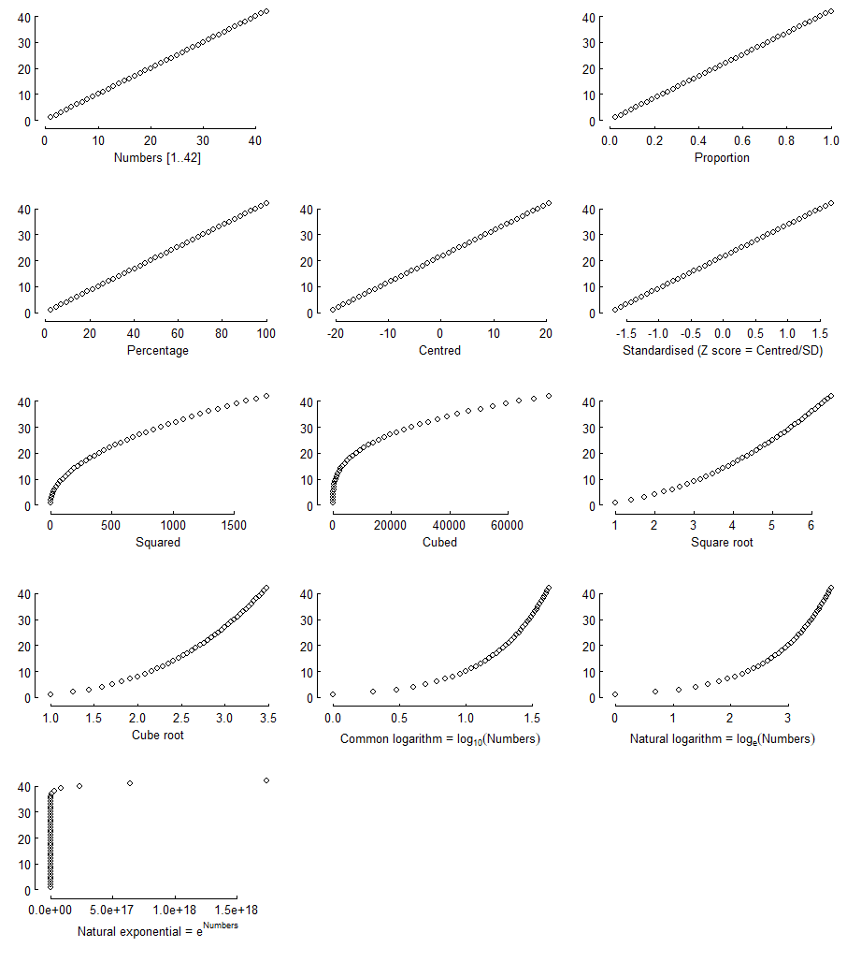
Transformations

Slide 17
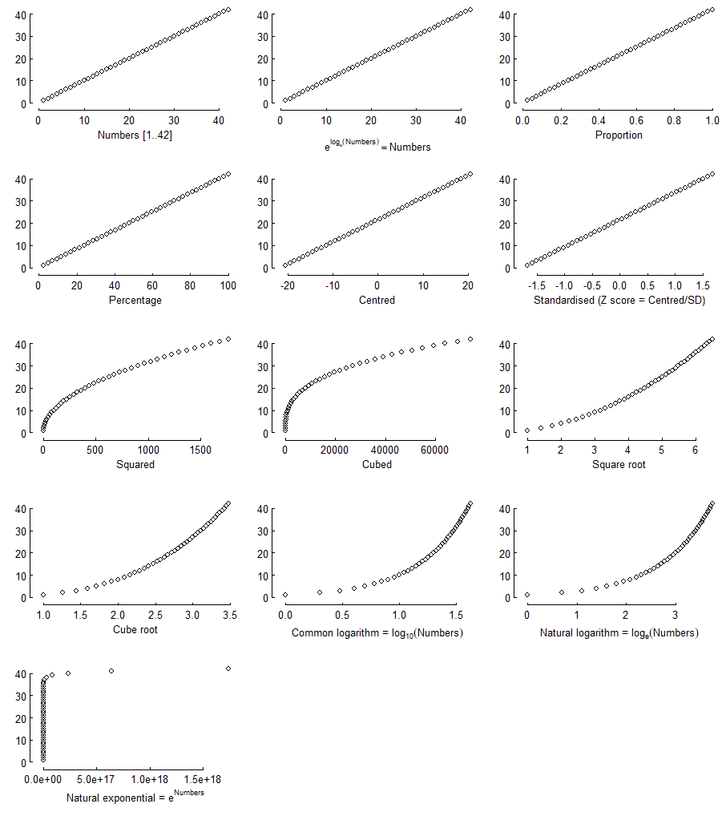
Transformations

Slide 18
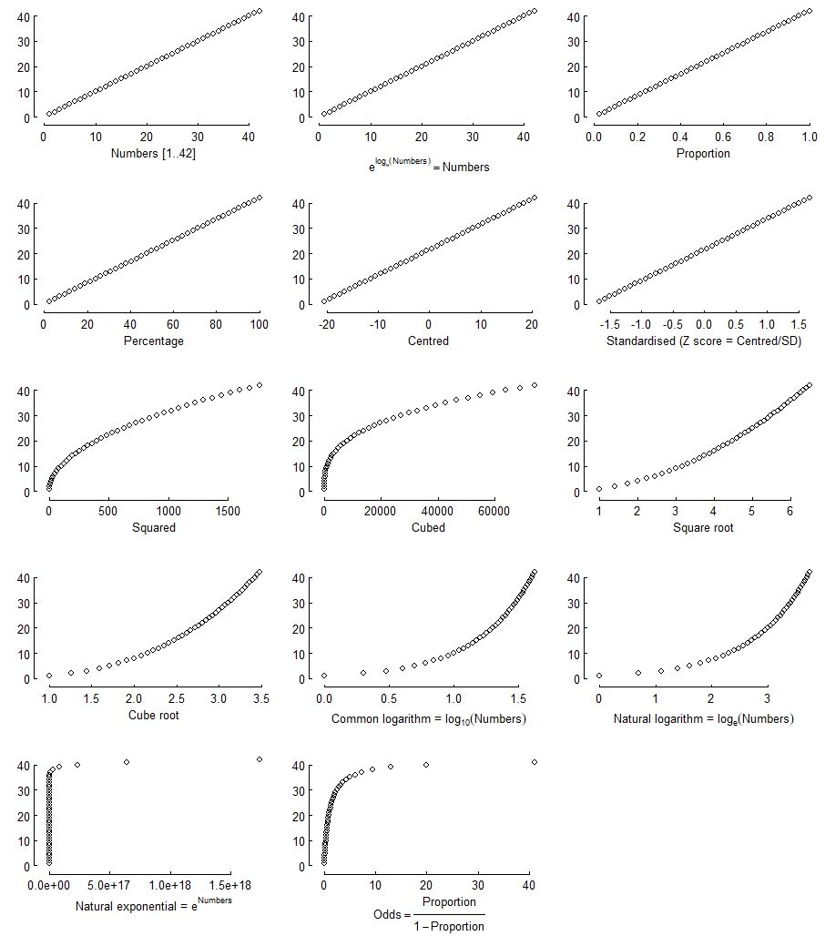
Transformations

Slide 19
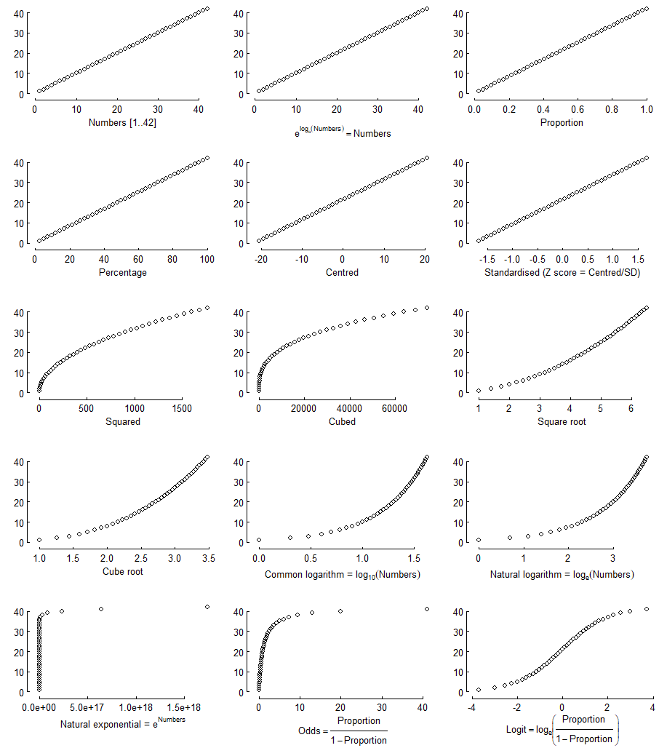
Transformations

Slide 20
Logistic regression

Slide 21
How does education relate to social trust?
Application reading:
Wu, Cary. 2021. “Education and Social Trust in Global Perspective.” Sociological Perspectives 64 (6): 1166–86. https://doi.org/10.1177/0731121421990045.
“there is a strong and positive relation between education level and trust”.
However, “several studies have shown that education might yield differential impacts on trust in different societies. In Sweden, Sven Oskarsson et al. (2017) show that education has little impact on trust. In China, Cary Wu and Zhilei Shi (2020) suggest that education has a negative impact on people’s trust. Several cross-national studies have also shown that the education and trust association can vary from positive to negative depending on the specific institutional contexts …”

Slide 22
How does education relate to social trust?
Methods:
“For the WVS, I use the standard survey item asking, “Generally speaking, would you say that most people can be trusted or that you can’t be too careful in dealing with people?” (Rosenberg 1956). The variable is coded on a 0 to 1 scale, with 1 corresponding to high levels of trust.” (p. 1170)
“For the WVS, I measure educational attainment using respondents’ highest education level attained with eight categories, namely, 1 = no formal education or inadequately completed elementary education, 2 = completed (compulsory) elementary education, 3 = incomplete secondary school: technical/vocational, 4 = complete secondary school: technical/vocational, 5 = incomplete secondary: university, 6 = complete secondary: university, 7 = some university without degree, and 8 = university with degree/higher education. In some analyses, I treat education as a categorical variable. To reduce the number of categories, I recode respondents’ education into Primary, Secondary, Post-secondary, and Tertiary. This is also consistent with the most recent wave of the WVS coding” (p. 1171)
“I also control for relevant demographic covariates such as gender, age, income, marital status, and occupational status at the individual level” (p. 1172)

Slide 23
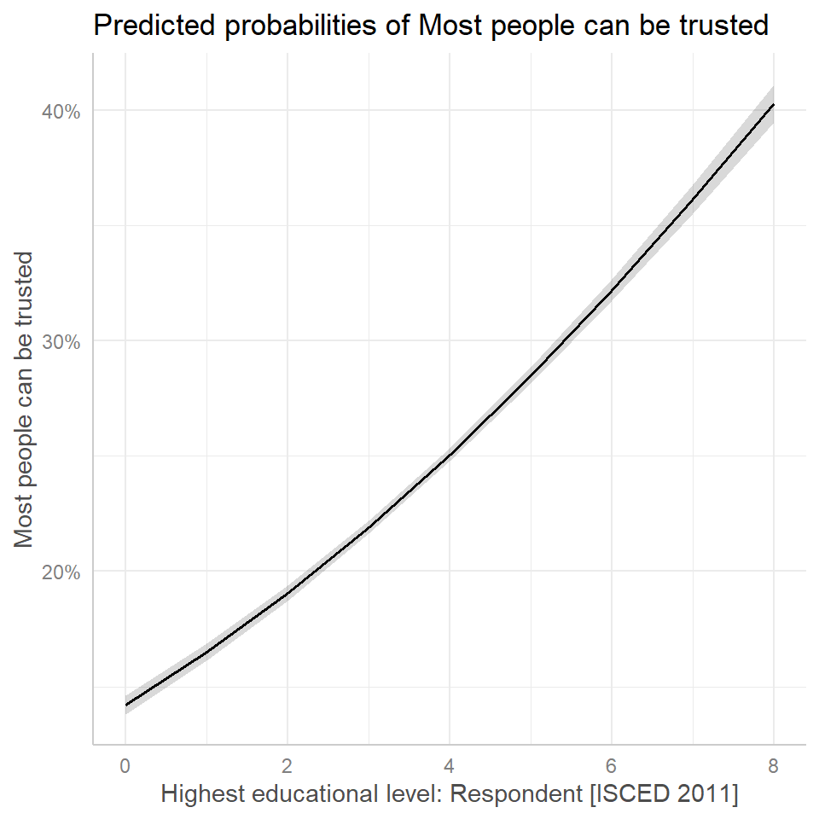
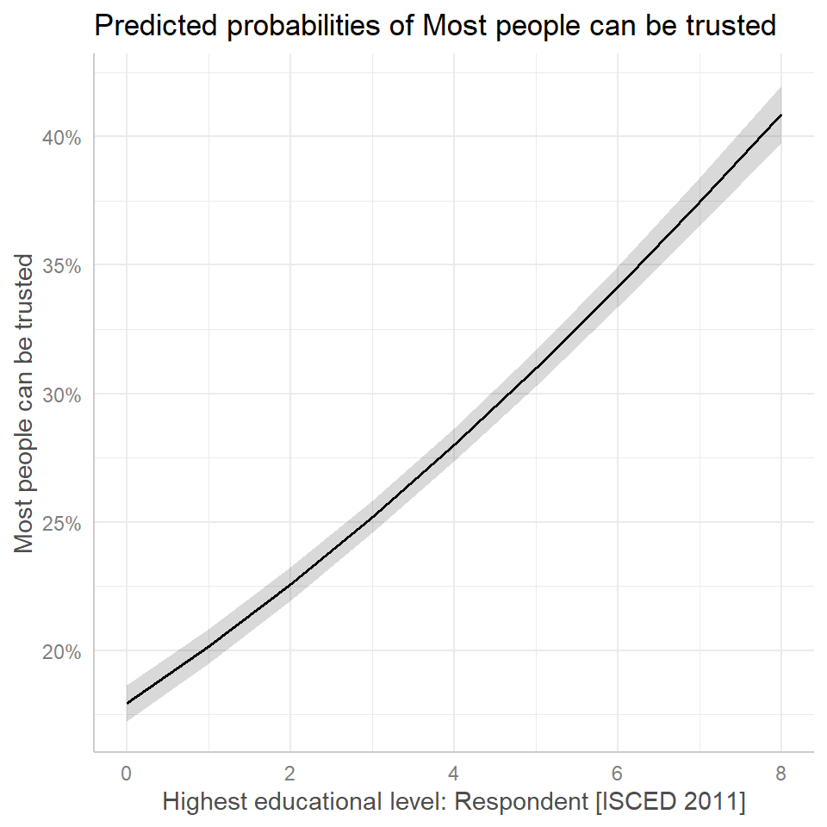
How does education relate to social trust?

Slide 24
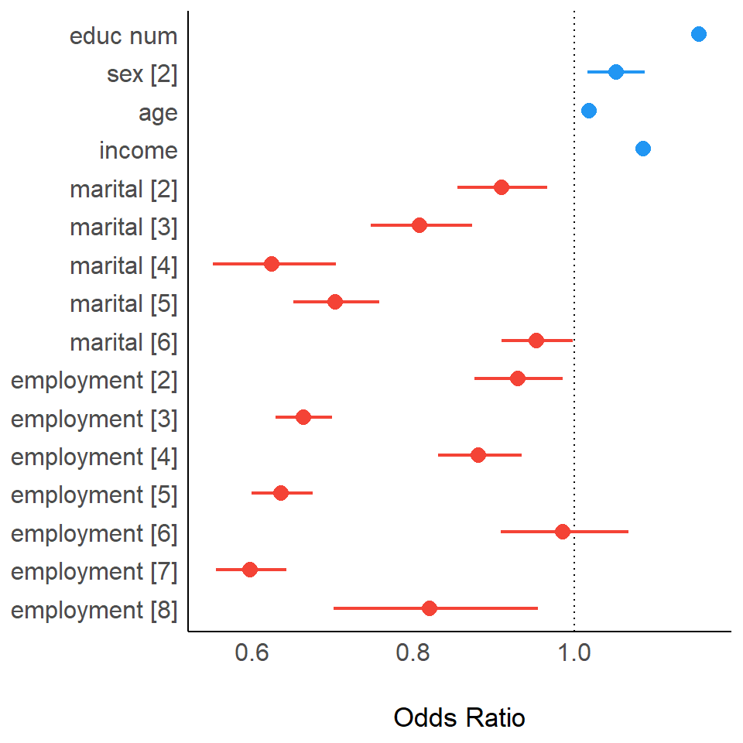
How does education relate to social trust?

Slide 25
Interactions

Slide 26
Statistical models
Interaction models
In linear models, each explanatory variable is assumed to have an effect on the outcome variable that is independent of the values of other explanatory variables included in the model → main effects
We can reject this assumption and model any theoretically motivated dependencies between the explanatory variables themselves
We “multiplicate” the effect of two explanatory variables to estimate their effect as dependent on the values of the other explanatory variable(s)

Slide 27
Visualising interactions
Margins plots are especially useful when we have an interaction term with at least one categorical variable.
The coefficient estimates in interactions with categorical variables are adjustments to the main effects.
The utility of plotting models with interactions is that these plots can tell us where we might or might not see differences, and they can guide our modelling process by helping us decide how to relevel our categorical variables.

Slide 28
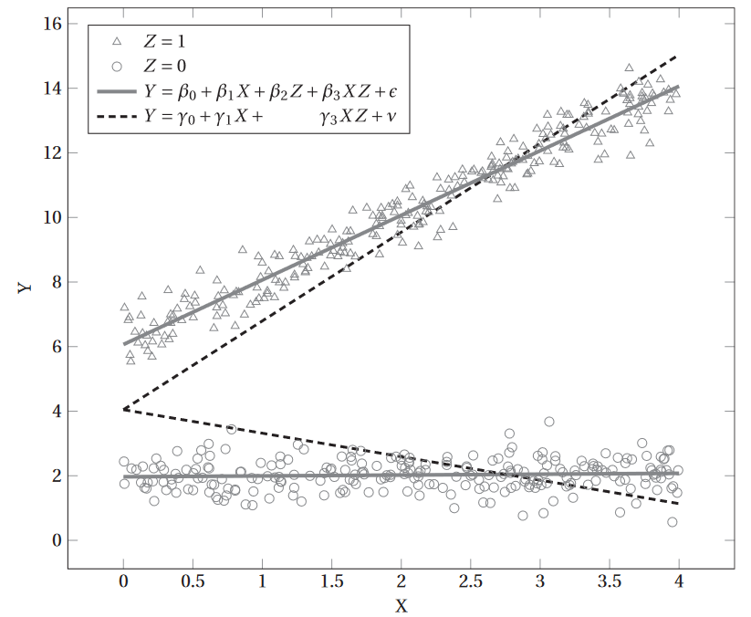
Visualising interactions

Slide 29
Example: Preferences for redistribution
Based on Akaeda (2023):
the dependent variable is the score of preferences for redistribution. This score is based on a question … that asks respondents to indicate on a scale from 1 to 10 whether ‘Incomes should be made more equal (1)’ or ‘We need larger income differences as incentives for individual effort (10)’. In accordance with previous research, the scores were reversed such that a higher score indicates stronger support for redistribution;
the level of education is a key independent variable because the association between education and support for redistribution is a main focus of this study. Because previous studies have shed light on the mechanisms of university education related to a conservative view of redistribution, this analysis adopts the dummy for university or higher degree as an independent variable;
as a key moderator variable … social trust as measured by the question, ‘Generally speaking, would you say that most people can be trusted or that you need to be very careful in dealing with people?’, which had the following two potential responses: ‘1. Most people can be trusted’, ‘2. Need to be very careful’. Based on previous research involving social trust, this analysis employs the dummy for social trust (1 = ‘Most people can be trusted’);
the following individual-level controls: gender (1 = female, 0= male), age, age squared, employment status (employed, self-employed, unemployed, retired, other), household income (z scored for country-year units, marital status (married = 1), child (having child = 1), and political orientation (1 = right to 10 = left)

Slide 30
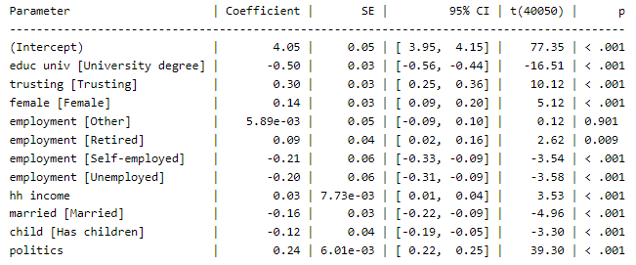
Example: Preferences for redistribution
lm(redistribute ~ educ_univ + trusting + female + employment + hh_income + married + child + politics)

Slide 31
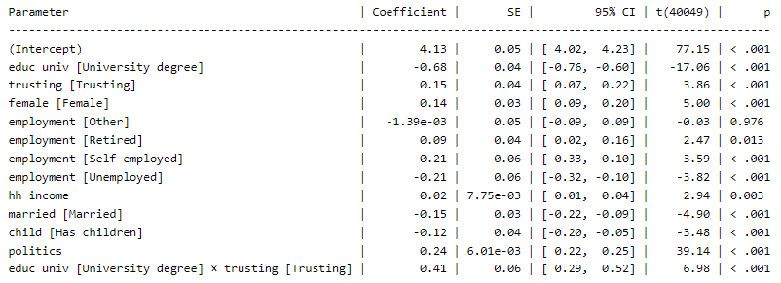
Example: Preferences for redistribution
lm(redistribute ~ educ_univ + trusting + educ_univ*trusting + female + employment + hh_income + married + child + politics)

Slide 32
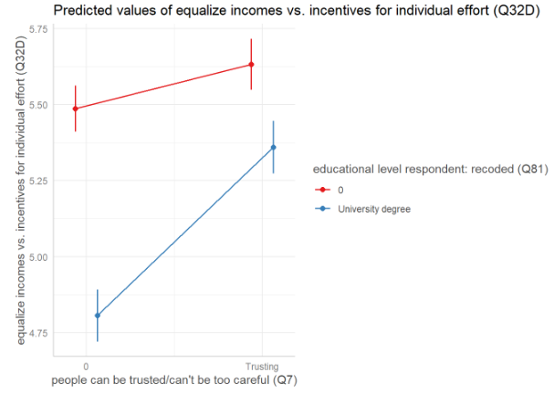
Example: Preferences for redistribution
lm(redistribute ~ educ_univ + trusting + educ_univ*trusting + female + employment + hh_income + married + child + politics)

