Slide 2
Week 9
Modelling continuous outcomes

Slide 3

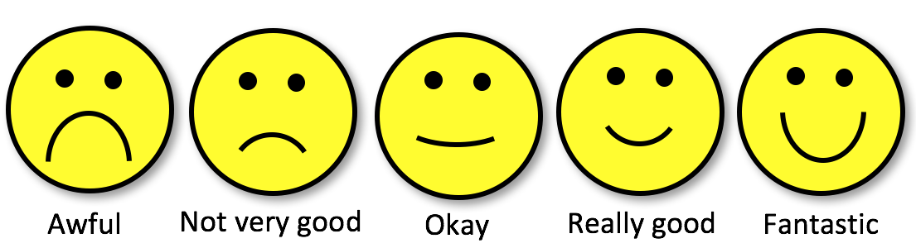
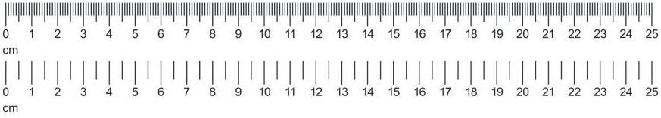
Continuous outcomes?
Categorical:
Nominal
Variable
types
/
Measurement
levels
Categorical:
Ordinal
Scale/Numeric:
Discrete,
Ratio,
Interval

Slide 4
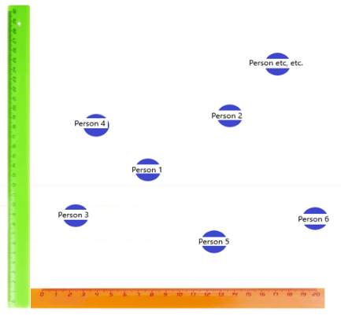
Continuous outcomes?
Dependent / Outcome
Variable
The variable we want to explain/predict
Independent
Variable
The variable we want to use for explaining/predicting the DV

Slide 5
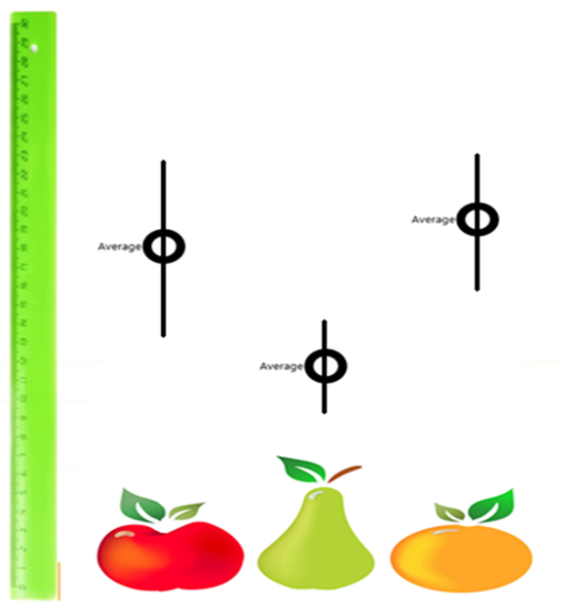
Continuous outcomes?
Dependent / Outcome
Variable
The variable we want to explain/predict
Independent
Variable
The variable we want to use for explaining/predicting the DV

Slide 6
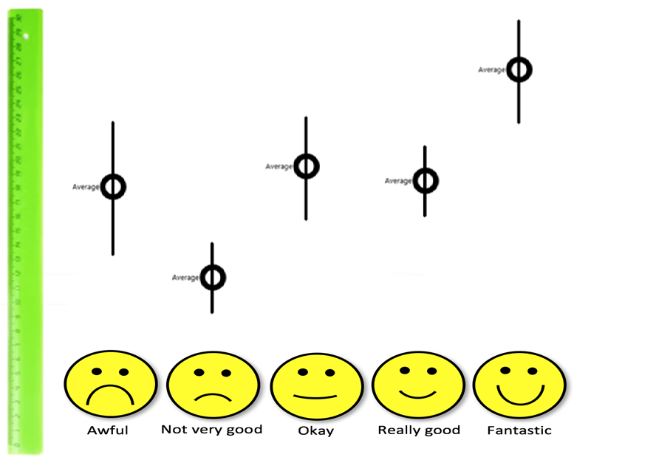
Continuous outcomes?
Dependent / Outcome
Variable
The variable we want to explain/predict
Independent
Variable
The variable we want to use for explaining/predicting the DV

Slide 7
How is income inequality associated with social trust?

Slide 8
Does inequality explain social trust?
Inequality as a predictor of social trust
Social trust as a function of inequality
A model of social trust dependent on inequality
…

Slide 9
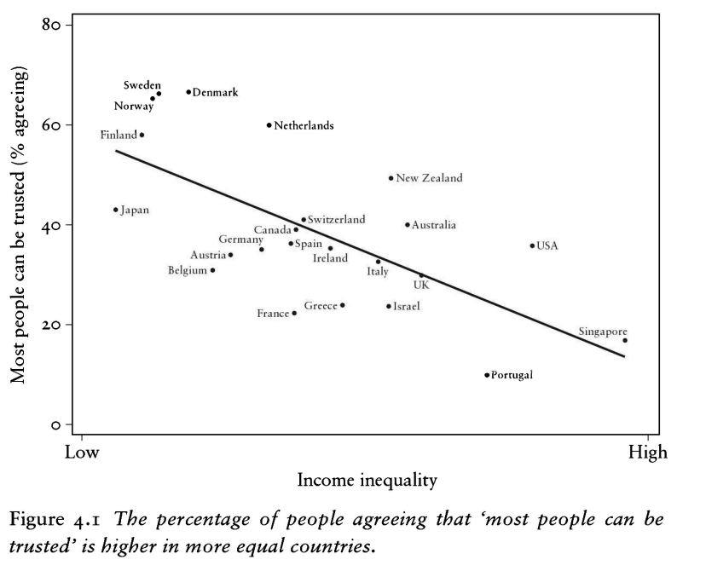

The spirit level (2010)

Slide 10
What is a ‘best’ line?
The same regression line could represent very different relationships
Source: F. J. Anscombe (1973). Graphs in Statistical Analysis. The American Statistician, 27(1):17-21. If you have access to JSTOR you can get the article at the following link: http://www.jstor.org/stable/2682899

Slide 11
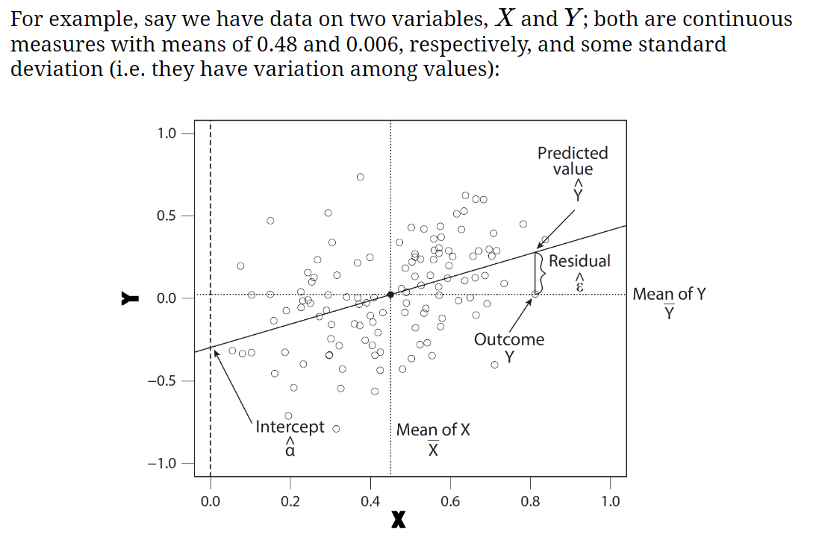

Slide 12
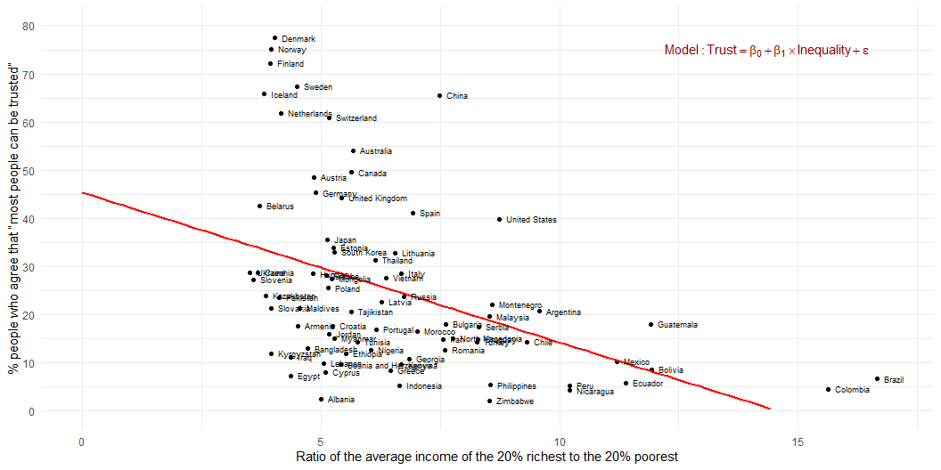
Estimation
Association between inequality and social trust at cross-national comparative level (W3Ex1) (Wilkinson and Pickett 2010)

Slide 13
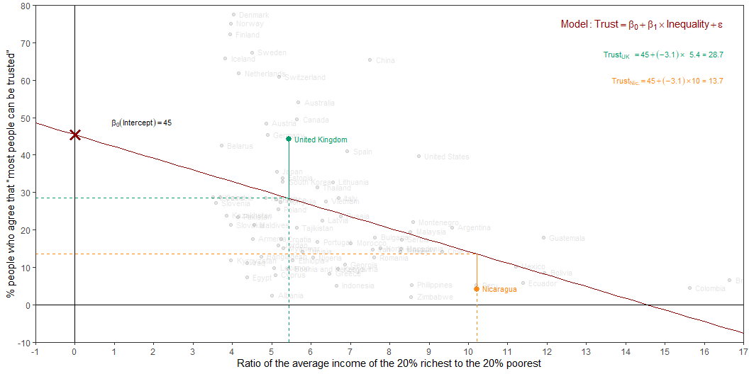
Estimation
Intercept: Social trust in countries with 0 inequality is expected to be 45.4 on average.
Slope: For each additional point increase in Inequality, the model predicts the level of social trust to be lower, on average, by 3.1 points.

Slide 14
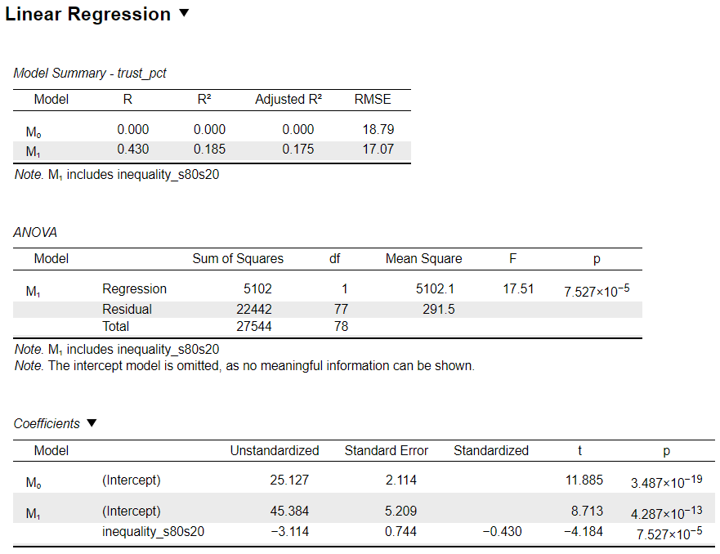
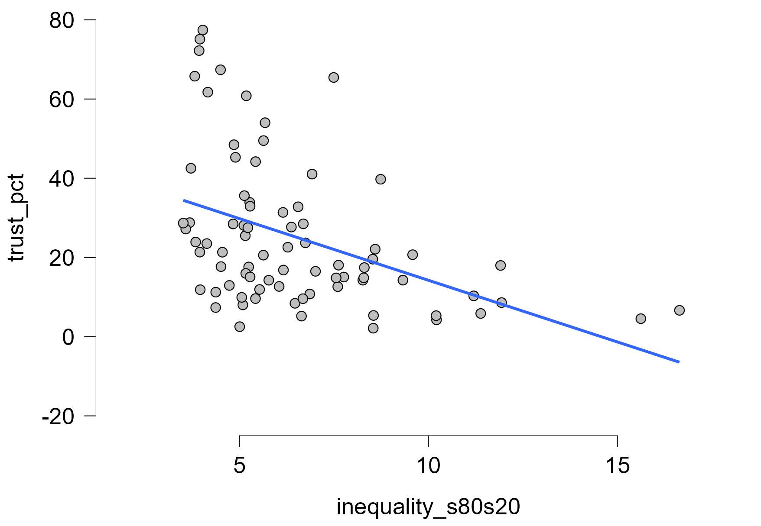
Inequality → Social trust

Slide 15
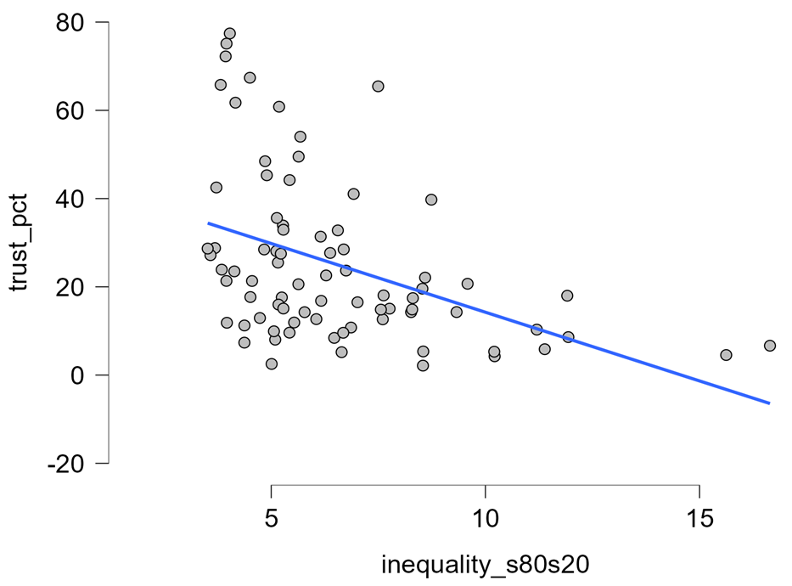
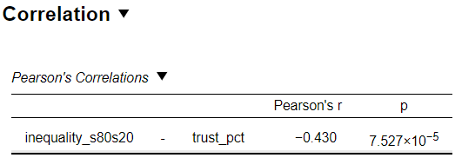
Inequality ←→ Social trust

Slide 16
Inequality → Social trust

Slide 17
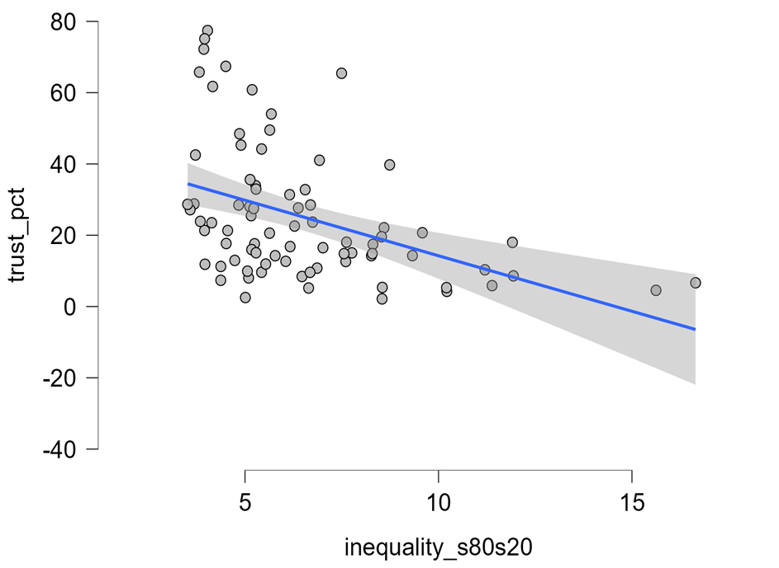
Inequality → Social trust

Slide 18
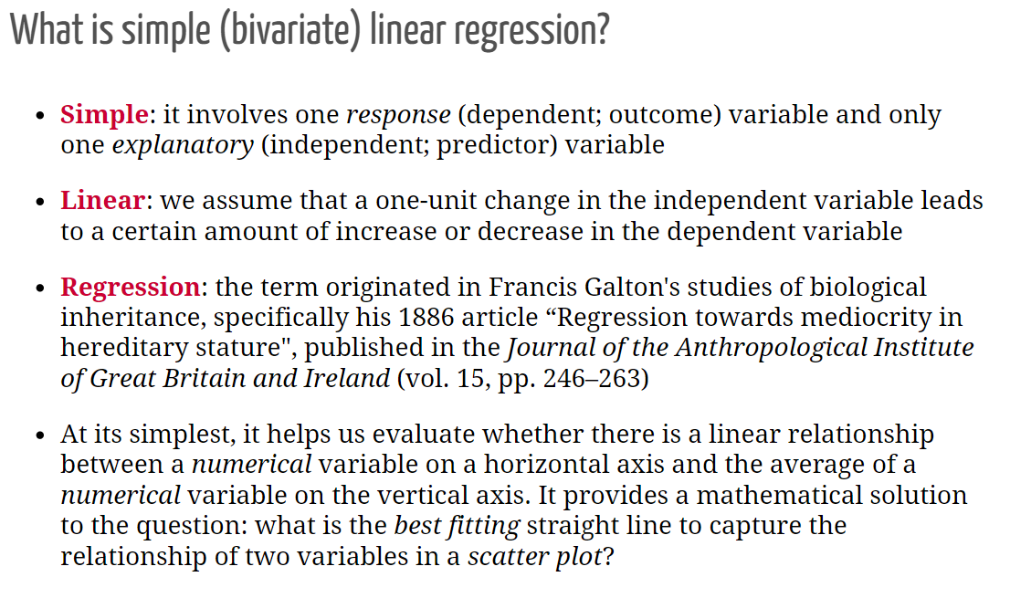

Slide 19
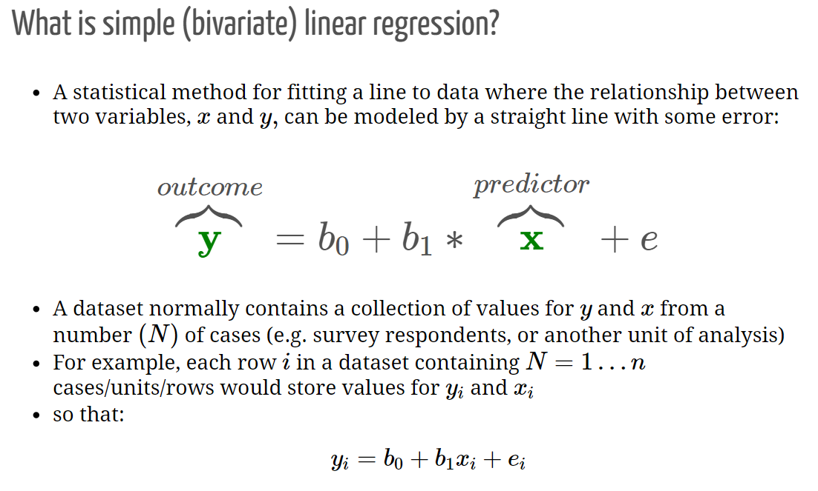

Slide 20
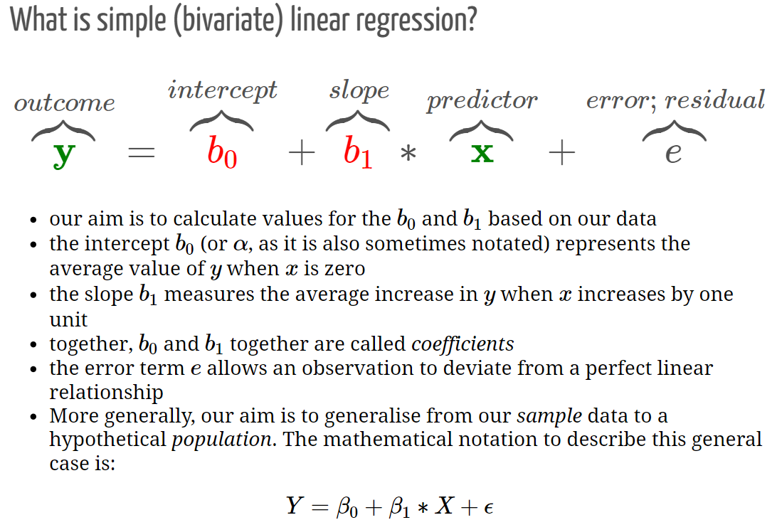

Slide 21
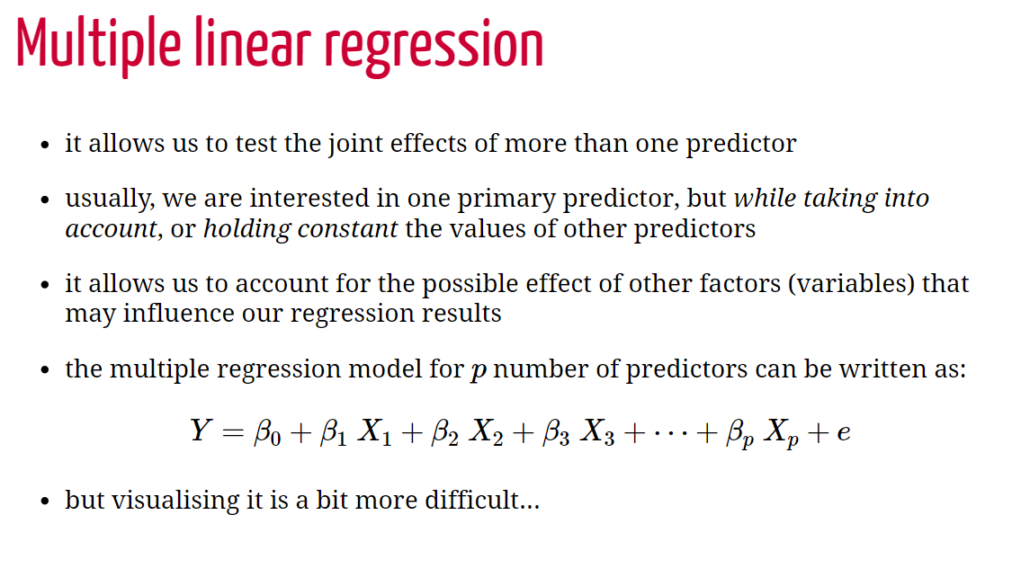

Slide 22
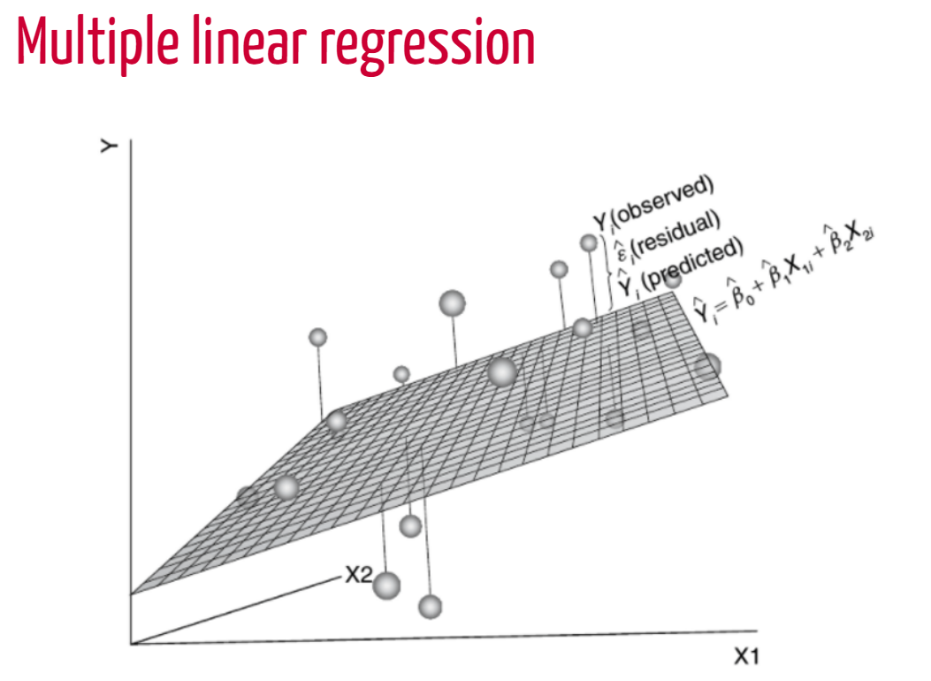
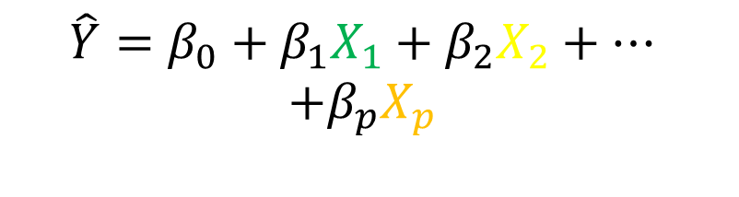
$$\hat{Y}=β_{0}+β_{1}X_{1}+β_{2}X_{2}+…$$
$$+β_{p}X_{p}$$
X1
X2
X3
60%
unexplained

Slide 23
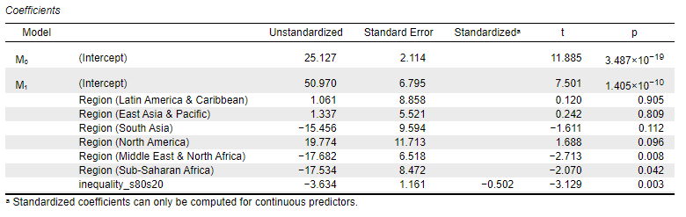
Inequality + Region → Social trust

Slide 24
Workshop
1-3pm

