Slide 2
Week 10
Modelling
dichotomous outcomes

Slide 3

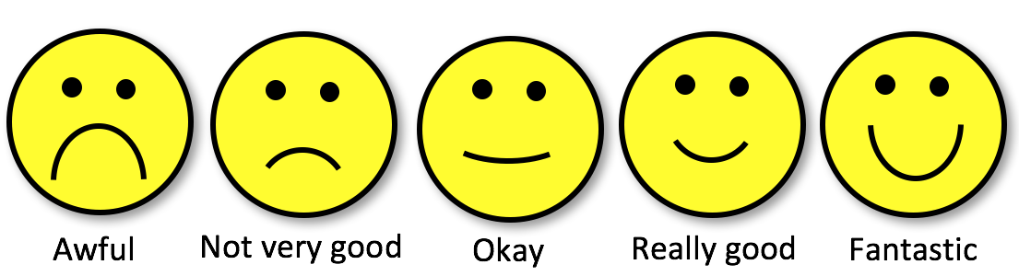
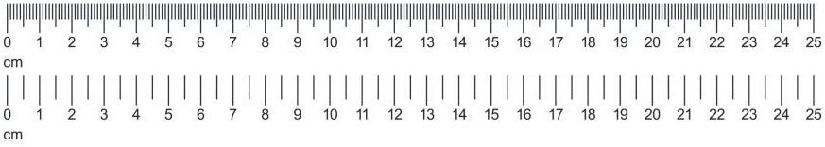
Dichotomous outcomes?
Categorical:
Nominal
Variable
types
/
Measurement
levels
Categorical:
Ordinal
Scale/Numeric:
Discrete,
Ratio,
Interval

Slide 4
Dichotomous outcomes?
Categorical:
Nominal
Variable
types
/
Measurement
levels
Categorical:
Ordinal
Scale/Numeric:
Discrete,
Ratio,
Interval

Slide 5
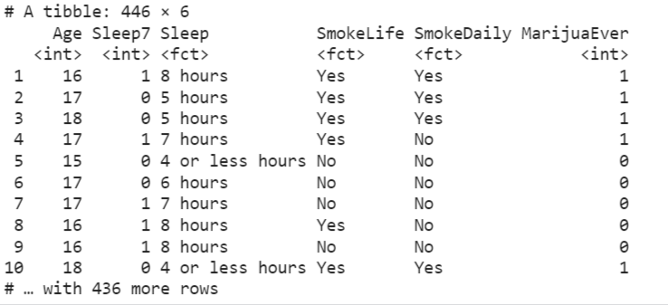
Example
Question: “Do teenagers get 7+ hours of sleep?”
Students in grades 9 - 12 surveyed about health risk behaviours including whether they usually get 7 or more hours of sleep
Sleep:
1 = “Yes”
0 = “No”

Slide 6
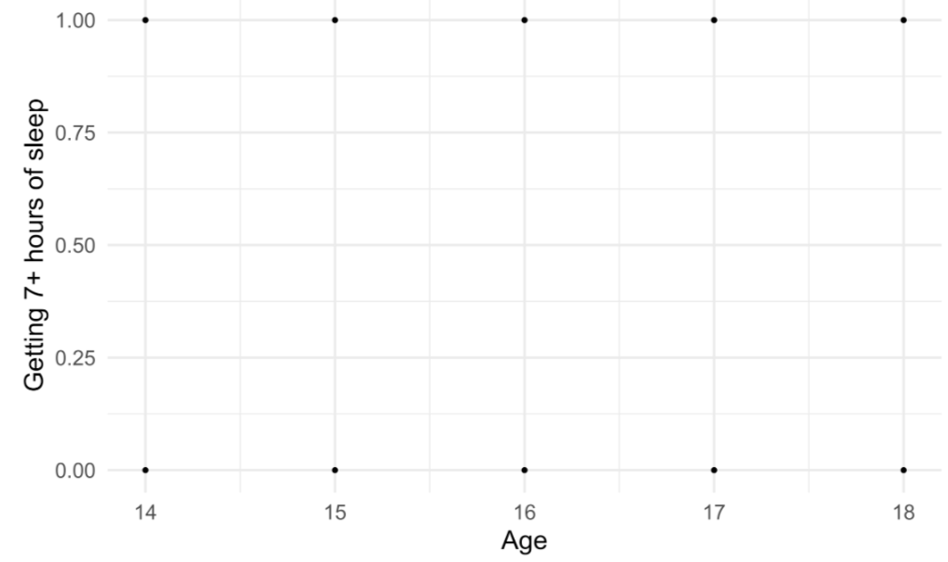
Example

Slide 7
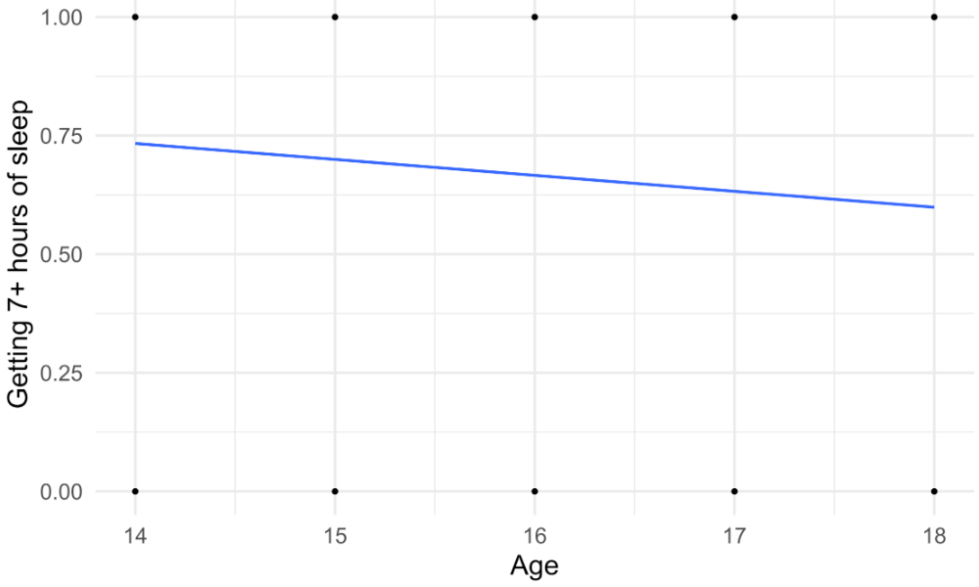
Example
Outcome: 1 = yes, 0 = no

Slide 8
Example
Outcome: Probability of getting 7+ hours of sleep

Slide 9
Example
Outcome: Probability of getting 7+ hours of sleep (Linear model)

Slide 10
Example
Outcome: Probability of getting 7+ hours of sleep (Logistic model)

Slide 11
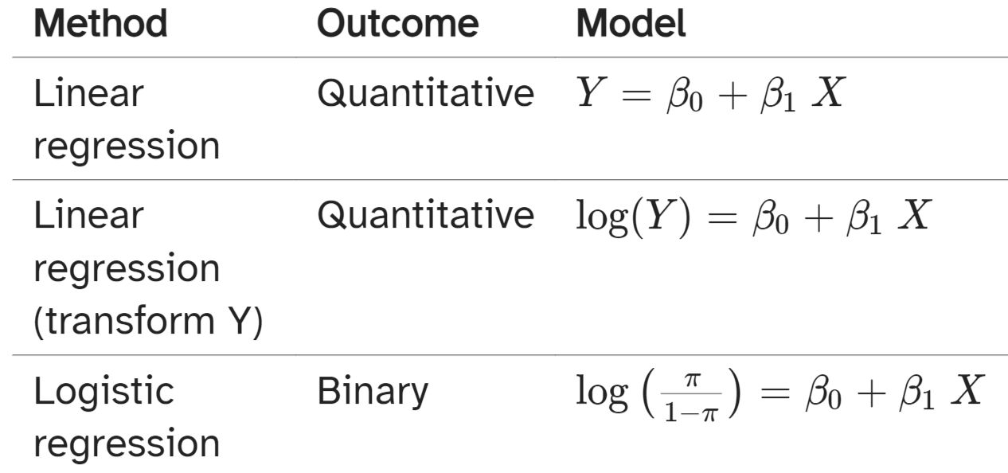
Different types of models

Slide 12
Logistic regression: the (ugly) theory

Slide 13
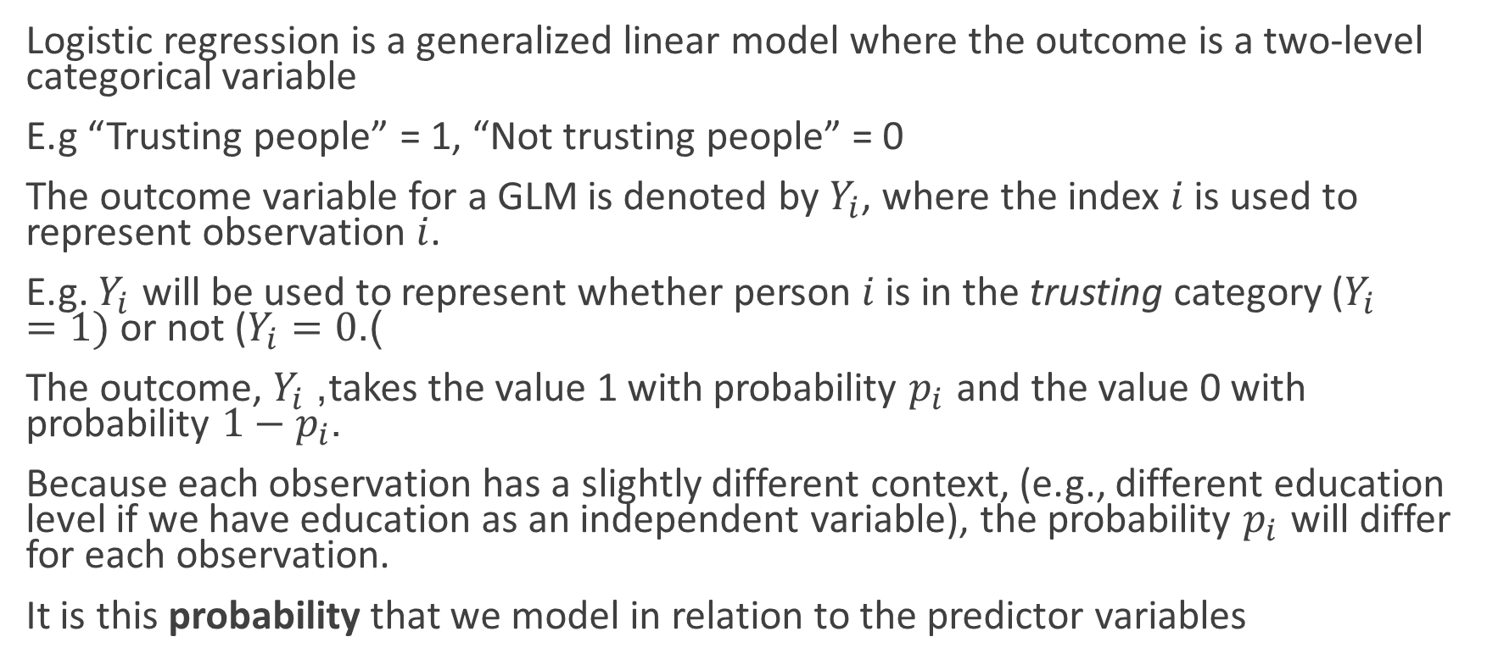
What is logistic regression?
Logistic regression is a generalized linear model where the outcome is a two-level categorical variable
E.g “Trusting people” = 1, “Not trusting people” = 0
The outcome variable for a GLM is denoted by $Y_{i}$, where the index $i$ is used to represent observation $i$.
E.g. $Y_{i}$ will be used to represent whether person $i$ is in the trusting category ($Y_{i}=1)$or not ($Y_{i}=0$).
The outcome, $Y_{i}$, takes the value 1 with probability $p_{i}$ and the value 0 with probability $1−p_{i}$.
Because each observation has a slightly different context, (e.g., different education level if we have education as an independent variable), the probability $p_{i}$ will differ for each observation.
It is this probability that we model in relation to the predictor variables

Slide 14
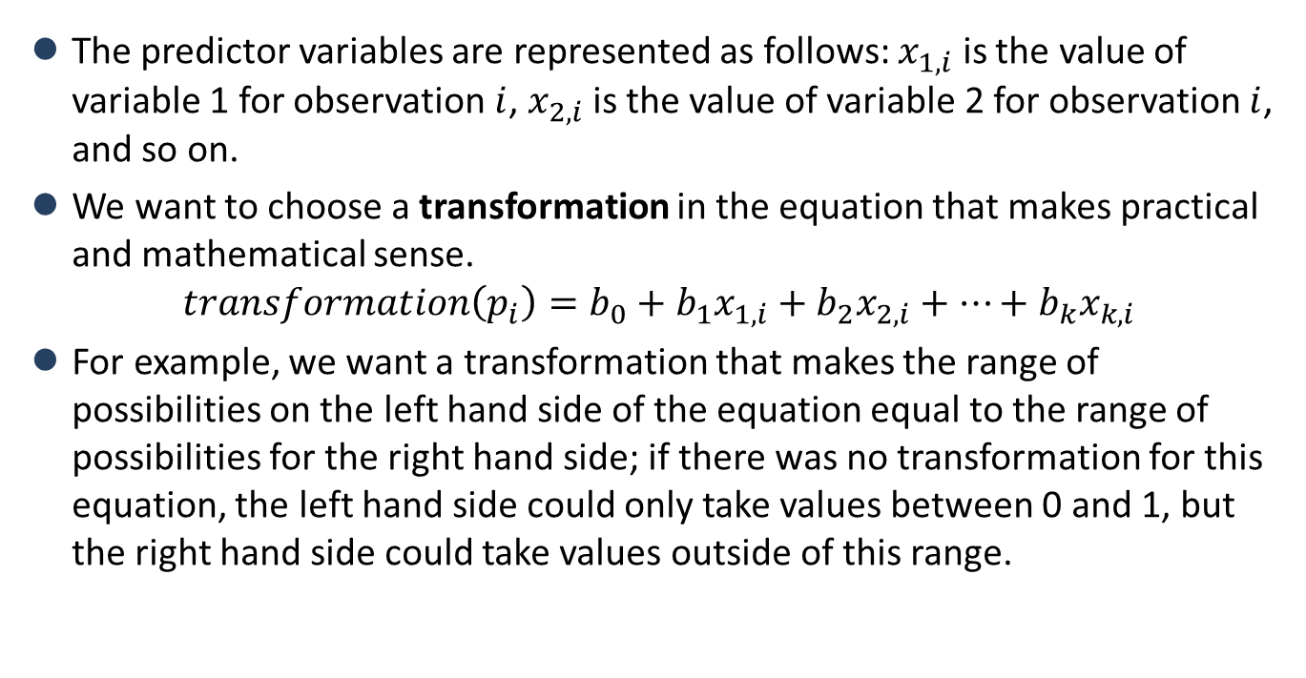
The logit transformation
The predictor variables are represented as follows: $x_{1,i}$ is the value of variable 1 for observation $i$, $x_{2,i}$ is the value of variable 2 for observation $i$, and so on.
We want to choose a transformation in the equation that makes practical and mathematical sense.
$$transformation\left(p_{i}\right)=b_{0}+b_{1}x_{1,i}+b_{2}x_{2,i}+⋯+b_{k}x_{k,i}$$
For example, we want a transformation that makes the range of possibilities on the left hand side of the equation equal to the range of possibilities for the right hand side; if there was no transformation for this equation, the left hand side could only take values between 0 and 1, but the right hand side could take values outside of this range.

Slide 15
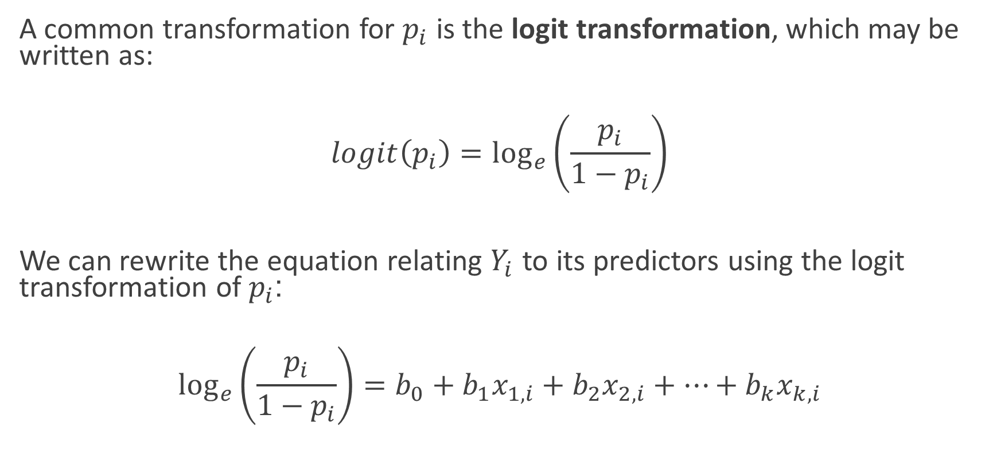
The logit transformation
A common transformation for $p_{i}$ is the logit transformation, which may be written as:
$$logit\left(p_{i}\right)=\log_{e}\left(\frac{p_{i}}{1−p_{i}}\right)$$
We can rewrite the equation relating $Y_{i}$ to its predictors using the logit transformation of $p_{i}$:
$$\log_{e}\left(\frac{p_{i}}{1−p_{i}}\right)=b_{0}+b_{1}x_{1,i}+b_{2}x_{2,i}+⋯+b_{k}x_{k,i}$$

Slide 16
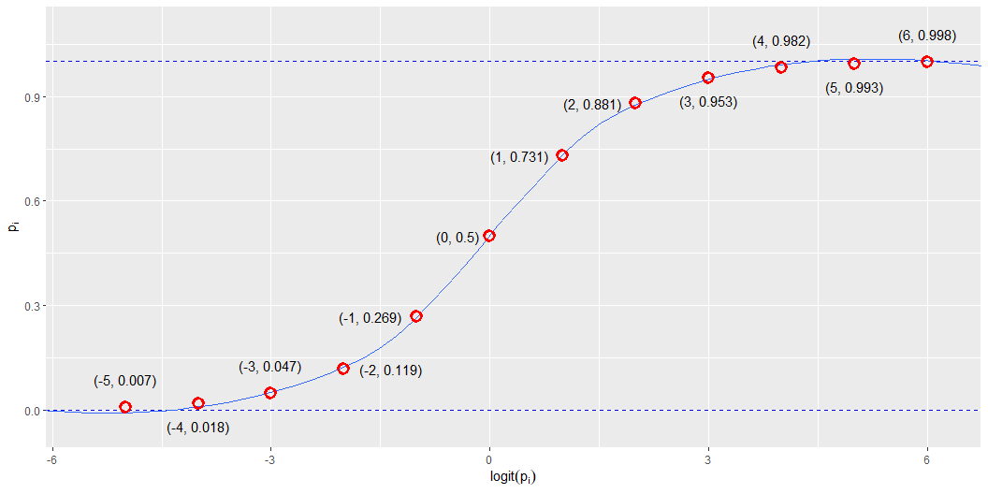
The logit transformation

Slide 17
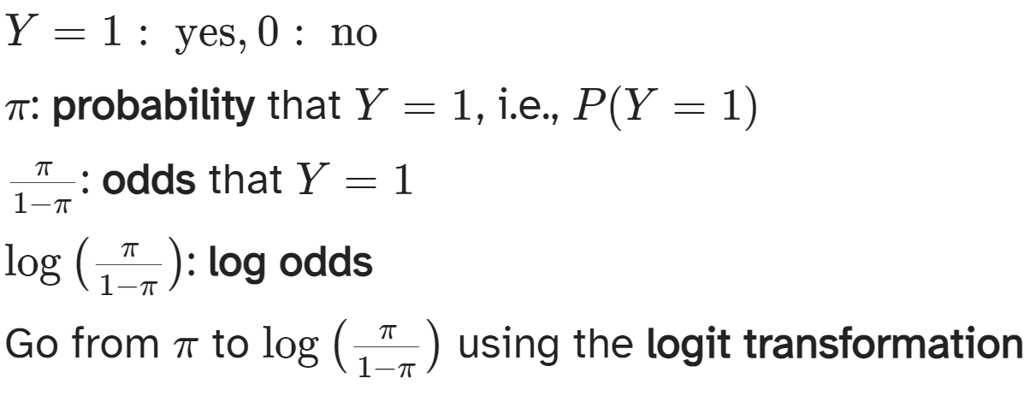
Odds and probabilities

Slide 18
Odds and probabilities
probs | odds | log_odds
0.01 | 0.01 | -4.60
0.05 | 0.05 | -2.94
0.10 | 0.11 | -2.20
0.20 | 0.25 | -1.39
0.33 | 0.50 | -0.69
0.40 | 0.67 | -0.41
0.50 | 1.00 | 0.00
0.60 | 1.50 | 0.41
0.67 | 2.00 | 0.69
0.80 | 4.00 | 1.39
0.90 | 9.00 | 2.20
0.95 | 19.00 | 2.94
0.99 | 99.00 | 4.60

Slide 19
Odds
Suppose there is a 70% chance it will rain tomorrow
Probability it will rain is p = 0.7
Probability it won’t rain is 1 − p = 0.3
Odds it will rain are 7 to 3, 7:3, 0.7/0.3 ≈ 2.33

Slide 20
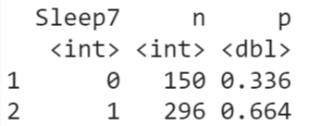
Are teenagers getting enough sleep?
P(7+ hours of sleep) = P(Y=1) = p = 0.664
P(< 7 hours of sleep)=P(Y=0) = 1−p = 0.336
P(odds of 7+ hours of sleep) = 0.664/0.336 = 1.976 = ~97.6%

Slide 21
Logistic regression applied: Workshop
1-3pm

Slide 22
How did sex-adjusted age shape social trust in Britain in 2010-2011?
Frequencies for SocTrust
SocTrust | Frequency | Percent | Valid Percent | Cumulative Percent
Can't be too careful in dealing with people | 579 | 17.6 | 54.6 | 54.6
Most people can be trusted | 481 | 14.6 | 45.4 | 100.0
Missing | 2230 | 67.8
Total | 3290 | 100.0

Slide 23
How did sex-adjusted age shape social trust in Britain in 2010-2011?
Descriptive Statistics
 | SocTrust | AgeCat | Age | Sex
Valid | 1060 | 3290 | 3290 | 3290
Missing | 2230 | 0 | 0 | 0
Mean |  |  | 51.02
Std. Deviation |  |  | 17.93
Minimum |  |  | 17.00
Maximum |  |  | 95.00

Slide 24
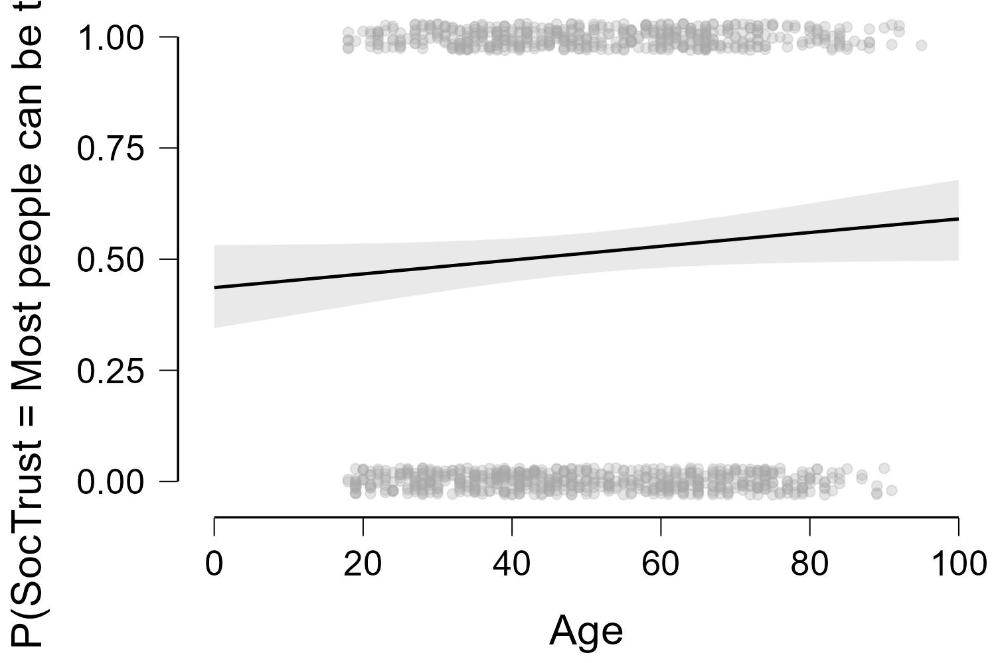
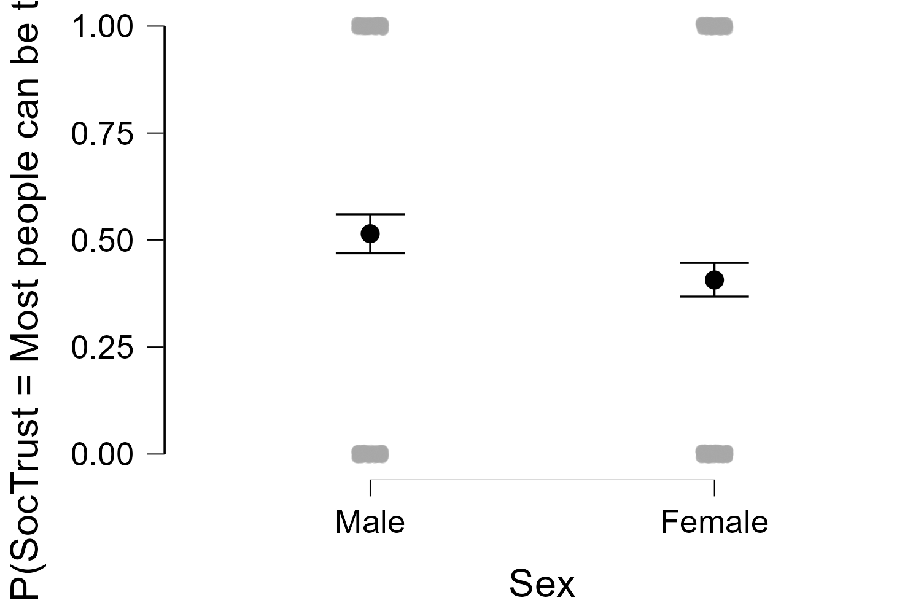
How did sex-adjusted age shape social trust in Britain in 2010-2011?

Slide 25
Assignment Questions
A. Are religious people more satisfied with life?
B. Are older people more likely to see the death penalty as justifiable?
C. What factors are associated with opinions about future European Union enlargement among Europeans?
D. Is higher internet use associated with stronger anti-immigrant sentiments?
E. How does victimisation relate to trust in the police?
F. What factors are associated with belief in life after death?
G. Are government/public sector employees more inclined to perceive higher levels of corruption than those working in the private sector?

