Slide 1


Slide 2
Week 2
Comparisons and Associations

Slide 3
Today
One variable
Last week: frequencies, centre and spread
Pick the tool
Contingency tables, group comparisons, scatter plots
Workshop
Trust by sex, age and inequality in JASP
Two variables
Do the values of one “rhyme” with the values of another?
This week’s application questions
Do men and women differ in social trust? Do older people trust more?
Are more unequal countries less trusting?

Slide 4
Which tool for which pair of variables?
Two variables that are … | Tool | Example from the module data | Size of the association
Categorical × categorical | Contingency table with % within groups | Trust (trusted / careful) by sex, BSA 2010 | Difference in percentage points
Categorical × scale | Group means and medians; box plots | Trust (0 to 10) by gender, ESS 2023-24 | Difference in means
Scale × scale | Scatter plot; correlation | Trust by income inequality, 23 countries | Pearson’s r (−1 to +1)
BSA = British Social Attitudes; ESS = European Social Survey.
Notes:
The measurement level of the two variables decides the tool, exactly as it decided the univariate statistics last week. Each row is one section of today's lecture and one exercise in Worksheet 2.

Slide 5
Outcome and explanatory variables
Explanatory variable
also: independent, predictor
e.g. sex, age, a country’s inequality
Outcome variable
also: dependent, response
e.g. social trust
In a contingency table
Explanatory variable in the columns, outcome in the rows: compare column percentages.
In a scatter plot
Explanatory variable on the x-axis, outcome on the y-axis.
Direction is a choice
Theory decides which way the arrow points. The data alone cannot.
Notes:
Most bivariate descriptions assume a direction: one variable helps explain the other. That is a theoretical decision, not something the data tell us. The conventions follow from it: explanatory variable in the columns of a table (so we compare column percentages) and on the x-axis of a plot.

Slide 6

Activity: which is the outcome?
1
Age and social trust
2
Sex and social trust
3
A country’s income inequality and its level of trust
4
Volunteering and social trust
5
Education and social trust
6
Being a victim of crime and trust in the police (assignment question E)
Notes:
2 minutes in pairs. For each pair, which variable would you treat as the outcome, and why? Answers on the next slide.

Slide 7
Which is the outcome? Answers
1
Age and social trust
Trust: age can shape trust, but trust cannot change age
2
Sex and social trust
Trust
3
A country’s income inequality and its level of trust
Usually trust, but trust may also shape support for redistribution: theory decides
4
Volunteering and social trust
Either: trust may lead to volunteering, and volunteering may build trust
5
Education and social trust
Trust: education usually comes earlier in life
6
Being a victim of crime and trust in the police (assignment question E)
Trust in police, though trust may also affect whether crimes are reported

Slide 8
Two categorical
variables
Contingency tables

Slide 9
Building a contingency table
BSA 2010: “Would you say that most people can be trusted, or that you can’t be too careful?” by sex
Counts | Men | Women | Total
Most people can be trusted | 240 | 244 | 484
Can’t be too careful | 224 | 356 | 580
Total | 464 | 600 | 1,064
Data: British Social Attitudes 2010 (gb-bsa10-trust.sav), respondents with a substantive answer, n = 1,064.
Notes:
Counts are hard to compare because the groups differ in size (more women than men answered). Dividing each count by its column total gives the percentage of men and of women in each answer category. That is the comparison we want: are men or women more trusting?

Slide 10
Column percentages
“Are men or women more trusting?”
Counts | Men | Women | Total
Most people can be trusted | 240 | 244 | 484
Can’t be too careful | 224 | 356 | 580
Total | 464 | 600 | 1,064
Column % | Men | Women | All
Most people can be trusted | 51.7 | 40.7 | 45.5
Can’t be too careful | 48.3 | 59.3 | 54.5
Total | 100 | 100 | 100
÷ column total
Men 51.7% vs women 40.7%: a gap of about 11 percentage points. The bigger the gap, the stronger the association.
Data: British Social Attitudes 2010 (gb-bsa10-trust.sav), respondents with a substantive answer, n = 1,064.
Notes:
Counts are hard to compare because the groups differ in size (more women than men answered). Dividing each count by its column total gives the percentage of men and of women in each answer category. That is the comparison we want: are men or women more trusting?

Slide 11
Row percentages
“Who are the trusting?”
Counts | Men | Women | Total
Most people can be trusted | 240 | 244 | 484
Can’t be too careful | 224 | 356 | 580
Total | 464 | 600 | 1,064
 | Men | Women | Total
Trusted | 49.6 | 50.4 | 100
Careful | 38.6 | 61.4 | 100
÷ row total
Among the “trusting”, men and women are distributed almost equally.
But:
Women are overrepresented in the whole sample!
Data: British Social Attitudes 2010 (gb-bsa10-trust.sav), respondents with a substantive answer, n = 1,064.
Notes:
Counts are hard to compare because the groups differ in size (more women than men answered). Dividing each count by its column total gives the percentage of men and of women in each answer category. That is the comparison we want: are men or women more trusting?

Slide 12
Row percentages - beware
“Who are the trusting?”
Counts | Men | Women | Total
Most people can be trusted | 240 | 2440 | 2,680
Can’t be too careful | 224 | 3560 | 3,784
Total | 464 | 6000 | 6,464
 | Men | Women | Total
Trusted | 9.0 | 91.0 | 100
Careful | 5.9 | 94.1 | 100
÷ row total
Among the “trusting”, men and women are distributed almost equally.
Women are heavily overrepresented in the whole sample!
Notes:
Counts are hard to compare because the groups differ in size (more women than men answered). Dividing each count by its column total gives the percentage of men and of women in each answer category. That is the comparison we want: are men or women more trusting?

Slide 13
Visualising the comparison
In the workshop
Worksheet 2, Exercise 1.1: the same table with the ESS 0 to 10 trust scale.
Data: British Social Attitudes 2010 (gb-bsa10-trust.sav), respondents with a substantive answer, n = 1,064.
Notes:
A 100% stacked bar is the picture of the column percentages. The gap between the dark segments is the association.

Slide 14
Activity: read this table
Citizenship Survey 2010-11 (column %) | Men | Women
People can be trusted | 39.0 | 35.0
You can’t be too careful | 48.2 | 52.6
Depends (volunteered) | 12.8 | 12.4
Total | 100 | 100
n | 7,815 | 9,111
What percentage of men say people can be trusted?
1
How big is the gap between men and women in trusting?
2
Do men and women differ in answering “it depends”?
3
The BSA 2010 gap was 11 points. Why might this one differ?
4
Data: Citizenship Survey 2010-11, England and Wales (gb-cs10-trust.sav), n = 16,926.
Notes:
Citizenship Survey 2010-11, column percentages. 3 minutes in pairs. Answers on the next slide.

Slide 15
Reading a table: answers
Citizenship Survey 2010-11 (column %) | Men | Women
People can be trusted | 39.0 | 35.0
You can’t be too careful | 48.2 | 52.6
Depends (volunteered) | 12.8 | 12.4
Total | 100 | 100
n | 7,815 | 9,111
What percentage of men say people can be trusted?
39.0%
1
How big is the gap between men and women in trusting?
4.0 points (39.0% vs 35.0%)
2
Do men and women differ in answering “it depends”?
Hardly: 12.8% vs 12.4%
3
The BSA 2010 gap was 11 points. Why might this one differ?
Different answer options (“depends”), samples and coverage; and chance (Week 5)
4
Data: Citizenship Survey 2010-11, England and Wales (gb-cs10-trust.sav), n = 16,926.

Slide 16
A categorical and
a scale variable
Comparing groups

Slide 17
Recall: mean, median and mode
Mean: 5.40
Median: 6
Mode: 7
Slight left skew
A tail of low answers pulls the mean below the median.
Data: European Social Survey Round 11 (2023-24), UK sample, valid n = 1,680 (gb-ess11-trust.sav).
Notes:
Real data. On ppltrst the three measures disagree: mean 5.40, median 6, mode 7. More people answer above the middle of the scale than below, but a tail of very low answers (0 to 2) pulls the mean down. This mild left skew is the same mechanism as the income example, in the opposite direction.

Slide 18
Recall: range and standard deviation
53.6
Mean age
54
Median age
19.0
Standard deviation
15 to 90
Range
Data: European Social Survey Round 11 (2023-24), UK sample, n = 1,647 with a valid age (agea).
Notes:
Real data rarely look like textbook curves. Age in the UK ESS sample is fairly flat from the early 30s to the late 70s, thins out at both ends, and mean and median are almost the same. Ask: why are there so few respondents under 25? (The ESS samples people aged 15+; young people are also harder to reach.)

Slide 19
Recall: same average, very different societies
Range
Highest minus lowest. Set by just two cases.
Interquartile range
Spread of the middle 50%. Ignores the extremes.
Standard deviation
Typical distance from the mean.
SYNTHETIC EXAMPLE DATA
Notes:
Synthetic example: two towns with the same mean income (£30k) but very different spread. Reporting only the average hides inequality. For sociologists, spread is often the story.

Slide 20
The standard deviation, step by step
Person | Trust (x) | x − mean | (x − mean)²
A | 2 | −3 | 9
B | 4 | −1 | 1
C | 5 | 0 | 0
D | 7 | 2 | 4
E | 7 | 2 | 4
Sum | 25 | 0 | 18
1 Mean
25 ÷ 5 = 5
2 Deviations
subtract the mean from each value
3 Variance
18 ÷ (5 − 1) = 4.5
4 Standard deviation
√4.5 ≈ 2.12
In the real ESS data the SD of ppltrst is 2.30: a typical answer lies about 2.3 points from the mean of 5.4.
SYNTHETIC EXAMPLE DATA
Notes:
Synthetic example: five trust scores. Deviations always add up to zero, which is why we square them. We divide by n - 1 for a sample. The square root brings us back to the original units: a typical answer is about 2 points from the mean.

Slide 21
Recall: the box plot
Median = 6
25th percentile (Q1) = 4
75th percentile (Q3) = 7
Minimum 0
Maximum 10
mean = 5.4
0
1
2
3
4
5
6
7
8
9
10
Trust in most people (0 to 10)
IQR = 3
The middle half of respondents answered between 4 and 7.
SD = 2.30
Typical distance of an answer from the mean.
60% in the box
With whole-number answers the box holds a bit more than half.
Data: European Social Survey Round 11 (2023-24), UK sample, n = 1,680 (gb-ess11-trust.sav).
Notes:
Real data. The box covers the middle half of respondents (25th to 75th percentile: 4 to 7); the line inside is the median (6). The whiskers run to the most extreme answers within 1.5 IQRs of the box, here the ends of the scale. The diamond marks the mean (5.4). In Week 2 we use box plots to compare groups.

Slide 22
Comparing group averages
ESS 2023-24 | n | Mean | Median | SD
Men | 822 | 5.54 | 6 | 2.24
Women | 858 | 5.27 | 5 | 2.34
Men − women |  | 0.27 | 1
Men
5.54
Women
5.27
Small gap, wide spread
The gap (0.27) is about a tenth of one standard deviation (≈ 2.3).
0
2
4
6
8
10
Trust (0 to 10)
Dot = mean; line = ± 1 standard deviation
Data: European Social Survey Round 11 (2023-24), UK sample, n = 1,680 (gb-ess11-trust.sav).
Notes:
ESS 0-10 trust by gender. Men score 0.27 points higher on average; the medians differ by a full point because the data are whole numbers. The bars show one standard deviation either side of each mean: the gap between groups is tiny compared with the spread within each group.

Slide 23
Box plots compare whole distributions
median 6
Men
median 5
Women
0
1
2
3
4
5
6
7
8
9
10
Medians
Men 6, women 5
Middle 50%
Both 4 to 7
Means (diamonds)
Men 5.54, women 5.27
Trust in most people (0 to 10)
Data: European Social Survey Round 11 (2023-24), UK sample, n = 1,680 (gb-ess11-trust.sav).
Notes:
Box plots for men and women on the 0-10 scale (whiskers to the most extreme values within 1.5 IQR, here the ends of the scale). Medians differ by one point, the boxes overlap almost completely. This is what you create in Worksheet 2, Exercise 1.2.

Slide 24
The same gap can be big or small
Small spread (SD = 0.6)
Wide spread (SD = 2.3)
Real data: the ESS gender gap is 0.27 points with an SD of about 2.3, so the two groups overlap even more than on the right.
SYNTHETIC EXAMPLE DATA
R code: synthetic_examples.R, section W2a. Two normal curves per panel, means 5 and 6.
Notes:
Synthetic example. In both panels the group means differ by exactly one point. With little spread (left) the groups barely overlap and the gap is substantial; with wide spread (right) most members of both groups look alike. The real ESS gender gap (0.27 points, SD about 2.3) is even smaller relative to its spread than the right panel.

Slide 25
Activity: describe this pattern
In one sentence
How does trust differ across age groups?
Then
Which groups would you compare to answer “Are young people less trusting?”
Data: Community Life Survey 2023-24, England (gb-cls23-trust_nm.sav), n = 51,079. Trust: “how much do you trust most people?” (0 to 10).
Notes:
Community Life Survey 2023-24 (England), mean trust on 0-10 by age group. Ask for one sentence. Good answers: trust is lowest among people under 35 (about 5.4 to 5.6) and rises steadily from the mid-30s to about 7 among those 75+. Note that 16-24s are not lower than 25-34s. To answer 'are young people less trusting?' we must decide which groups to compare: we return to this exact question in Week 4.

Slide 26
Two scale
variables
Scatter plots and correlation

Slide 27
Reading a scatter plot
r = −0.80
Strong negative
r = 0.00
No linear association
r = 0.40
Moderate positive
r = 0.91
Strong positive
Sign = direction (up or down)
Size = strength (how tightly the points follow a straight line)
SYNTHETIC EXAMPLE DATA
https://guessthecorrelation.com
Notes:
Synthetic example: four samples of 80 cases. Pearson's r runs from -1 to +1. The sign gives the direction (does the cloud go up or down?) and the size gives the strength (how tightly the points hug a straight line).

Slide 28
Correlation only sees straight lines
r = −0.01
Pearson’s r says “no association” …
… but y clearly depends on x
Rule
Always plot before you correlate.
SYNTHETIC EXAMPLE DATA
Notes:
Synthetic example: y depends very strongly on x, but the relationship is U-shaped, so Pearson's r is almost exactly zero. r measures linear association only. Always look at the scatter plot before you trust a correlation.

Slide 29
APPLICATION
Is income inequality associated with social trust? The Spirit Level (2009) and 15 years later

Slide 30

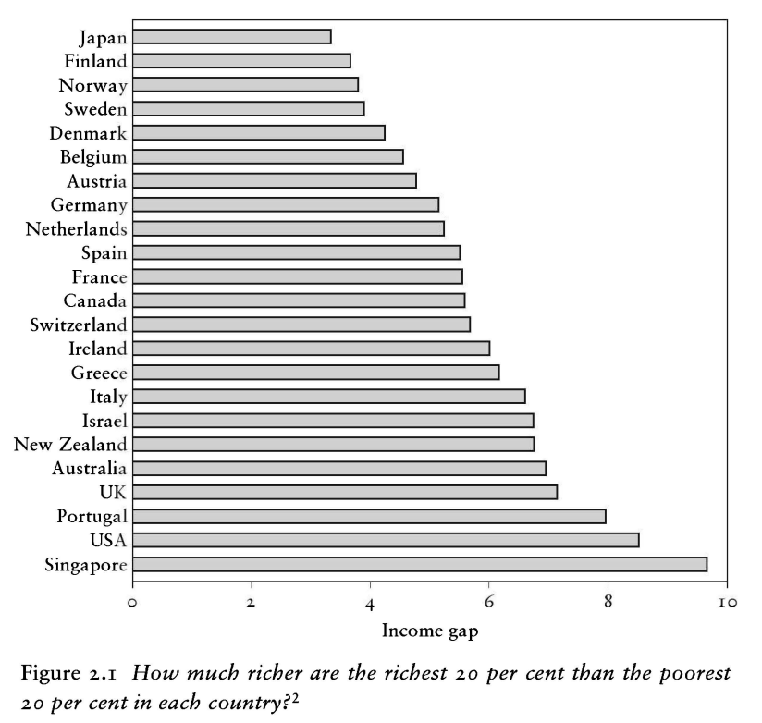
“The spirit level” (2010)

Slide 31
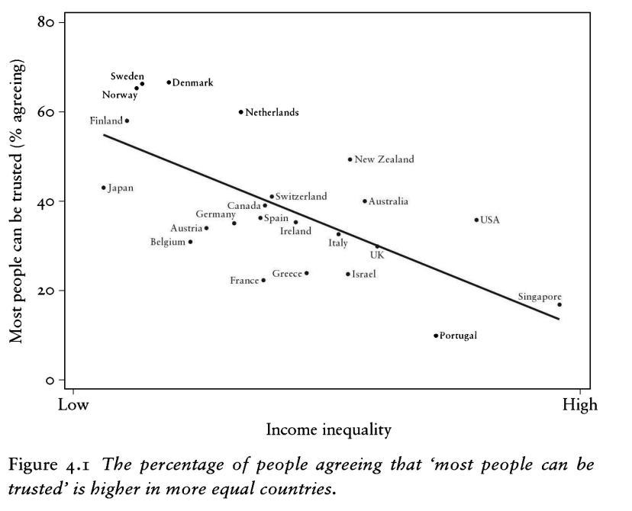
“The spirit level” (2010)

Slide 32
Inequality and trust in 23 rich countries
r = −0.66
strong, negative
Reading it
More unequal countries tend to have lower trust, with plenty of exceptions.
Data: pickett2009.csv (Wilkinson & Pickett 2009, Figure 4.1), 23 countries.
Notes:
Worksheet 2, Exercise 3: the data behind Figure 4.1 in Wilkinson and Pickett. Each dot is a country. Trust is the percentage who say most people can be trusted; inequality is how many times more income the richest fifth receives than the poorest fifth. The correlation is -0.66: strong and negative. Portugal and Singapore sit low right; the Nordic countries high left.

Slide 33
Fifteen years later: 43 countries
Gini coefficient: r = −0.43 (without China: −0.60)
Richest ÷ poorest fifth: r = −0.15 (without China: −0.58)
Data: pickett&al2024.sav (Pickett et al. 2024), 43 countries.
Notes:
Worksheet 2, Exercise 3b: the 2024 update (Pickett et al.) covers 43 countries, including middle-income countries such as Brazil, India and China. With the Gini coefficient the correlation is moderate. With the quintile ratio it almost disappears, because of one country: China combines very high measured inequality (ratio 28) with high measured trust. Removing it brings r back to about -0.6. One case can change a correlation; and when a dataset adds very different countries, we are no longer studying the same population.

Slide 34
Trust and other national indicators
Strongest
Income inequality (r = −0.66)
Country-level
These describe countries, not individuals.
Data: pickett2009.csv, 23 countries. Pearson correlations with the % who say most people can be trusted.
Notes:
All correlations with Trust in the 23-country Spirit Level data. Inequality stands out. Remember these are country-level associations: they say nothing directly about whether unequal individuals trust less (the ecological fallacy).

Slide 35
Activity: why are they associated?
The correlation is r = −0.66. Which story would you test, and what data would you need?
A
B
C
Inequality erodes trust
Trust reduces inequality
Something else drives both
Inequality → Trust
Trust → Inequality
History, institutions → both
Notes:
Three explanations for the same correlation. A: Wilkinson and Pickett's argument: inequality widens social distance and status competition, which erodes trust. B: trusting societies are more willing to support redistribution and welfare states, which reduce inequality. C: something else drives both, e.g. long histories of strong institutions, or religious traditions (Delhey & Newton, Week 3). A correlation alone cannot tell them apart. Next week, regression lets us adjust for some third factors.

Slide 36
Key takeaways
1
The variables’ levels pick the tool
2
Compare within groups
Contingency table, group comparison or scatter plot.
Column percentages (explanatory variable in the columns) answer “do groups differ?”
3
Size against spread
4
Look before you correlate
A gap in means matters only relative to the spread within groups.
r captures straight lines only, and one case can move it a lot.

Slide 37
Assignment Questions
A. Are religious people more satisfied with life?
B. Are older people more likely to see the death penalty as justifiable?
C. What factors are associated with opinions about future European Union enlargement among Europeans?
D. Is higher internet use associated with stronger anti-immigrant sentiments?
E. How does victimisation relate to trust in the police?
F. What factors are associated with belief in life after death?
G. Are government/public sector employees more inclined to perceive higher levels of corruption than those working in the private sector?

Slide 38
Workshop
3 -5pm

