Slide 1
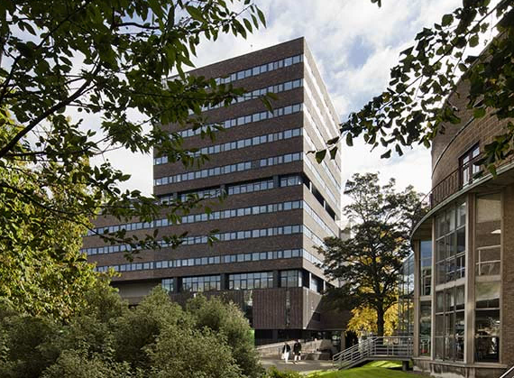

Slide 2
Week 1
Measurement and Description

Slide 3
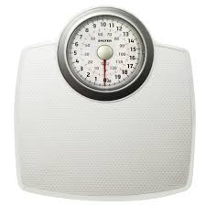
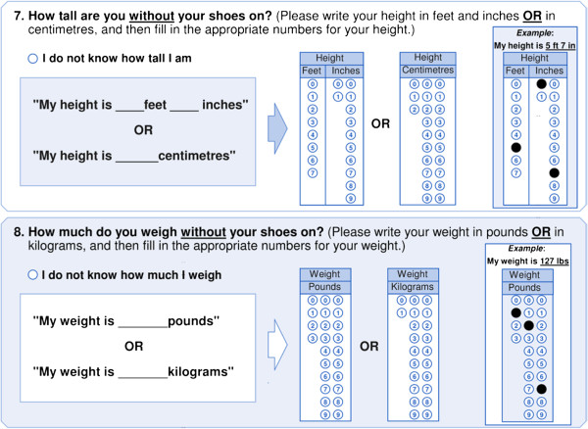
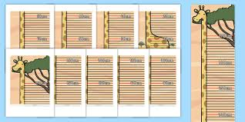
Measurement

Slide 4
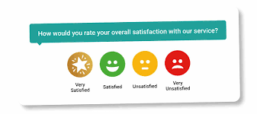
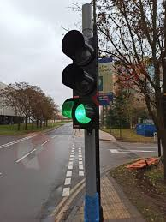
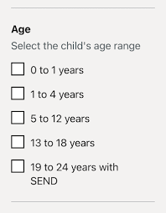

Measurement

Slide 5


Slide 6
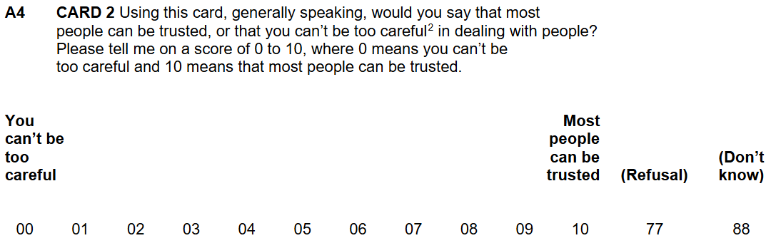
ESS11
² ‘Can’t be too careful’: need to be wary or always somewhat suspicious

Slide 7
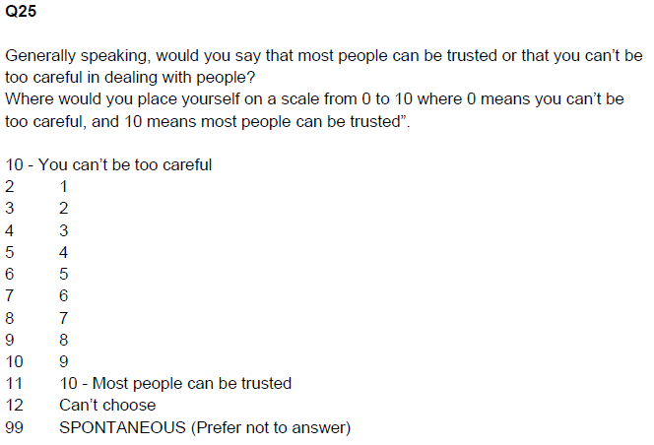
BSA 2024

Slide 8
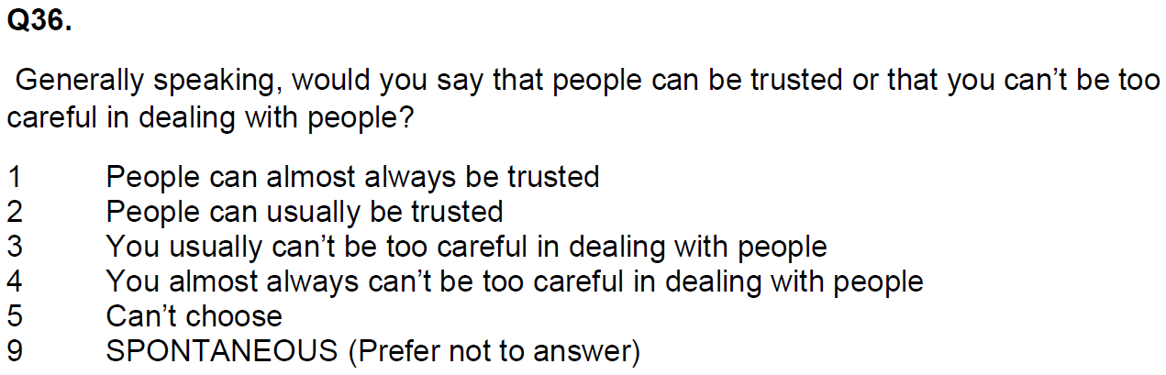
BSA 2023

Slide 9
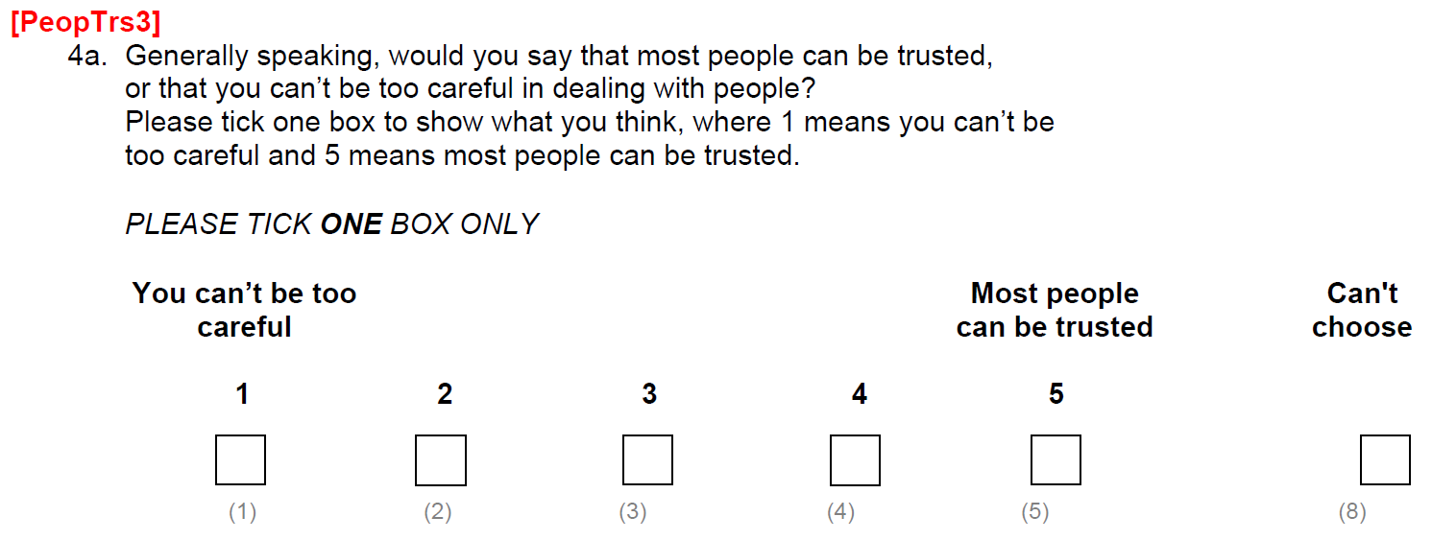
BSA 2010
(SELF-COMPLETION QUESTIONNAIRE)

Slide 10
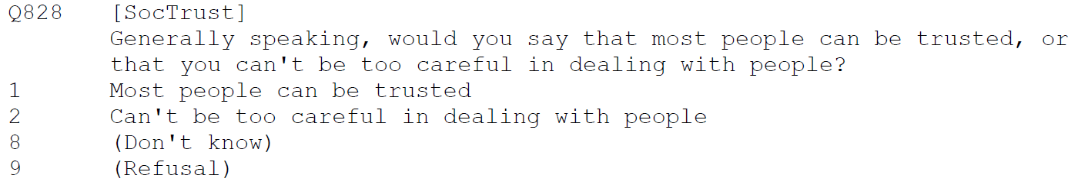
BSA 2010 (Q828)

Slide 11
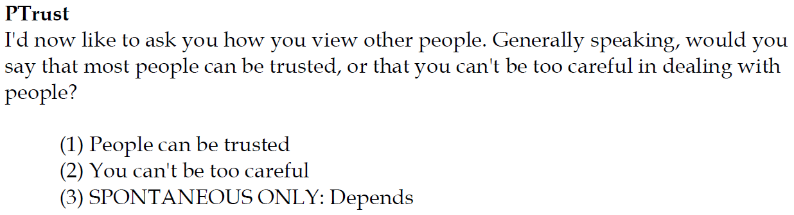
Citizenship Survey: 2010-11

Slide 12
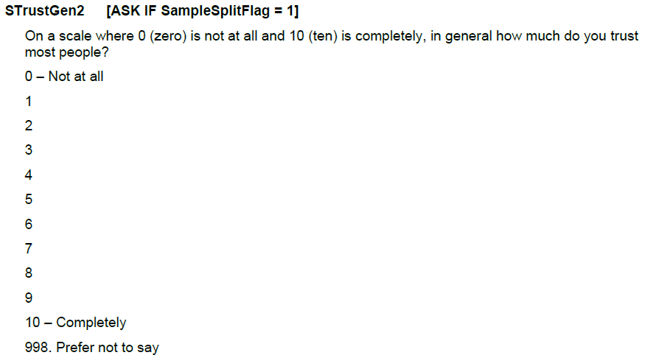
CLS 2023-24

Slide 13
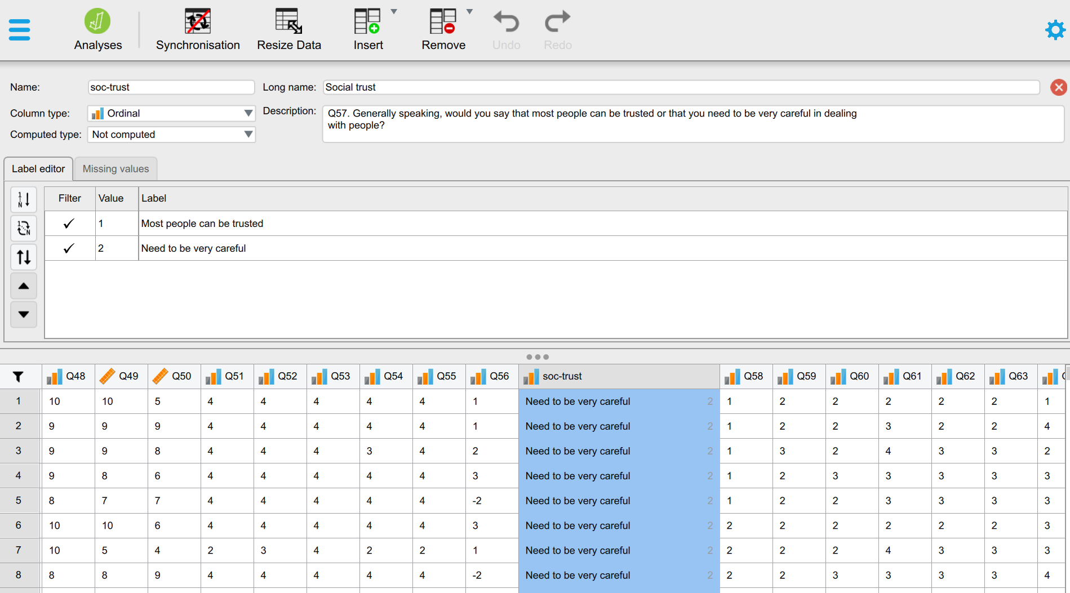
Variables in a dataset

Slide 14
Variables in a dataset

Slide 15
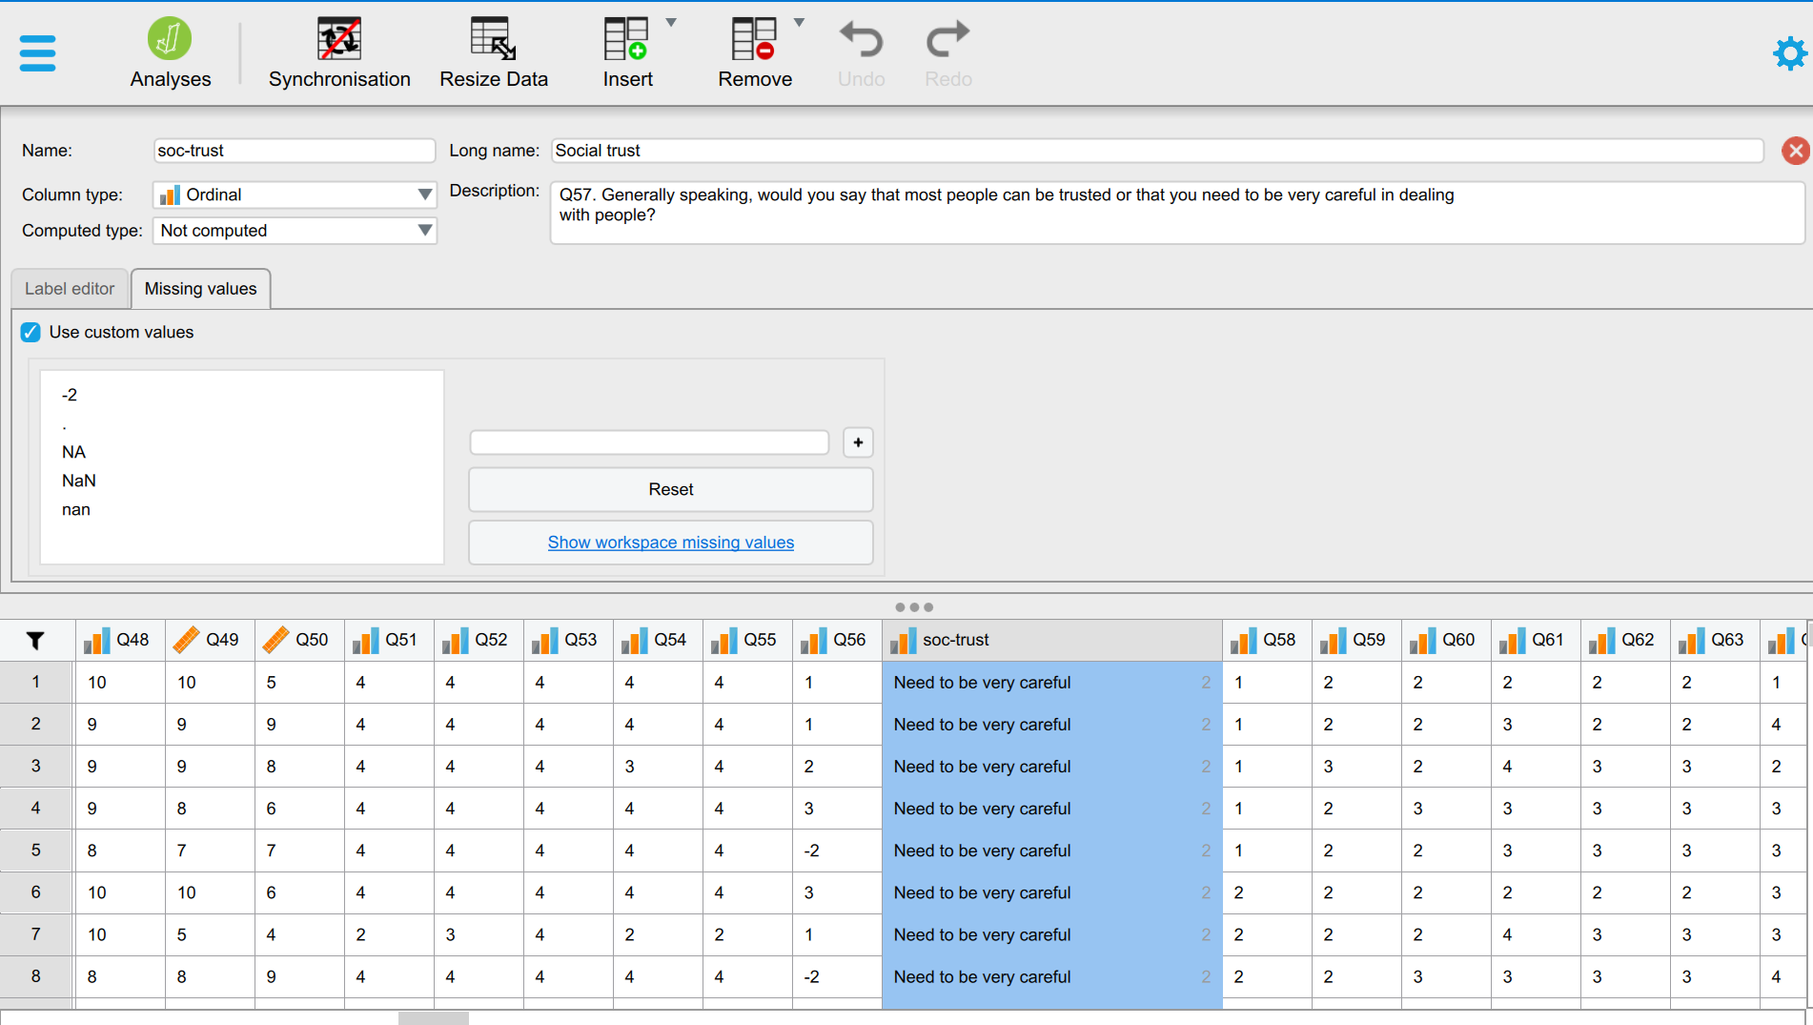
Variables in a dataset

Slide 16
Describing data
Univariate (e.g. an age distribution)
Bivariate (e.g. age distribution by gender)
Multivariate (e.g. age distribution by gender and ethnicity)
Notes:
So what exactly do we mean by ‘data’ here?
Variables

Slide 17
Describing data
Univariate (e.g. an age distribution)
Bivariate (e.g. age distribution by gender)
Multivariate (e.g. age distribution by gender and ethnicity)
Notes:
So what exactly do we mean by ‘data’ here?
Variables

Slide 18
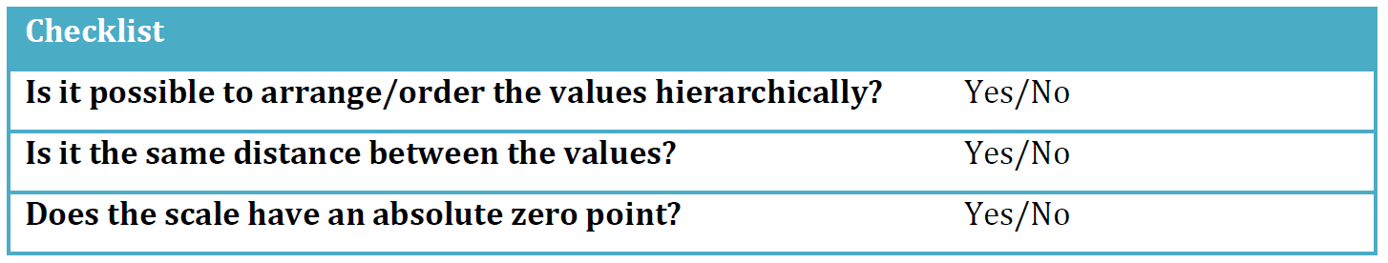
Variable types and measurement levels
Data
Numerical
(Quantitative)
Categorical
(Qualitative)
Ratio
Interval
Ordinal, categories you can rank
Nominal, categories without order or direction
Dichotomous
(binary or ‘dummy’)
Polytomous
Height, weight, age, income
Temperature
e.g. educational attainment, satisfaction
e.g. gender
Marital status
Notes:
Numerical data more common in the natural, physical world;
In social science we have many categorical variables, as much of what we do is categorise people and their characteristics.

Slide 19
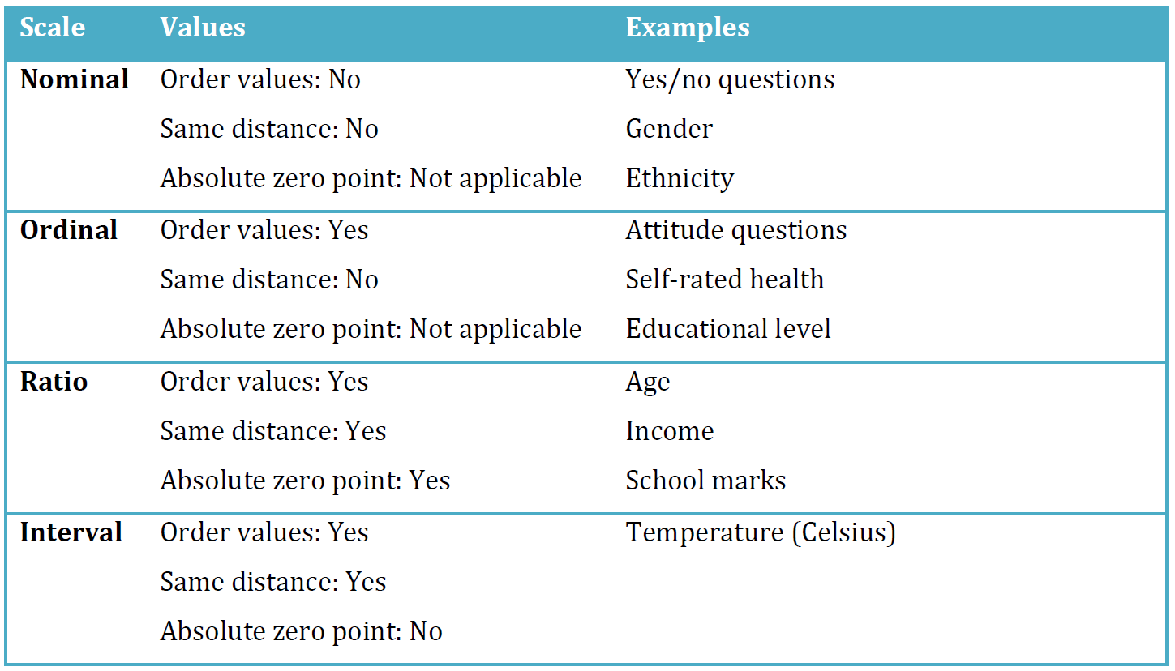
Variable types and measurement levels

Slide 20
Univariate descriptive statistics
Frequencies
Proportions / Percentages
Mode
Raw frequencies (counts)
Relative (standardised) frequencies
Central tendency
Frequencies
Proportions / Percentages
Median
Raw frequencies (counts)
Relative (standardised) frequencies
Central tendency
Median
Mean
Range (maximum – minimum)
Percentile interquartile range, Standard deviation …
Central tendency
Dispersion

Slide 21
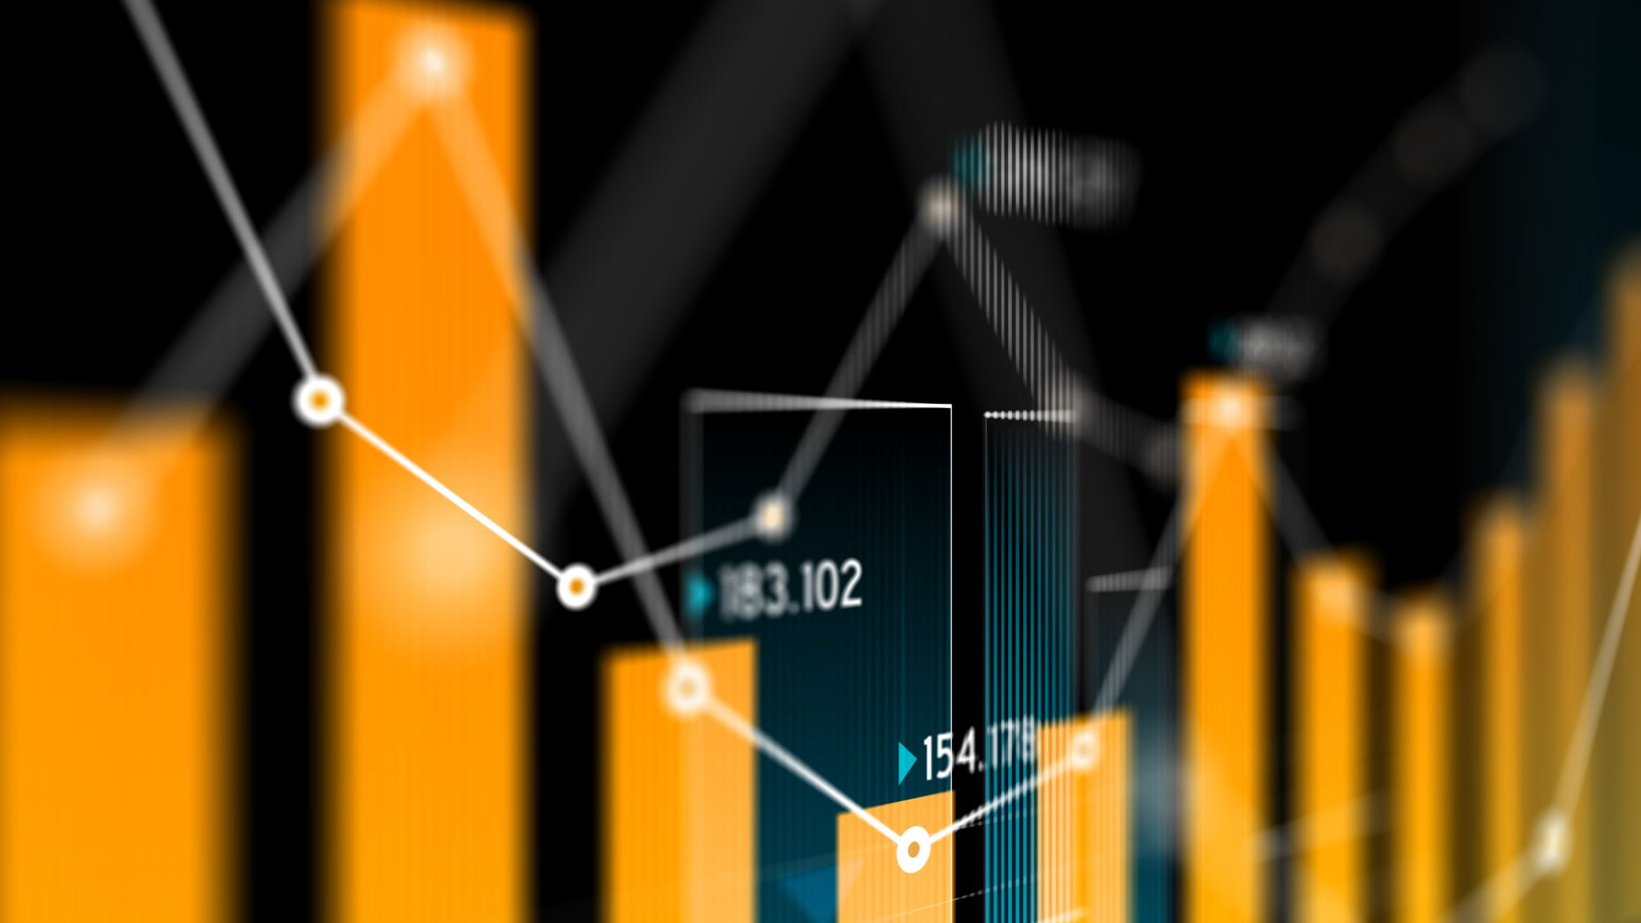
Frequencies
Counts, Percentages, Proportions, Ratios

Slide 22
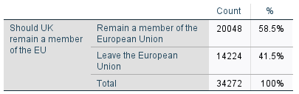
Simple frequency table

Slide 23



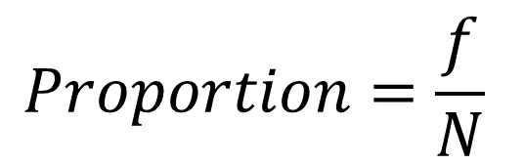
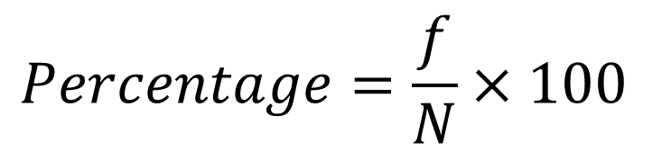
Simple frequency table

Slide 24
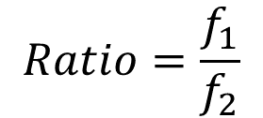
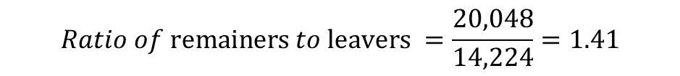
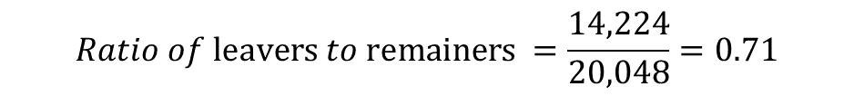
Simple frequency table
$$Ratio of \text{leavers} to \text{remainers} =\frac{14,224}{20,048}=0.71$$
$$Ratio of \text{remainers} to \text{leavers} =\frac{20,048}{14,224}=1.41$$
Notes:
Another statistic that is not usually produced in frequency tables but can be very useful for conveying quantities of interest; direct comparisons of different categories;
For every person preferring ‘remain’ there are 0.7 people preferring ‘leave’;
It sounds awkward to talk about fractions of human beings; so it’s often clearer to multiply the values by ten or its multiples to confer more meaningful summaries;
For every 10 remainers there are 7 leavers in the data

Slide 25
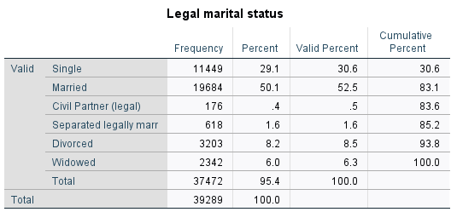
Question:
What is the ratio of singles to married respondents in the dataset?

Slide 26
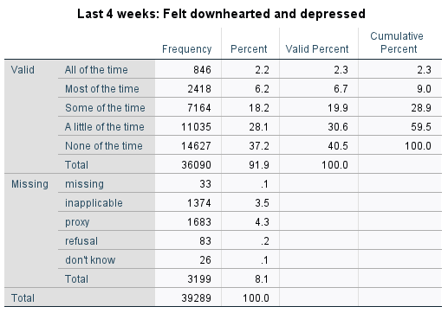
Summary frequency table

Slide 27
Summary frequency table

Slide 28
Central tendency
Mean, Median, Mode

Slide 29
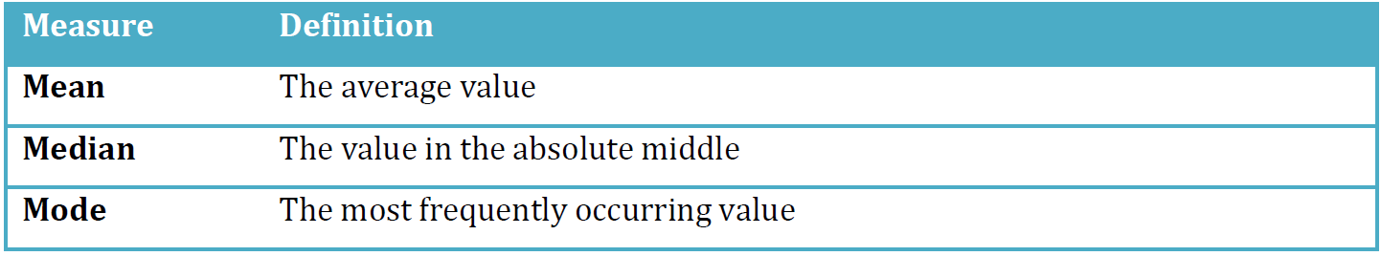
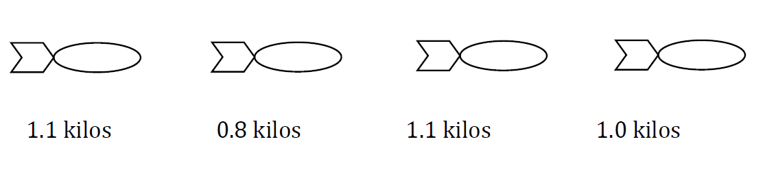
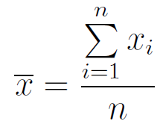
Measures of ‘central tendency’
Example 1: Mean
Notes:
Central tendency can be defined as measures of the location of the middle in a distribution.

Slide 30
Measures of ‘central tendency’
Example 1: Mean
1. Add values together
2. Divide sum by number of values
+ + + = 4
4/(1+1+1+1)=1 => Mean = 1 kilo
Notes:
Central tendency can be defined as measures of the location of the middle in a distribution.

Slide 31
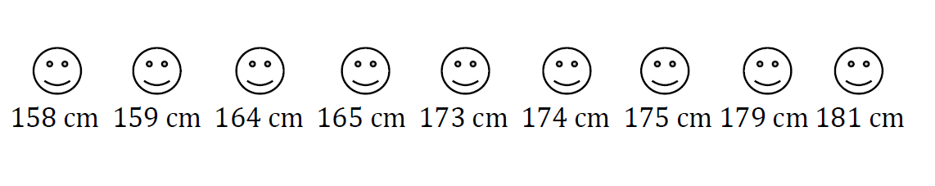
Measures of ‘central tendency’
Example 2: Median
Sort values from low to high and then identifying the value in the middle
Notes:
The median is the value in the absolute middle of the distribution. We sort all the values from low to high and then identifying the value in the middle of the list.
Media here is 173 cm.

Slide 32
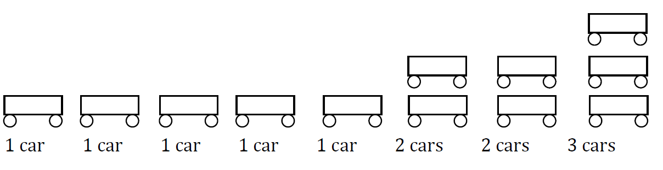
Measures of ‘central tendency’
Example 3: Mode
It’s the most frequently occurring value in a distribution.
Notes:
The mode - or “type” - is defined as the most frequently occurring value in a distribution: here 1.

Slide 33
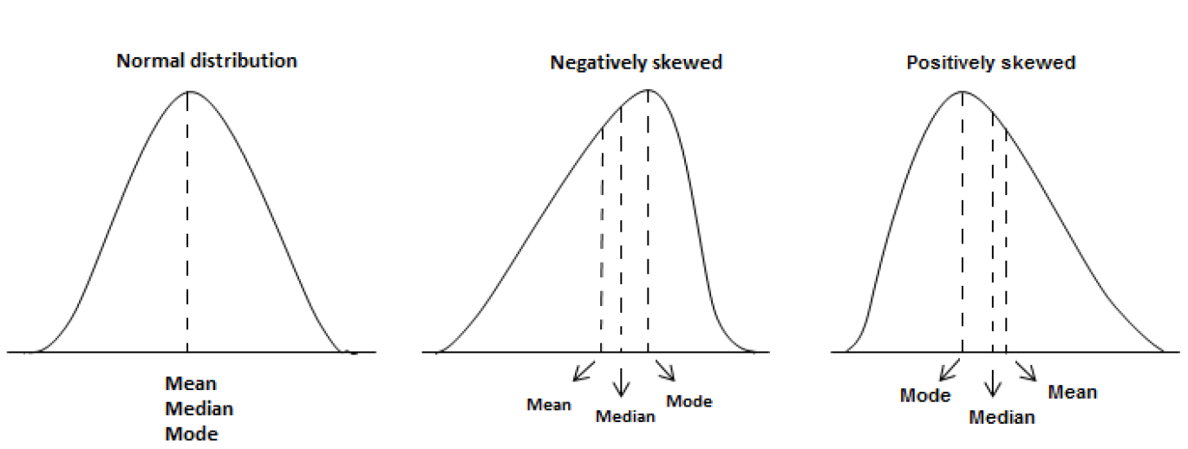
Measures of ‘central tendency’
Notes:
Always bell-shaped.
The peak always indicates the mean value.
Always symmetrical, i.e. the tails on each side of the mean are equally large. This means that 50 % of the values are on one side of the mean, and 50 % of the values are on the other side of the mean. The area under the curve is always 1 (100 % of the values).

Slide 34
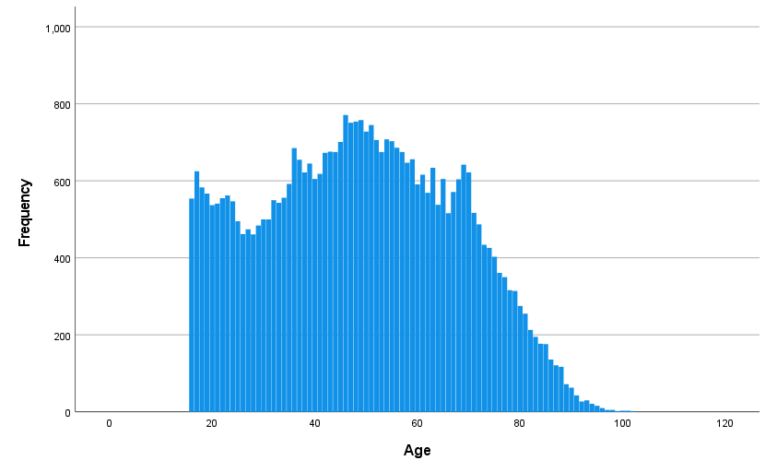
Example of age distribution

Slide 35

Example of age distribution

Slide 36
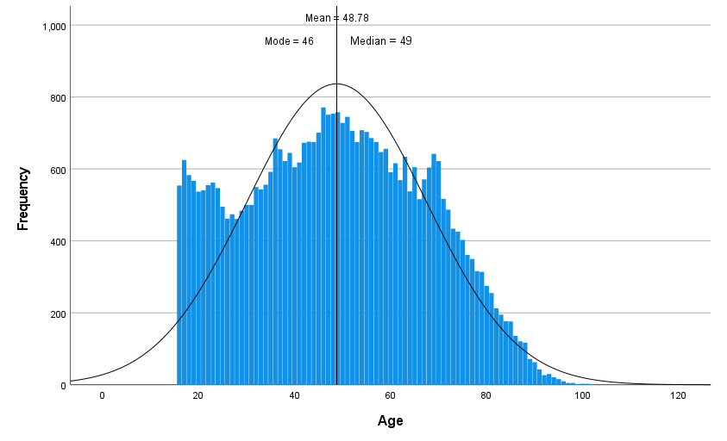
Example of age distribution

Slide 37
Dispersion
Range, Variance, Standard Deviation

Slide 38
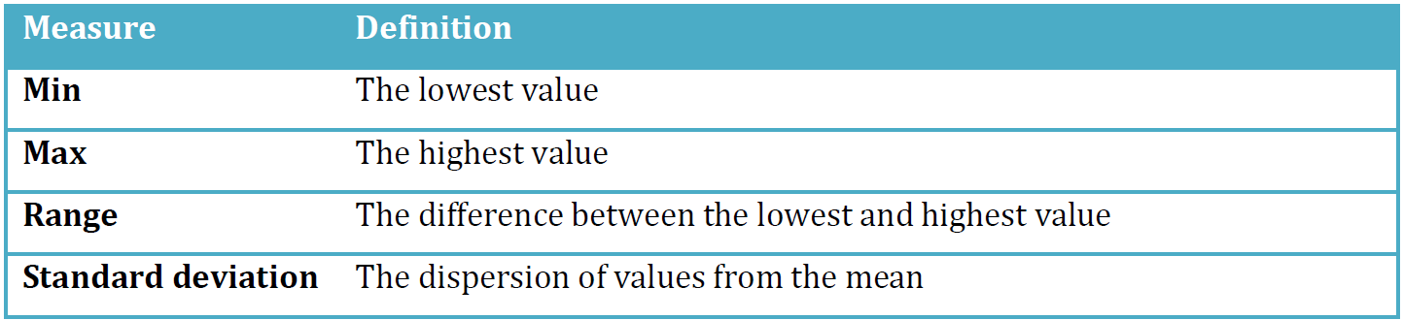
Measures of ‘dispersion’
Notes:
These measures are most suitable for continuous variables (i.e. ratio or interval) but sometimes min, max, and range are used for ordinal variables as well. However, they cannot be used for nominal variables (for the same reason as why we do not use mean or median to describe nominal variables).

Slide 39
Example of age distribution

Slide 40

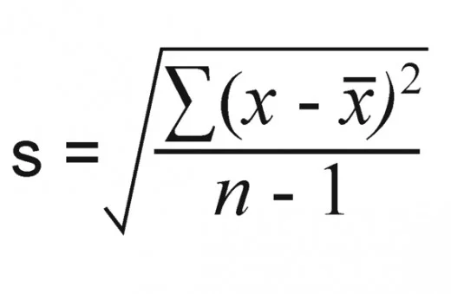
The Standard Deviation in an age distribution

Slide 41
The Standard Deviation
The sample SD expresses how much variation exists from the mean for a given variable
1. Mean: the average of the numbers
2. Case deviations (Residuals): subtract the mean from each number
3. Variance: square each of the differences, add them up to get the sum of squares, and divide the sum of squares by the number of cases minus one
4. SD: take the square root of the variance
where xi is each value is the data set, x-bar is the mean, and n is the number of values in the data set
Notes:
The difference lies in the amount of spread of the values: because the shape of a normal distribution is not only defined by the mean value, but by the standard deviation!
But what is “standard deviation”? A simple definition is that it expresses how much variation exists from the mean for a given variable. If we have a low standard deviation, it suggests that the individuals in our data have values close to the mean, and if we have a high standard deviation, it indicates that the values are more spread out over a large range of values.

Slide 42

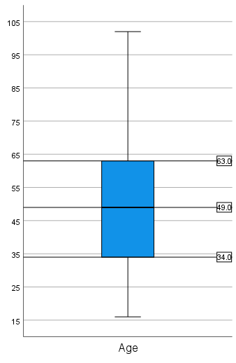
Percentiles and the IQR
Median = 50th percentile (P50)
P25
P75
Interquartile range (IQR) = P75 - P25
Notes:
While mean is ‘average’, median is the one in the ‘middle’; the 50th percentile; means 50% of the data is below the P50 value;
Divide each half into two again to get P25 and P75; the data is split into 4 quartiles;
The range between P25 and P75 measures the amount of data in middle 50%.
Boxplots specifically designed to capture this information.

Slide 43
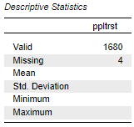
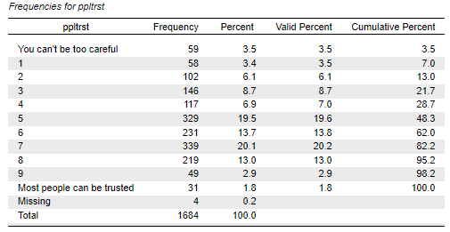
Workshop exercise

Slide 44
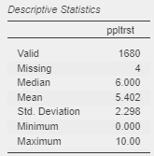
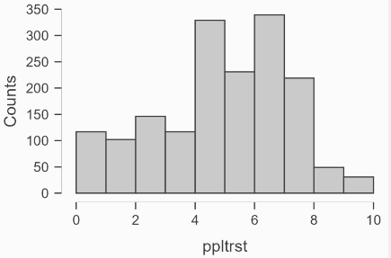
Workshop exercise

Slide 45
Workshop
3-5pm

