Slide 2
Week 6
Uncertainty and Inference

Slide 3
Inference
From “data” to “population”
From “association” to “causality”
Statistical inference can be formulated as a set of operations on data that yield estimates and uncertainty statements about predictions and parameters of some underlying process or population (Gelman, Hill, and Vehtari 2020)
From a mathematical standpoint, these probabilistic uncertainty statements are derived based on some assumed probability model for observed data.
The normal (Gaussian) distribution — linear regression
The binomial distribution — logistic regression
So far we have focused on the “point” estimates from regression models

Slide 4
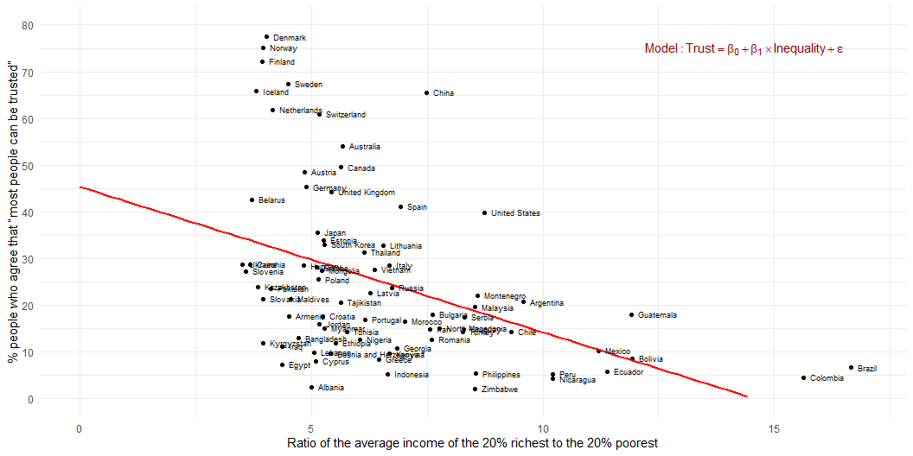
Estimation
Association between inequality and social trust at cross-national comparative level (W3Ex1) (Wilkinson and Pickett 2010)

Slide 5
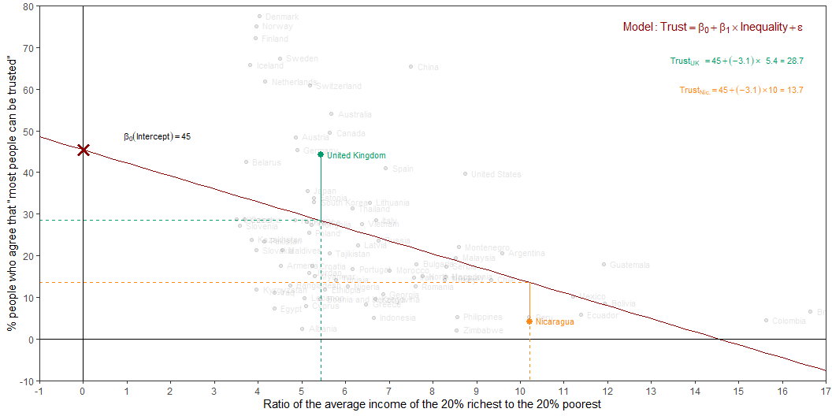
Estimation
Intercept: Social trust in countries with 0 inequality is expected to be 45.4 on average.
Slope: For each additional point increase in Inequality, the model predicts the level of social trust to be lower, on average, by 3.1 points.

Slide 6
From (sample) estimation to (population) inference
For each additional point increase in Inequality, the model predicts the level of social trust to be lower, on average, by 3.1 points
This estimate is valid for the single sample of the countries in the model
But what if we’re not interested in quantifying the relationship between Inequality and Trust in only this sample?
What if we want to say something about the relationship between these variables for all the countries in the world?

Slide 7
Statistical inference
Statistical inference provides methods and tools for us to use the single sample we have observed to make valid statements (inferences) about the population it comes from
For our inferences to be valid, the sample should be random and representative of the population it was sampled from

Slide 8

Inference for simple linear regression
Calculate a confidence interval for the slope, $β_{1}$
Conduct a hypothesis test for the interval, $β_{1}$

Slide 9
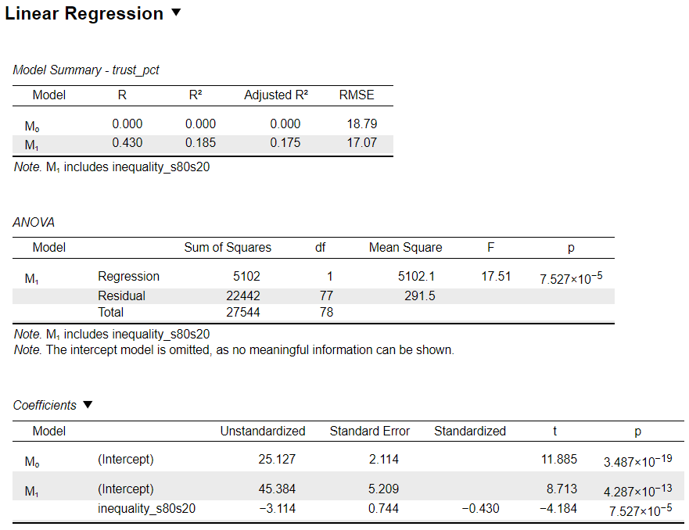
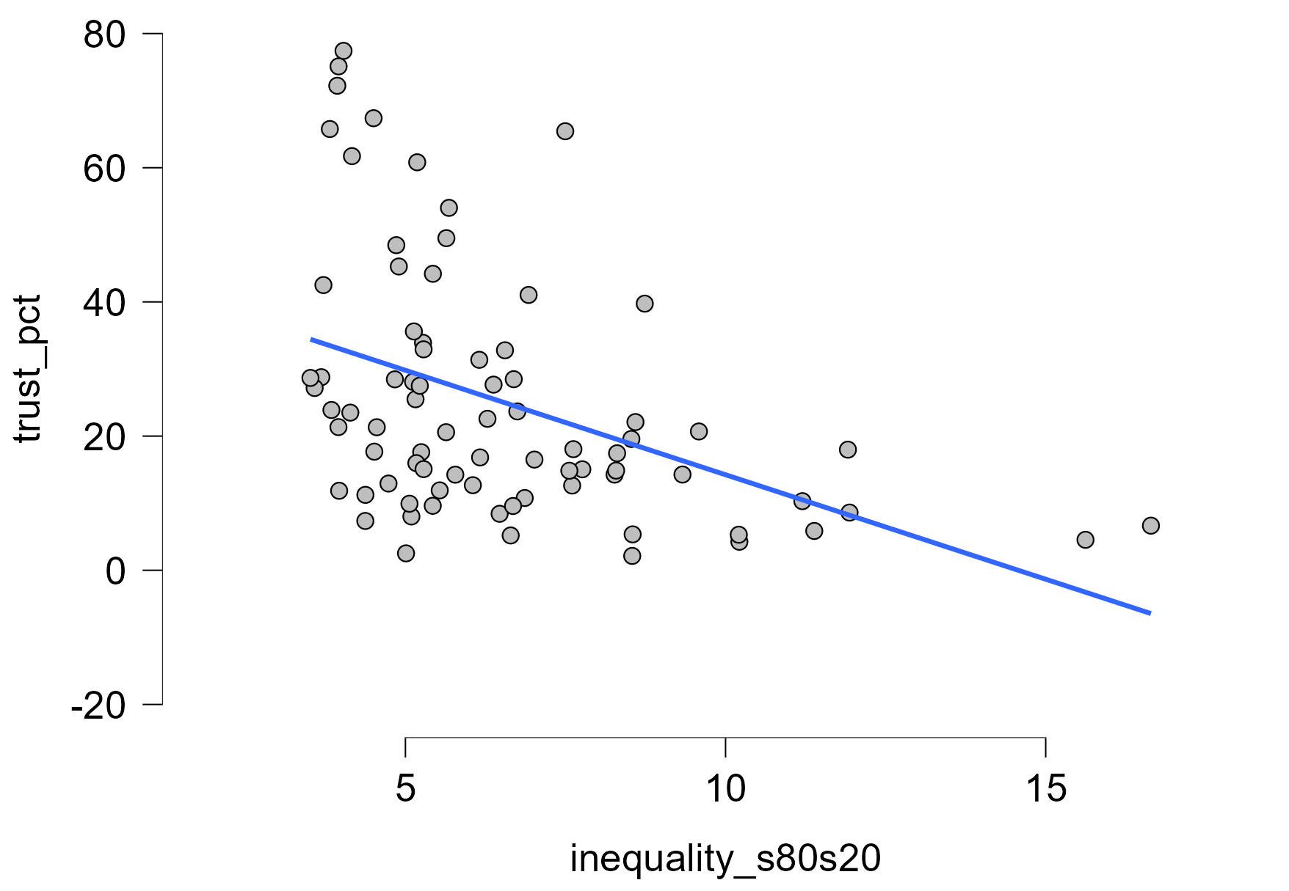
Inequality → Social trust

Slide 10
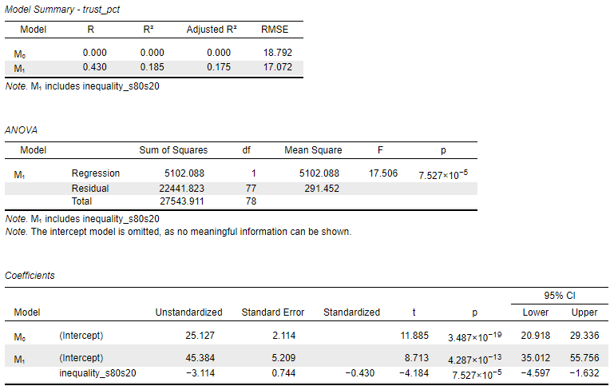
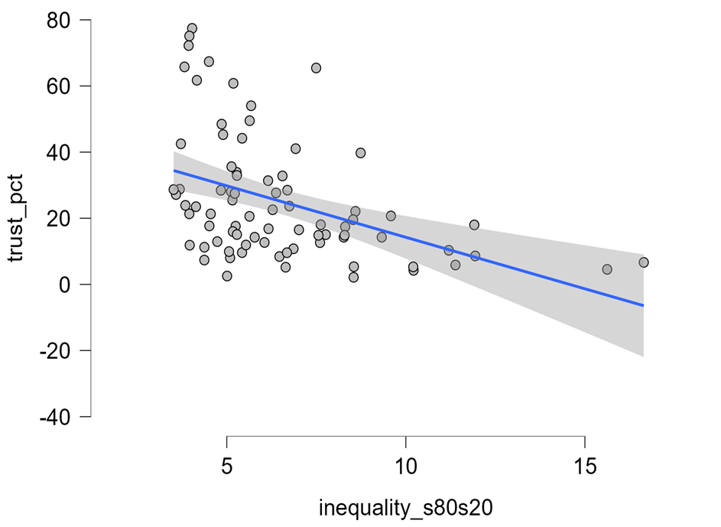
Inequality → Social trust

Slide 11
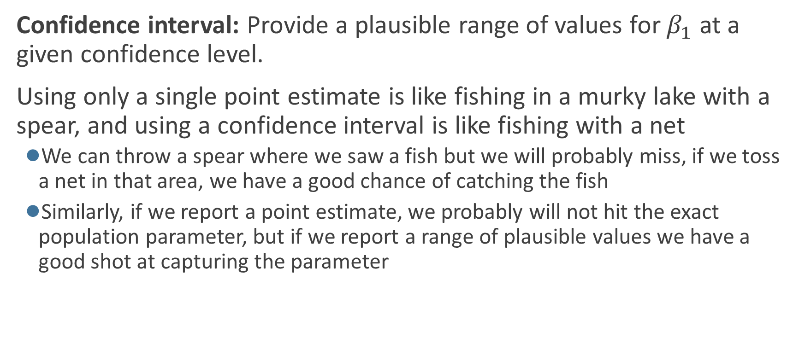
Confidence interval for the slope
Confidence interval: Provide a plausible range of values for $β_{1}$ at a given confidence level.
Using only a single point estimate is like fishing in a murky lake with a spear, and using a confidence interval is like fishing with a net
We can throw a spear where we saw a fish but we will probably miss, if we toss a net in that area, we have a good chance of catching the fish
Similarly, if we report a point estimate, we probably will not hit the exact population parameter, but if we report a range of plausible values we have a good shot at capturing the parameter

Slide 12
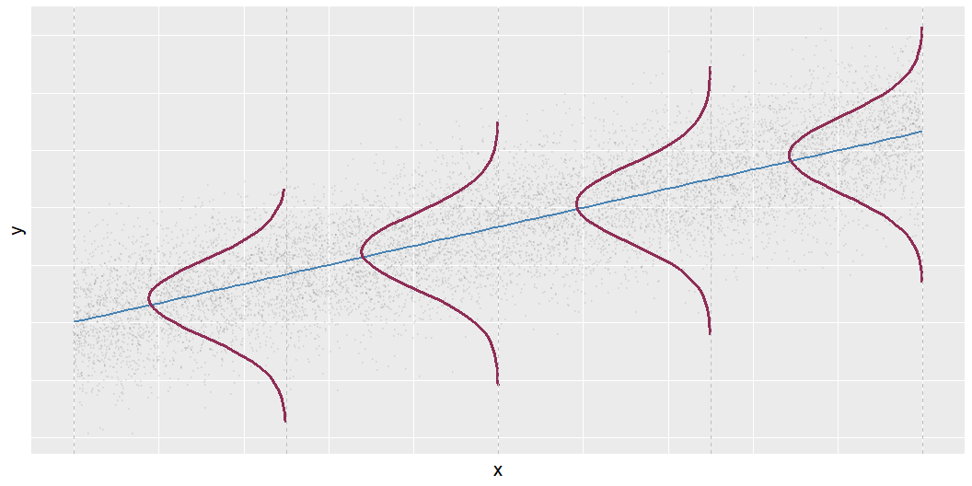
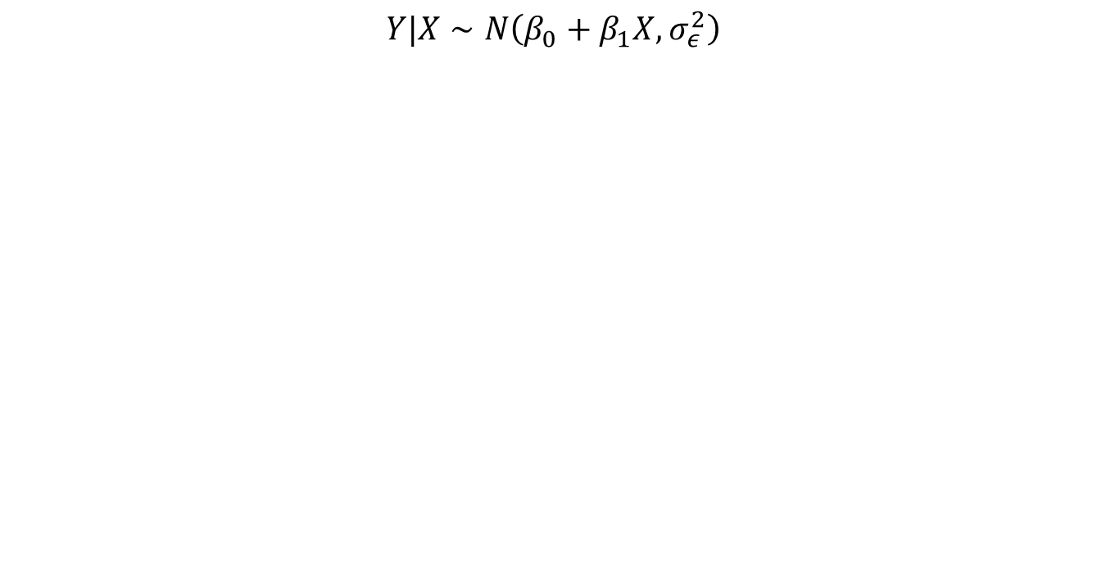

Mathematical representation, visualized
$$Y|X∼N\left(β_{0}+β_{1}X,σ_{ε}^{2}\right)$$
Mean: $β_{0}+β_{1}X$, the predicted value based on the regression model
Variance: $σ_{ε}^{2}$, constant across the range of $X$
How do we estimate $σ_{ε}^{2}$?

Slide 13
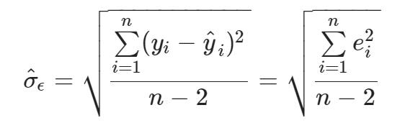
Regression standard error
Once we fit the model, we can use the residuals to estimate the regression standard error (the spread of the distribution of the response, for a given value of the predictor variable):

Slide 14
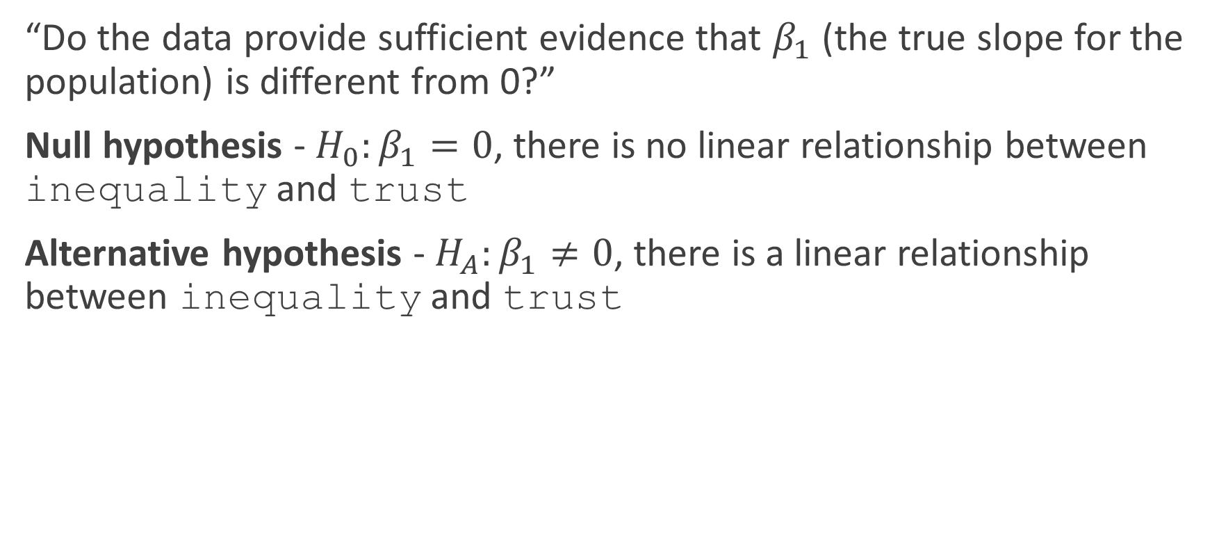
Hypothesis test for the slope
“Do the data provide sufficient evidence that $β_{1}$ (the true slope for the population) is different from 0?”
Null hypothesis - $H_{0}:β_{1}=0$, there is no linear relationship between inequality and trust
Alternative hypothesis - $H_{A}:β_{1}≠0$, there is a linear relationship between inequality and trust

Slide 15
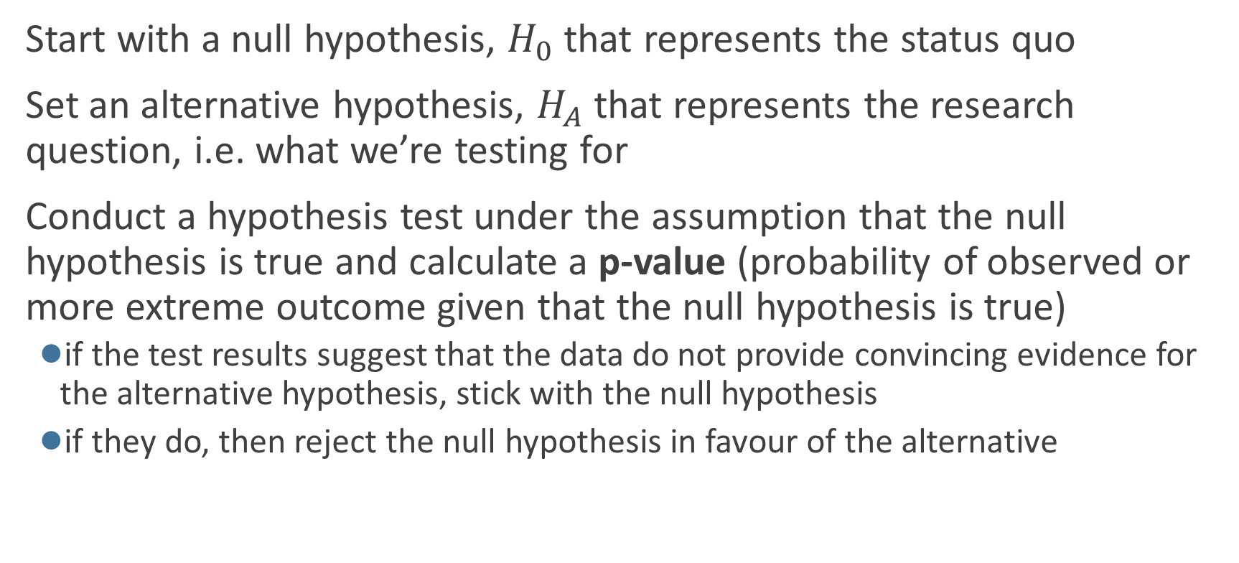
Hypothesis testing framework
Start with a null hypothesis, $H_{0}$ that represents the status quo
Set an alternative hypothesis, $H_{A}$ that represents the research question, i.e. what we’re testing for
Conduct a hypothesis test under the assumption that the null hypothesis is true and calculate a p-value (probability of observed or more extreme outcome given that the null hypothesis is true)
if the test results suggest that the data do not provide convincing evidence for the alternative hypothesis, stick with the null hypothesis
if they do, then reject the null hypothesis in favour of the alternative

Slide 16
Hypothesis testing framework
Statistical hypothesis testing is a thought experiment.
Could our results just be due to random chance?
What would the world look like if we knew the truth?
Example:
An analyst claims that 20% of Newcastle households are in poverty.
You take a sample of 500 households and find that 23% of the sample is under the poverty line.
Should you conclude that the analyst is wrong?

Slide 17
Hypothesis testing framework
Null hypothesis: Some statement about the population parameters
“Devil’s advocate” position → assumes what you seek to prove wrong.
Usually that an observed difference is due to chance.
Ex: poll drawn from the same population as all voters.
Denoted 𝘏𝟢
Alternative hypothesis: The statement we hope or suspect is true instead of 𝘏𝟢
It is the opposite of the null hypothesis.
An observed difference is real, not just due to chance.
Ex: polling for Trump is systematically wrong.
Denoted 𝘏𝟣 or 𝘏𝘢
Probabilistic proof by contradiction: try to “disprove” the null

Slide 18
Hypothesis testing framework
p-value:
The p-value is the probability of observing data as or more extreme as our data under the “null”
If the null is true, how often would we expect polling errors this big?
Smaller p-value⇝stronger evidence against the null
NOT the probability that the null is true!
A p-value of 0.05 says that data this extreme would only happen in 5% of repeated samples if the null were true.
→5% of the time we’ll reject the null when it is actually true.

