Slide 1
S
Statistics

Slide 2
S
tatistics

Slide 3

Who’s afraid of statistics?

Slide 4
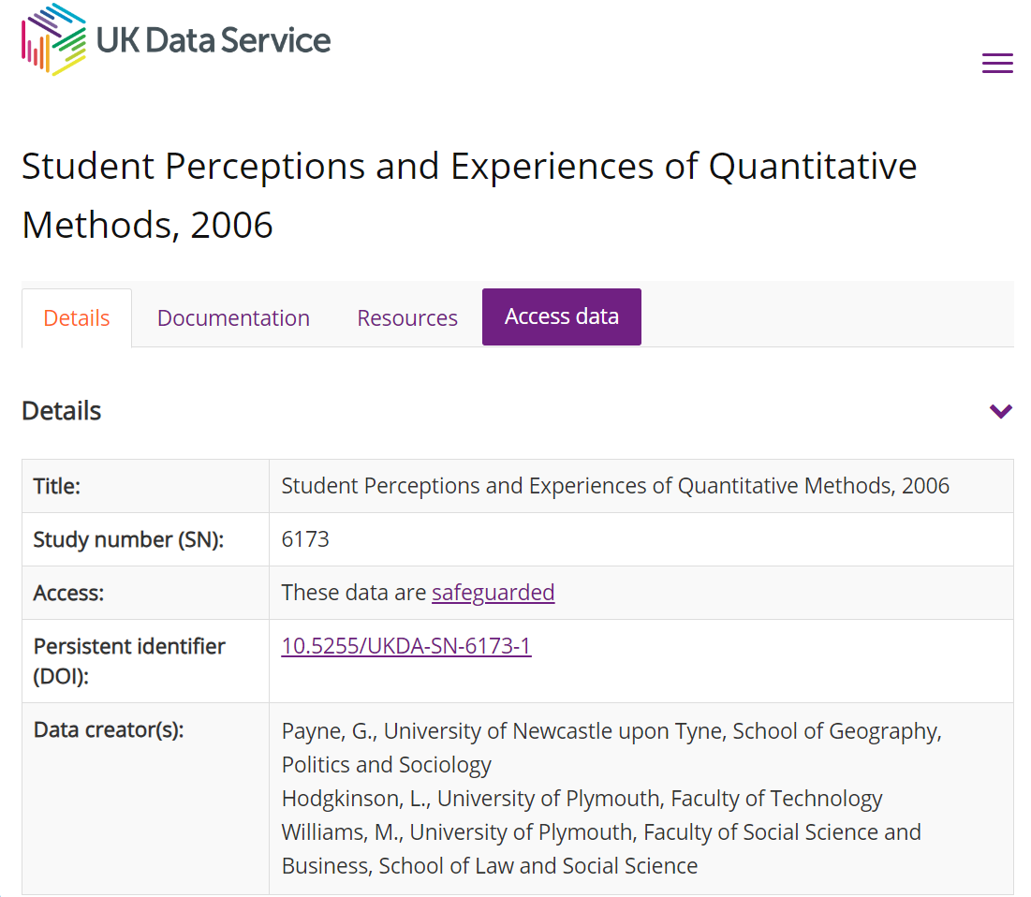

Slide 5
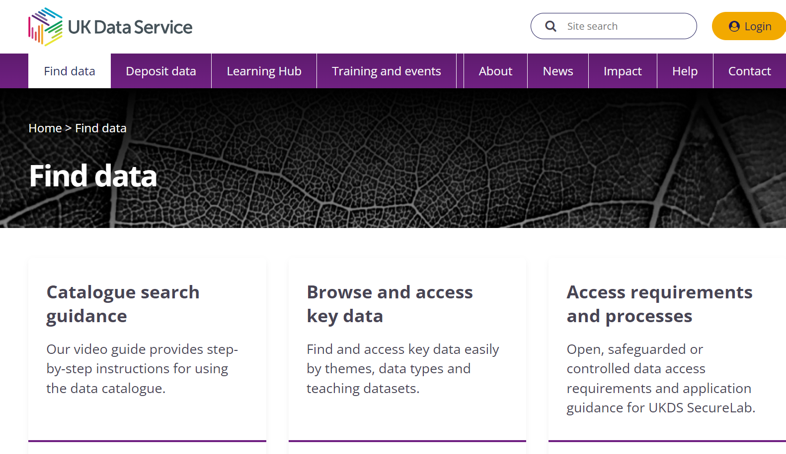
https://ukdataservice.ac.uk

Slide 6
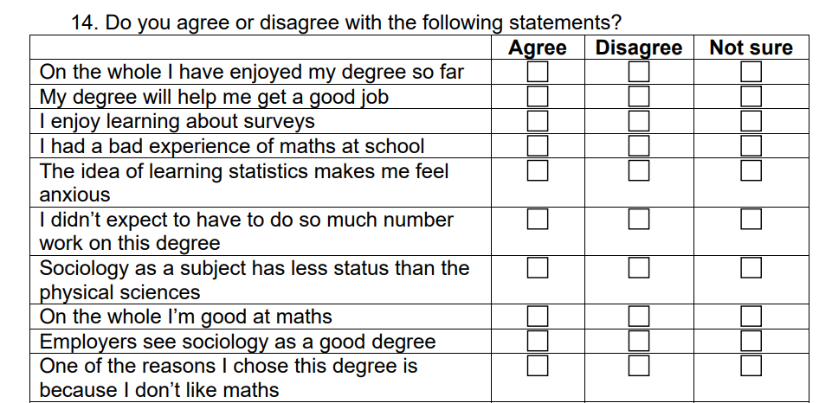

Slide 7
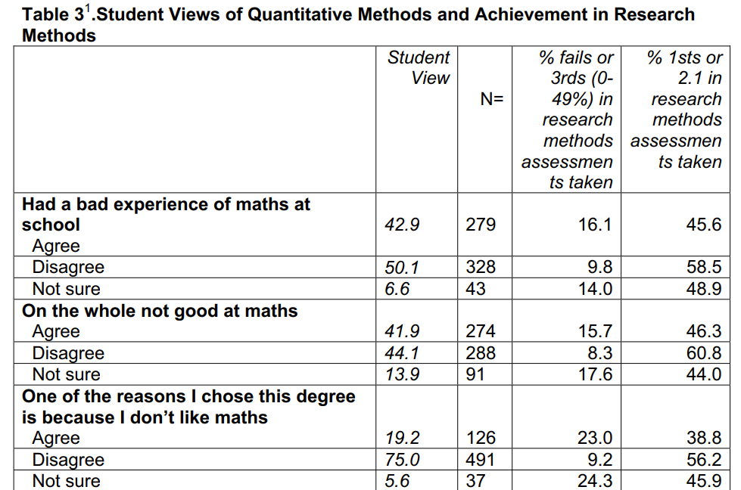

Slide 8

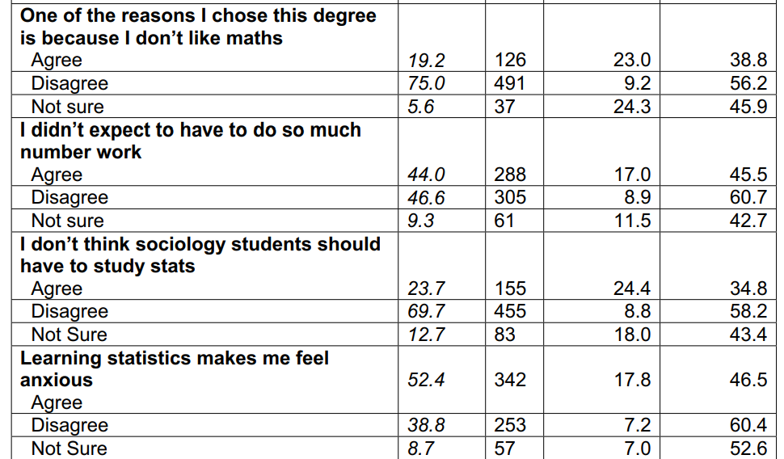

Slide 9
Is it statistics?
Does it address a sociologically relevant research question?
Could the analysis be strengthened?

Slide 10
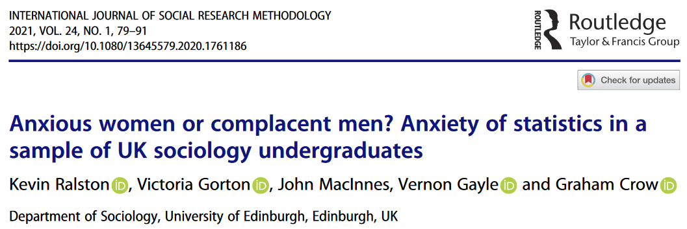



Slide 11
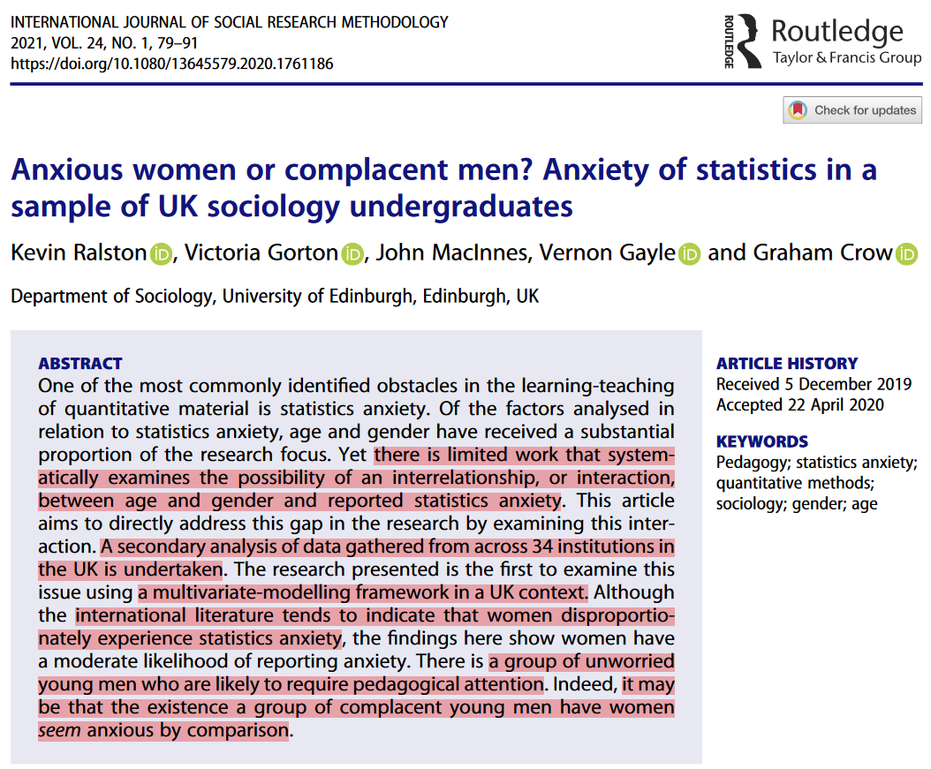

Slide 12
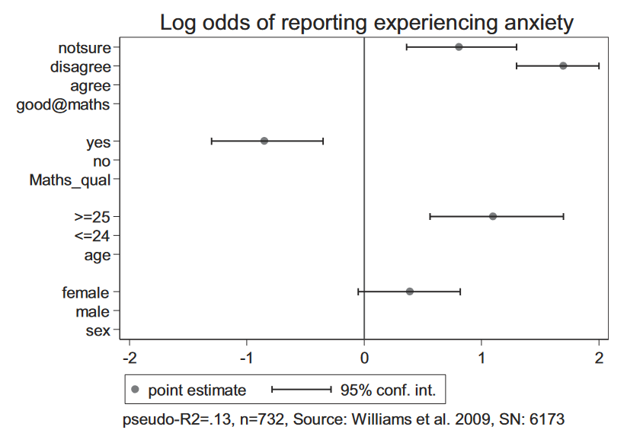
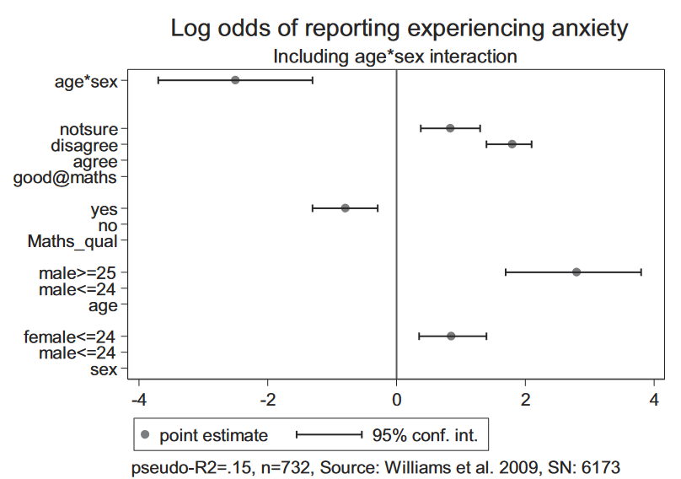

Slide 13
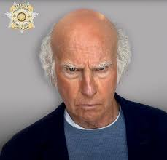
Meet Larry…

Slide 14


Slide 15
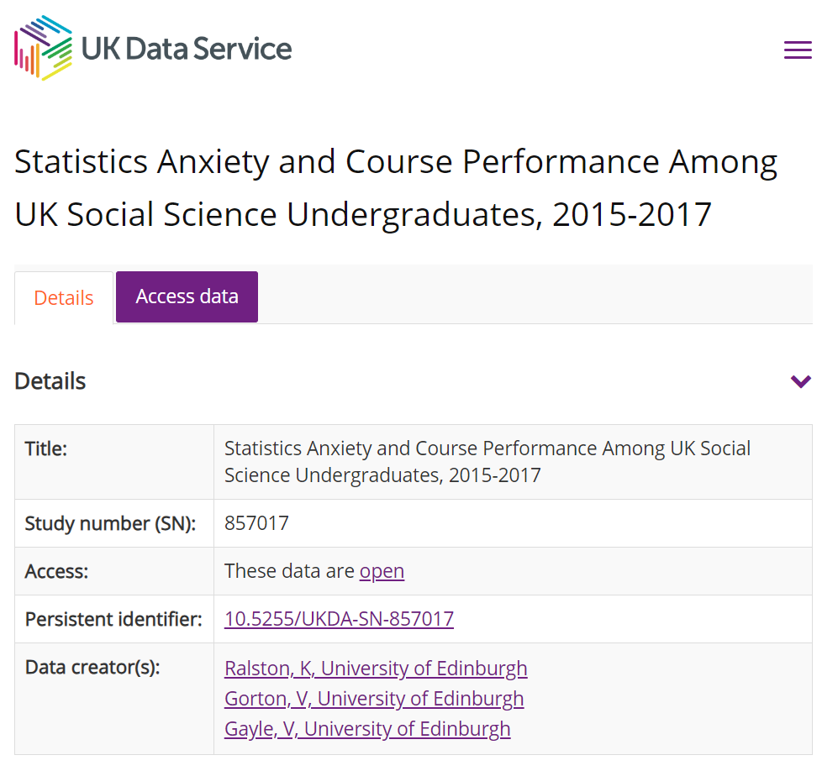
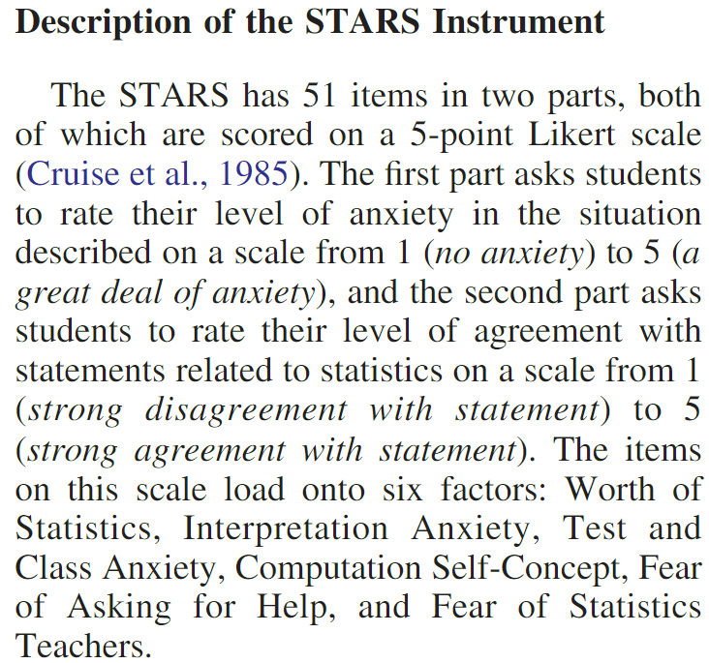

Slide 16
Who’s afraid of statistics?

Slide 17
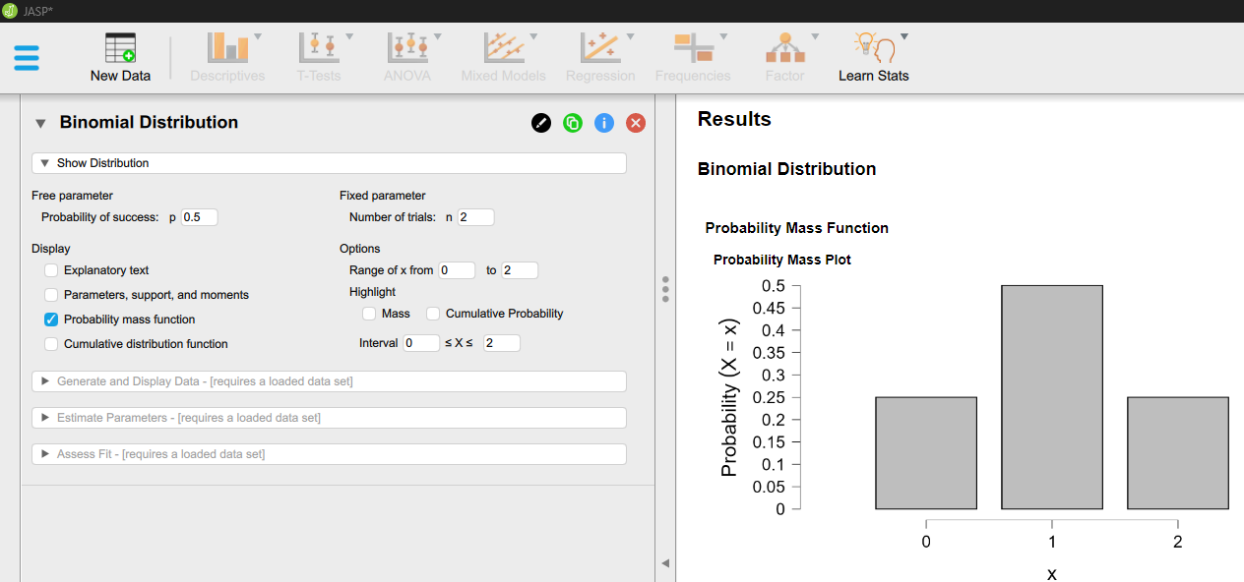

Slide 18


Slide 19
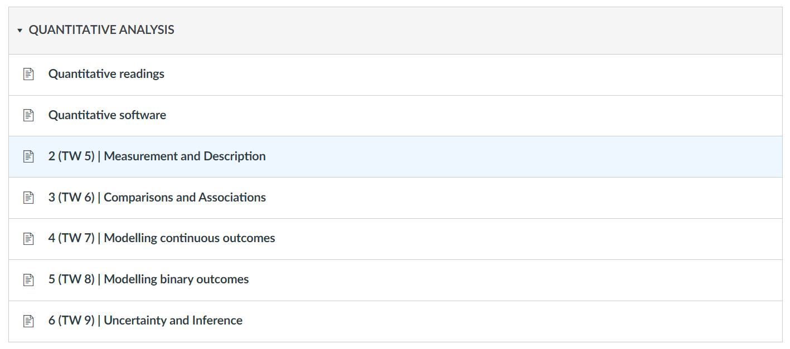

Slide 20


Slide 21
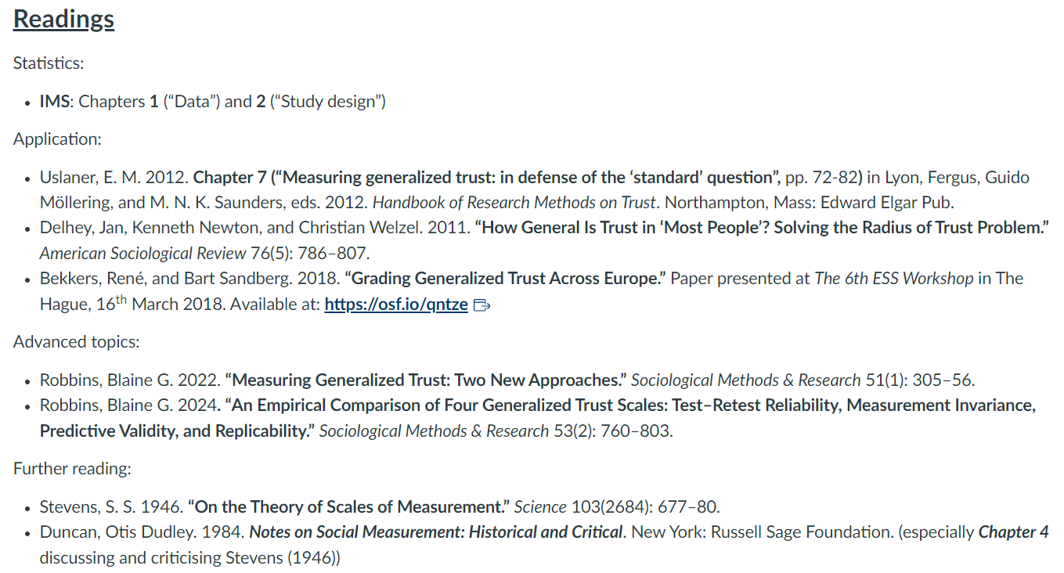

Slide 22


Slide 23
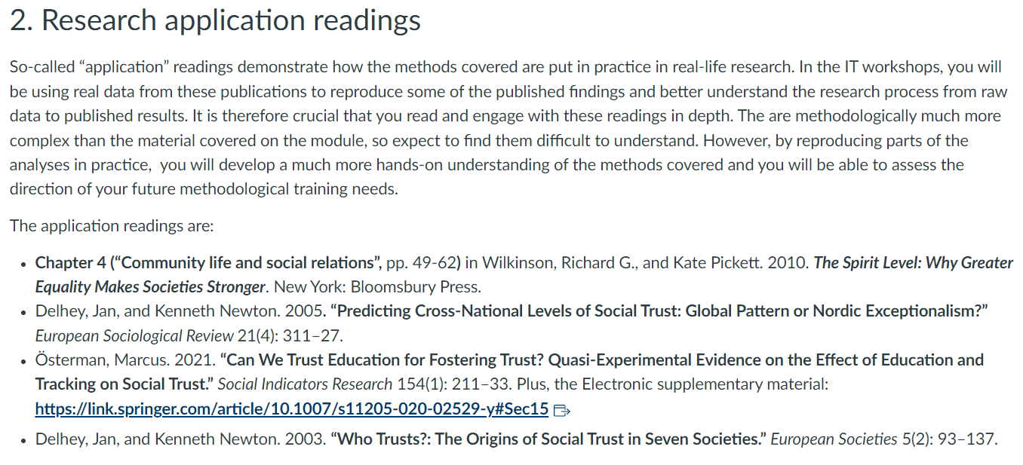

Slide 24
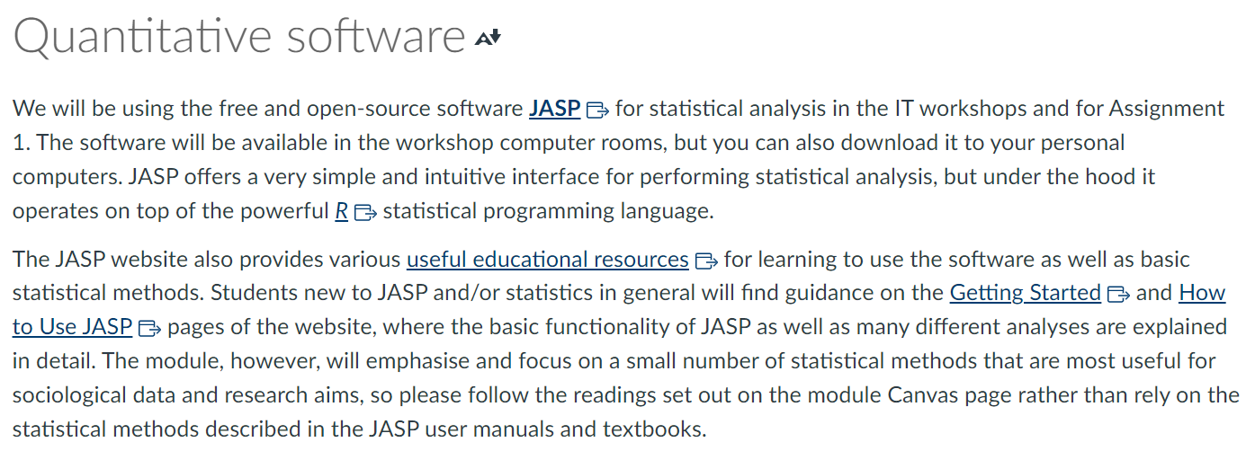

Slide 25
Thank you!
See you next week

