Slide 1
Introduction: Information, Data, Models
Week 1

Slide 2
Module outline

Slide 3
Where are we?
Year 1
Year 2
Year 3
SOC1031
What can we know?
How can we know it?
SOC2069 & SOC2070
How do we apply sociological methodology?
How do we design a sociological study?
SOC3097
Dissertation

Slide 4
Topic outline
Timetable week | Topic week | Calendar week | Topic
4 | 1 | 25/09/2022 | Introduction: Questions, Data, Models
5 | 2 | 02/10/2022 | Measurement, Understanding, Description
6 | 3 | 09/10/2022 | Linear models
7 | 4 | 16/10/2022 | Logistic models
8 | 5 | 23/10/2022 | Interaction models
9 | 6 | 30/10/2022 | Probability and uncertainty, inference
10 |  | 06/11/2022
11 |  | 13/11/2022
12 | 7 | 20/11/2022 | Elicitation: Interviews and focus groups
13 | 8 | 27/11/2022 | Observation: ethnographic fieldwork
14 | 9 | 04/12/2022 | Exploration: documents and archives
15 | 10 | 11/12/2022 | Interpretation: analysis and writing

Slide 5

Canvas

Slide 6
Information > Data > Models

Slide 7
Typical research objectives by required sample size (n)
$n→∞$
n $≈$ 5,000 - 100,000: stratified population survey
n $≈$ 1,000 - 5,000: population survey
n $≈$ 100 - 1,000: targeted survey
n $≈$ 50 - 100: stratified narrative study
n $≈$ 10 - 50: narrative study
n $≈$ 5 - 10: interactive narrative study
n = 2 - 4: comparative case study
n = 1: case study
n = 0: theoretical/simulation study

Slide 8
The n = 0 principle
</>
set.seed(2069)

Slide 9
The n = 0 principle
</>
set.seed(2069) student_numbers <- 120

Slide 10
The n = 0 principle
</>
set.seed(2069) student_numbers <- 120 sex <- sample(c("Female", "Male"), size = student_numbers, prob = c(70, 30), replace = TRUE)

Slide 11
The n = 0 principle
</>
set.seed(2069) student_numbers <- 120 sex <- sample(c("Female", "Male"), size = student_numbers, prob = c(70, 30), replace = TRUE) height <- case_when(
sex %in% c("Female") ~ rnorm(n = student_numbers, mean = 162.4, sd = 12), sex %in% c("Male") ~ rnorm(n = student_numbers, mean = 175.9, sd = 13))

Slide 12
The n = 0 principle
</>
set.seed(2069) student_numbers <- 120 sex <- sample(c("Female", "Male"), size = student_numbers, prob = c(70, 30), replace = TRUE) height <- case_when(
sex %in% c("Female") ~ rnorm(n = student_numbers, mean = 162.4, sd = 12), sex %in% c("Male") ~ rnorm(n = student_numbers, mean = 175.9, sd = 13)) dataset <- data.frame(sex, height)

Slide 13
The n = 0 principle
</>
sex height 1 Female 154.6208 2 Female 163.8226 3 Female 162.6665 4 Female 162.1338 5 Female 167.3965 6 Female 159.2073
sex height 115 Female 164.7633 116 Female 153.7522 117 Female 164.0542 118 Female 175.2531 119 Female 158.4923 120 Male 178.2895
set.seed(2069) student_numbers <- 120 sex <- sample(c("Female", "Male"), size = student_numbers, prob = c(70, 30), replace = TRUE) height <- case_when(
sex %in% c("Female") ~ rnorm(n = student_numbers, mean = 162.4, sd = 12), sex %in% c("Male") ~ rnorm(n = student_numbers, mean = 175.9, sd = 13)) dataset <- data.frame(sex, height) head(dataset) tail(dataset)

Slide 14
Finding data

Slide 15
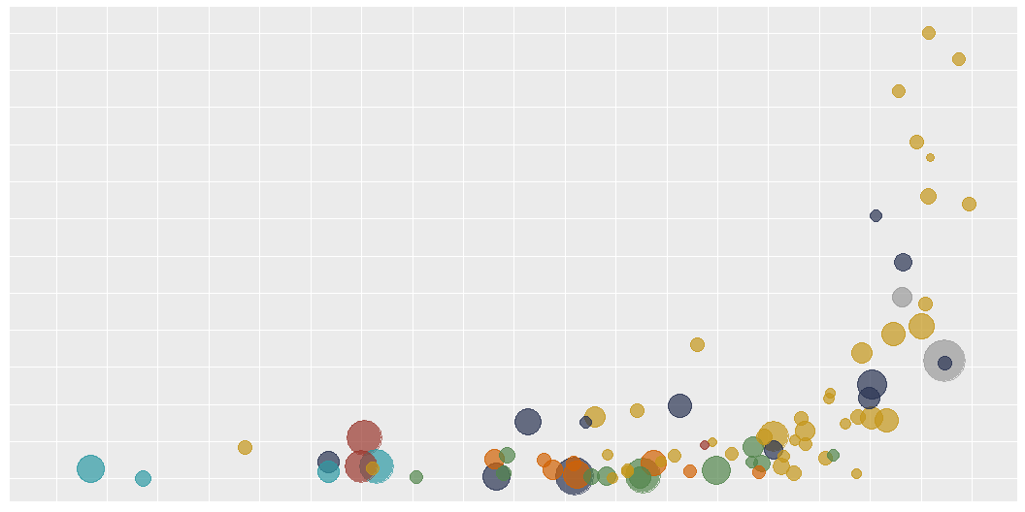

Slide 16
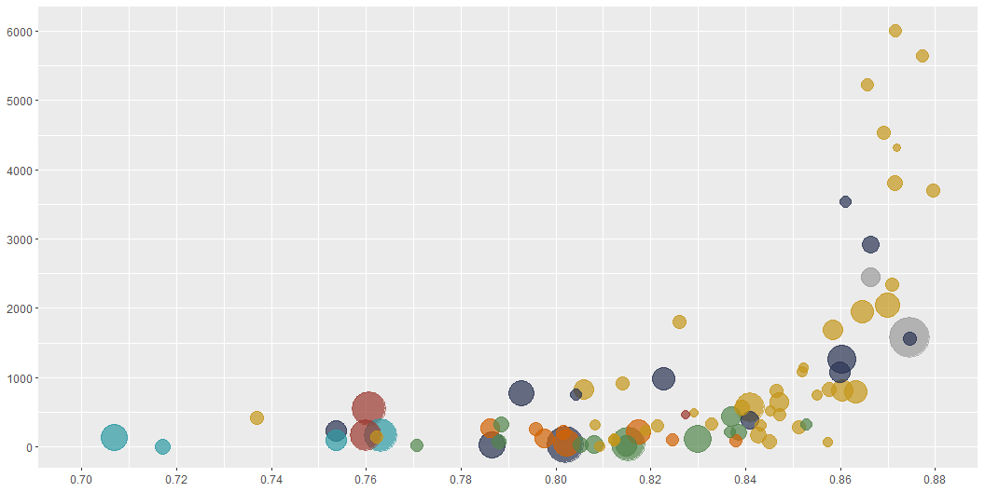

Slide 17
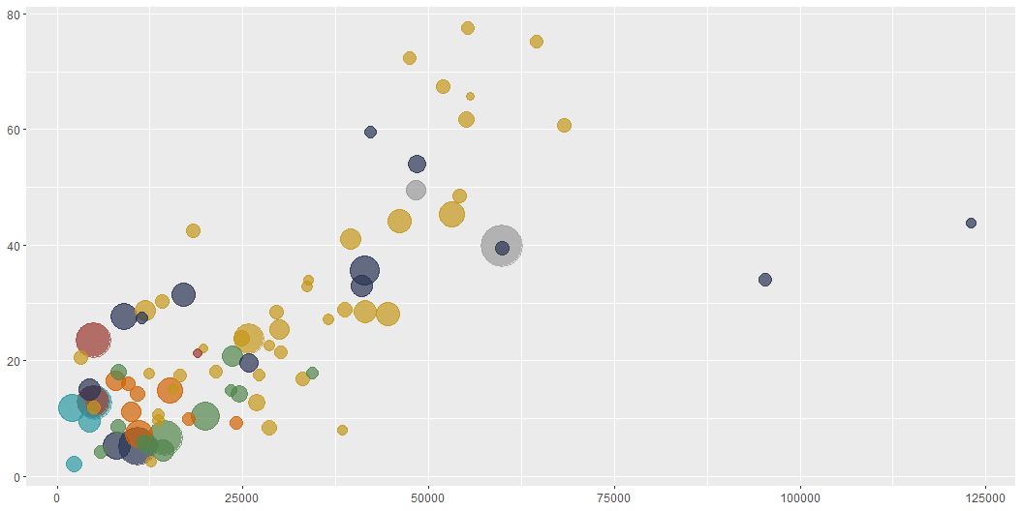

Slide 18
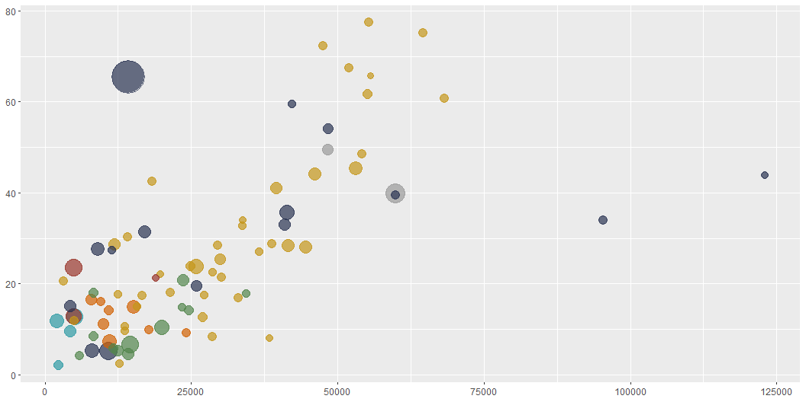

Slide 19
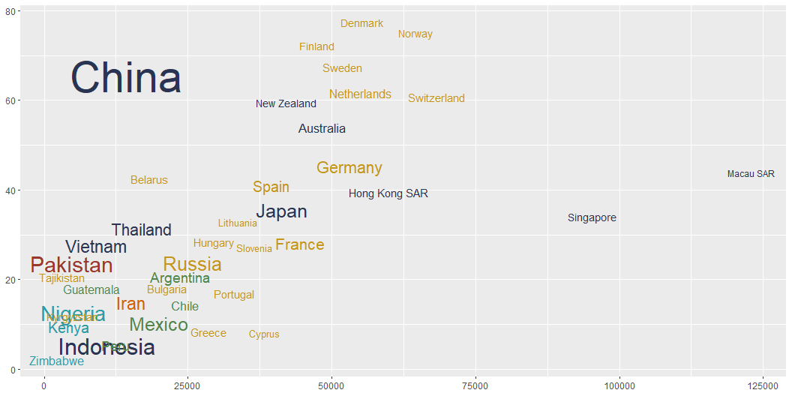

Slide 20
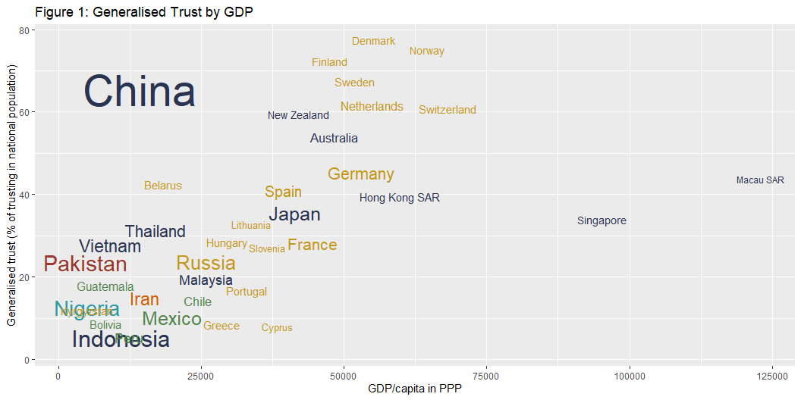

Slide 21

Finding data
The whole world in data?

Slide 22
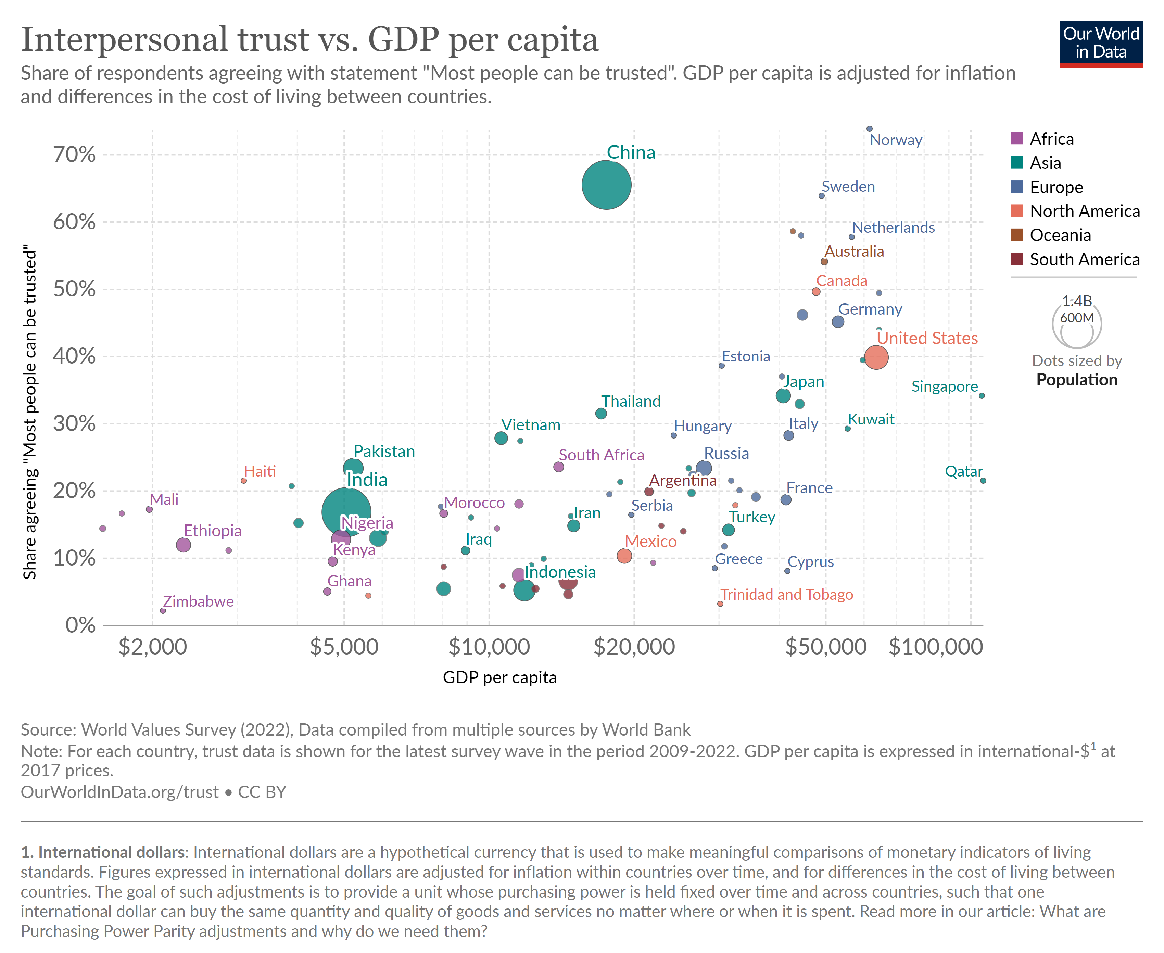
Trust and GDP

Slide 23
Models in social science
Descriptive
Predictive
Inferential
Causal

Slide 24
Models in social science
Descriptive
Predictive
Inferential
Causal
Trust
GDP per capita
The aim of modelling is to explain
Are we assuming a “linear” relationship?
Are we assuming that no other factors affect trust?
Are we assuming that the relationship between GDP and trust is not affected by other factors? (hidden “third” variables?)

