Slide 1
Logistic regression
Week 4

Slide 2
Last week, this week
Multiple linear regression (OLS)
Simple linear regression and correlation
Multiple logistic regression
Simple logistic regression

Slide 3
Motivating example: teenage sleep survey

Slide 4
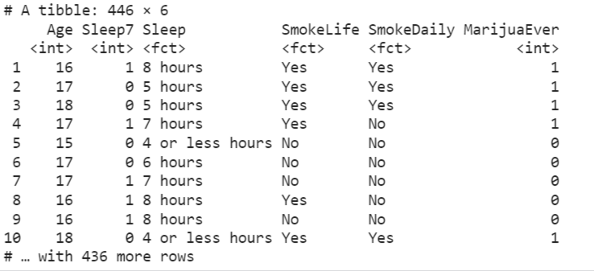
Example
Question: “Do teenagers get 7+ hours of sleep?”
Students in grades 9 - 12 surveyed about health risk behaviours including whether they usually get 7 or more hours of sleep
Sleep:
1 = “Yes”
0 = “No”

Slide 5
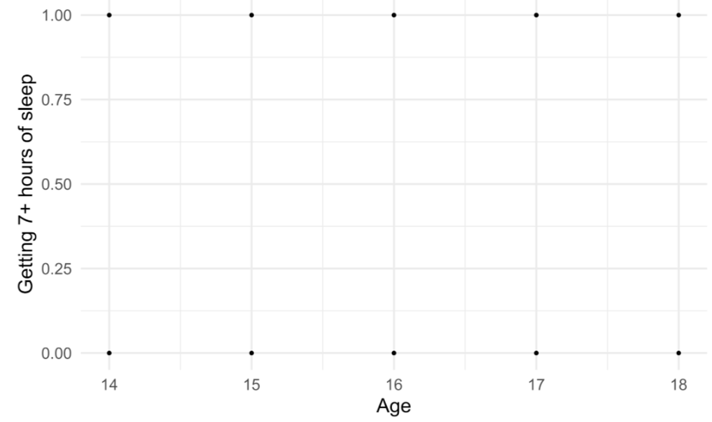
Example

Slide 6
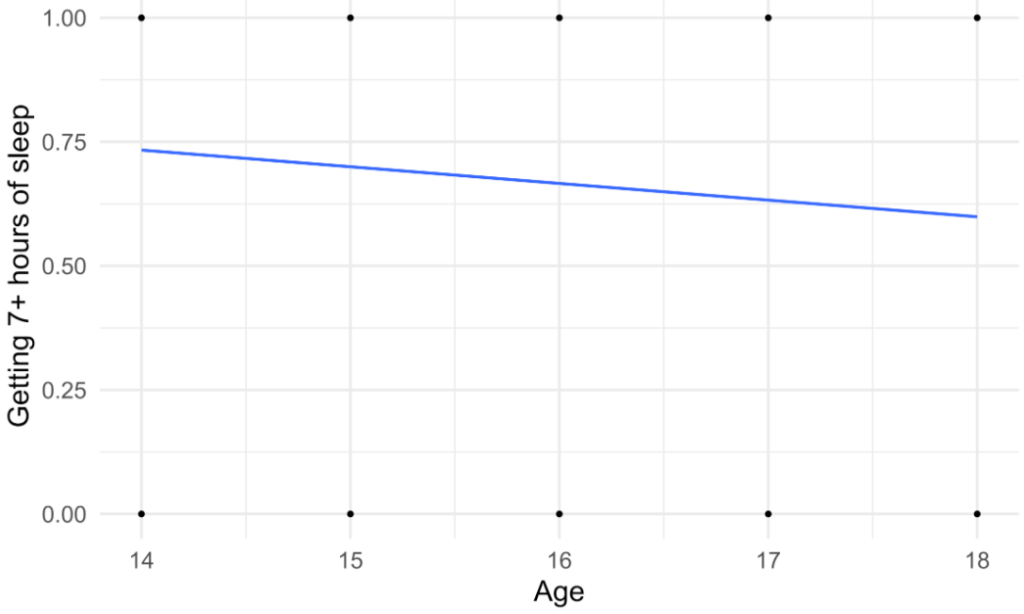
Example
Outcome: 1 = yes, 0 = no

Slide 7
Example
Outcome: Probability of getting 7+ hours of sleep

Slide 8
Example
Outcome: Probability of getting 7+ hours of sleep (Linear model)

Slide 9
Example
Outcome: Probability of getting 7+ hours of sleep (Logistic model)

Slide 10
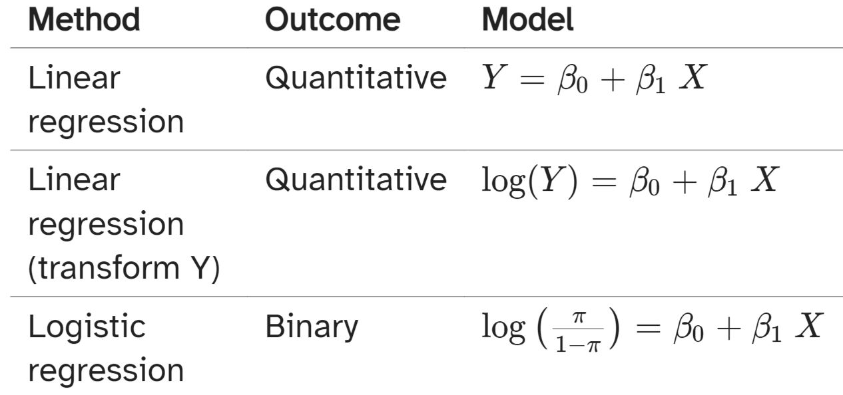
Different types of models

Slide 11
2. Logistic regression: the theory

Slide 12
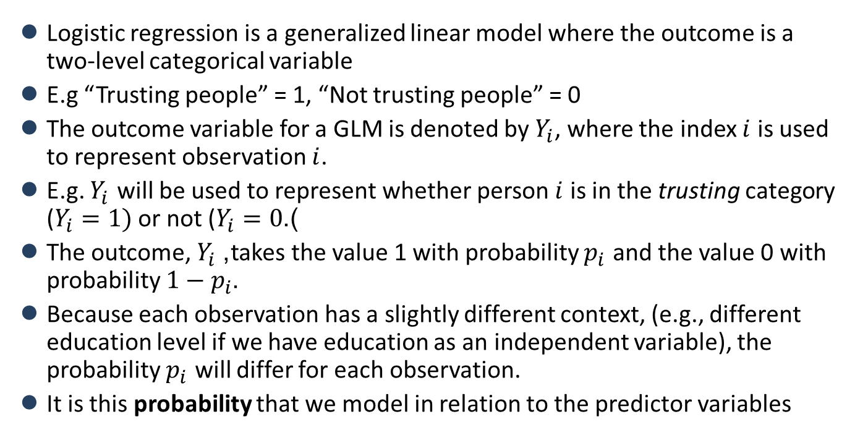
What is logistic regression?
Logistic regression is a generalized linear model where the outcome is a two-level categorical variable
E.g “Trusting people” = 1, “Not trusting people” = 0
The outcome variable for a GLM is denoted by $Y_{i}$, where the index $i$ is used to represent observation $i$.
E.g. $Y_{i}$ will be used to represent whether person $i$ is in the trusting category ($Y_{i}=1)$or not ($Y_{i}=0$).
The outcome, $Y_{i}$, takes the value 1 with probability $p_{i}$ and the value 0 with probability $1−p_{i}$.
Because each observation has a slightly different context, (e.g., different education level if we have education as an independent variable), the probability $p_{i}$ will differ for each observation.
It is this probability that we model in relation to the predictor variables

Slide 13
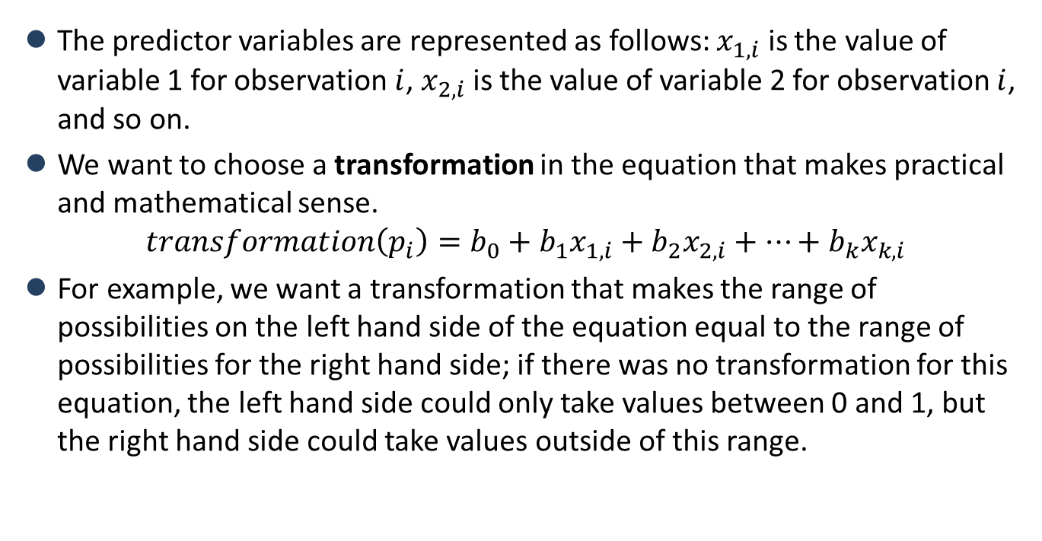
The logit transformation
The predictor variables are represented as follows: $x_{1,i}$ is the value of variable 1 for observation $i$, $x_{2,i}$ is the value of variable 2 for observation $i$, and so on.
We want to choose a transformation in the equation that makes practical and mathematical sense.
$$transformation\left(p_{i}\right)=b_{0}+b_{1}x_{1,i}+b_{2}x_{2,i}+⋯+b_{k}x_{k,i}$$
For example, we want a transformation that makes the range of possibilities on the left hand side of the equation equal to the range of possibilities for the right hand side; if there was no transformation for this equation, the left hand side could only take values between 0 and 1, but the right hand side could take values outside of this range.

Slide 14
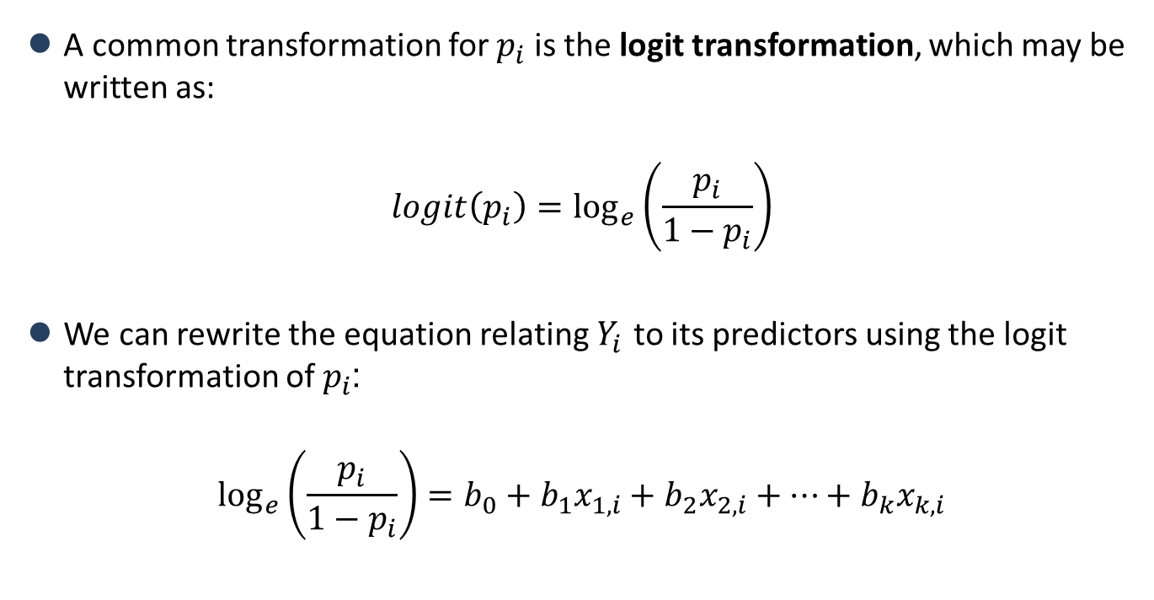
The logit transformation
A common transformation for $p_{i}$ is the logit transformation, which may be written as:
$$logit\left(p_{i}\right)=\log_{e}\left(\frac{p_{i}}{1−p_{i}}\right)$$
We can rewrite the equation relating $Y_{i}$ to its predictors using the logit transformation of $p_{i}$:
$$\log_{e}\left(\frac{p_{i}}{1−p_{i}}\right)=b_{0}+b_{1}x_{1,i}+b_{2}x_{2,i}+⋯+b_{k}x_{k,i}$$

Slide 15
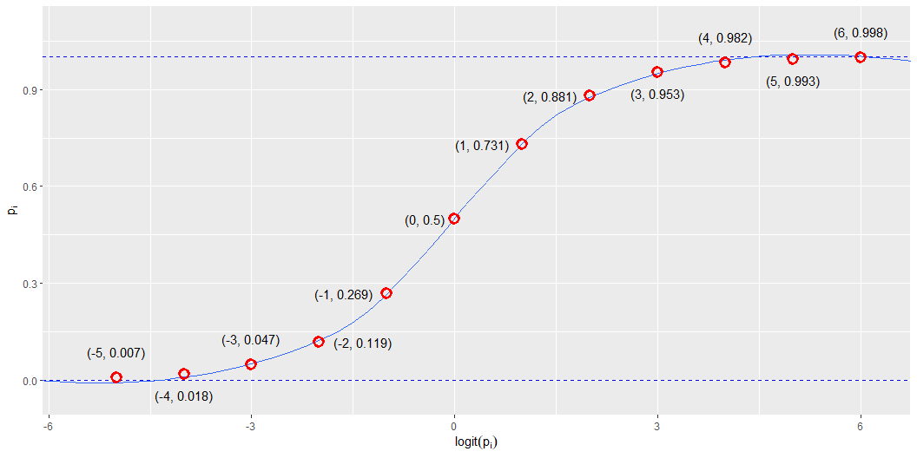
The logit transformation

Slide 16
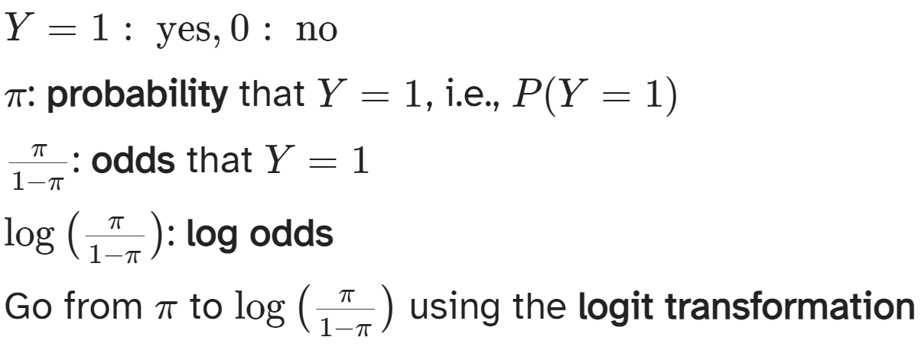
Odds and probabilities

Slide 17
Odds and probabilities
probs | odds | log_odds
0.01 | 0.01 | -4.60
0.05 | 0.05 | -2.94
0.10 | 0.11 | -2.20
0.20 | 0.25 | -1.39
0.33 | 0.50 | -0.69
0.40 | 0.67 | -0.41
0.50 | 1.00 | 0.00
0.60 | 1.50 | 0.41
0.67 | 2.00 | 0.69
0.80 | 4.00 | 1.39
0.90 | 9.00 | 2.20
0.95 | 19.00 | 2.94
0.99 | 99.00 | 4.60

Slide 18
Odds
Suppose there is a 70% chance it will rain tomorrow
Probability it will rain is p = 0.7
Probability it won’t rain is 1 − p = 0.3
Odds it will rain are 7 to 3, 7:3, 0.7/0.3 ≈ 2.33

Slide 19
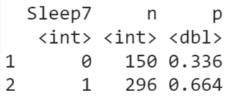
Are teenagers getting enough sleep?
P(7+ hours of sleep) = P(Y=1) = p = 0.664
P(< 7 hours of sleep)=P(Y=0) = 1−p = 0.336
P(odds of 7+ hours of sleep) = 0.664/0.336 = 1.976

Slide 20
3. Worksheet example

Slide 21
How does education relate to social trust?
Application reading:
Wu, Cary. 2021. “Education and Social Trust in Global Perspective.” Sociological Perspectives 64 (6): 1166–86. https://doi.org/10.1177/0731121421990045.
“there is a strong and positive relation between education level and trust”.
However, “several studies have shown that education might yield differential impacts on trust in different societies. In Sweden, Sven Oskarsson et al. (2017) show that education has little impact on trust. In China, Cary Wu and Zhilei Shi (2020) suggest that education has a negative impact on people’s trust. Several cross-national studies have also shown that the education and trust association can vary from positive to negative depending on the specific institutional contexts …”

Slide 22
How does education relate to social trust?
Methods:
“For the WVS, I use the standard survey item asking, “Generally speaking, would you say that most people can be trusted or that you can’t be too careful in dealing with people?” (Rosenberg 1956). The variable is coded on a 0 to 1 scale, with 1 corresponding to high levels of trust.” (p. 1170)
“For the WVS, I measure educational attainment using respondents’ highest education level attained with eight categories, namely, 1 = no formal education or inadequately completed elementary education, 2 = completed (compulsory) elementary education, 3 = incomplete secondary school: technical/vocational, 4 = complete secondary school: technical/vocational, 5 = incomplete secondary: university, 6 = complete secondary: university, 7 = some university without degree, and 8 = university with degree/higher education. In some analyses, I treat education as a categorical variable. To reduce the number of categories, I recode respondents’ education into Primary, Secondary, Post-secondary, and Tertiary. This is also consistent with the most recent wave of the WVS coding” (p. 1171)
“I also control for relevant demographic covariates such as gender, age, income, marital status, and occupational status at the individual level” (p. 1172)

Slide 23
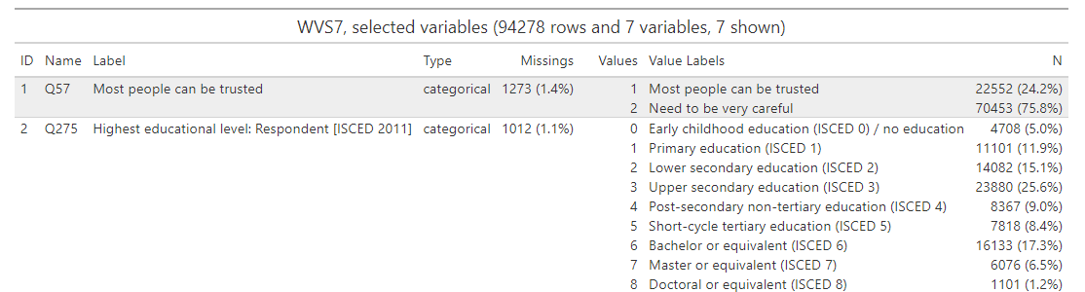
How does education relate to social trust?

Slide 24
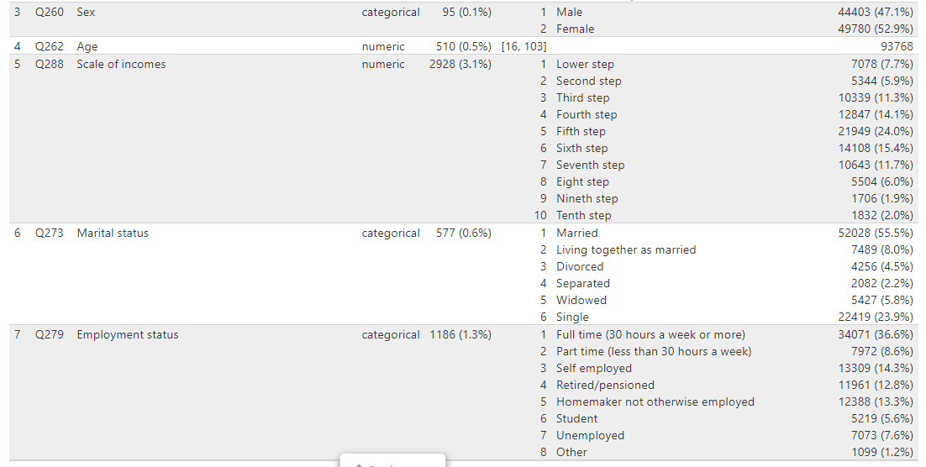
How does education relate to social trust?

Slide 25
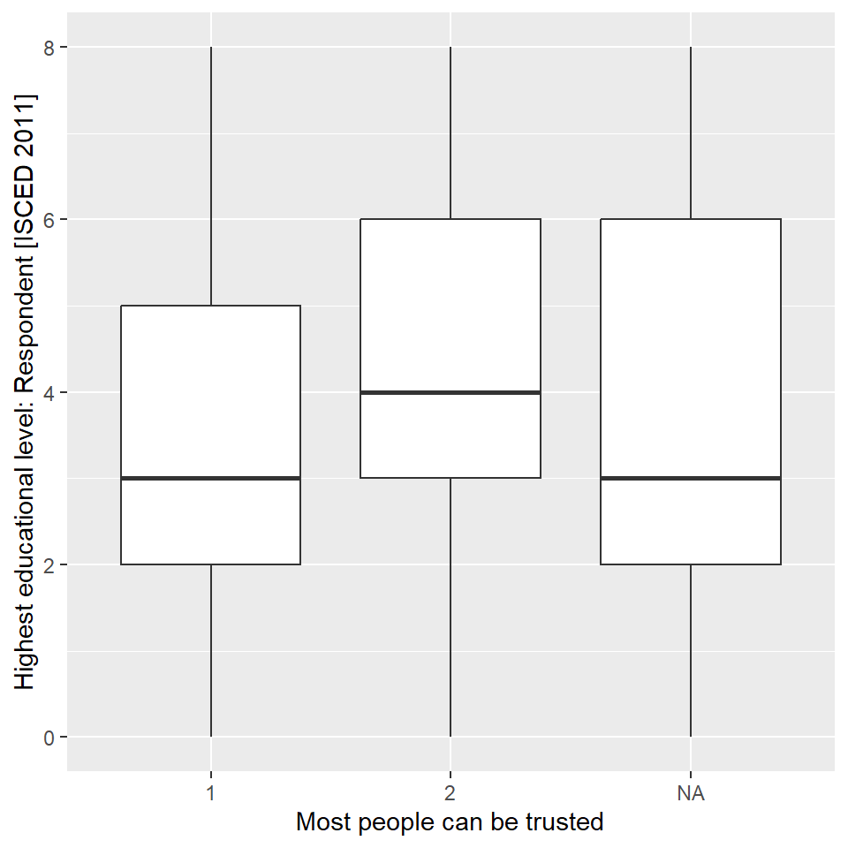
How does education relate to social trust?

Slide 26
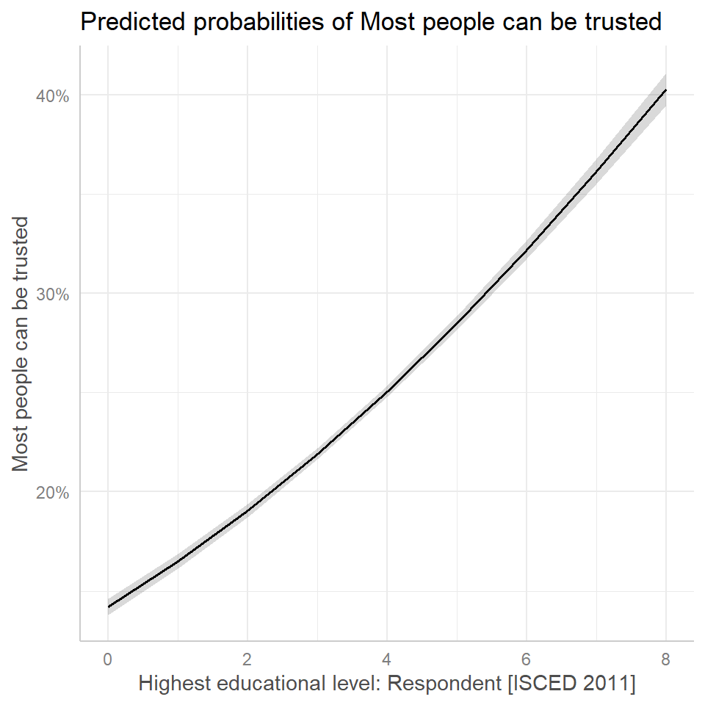
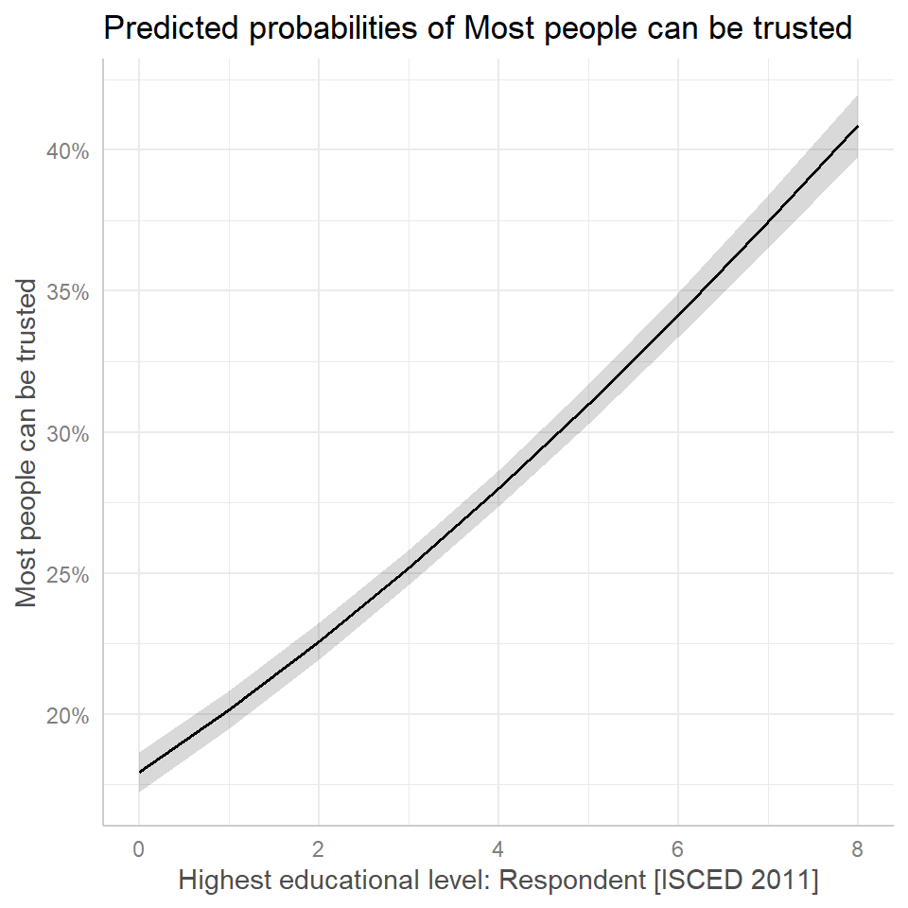
How does education relate to social trust?

Slide 27
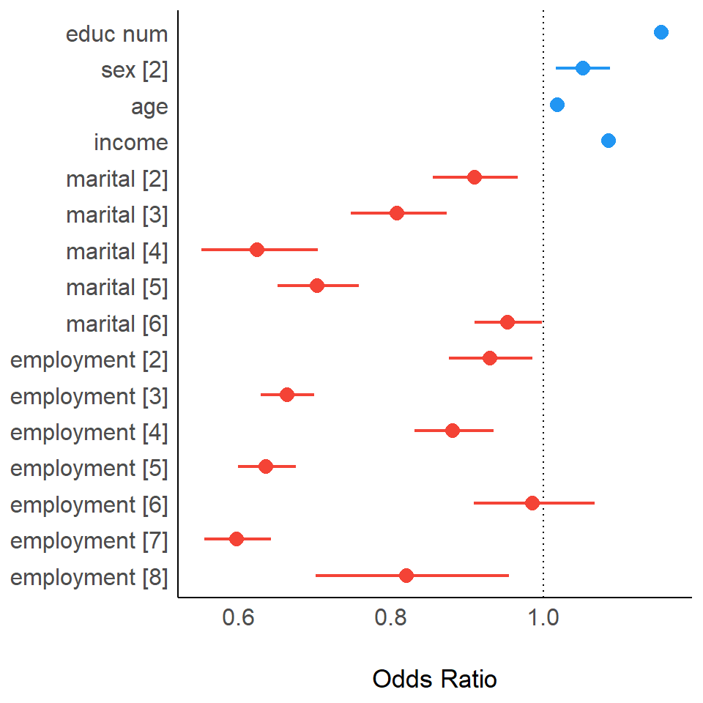
How does education relate to social trust?

Slide 28
Good luck in the labs!

