Slide 1
Elicitation: interviews and focus groups
Week 8

Slide 2
Ethnography, participant observation or interviewing?
“If you get to go home at night, it’s participant observation, and if you don’t, it’s ethnography” (Luker 2008, p. 156)

Slide 3
Ethnography, participant observation or interviewing?
“If you get to go home at night, it’s participant observation, and if you don’t, it’s ethnography” (Luker 2008, p. 156)
If you get to go home after a one-hour conversation, it’s an interview

Slide 4
Why interviewing?
Can everything be quantified and measured?
Can everything be observed?
We cannot observe feelings, thoughts, and intentions.
We cannot observe behaviors that took place at some previous point in time.
We cannot observe situations that preclude the presence of an observer.
We cannot observe how people have organized the world and the meanings they attach to what goes on in the world.
We have to ask people questions about those things
(Patton 2002, p. 341)

Slide 5

Voice, Veracity and Truth
Participant’s voice at the heart of the research
Interviews are “narratives” - stories about what people think happened, or should have happened, or even wanted to have happened
Interest is not in the veracity of the interviews, but in their deep truth
Regardless of whether things happened the way people said they did, what interests us is that people chose to tell us that they happened that way
“The point of interviews, however, is not what is going on inside one person’s head, but what is going on inside lots of people’s heads. When you hear the same thing from people all over the country who don’t know one another, you can be reasonably sure that you are tapping into something that is reliably social and not just individual” (Luker 2008, p. 167)

Slide 6

Focus groups
A special form of interviewing
The interview asks focused questions of a group of persons, optimally between five and eight
The group can be close friends, family members, or complete strangers
Unlike one-on-one interviews, which can probe deeply, focus group questions are narrowly tailored (“focused”) to a particular topic and issue
The focus is on the group and its interactions and evaluations rather than on the individuals in that group.
Sometimes used to initiate areas of inquiry for later data collection methods

Slide 7
Focus groups – how many participants?
Moderating a focus group can be a challenge
Confining the group to no more than eight participants is recommended
You probably want at least four persons to capture group interaction. Fewer than four participants can also make it more difficult for participants to remain (relatively) anonymous
But: naturally occurring groups (as in the case of a family of three, a social club of ten, or a program of fifteen)
If we really are interested in the group’s dynamic (not just a set of random strangers’ dynamic), then we want to include all its members or as many as are willing and able to participate.

Slide 8
Focus groups – two main strategies
Diversity focus groups include people with diverse perspectives and experiences. This helps the researcher identify commonalities across this diversity and/or note interactions across differences
Convergence focus groups include people with similar perspectives and experiences. These are particularly helpful for identifying shared patterns and group consensus.

Slide 9
Considerations
Who to interview? Sampling
How many interviews to conduct?
What types of interviews to conduct?
What kind of questions to ask, and how?
How to analyse the data?

Slide 10
Who to interview? Sampling
Type | Used in... | Strategies
Probabilistic | Quantitative research
 |  | Simple random | Each member of the population has an equal chance at being selected
 |  | Stratified | The sample is split into strata; members of each strata are selected in proportion to the population at large (e.g, half of sample identifies as male, half identifies as female)
Non-probabilistic | Qualitative research
 |  | Convenience | Simply includes the individuals who happen to be most accessible to the researcher
 |  | Snowball | Used to recruit participants via other participants. The number of people you have access to “snowballs” as you get in contact with more people
 |  | Purposive | Involves the researcher using their expertise to select a sample that is most useful to the purposes of the research; An effective purposive sample must have clear criteria and rationale for inclusion (e.g., political liberal and political conservative college students in a study of politics on campus)
 |  | Quota | Set quotas to ensure that the sample you get represents certain characteristics in proportion to their prevalence in the population

Slide 11
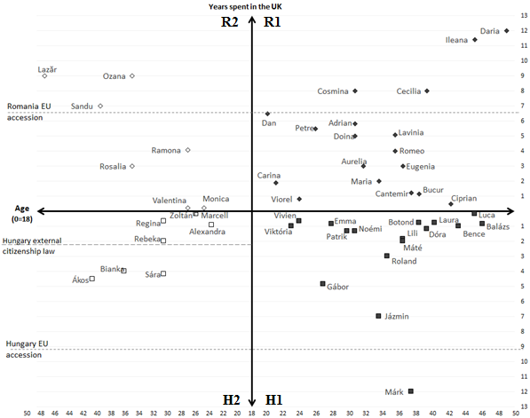
Who to interview? Sampling

Slide 12
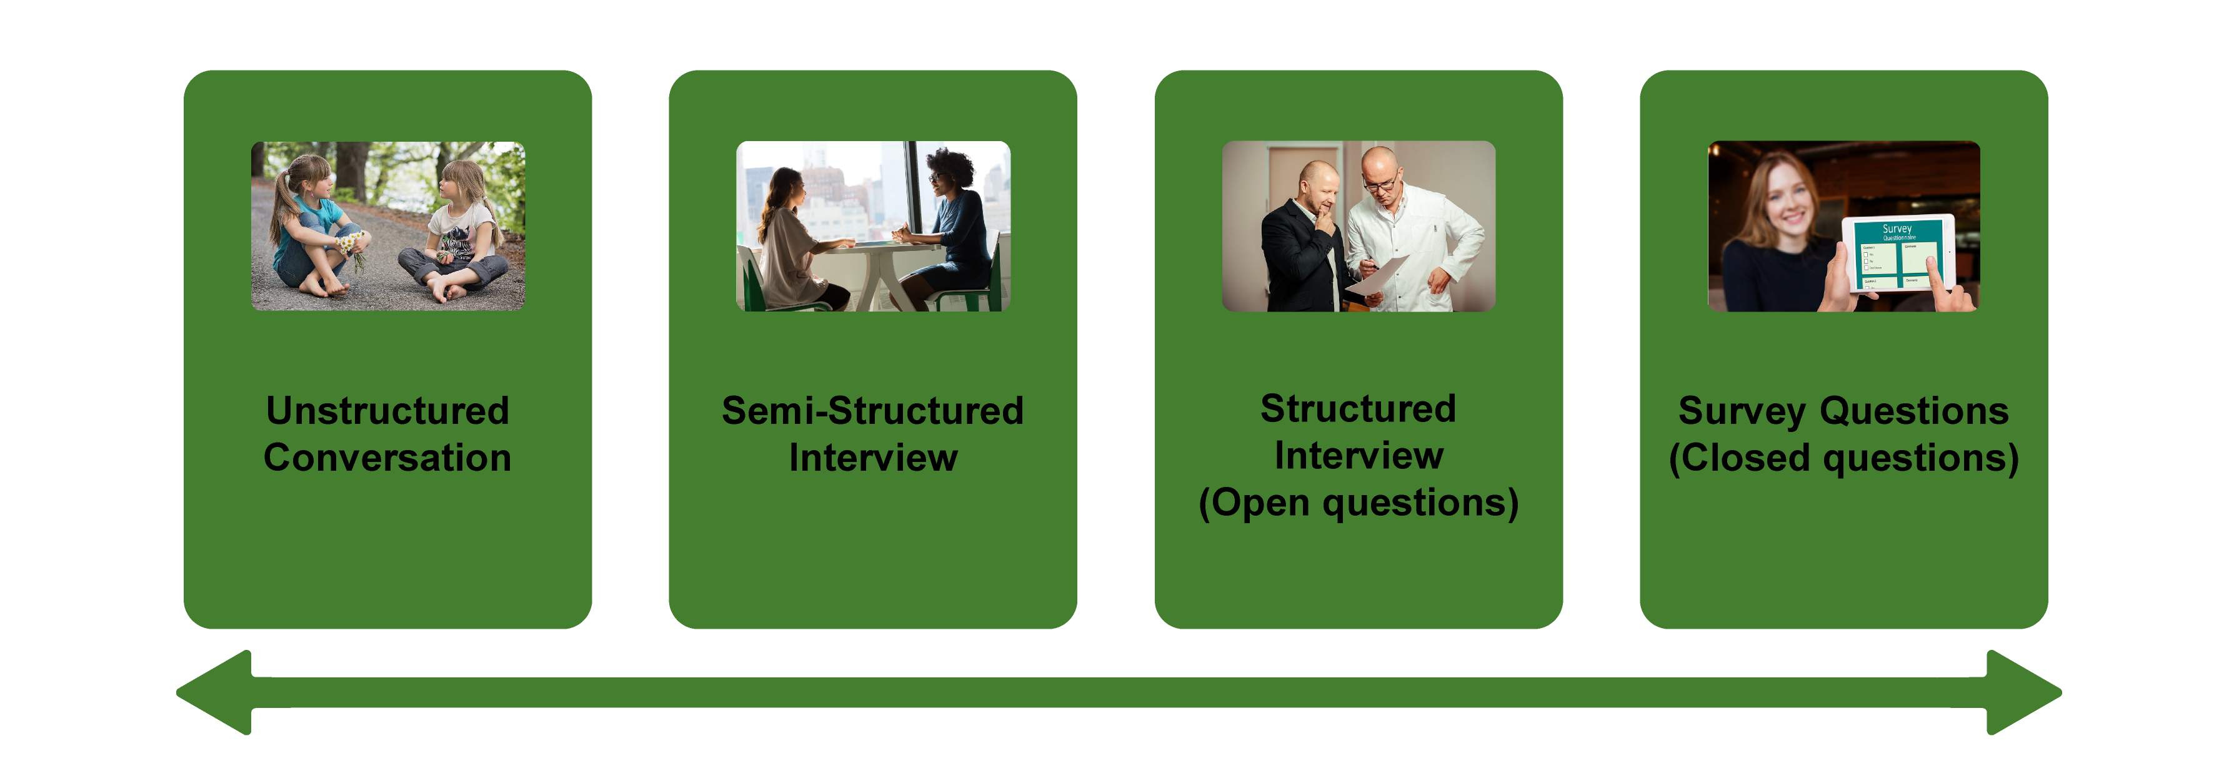
Types of interviews

Slide 13
How many interviews?
Saturation: “…when you don’t learn anything new for a while, your study is complete” (Becker 2017, Evidence, p. 173.)
Researchers often draw on existing reports of saturation to estimate a sample size prior to data collection; between 12 and 20 interviews per category of participant has often been suggested; but it varies greatly
Assumes that data collection and analysis are happening in tandem
Assumes that meaning inheres in the data, waiting to be discovered — and confirmed — once saturation has been reached
But: data are often multivalent and can give rise to different interpretations
More important: that the research design allows for collecting rich and textured data that provide insight into participants’ understandings, accounts, perceptions and interpretations

Slide 14
From research questions to interview questions
Rao, A. H. Gendered interpretations of job loss and subsequent professional pathways. Gend. Soc. 35, 884–909 (2021).
Aim: to understand the gendered experience and understanding of unemployment
Methods: Dozens of interviews with men and women who had lost their jobs, some of the participants’ spouses and follow-up interviews with about half the sample approximately 6 months after the initial interview
Findings: she found that the very process of losing their jobs meant different things for men and women. Women often saw job loss as being a personal indictment of their professional capabilities. Men, by contrast, saw it as part and parcel of a weak economy rather than a personal failing.

Slide 15
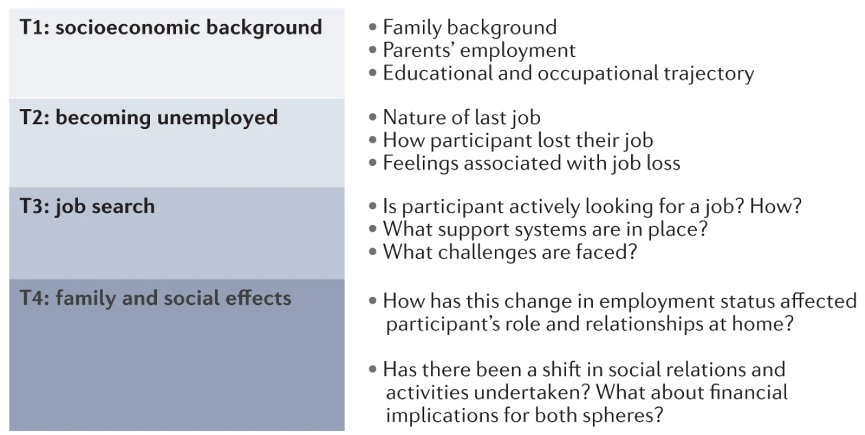
Interview topic guides

Slide 16
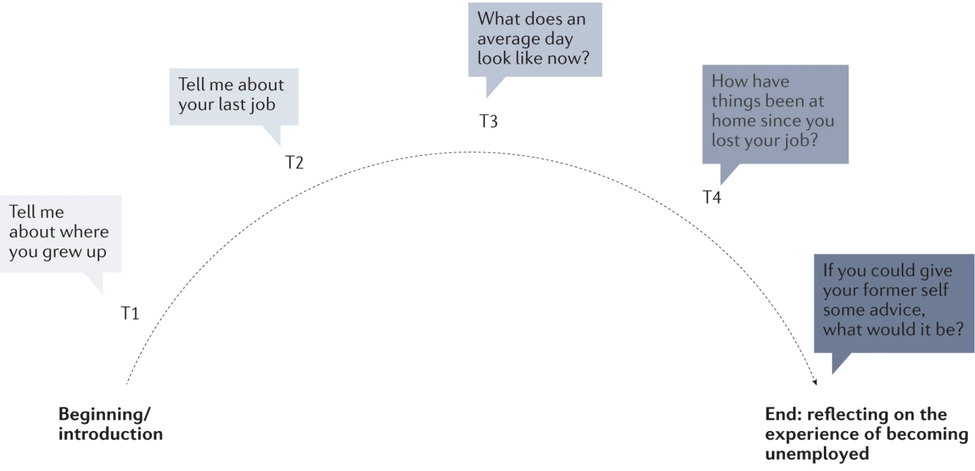
A “topic guide arc”

Slide 17
Types of interview questions
Type of question | Example
Introductory | Can you tell me about … (something specific)?
Follow-up | Non-verbal cues: mmm..., nod Verbal cues: repeat back keywords to participants, ask for reflection or unpacking of point just made
Probing | Can you say a little more about X? Why do you think X…? (for example, Why do you think X is that way? Why do you think X is important?)
Specifying | Can you give me an example of X?
Abstract | How did you feel when X happened?
Indirect | How do you think other people view X?
Structuring | Thank you for that. I’d like to move to another topic…
Direct (later stages) | When you mention X, are you thinking like Y or Z?
Interpreting | So, what I have gathered is that…
Ending | I have asked all the questions I had, but I wanted to check whether there is something else about your experience/understanding we haven’t covered? Do you have any questions for me?
Listening | (non-verbal) We note that waiting and listening can also leave space for participants to open up or discuss more without verbal prompting
Silence | (non-verbal)

Slide 18
Analysing interview data
The two most common methods used to analyse interview material across the social sciences are thematic analysis and discourse analysis
Thematic analysis is a particularly useful and accessible method for those starting out in analysis of qualitative data and interview material as a method of coding data to develop and interpret themes in the data
Discourse analysis is more specialized and focuses on the role of discourse in society by paying close attention to the explicit, implicit and taken-for-granted dimensions of language and power
In practice researchers might flexibly combine these approaches depending on the object of analysis
(We’ll practice qualitative data analysis in Week 10)

