Slide 1
Linear regression
Week 3

Slide 2
Is inequality affecting social trust?

Slide 3

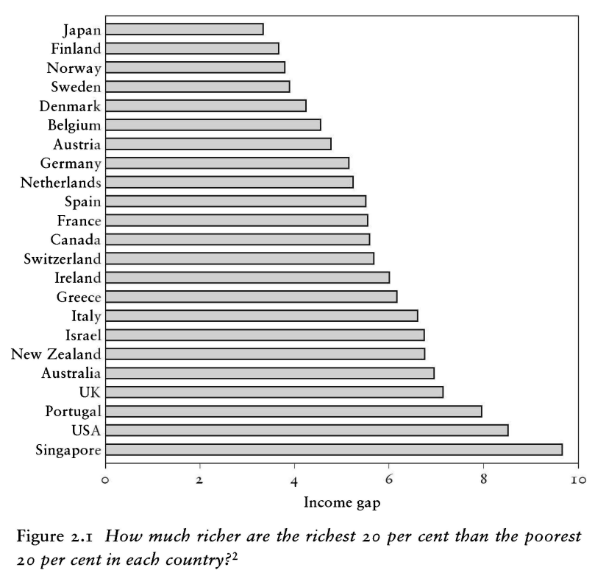
“The spirit level” (2010)

Slide 4
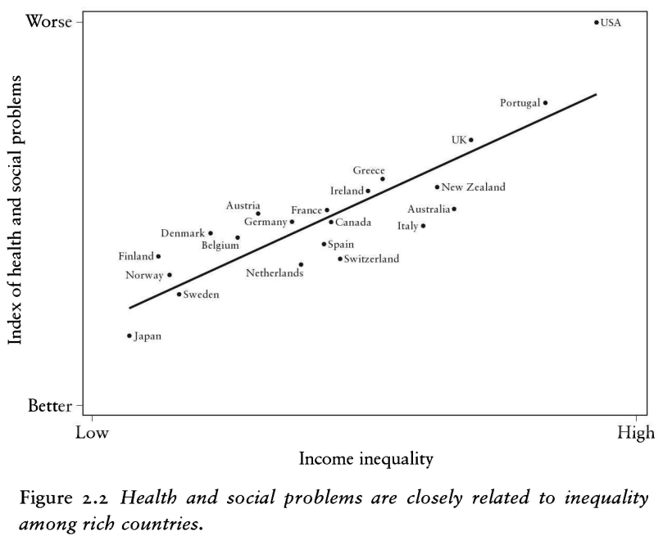
“The spirit level” (2010)

Slide 5
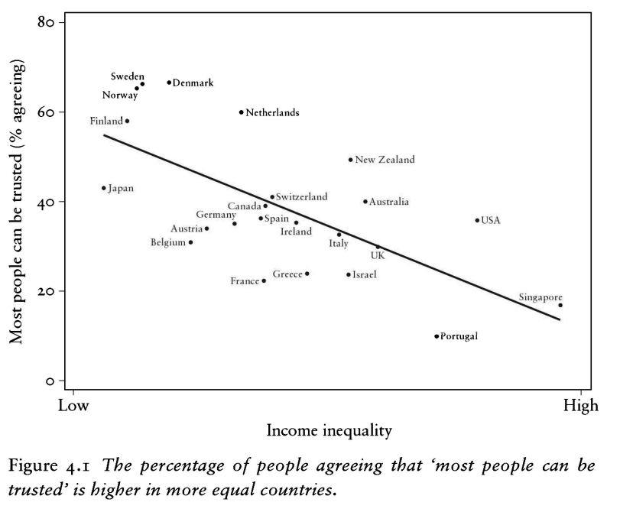
“The spirit level” (2010)

Slide 6
data_peek(inequality)
Data frame with 89 rows and 10 variables Variable | Type | Values ----------------------------------------------------------------------- cntry_AN | character | AL, AZ, AT, AM, BA, BG, BY, HR, CZ, DK, ... country | character | Albania, Azerbaijan, Austria, Armenia, ... trust_pct | numeric | 2.52, 30.36, 48.46, 17.68, 9.61, 18.05, ... GDPpercap2 | numeric | 12770.9918634405, 14121.4069355591, ... pop | numeric | 2873457, 9854033, 8797566, 2851923, ... urban_pop_pct | numeric | 59.383, 55.343, 58.094, 63.103, 47.876, ... inc_top20 | numeric | 39.6375, NA, 38.4181818181818, 39.575, ... inc_bottom20 | numeric | 7.9125, NA, 7.90909090909091, ... s80s20 | numeric | 5.00947867298578, NA, 4.85747126436782, ... Region | character | Europe & Central Asia, ...

Slide 7
describe_distribution(inequality)
Variable | Mean | SD | IQR | Range | Skewness | Kurtosis | n | n_Missing ------------------------------------------------------------------------------------------------------------ trust_pct | 25.73 | 18.41 | 21.14 | [2.14, 77.42] | 1.13 | 0.62 | 89 | 0 GDPpercap2 | 27447.01 | 21342.56 | 28284.55 | [1987.97, 1.23e+05] | 1.62 | 4.20 | 86 | 3 pop | 5.78e+07 | 1.58e+08 | 4.68e+07 | [73837.00, 1.40e+09] | 7.32 | 61.13 | 87 | 2 urban_pop_pct | 67.92 | 18.93 | 25.93 | [20.31, 100.00] | -0.49 | -0.38 | 87 | 2 inc_top20 | 42.69 | 5.09 | 6.80 | [34.56, 57.35] | 0.86 | 0.42 | 79 | 10 inc_bottom20 | 7.15 | 1.62 | 2.32 | [3.45, 10.08] | -0.19 | -0.69 | 79 | 10 s80s20 | 6.50 | 2.60 | 2.79 | [3.52, 16.64] | 1.67 | 3.50 | 79 | 10

Slide 8
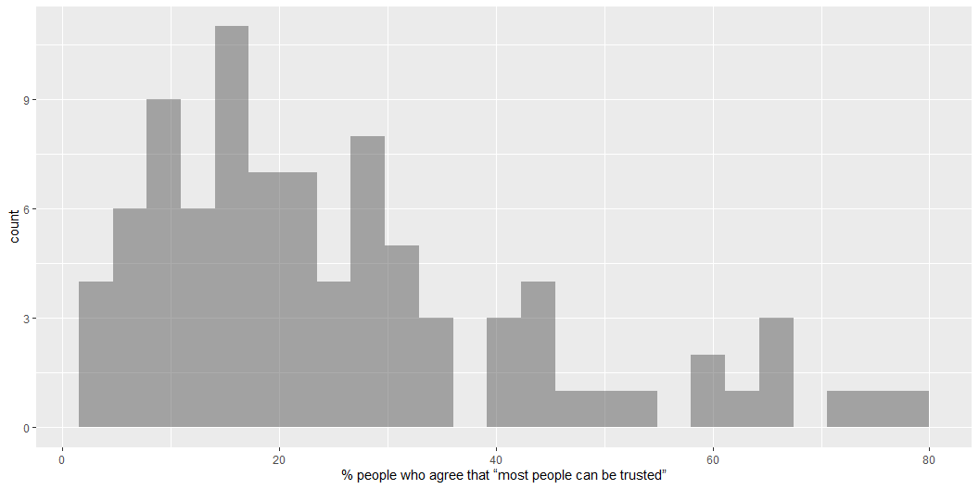
gf_histogram( ~ trust_pct, data = inequality)

Slide 9
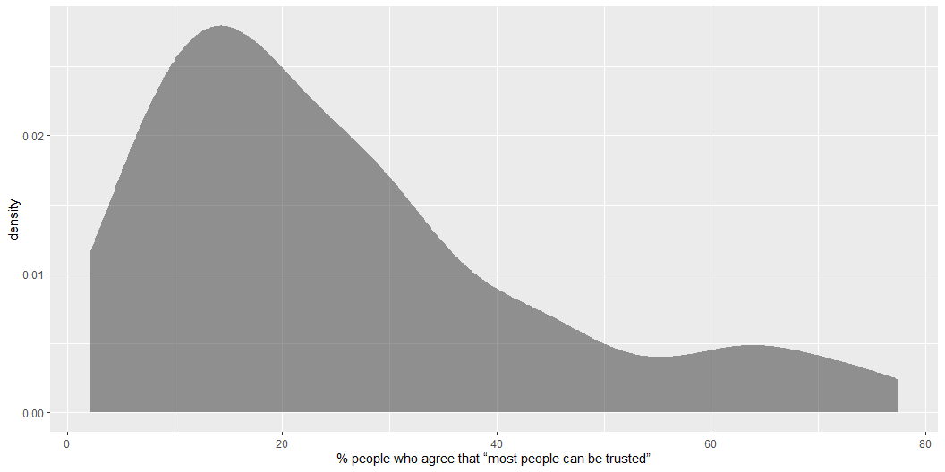
gf_density( ~ trust_pct, data = inequality)

Slide 10
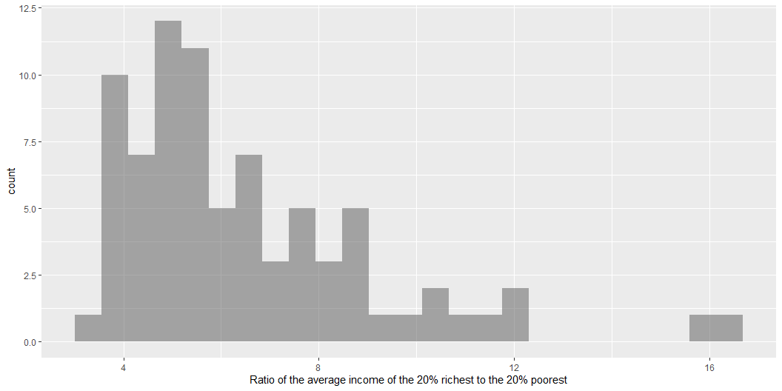
gf_histogram( ~ s80s20, data = inequality)

Slide 11
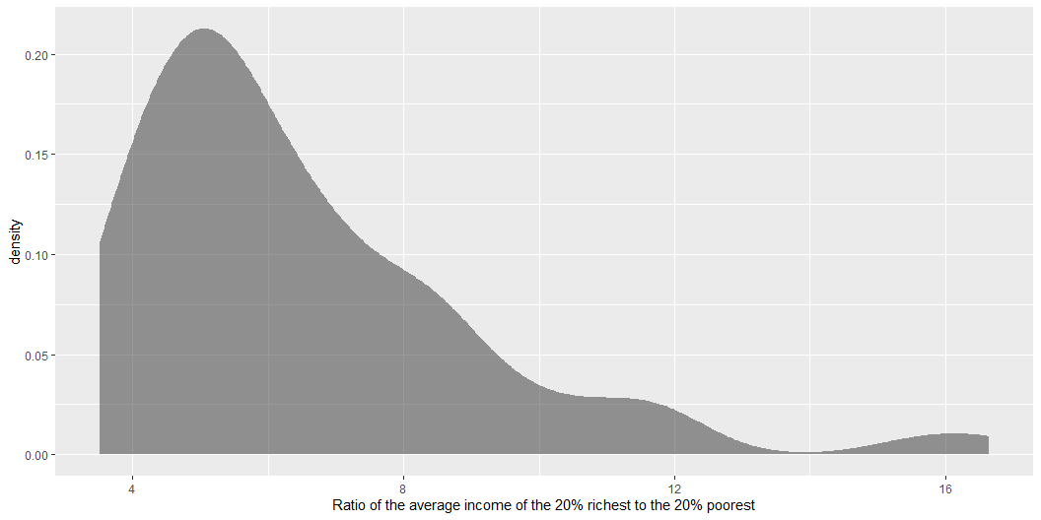
gf_density( ~ s80s20, data = inequality)

Slide 12
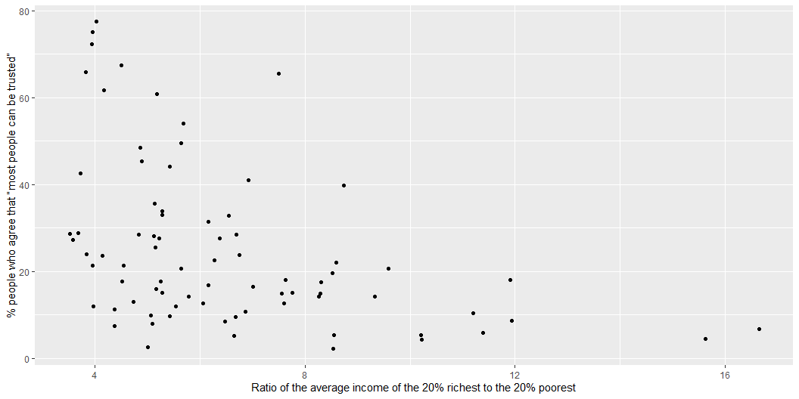

Slide 13
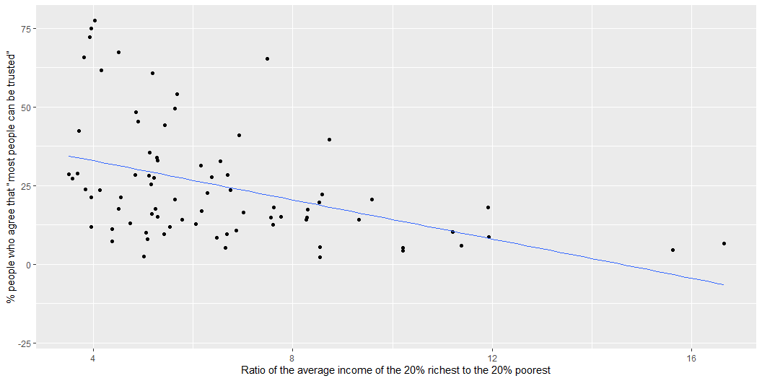

Slide 14
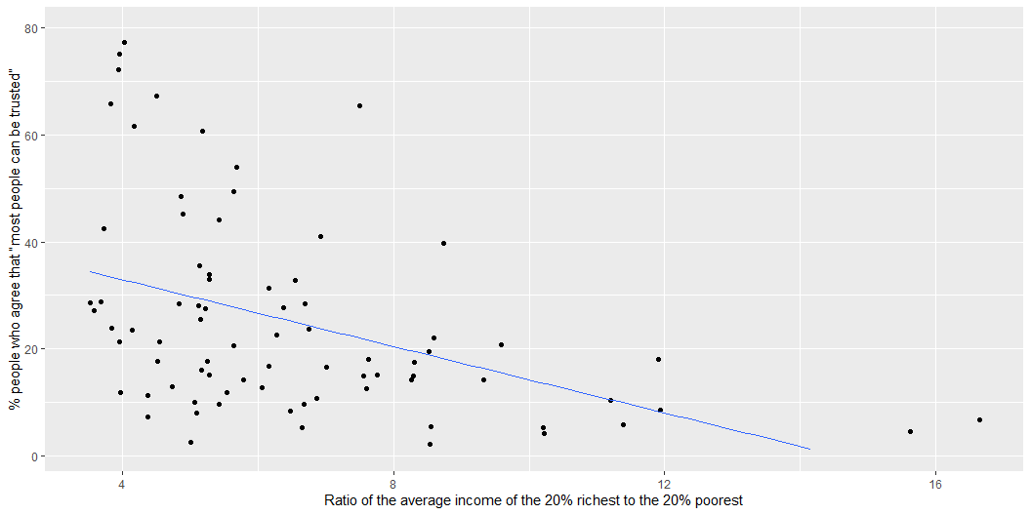

Slide 15
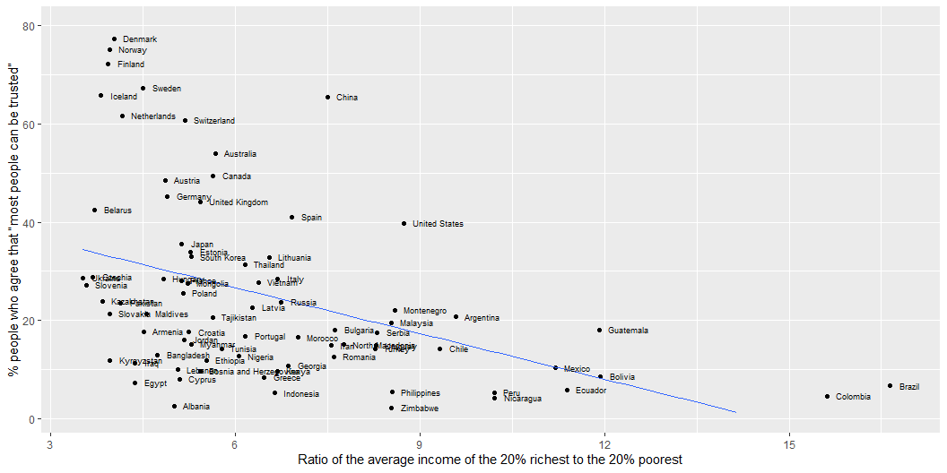

Slide 16
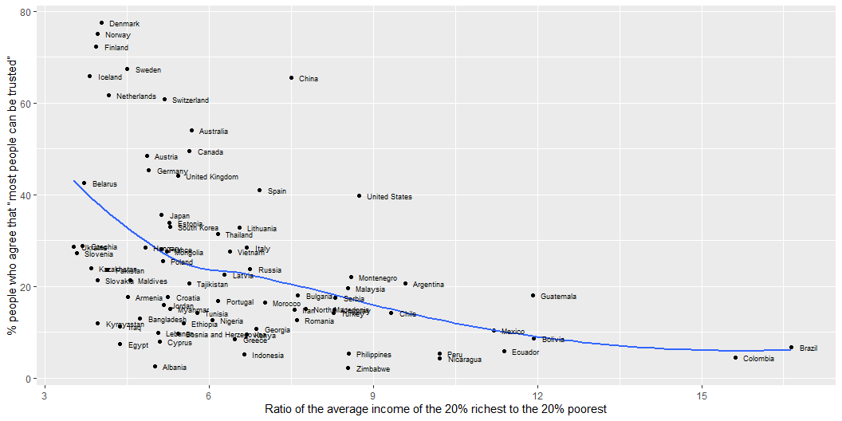

Slide 17
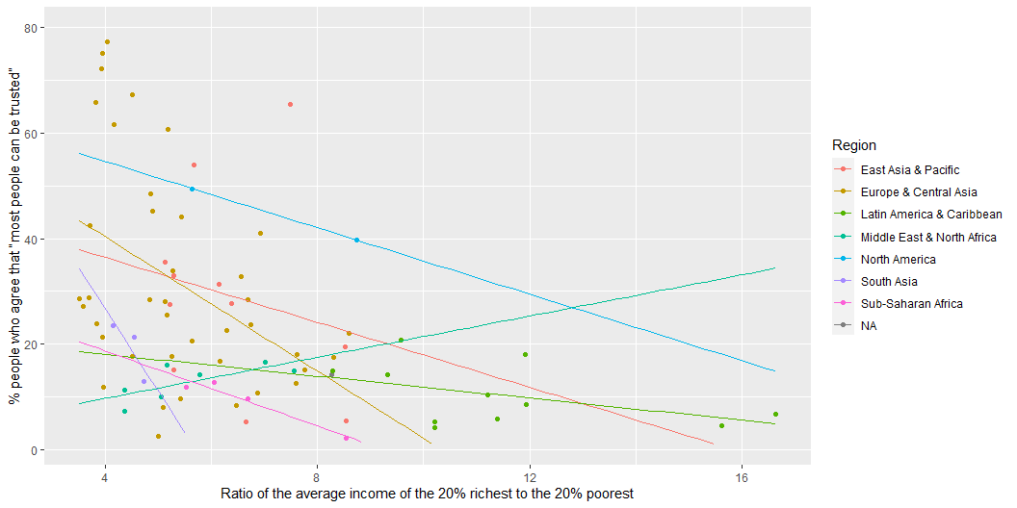

Slide 18
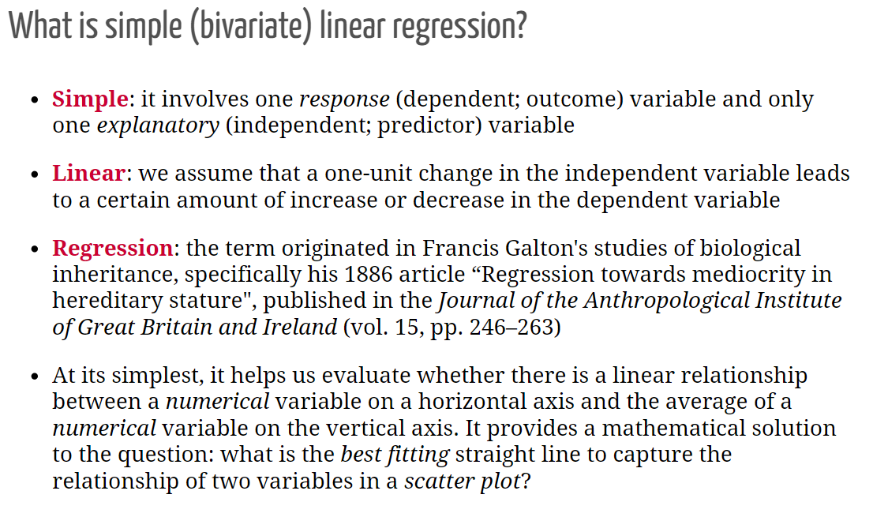

Slide 19
What is a ‘best’ line?
The same regression line could represent very different relationships
Source: F. J. Anscombe (1973). Graphs in Statistical Analysis. The American Statistician, 27(1):17-21. If you have access to JSTOR you can get the article at the following link: http://www.jstor.org/stable/2682899

Slide 20
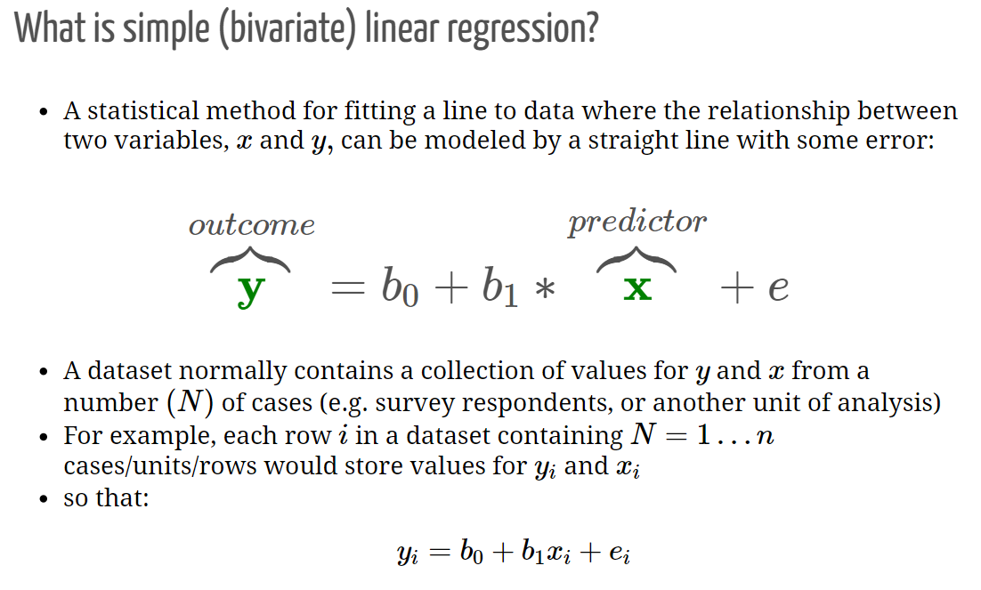

Slide 21
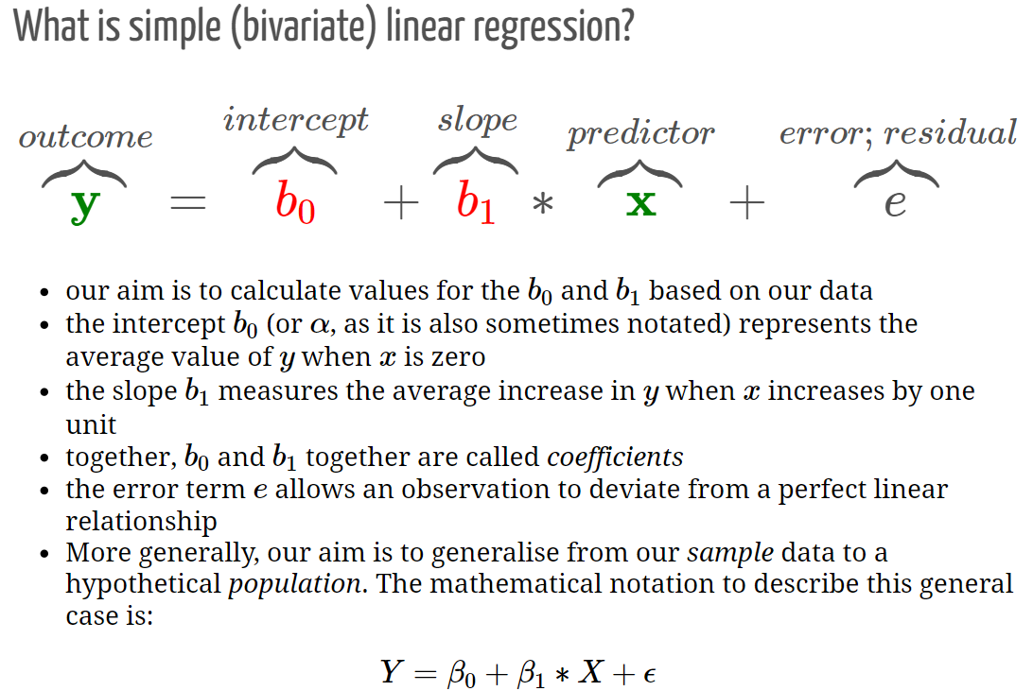

Slide 22
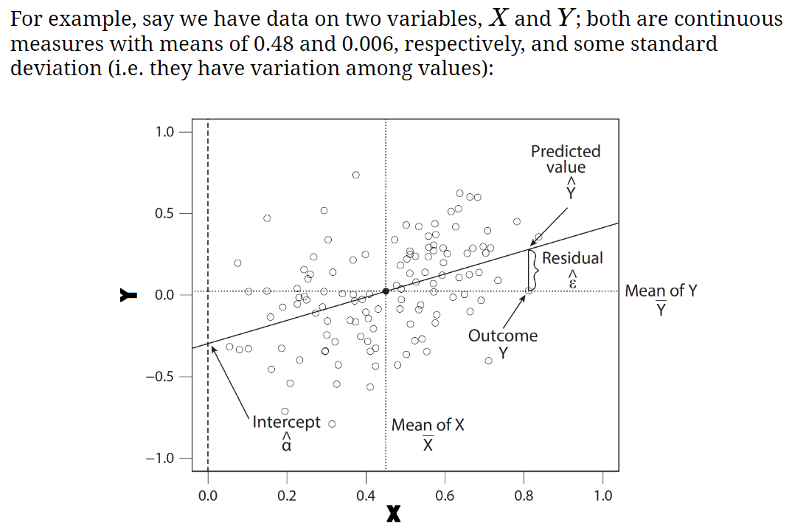

Slide 23
Applied regression

Slide 24
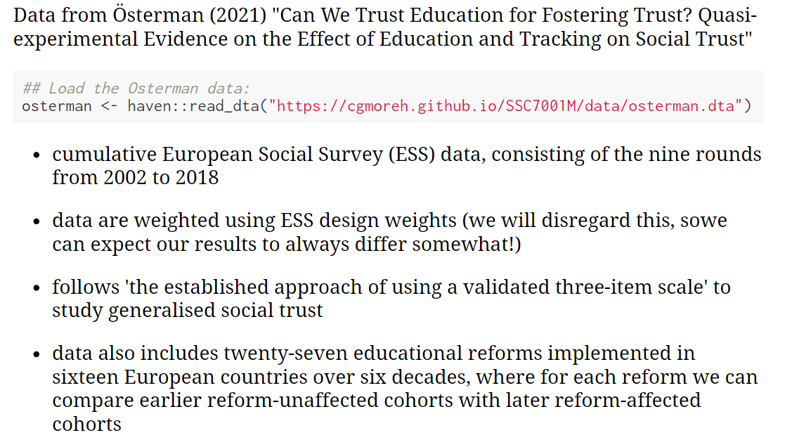

Slide 25
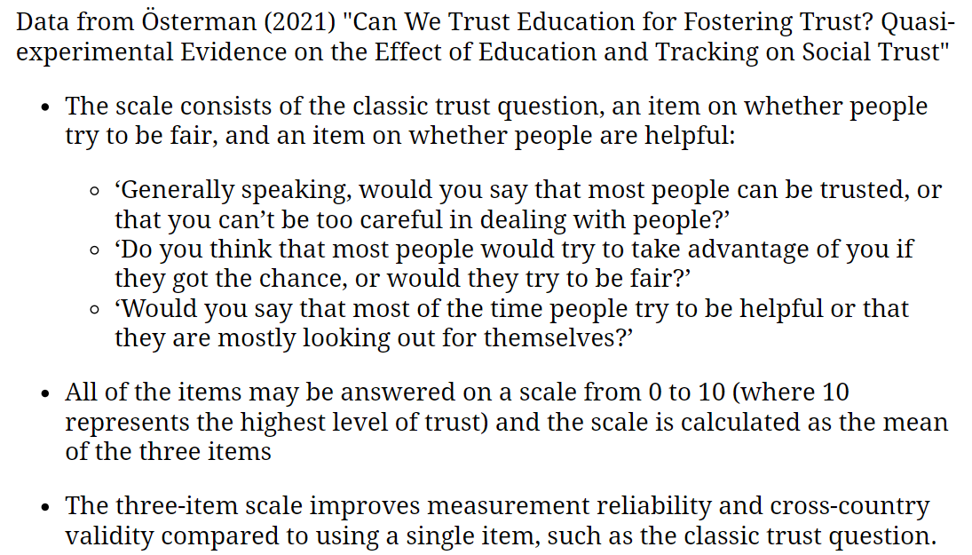

Slide 26
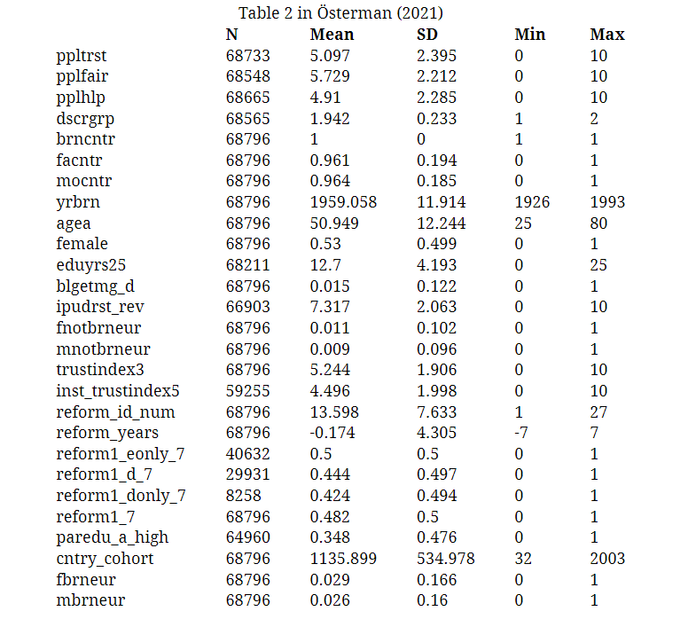

Slide 27
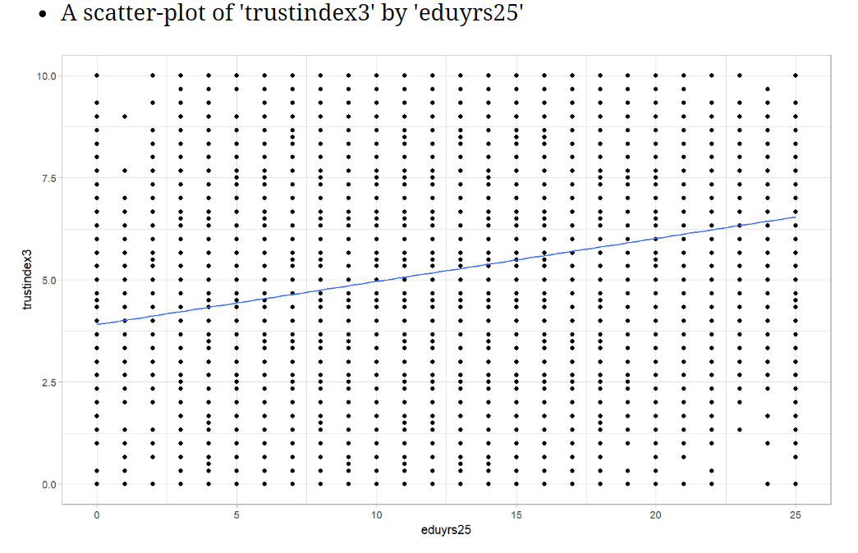

Slide 28
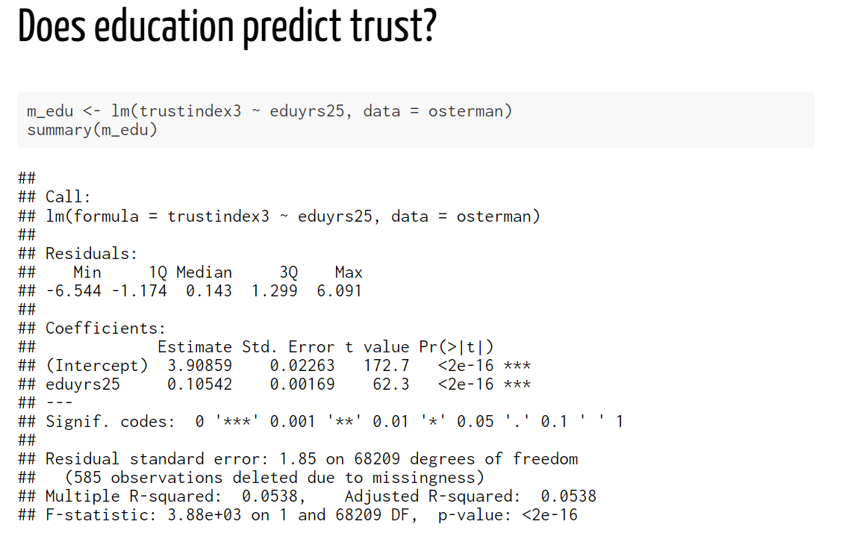
The “slope” coefficient; rather weak, but more years of education completed is associated with higher levels of social trust
p-value; very small; smaller than 0.001, and definitely smaller than 0.05 (for what it’s worth)
Conclusion:
One’s education appears to have an impact on their level of social trust. Each additional year of completed formal education is associated with a 0.105-point increase on the measured “social trust” scale. Based on the p-value (<0.001), we reject the null-hypothesis that this relationship would appear in our data by chance only, and provisionally accept that education affects social trust in the wider EU population.

Slide 29
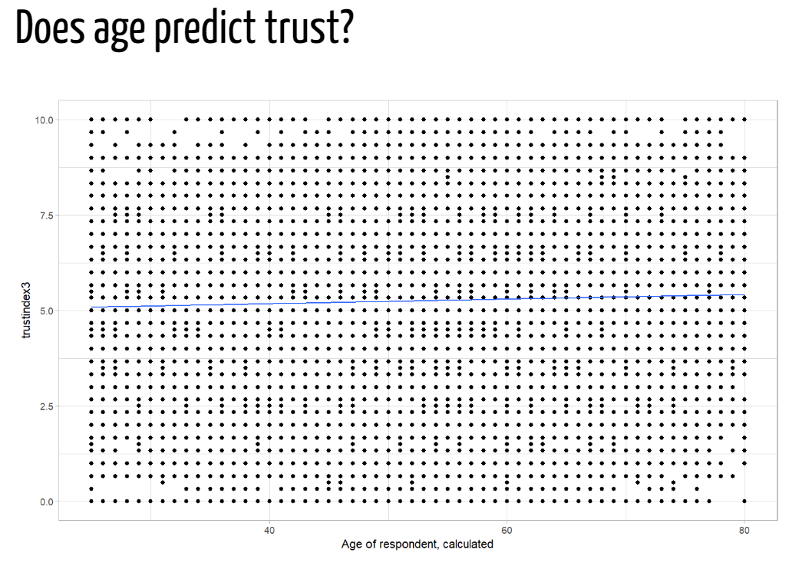

Slide 30
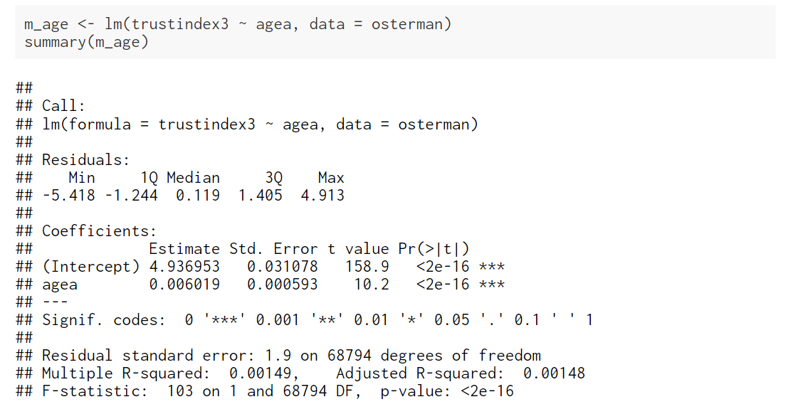
The “slope” coefficient; rather weak, but being older is associated with higher levels of social trust
p-value; very small; smaller than 0.001, and definitely smaller than 0.05 (for what it’s worth)
Conclusion:
One’s age appears to have an impact on their level of social trust. This association is weak in substantive terms. Each additional year of age is associated with a 0.006-point increase on the measured “social trust” scale. Based on the p-value (<0.001), we reject the null-hypothesis that this relationship would appear in our data by chance only, and provisionally accept that age affects social trust in the wider EU population.

Slide 31
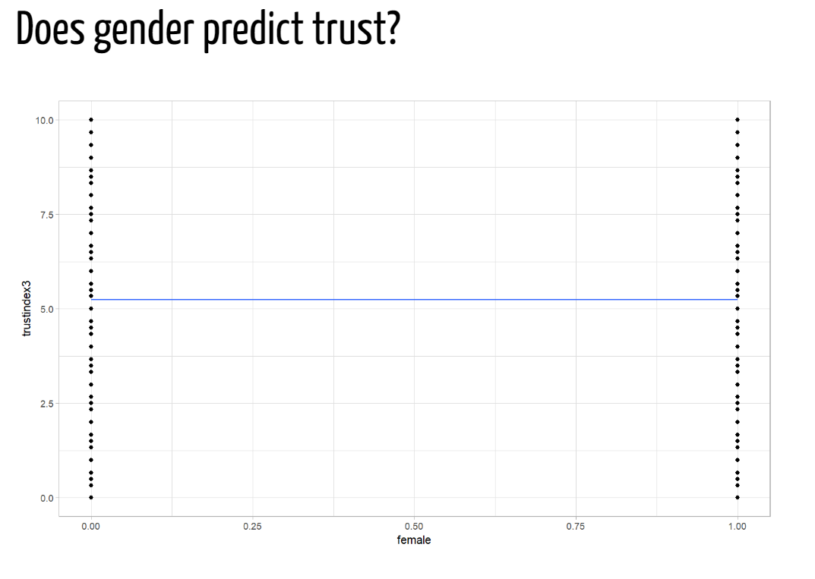

Slide 32
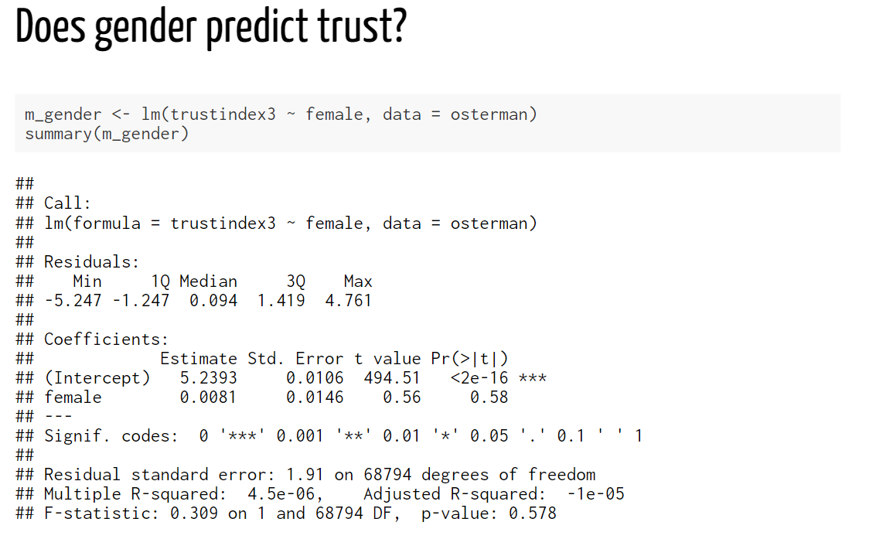
The “slope” coefficient; very weak, but being a woman is associated with higher levels of social trust compared to being a man
p-value; it runs on a 0-1 scale, so 0.58 (i.e. 58%) is very high, and much much higher than 0.05 (for what it’s worth)
Conclusion:
One’s sex doesn’t appear to have an impact on their level of social trust. The average score of women on the social trust scale is merely 0.008 points higher than that of men. Based on the p-value (0.58), we cannot reject the null-hypothesis that the difference between men and women in the wider EU population is in fact equal to 0 (as opposed to 0.008). There is in fact a probability of 0.58 (or 58%) that we would be wrong in rejecting the null-hypothesis. In conclusion, we don’t have evidence to suggest that sex is associated with differences in levels of social trust.

Slide 33
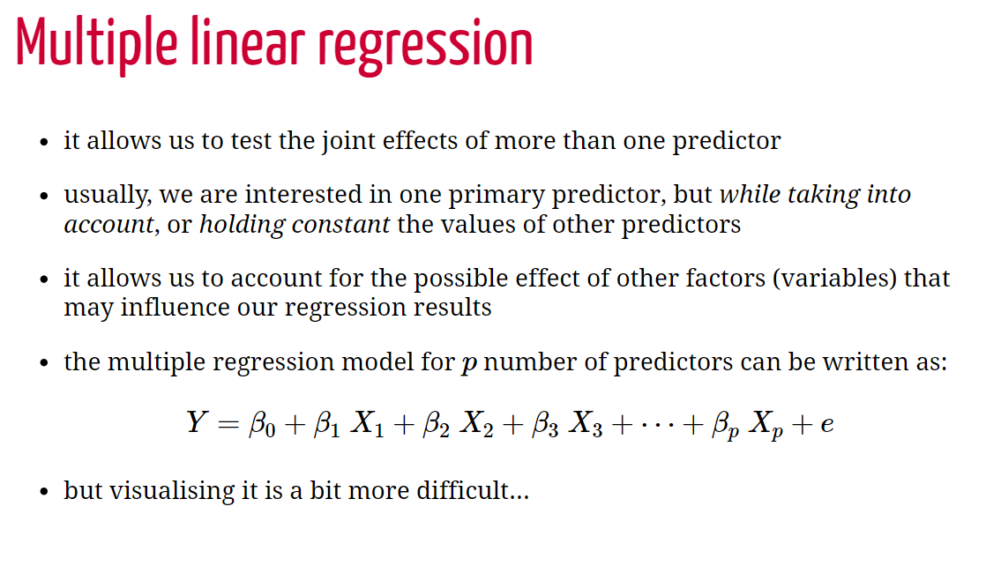

Slide 34
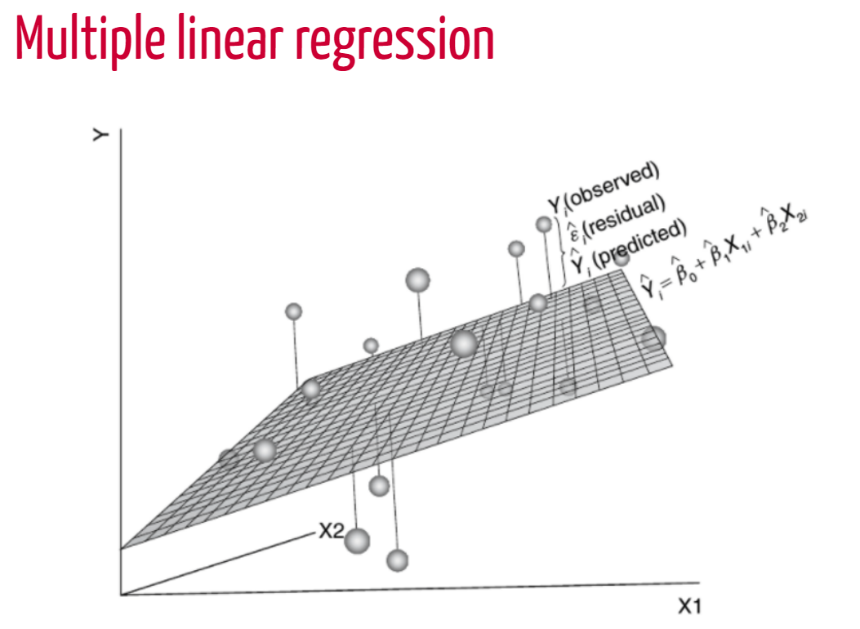
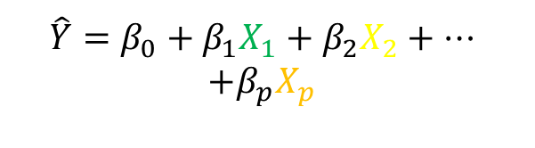
$$\hat{Y}=β_{0}+β_{1}X_{1}+β_{2}X_{2}+…$$
$$+β_{p}X_{p}$$
X1
X2
X3
60%
unexplained

Slide 35
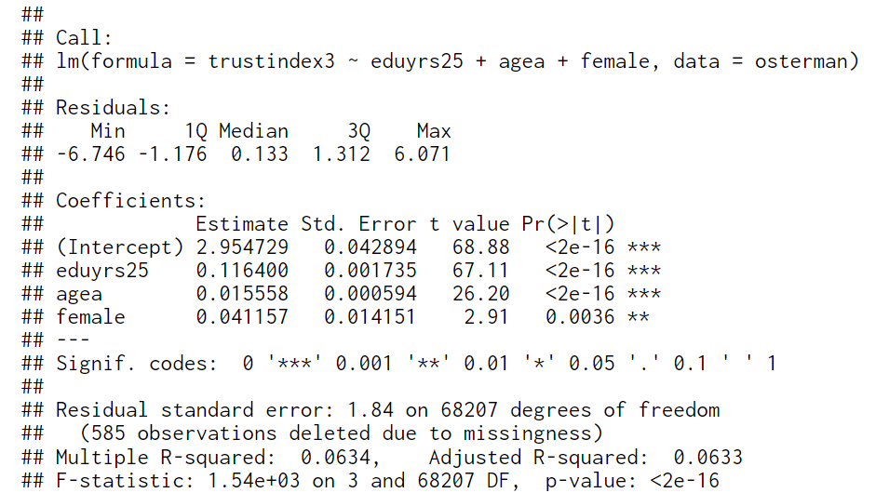
We are now interpreting each “slope” coefficient, keeping in mind that they represent the effect of that variable while keeping constant (eliminating) the effect of the other variables in the model
p-value; small!; smaller than 0.01; note that this has changed compared to the previous model; now, once we also account for education and age (i.e. keeping the effect of those variables constant, one’s sex seems to have an impact on their level of social trust
Conclusion:
In a statistical model that predicts levels of social trust from education, age and gender, we find that all three predictors are associated with social trust. Having more education, being older and being a woman is associated with higher levels of social trust.
This is now the p-value for the entire model

