Slide 1
Linear regression
Week 3

Slide 4
Is inequality affecting social trust?

Slide 5
“The spirit level” (2010)

Slide 7
data_peek(inequality)
Data frame with 89 rows and 10 variables Variable | Type | Values ----------------------------------------------------------------------- cntry_AN | character | AL, AZ, AT, AM, BA, BG, BY, HR, CZ, DK, ... country | character | Albania, Azerbaijan, Austria, Armenia, ... trust_pct | numeric | 2.52, 30.36, 48.46, 17.68, 9.61, 18.05, ... GDPpercap2 | numeric | 12770.9918634405, 14121.4069355591, ... pop | numeric | 2873457, 9854033, 8797566, 2851923, ... urban_pop_pct | numeric | 59.383, 55.343, 58.094, 63.103, 47.876, ... inc_top20 | numeric | 39.6375, NA, 38.4181818181818, 39.575, ... inc_bottom20 | numeric | 7.9125, NA, 7.90909090909091, ... s80s20 | numeric | 5.00947867298578, NA, 4.85747126436782, ... Region | character | Europe & Central Asia, ...
describe_distribution(inequality)
Variable | Mean | SD | IQR | Range | Skewness | Kurtosis | n | n_Missing ------------------------------------------------------------------------------------------------------------ trust_pct | 25.73 | 18.41 | 21.14 | [2.14, 77.42] | 1.13 | 0.62 | 89 | 0 GDPpercap2 | 27447.01 | 21342.56 | 28284.55 | [1987.97, 1.23e+05] | 1.62 | 4.20 | 86 | 3 pop | 5.78e+07 | 1.58e+08 | 4.68e+07 | [73837.00, 1.40e+09] | 7.32 | 61.13 | 87 | 2 urban_pop_pct | 67.92 | 18.93 | 25.93 | [20.31, 100.00] | -0.49 | -0.38 | 87 | 2 inc_top20 | 42.69 | 5.09 | 6.80 | [34.56, 57.35] | 0.86 | 0.42 | 79 | 10 inc_bottom20 | 7.15 | 1.62 | 2.32 | [3.45, 10.08] | -0.19 | -0.69 | 79 | 10 s80s20 | 6.50 | 2.60 | 2.79 | [3.52, 16.64] | 1.67 | 3.50 | 79 | 10

Slide 8
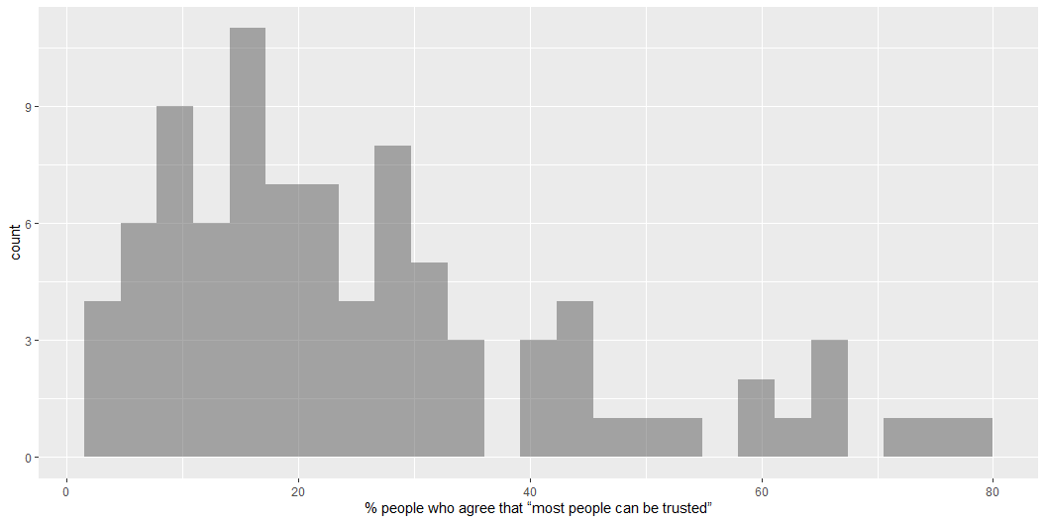
gf_histogram( ~ trust_pct, data = inequality)

Slide 9
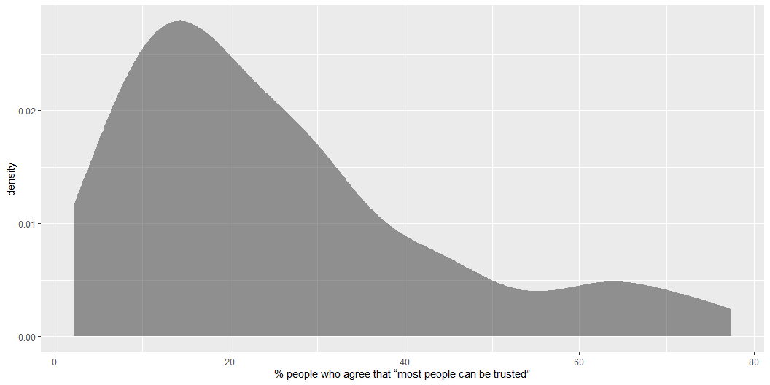
gf_density( ~ trust_pct, data = inequality)

Slide 10
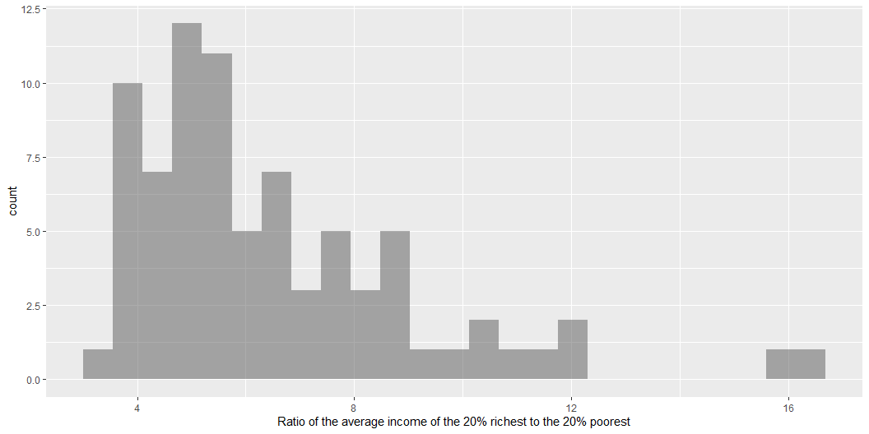
gf_histogram( ~ s80s20, data = inequality)

Slide 11
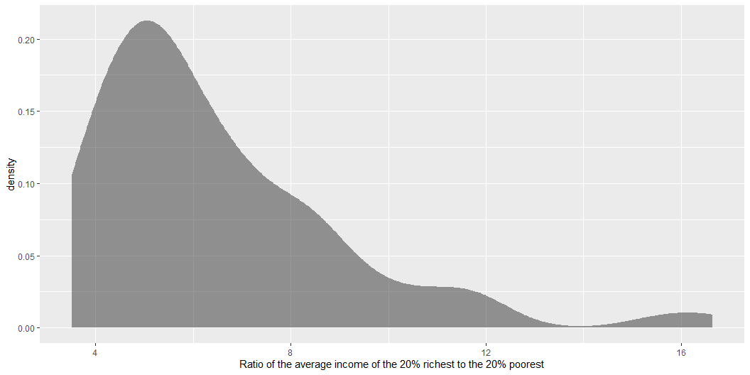
gf_density( ~ s80s20, data = inequality)

Slide 12
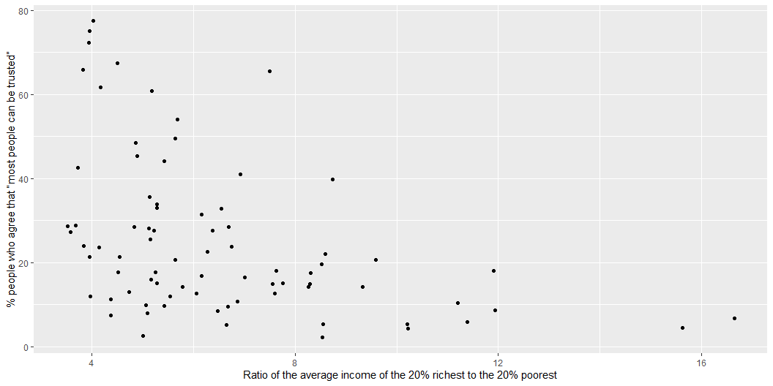

Slide 13
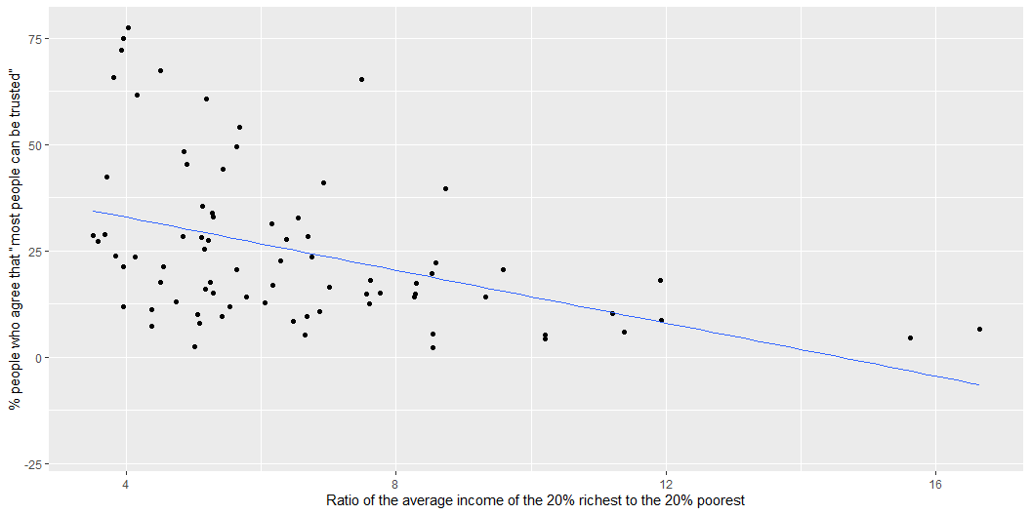

Slide 14
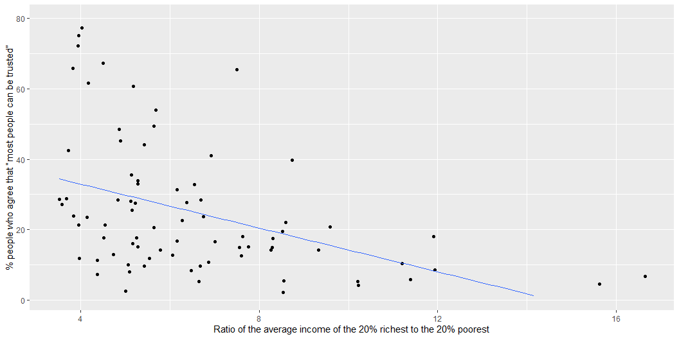

Slide 15
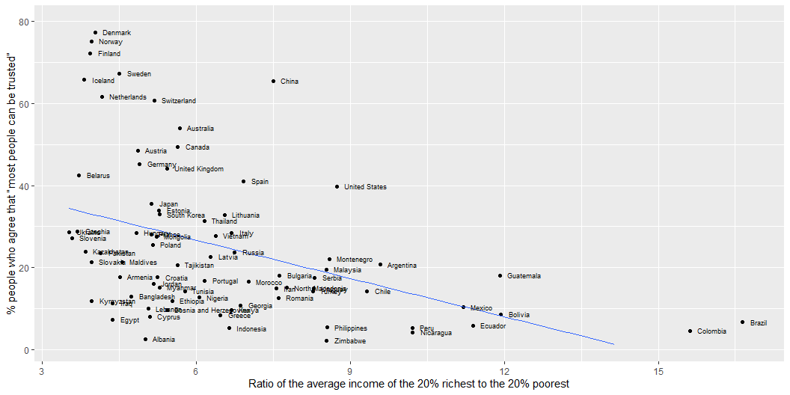

Slide 17
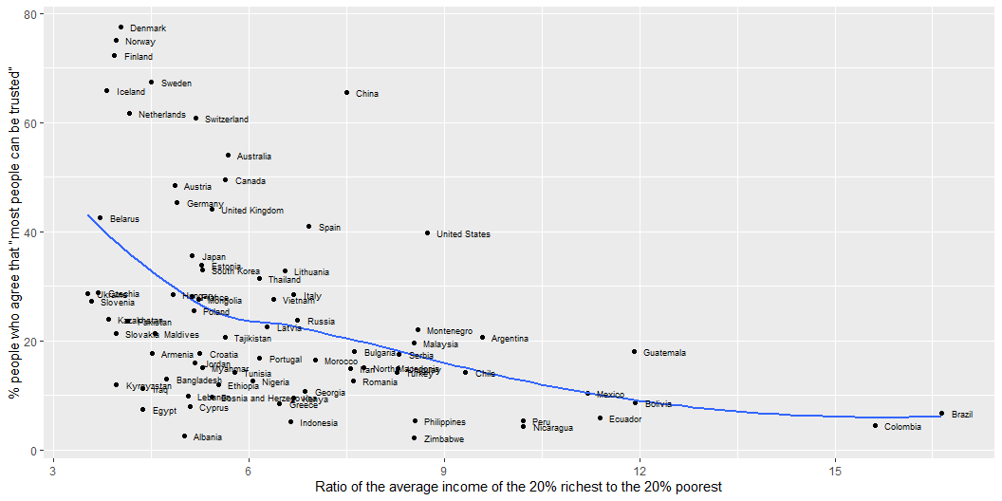

Slide 18
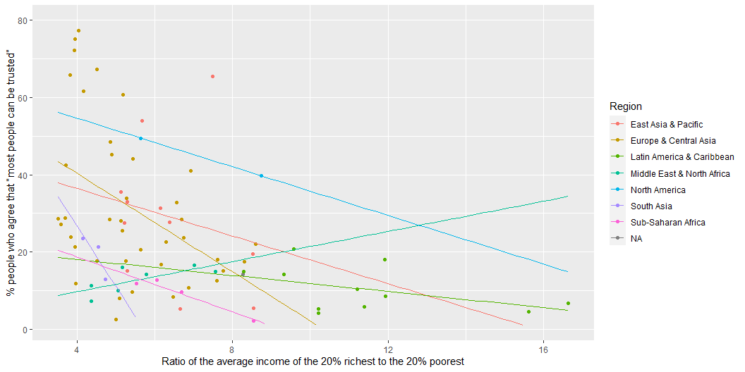

Slide 19
Call: lm(formula = trust_pct ~ s80s20, data = inequality) Residuals: Min 1Q Median 3Q Max -27.263 -12.432 -3.831 7.003 44.597 Coefficients: Estimate Std. Error t value Pr(>|t|) (Intercept) 45.3844 5.2088 8.713 4.29e-13 *** s80s20 -3.1144 0.7444 -4.184 7.53e-05 *** --- Signif. codes: 0 '***' 0.001 '**' 0.01 '*' 0.05 '.' 0.1 ' ' 1 Residual standard error: 17.07 on 77 degrees of freedom (10 observations deleted due to missingness) Multiple R-squared: 0.1852, Adjusted R-squared: 0.1747 F-statistic: 17.51 on 1 and 77 DF, p-value: 7.527e-05

Slide 20
Measurement: from questionnaire items to dataset variables

Slide 21
Variables

Slide 22
Understanding and describing (clean) data

Slide 23
Managing “messy” data

Slide 24
Visualisation

Slide 25
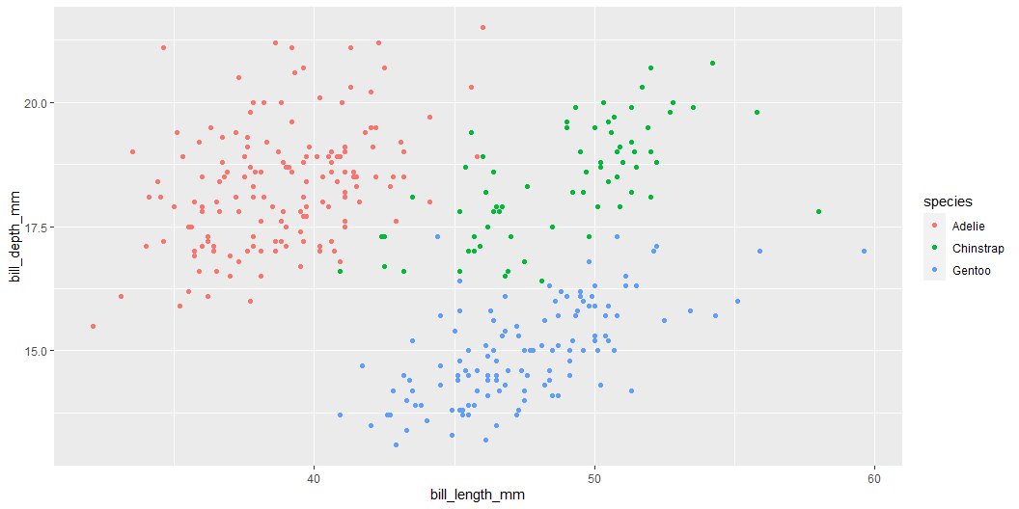
This print “Two content” output
library(palmerpenguins) ggplot(penguins, aes(x = bill_length_mm, y = bill_depth_mm, color = species)) + geom_point()
Something else
Notes:
I may write a lot of extra stuff here in case you are interested.

Slide 26
Title
ggplot(penguins, aes(x = bill_length_mm, y = bill_depth_mm, color = species)) + geom_point()

Slide 27
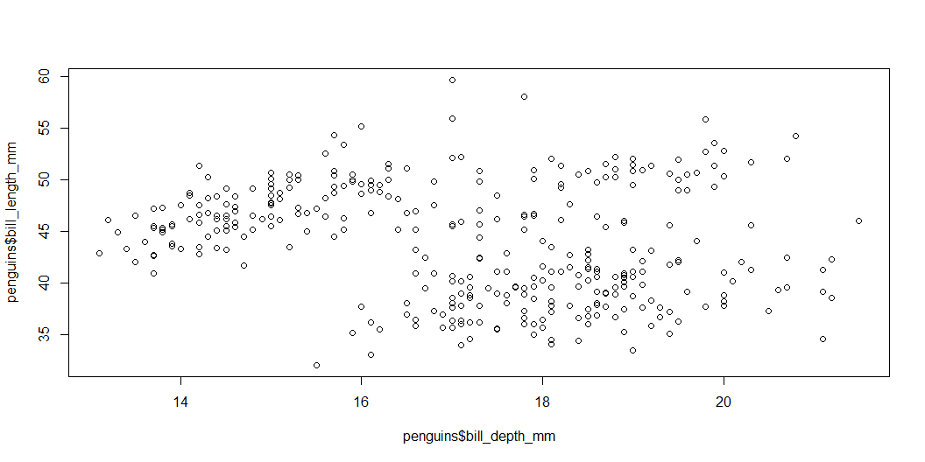
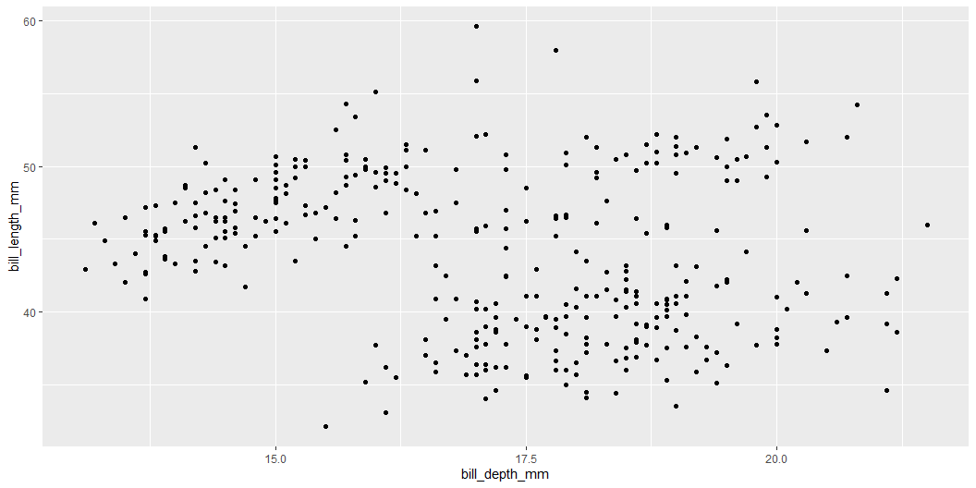
This prints to Comparison
plot(penguins$bill_depth_mm, penguins$bill_length_mm)
ggplot(penguins, aes(bill_depth_mm, bill_length_mm)) + geom_point()

Slide 28
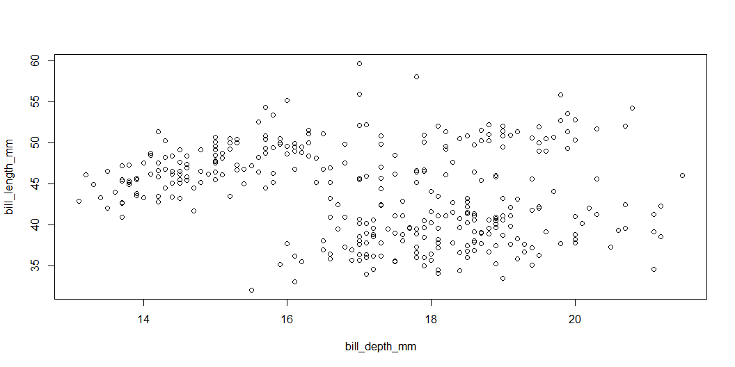
Using with() in base R
with(penguins, plot(bill_depth_mm, bill_length_mm))
ggplot(penguins, aes(bill_depth_mm, bill_length_mm)) + geom_point()

Slide 29
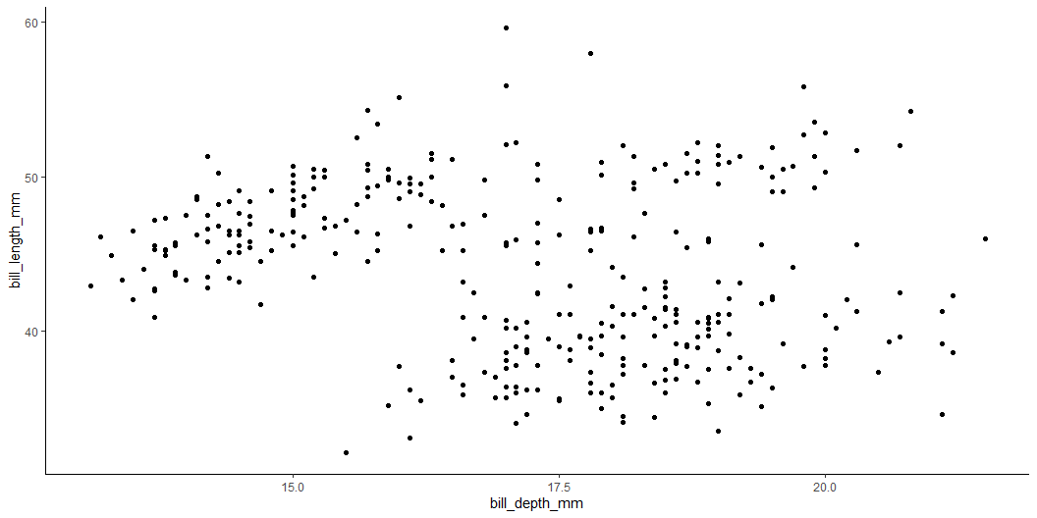
Changing the ggplot theme
with(penguins, plot(bill_depth_mm, bill_length_mm))
ggplot(penguins, aes(bill_depth_mm, bill_length_mm)) + geom_point() + theme_classic()

Slide 30
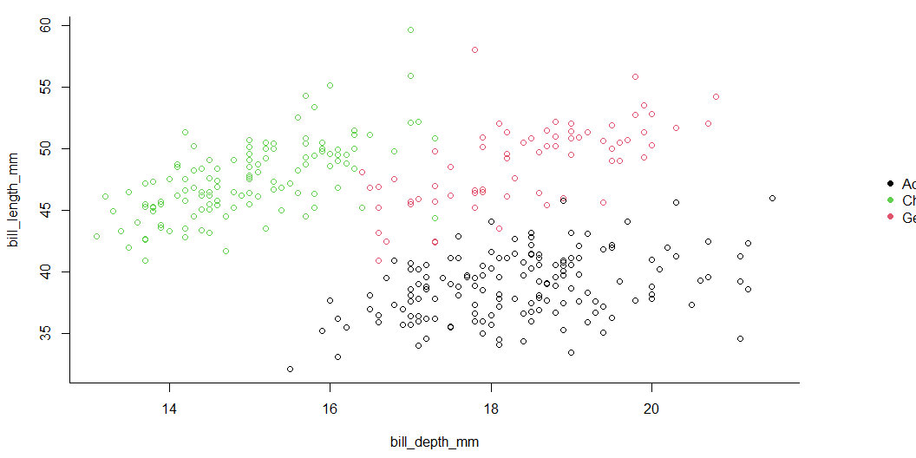
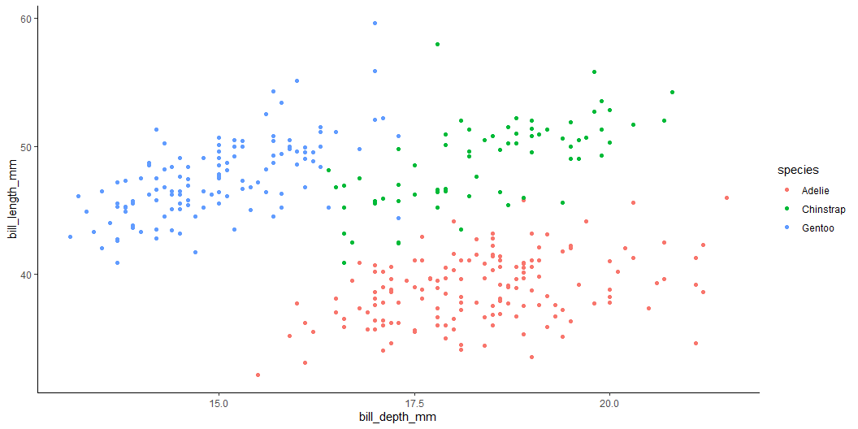
Some further styling options
par(mar=c(4.5, 4.2, 1, 7), xpd=TRUE) # set custom plot size with(penguins, # select data frame plot(bill_depth_mm, # select variables to plot bill_length_mm, col = species, # grouping colour bty = "L") # change plot border style ) with(penguins, legend("right", # legend position inset=c(-0.23,0.5), # legend custom location (outside the plot) legend = levels(species), # legend labels pch = 16, # legend symbol size col = unique(species), # legend symbol colour bty = "n" # remove legend borders ) )
ggplot(penguins, # draw empty canvas aes(bill_depth_mm, # select variables to plot bill_length_mm, color = species)) + # grouping colour geom_point() + # select plot type theme_classic() # select pre-set style settings (theme)

Slide 31
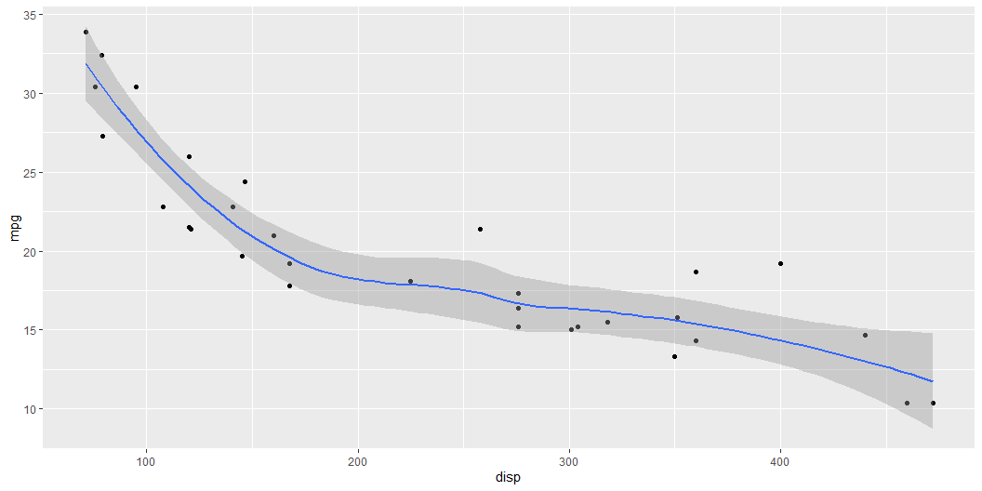
Test
library(ggplot2) mtcars |> ggplot(aes(x = disp, y = mpg)) + geom_point() + geom_smooth(method = "loess", formula = "y~x")

