Slide 1
Interaction models
Week 5

Slide 2
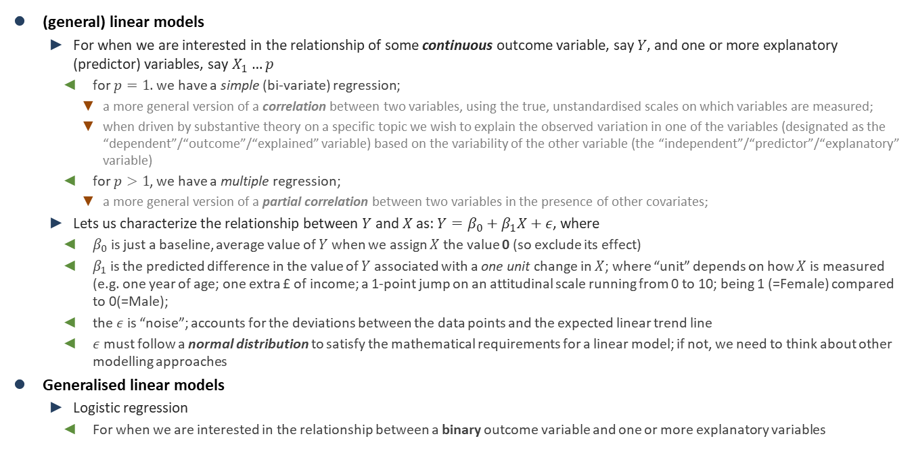
Statistical models
(general) linear models
For when we are interested in the relationship of some continuous outcome variable, say $Y$, and one or more explanatory (predictor) variables, say $X_{1}…p$
for $p=1$. we have a simple (bi-variate) regression;
a more general version of a correlation between two variables, using the true, unstandardised scales on which variables are measured;
when driven by substantive theory on a specific topic we wish to explain the observed variation in one of the variables (designated as the “dependent”/“outcome”/“explained” variable) based on the variability of the other variable (the “independent”/“predictor”/“explanatory” variable)
for $p>1$, we have a multiple regression;
a more general version of a partial correlation between two variables in the presence of other covariates;
Lets us characterize the relationship between $Y$ and $X$ as: $Y=β_{0}+β_{1}X+ε$, where
$β_{0}$ is just a baseline, average value of $Y$ when we assign $X$ the value 0 (so exclude its effect)
$β_{1}$ is the predicted difference in the value of $Y$ associated with a one unit change in $X$; where “unit” depends on how $X$ is measured (e.g. one year of age; one extra £ of income; a 1-point jump on an attitudinal scale running from 0 to 10; being 1 (=Female) compared to 0(=Male);
the $ε$ is “noise”; accounts for the deviations between the data points and the expected linear trend line
$ε$ must follow a normal distribution to satisfy the mathematical requirements for a linear model; if not, we need to think about other modelling approaches
Generalised linear models
Logistic regression
For when we are interested in the relationship between a binary outcome variable and one or more explanatory variables

Slide 3
Statistical models
Interaction models
In linear models, each explanatory variable is assumed to have an effect on the outcome variable that is independent of the values of other explanatory variables included in the model → main effects
We can reject this assumption and model any theoretically motivated dependencies between the explanatory variables themselves
We “multiplicate” the effect of two explanatory variables to estimate their effect as dependent on the values of the other explanatory variable(s)

Slide 4
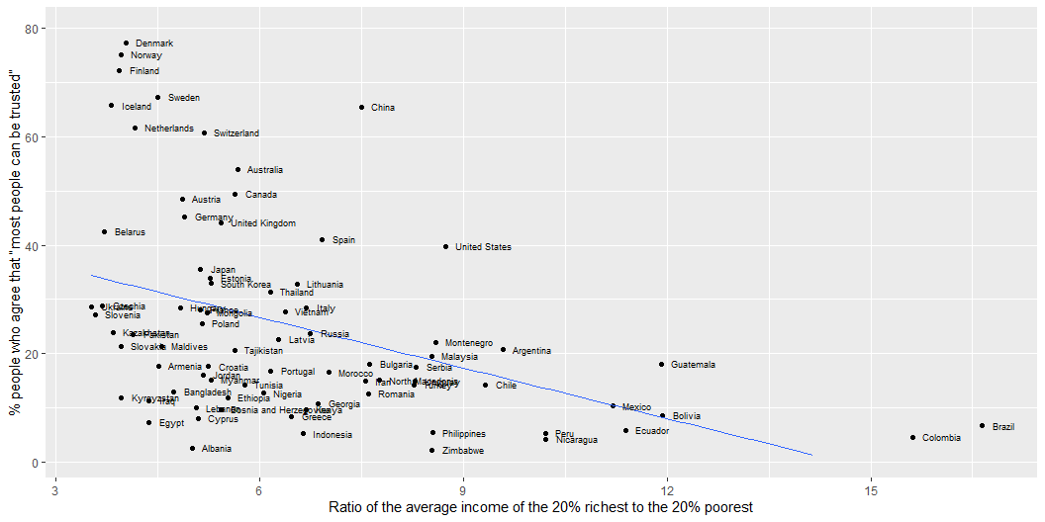
Remember…

Slide 5
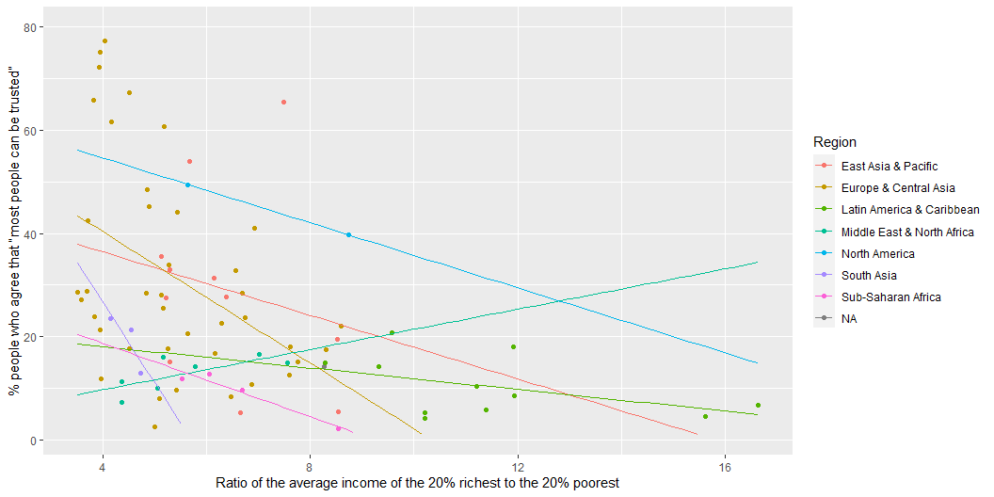
Remember…

Slide 6
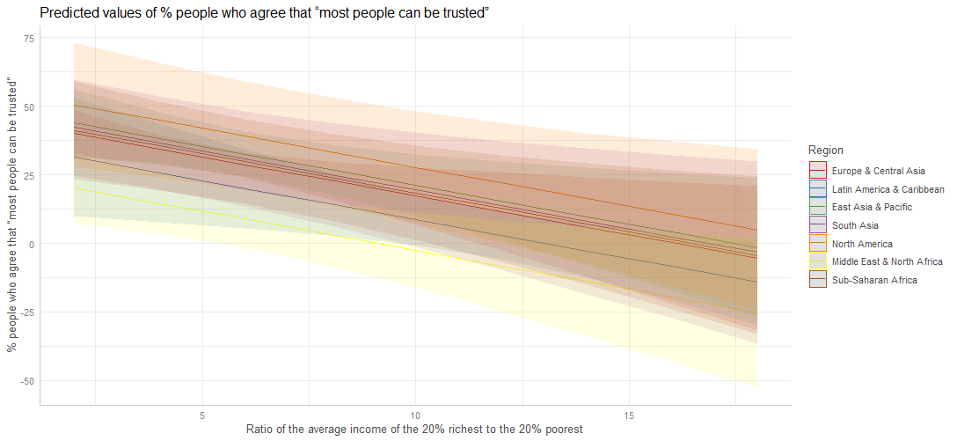
Our first model (Week 3)
lm(trust_pct ~ s80s20 + urban_pop_pct + Region , data = inequality)

Slide 7
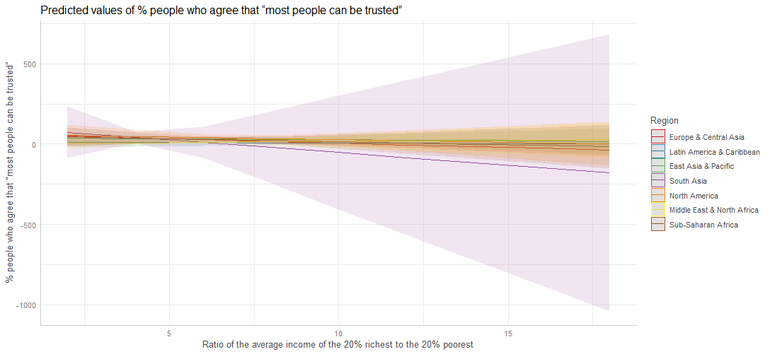
Our first model revisited
lm(trust_pct ~ s80s20 + urban_pop_pct + Region + s80s20*Region, data = inequality)

Slide 8
Visualising interactions
Margins plots are especially useful when we have an interaction term with at least one categorical variable.
The coefficient estimates in interactions with categorical variables are adjustments to the main effects.
The utility of plotting models with interactions is that these plots can tell us where we might or might not see differences, and they can guide our modelling process by helping us decide how to relevel our categorical variables.

Slide 9
Example: Preferences for redistribution
Based on Akaeda (2023):
the dependent variable is the score of preferences for redistribution. This score is based on a question … that asks respondents to indicate on a scale from 1 to 10 whether ‘Incomes should be made more equal (1)’ or ‘We need larger income differences as incentives for individual effort (10)’. In accordance with previous research, the scores were reversed such that a higher score indicates stronger support for redistribution;
the level of education is a key independent variable because the association between education and support for redistribution is a main focus of this study. Because previous studies have shed light on the mechanisms of university education related to a conservative view of redistribution, this analysis adopts the dummy for university or higher degree as an independent variable;
as a key moderator variable … social trust as measured by the question, ‘Generally speaking, would you say that most people can be trusted or that you need to be very careful in dealing with people?’, which had the following two potential responses: ‘1. Most people can be trusted’, ‘2. Need to be very careful’. Based on previous research involving social trust, this analysis employs the dummy for social trust (1 = ‘Most people can be trusted’);
the following individual-level controls: gender (1 = female, 0= male), age, age squared, employment status (employed, self-employed, unemployed, retired, other), household income (z scored for country-year units, marital status (married = 1), child (having child = 1), and political orientation (1 = right to 10 = left)

Slide 10
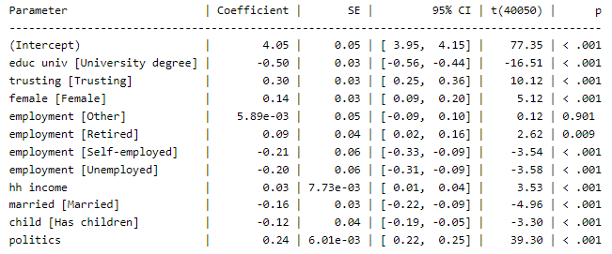
Example: Preferences for redistribution
lm(redistribute ~ educ_univ + trusting + female + employment + hh_income + married + child + politics)

Slide 11
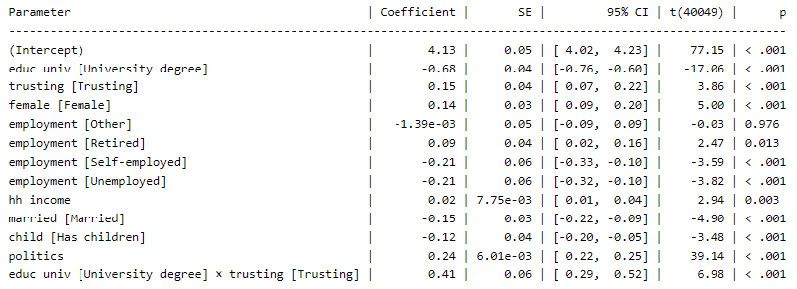
Example: Preferences for redistribution
lm(redistribute ~ educ_univ + trusting + educ_univ*trusting + female + employment + hh_income + married + child + politics)

Slide 12
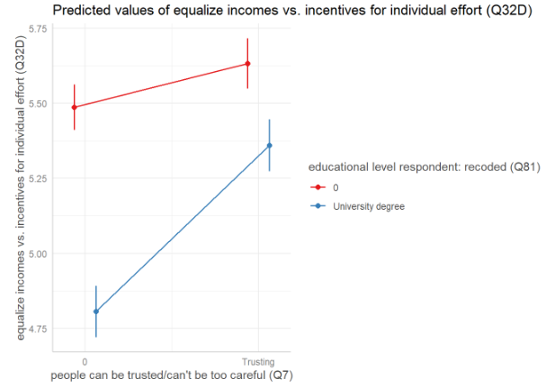
Example: Preferences for redistribution
lm(redistribute ~ educ_univ + trusting + educ_univ*trusting + female + employment + hh_income + married + child + politics)

