Slide 1
Intro
Week One

Slide 2
In the morning

Slide 3
Getting up
Turn off alarm
Get out of bed
something else
something other

Slide 4
Breakfast
Eat eggs
Drink coffee
more eggs
loads of coffee

Slide 5
In the evening

Slide 6
Dinner
Eat spaghetti
Drink wine

Slide 7
Going to sleep
Get in bed
Count sheep

Slide 8
Incremental stuff
contents…
contents…
Notes:
I may write a lot of extra stuff here in case you are interested.

Slide 9
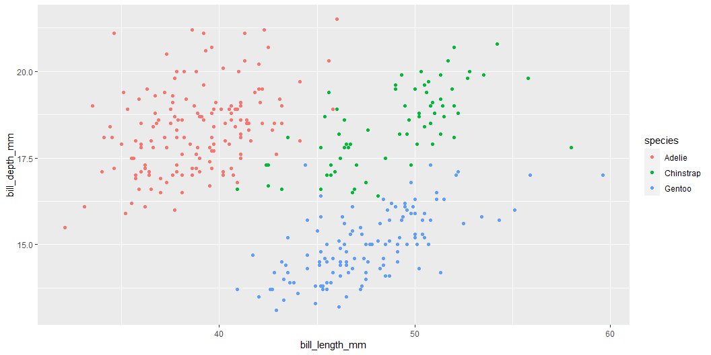
Title
ggplot(penguins, aes(x = bill_length_mm, y = bill_depth_mm, color = species)) + geom_point()

Slide 10
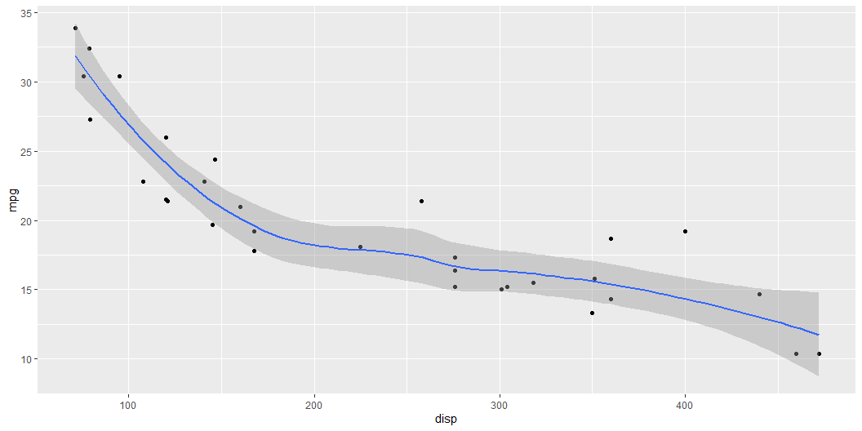
library(ggplot2) mtcars |> ggplot(aes(x = disp, y = mpg)) + geom_point() + geom_smooth(method = "loess", formula = "y~x")

Slide 11
Final
This is an important sentence!

