Slide 1
Interaction models
Week 4

Slide 2
Statistical models
(general) linear models
For when we are interested in the relationship of some continuous outcome variable, say $Y$, and one or more explanatory (predictor) variables, say $X_{1}…p$
for $p=1$. we have a simple (bi-variate) regression;
a more general version of a correlation between two variables, using the true, unstandardised scales on which variables are measured;
when driven by substantive theory on a specific topic we wish to explain the observed variation in one of the variables (designated as the “dependent”/“outcome”/“explained” variable) based on the variability of the other variable (the “independent”/“predictor”/“explanatory” variable)
for $p>1$, we have a multiple regression;
a more general version of a partial correlation between two variables in the presence of other covariates;
Lets us characterize the relationship between $Y$ and $X$ as: $Y=β_{0}+β_{1}X+ϵ$, where
$β_{0}$ is just a baseline, average value of $Y$ when we assign $X$ the value 0 (so exclude its effect)
$β_{1}$ is the predicted difference in the value of $Y$ associated with a one unit change in $X$; where “unit” depends on how $X$ is measured (e.g. one year of age; one extra £ of income; a 1-point jump on an attitudinal scale running from 0 to 10; being 1 (=Female) compared to 0(=Male);
the $ϵ$ is “noise”; accounts for the deviations between the data points and the expected linear trend line
$ϵ$ must follow a normal distribution to satisfy the mathematical requirements for a linear model; if not, we need to think about other modelling approaches
Generalised linear models
Logistic regression
For when we are interested in the relationship between a binary outcome variable and one or more explanatory variables

Slide 3
Interaction models
In linear models, each explanatory variable is assumed to have an effect on the outcome variable that is independent of the values of other explanatory variables included in the model → main effects
We can reject this assumption and model any theoretically motivated dependencies between the explanatory variables themselves
We “multiplicate” the effect of two explanatory variables to estimate their effect as dependent on the values of the other explanatory variable(s)

Slide 4
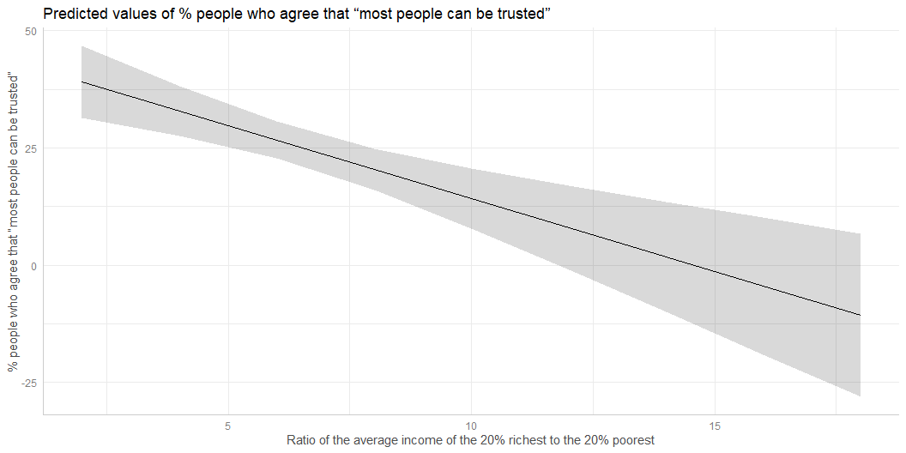
Remember…

Slide 5
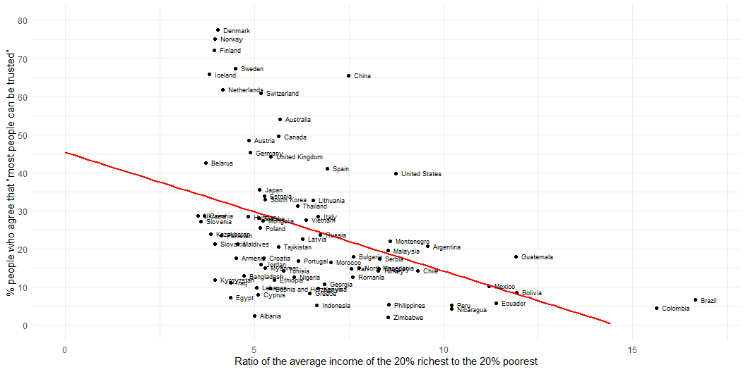
Parameter | Coefficient | SE | 95% CI | t(77) | p ------------------------------------------------------------------ (Intercept) | 45.38 | 5.21 | [35.01, 55.76] | 8.71 | < .001 s80s20 | -3.11 | 0.74 | [-4.60, -1.63] | -4.18 | < .001

Slide 6
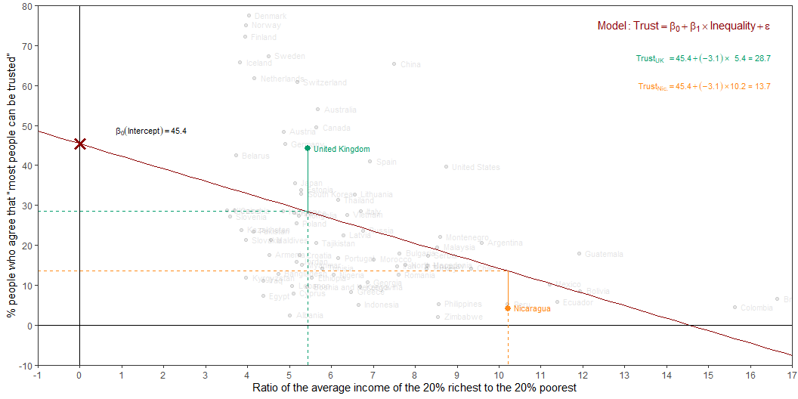

Slide 7
