Slide 1
Probability, uncertainty, inference
Week 6

Slide 2
Inference
From “data” to “population”
From “association” to “causality”
Statistical inference can be formulated as a set of operations on data that yield estimates and uncertainty statements about predictions and parameters of some underlying process or population (Gelman, Hill, and Vehtari 2020)
From a mathematical standpoint, these probabilistic uncertainty statements are derived based on some assumed probability model for observed data.
The normal (Gaussian) distribution — linear regression
The binomial distribution — logistic regression
So far we have focused on the “point” estimates from regression models

Slide 3
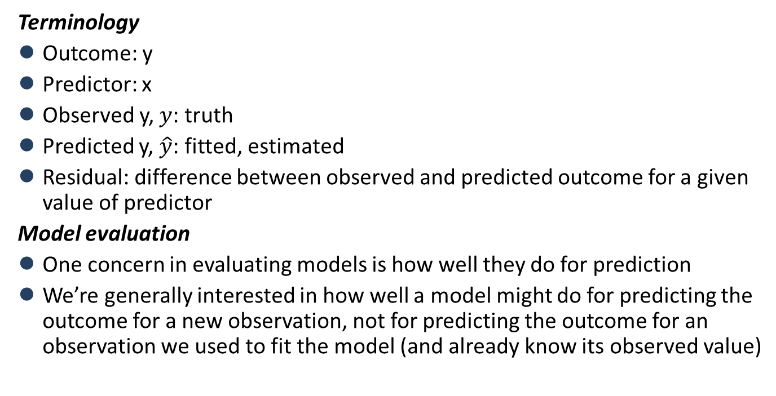
Estimation
Terminology
Outcome: y
Predictor: x
Observed y, $y$: truth
Predicted y, $\hat{y}$: fitted, estimated
Residual: difference between observed and predicted outcome for a given value of predictor
Model evaluation
One concern in evaluating models is how well they do for prediction
We’re generally interested in how well a model might do for predicting the outcome for a new observation, not for predicting the outcome for an observation we used to fit the model (and already know its observed value)

Slide 4
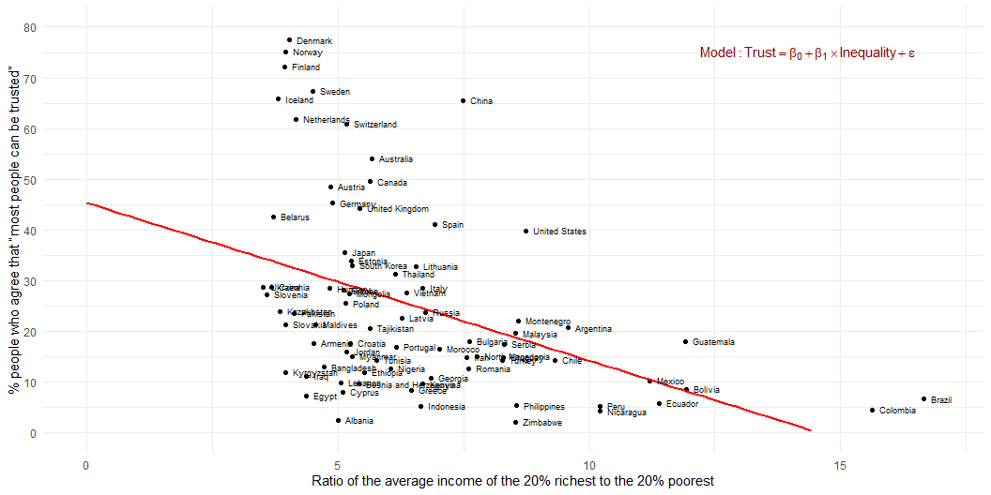
Estimation
Association between inequality and social trust at cross-national comparative level (W3Ex1) (Wilkinson and Pickett 2010)

Slide 5
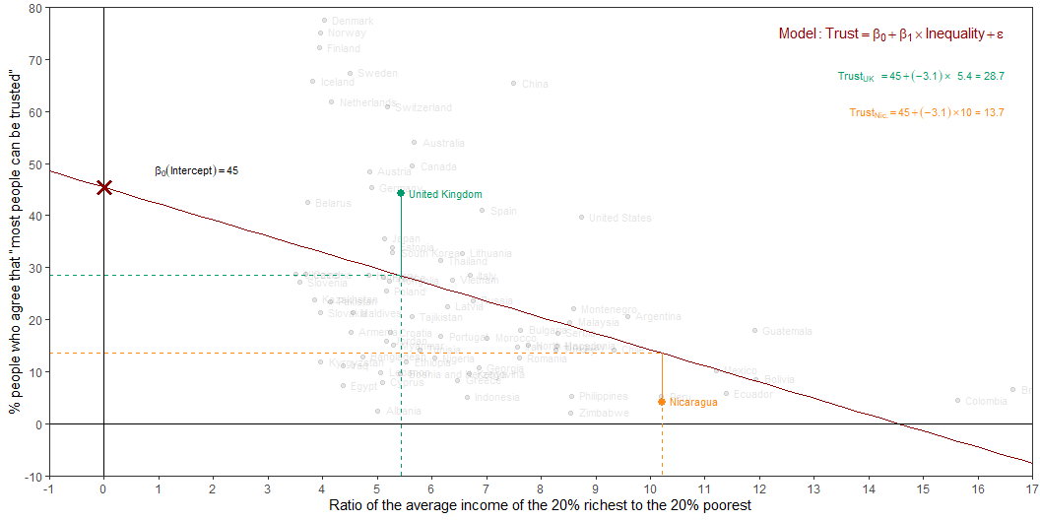
Estimation
Intercept: Social trust in countries with 0 inequality is expected to be 45.4 on average.
Slope: For each additional point increase in Inequality, the model predicts the level of social trust to be lower, on average, by 3.1 points.

Slide 6
From (sample) estimation to (population) inference
For each additional point increase in Inequality, the model predicts the level of social trust to be lower, on average, by 3.1 points
This estimate is valid for the single sample of the countries in the model
But what if we’re not interested in quantifying the relationship between Inequality and Trust in only this sample?
What if we want to say something about the relationship between these variables for all the countries in the world?

Slide 7
Statistical inference
Statistical inference allows provide methods and tools for us to use the single sample we have observed to make valid statements (inferences) about the population it comes from
For our inferences to be valid, the sample should be random and representative of the population we’re interested in

Slide 8
Inference for simple linear regression
Calculate a confidence interval for the slope, $β_{1}$
Conduct a hypothesis test for the interval, $β_{1}$

Slide 9
Confidence interval for the slope
Confidence interval: Provide a plausible range of values for $β_{1}$ at a given confidence level.
Using only a single point estimate is like fishing in a murky lake with a spear, and using a confidence interval is like fishing with a net
We can throw a spear where we saw a fish but we will probably miss, if we toss a net in that area, we have a good chance of catching the fish
Similarly, if we report a point estimate, we probably will not hit the exact population parameter, but if we report a range of plausible values we have a good shot at capturing the parameter

Slide 10
Quantify the variability of the slope
Two approaches:
Via simulation
Via mathematical models
Bootstrapping to quantify the variability of the slope for the purpose of estimation:
Bootstrap new samples from the original sample
Fit models to each of the samples and estimate the slope
Use features of the distribution of the bootstrapped slopes to construct a confidence interval

Slide 11
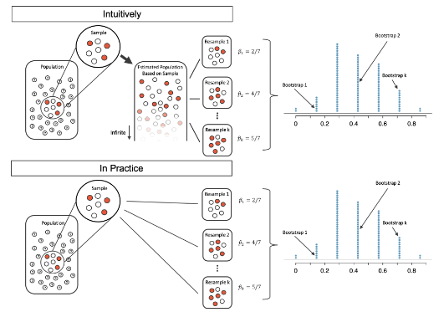
Quantify the variability of the slope (simulation)

Slide 12
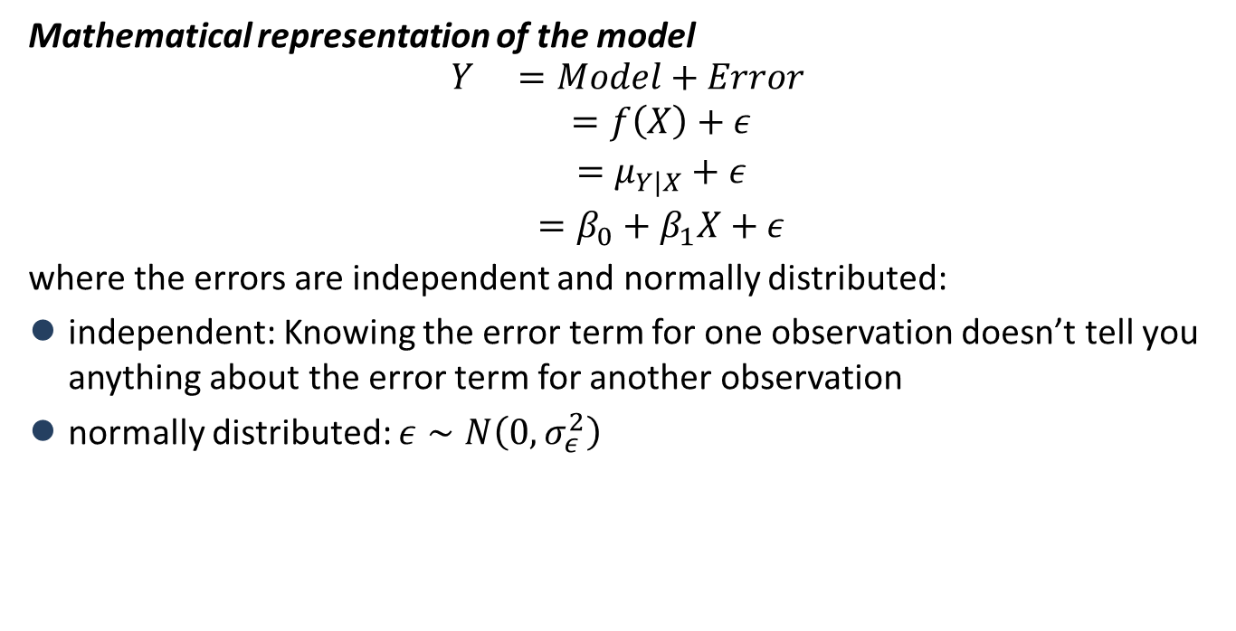
Quantify the variability of the slope (mathematical models)
Mathematical representation of the model
$$\begin{matrix}Y & =Model+Error \\ & =f\left(X\right)+ε \\ & =μ_{Y|X}+ε \\ & =β_{0}+β_{1}X+ε\end{matrix}$$
where the errors are independent and normally distributed:
independent: Knowing the error term for one observation doesn’t tell you anything about the error term for another observation
normally distributed: $ε∼N\left(0,σ_{ε}^{2}\right)$

Slide 13
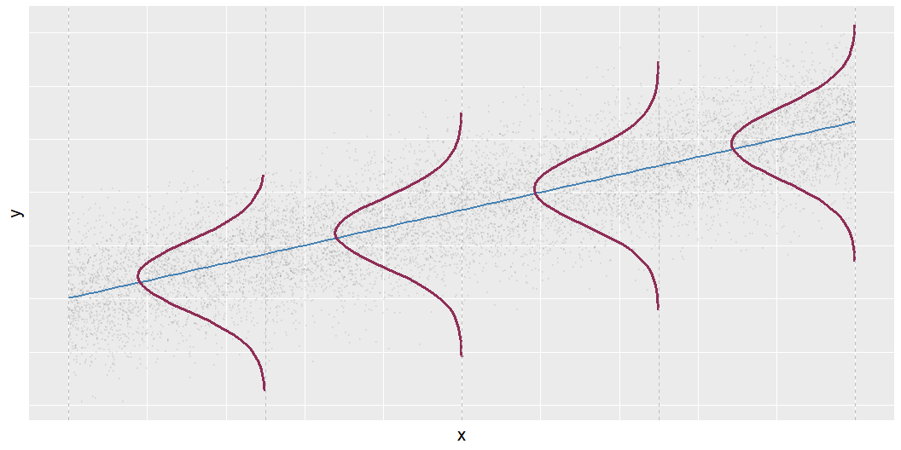


Mathematical representation, visualized
$$Y|X∼N\left(β_{0}+β_{1}X,σ_{ε}^{2}\right)$$
Mean: $β_{0}+β_{1}X$, the predicted value based on the regression model
Variance: $σ_{ε}^{2}$, constant across the range of $X$
How do we estimate $σ_{ε}^{2}$?

Slide 14
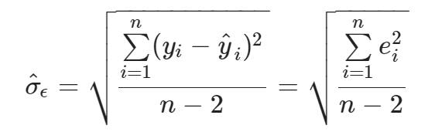
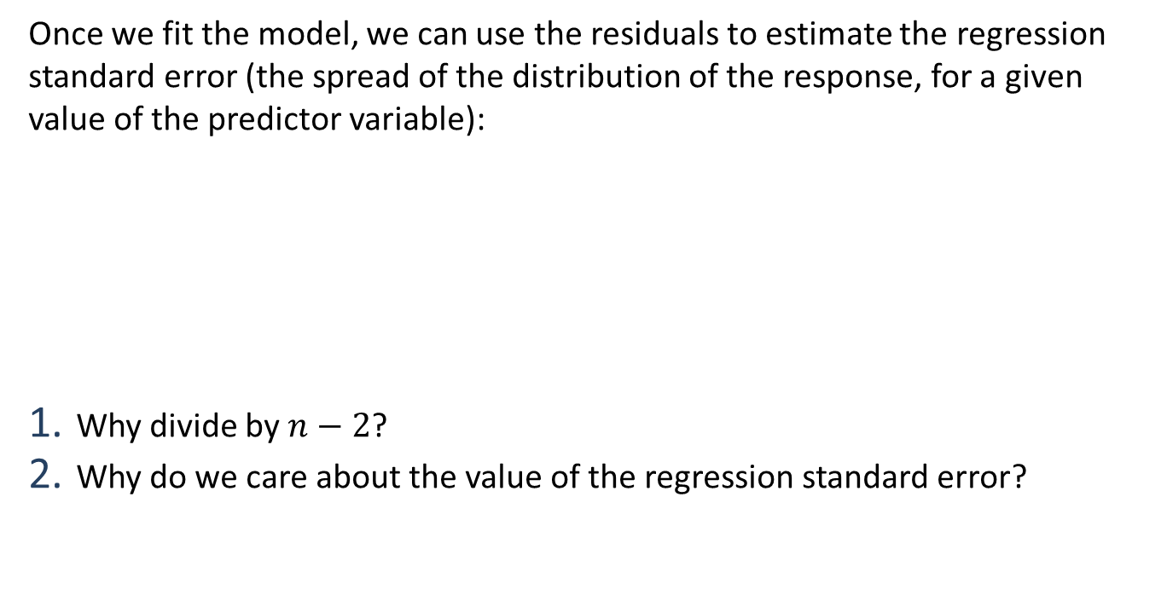
Regression standard error
Once we fit the model, we can use the residuals to estimate the regression standard error (the spread of the distribution of the response, for a given value of the predictor variable):
Why divide by $n−2$?
Why do we care about the value of the regression standard error?

Slide 15
Hypothesis test for the slope
“Do the data provide sufficient evidence that $β_{1}$ (the true slope for the population) is different from 0?”
Null hypothesis - $H_{0}:β_{1}=0$, there is no linear relationship between inequality and trust
Alternative hypothesis - $H_{A}:β_{1}≠0$, there is a linear relationship between inequality and trust

Slide 16
Hypothesis testing framework
Start with a null hypothesis, $H_{0}$ that represents the status quo
Set an alternative hypothesis, $H_{A}$ that represents the research question, i.e. what we’re testing for
Conduct a hypothesis test under the assumption that the null hypothesis is true and calculate a p-value (probability of observed or more extreme outcome given that the null hypothesis is true)
if the test results suggest that the data do not provide convincing evidence for the alternative hypothesis, stick with the null hypothesis
if they do, then reject the null hypothesis in favour of the alternative

Slide 17
Review of questions and models

Slide 18
Review of questions and models
Predicting social trust from inequality and urbanization, while accounting for world region (W3, Ex2)
Are anti-immigrant attitudes associated with lower social trust? (W3, Ex3; also, assignment example analysis)
How does education relate to social trust (in a global perspective)? (W4Ex1) (Wu 2021)
How does education relate to social trust in a chosen country? (W4Ex2)
Are preferences for redistribution associated with education in European countries, and is the association moderated by social trust? (W5Ex1) (Akaeda 2023)
Are anti-immigrant attitudes associated with lower social trust, and is the association dependent on gender, financial insecurity or authoritarian inclinations? (W5Ex2) (a development of W3Ex3)
How does education relate to social trust in Great Britain, and is the relationship dependent on income? (W5Ex3)

Slide 19
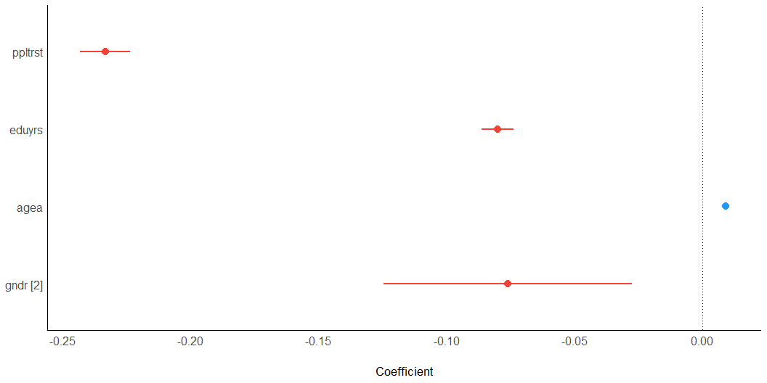
Anti-immigrant attitudes

Slide 20
Parameter | Coefficient | SE | 95% CI | t(35537) | p
(Intercept) | 6.71 | 0.06 | (6.58, 6.84) | 104.58 | < .001
ppltrst | -0.23 | 5.00e-03 | (-0.24, -0.22) | -46.72 | < .001
eduyrs | -0.08 | 3.20e-03 | (-0.09, -0.07) | -24.99 | < .001
agea | 9.11e-03 | 6.91e-04 | (7.75e-03, 0.01) | 13.18 | < .001
gndr (2) | -0.08 | 0.02 | (-0.12, -0.03) | -3.07 | 0.002

Slide 21
References
Akaeda, Naoki. 2023. “Trust and the Educational Gap in the Demand for Redistribution: Evidence from the World Values Survey and the European Value Study.” International Sociology 38 (3): 290–310. https://doi.org/10.1177/02685809231167834.
Gelman, Andrew, Jennifer Hill, and Aki Vehtari. 2020. Regression and other stories. Cambridge: Cambridge University Press. https://doi.org/10.1017/9781139161879.
Wilkinson, Richard G., and Kate Pickett. 2010. The Spirit Level: Why Greater Equality Makes Societies Stronger. New York: Bloomsbury Press.
Wu, Cary. 2021. “Education and Social Trust in Global Perspective.” Sociological Perspectives 64 (6): 1166–86. https://doi.org/10.1177/0731121421990045.

