Slide 1
Introduction: Information, Data, Models
Week 1

Slide 2
Information > Data > Models

Slide 3
Models in social science
Descriptive
Predictive
Inferential
Causal

Slide 4
Typical research objectives by required sample size (n)
$n→∞$
n $≈$ 5,000 - 100,000: stratified population survey
n $≈$ 1,000 - 5,000: population survey
n $≈$ 100 - 1,000: targeted survey
n $≈$ 50 - 100: stratified narrative study
n $≈$ 10 - 50: narrative study
n $≈$ 5 - 10: interactive narrative study
n = 2 - 4: comparative case study
n = 1: case study
n = 0: theoretical/simulation study

Slide 5
The n = 0 principle
set.seed(2069) student_numbers <- 120 sex <- sample(c("Female", "Male"), size = student_numbers, prob = c(70, 30), replace = TRUE) height <- case_when(sex %in% c("Female") ~ rnorm(n = student_numbers, mean = 162.4, sd = 12), sex %in% c("Male") ~ rnorm(n = student_numbers, mean = 175.9, sd = 13)) dataset <- data.frame(sex, height) head(dataset) tail(dataset)
sex height 1 Female 154.6208 2 Female 163.8226 3 Female 162.6665 4 Female 162.1338 5 Female 167.3965 6 Female 159.2073
sex height 115 Female 164.7633 116 Female 153.7522 117 Female 164.0542 118 Female 175.2531 119 Female 158.4923 120 Male 178.2895

Slide 6
Module outline

Slide 7
Finding data

Slide 8
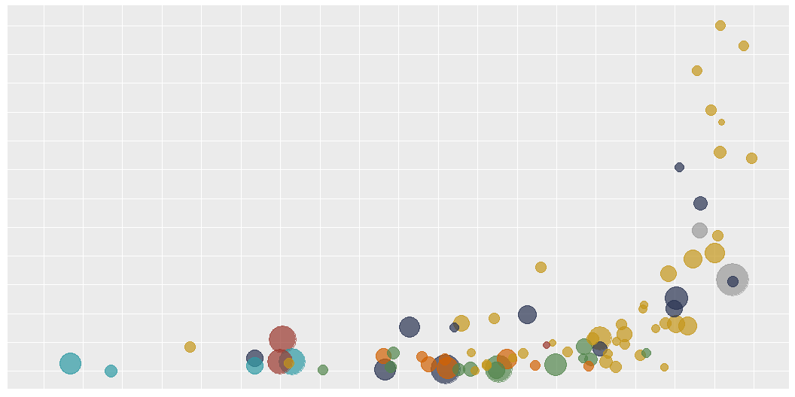
# Attaching packages ✔ ggeffects 1.3.1 ✔ sjlabelled 1.2.0 ✔ sjmisc 2.8.9 ✔ sjstats 0.18.2 ✔ sjPlot 2.8.15 ✔ esc 0.5.1

Slide 9
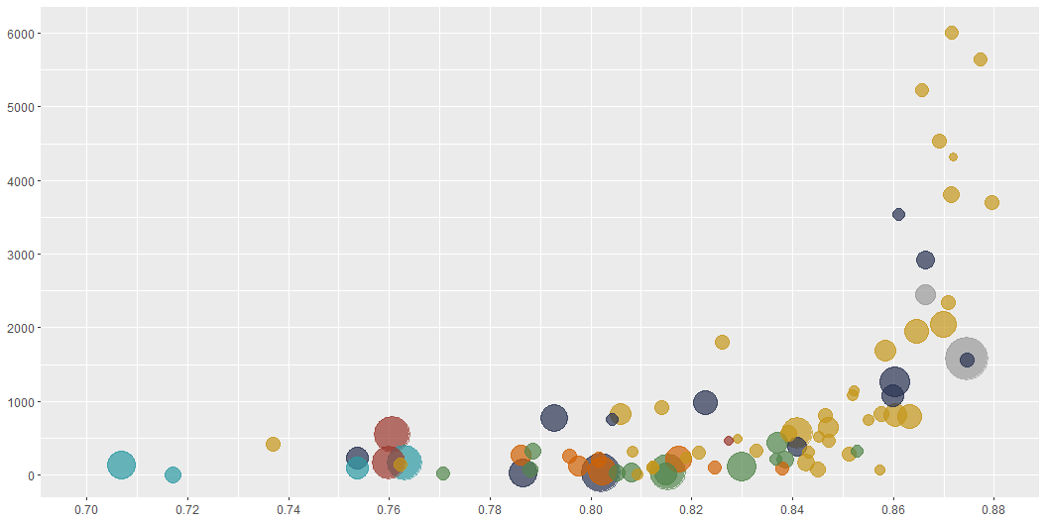

Slide 10
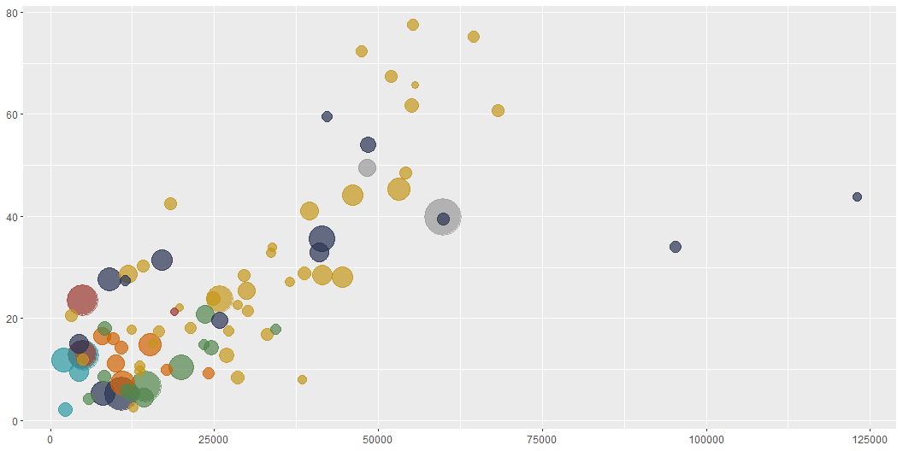

Slide 11
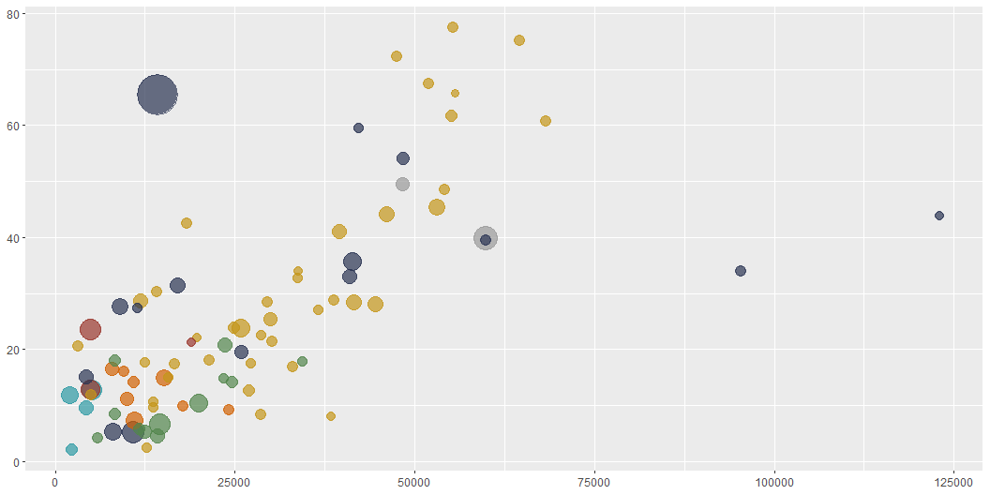

Slide 12
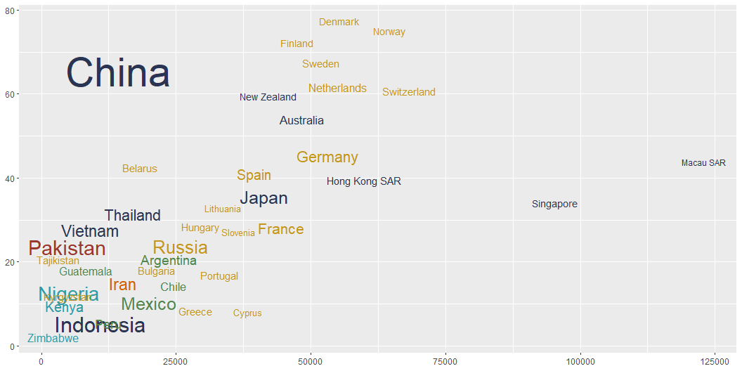

Slide 13
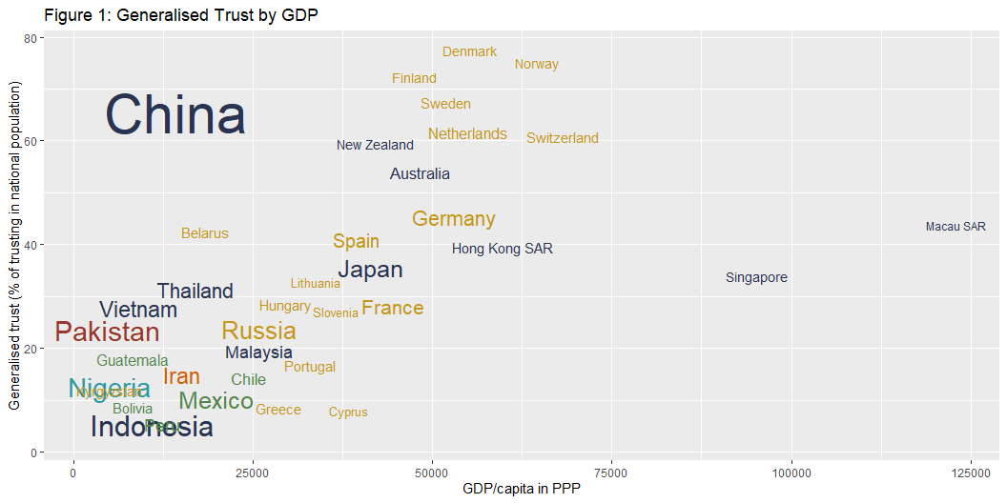

Slide 14
Finding data

Slide 15
This print “Two content” output
Something else
Notes:
Notes.

Slide 16
Title

Slide 17
This prints to Comparison

Slide 18
Using with() in base R

Slide 19
Changing the ggplot theme

Slide 20
Some further styling options

Slide 21
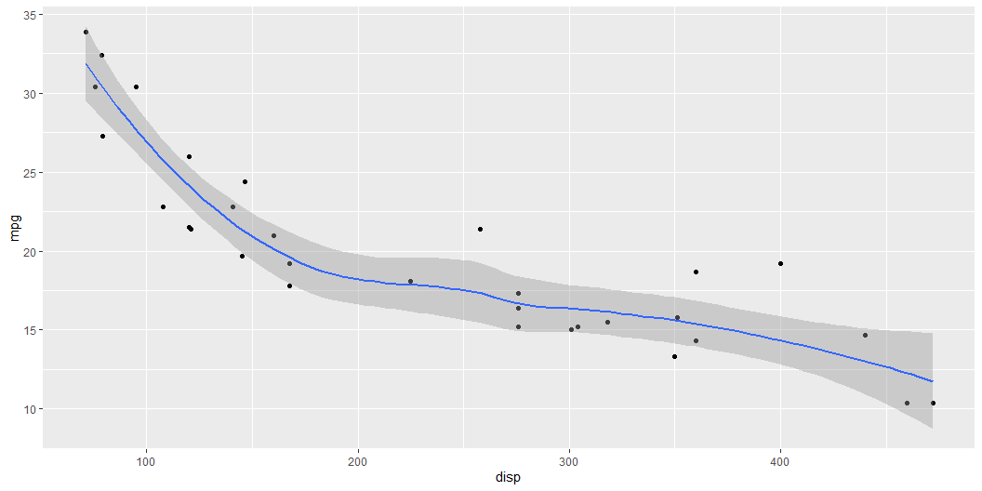
Test
library(ggplot2) mtcars |> ggplot(aes(x = disp, y = mpg)) + geom_point() + geom_smooth(method = "loess", formula = "y~x")

Slide 22
Final
This is an important sentence!

