Slide 1
Measurement, Understanding, Description
Week 2

Slide 2
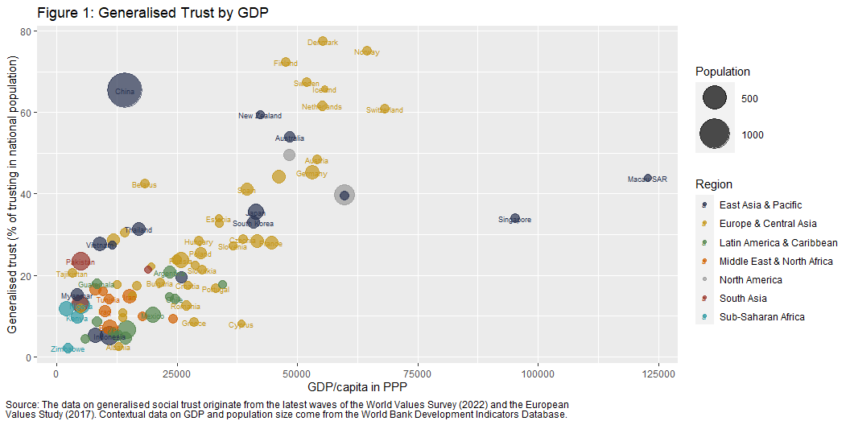

Slide 4
Working in R and RStudio

Slide 5
こんにちは、私の名前は R です。
A statistical programming language
A language called S is developed at Bell Labs (USA) in 1976
The R language created as a free open source implementation of S in 1991 at the University of Auckland (NZ); it developed into a different “dialect” of the original language S
R goes public in 1993, a core maintainer group is set up in 1997, and Version 1.0.0 is released in 2000
Current stable, released version (2023-10-03) is R-4.3.1 (2023-06-16, “Beagle Scouts”); minor releases about 4/5 times a year; mid-version releases about once a year; major releases every 7/8 years

Slide 6
こんにちは、私の名前は：R
A statistical programming language
Computer commands as speech acts

Slide 7
RStudio: “But I’m here to help!”
An Integrated Development Interface (IDE)
Company founded in 2009 in Boston (MA, USA) to develop open source and enterprise-ready professional software for the R statistical computing environment
First public beta version (v0.92) of the RStudio IDE came out in 2011; Version 1 released in 2016; latest version (on 2023-10-03) is Version: 2023.09.0+463, released: 2023-09-28
In 2022 the company changes its name to Posit PBC in a move to be seen as more language-agnostic and embrace other programming languages too (Python, Julia, etc.). RStudio lives on as an IDE

Slide 8
The RStudio interface

Slide 9
Other essential tools we will use
R packages
tidyverse
dplyr
easystats
datawizard
ggplot2
ggformula
gtsummary
R Markdown / Quarto

Slide 10
Functions
Example:
Chris_s_mean <- function(number1, number2) { mean_value <- (number1 + number2) / 2 print(paste("The mean of", number1, "and", number2, "is", mean_value)) }
Chris_s_mean(2, 8)
[1] "The mean of 2 and 8 is 5"
Chris_s_mean(7, 9)
[1] "The mean of 7 and 9 is 8"
Chris_s_mean(461325, 7849545)
[1] "The mean of 461325 and 7849545 is 4155435"
Chris_s_mean(1, 2, 3)
Error in Chris_s_mean(1, 2, 3): unused argument (3)

Slide 11
Functions
What if we want more?
Chris_s_mean <- function(...) { numbers <- c(...) mean_value <- mean(numbers) print(ifelse(length(numbers) > 2, paste("The mean of the numbers is", mean_value), paste("The mean of", numbers[1], "and", numbers[2], "is", mean_value)) ) }
Chris_s_mean(1, 2, 3)
[1] "The mean of the numbers is 2"
Chris_s_mean(9, 23)
[1] "The mean of 9 and 23 is 16"
Chris_s_mean(4:400)
[1] "The mean of the numbers is 202"

Slide 12
Measurement: from questionnaire items to dataset variables

Slide 13
Variables
Variables vs. constants
“Lives in Newcastle” (Yes/No)
“Lives in the UK” (Yes/No)
“Lives on planet Earth” (Yes/No) (When you will be giving this lecture and your children will be sitting where you are sitting now, this may no longer be the case)

Slide 14
Understanding and describing (clean) data

Slide 15
Managing “messy” data

Slide 16
Visualisation

Slide 17
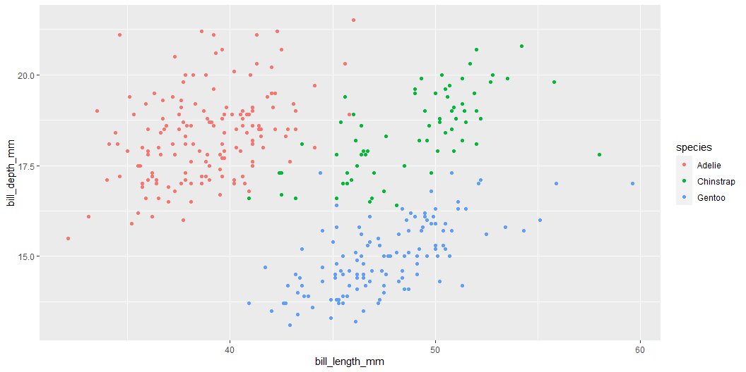
This print “Two content” output
library(palmerpenguins) ggplot(penguins, aes(x = bill_length_mm, y = bill_depth_mm, color = species)) + geom_point()
Something else
Notes:
I may write a lot of extra stuff here in case you are interested.

Slide 18
Title
ggplot(penguins, aes(x = bill_length_mm, y = bill_depth_mm, color = species)) + geom_point()

Slide 19
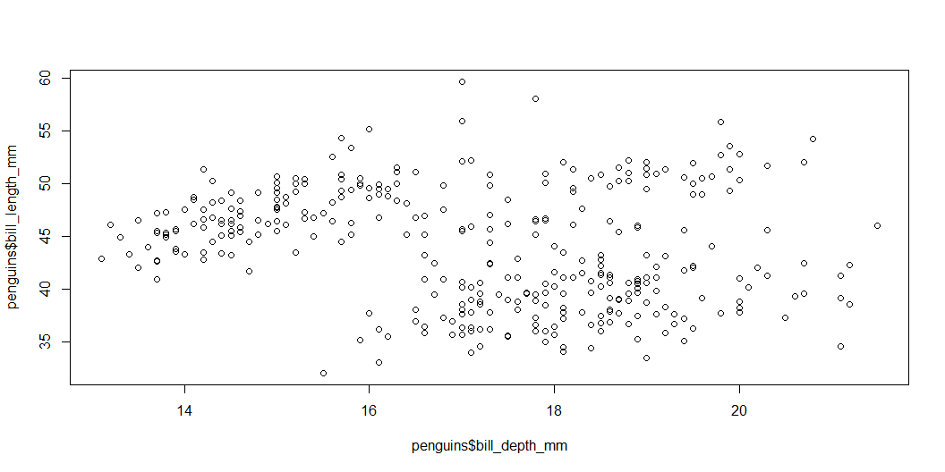
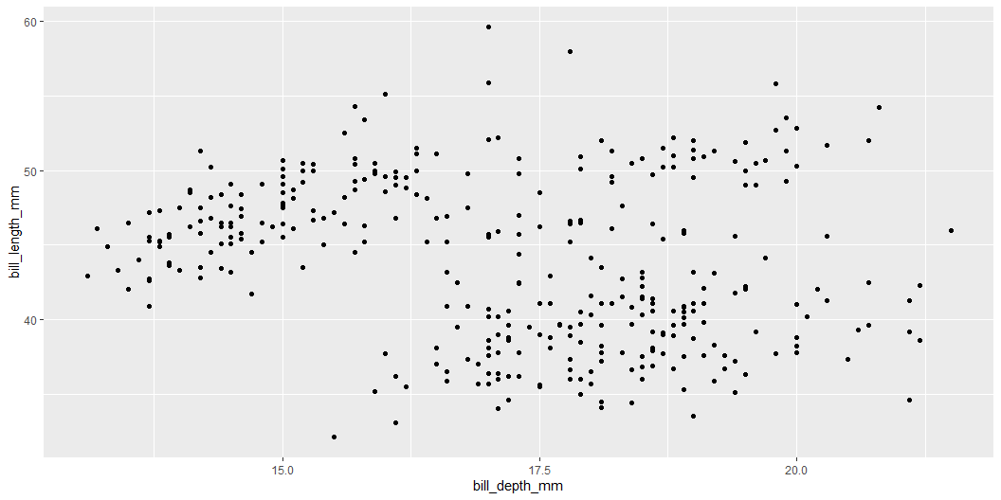
This prints to Comparison
plot(penguins$bill_depth_mm, penguins$bill_length_mm)
ggplot(penguins, aes(bill_depth_mm, bill_length_mm)) + geom_point()

Slide 20
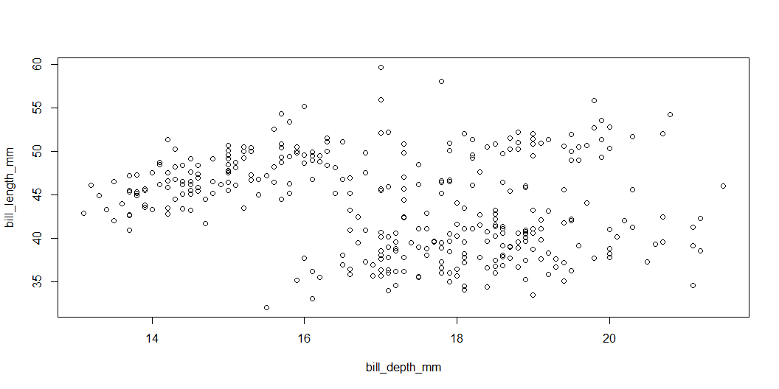
Using with() in base R
with(penguins, plot(bill_depth_mm, bill_length_mm))
ggplot(penguins, aes(bill_depth_mm, bill_length_mm)) + geom_point()

Slide 21
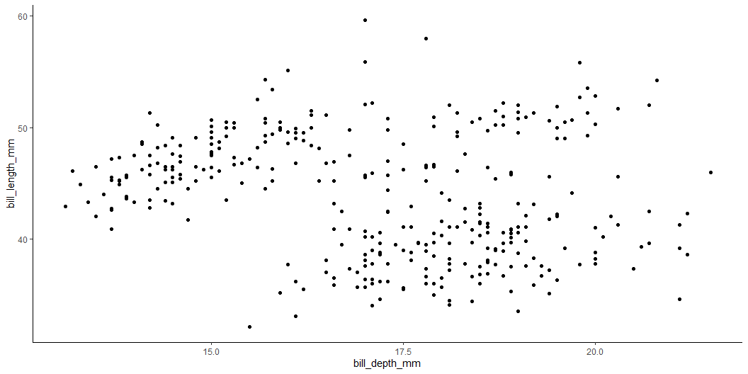
Changing the ggplot theme
with(penguins, plot(bill_depth_mm, bill_length_mm))
ggplot(penguins, aes(bill_depth_mm, bill_length_mm)) + geom_point() + theme_classic()

Slide 22
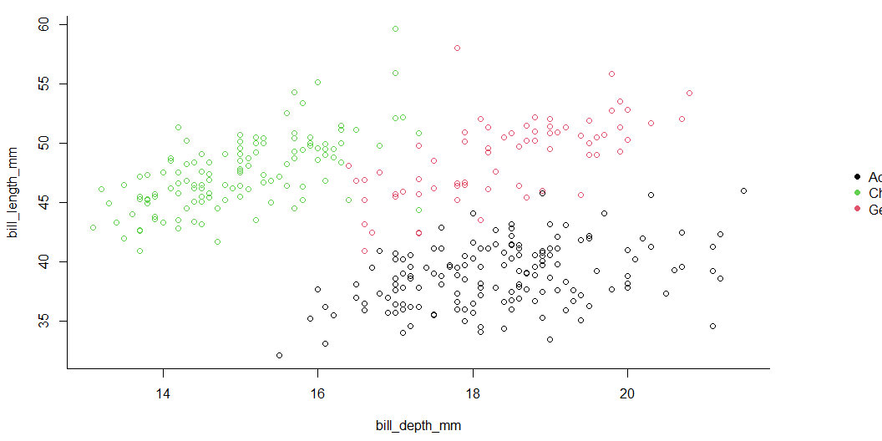
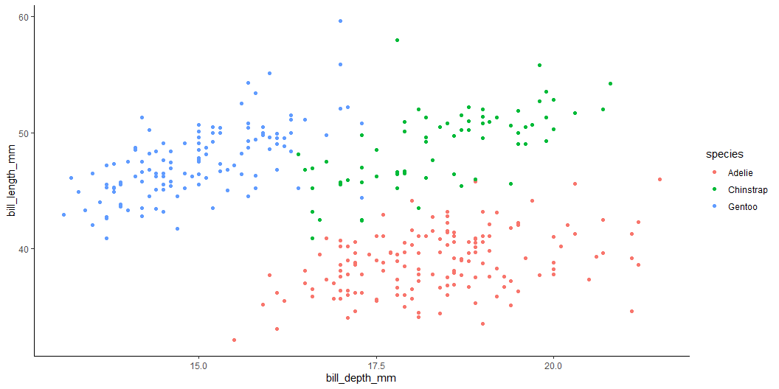
Some further styling options
par(mar=c(4.5, 4.2, 1, 7), xpd=TRUE) # set custom plot size with(penguins, # select data frame plot(bill_depth_mm, # select variables to plot bill_length_mm, col = species, # grouping colour bty = "L") # change plot border style ) with(penguins, legend("right", # legend position inset=c(-0.23,0.5), # legend custom location (outside the plot) legend = levels(species), # legend labels pch = 16, # legend symbol size col = unique(species), # legend symbol colour bty = "n" # remove legend borders ) )
ggplot(penguins, # draw empty canvas aes(bill_depth_mm, # select variables to plot bill_length_mm, color = species)) + # grouping colour geom_point() + # select plot type theme_classic() # select pre-set style settings (theme)

Slide 23
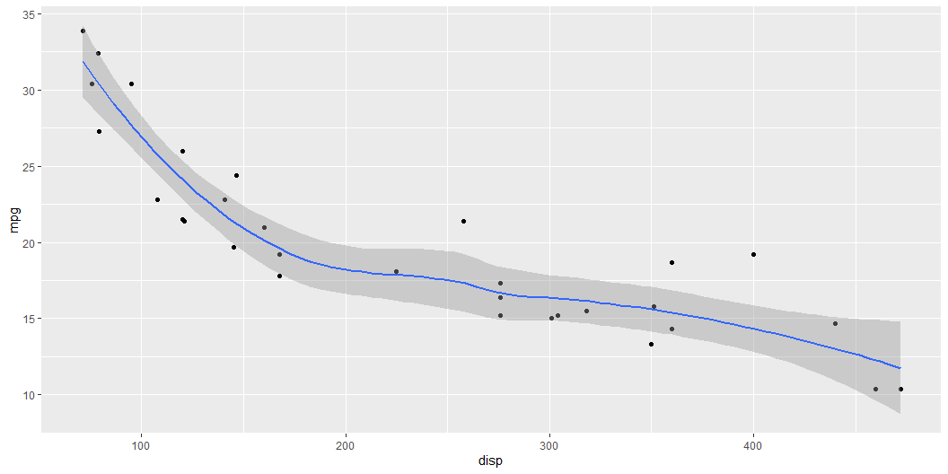
Test
library(ggplot2) mtcars |> ggplot(aes(x = disp, y = mpg)) + geom_point() + geom_smooth(method = "loess", formula = "y~x")

Slide 24
Final
This is an important sentence!

