Slide 1
Logistic regression
Week 4

Slide 2
What is logistic regression?
Logistic regression is a generalized linear model where the outcome is a two-level categorical variable
E.g “Trusting people” = 1, “Not trusting people” = 0
The outcome variable for a GLM is denoted by $Y_{i}$, where the index $i$ is used to represent observation $i$.

Slide 3
What is logistic regression?
E.g. $Y_{i}$ will be used to represent whether person $i$ is in the trusting category ($Y_{i}=1$) or not ($Y_{i}=0$).
The outcome, $Y_{i}$, takes the value 1 with probability $p_{i}$ and the value 0 with probability $1−p_{i}$.
Because each observation has a slightly different context, (e.g., different education level if we have education as an independent variable), the probability $p_{i}$ will differ for each observation.
It is this probability that we model in relation to the predictor variables

Slide 4
The logit transformation
The predictor variables are represented as follows: $x_{1,i}$ is the value of variable 1 for observation $i$, $x_{2,i}$ is the value of variable 2 for observation $i$, and so on.
We want to choose a transformation in the equation that makes practical and mathematical sense.
$$transformation\left(p_{i}\right)=b_{0}+b_{1}x_{1,i}+b_{2}x_{2,i}+⋯+b_{k}x_{k,i}$$

Slide 5
The logit transformation
For example, we want a transformation that makes the range of possibilities on the left hand side of the equation equal to the range of possibilities for the right hand side; if there was no transformation for this equation, the left hand side could only take values between 0 and 1, but the right hand side could take values outside of this range.
A common transformation for $p_{i}$ is the logit transformation, which may be written as:
$$logit\left(p_{i}\right)=\log_{e}\left(\frac{p_{i}}{1−p_{i}}\right)$$

Slide 6
The logit transformation
We can rewrite the equation relating $Y_{i}$ to its predictors using the logit transformation of $p_{i}$:
$$\log_{e}\left(\frac{p_{i}}{1−p_{i}}\right)=b_{0}+b_{1}x_{1,i}+b_{2}x_{2,i}+⋯+b_{k}x_{k,i}$$

Slide 7
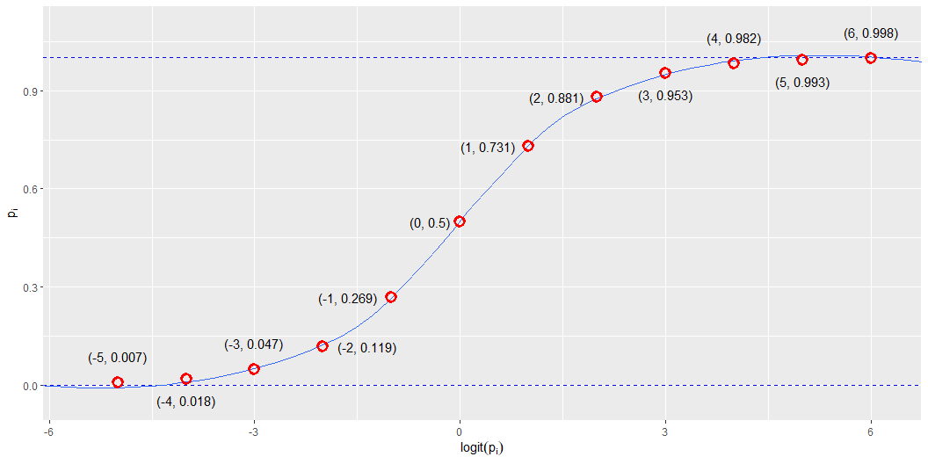
The logit transformation

Slide 8
What are probabilities?

