Slide 1
“Has the Credibility of the Social Sciences Been Credibly Destroyed?”
17 October 2024
ReproducibiliTea journal club
Newcastle University

Slide 3
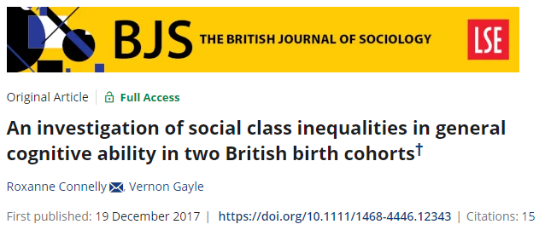
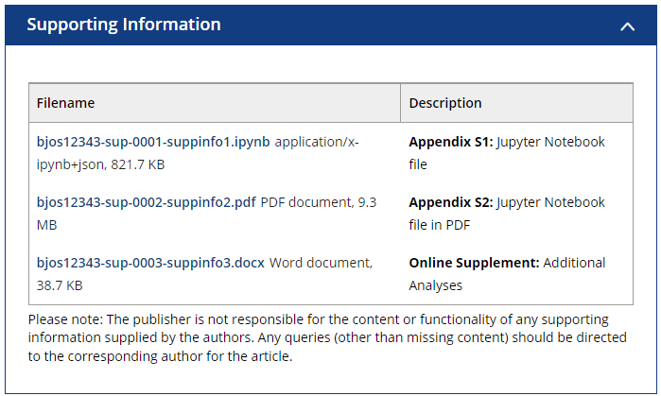
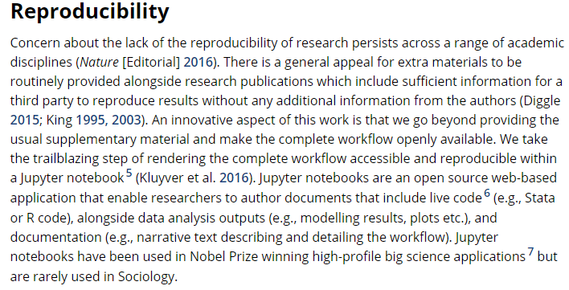
Journey into open research and reproducible workflows
2018 – 2021: teaching intro quantitative methods to sociology students at York St John University
How to bridge the gap between “classroom statistics” and applied, “published research”?
Analysis workflows in sociology are not transparent
Lack of transparency limits reproducibility
Analysis workflows and reproducibility are not taught
Lack of pedagogical focus reinforces the cycle

Slide 4
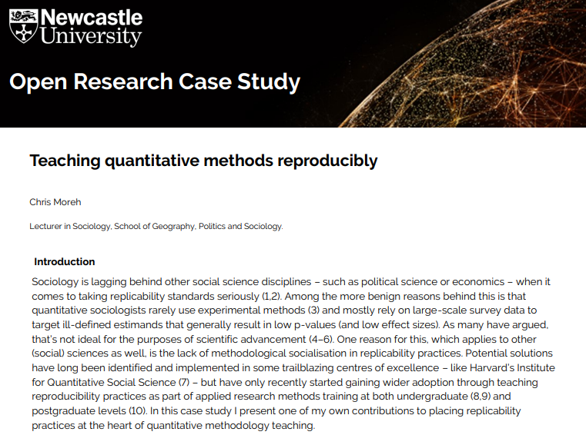
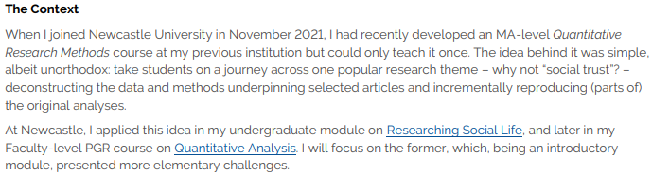
Reproducible workflows and pedagogy
https://www.ncl.ac.uk/mediav8/library/file-downloads/research-services/open-research/moreh.pdf

Slide 5
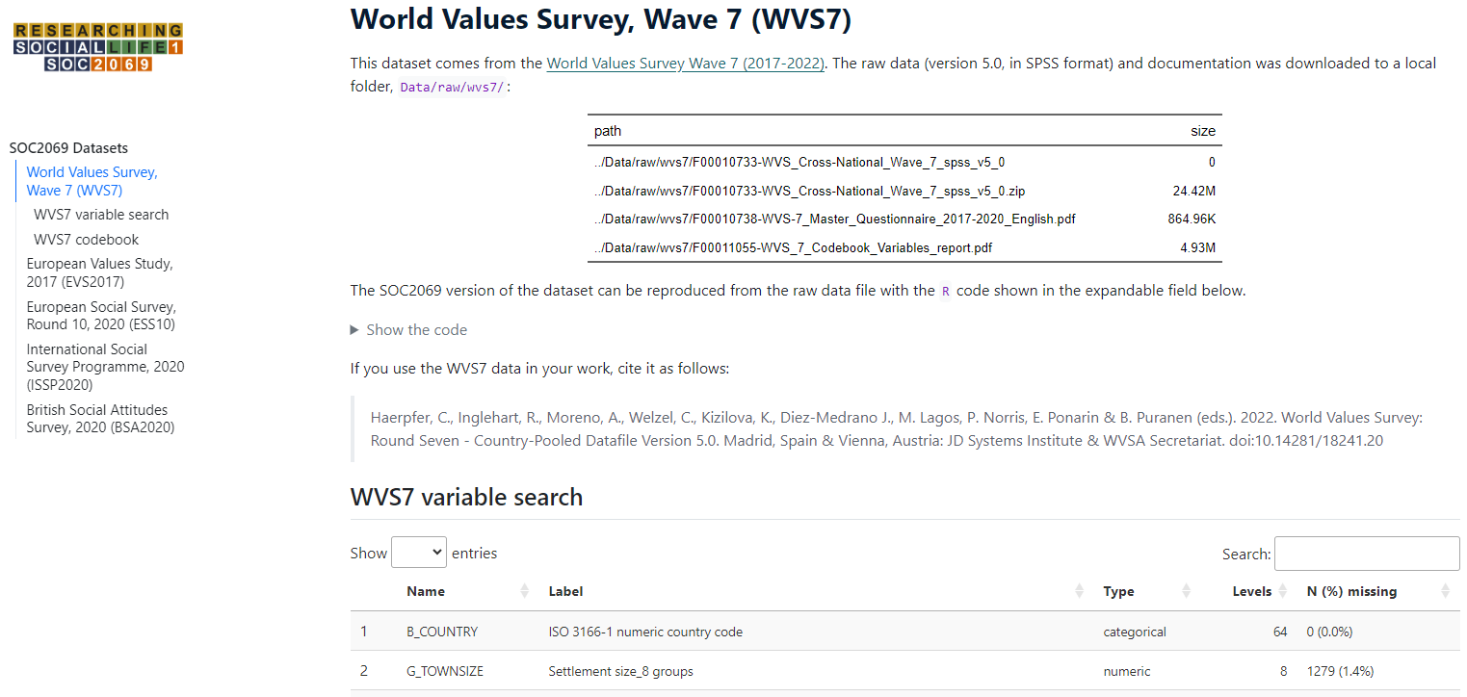
Reproducible workflows and pedagogy

Slide 6
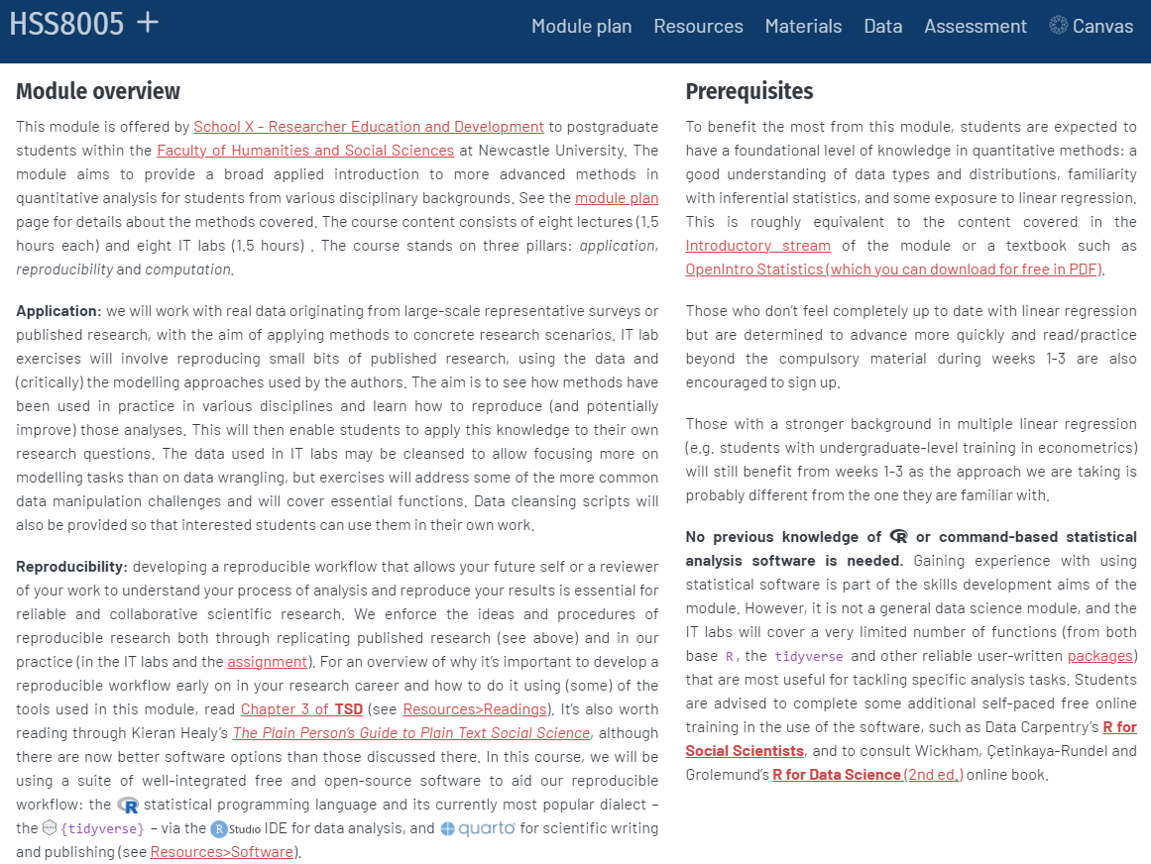
Reproducible workflows and pedagogy

Slide 7

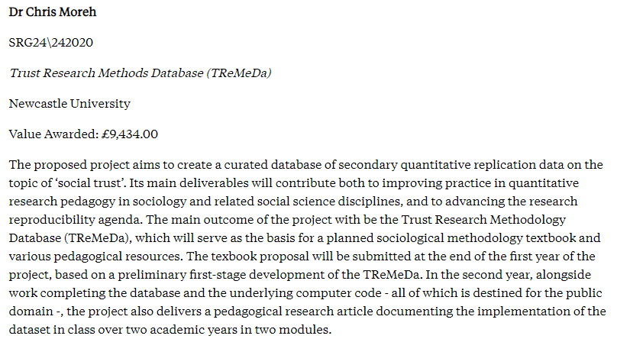
Reproducible workflows and pedagogy

Slide 8
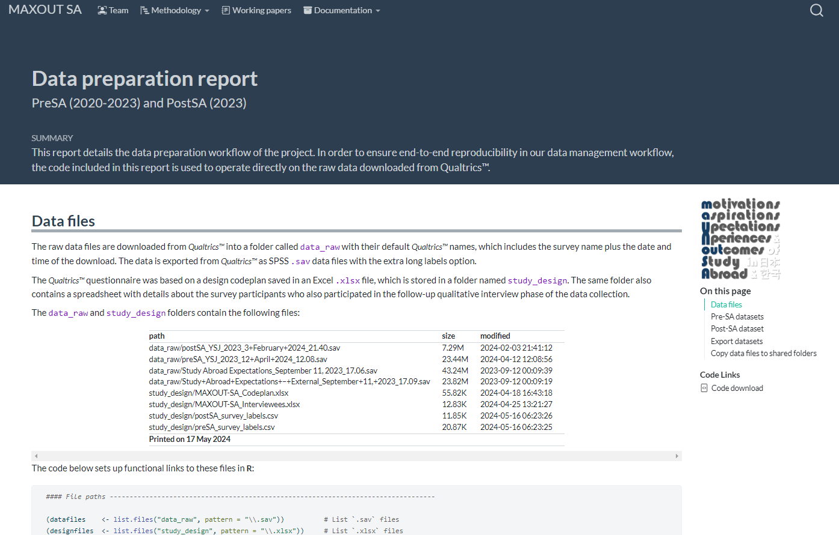
Reproducible workflows and research

Slide 9
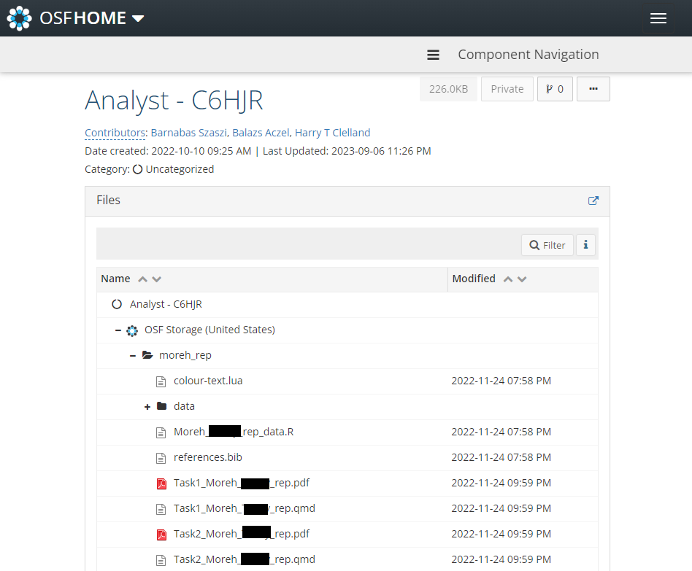
Reproducible workflows and replication exercises

Slide 10
Reproducibility in sociology: practices, challenges and limits
Reproducibility exercises themselves can attract criticism and fail to replicate.
The criticism of OSC (2015) by Gilber et al. (2016) and the ensuing discussion among a wider group of researchers with strong track records in promoting open science and championing reproducibility practices has demonstrated this in the context of psychological research and experimental data.
Disciplines where the most commonly employed quantitative data come from large-scale observational studies – like sociology – have largely stayed on the margins of the reproducibility agenda.
Silberzahn et al. (2018) was an important contribution in this respect, not only in terms of the approach and size of the conducted replication exercise, but also in its ability to cast doubts on the credibility of social research with observational data.
Auspurg and Brüderl (2021), however, have challenged these findings, putting forward that at fault was the unclear research question given to the replicators. They argue that crowdsourcing (and then simply averaging) many studies of lower quality is not a useful approach to reproducibility exercises in the social sciences, and that a better strategy is to increase the quality of individual studies by calling for more precise definitions of the theoretical (research question) and empirical (parameter of interest) estimands driving the analysis, a plea made forcefully by Lundberg, Johnson, and Stewart (2021).

Slide 11
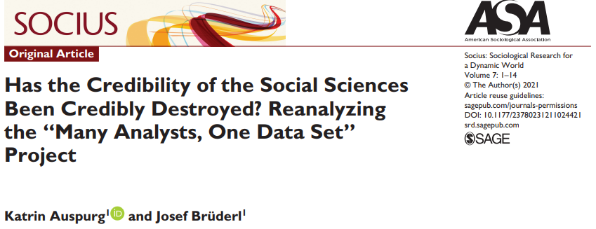
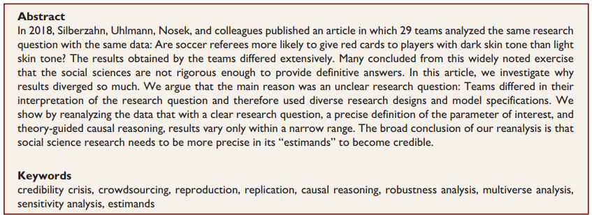
“Has the Credibility of the Social Sciences Been Credibly Destroyed?”

Slide 12
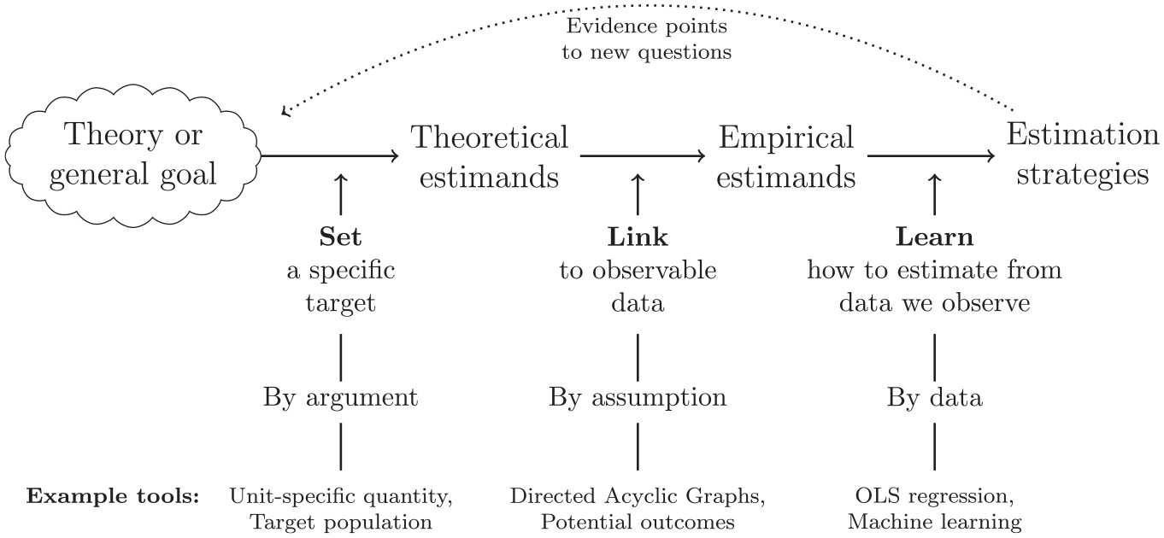
“Has the Credibility of the Social Sciences Been Credibly Destroyed?”
Lundberg Ian, Johnson Rebecca, Stewart Brandon M. 2021“What Is Your Estimand? Defining the Target Quantity Connects Statistical Evidence to Theory.” American Sociological Review. OnlineFirst. https://doi.org/10.1177/00031224211004187.

Slide 13
Thank you!

