Slide 1

JPA Java Persistance API O/R Mapping
JEE Microservices
@ CGS IT – 2023
Version 1.0.5

Slide 2
Content
JPA Definitions
JPA-Framework - Modules and APIS
Entity Manager
JTA - Transaction Management
Entity Definitions and Annotations
Mapping Examples
JPQL
Query API
Quarkus Configuration

Slide 3
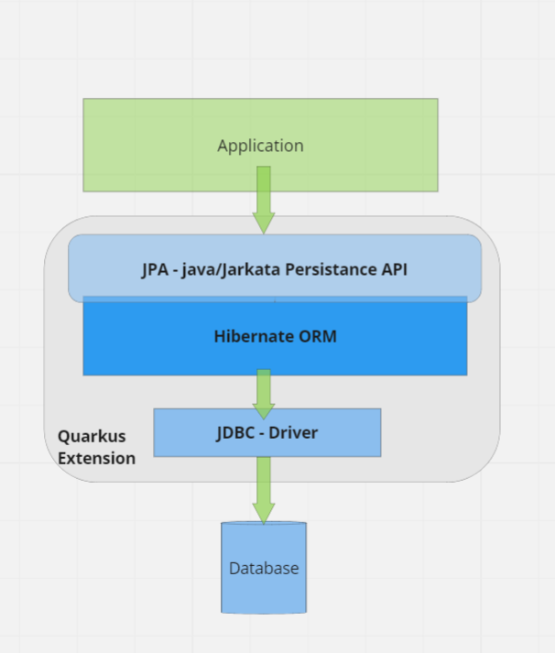

JPA Architecture
Java Persistence API or now Jakarta Persistence API
JPA provides Java developers with an object/relational mapping facility for managing relational data in Java applications.
JPA itself is just a specification, not a product, it cannot perform persistence or anything else by itself.
JPA is a set of interfaces and requires an implementation
There are open-source and commercial JPA implementations to choose from and any Java EE 5 application server should provide support for its use
JPA also requires a database to persist to

Slide 4
JPA – Framework Componentens
The Java Persistence API
Object/Relational Mapping Metadata
The Query Language
The Java Persistence Criteria API

Slide 5
JPA - API
JPA specifies interfaces, Annotations and Patterns for OR-Mapping
JPA enables a more Object-Oriented View do store objects to a relational database.
Within the standard it also defines Entity Mapping Annotations
It also defines a Query Language (JPQL) and
a programatic Query API.

Slide 6
Modules and APIS used with JPA
Java Bean Validation Framework
Integrates into JPA for additional bean validations during JPA operations
JTA – Java Transaction API
Transaction Support via also Annotations for JPA
Hibernate
Is often and used in Quarkus as an Implementation for JPA
JDBC
JPA/Hibernate always connects to the database via a JDBC-Driver implemenation.

Slide 7

JPA – Entity Manager
Main API is the EntityManger Interface
API allows to manage Entities by providing all required
CRURD (create, read, update delete) methods
as well as search and query api utilites
Getting an Instance for this API is simply done via @Inject

Slide 8
JPA – Entity Manager – API
Method | Description
em.persist(Object entity) | Make an instance managed and persistent It will be attached to the EM Session and persisted during commit
Update ? | An Entity is updated whenever you modify an Entity which is attached to a session, so loaded from the entity manager inside an active transaction An Entity/Table can also be updated by directly using update statement queries
<T> T em.merge(T entity) | If an Entity was loaded via EM but the Entity Manager and Transaction is not active anymore, the Entity gets the status „DETACHED“. The Return value is the new attached merged Entity for the current EM Session
em.remove(Object entity) | Remove the entity instance from the Session, which leads to a db delete
em. find(Class<T> entityClass, Object primaryKey) | Find by primary key. Search for an entity of the specified class and primary key

Slide 9
JPA – JTA - Transactions
The Java Transaction API specified by JSR 707
The Api specifies Interfaces and Annotations to demarcate transaction boundaries
Also defines an API to directly deal with the Transaction-Manager

Slide 10
JPA – JTA – Transactions and Scopes
Annotation | Description
@Transactional | Annoation to define TX Boundaries automatically Default Scope is : REQUIRED
@TransactionScoped | standard CDI scope to define bean instances whose lifecycle is scoped to the currently active JTA transaction
@Transactional( Transactional.TxType.REQUIRED) | Same as default. A Transaction is required. If no
Transactional.TxType. REQUIRES_NEW | Always will create a new transaction for this method, even if another one is already active. If another TX is active the other TX will be suspended
Transactional.TxType.SUPPORTS | Participate in an existing TX or call the method without any additional TX. If you have read only methods todo you can use it
Transactional.TxType.MANDATORY | Mandatory is like Supports but if no TX is active a TransactionalException is thrown
Transactional.TxType.NOT_SUPPORTED | If the caller/client has a TX actve, it is suspended before processing continous
Transactional.TxType.NEVER | If the client is running in a TX context. A TransactionalException is thrown

Slide 11

JPA – JTA –Programatic TX-Management
UserTransaction can also be manually injected
And controlled manually also
public void insertChatMessageManualTX(ChatMessageEntity newObject) throws SystemException, NotSupportedException { utx.begin(); try { em.persist(newObject); utx.commit(); } catch (Exception e) { utx.rollback(); throw new RuntimeException("tx erorr ",e); } }
As a rule of thumb use annotations
if no specific requirement needs to be fullfilled

Slide 12
Entities
An entity represents a table in a relational database, and each
entity instance corresponds to a row in that table
An entity is a lightweight persistence domain object
The primary programming artifact of an entity is the entity class

Slide 13
Entities - Basics
The class must be annoyed with java.persistence.Entity
annotation .
The class must not be declared final.
The class must implement the Serializable interface.
Entities may extend both entity and non-entity classes, and nonentity classes may extend entity class.
Persistent instance variable must be declared private, protected, or package-private.

Slide 14
Entity Mapping Annotations
Annotation | Description
@Entity | The POJO annotated with @Entity becomes a pesistant object.
@Table | Specifies a primary database table (name) for this entity
@SecondaryTable | Enables the storage into multiple tables for one Entity
@Embeddable | Annotates a a pojo used within Entites as an embedded class
@Inheritance @DiscriminatorValue @PrimaryKeyJoinColumn | Enables the Entity to use Java Inheritance and mapp it correctly to one or multipe database tables.

Slide 15
Entity Mapping Annotations - Fields
Annotation | Description
@Column | Specifies the mapped colum for a property in the Entity Class. Normally annotated on the property itself
@Id | Markes a property as a primary key column
@GeneratedValue | Used with ID columns to specify how the value is generated. @GeneratedValue(strategy=GenerationType. SEQUENCE)
@Basic | The simplest type of mapping to a database column. Used especially with EAGER or LAZY loading flag
@Enumerated | Annotates the mapping for java enumerations by ordinal or String mapping. ORDINAL is the default currently
@Temporal | Used for date, time and timestamp mappings: @Temporal(DATE) protected java.util.Date endDate;
@Lob | for BLOBs /CLOB mappings
@Transient | A transient field is not persisted at all

Slide 16
Entity Mapping - Example
Easy mapping for any Pojo into a Table
If the @Table annotation is not used it defaults to the entity name
NotBlank is already added as an example for bean valdation framwork usage
@Entity @Table( name="chat_message") public class ChatMessageEntity { @Id @GeneratedValue(strategy=GenerationType.AUTO) private Long id; @Column(name="user_name", length= 100, nullable = false) private String userName; @NotBlank(message="ChatRoom may not be blank") @Column(name="chat_room", length= 50, nullable = true) private String chatRoom; …

Slide 17
Entity Mapping Annotations - Relations
Annotation | Description
@OneToOne | 1:1 relation to another Entity
@OneToMany | 1:n relation to another entity used as annotation on the first „1“ side of the relation
@ManyToOne | Defines the N-side for a 1:n Relation (is a reference to the primary key of the target)
@ManyToMany | Used for n:m relations and used on both sides
@JoinColumn | Addional information for join columns

Slide 18
Entity Relation Mapping: Many to Many
Both sides use @ManyToMany as Annotation
The join table is specified on the owning side (customer)
See ManyToMany Java Documentation for more examples
// In Customer class: @ManyToMany @JoinTable(name="CUST_PHONES") public Set<PhoneNumber> getPhones() { return phones; } // In PhoneNumber class: @ManyToMany(mappedBy="phones") public Set<Customer> getCustomers() { return customers; }

Slide 19
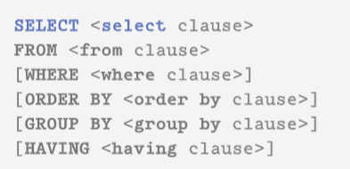
JPA - JPQL - Java/Jakarta Persistence Query Language
Provides a SQL Like Query Language but against the mapped entity objects instead of the Database
It provides select, Join, Where, order, group by and having support.
See the specification and tuturials for more details
SELECT e from ChatMessageEntity e " + "WHERE e.chatRoom like :chatMessageLike " + "ORDER by e.creationTime DESC
See also:
https://en.wikipedia.org/wiki/Jakarta_Persistence_Query_Language
https://docs.oracle.com/javaee/6/tutorial/doc/bnbtg.html

Slide 20
JPA - JPQL - Query API
Enables a programatic approach to queries by using a Criteria Builder
and Expressions for the select and where conditions
Is more save for refactoring
public Long countChatMessages() { CriteriaBuilder cb = em.getCriteriaBuilder(); CriteriaQuery<Long> query = cb.createQuery(Long.class); Root<ChatMessageEntity> from = query.from(ChatMessageEntity.class); Expression<Long> count = cb.count(from); query.select( count ); // cq.where(/*your stuff*/); TypedQuery<Long> query1 = em.createQuery(query); Long singleResult = query1.getSingleResult(); return singleResult; }

Slide 21
Quarkus – JPA Configuration
JPA Configuration is simplified via Quarkus to minimal settings
The db-kind desides on a database type
to use a database you need to import the driver maven dependency for the jdbc diver
Datasource url and password
# datasource configuration quarkus.datasource.db-kind = postgresql quarkus.datasource.username = sc_admin quarkus.datasource.password = sc_admin quarkus.datasource.jdbc.url = jdbc:postgresql://localhost:5432/simplechat quarkus.hibernate-orm.database.generation=drop-and-create # quarkus.hibernate-orm.database.generation=update
quarkus.hibernate-orm.log.sql=true quarkus.hibernate-orm.log.bind-parameters=true
To see the generated SQL use ORM SQL logging parameters, which are also simplified a bit compared to hibernate direct logging configuration

Slide 22
Examples

Slide 23
Example JPQL Query
public Long countChatMessagsForRoom(String roomName) { // like query Query query = em.createQuery("select count(e) from ChatMessageEntity e WHERE e.chatRoom like :chatRoomLike "); // :chatRoomLike wird durch den eigentlichen Wert ersetzt query.setParameter("chatRoomLike", "%room1%"); // equals Query query2 = em.createQuery("select count(e) from ChatMessageEntity e WHERE e.chatRoom = :chatRoomLike "); query2.setParameter("chatRoomLike", roomName); Long singleResult = (Long) query2.getSingleResult(); return singleResult; }

Slide 24
Example JPQL Query 2
@Transactional public List<ChatMessageEntity> findChatMessagesWithLikeNameAndOrdedByDate(String likeStatement) { // suche alle chat messages and order by date descending Query query = em.createQuery( "SELECT e from ChatMessageEntity e " + "WHERE e.chatMessage like :chatMessageLike " + "ORDER by e.creationTime DESC" ); if( !StringUtil.isNullOrEmpty(likeStatement)) { query.setParameter("chatMessageLike", likeStatement); } else { query.setParameter("chatMessageLike", "%"); } List resultList = query.getResultList(); return resultList; }

Slide 25
Examples
@Transactional(Transactional.TxType.REQUIRED) public int deleteAllChatMessageEntity() { Query query = em.createQuery("DELETE FROM ChatMessageEntity"); // returns the number of deleted entities int i = query.executeUpdate(); return i; } @Transactional(Transactional.TxType.REQUIRED) public void deleteWithoutLoading(Long idToDelete) { Query query = em.createQuery("delete from ChatMessageEntity where id = :id"); query.setParameter("id", idToDelete).executeUpdate(); } /** * delete entity if object is already loaded * @param entity */ @Transactional(Transactional.TxType.REQUIRED) public void deleteByObject(ChatMessageEntity entity) { em.remove(entity); }
Delete Query
Delete without loading
Delete from EM and DB for loaded Object

Slide 26
Example Critery Builder
@Transactional public List<ChatMessageEntity> findChatMessagesWithLikeNameAndOrdedByDateWithQueryBuilder(String likeStatement ) { // "SELECT e from ChatMessageEntity e WHERE e.chatRoom like :chatMessageLike ORDER by e.creationTime DESC" CriteriaBuilder cb = em.getCriteriaBuilder(); CriteriaQuery<ChatMessageEntity> criteriaQuery = cb.createQuery(ChatMessageEntity.class); Root<ChatMessageEntity> from = criteriaQuery.from(ChatMessageEntity.class); criteriaQuery.select( from ); Predicate like = cb.like(from.get("chatMessage"), likeStatement); criteriaQuery.where( like ); Order orderByCT = cb.desc(from.get("creationTime")); criteriaQuery.orderBy(orderByCT ); Query query = em.createQuery(criteriaQuery); List<ChatMessageEntity> resultList = query.getResultList(); return resultList; }

Slide 27
Danke für Ihre Aufmerksamkeit

