Slide 1

Quarkus Testing
JEE Microservices
@ CGS IT – 2025
Version 1.0.7

Slide 2
Inhalt
Quarkus – Test Überblick
Quarkus-Test Grundlagen
Beispiele
Rest Assured Framework for API Testing
Junit 5 Features

Slide 3
Quarkus Tests
Simple Container based Testing Unit + CDI + Quarkus
Component Tests via @QuarkusTest
Integration tests via @QuarkusIntegrationTest
Einfaches Testen von CDI Beans, Rest und DB-Objekten
Unterstützung von RestAssured für Rest API Tests

Slide 4
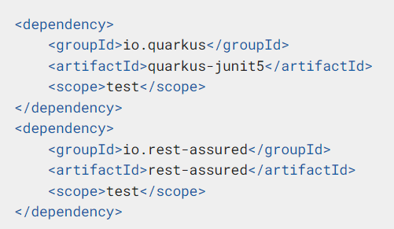
Quarkus Testing - Grundlagen
Basis Junit 5
Rest Assured Library für einfaches api testen

Slide 5
Quarkus Test – DB Repository Bean
Inject des Respositories ist direkt in den Test möglich
Initialisierung der DB und des gesamten JPA Layers via CDI Quarkus Test Containers
@QuarkusTest class ChatMessageRepositoryTest { @Inject Logger log; @Inject ChatMessageRepository cmRepository; @Test void readChatMessage() { ChatMessageEntity cmEntity = cmRepository.readChatMessage(1L); assertNotNull(cmEntity); log.info("cmresult" + cmEntity.toString()); }}

Slide 6

@QuarkusTest - Funktionsweise
Das Verhalten von @QuarkusTest ist folgendermaßen:
@QuarkusTest initialisiert einmalig eine Quarkus-Testumgebung (bzw. einen Quarkus-Testcontainer) pro Testklasse.
Innerhalb dieser Testklasse werden alle Testmethoden in derselben Quarkus-Instanz ausgeführt.
Das spart Zeit, weil der Container nicht für jede Methode neu gestartet wird.
Für jede weitere Testklasse mit @QuarkusTest wird eine neue, eigene Instanz der Quarkus-Testumgebung erzeugt.
Das bedeutet
Eine Quarkus-Testumgebung lebt genau für die Dauer einer Testklasse.
Zwischen Testklassen findet kein Teilen des Containers oder States statt.

Slide 7
Quarkus Test Configruation Properties
🔧 If `src/test/resources/application.properties` exists:
- It overrides values from `src/main/resources/application.properties`
- Only for **duplicated keys** (non-overlapping keys are merged)
✅ Use Cases:
- Switch datasource for tests
- Override service URLs
- Change logging levels
Example:
Main: `greeting.message=Hello from main`
Test: `greeting.message=Hello from test`
➡️ Test will see: `Hello from test`

Slide 8
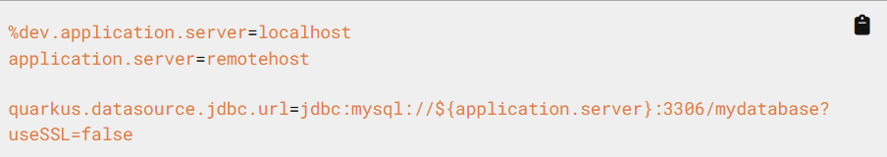
Quarkus Profiles - Definition
We often need to configure our application differently depending on the target environment. For example, the local development environment may be different from the production environment.
Configuration Profiles allow for multiple configurations in the same file or separate files and select between them via a profile name.

Slide 9
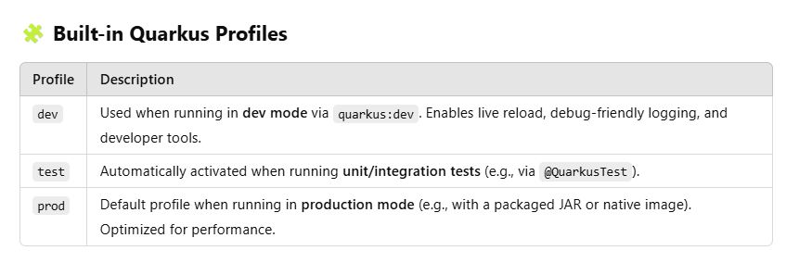
Quarkus Profiles
Example Property Files:
application.properties
application-dev.properties
application-test.properties
application-prod.properties
java -Dquarkus.profile=staging -jar target/app-runner.jar

Slide 10
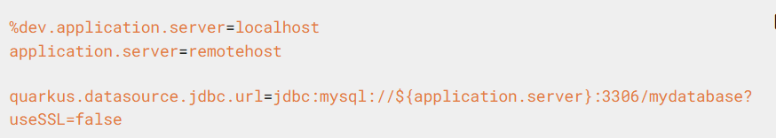
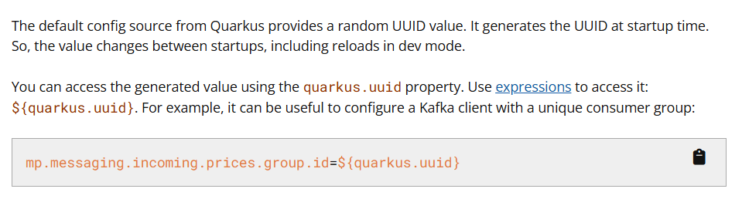
Quarkus Profile Config Variables

Slide 11
Quarkus Profiles
✅
Override config for specific tests
Simulate different environments (dev, staging, etc.)
Enable/disable beans with @IfBuildProfile, @IfBuildProperty
Use different databases or mock services per profile
Avoid cross-test pollution by keeping test setups isolated

Slide 12
Quarkus Test – Endpoint with RestAssured
@QuarkusTest initialisiert den gesamten Quarkus Server so weit benötigt
@TestHTTPEndpoint Annotation setzt alle test roots auf die Base URL der ExampleResource „/hello“
@QuarkusTest @TestHTTPEndpoint(ExampleResource.class) public class ExampleResourceTest { @Test public void testHelloEndpoint() { given() .when() //.get("/hello") .get() .then() .statusCode(200) .body(is(notNullValue())); //.body(is("Hello RESTEasy")); } }

Slide 13

Rest Assured – Test Library
Open Source Library
DSL – Domain Specific Language for
Testing Rest Services – Restful APIS
Invokes APIs
Enables to simply test the Results
Includes JsonPath and XmlPath
Rest Assured Extension to Quarkus is available and integrated
https://rest-assured.io/
https://github.com/rest-assured/rest-assured/wiki/Usage

Slide 14
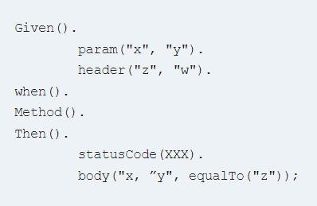
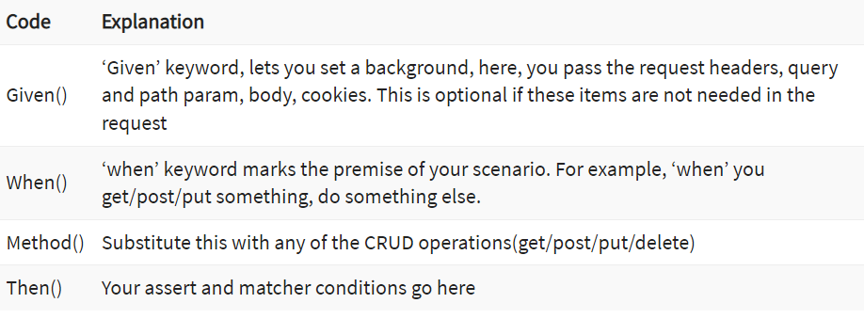
RestAssured Grundlagen

Slide 15
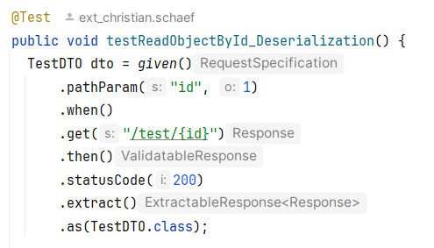
Quarkus Test – Testing Object Results
Extract Response Body und Deserialisierung in DTO zur Validierung
@QuarkusTest class ChatMessageResourceTest { @Test @Disabled public void readChatMessage() { ResponseBody body = given() .when().get("/chatMessageResource/chatMessage/10") .then().extract().response().body(); ChatMessageDTO dto = body.as(ChatMessageDTO.class); assertNotNull(dto); }

Slide 16
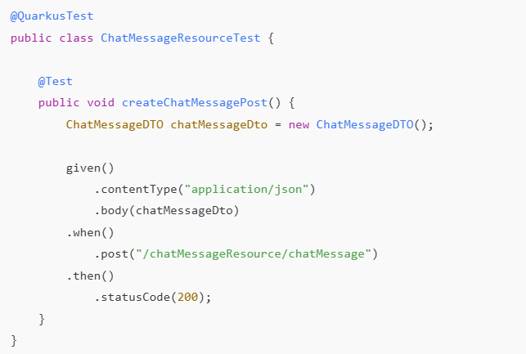
Rest Assured – POST Object
Clean and Fluent Syntax: Uses RestAssured's fluent API for improved readability and simplicity.
Integrated Assertions: Response validation is embedded directly using .then().statusCode(...).
Minimal Boilerplate: Eliminates extra variables for a more concise and maintainable test.

Slide 17
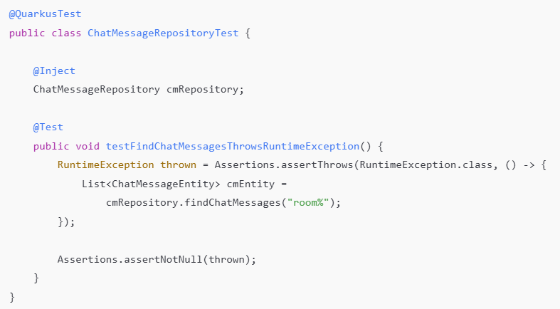
Quarkus Test – Asserting Excepions (JUnit 5)
Assertions.assertThrows
Purpose: Verifies that a specific block of code throws an expected exception.
It will catch the exception
Usage: Ensures your code fails as expected under certain conditions (e.g., invalid input).
Returns: The thrown exception, allowing further assertions (like checking the message).

Slide 18
QuarkusComponentTest (since Quarkus 3.4+)
A lighter-weight alternative meant for isolated component testing.
It avoids starting the full application context and allows you to focus on testing just the component(s) you specify, with fine-grained control over what gets injected and initialized.
It's faster and more focused than @QuarkusTest.

Slide 19
QuarkusComponentTest - Usage
in practice:
✅ Use @QuarkusTest for
testing repositories, persistence logic, transactions, or anything involving a real database.
✅ Use @QuarkusComponentTest for
fast tests of single beans or small groups of components, where you want to avoid the overhead of booting the full app.

Slide 20
Test Component maven dependency
<dependency>
<groupId>io.quarkus</groupId>
<artifactId>quarkus-test-component</artifactId>
<scope>test</scope>
</dependency> <dependency>
<groupId>io.quarkus</groupId>
<artifactId>quarkus-junit5-mockito</artifactId>
<scope>test</scope>
</dependency>
You need to add the quarkus-test-component dependency:

Slide 21

What is @InjectMock?
- Provided by Quarkus (quarkus-junit5-mockito)
- Automatically creates a Mockito mock
- Replaces the real CDI bean in the test context
- Works with @QuarkusTest and @QuarkusComponentTest

Slide 22
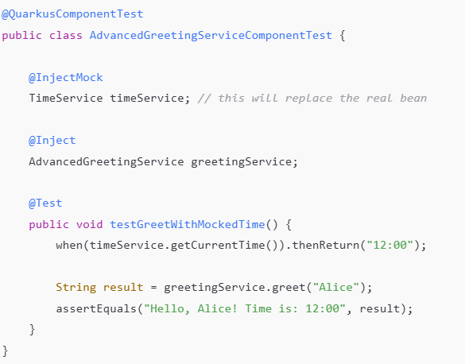
Quarkus Test – Inject Mock support
This setup allows us to:
Test the bean in isolation
Replace real dependencies (TimeService) with mocks
Run fast and focused tests
without starting the full Quarkus runtime

Slide 23
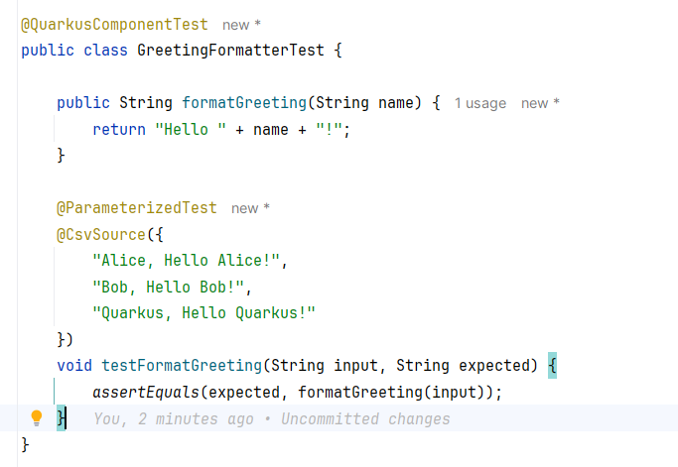
Junit 5 – Parameterized Test
@ParameterizedTest tells JUnit to run the test multiple times, each with a different set of parameters.
@CsvSource provides those values (comma-separated).
This avoids repetitive test methods for different inputs and improves readability.

Slide 24
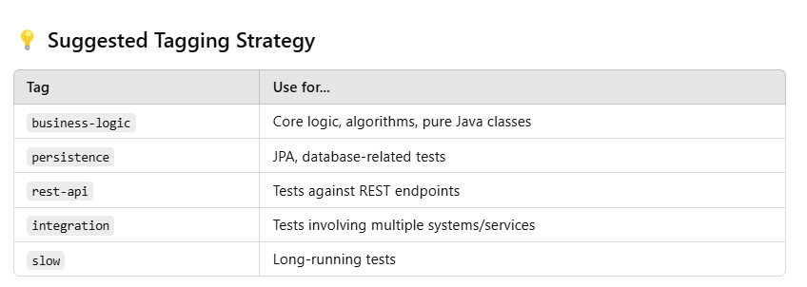
Junit 5 - Tagging
@Tag("business-logic“)
@Tag("retry")
public class RetryServiceTest {
mvn test -DincludeTags=business-logic

Slide 25
Quarkus Test – Link Collection
https://quarkus.io/guides/getting-started-testing
https://rest-assured.io/
https://github.com/rest-assured/rest-assured/wiki/Usage

Slide 26
Danke für Ihre Aufmerksamkeit

