Slide 1





Microservices
Definition, Standards and Patterns
Java Dev-Ops Cloud Training
V 1.0.2

Slide 2
Inhalt
MicroServices Definitions
MicroServices Design Patterns
Micro Profile
Jakarta RESTful Web Services
CDI
SmallRye Implemenation

Slide 3
Microservice Definition
is an architectural style that structures an application as a collection of services that are
Independently deployable
Loosely coupled
Organized around business capabilities
Owned by a small team
Highly maintainable and testable
The phrase “Micro-Web-Services” was first used conference by Dr. Peter Rodgers in 2005.
https://en.wikipedia.org/wiki/Microservices
https://microservices.io/patterns/microservices.html

Slide 4
Microservices – Definiton 2
Microservices are small autonomous services that work togehter
https://samnewman.io/talks/principles-of-microservices/

Slide 5
Microservices – Definiton 3
Is a concept to develop an application as a suite of multiple small services,
each running on ist own process and
Communicate with lightweight mechanisms
See also:
https://martinfowler.com/articles/microservices.html#CharacteristicsOfAMicroserviceArchitecture

Slide 6
Microservices - Advantages
A Set up standardizes practices
Increase speed of development and deployment
Enables easy scaling
Are technology agnostic

Slide 7
Microservices – Design Patterns
Defines and exposes APIs via synchronous or asynchronous Messages
Mostly Rest Services (see REST-Services Slides and definitons)
Operations
Flexible Configuration Management
(Central) Monitoring – and Service Metrics
Service Availability and Network failure handling
Security
Mostly via Access Tokens
E.g. Json-Web-Token

Slide 8
Micro-Profile – Defininition
Enterprise Java for a microservice architecture
Implements microservice design patterns
Standardized via Eclipse Foundation
Open Source
https://microprofile.io/

Slide 9
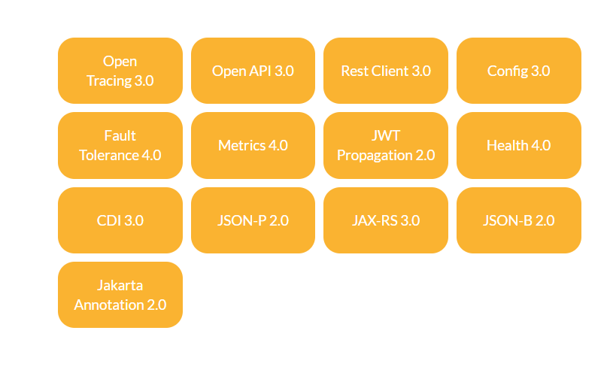
MicroProfile 5.0 - Specification
The MicroProfile 6.0 is based on Jakarta EE 10 Core Profile, which also enables MicroProfile APIs to be used together with the full set of Jakarta EE 10 specifications.

Slide 10
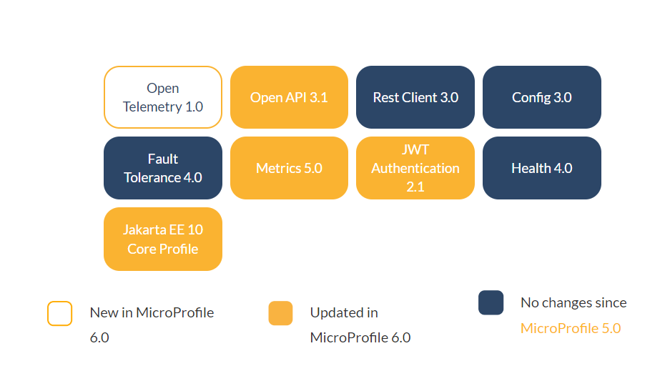
MicroProfile – Specification – Profile v 6.0
https://microprofile.io/2023/01/10/microprofile-6-0-release/
https://microprofile.io/

Slide 11








Current MicroProfile Implementations

Slide 12
MicroProfile - Jakarta RESTful Web Services
The specification defines a set of Java APIs for the development of Web services built according to the Representational State Transfer[1] (REST) architectural style.
Pojo Based
HTTP Centric
Format Independent
Container Independent
Inclusion in Jakarta EE

Slide 13
MicroProfile - CDI Specification
Provides the CDI Specification included in the Micro Profile Specificiation
Specification for automatic lifecycle Managment for Beans including injection and IoC.
https://jakarta.ee/specifications/cdi/3.0/jakarta-cdi-spec-3.0.html

Slide 14
MicroProfile – ImplementationSmallRye.io
MicroProfile Implementation
Included in:
Quarkus
Wildfly
Open-Liberty
(https://smallrye.io)

Slide 15
Documentation Links
Microservices Defintions
https://en.wikipedia.org/wiki/Microservices
https://microservices.io/patterns/microservices.html
https://martinfowler.com/articles/microservices.html#CharacteristicsOfAMicroserviceArchitecture
https://samnewman.io/talks/principles-of-microservices/
Micro Profiles
https://microprofile.io/
https://jakarta.ee/specifications/restful-ws/3.0/jakarta-restful-ws-spec-3.0.html
https://jakarta.ee/specifications/cdi/3.0/jakarta-cdi-spec-3.0.html

Slide 16
Danke für Ihre Aufmerksamkeit

