Slide 1

Quarkus Logging
JEE Microservices
@ CGS IT – 2025
Version 1.0.5

Slide 2
Inhalt
Quarkus – Supported Logging APIS
Quarkus/Jboss – Log Levels
Quarkus - Runtime configuration
Quarkus - Log Handlers
Quarkus – Dokumentation Links

Slide 3

Quarkus – Supported Logging APIS
JBoss Logging
JDK java.util.logging (also called JUL)
SLF4J
Apache Commons Logging
Internally Quarkus uses JBoss Logging; you can also use it inside your application so that no other dependencies should be added for your logs.

Slide 4
Quarkus/Jboss – Log Levels
OFF | Special level to turn off logging.
FATAL | A critical service failure/complete inability to service requests of any kind.
ERROR | A significant disruption in a request or the inability to service a request.
WARN | A non-critical service error or problem that may not require immediate correction.
INFO | Service lifecycle events or important related very-low-frequency information.
DEBUG | Messages that convey extra information regarding lifecycle or non-request-bound events which may be helpful for debugging.
TRACE | Messages that convey extra per-request debugging information that may be very high frequency.
ALL | Special level for all messages including custom levels.

Slide 5
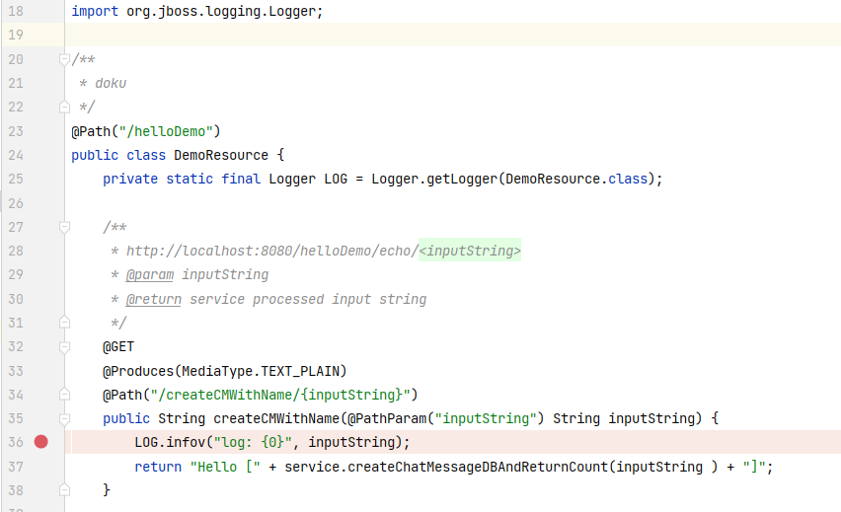
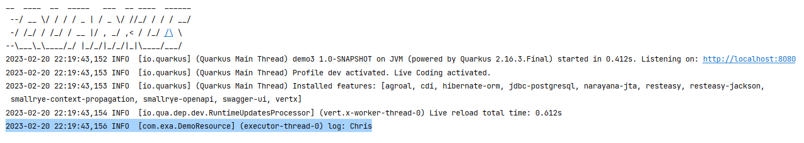
Logging Example
Jboss logger
LOG.infov Message Format

Slide 6
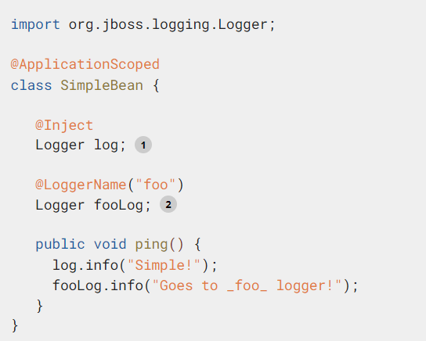
Injecting a Logger
You can also inject a configured org.jboss.logging.Logger instance in your beans and resource classes.
1. The FQCN of the declaring class is used as a logger name, will be used. org.jboss.logging.Logger.getLogger(SimpleBean.class)
2. In this case, the name foo is used as a logger name, i.e. org.jboss.logging.Logger.getLogger("foo") will be used.

Slide 7
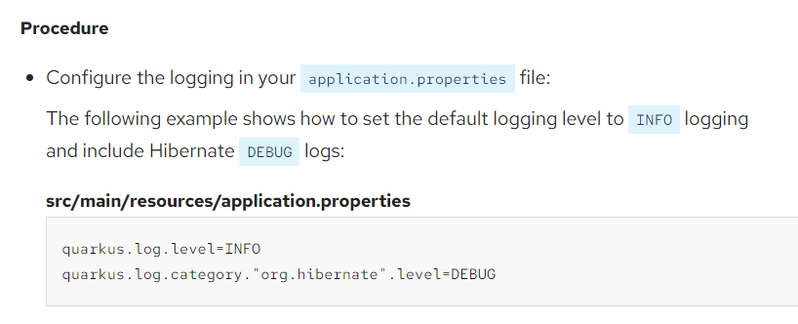
Quarkus - Runtime configuration
Quarkus Logging Configuration Reference:
https://quarkus.io/guides/logging#loggingConfigurationReference

Slide 8
Quarkus - Log Handlers
The console log handler is enabled by default. It outputs all log events to the console of your application (typically to the system’s stdout).
For details of its configuration options, see the Console Logging configuration reference.
quarkus.log.file.enable=true # Send output to a trace.log file under the /tmp directory quarkus.log.file.path=quarkus-log.log
quarkus.log.file.level=debug
quarkus.log.file.format=%d{HH:mm:ss} %-5p [%c{2.}] (%t) %s%e%n

Slide 9
Quarkus – Dokumentation Links
Quarkus Logging
https://quarkus.io/guides/logging
Jboss Logging https://docs.jboss.org/seam/3/latest/reference/en-US/html/solder-logging.html

Slide 10
Danke für Ihre Aufmerksamkeit

