Slide 1

JEE Microservices Configuration
JEE Microservices
@ CGS IT – 2023
Version 1.0.5

Slide 2
Inhalt
Quarkus Konfigurations Hierarchie
Quarkus Config Property Verwendung und Inject
System Properties
IntelliJ Run Configuration

Slide 3
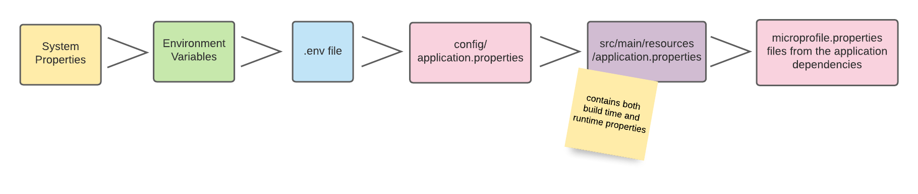
Quarkus Config – Quellen und Hierarchie

Slide 4
Quarkus Config – Quellen und Hierarchie
By default, Quarkus reads configuration properties from multiple sources:
(400) System properties
(300) Environment variables
(295) .env file in the current working directory
(260) Quarkus Application configuration file in $PWD/config/application.properties
(250) Quarkus Application configuration file application.properties in classpath
(100) MicroProfile Config configuration file META-INF/microprofile-config.properties in classpath
https://quarkus.io/guides/config-reference

Slide 5
Use Config Property Example
@Path("/helloMicroDemo") public class DemoMicroResource { private static final Logger LOG = Logger.getLogger(DemoMicroResource.class); @ConfigProperty(name = "greeting.message", defaultValue = "default-value") String message; @GET @Path("/showMessage") @Produces(MediaType.TEXT_PLAIN) public String showMessage() { LOG.infov( "INFO :: showMessage {0}", message); try { return "Hello: " + message; } catch (RuntimeException ex ) { LOG.error("fehler beim message lesen ", ex); } return ""; }

Slide 6
Config Property in Configuration File
# Das ist mein erstes Property greeting.message="greeting configuration new" # logging configuration quarkus.log.console.format=TEE: %d{HH:mm:ss} %-5p [%c{2.}] (%t) %s%e%n quarkus.log.console.level=INFO quarkus.log.level=DEBUG
Use:
${project rood}/config/application.property file for external property file

Slide 7
Programatischer Zugriff auf die Configuration
String databaseName = ConfigProvider.getConfig().getValue("database.name", String.class);
Optional<String> maybeDatabaseName = ConfigProvider.getConfig().getOptionalValue("database.name", String.class);

Slide 8
Externes File

Slide 9
System Properties - Example
System properties can be handed to the application through the -D flag during startup. The following examples assign the value youshallnotpass to the attribute quarkus.datasource.password.
For Quarkus dev mode: ./mvnw quarkus:dev -Dquarkus.datasource.password=youshallnotpass
For a runner jar: java -Dquarkus.datasource.password=youshallnotpass -jar target/quarkus-app/quarkus-run.jar
For a native executable: ./target/myapp-runner -Dquarkus.datasource.password=youshallnotpass

Slide 10
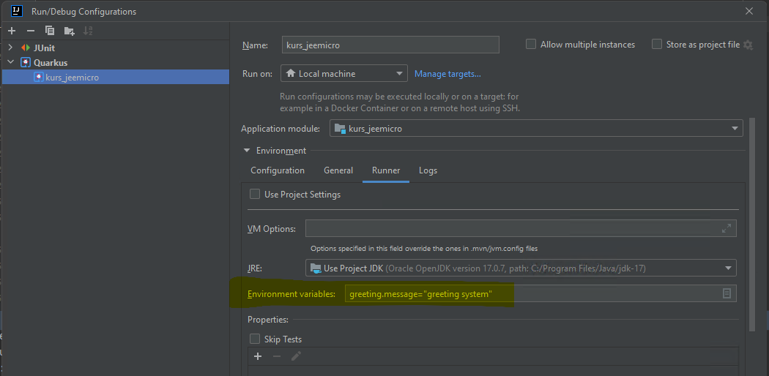
System Variable in IntellIJ

Slide 11
Danke für Ihre Aufmerksamkeit

