Slide 1

Java Rest Services
JEE Microservices
@ CGS IT – 2023
Version 1.0.5

Slide 2
Inhalt
Rest Standards
Rest Methoden
JaxRs Library
Java Beispiele
Erweiterte Dokumentation
Dokumentations Links

Slide 3
REST : Definition [Wikipedia]
A REST API is an application programming interface (API) that uses a representational state transfer (REST) architectural style. The REST architectural style uses HTTP to request access and use data. This allows for interaction with RESTful web services.
Representational State Transfer
A style of software architecture for distributed hypermedia systems such as the World Wide Web.
was introduced and defined in 2000 by Roy Fielding in his doctoral dissertation.
Conforming to the REST constraints is referred to as being ‘RESTful’.

Slide 4
Rest is
An architectural style, not technology
Client/server + Request/response approach.
Everything is a RESOURCE.
CRUD (Create / Read / Update / Delete)
Stateless by nature (excellent for distributed systems)
Cacheable (naturally supported)
A great way to web-service

Slide 5
Rest Methods
Method | Description
GET | Retrieve information about the REST API resource
POST | Create a REST API resource
PUT | Update a REST API resource
DELETE | Delete a REST API resource or related component

Slide 6
Rest API URL Design
Method
GET | /tickets | Retrieves a list of tickets
GET | /tickets/12 | Retrieves a specific ticket
POST | /tickets | Creates a new ticket
PUT | /tickets/12 | Updates ticket #12
DELETE | /tickets/12 | Deletes ticket #12

Slide 7
Jax-RS Rest Services

Slide 8
Jax-RS Definition - Wikipedia
Bei den Jakarta RESTful Web Services (JAX-RS; handelt es sich um die Spezifikation einer Programmierschnittstelle (API) der Programmiersprache Java,
die die Verwendung des Software-Architekturstils Representational State Transfer (REST) im Rahmen von Webservices ermöglicht und vereinheitlicht.
Die in der Spezifikation beschriebenen Funktionalitäten wurden vom Java Community Process erarbeitet
und im Java Specification Request 311^{[1]} verabschiedet.
Wie auch andere Programmierschnittstellen der Jakarta EE (JEE) benutzt JAX-RS Annotationen, um die Entwicklung und das Deployment von Webservice-Clients und Service-Endpunkten zu vereinfachen.
https://de.wikipedia.org/wiki/Jakarta_RESTful_Web_Services

Slide 9

JAX-RS (JSR-311) : Goals
POJO-based
HTTP-centric
Format independent
Container independent
Availability as standalone and enterprise platforms

Slide 10
Jaxrs - Resteasy
RESTEasy is a JBoss / Red Hat project that provides various frameworks to help you build RESTful Web Services and RESTful Java applications.
It is an implementation of the Jakarta RESTful Web Services, an Eclipse Foundation specification that provides a Java API for RESTful Web Services over the HTTP protocol.
Moreover, RESTEasy also implements the MicroProfile REST Client specification API.
RESTEasy can run in any Servlet container, WildFly Application Server and Quarkus is also available to make the user experience nicer in those environments.
https://resteasy.dev/

Slide 11
Jaxrs & Resteasy Documentation
https://jcp.org/en/jsr/detail?id=311
https://docs.jboss.org/resteasy/docs/6.2.2.Final/userguide/html_single/index.html
Cheat Sheet für Resteasy Annotations
https://www.mastertheboss.com/jboss-frameworks/resteasy/jax-rs-cheatsheet/

Slide 12
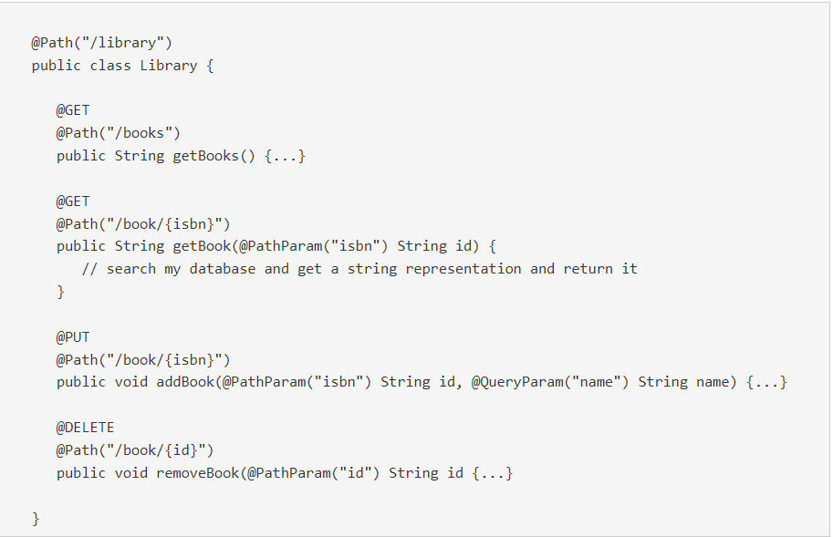
Using @Path and @GET, @POST, etc.
RESTEasy servlet is configured and reachable
at a root path of http://myhost.com/services.
The requests handled by class, Library, are:
GET http://myhost.com/services/library/books
GET http://myhost.com/services/library/book/333
PUT http://myhost.com/services/library/book/333
DELETE http://myhost.com/services/library/book/333
https://docs.jboss.org/resteasy/docs/6.2.2.Final/userguide/html_single/index.html#Using_Path

Slide 13
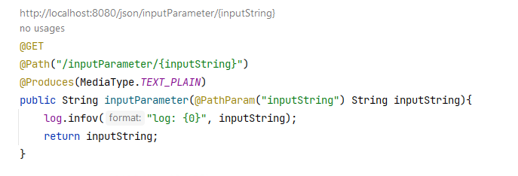
@PathParam
@Path("/parameter") public class ParameterResource { }

Slide 14
Lösung1
@Path("/parameter") public class ParameterResource { @Inject Logger log; @GET @Path("/") @Produces(MediaType.TEXT_PLAIN) public String basePath(){ log.infov("basePath"); return "basePath"; } @GET @Path("/inputParameter/{inputString}") @Produces(MediaType.TEXT_PLAIN) public String inputParameter( @PathParam("inputString") String inputString){ log.infov("log: {0}", inputString); StringBuilder sbStr = new StringBuilder(); sbStr.append(inputString).reverse(); return sbStr.toString(); }

Slide 15
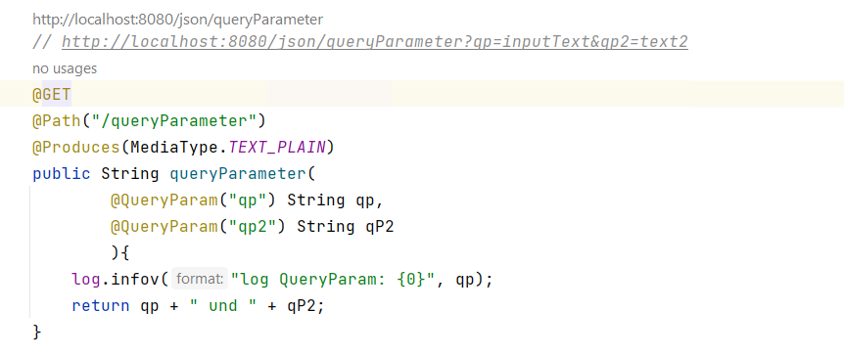
@QueryParam
@Path("/parameter") public class ParameterResource { }

Slide 16
Query Parameter – 2
Query Parameter als Long :
public String queryParameter(
@QueryParam("qp") String qp, @QueryParam("qp2") Long qP2
Wenn ein Parameter nicht übergeben wird ist is „null“
Wenn ein Input Parameter nicht konvertiert werden kann, wird kein Fehler geworfen, sondern die Methode nicht gefunden.
Test: String input für qP2 sollte die Methode nicht finden

Slide 17
Default Werte für Query Parameter
@GET @Path("/queryParameter") @Produces(MediaType.TEXT_PLAIN) public String queryParameter( @QueryParam("qp") String qp, @DefaultValue(„5") @QueryParam("qp2") Long qP2 ){ log.infov("log QueryParam: {0}", qp); return "query params ["+ qp + "] und [" + qP2 + "]"; }

Slide 18
Spezial Informationen
@GET @Path("header") public String checkBrowser(@HeaderParam("User-Agent") String whichBrowser) { return "Browser is "+whichBrowser; } // Reading REST Parameters Programmatically // z.b. http://localhost:8080/json/context?username=chris @GET @Path("context") public Response login(@Context UriInfo info) { String id = info.getQueryParameters().getFirst("username"); return Response .status(200) .entity("login called with id: " + id) .build(); }

Slide 19
Try and Test APIs
OpenAPI / Swagger dependency erlaubt das einfache testen direkt via Browser unter:
http://localhost:8080/q/swagger-ui/
<!-- add openapi swagger support --> <dependency> <groupId>io.quarkus</groupId> <artifactId>quarkus-smallrye-openapi</artifactId> </dependency>

Slide 20
Form Param & @Form
@Form is a RESTEasy specific annotation that allows the re-use of any @*Param annotation within an injected class.
RESTEasy will instantiate the class and inject values into any annotated @*Param or @Context property.
This is useful when there are a lot of parameters on a method and it is wanted to condense them into a value object.
Siehe:
https://docs.jboss.org/resteasy/docs/6.2.2.Final/userguide/html_single/index.html#Using_Path

Slide 21
Jakarta Content Negotiation
The HTTP protocol has built in content negotiation headers that allow the client and server to specify what content they are transferring and what content they would prefer to get. The server declares content preferences via the @Produces and @Consumes headers.

Slide 22
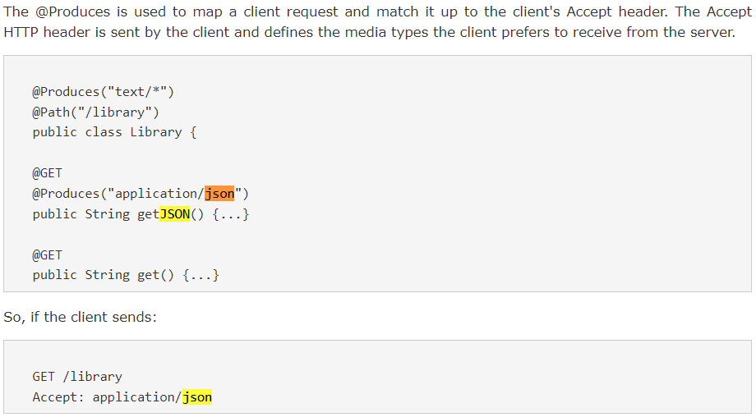
@Produces and @Consumes

Slide 23
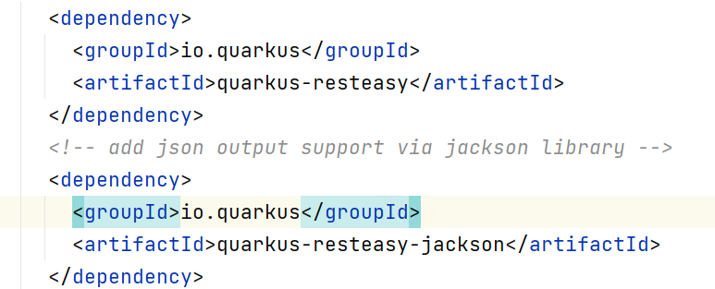
JSON Support via Jackson Project

Slide 24
Aufgabe 2:
@GET @Path("/") @Produces({MediaType.APPLICATION_JSON, MediaType.APPLICATION_XML}) public List<TestDTO> listAllObects(){ log.infov("objectOutput {0}", ""); TestDTO dto = new TestDTO(); dto.setName("name"); dto.setVorname("voranme"); TestDTO dto2 = new TestDTO(); dto.setName("name2"); dto.setVorname("voranme2"); List result = new ArrayList(); result.add(dto); result.add(dto2); return result; }
RestFull Compatible GET
READ /{id}
GET /testdto/11 -> liefert das objekt mit der ID 11
List All wenn keine ID angeben
GET /testdto → liefert alle Objekte
public List<TestDTO> listAllObects(){

Slide 25
Jaxrs Resteasy Advanced Features
CORS Support
Multipart Provider
Security
Zip Support
Exception Handlin
See Resteay User-Guide:
https://docs.jboss.org/resteasy/docs/6.2.2.Final/userguide/html_single/index.html#d5e2342

Slide 26
Json – Object Output
@Path("/json") public class JsonApiResource { @Inject Logger log; @GET @Path("/objectOutput") @Produces(MediaType.APPLICATION_JSON) public TestDTO objectOutput(){ log.infov("objectOutput {0}", ""); TestDTO dto = new TestDTO(); dto.setName("name"); dto.setVorname("voranme"); return dto; }
@Produces gibt an welches Output Format erzeugt wird.
localhost:8080/json/objectOutput

Slide 27
Json – Object Input
@Consumes(MediaType.APPLICATION_JSON)
Gibt an welches Object als Input übernommen werden soll
@PUT @Path("createTestMessage") @Produces(MediaType.APPLICATION_JSON) @Consumes(MediaType.APPLICATION_JSON) public TestDTO updateTestMessage(TestDTO input) { log.infov("got object : {0}", input.toString()); return input; }

Slide 28
Danke für Ihre Aufmerksamkeit

