Slide 1

Quarkus Grundlagen
Kurs Mitschrift 03/2025
2025

Slide 2
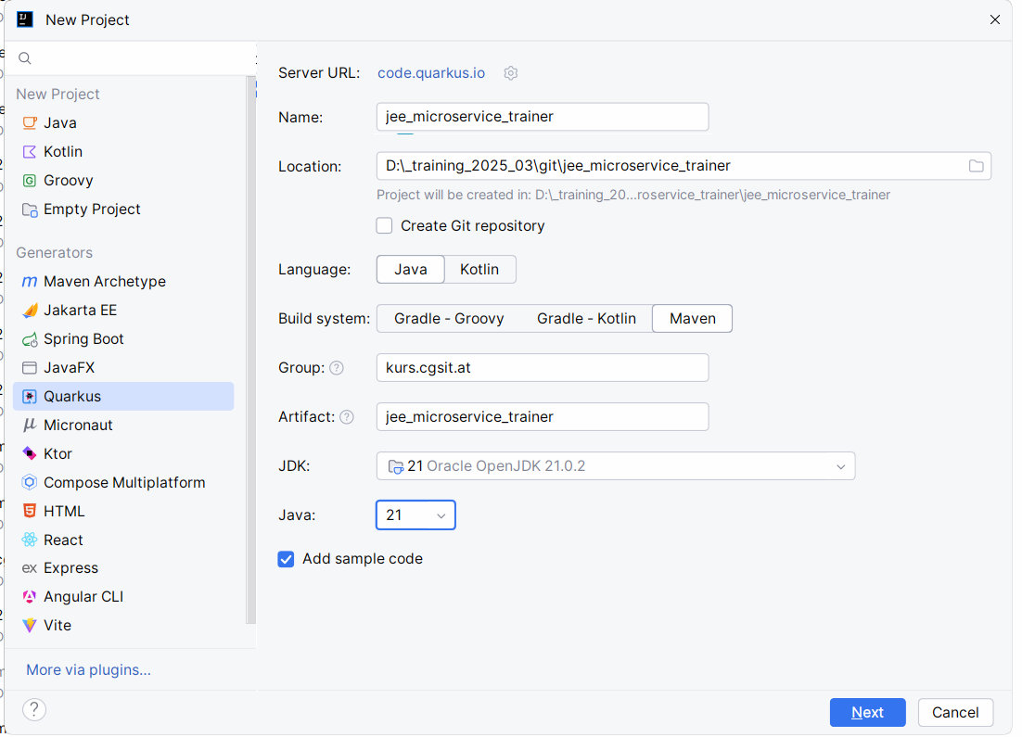

Slide 3
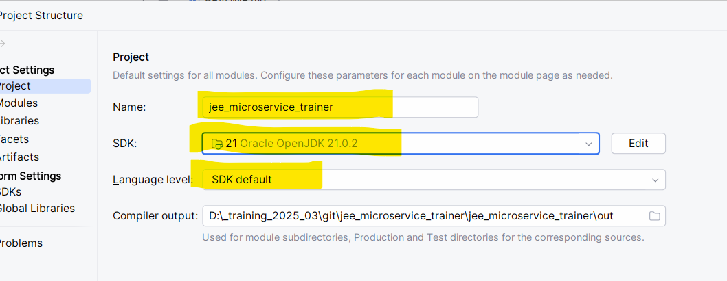

Slide 4
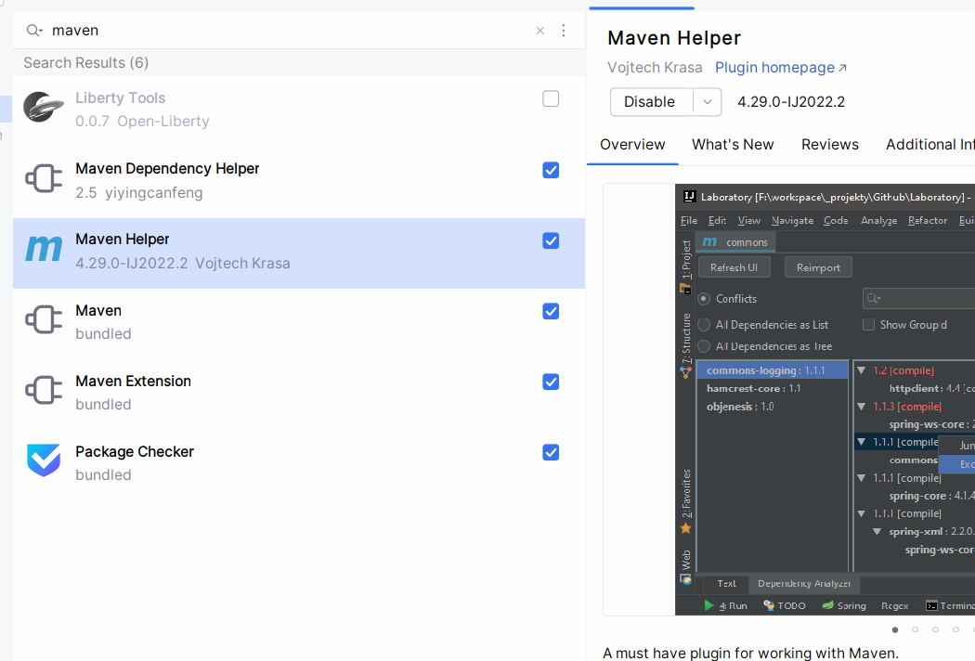

Slide 5
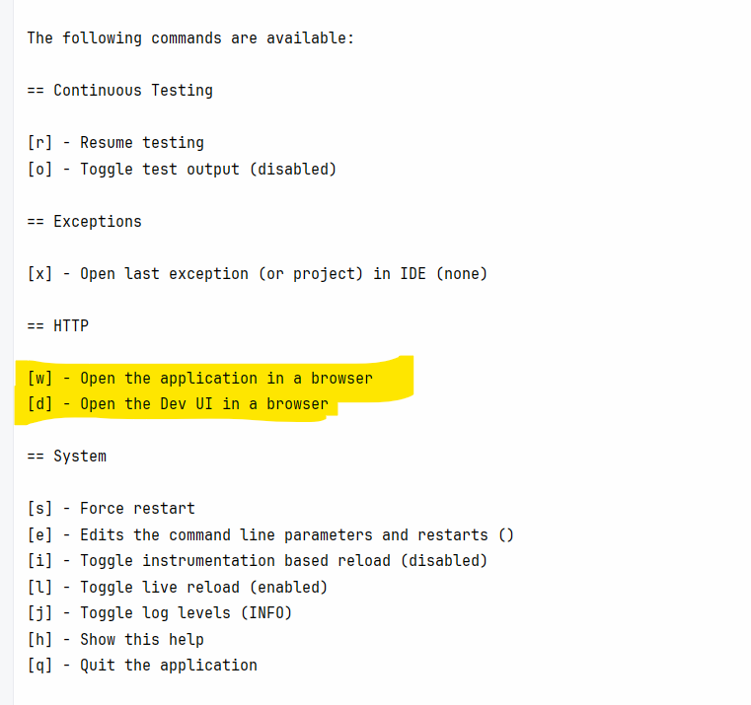

Slide 6
Mitschrift Tag 4

Slide 7
Wiederholung
Wiederholung
JPA - Parent Child System
Version Number System
Bidrectionale Verknüufpung parent child
Test
Test Component
Quarkus Test
JPA Test mit daten initialisierung
REST Assuired Test mit Object und POST methode
IT Test

Slide 8
PULL Beispiele --> Erweitert um CDI Examples https://github.com/CGS-IT/jee_microservices_training_2025

Slide 9
Inhalt
Quarkus – Voraussetzungen - Prerequsites
Maven Quickstart: Create by hand
Quarkus Quickstart: create via IntelliJ
Quickstart : launch new app
Quarkus – Generated Output
Quarkus Maven plugin
Start Quarkus App
Quarkus – Rest API
Add to git
Import into intelliJ
IntellJ Project
Maven Settings in IntelliJ
Intellij: Java Settings for Java Project
Run Quarkus from IntellJ maven
Quarkus Development Mode
IntelliJ - Quarkus – Attach Debugger
Quarkus - Testing

Slide 10
Quarkus – Voraussetzungen - Prerequsites
IDE: IntelliJ or Eclipse
JDK 11+ installed with JAVA_HOME configured appropriately
Apache Maven 3.8.1+

Slide 11
Maven Quickstart: Create by hand
mvn io.quarkus.platform:quarkus-maven-plugin:2.5.1.Final:create \
-DprojectGroupId=at.cgsit.train \
-DprojectArtifactId=quarkus-demo \
-DclassName="at.cgsit.train.quarkus.DemoResource" \
-Dpath="/helloDemo„
cd quarkus-demo

Slide 12
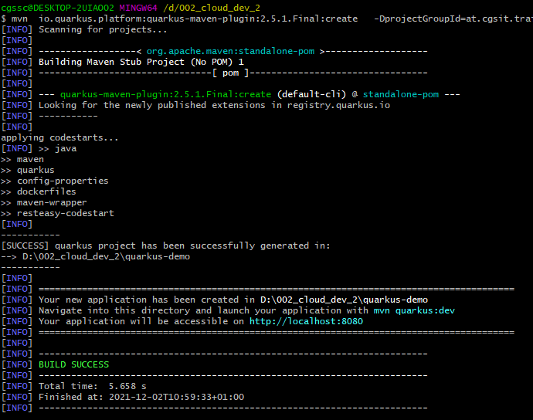
Build success

Slide 13
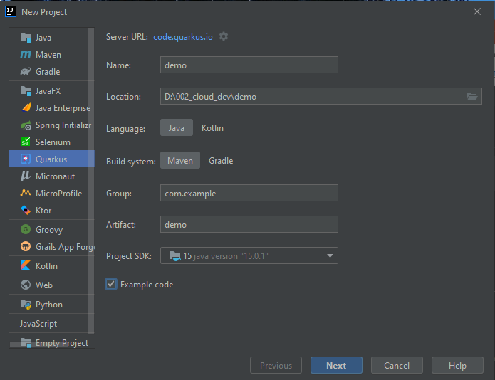
Quarkus Quickstart: create via IntelliJ

Slide 14
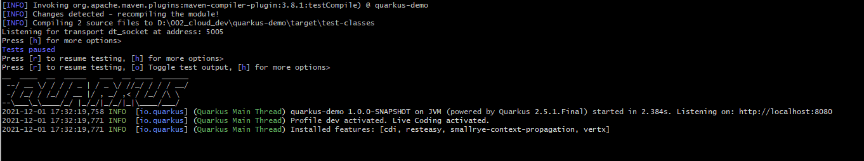
Quickstart : launch new app
cd quarkus-demo
mvn quarkus:dev
Browser: http://localhost:5005/

Slide 15
Quarkus – Generated Output
the Maven structure
an org.acme.getting.started.GreetingResource resource exposed on /hello
an associated unit test
a landing page that is accessible on http://localhost:8080 after starting the application
example Dockerfile files for both native and jvm modes in src/main/docker
the application configuration file

Slide 16
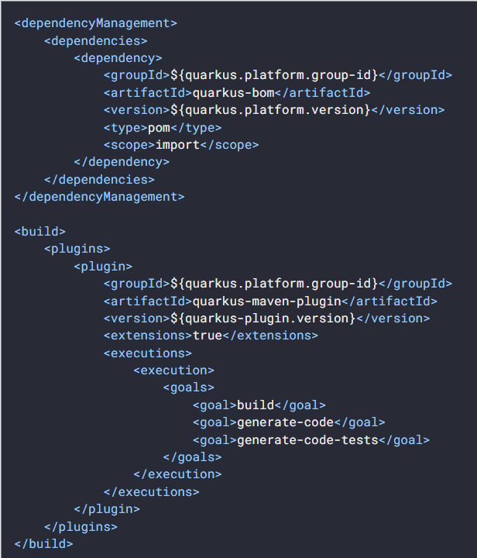
Quarkus Maven plugin
Quarkus BOM, allowing you to omit the version on the different Quarkus dependencies
quarkus-maven-plugin responsible of the packaging of the application and also providing the development mode

Slide 17
Start Quarkus App
Edit Rest Service
Auto-Deployment is done automatically
Open w and d in quarkus command line console
Or use
curl -w "\n" http://localhost:8080/helloDemo

Slide 18
Quarkus – Rest API
Differences with vanilla JAX-RS
With Quarkus, there is no need to create an Application class. It’s supported, but not required.
In addition, only one instance of the resource is created and not one per request.
You can configure this using the different
*Scoped annotations (ApplicationScoped, RequestScoped, etc).

Slide 19
Add to git
git init
git add –A
git commit -m "first commit"
git branch -M main
git remote add origin https://github.com/chrascher/quarkus_demo.git
git remote add origin https://github.com/<user>/quarkus_demo.git
git push -u origin main
git pull

Slide 20
Import into intelliJ
Open IntelliJ → Open Project
Choose directory: z.b. D:\002_cloud_dev\quarkus-demo
Open project
Conntect to github and provide password

Slide 21
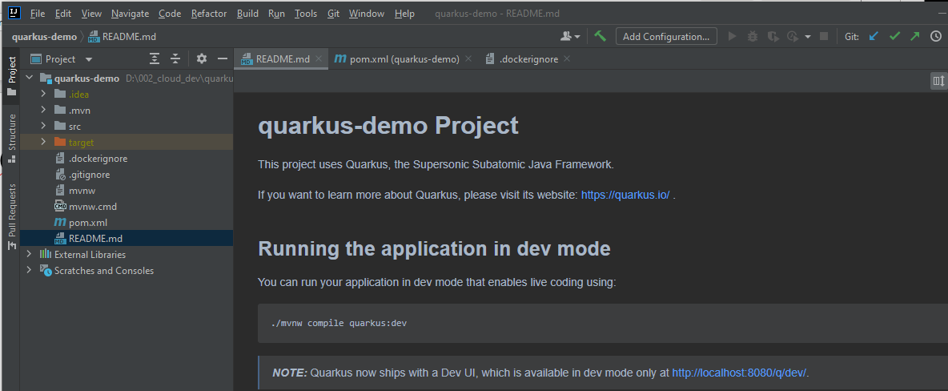
IntellJ Project

Slide 22
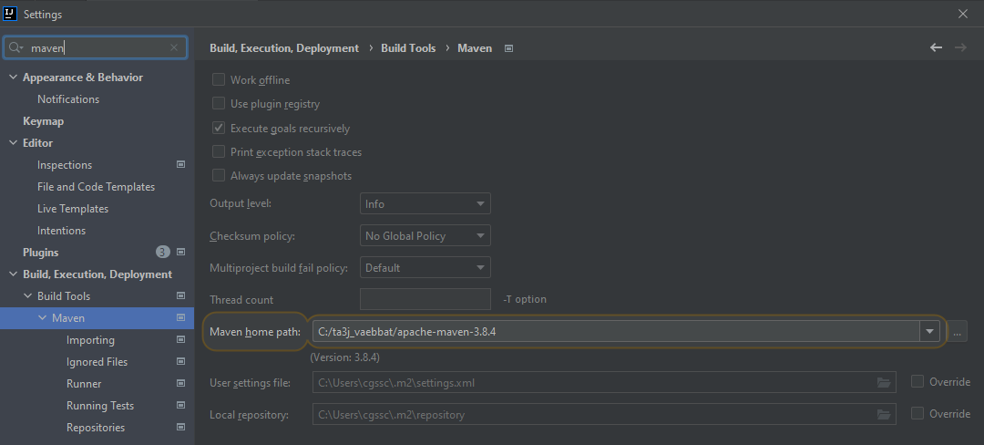
Maven Settings in IntelliJ

Slide 23
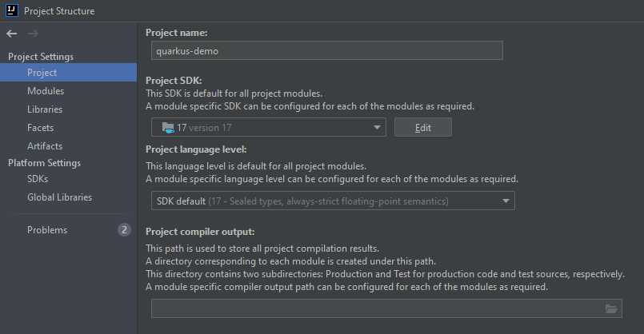
Intellij: Java Settings for Java Project

Slide 24
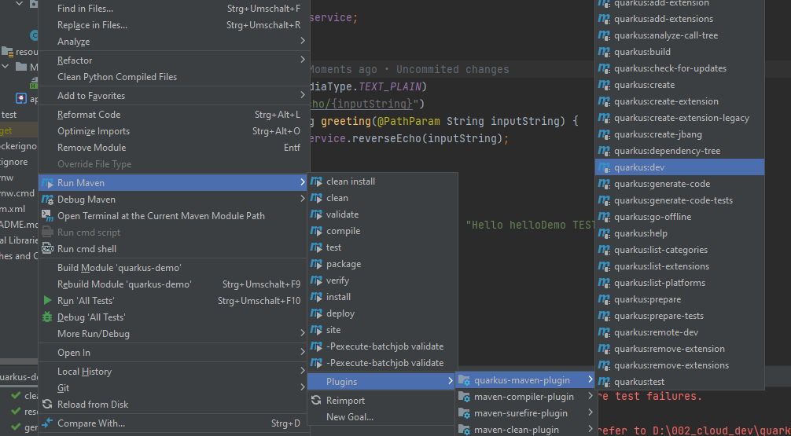
Run Quarkus from IntellJ maven
Mvn compile quarkus:dev

Slide 25
Quarkus Development Mode
quarkus:dev runs Quarkus in development mode
This enables hot deployment with background compilation
This works too for resource files like the configuration property file
Refreshing the browser triggers a scan of the workspace
This will also listen for a debugger on port 5005

Slide 26
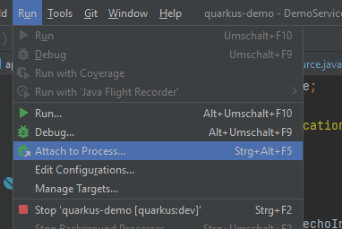
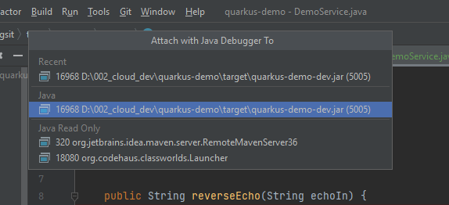
IntelliJ - Quarkus – Attach Debugger

Slide 27
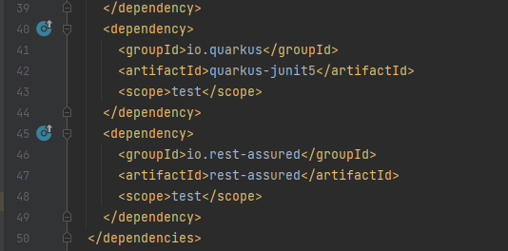
Quarkus - Testing
In the generated pom.xml file, you can see 2 test dependencies:

Slide 28
Danke für Ihre Aufmerksamkeit

