Slide 1

Quarkus Application Architecture and Patterns
JEE Microservices
@ CGS IT – 2025
Version 1.0.1

Slide 2
Content
Layering
Object Translation
Producer over multiple injections

Slide 3
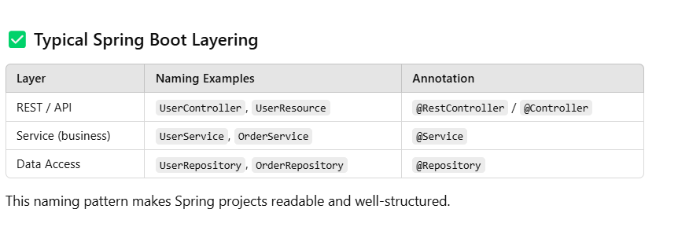
Layer Architecture and Naming Conventions

Slide 4
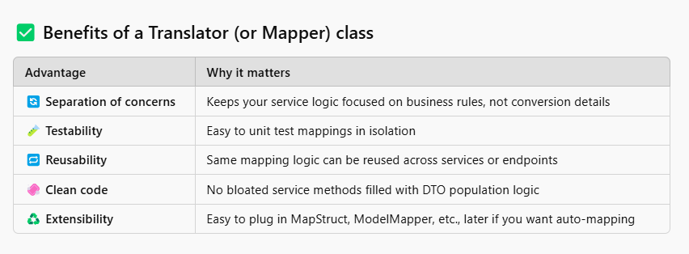
Object Translators

Slide 5
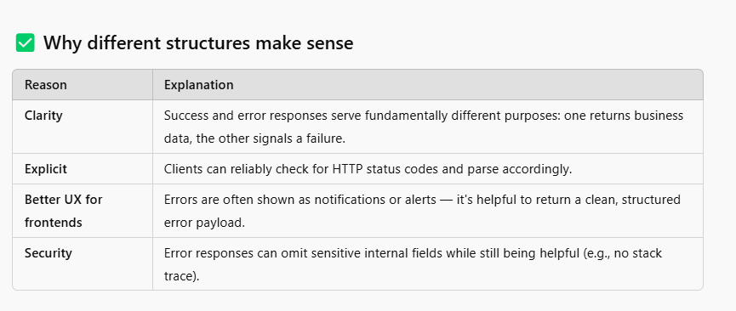
Should Exception Handler return common response object?
Separating error response from business Response can make sense

