Slide 1

Java Quarkus Metrics and Health
JEE Microservices
@ CGS IT – 2025
Version 1.0.7

Slide 2
Inhalt
Übersicht
Metrics and Health
Quarkus Metrics Features
Source Code Example
Quarkus Health

Slide 3

Quarkus – Health and Metrics
Quarks includes Microprofile health
https://quarkus.io/guides/smallrye-health
and Metrics as Microprofile Standards
https://quarkus.io/guides/smallrye-metrics
This enables health and metrics checks easyly for the Mircro Service
Annotations are provided for easy usage
Metrics and Health are available via URL:
http://localhost:8080/q/metrics
http://localhost:8080/q/metrics

Slide 4
Quarkus - SmallRye Metrics and Health
Add the Quarkus Metrics extension to start with metrics
Add health extension to use health
Annotate your Rest API services
See extension page for configuration options
<dependency>
<groupId>io.quarkus</groupId>
<artifactId>quarkus-smallrye-metrics</artifactId>
</dependency>
<dependency>
<groupId>io.quarkus</groupId>
<artifactId>quarkus-smallrye-health</artifactId>
</dependency>

Slide 5
Quarkus – Metrics Features
Annotation-based metrics:
@Counted:
counts how many times a method is invoked
@Timed:
measures how long the method takes
@Gauge:
exposes a current value (e.g., memory usage)
@Metered:
tracks the rate of events

Slide 6
Metrics Example
@Path("/metricsResource") public class MetricsResouce { @Inject Logger LOG; @GET @Path("/chatMessage") @Produces(MediaType.APPLICATION_JSON) @Counted(name = "chatMessageFindAllCount", description = "How many primality checks have been performed.") @Timed(name = "chatMessageFindAllTimer", description = "A measure of how long it takes to perform the primality test.", unit = MetricUnits.MILLISECONDS) public List<ChatMessageDTO> chatMessageFindAll() { LOG.info("info chatMessage "); List<ChatMessageDTO> result = new ArrayList<>(); return result; }
Use @Counted for simple count of calls to this api
Use @Timed to get a standard Timing Framework interceptor to this api path
localhost:8080/q/metrics/application

Slide 7
Quarkus - Health

Slide 8
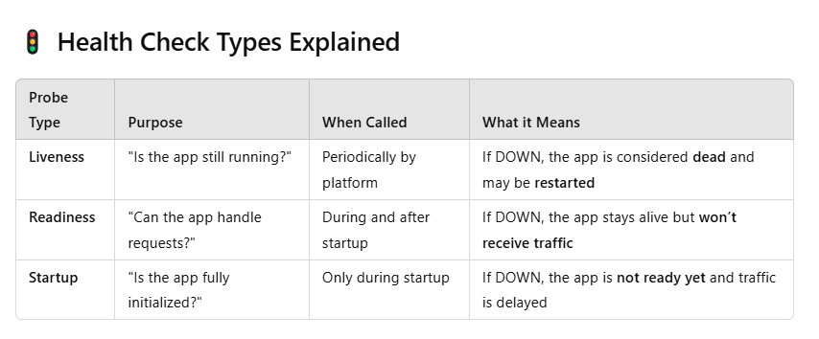
Quarkus Health

Slide 9
Quarkus - Health
If health is enabled the checks are exposed via q/health api:
http://localhost:8080/q/health/live
All health REST endpoints return a simple JSON object with two fields:
status — the overall result of all the health check procedures
checks — an array of individual checks
The general status of the health check is computed as a logical AND of all the declared health check procedures.
The checks array is empty as we have not specified any health check procedure yet so let’s define some.

Slide 10
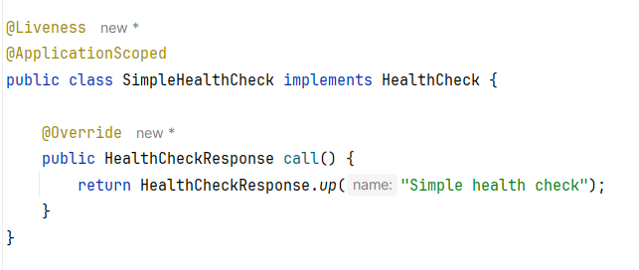
Simple Health Check for Live and Readiness
Use @Liveness
@Readiness for readiness probes

Slide 11
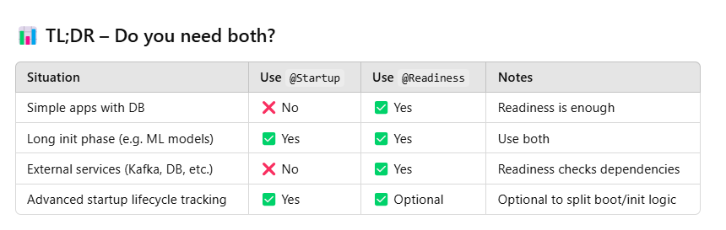
Readiness and or Startup

Slide 12
Quarkus - Management interface
By default, the health checks are exposed on the main HTTP server.
You can expose them on a separate network interface and port by setting
quarkus.management.enabled=true in your application configuration.
Note that this property is a build-time property. The value cannot be overridden at runtime.
For more details see:
https://quarkus.io/guides/smallrye-health#management-interface

Slide 13
Danke für Ihre Aufmerksamkeit

