Slide 1

Java Rest Services OpenAPI Swagger
JEE Microservices
@ CGS IT – 2025
Version 1.0.5

Slide 2
Inhalt
Rest Standards
OpenAPI Spezifikation
Open API Document Structure
Open API Elements
Open API Examples
Open API Query and Path Parameters

Slide 3
Editor
https://editor.swagger.io/
https://editor-next.swagger.io/
Download
https://swagger.io/tools/swagger-editor/download/

Slide 4
Open API - Spezifikation
The OpenAPI Specification (OAS) defines a standard, language-agnostic interface to RESTful APIs which allows both humans and computers to discover and understand the capabilities of the service without access to source code, documentation, or through network traffic inspection.
When properly defined, a consumer can understand and interact with the remote service with a minimal amount of implementation logic.
An OpenAPI definition can then be used by documentation generation tools to display the API,
Code generation tools to generate servers and clients in various programming languages, testing tools, and many other use cases.

Slide 5
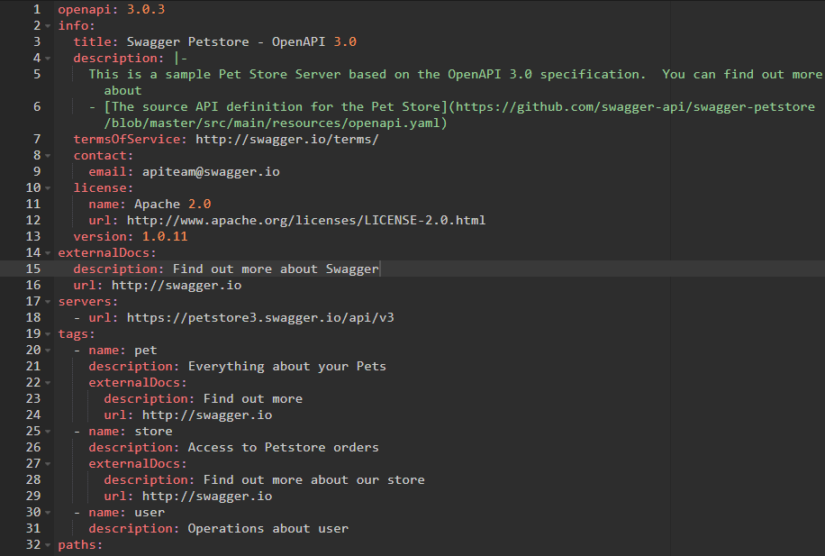
Open API – Document Structure
OpenAPI : versions info
Info Sektion für generelle Infos

Slide 6
Info Annotations
@OpenAPIDefinition( tags = { @Tag(name = "widget", description = "Widget operations."), @Tag(name = "gasket", description = "Operations related to gaskets") }, info = @Info( title = "Chat Message Example API", version = "1.0.1", contact = @Contact( name = "Chat Message Example API Support", url = "http://exampleurl.com/contact", email = "techsupport@example.com"), license = @License( name = "Apache 2.0", url = "https://www.apache.org/licenses/LICENSE-2.0.html")) ) public class ChatApplication extends Application { }

Slide 7
Open API
Field Name | Type | Description
openapi | string | REQUIRED. This string MUST be the semantic version number of the OpenAPI
info | Info Object | REQUIRED. Provides metadata about the API. The metadata MAY be used by tooling as required.
Servers | [Server Object] | An array of Server Objects, which provide connectivity information to a target server. If the servers property is not provided, or is an empty array, the default value would be a Server Object with a url value of /.
Paths | Paths Object | REQUIRED. The available paths and operations for the API.
Components | Components Object | An element to hold various schemas for the specification.
security | [Security Requirement Object | A declaration of which security mechanisms can be used across the API.
tags | [Tag Object] | A list of tags used by the specification with additional metadata
externalDocs | External Documentation Object | Additional external documentation.
Siehe dazu: https://swagger.io/specification/v3/

Slide 8
OpenAPI – Maven Dependency
<dependency>
<groupId>io.quarkus</groupId>
<artifactId>quarkus-smallrye-openapi</artifactId>
</dependency>

Slide 9
OpenAPI – Paths Beispiel
@GET @Path("/") @Produces({MediaType.APPLICATION_JSON, MediaType.APPLICATION_XML}) public List<TestDTO> listAllObects(){

Slide 10
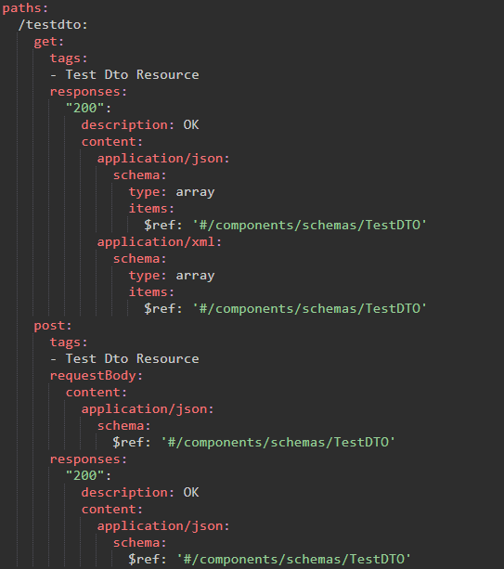
OpenAPI – Paths Beispiel
Für das Test DTO werden die einzelnen implementieren Methoden folgendermaßen beschrieben:
/testdto: Definiert den Basis Pfad für diese Beschreibung des TestDTO APIs
Get: wird hier ohne weiteren Pfad dokumentiert für die http GET Aufruf
Für den GET Aufruf ist bisher nur eine Antwort „200“ als OK dokumentiert
Es könnten aber auch weitere Fehlerfälle mit anderen http Error Codes beschrieben werden
Als Content für den Response werden sowohl eine JSON als auch eine XML Version des DTOs beschrieben.
Die Antwort ist wie im Java Code Angegeben eine Liste, die hier als Array abgebildet ist.
Die Elemente des Arrays werden hier als Items beschreiben und mittels $ref in als DTO

Slide 11
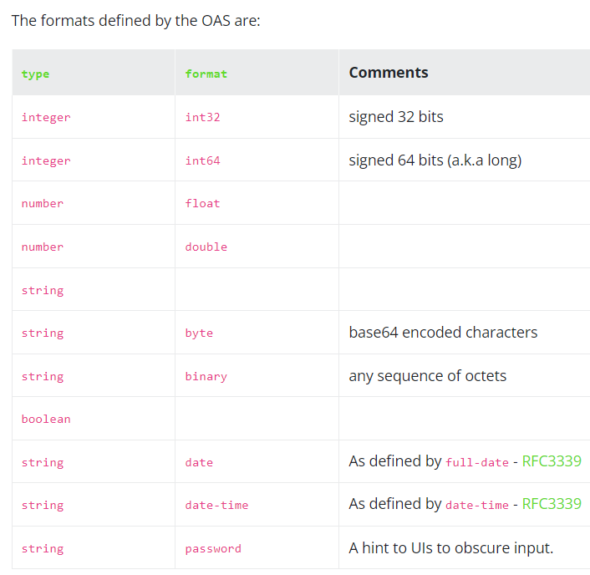
OpenAPI – DataTypes
Primitive data types in the OAS are based on the types supported by the JSON Schema Specification Wright Draft 00.
Primitives have an optional modifier property: format. OAS uses several known formats to define in fine detail the data type being used.

Slide 12
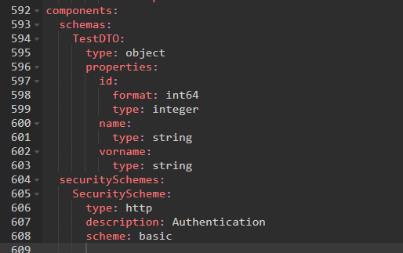
OpenAPI – DTO Abbildung
public class TestDTO { private Long id; String name; String vorname;

Slide 13
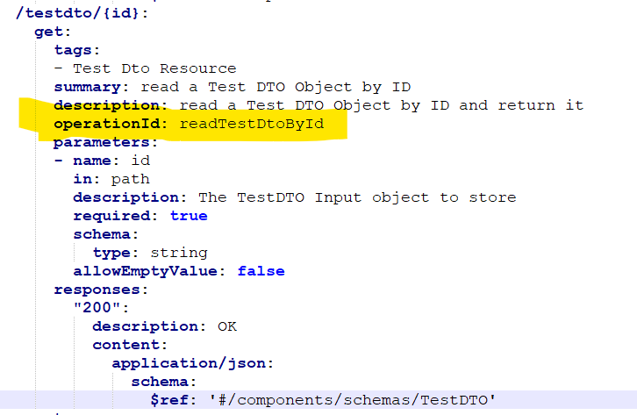
OpenAPI – Method OperationID
Unique (UseCase) Identifier für die Operations im API
If provided, these IDs must be unique among all operations described in your API.
@Operation( summary = "read a Test DTO Object by ID", description = "read a Test DTO..", operationId = "readTestDtoById") @GET @Path("/{id}") @Produces(MediaType.APPLICATION_JSON) public TestDTO readObjectById(@PathParam("id") String id ){
log.infov("input {} , objectOutput {0}", id, "");

Slide 14
OpenAPI – Query Parameter
/parameter/queryParameter: get: tags: - Parameter Resource parameters: - name: qp in: query schema: type: string - name: qp2 in: query schema: format: int64 default: "1" type: integer responses:
Query string parameters must not be included in paths. They should be defined as query parameters instead.
// http://localhost:8080/parameter/queryParameter?qp=inputText&qp2=text2 @GET @Path("/queryParameter") @Produces(MediaType.TEXT_PLAIN) public String queryParameter( @QueryParam("qp") String qp, @DefaultValue("1") @QueryParam("qp2") Long qP2 ){ log.infov("log QueryParam: {0}", qp); return "query params ["+ qp + "] und [" + qP2 + "]"; }

Slide 15
OpenAPI – Path Parameter
/parameter/inputParameter/{inputString}: get: tags: - Parameter Resource parameters: - name: inputString in: path required: true schema: type: string responses: "200": description: OK content: text/plain: schema: type: string
Path Parameter werden mit ihrem Platzhalter im Path angegeben und als Parameter dokumentiert:
@GET @Path("/inputParameter/{inputString}") @Produces(MediaType.TEXT_PLAIN) public String inputParameter( @PathParam("inputString") String inputString){ log.infov("log: {0}", inputString); StringBuilder sbStr = new StringBuilder(); sbStr.append(inputString).reverse(); return sbStr.toString() + "{}"; }

Slide 16
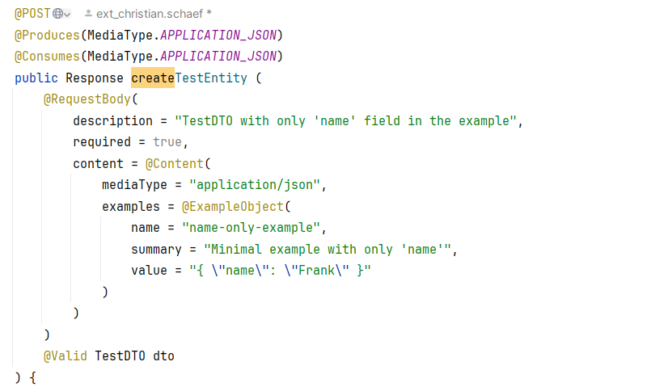
OpenAPI – Swagger Example Input
The Request Body can be described via openapi also
Examples will be available as select option in the swagger gui and openapi yaml

Slide 17
Danke für Ihre Aufmerksamkeit

