Slide 1

O/R Mapping Quarkus Panache
JEE Microservices
@ CGS IT – 2023
Version 1.0.5

Slide 2
Content
JPA Definitions
JPA-Framework - Modules and APIS
Entity Manager
JTA - Transaction Management
Entity Definitions and Annotations
Mapping Examples
JPQL
Query API
Quarkus Configuration

Slide 3
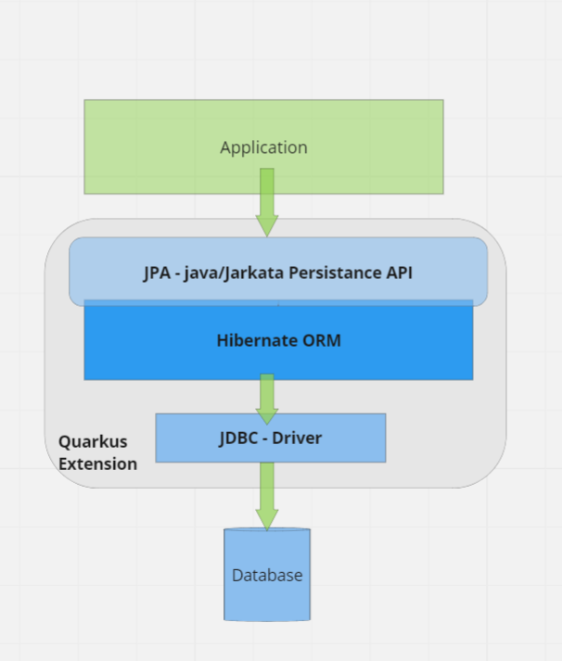

JPA Architecture
Java Persistence API or now Jakarta Persistence API
JPA provides Java developers with an object/relational mapping facility for managing relational data in Java applications.
JPA itself is just a specification, not a product, it cannot perform persistence or anything else by itself.
JPA is a set of interfaces and requires an implementation
There are open-source and commercial JPA implementations to choose from and any Java EE 5 application server should provide support for its use
JPA also requires a database to persist to

Slide 4
Quarkus Panache
Active Record Pattern:
Entities extend PanacheEntity or PanacheEntityBase for simplified CRUD and query operations.
Repository Pattern:
Separation of concerns with PanacheRepository and PanacheRepositoryBase for more flexible DAO-style access.
Concise Queries:
Write queries with minimal boilerplate using intuitive methods like find(), list(), and delete().

Slide 5
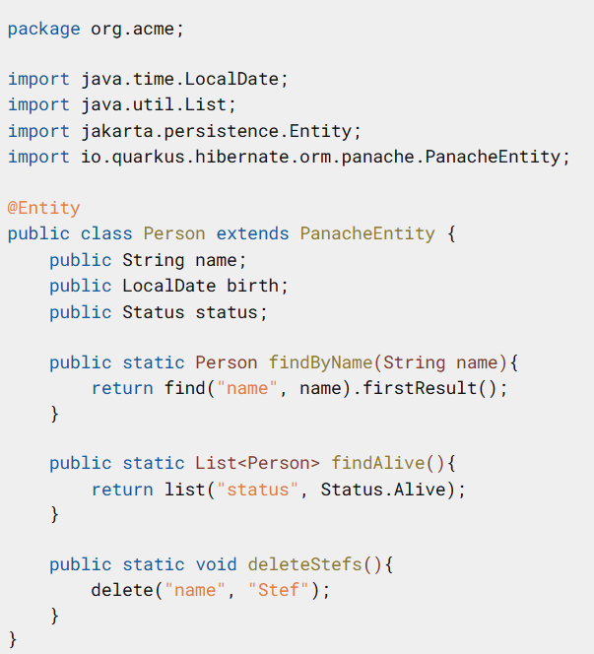
Panache – Active Entity – Rich domain model
what was described is essentially the active record pattern
sometimes just called the entity pattern.
Hibernate with Panache also allows for the use of the more classical repository pattern via PanacheRepository.

Slide 6
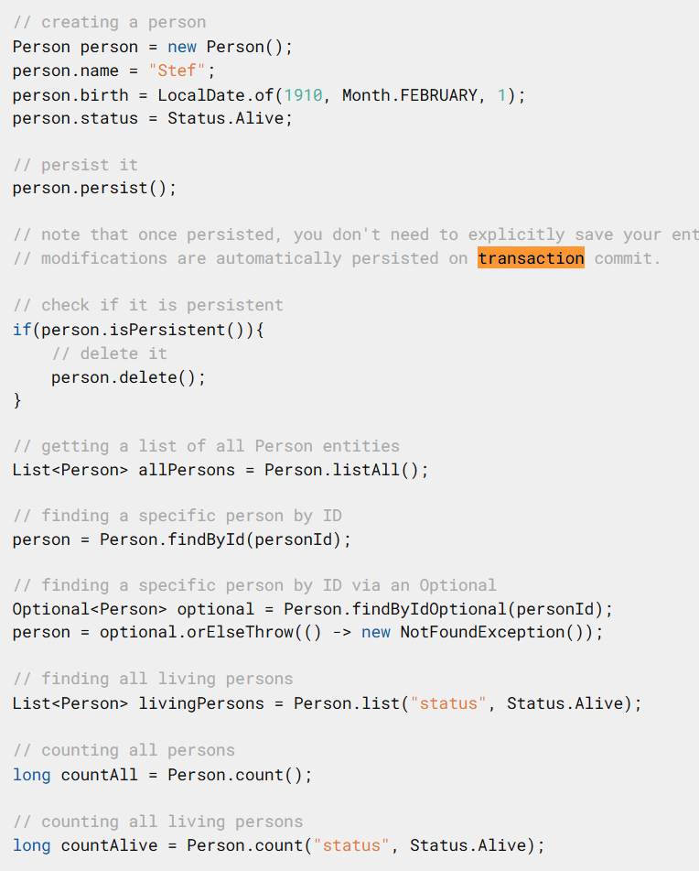
Panache - Repository
Enables most repoistory methods
listAll
FindById, deleteByID
List with options

Slide 7
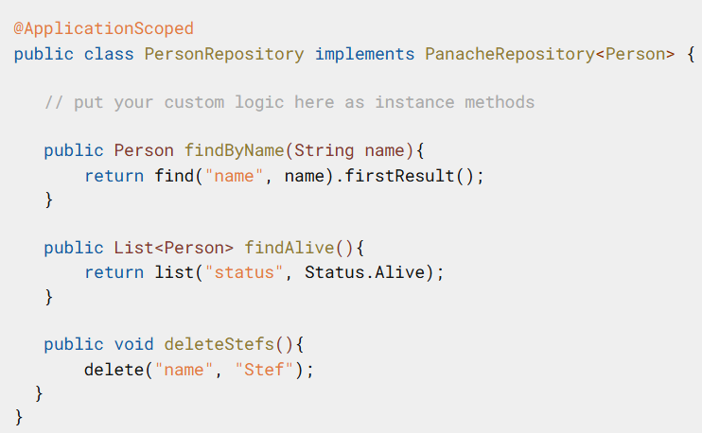
Panache – Repository Pattern
Enables classic repository pattern

Slide 8
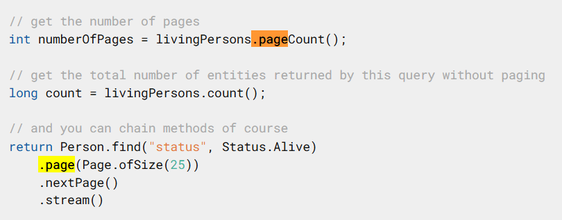
Implicit Paging support

Slide 9
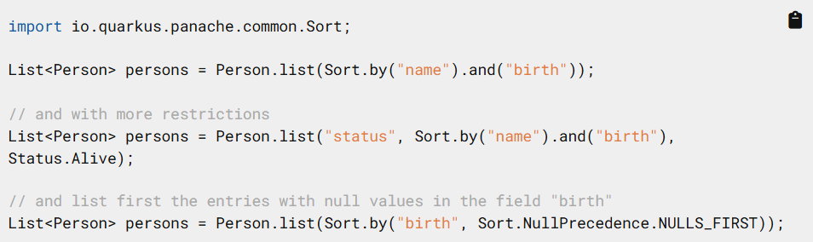
Advanced Queries
Simplyfies advanced queries via API

Slide 10
Danke für Ihre Aufmerksamkeit

