Slide 1

JPA Java Persistance API O/R Mapping
JEE Microservices
@ CGS IT – 2023
Version 1.0.7

Slide 2
Content
JPA Metamodel Klasses

Slide 3
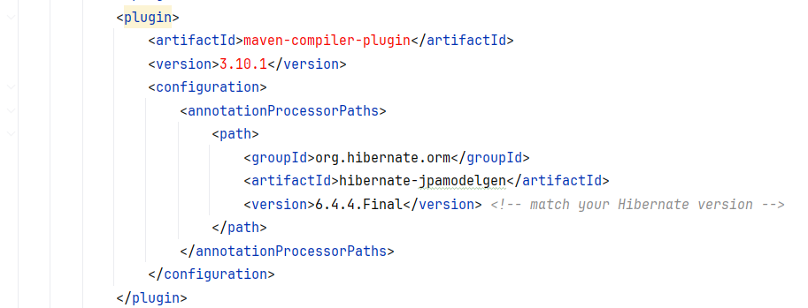
JPA Metamodel - generate
Plugin for JPA Model Gen Processor into Compile maven Phase

Slide 4
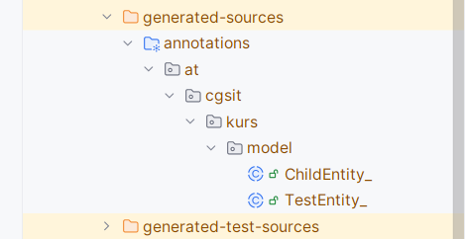
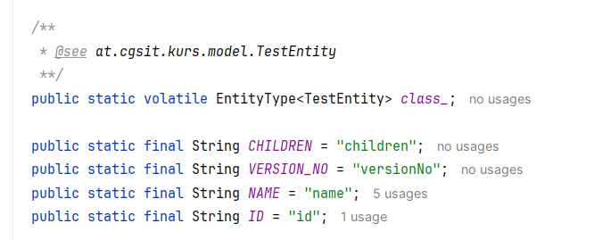
Generated Ouptut

Slide 5
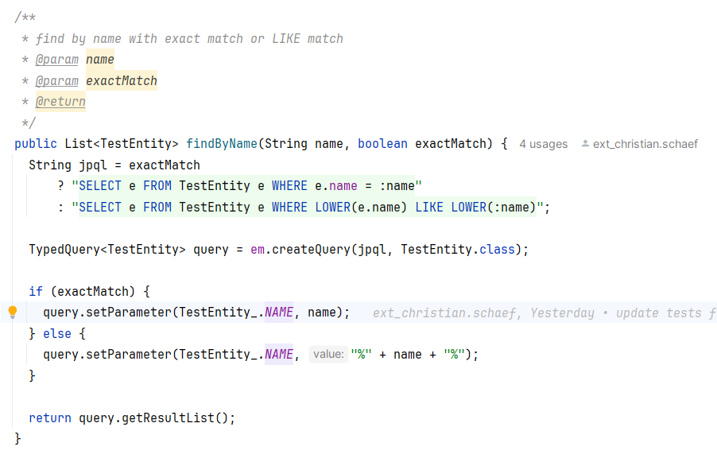
Usage

Slide 6
Danke für Ihre Aufmerksamkeit

