Slide 1
Apache Maven Überblick Build Management 10 - 2021
@ CGS-IT Solutions GmbH 2021

Slide 2
Inhalt
Maven Directory Structure
Maven Workflow
Maven Web Application
Repositories
How it Works!

Slide 3
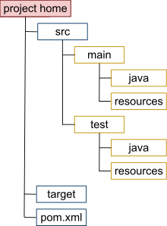
Maven Directory Structure

Slide 4
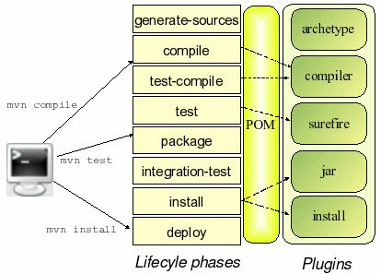
Maven Arbeitsablauf

Slide 5
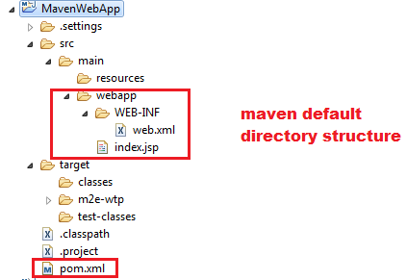
Maven Web Application

Slide 6
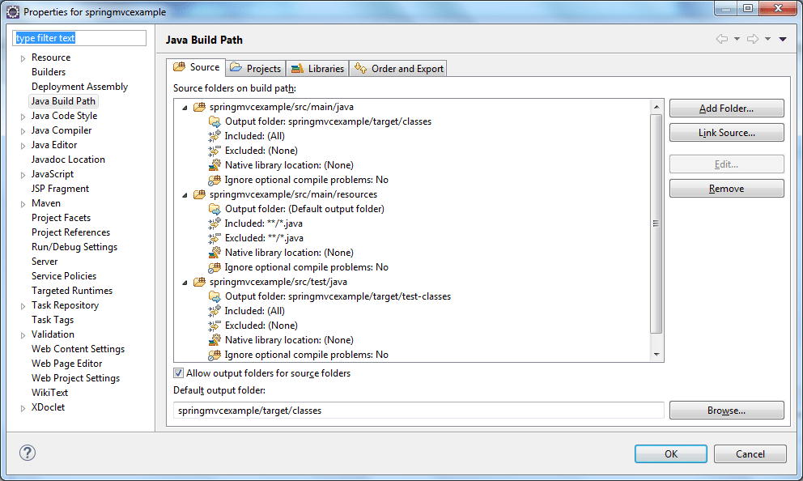
Maven - folders

Slide 7
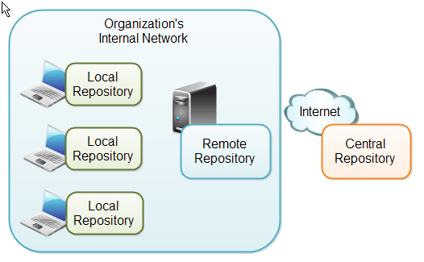
Maven Repositories

Slide 8
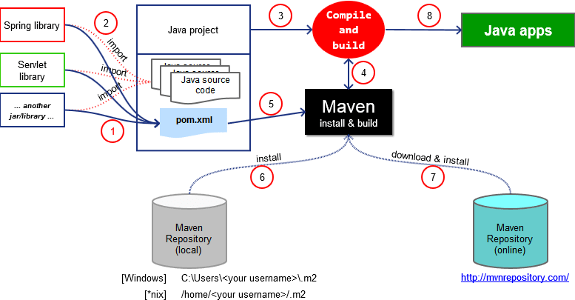
Maven How it Works

