Slide 1
Basic Concepts of Multiplier Design
Lecture 06 (Part A)
Recall what you learned in Computer Organization course
(Chap. 9)

Slide 2
How a computer performs multiply
the elementary-school scheme

Slide 3
Basic multiply scheme
1 0 1 1
*)
0 1 0 1
1 0 1 1
0 0 0 0
1 0 1 1
+)
0 0 0 0

Slide 4
Basic multiply scheme
multiplicand MD
1 0 1 1
*)
0 1 0 1
multiplier MR
1 0 1 1
0 0 0 0
1 0 1 1
+)
0 0 0 0

Slide 5
Basic multiply scheme
the method:
  examine one bit of the multiplier each time
  generate the partial product MD*MR[i]
  and accumulate
1 0 1 1
*)
0 1 0 1
1 0 1 1
0 0 0 0
1 0 1 1
+)
0 0 0 0

Slide 6
Basic multiply scheme
Step 1:
the method:
  examine one bit of the multiplier each time
  generate the partial product MD*MR[i]
  and accumulate
1 0 1 1
*)
0 1 0 1
1 0 1 1
0 0 0 0
1 0 1 1
+)
0 0 0 0

Slide 7
Basic multiply scheme
Step 2:
the method:
  examine one bit of the multiplier each time
  generate the partial product MD*MR[i]
  and accumulate
1 0 1 1
*)
0 1 0 1
1 0 1 1
0 0 0 0
1 0 1 1
+)
0 0 0 0

Slide 8
Basic multiply scheme
Step 3:
the method:
  examine one bit of the multiplier each time
  generate the partial product MD*MR[i]
  and accumulate
1 0 1 1
*)
0 1 0 1
1 0 1 1
0 0 0 0
1 0 1 1
+)
0 0 0 0

Slide 9
Basic multiply scheme
Step 4:
the method:
  examine one bit of the multiplier each time
  generate the partial product MD*MR[i]
  and accumulate
1 0 1 1
*)
0 1 0 1
1 0 1 1
0 0 0 0
1 0 1 1
+)
0 0 0 0

Slide 10
Basic multiply scheme
the method:
  examine one bit of the multiplier each time
  generate the partial product MD*MR[i]
  and accumulate
1 0 1 1
*)
0 1 0 1
1 0 1 1
0 0 0 0
1 0 1 1
Partial Products
+)
0 0 0 0

Slide 11
Basic multiply scheme
the method:
  examine one bit of the multiplier each time
  generate the partial product MD*MR[i]
  and accumulate
1 0 1 1
*)
0 1 0 1
1 0 1 1
0 0 0 0
1 0 1 1
+)
0 0 0 0
0 1 1 0 1 1 1
the product is the sum of
all partial products

Slide 12
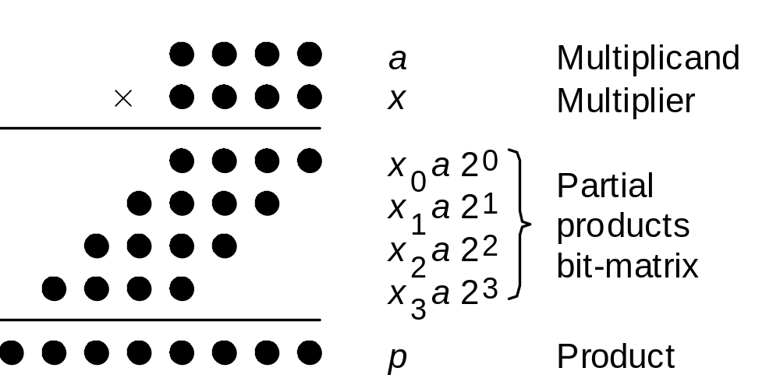
The dot-diagram
Notation for our discussion of multiplication algorithms:
a Multiplicand a_{k–1}a_{k–2} . . . a₁a₀
x Multiplier x_{k–1}x_{k–2} . . . x₁x₀
p Product (a × x) p_{2k–1}p_{2k–2} . . . p₃p₂p₁p₀
Initially, we assume unsigned operands
Fig. 9.1 Multiplication of two 4-bit unsigned binary numbers in dot notation.

Slide 13
Shift-and-add multiplier
Hardware design of the multiply scheme

Slide 14
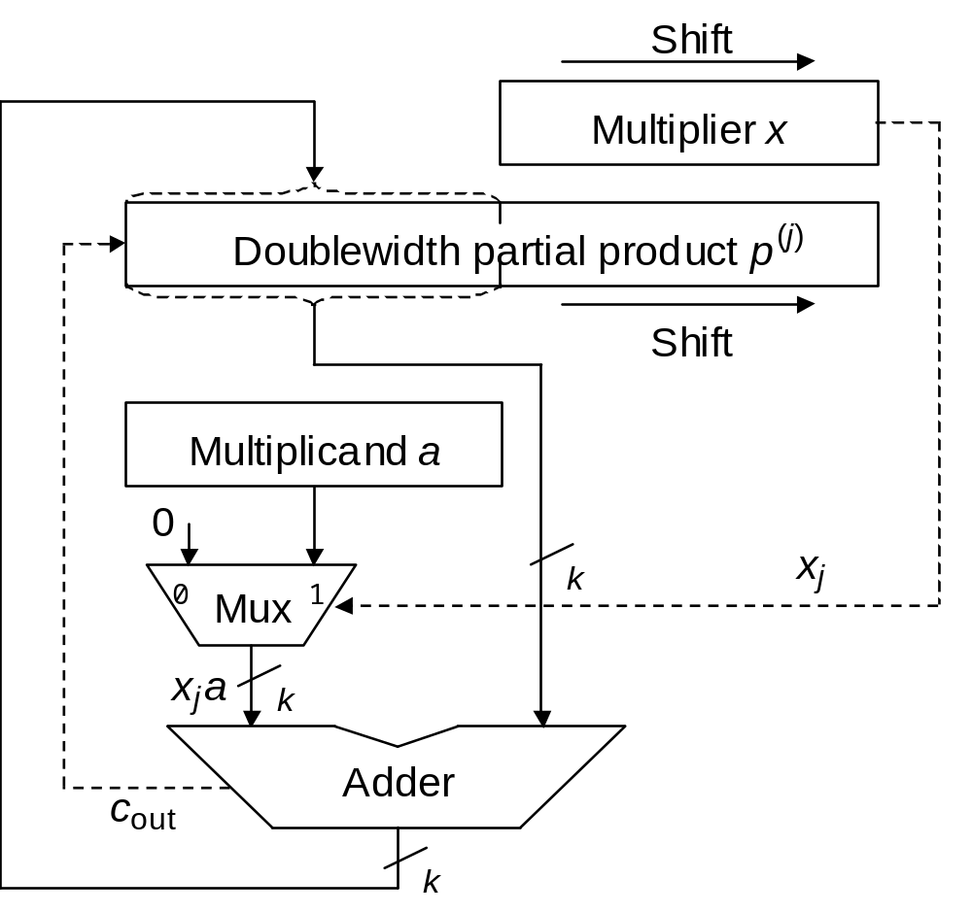
Data path of the multiplier
registers to store data
shift-right each step
Fig. 9.4 Hardware realization of the sequential multiplication algorithm with additions and right shifts.

Slide 15
Algorithm behind the hardware
a simple recurrence relation
Fig. 9.1
Preferred
Multiplication with right shifts: top-to-bottom accumulation
p^{(j+1)} = (p^{(j)} + x_{j} a 2^{k}) 2^{–1} with p⁽⁰⁾ = 0 and
|–––add–––| p^{(k)} = p = ax + p⁽⁰⁾2^{–k}
|––shift right––|

Slide 16
Hardware-Algorithm Match
x2

Slide 17
Hardware-Algorithm Match
shift-right each step
x2

Slide 18
In-Class Exercise
for this example, show register content for each step
1 0 1 1
*)
0 1 0 1
1 0 1 1
0 0 0 0
1 0 1 1
+)
0 0 0 0

Slide 19
Concluding Remarks

Slide 20
Performance of this multiplier
n steps (cycles) to multiply two n-bit numbers
How to do faster?

Slide 21
Guidelines to design a fast multiplier
reduce amount of partial products
  Booth encoding (Chap. 10)
sum of all partial products as fast as possible
  array and tree multiplier (Chap. 11)
1 0 1 1
*)
0 1 0 1
1 0 1 1
0 0 0 0
1 0 1 1
Partial Products
+)
0 0 0 0

