Slide 1
Fast Summation
Lecture 06 (Part C)

Slide 2
Requirement of high-performance multiplier

Slide 3
The requirement: pipelining
pipelined execution for instructions I₁, I₂, I₃, and I₄ in a CPU
time
I₁
Fetch
Decode
Execute
Write-back
I₂
Fetch
Decode
Execute
Write-back
I₃
Fetch
Decode
Execute
Write-back
I₄
Fetch
Decode
Execute
Write-back

Slide 4
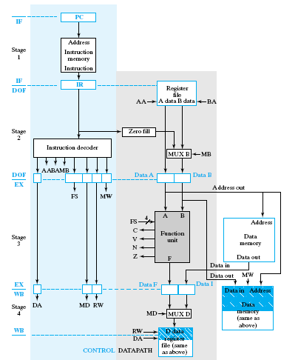
Pipelined processor architecture

Slide 5
Questions
Q1: How to design a MIPS processor with multiply/divide instruction?
Q2: How to design an accelerator (say, in SoC) with multiply operations?
Pipelining is a must in hardware design!

Slide 6
Multiplier framework and design issues
the multiplier I want to talk about

Slide 7
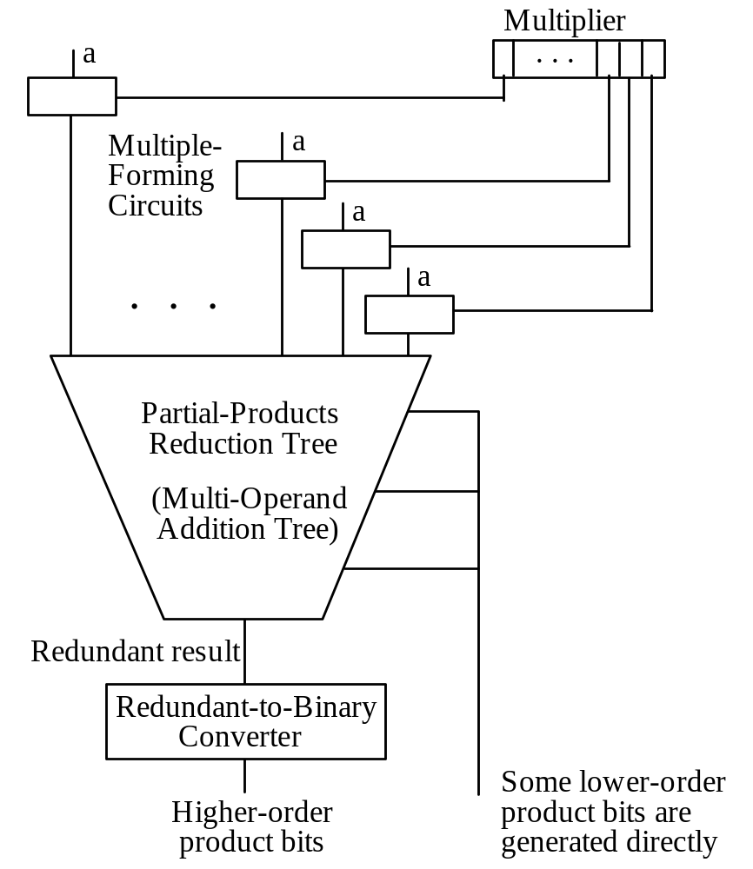
General structure of the multiplier
1 0 1 1
*)
0 1 0 1
1 0 1 1
0 0 0 0
1 0 1 1
+)
0 0 0 0
Fig. 11.1 General structure of a full-tree multiplier.

Slide 8
General structure of the multiplier
Partial product generation
1 0 1 1
*)
0 1 0 1
1 0 1 1
0 0 0 0
1 0 1 1
+)
0 0 0 0
Fig. 11.1 General structure of a full-tree multiplier.

Slide 9
General structure of the multiplier
1 0 1 1
*)
0 1 0 1
1 0 1 1
0 0 0 0
1 0 1 1
+)
0 0 0 0
fast summation of partial products
Fig. 11.1 General structure of a full-tree multiplier.

Slide 10
Issues to realize the general structure
partial product generation
  reduce amount of partial products: (high-radix) Booth encoding
  reduce the width of a partial product: Baugh-Wooly encoding
fast summation: Wallace and Dada trees

Slide 11
Reference
[Flynn] Michael J. Flynn and Stuart F. Oberman, Advanced Computer Arithmetic Design, 2001
  Chap. 3-4
  Chap. 5: technology scaling and wire effects

Slide 12
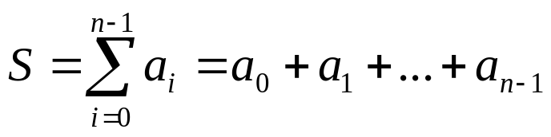
Core Problem
compute the following as fast as possible
  a_{i}: k-bit integer
  n: known at compile time
  minimize the circuit delay

Slide 13
Analysis to the straight approach

Slide 14
Straight approach for summation
O(log n) levels of addition
each addition requires O(log k) delay
  for k-bit carry-lookahead adder
total delay: O(log n)*O(log k)
obstacle to do summation fast:
  still the carry in addition!
Thiking direction:
  deal with carry in parallel!
  across addition boundary
a₇
a₆
a₅
a₄
a₃
a₂
a₁
a₀
+
+
+
+
+
+
+
S

Slide 15
Observation: redundant number system
to derive carry-free addition

Slide 16
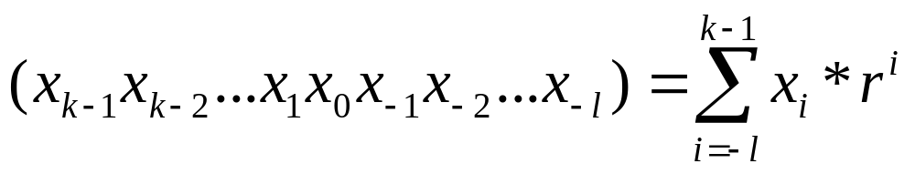
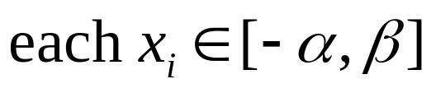
Recap:
General formula: radix-r number system
the number represented by a vector:

Slide 17
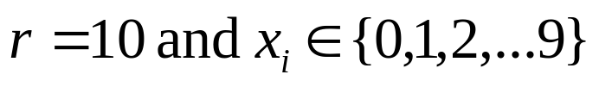
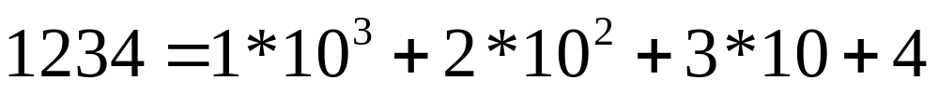
Radix-10 number system

Slide 18
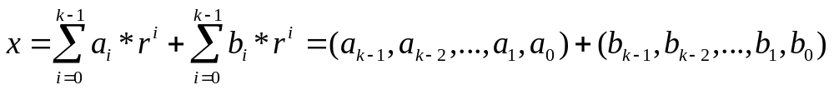
Redundant number system
(with radix-r)
represent an integer x with two vectors
  (a_{k-1}, a_{k-2}, ..., a₁, a₀)
  (b_{k-1}, b_{k-2}, ..., b₁, b₀)

Slide 19
Redundant number system with radix-10
integer 1207638 represented as
  (0, 1, 9, 7, 5, 2, 8)
  (1, 0, 1, 0, 1, 1, 0)

Slide 20
Why redundant number system?
5 7 8 2 4 9
+)
6 2 9 3 8 9
11 9 17 5 12 18
1 9 7 5 2 8
+)
1 0 1 0 1 1
1 2 0 7 6 3 8
to enable carry-free addition

Slide 21
The key to fast summation
Idea of redundant number system
  reserve the carry for the next addition
  to exploit parallelism on additions of multiple operands

Slide 22
Carry save adder
for carry-free addition on binary numbers

Slide 23
Carry free addition on binary numbers
1 0 0 1 1 0 1
0 1 1 1 1 0 0
+)
1 0 1 0 1 0 1
2 1 2 2 3 0 2
0 1 0 0 1 0 0
1 0 1 1 1 0 1

Slide 24
Carry free addition on binary numbers
How to implement?
  a full adder for a bit
inputs
1 0 0 1 1 0 1
0 1 1 1 1 0 0
FA
(full adder)
+)
1 0 1 0 1 0 1
2 1 2 2 3 0 2
C
S
outputs
0 1 0 0 1 0 0
1 0 1 1 1 0 1

Slide 25
Carry free addition on binary numbers
How to implement?
  parallel full adders for the addition
1 0 0 1 1 0 1
0 1 1 1 1 0 0
FA
...
FA
FA
FA
+)
1 0 1 0 1 0 1
C7
S6
C3
S3
C2
S2
C1
S0
2 1 2 2 3 0 2
CSA (Carry-Save Adder)
0 1 0 0 1 0 0
1 0 1 1 1 0 1

Slide 26
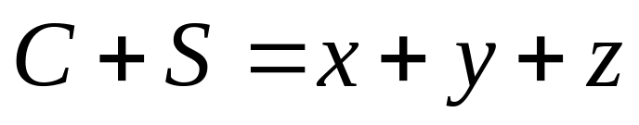
Carry-Save Adder (CSA)
z
y
x
CSA
FA
...
FA
FA
FA
C7
S6
C3
S3
C2
S2
C1
S0
C
S
CSA (Carry-Save Adder)

Slide 27
CSA-tree for fast summation

Slide 28
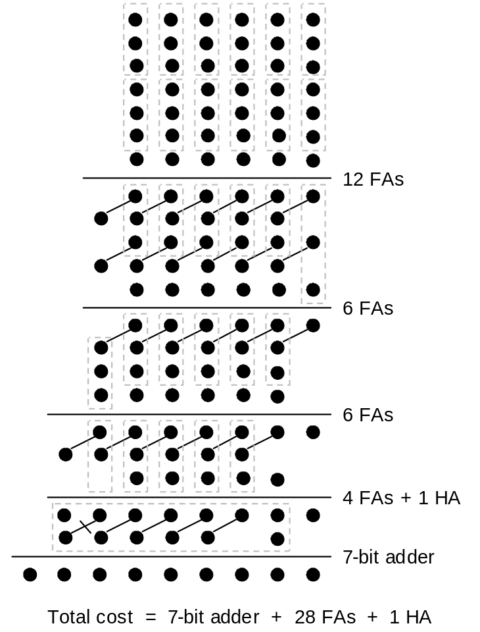
Scheme of fast summation
x
one full adder per 3 input dots
  reduce to 2 dots in 2nd segment
y
z
z[0]
y[0]
x[0]
u
v
FA
v[1]
u[0]
Fig. 8.10 Addition of seven 6-bit numbers in dot notation.

Slide 29
Scheme of fast summation
x
one full adder per 3 input dots
  reduce to 2 dots in 2nd segment
y
z
z[0]
y[1]
x[1]
z[0]
y[0]
x[0]
u
v
FA
FA
v[2]
u[1]
v[1]
u[0]
Fig. 8.10 Addition of seven 6-bit numbers in dot notation.

Slide 30
Scheme of fast summation
x
one CSA per 3 rows and reduces to 2 rows
y
z
z
y
x
CSA
u
v
v
u
Fig. 8.10 Addition of seven 6-bit numbers in dot notation.

Slide 31
Scheme of fast summation
one CSA per 3 rows and reduces to 2 rows
a
c
b
a
z
y
x
b
c
CSA
CSA
w
r
r
w
v
u
Fig. 8.10 Addition of seven 6-bit numbers in dot notation.

Slide 32
Scheme of fast summation
left the remaining row to next stage
d
c
b
a
z
y
x
d
CSA
CSA
r
w
v
u
d
CSAs of 2nd stage
Fig. 8.10 Addition of seven 6-bit numbers in dot notation.

Slide 33
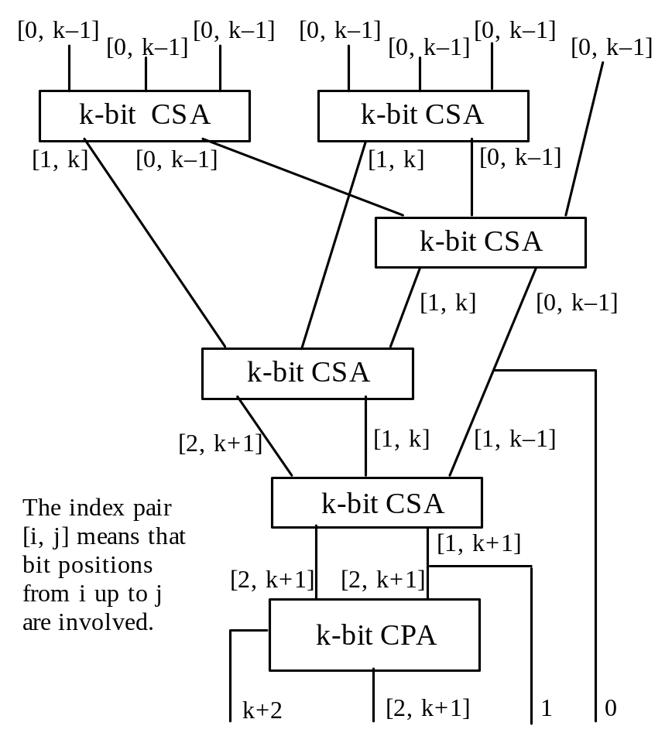
CSA tree for fast summation
Fig. 8.12 Adding seven k-bit numbers and the CSA/CPA widths required.

Slide 34
CSA tree for fast summation
Fig. 8.12 Adding seven k-bit numbers and the CSA/CPA widths required.

Slide 35
CSA tree for fast summation
Fig. 8.12 Adding seven k-bit numbers and the CSA/CPA widths required.

Slide 36
CSA tree for fast summation
Fig. 8.12 Adding seven k-bit numbers and the CSA/CPA widths required.

Slide 37
CSA tree for fast summation
Fig. 8.12 Adding seven k-bit numbers and the CSA/CPA widths required.

Slide 38
CSA tree for fast summation
Fig. 8.12 Adding seven k-bit numbers and the CSA/CPA widths required.
a carry-propagation adder to get the final result

Slide 39
CSA tree for fast summation
Fig. 8.12 Adding seven k-bit numbers and the CSA/CPA widths required.
Delay: O(log k)+O(log n)

Slide 40
Remark
different strategy to design the CSA tree
  Wallace tree
  Dada tree: see Section 8.3

Slide 41
In-Class Exercise
Draw the CSA-tree for 8*8->16 unsigned multiplier
  Notice the operand shifting
1 0 1 1
*)
0 1 0 1
1 0 1 1
0 0 0 0
1 0 1 1
+)
0 0 0 0

